Slide 1
USED CAR PRICE PREDICTION
Aarti A Ambhore

Slide 2
Problem Statement
With the covid 19 impact in the market, we have seen lot of changes in the car market. Now some cars are in demand hence making them costly and some are not in demand hence cheaper. One of our clients works with small traders, who sell used cars. With the change in market due to covid 19 impact, our client is facing problems with their previous car price valuation machine learning models. So, they are looking for new machine learning models from new data. We have to make car price valuation model. This project contains two phase-
Data Collection Phase
Model Building Phase
…Continued…

Slide 3
1.Data Collection Phase:
You have to scrape at least 5000 used cars data. You can scrape more data as well, it’s up to you. more the data better the model In this section You need to scrape the data of used cars from websites (Olx, cardekho, Cars24 etc.) You need web scraping for this. You have to fetch data for different locations. The number of columns for data doesn’t have limit, it’s up to you and your creativity. Generally, these columns are Brand, model, variant, manufacturing year, driven kilometers, fuel, number of owners, location and at last target variable Price of the car. This data is to give you a hint about important variables in used car model. You can make changes to it, you can add or you can remove some columns, it completely depends on the website from which you are fetching the data. Try to include all types of cars in your data for example- SUV, Sedans, Coupe, minivan, Hatchback.

Slide 4
2.Model Building Phase:
After collecting the data, you need to build a machine learning model. Before model building do all data pre-processing steps. Try different models with different hyper parameters and select the best model. Follow the complete life cycle of data science. Include all the steps like.
Data Cleaning
Exploratory Data Analysis
Data Pre-processing
Model Building
Model Evaluation
Selecting the best model

Slide 5
Data Description
The dataset contains 6224 records (rows) and 12 features (columns).
Here, we will provide a brief description of dataset features. Since the
number of features is 12, we will attach the data description i.e.,
'Unnamed: 0', 'Unnamed: 0.1', 'Model', 'Make_Year', 'Driven_Kilometers', 'Fuel', 'Transmission', 'Owner(s)', 'Mileage', 'Engine', 'Price', 'Location

Slide 6
Target Variable
Price(Selling Price): It’s continuous type of data, so the model approach is carried out for Regression analysis.

Slide 7
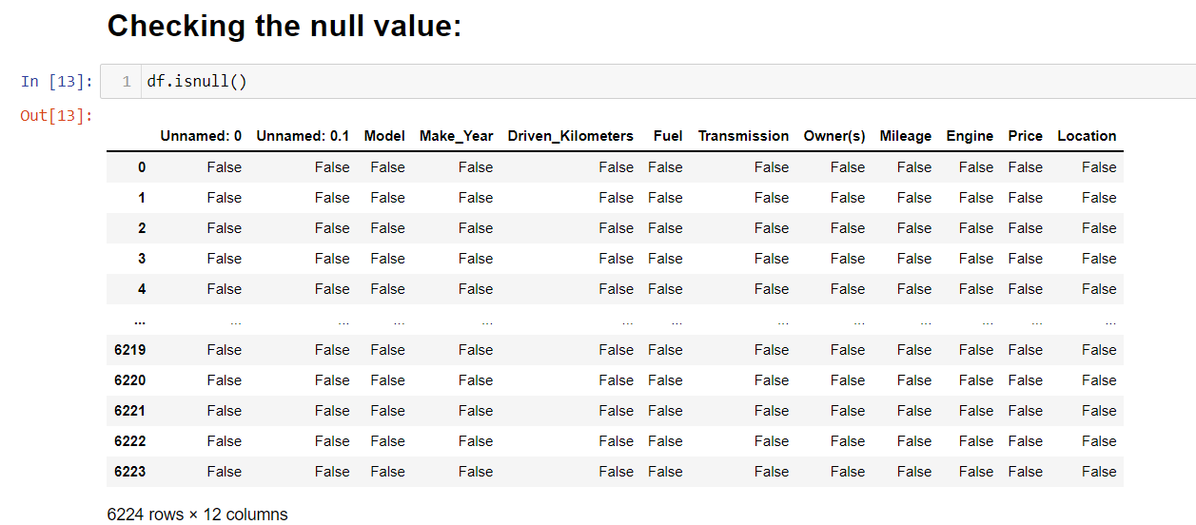
Checking for the null values:
From above we can clearly say that there no null value in the given dataset.

Slide 8
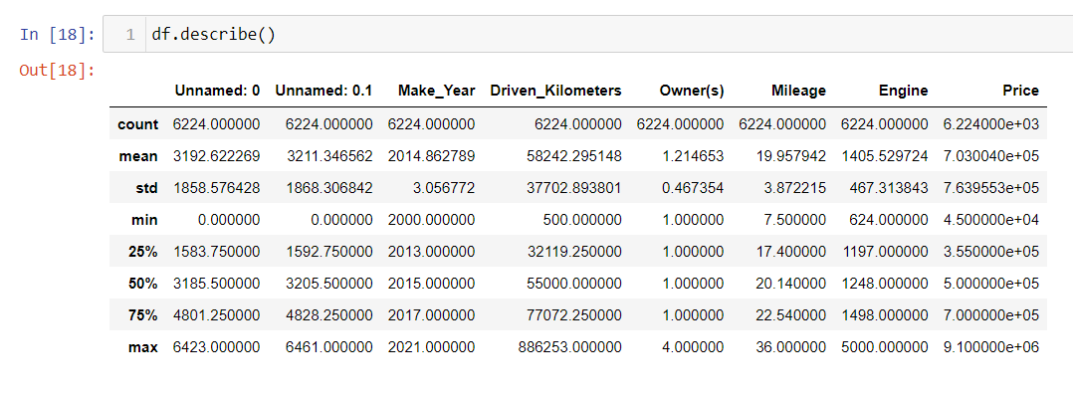
Statistical Summary
To see statistical information
There are outliers in the data so the outliers has been removed using IQR method.

Slide 9
EDA(Exploratory Data Analysis)

Slide 10
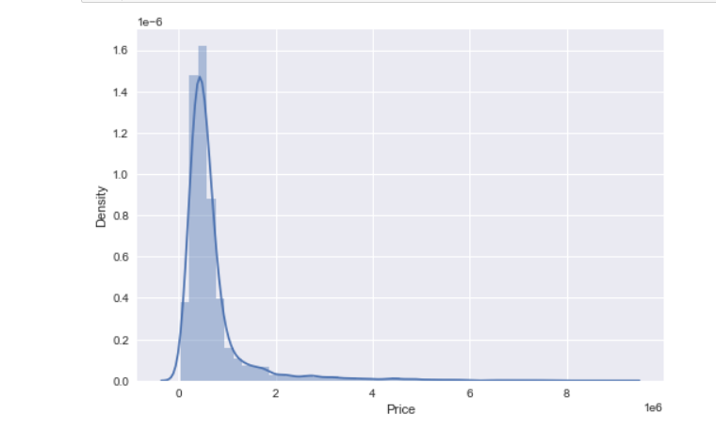
Target Variable (Selling Price) Univariate Analysis
From the graph we can say that the data is normally distributed.

Slide 11
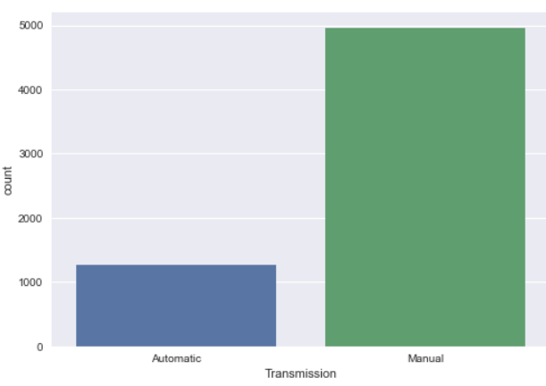
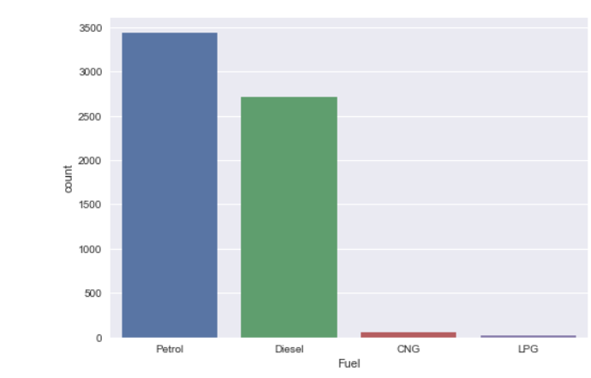
Manual Used Car are mostly available for sale
From above both the graphs we can say that,
Manual cars are highly available for the sale
And cars with petrol and diesel are available for sales respectively.

Slide 12
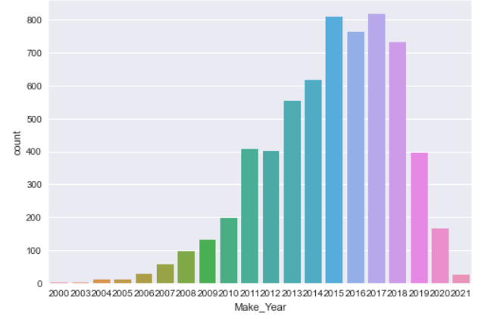
From the above graph we can say that most of the cars are manufactured in 2017, 2015 followed by 2016

Slide 13
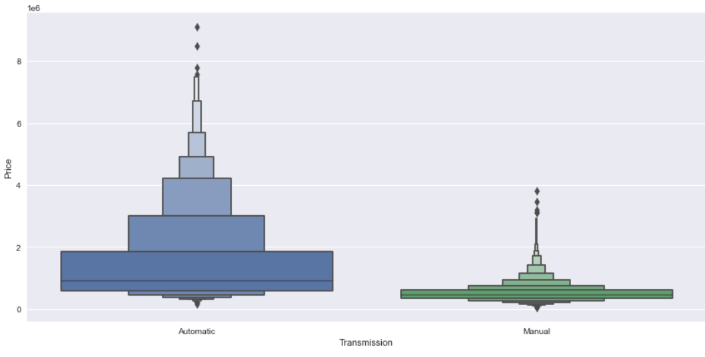
Automatic Car Price is higher when compared to Manual Car transmission Car Price

Slide 14
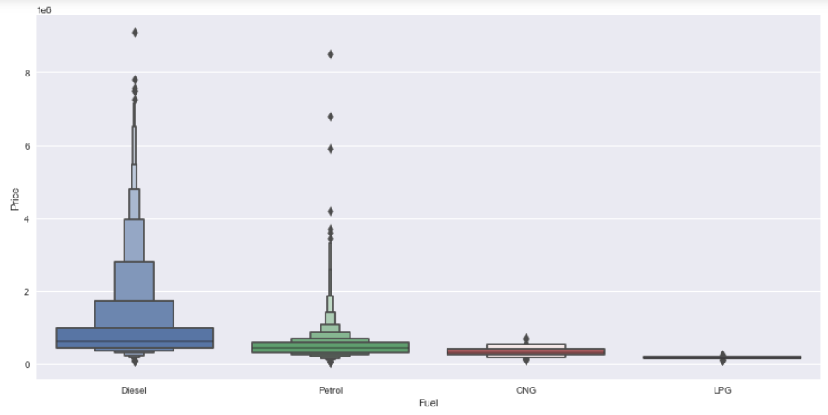
Used Cars with fuel type: “Diesel” and “Petrol” are mostly costly

Slide 15
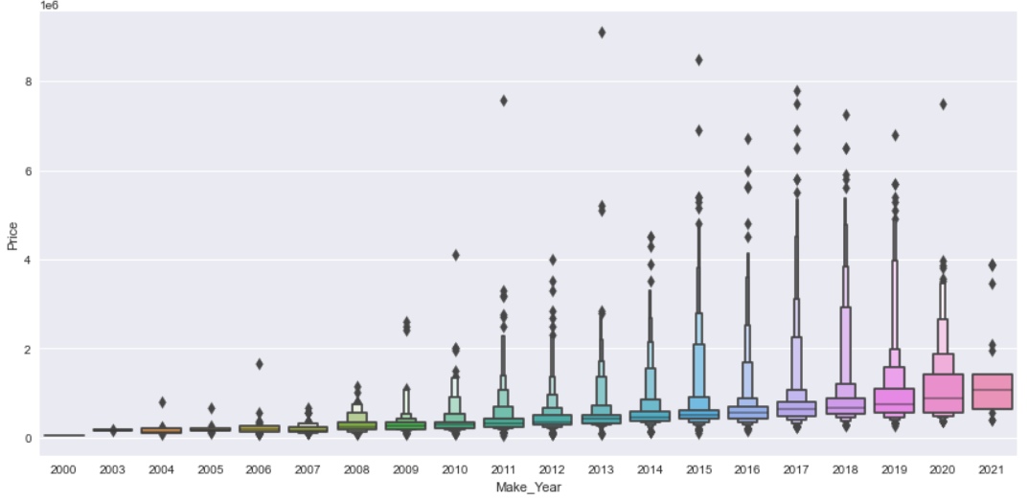
During 2013 - 2017, people were selling the cars with high price, but due to this pandemic (covid-19) the used car sale price is drastically reduced

Slide 16
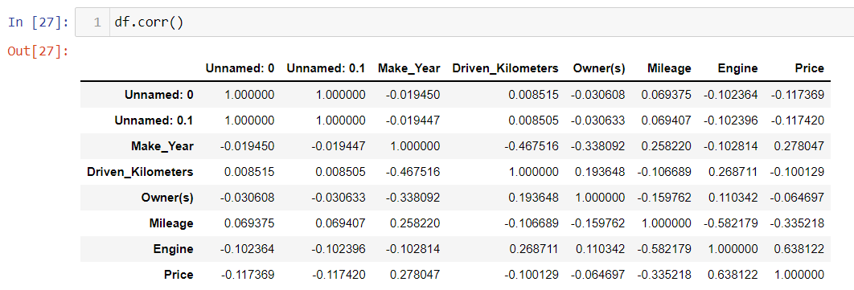
Correlation matrix:

Slide 17
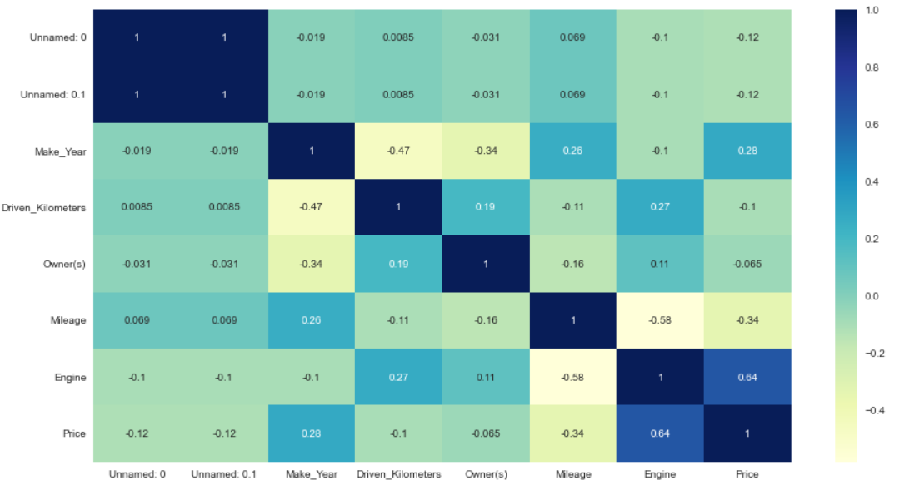
We see that, the largest correlated features are "Engine" and "Price" with correlated values: "0.64" the lowest correlated features are "Owner(s)" and "Price" with correlated values: "-0.065"

Slide 18
Data Pre-processing

Slide 19
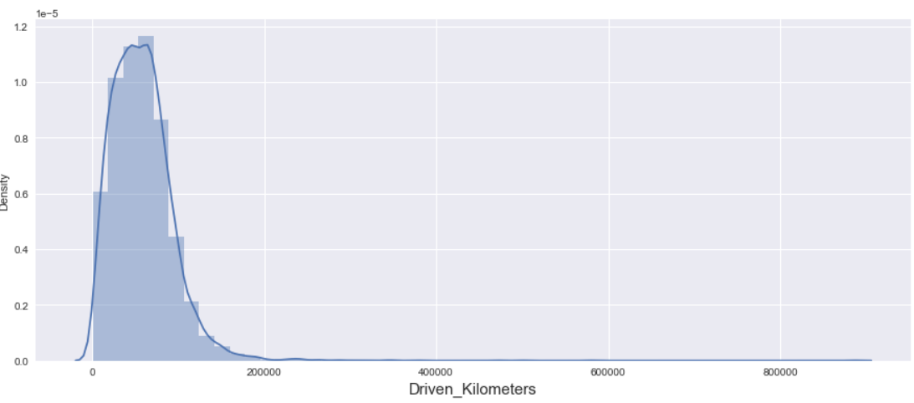
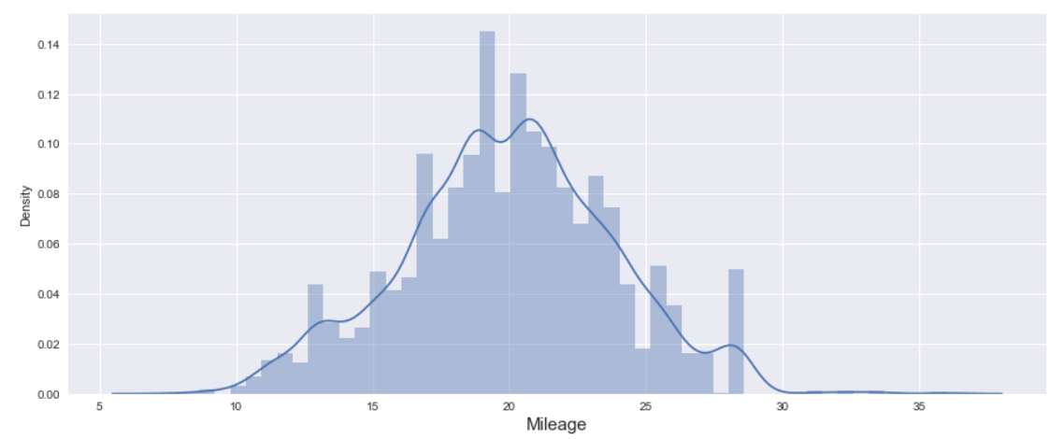
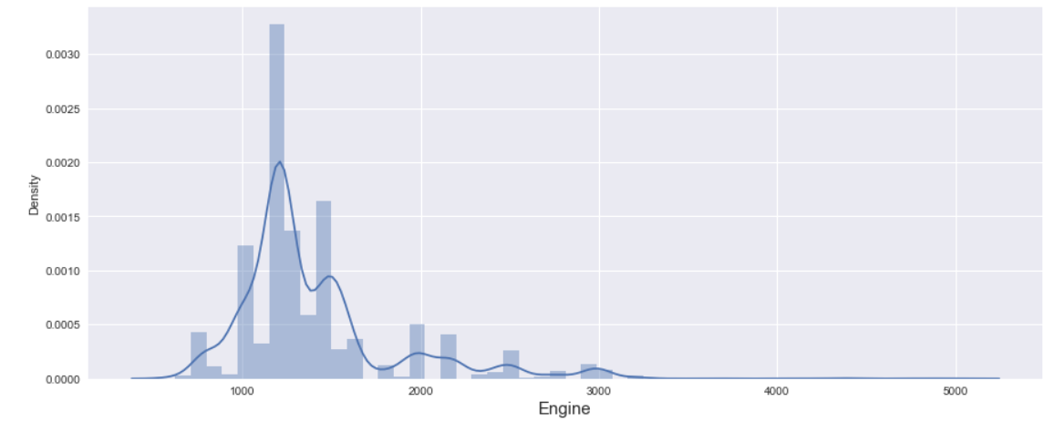
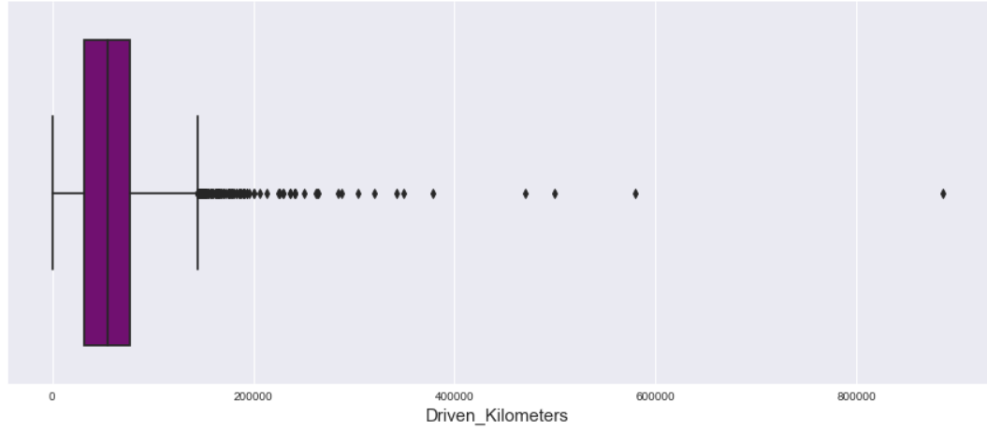
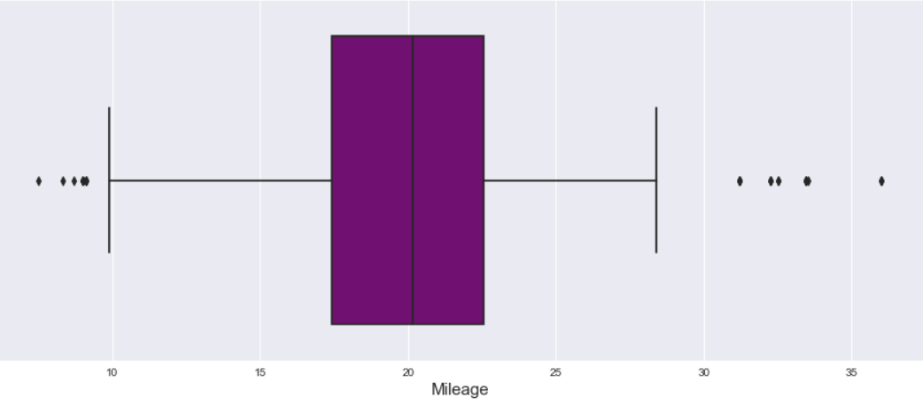
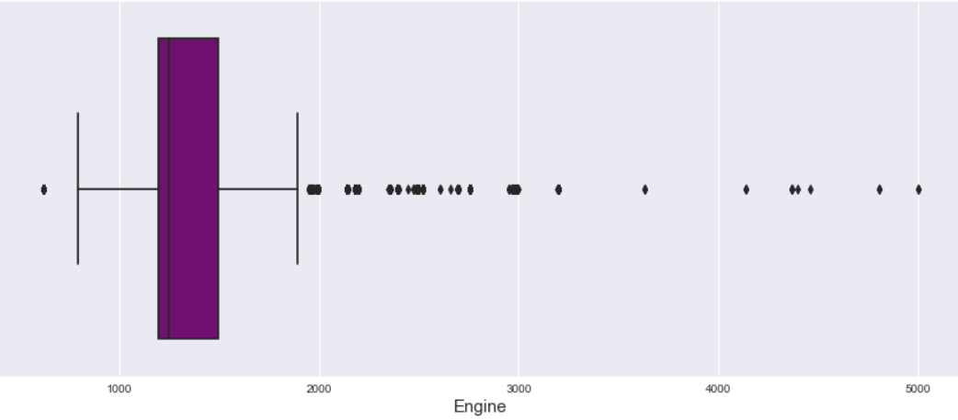
Checking the distribution:

Slide 20
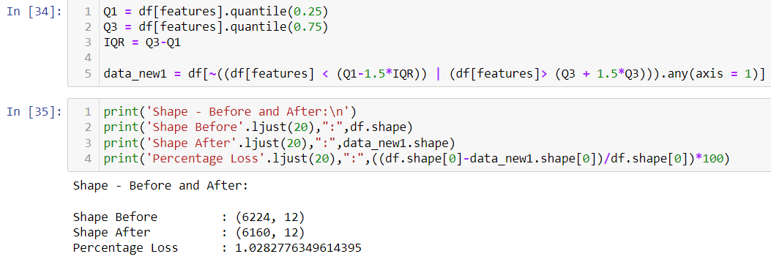
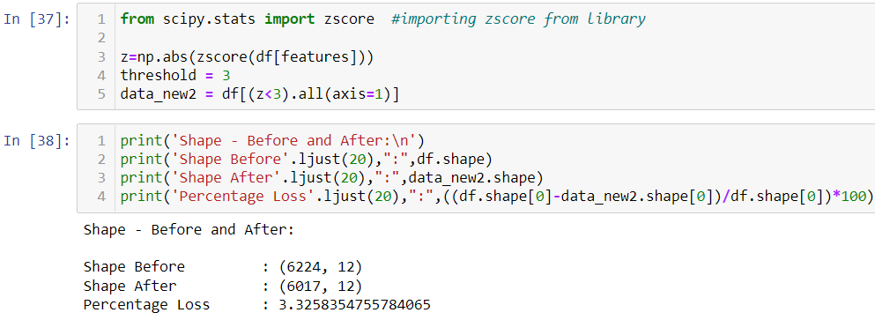
Outliers removal : IQR and Z-Score method
Percentage loss in IQR method is 1.0283
And percentage loss in Z-Score method is 3.3258
So, in IQR there is less percentage loss so continuing with IQR method.

Slide 21
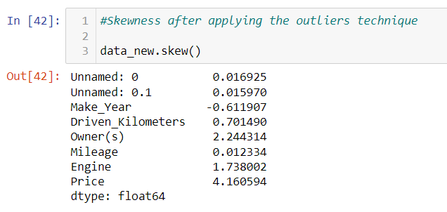
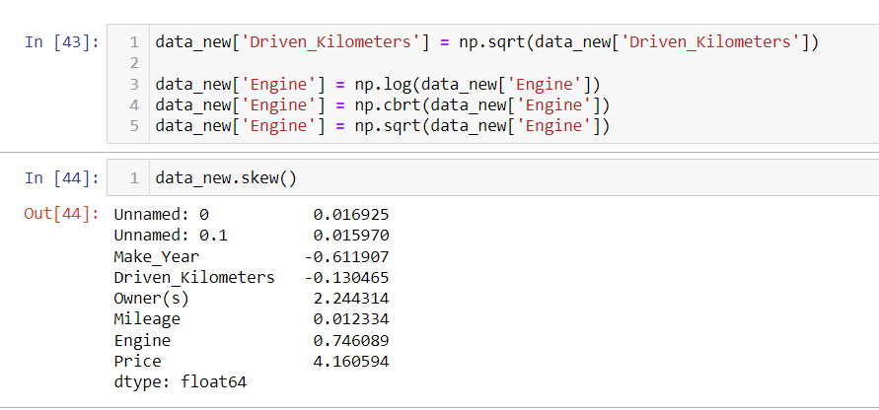
From the above we can say that we have removed the skewness from the dataset.

Slide 22
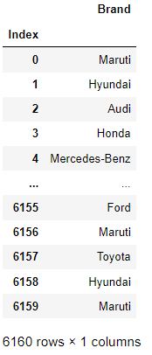
Adding Features in Datasets
Adding new feature “Brand” in data frame
Dropped Features
Models

Slide 23
Encoding the Categorical Columns

Slide 24
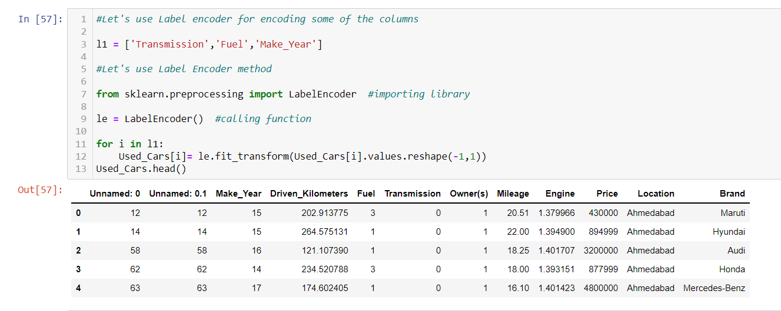
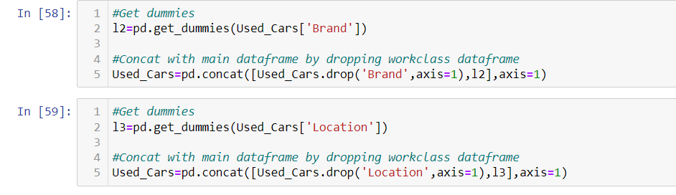
Encoding of Data Frame:
The Encoding Technique is used for this problem:
Secondly, proceed with getting dummies for location and Brand

Slide 25
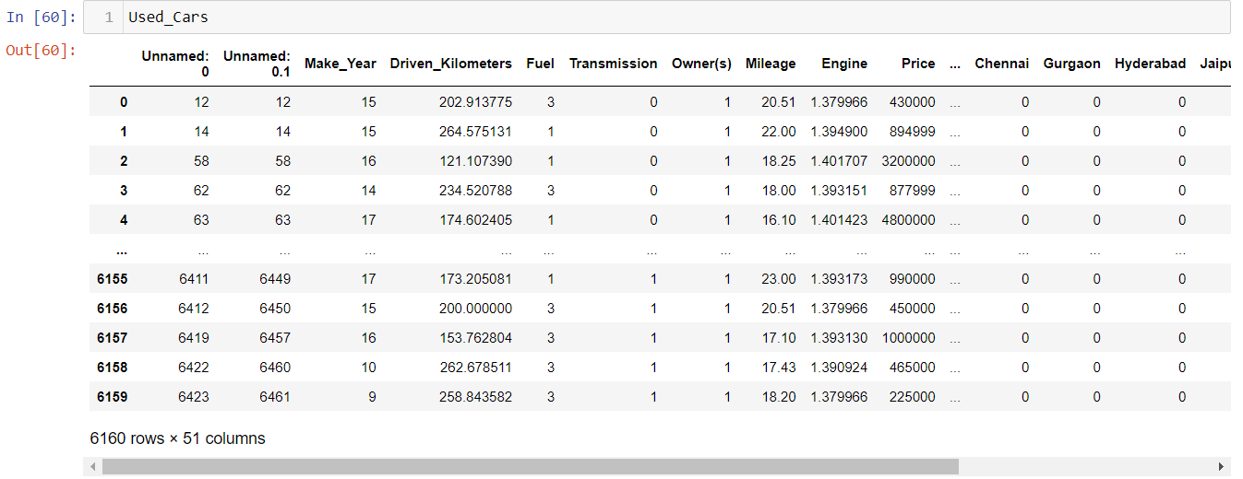
Now, we can see all features is converted into numerical one after proceeding with encoding technique.

Slide 26
MODEL BUILDING

Slide 27
Model Building and Evaluation
These are modelling approach made to build an model :
Random Forest
k-nearest neighbors (KNN)
Decision Tree
Gradient Boosting
Lasso
Ridge

Slide 28
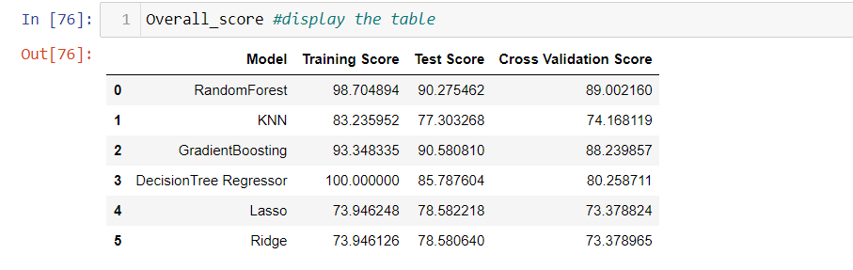
Overview of the score:
According to performance matrix R2 for Random forest is higher than any other model, so this is our best model

Slide 29
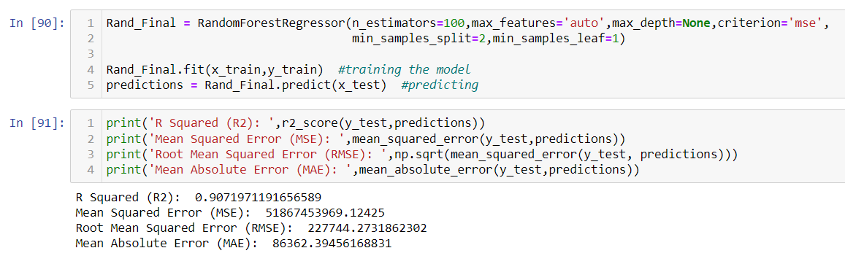
Performance matrix of the model

Slide 30
Best Model
Hyper parameter Tuning performance is carried out for Random Forest Regressor:
Hyper parameter Tuning i.e.,R2 score = 90.71%
So we can say that Random Forest Regressor is best model for these dataset.

Slide 31
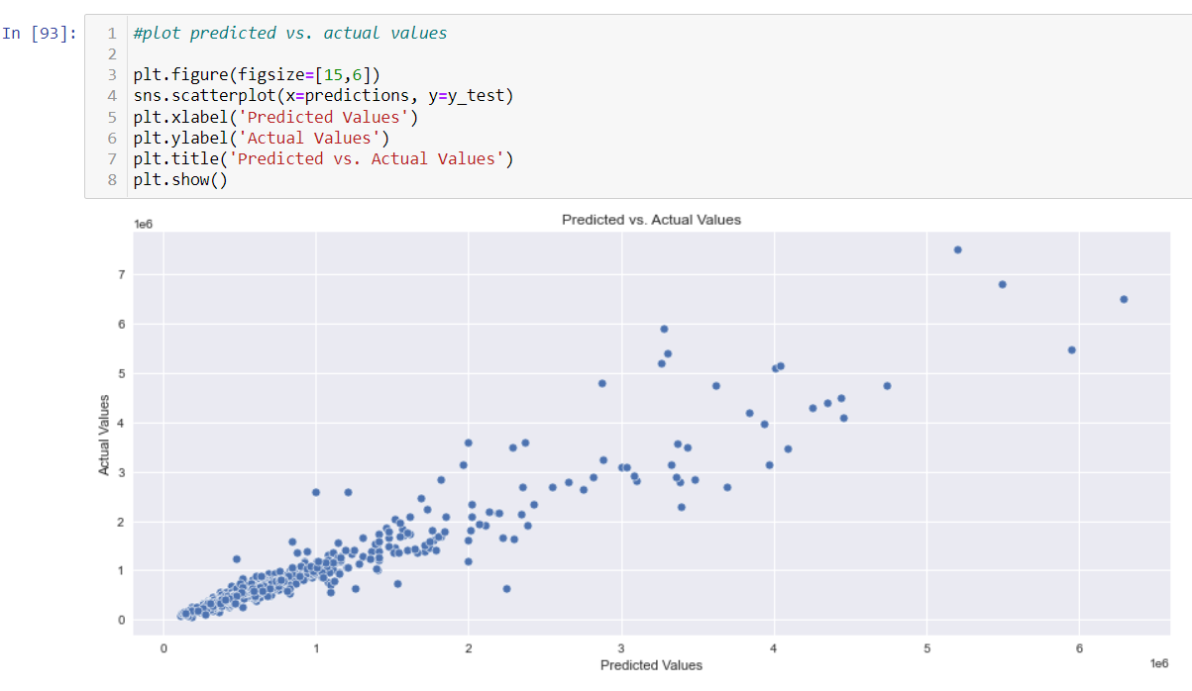
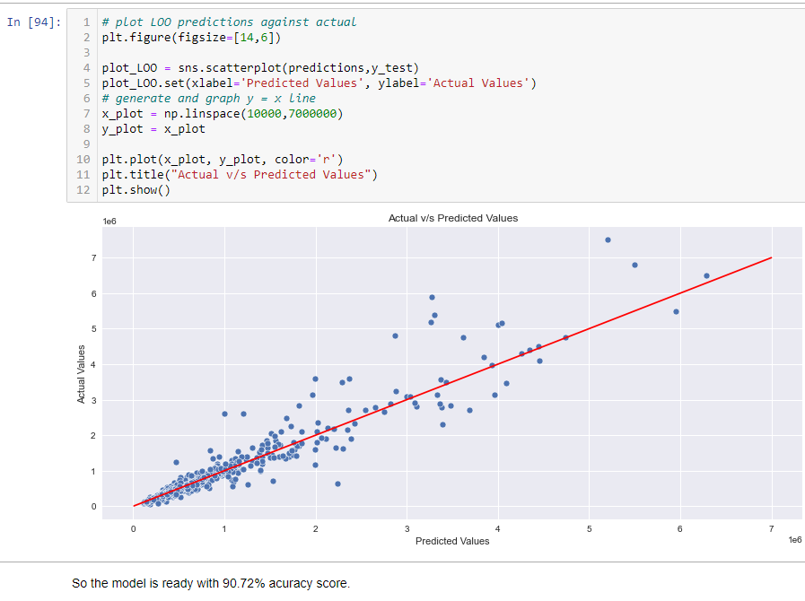
Plotting Predicted vs actual values

Slide 32

Saving the model
The model has been saved
Also saved the csv file for this dataframe

Slide 33
Conclusion:
In this paper, we built several regression models to predict the selling price of cars by given some of the cars features. We evaluated and compared each model to determine the one with highest performance. We also looked at how some models rank the features according to their importance. In this paper, we followed the data science process starting with getting the data, then cleaning and pre-processing the data, followed by exploring the data and building models, then evaluating the results.
As a recommendation, we advise to use this model (or a version of it trained with more recent data) by car market who want to get an idea about car price. The model can be used also with datasets that covered areas provided that they contain the same features. We also suggest that people take into consideration the features that were deemed as most important as seen in the previous section; this might help them estimate the car price is better.

Slide 34
Thank you

