Slide 1
Library Management System
Course - CS401 Modern Programming Practices (MPP)
Professor - Renuka Mohanraj
Group #6:
Dawit Woldegiorgis: 109407
Ganbat Bayar: 986537
Tuy Tam Phan: 986589

Slide 2
Overview
This system allows to manage the books, members and checkout records by library employees (Librarian and Administrator).
Librarian can use to search books, check out books for library members.
Administrator can use to add new books to the collection, create new library members and edit library member information.

Slide 3
Main functionalities of system
Add member
Add book – Extra Credit
Add book copy
Checkout book
Search member – Extra Credit
Search book – Extra Credit

Slide 4
Main points of presentation
Introduce about class diagram, use case diagram, sequence diagram
Design of UI - Implemented use cases
Demo
Conclusion with SCI principles

Slide 5
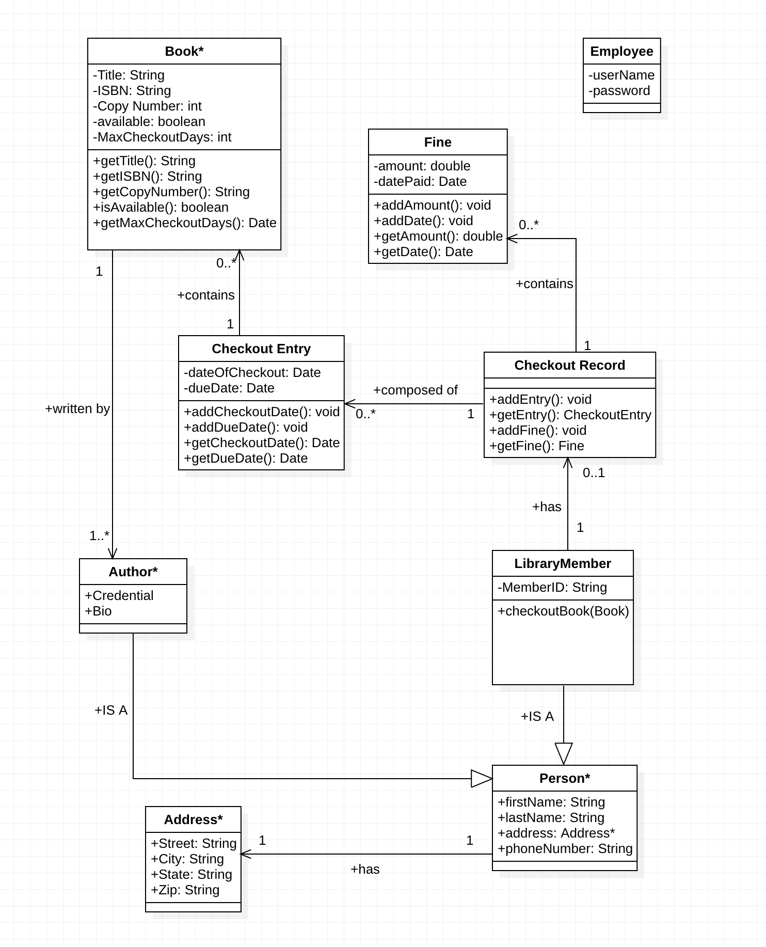
Class Diagram

Slide 6
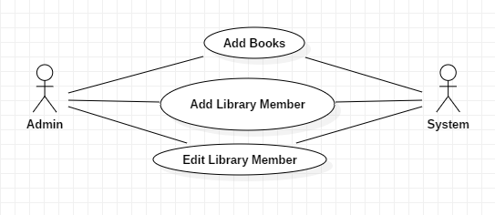
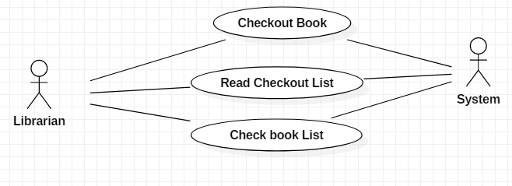
Use Case Diagram

Slide 7
Sequence Diagram
Add a new book
Checkout a book (if available) for a library member

Slide 8
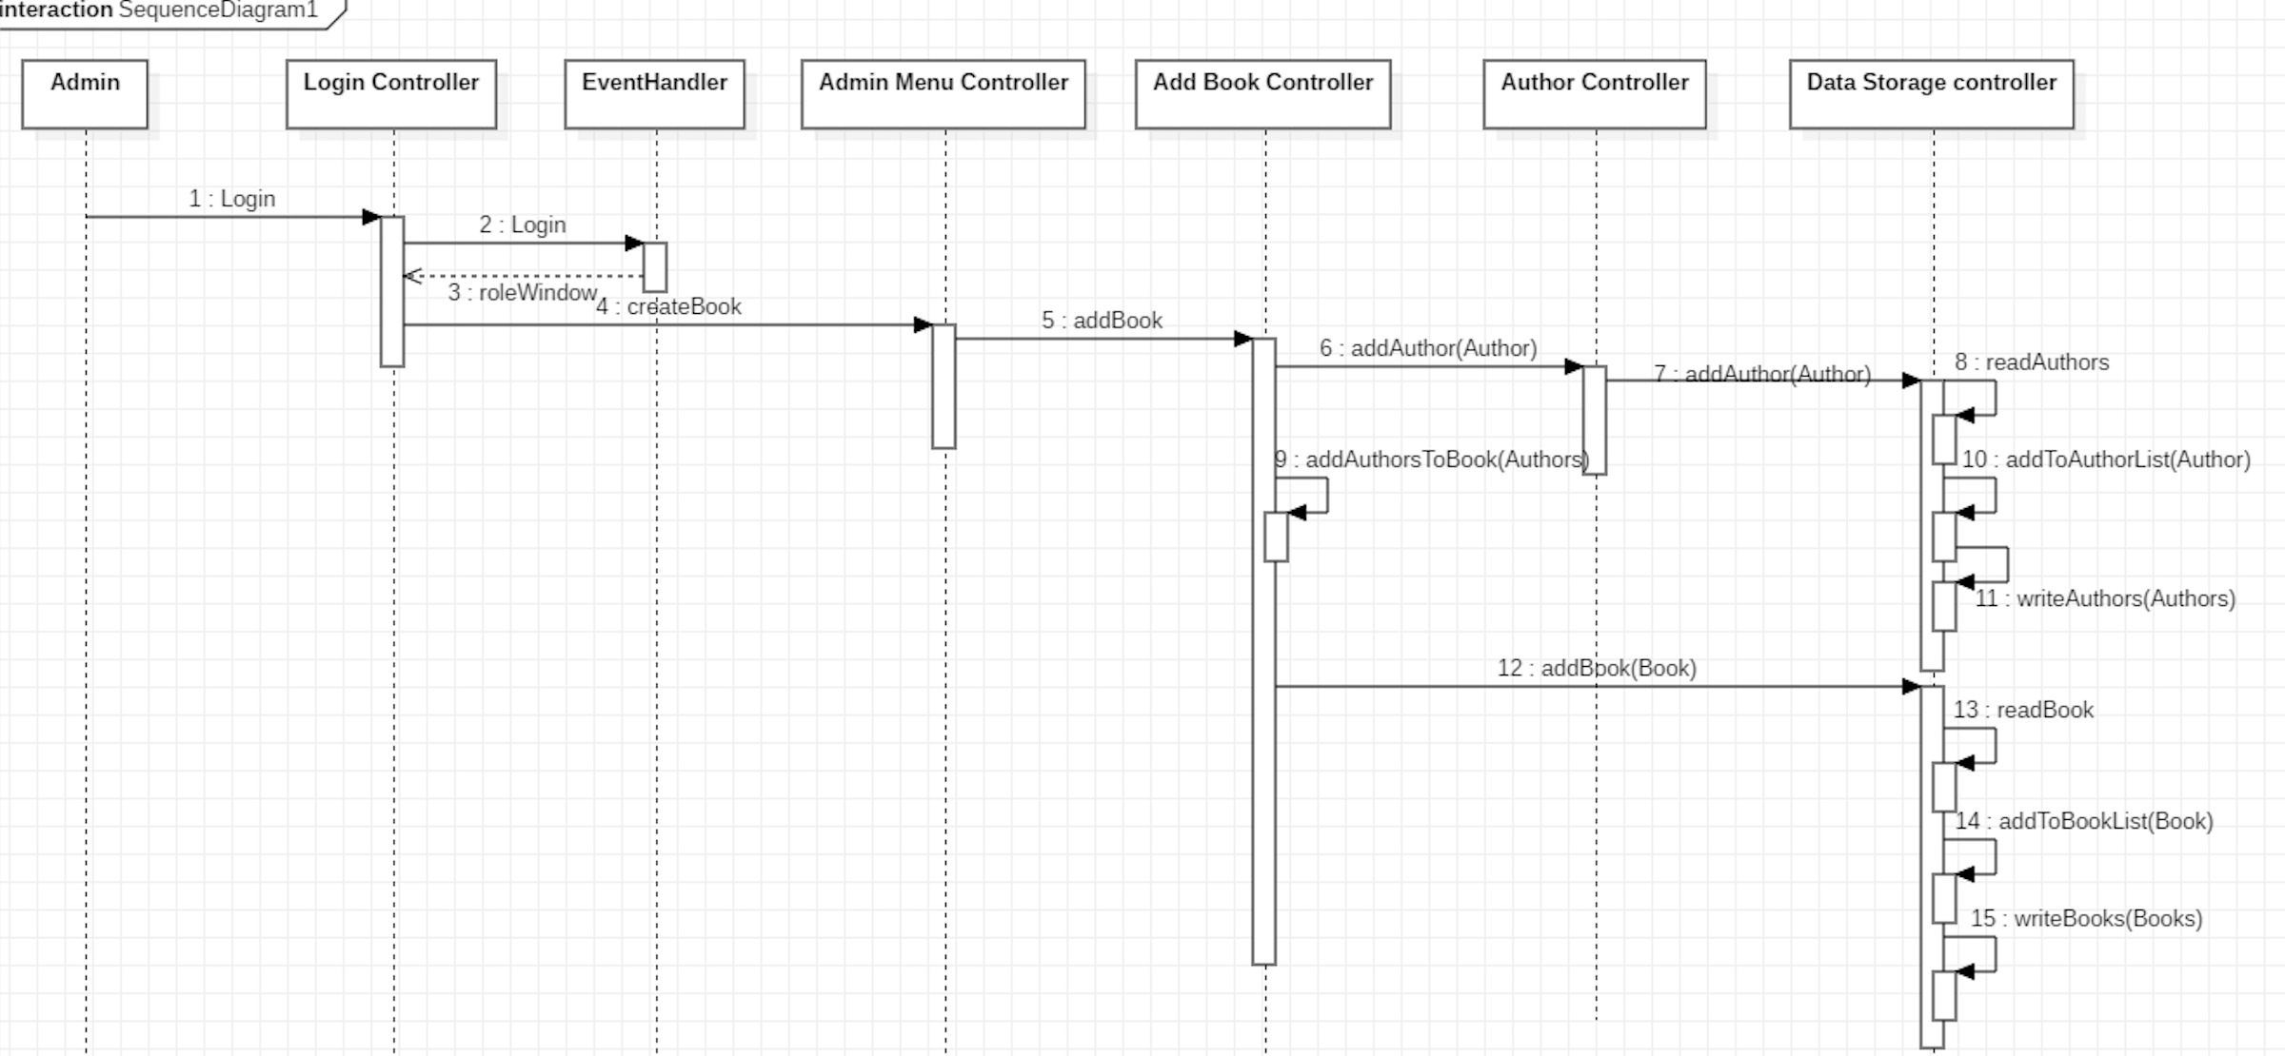
Sequence Diagram 1. Add a new book

Slide 9
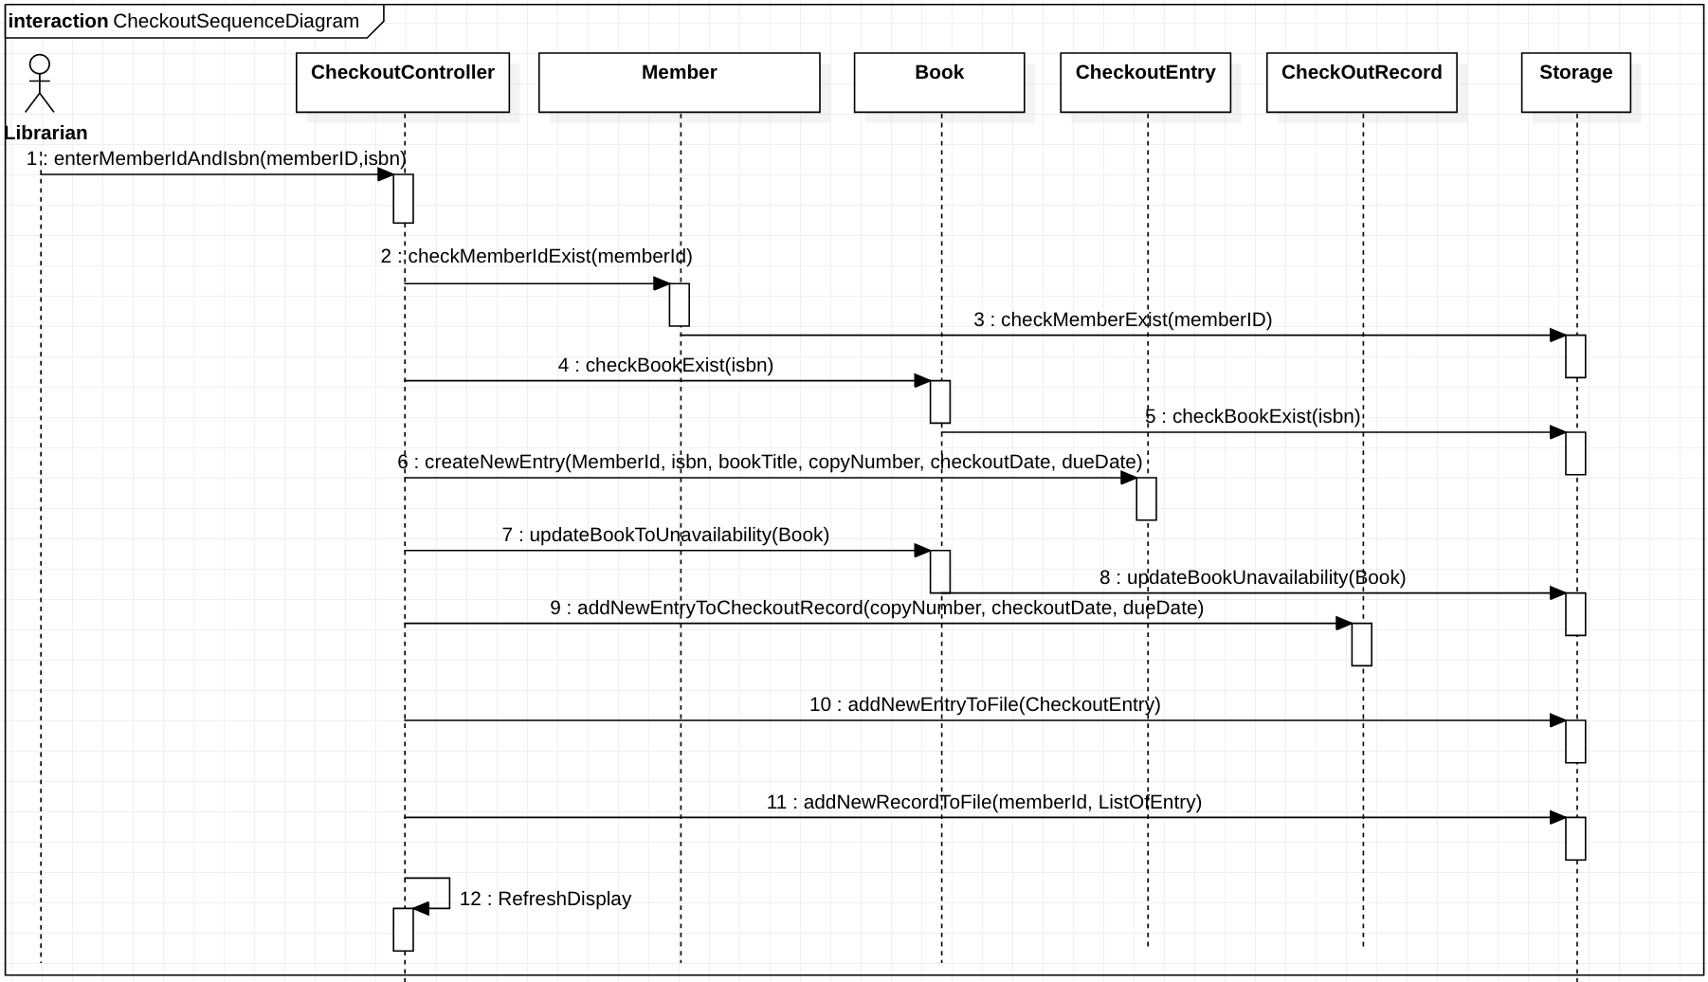
Sequence Diagram 2. Checkout a book (if available) for a library member

Slide 10
Design of UI - Implemented use cases
What UI features are involved in the use case
How the UI communicates with the controller
What the controller does in response to the request from the UI (to display data, update records, etc)

Slide 11
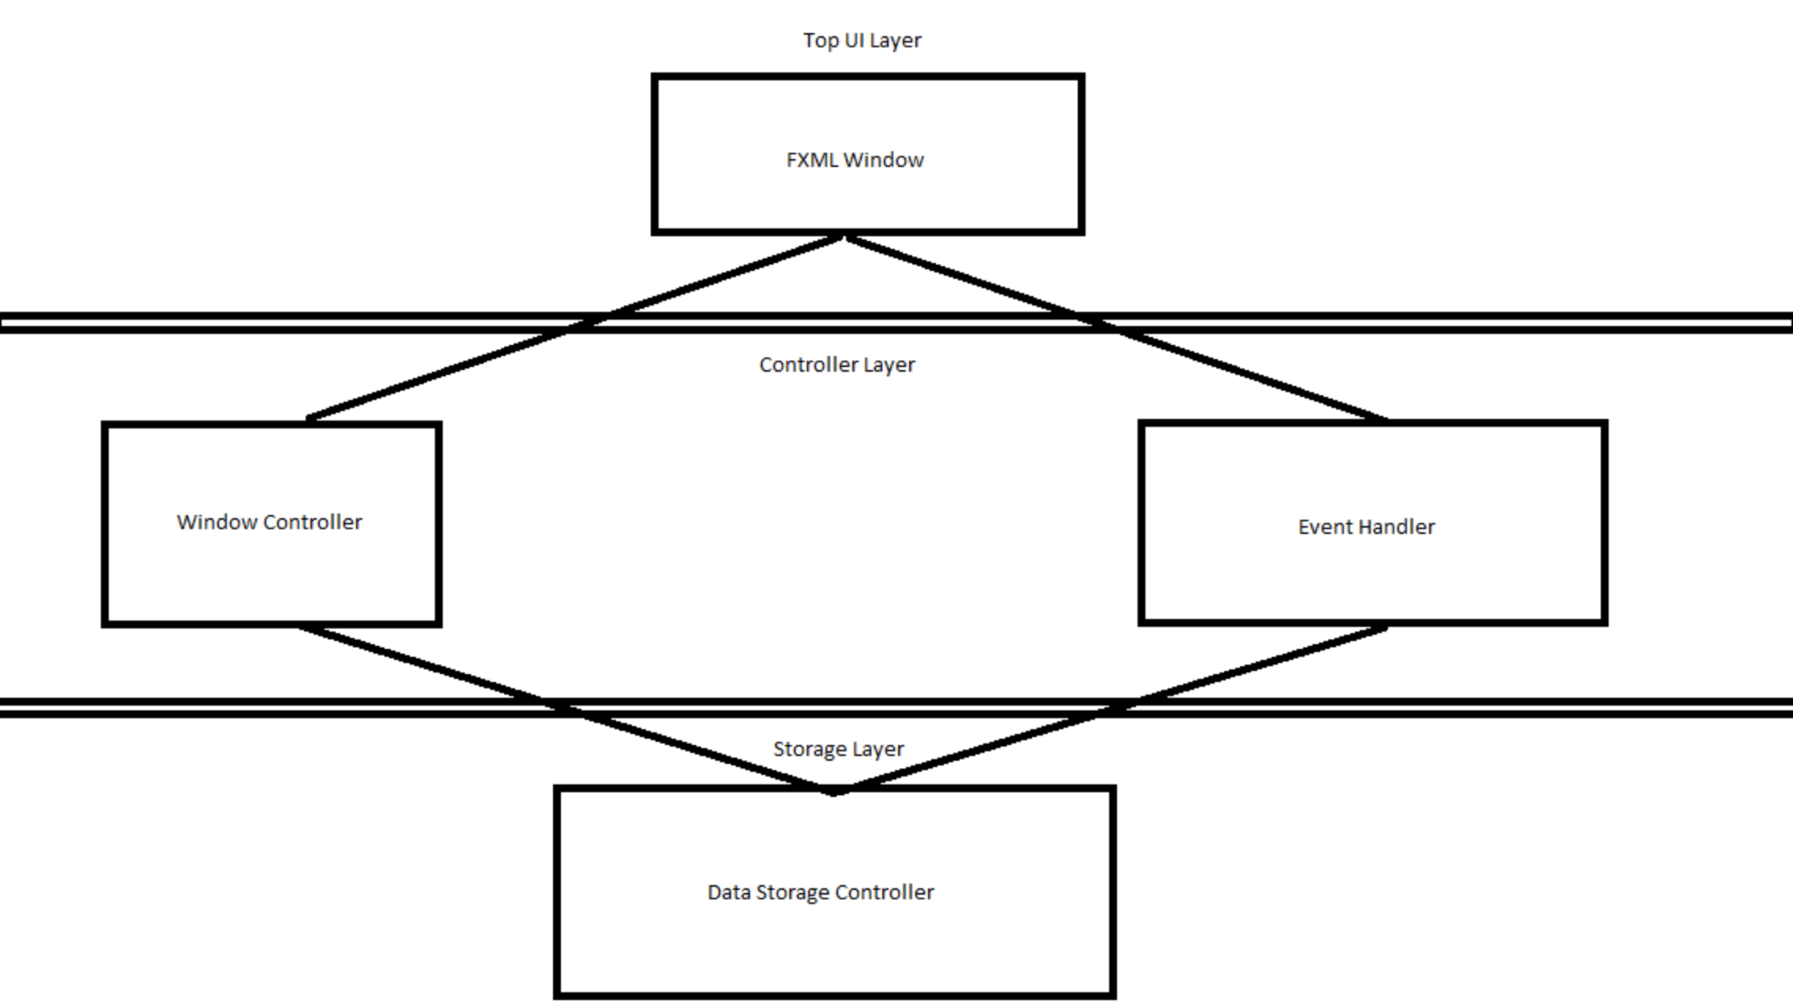
Design of UI

Slide 12
Demo

Slide 13
Conclusion with SCI Principle
SCI Principle 1: The whole is greater than the sum of the parts
Project is composed of different modules
Modules by themselves do not make the system unless there is a unifying system (integration)
SCI Principle 2: Deterministic property of unified field
Interaction with modules need to happen in a specific way for the whole system to work properly

