Slide 1


Dr. D.Y.PATIL COLLEGE OF
ENGINEERING AND INNOVATION
DEPARTMENT OF COMPUTER ENGINEERING
Dr. D. Y. Patil College of Engineering & Innovation
Talegaon, Pune
[2026-2027]
A Seminar Presentation on
“Cybersecurity Threat Detection”
By:
Kalyani R. Darekar TE A2 13142
Guided By:
Prof. Shirsagar Shubhangi

Slide 2
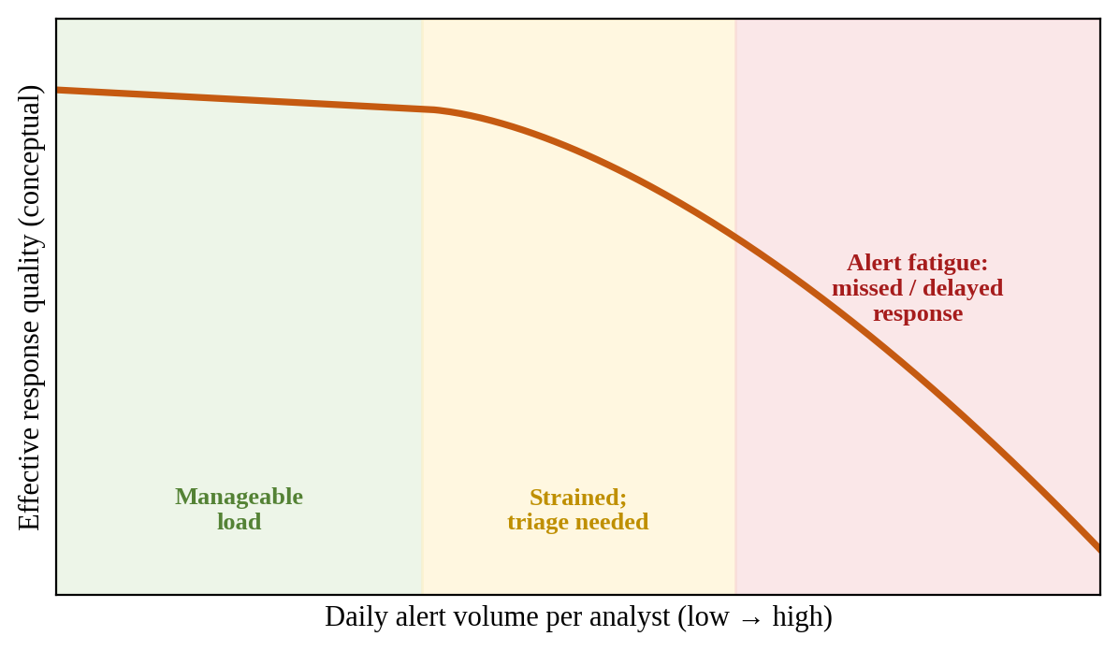
Introduction to Threat Detection
Cybersecurity threat detection identifies malware, phishing, ransomware, DDoS attacks, and intrusions in near real time.
Traditional signature-based defences cannot recognise novel, zero-day, or polymorphic attacks.
Security teams receive thousands of alerts daily; excess volume causes alert fatigue and missed incidents.
Layered, intelligent detection (anomaly, behaviour, and ML-based) offers an efficient and scalable solution.

Slide 3
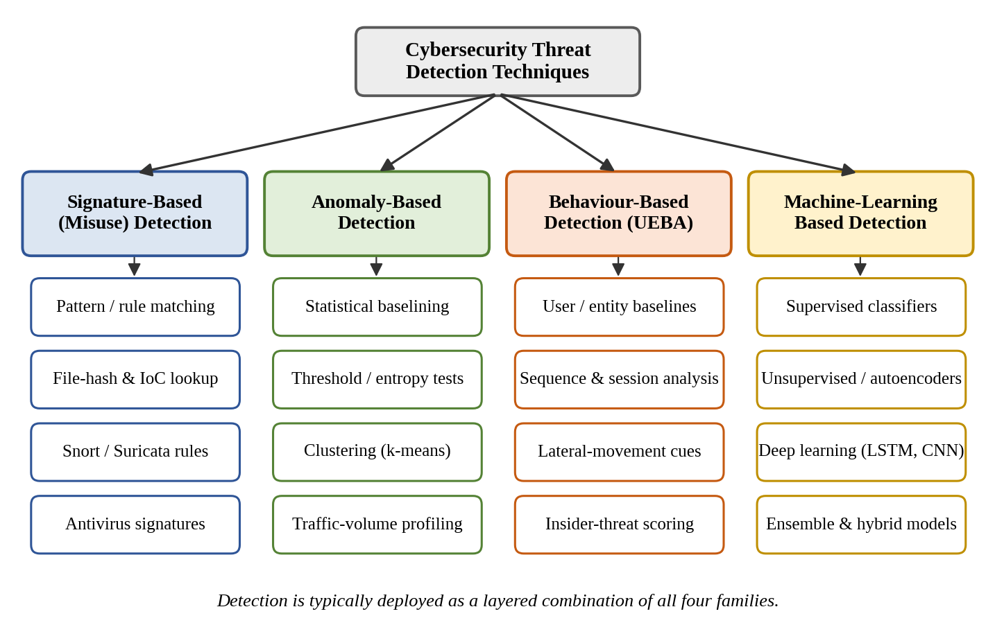
Detection Techniques Compared
Signature-Based: Matches events against known patterns and hashes.
Limitation: Misses zero-day and polymorphic attacks.
Anomaly-Based: Flags deviations from a baseline of normal behaviour.
Limitation: Higher false-positive rate.
Behaviour-Based (UEBA): Models user and device action sequences over time.
Limitation: Needs reliable baselines; costlier to run.
ML-Based: Supervised and unsupervised models adapt to unseen attacks.
Limitation: Depends on data quality; hard to interpret.
Result: No single technique is enough; a layered combination works best.

Slide 4
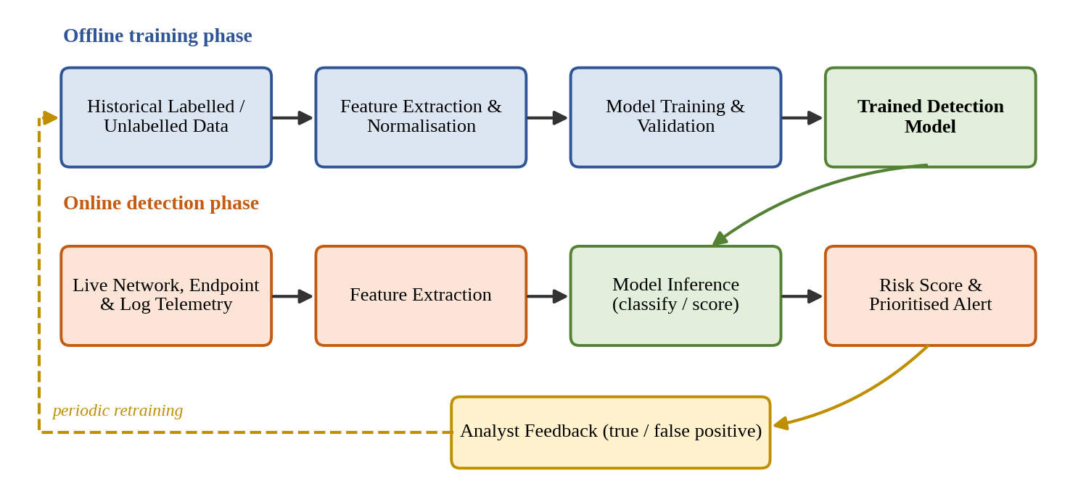
System Architecture: How It Works
Core Idea: Telemetry from networks, endpoints, and logs is turned into features and scored by a detection engine to raise prioritised alerts.
Method:
Collect: live network, endpoint, and log telemetry.
Pre-process: convert raw data into features (flow duration, byte counts, protocol flags).
Detect: a trained model (or signature engine) scores each event for likelihood of malicious intent.
Alert & Learn: a risk-scored alert is raised (or traffic is blocked in IPS mode); analyst verdicts retrain the model.

Slide 5
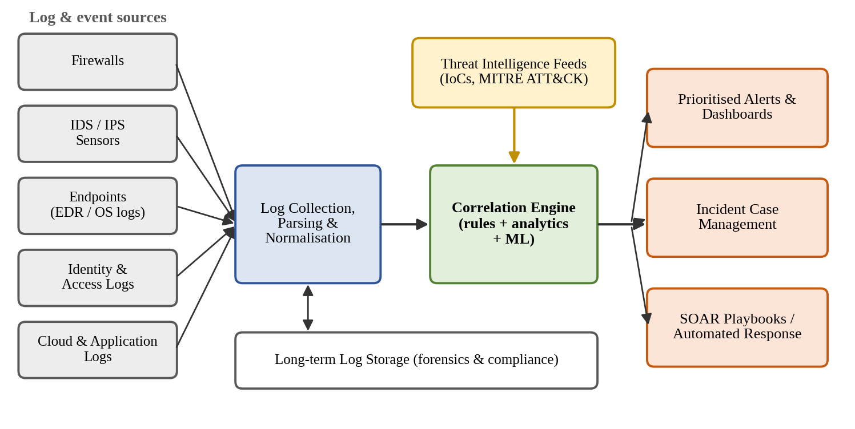
Pushing Capability Further: SIEM
Goal: Move beyond isolated sensor alerts toward correlated, intelligence-driven detection.
Method: A SIEM adds two capabilities on top of individual sensors:
Log Collection & Correlation: aggregates logs from firewalls, IDS/IPS, endpoints, identity, and cloud; rules and ML link weak events into a multi-stage attack picture.
Threat Intelligence: IoCs, MITRE ATT&CK, and CISA advisories keep detection logic ahead of emerging campaigns.
Result: Prioritised alerts, case management, and SOAR playbooks enable fast, largely automated response.

Slide 6
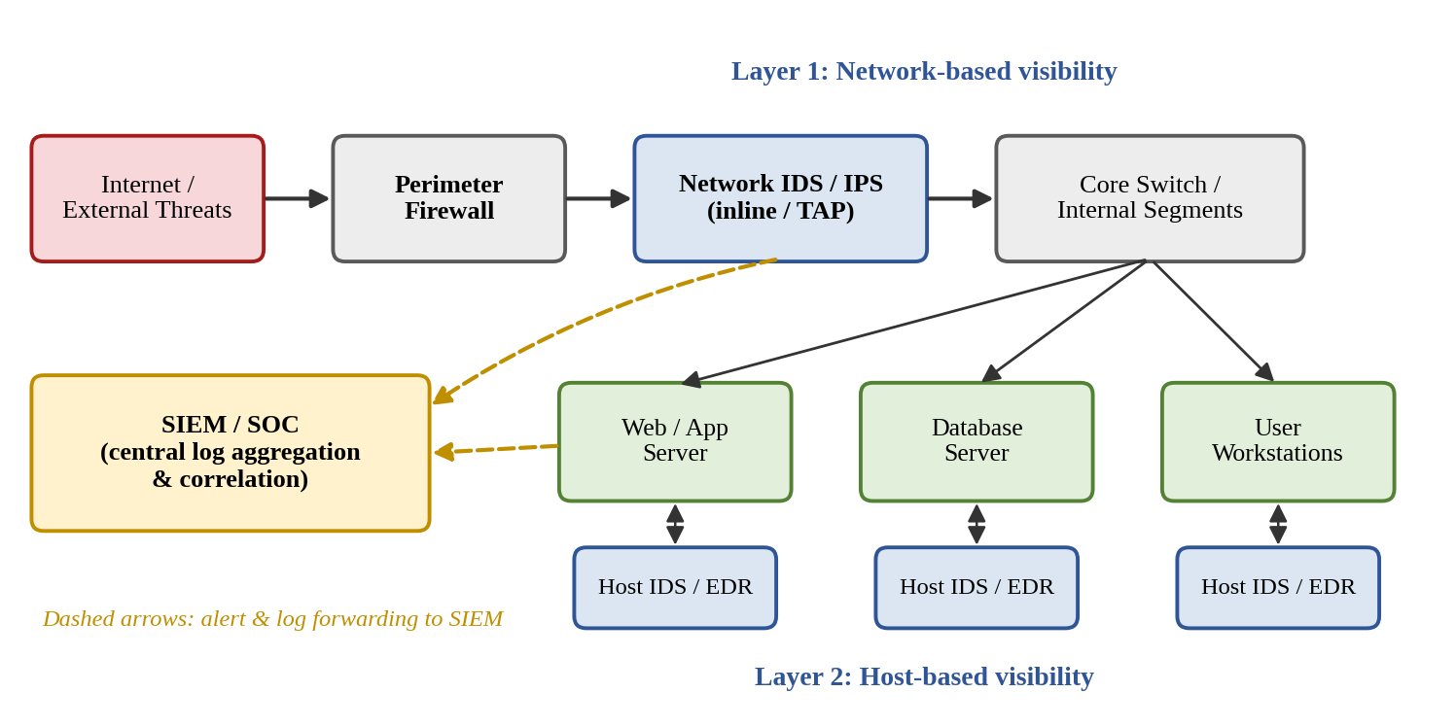
Deployment: IDS vs. IPS vs. SIEM
IDS: Out-of-band (TAP/SPAN) or host agent; detects and alerts only (e.g., Snort, Suricata, Zeek).
IPS: Inline in the traffic path; detects and blocks, but false positives may block legitimate traffic.
SIEM: Central platform that aggregates and correlates logs; response via SOAR (e.g., Splunk, Wazuh).
Network-based (NIDS/NIPS) gives broad visibility but limited insight into encrypted traffic; host-based (HIDS/HIPS) gives deep endpoint visibility but needs agents.
Mature architectures deploy both in a layered, defence-in-depth design.

Slide 7
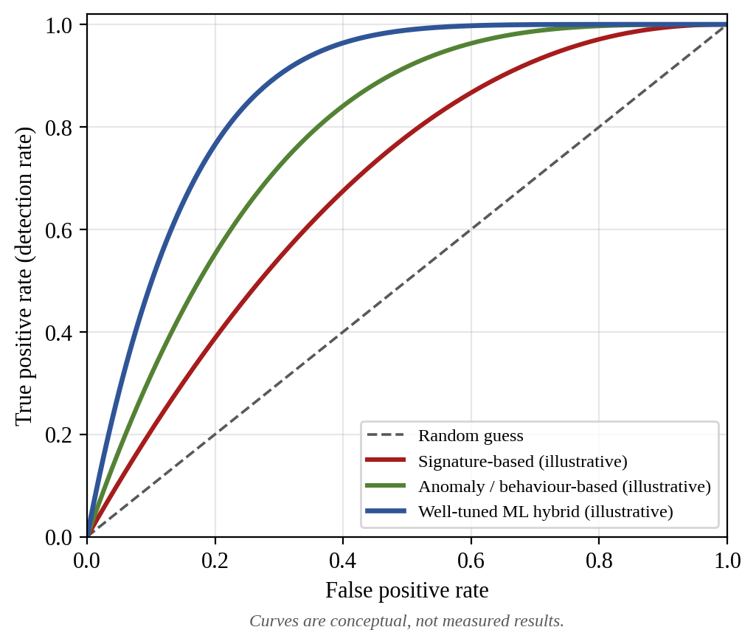
Performance Comparison
Evaluation: ROC curves plot detection rate against false-positive rate; a curve nearer the top-left is a better detector.
Signature-Based: Low false positives and low cost, but cannot detect unknown threats.
Anomaly / Behaviour-Based: Detect unseen and insider threats, with moderate to high false-positive tendency.
ML Hybrid: Best trade-off when well tuned, but higher compute cost and lower explainability.
Note: Curves are conceptual illustrations, not measured results.

Slide 8
Real-World Applications
Enterprise IT & Cloud: SIEM and cloud-native detection monitor identity, network, and workload activity across hybrid and multi-cloud environments.
Banking & Finance: Real-time transaction monitoring combines rules with behavioural analytics to detect fraud and account takeover.
Critical Infrastructure (ICS/OT): Anomaly detection protects power grids, water treatment, and manufacturing, where availability and safety come first.
Healthcare: Protects health records and connected medical devices from ransomware and unauthorised access.
Government & Defence: CERTs and agencies such as CISA coordinate threat-intelligence sharing and incident response.

Slide 9
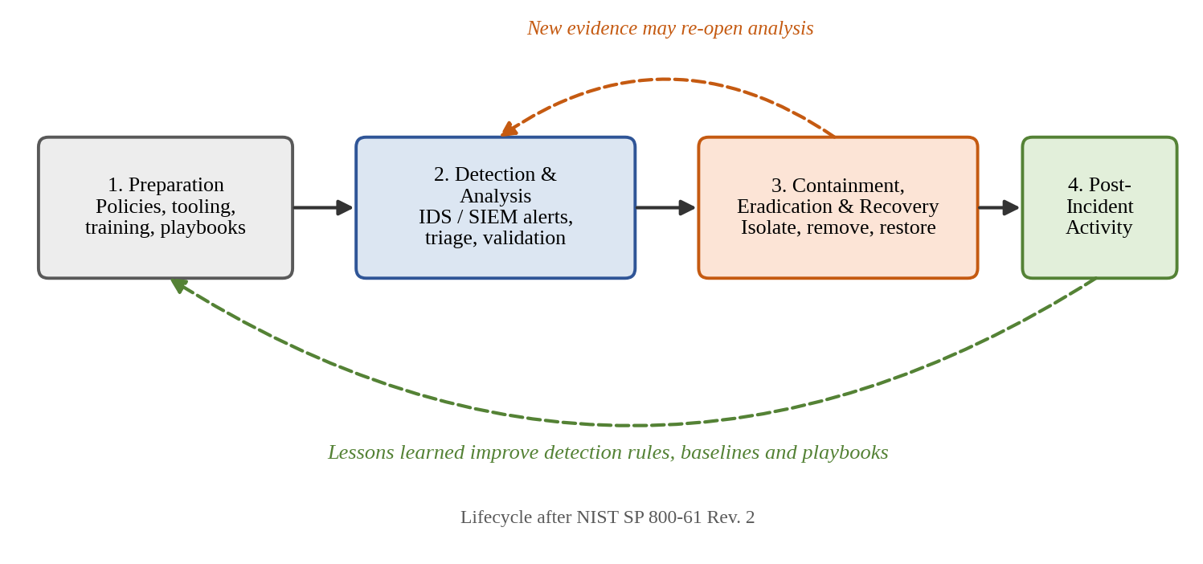
Illustrative Scenarios
Ransomware Precursor: After a phishing foothold, UEBA flags unusual file-share access from an atypical host; the SIEM correlates it with a process-injection alert, and the SOC isolates the host before encryption begins.
Volumetric DDoS: Sensors spot a request surge against baseline; the SIEM confirms service degradation, and a SOAR playbook applies rate-limiting and traffic scrubbing.
Incident Response (NIST SP 800-61): Detection is only stage two of the lifecycle; lessons learned feed back into rules and playbooks.

Slide 10
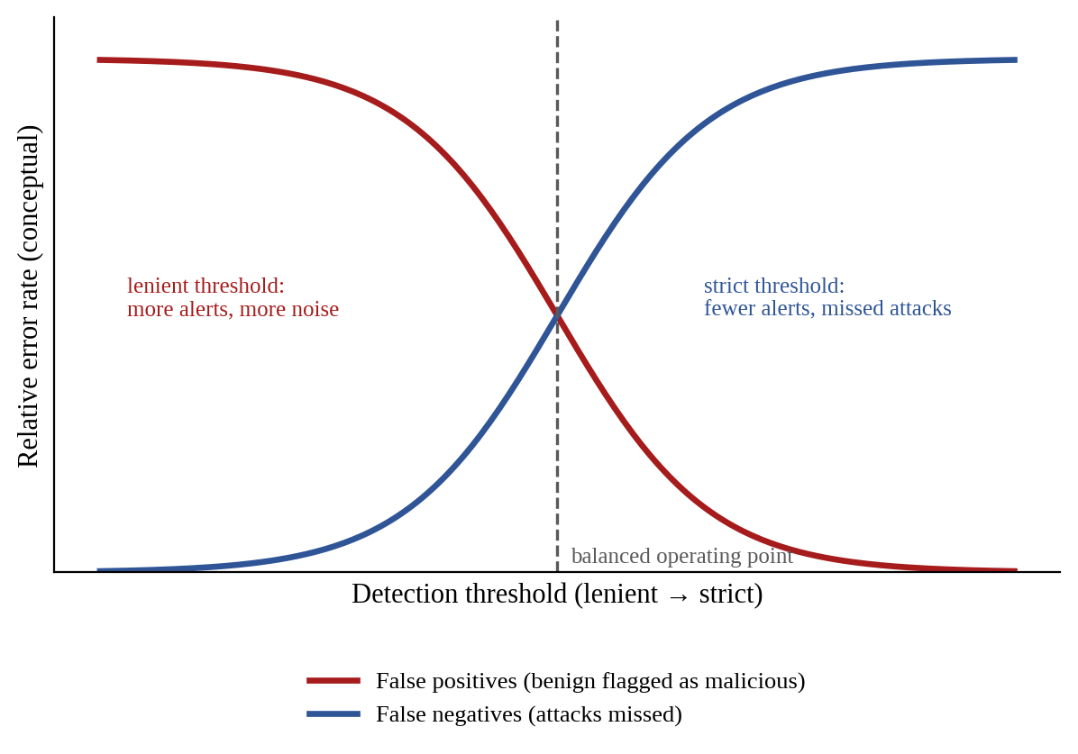
Discussion: Challenges & Future Work
Challenges:
False positives vs. false negatives must be balanced; alert fatigue overloads analysts.
Adversarial evasion, zero-days, encrypted traffic, and privacy limits reduce visibility.
APTs, ransomware, and supply-chain attacks evade short-duration anomaly detection.
Future Directions:
SOAR: Automated playbooks cut response time from hours to seconds for known patterns.
Explainable AI: Shows which features drive an alert, building analyst trust.
Collaborative Threat Intelligence: ISACs, CISA, and MITRE ATT&CK shorten time-to-detection.
Adaptive, self-tuning detection driven by analyst feedback.

Slide 11
Conclusion
Threat detection is a layered discipline: signatures for known threats, anomaly and behavioural analytics for novel and insider threats, and ML for adaptability and scale.
IDS/IPS, SIEM, and threat intelligence correlate weak signals into prioritised incidents; SOAR, explainable AI, and shared intelligence address alert fatigue and evasion.
Resilient security needs human oversight, alignment with standards such as the NIST Cybersecurity Framework, and continuous adaptation to evolving threats.

Slide 12
References
V. Chandola, A. Banerjee, and V. Kumar, “Anomaly Detection: A Survey,” ACM Computing Surveys, vol. 41, no. 3, art. 15, 2009.
P. Garcia-Teodoro et al., “Anomaly-based network intrusion detection: Techniques, systems and challenges,” Computers & Security, vol. 28, no. 1–2, pp. 18–28, 2009.
R. Sommer and V. Paxson, “Outside the Closed World: On Using Machine Learning for Network Intrusion Detection,” IEEE Symp. Security and Privacy, 2010, pp. 305–316.
A. L. Buczak and E. Guven, “A Survey of Data Mining and Machine Learning Methods for Cyber Security Intrusion Detection,” IEEE Commun. Surveys & Tutorials, vol. 18, no. 2, pp. 1153–1176, 2016.
K. Scarfone and P. Mell, Guide to Intrusion Detection and Prevention Systems (IDPS), NIST SP 800-94, 2007.
P. Cichonski et al., Computer Security Incident Handling Guide, NIST SP 800-61 Rev. 2, 2012.
NIST, The NIST Cybersecurity Framework (CSF) 2.0, U.S. Department of Commerce, 2024.
MITRE Corporation, “MITRE ATT&CK Framework,” attack.mitre.org, accessed 2026.
CISA, “Cyber Threats and Advisories,” cisa.gov, accessed 2026.

Slide 13
THANK YOU
Questions?

