Slide 1
L&L: PE TCL Characterization scripts
Daniel Bertrand
June 5, 2015

Slide 2
Outline
PE_COMMON Vault TCL scripts
Register namespace
Equipment Namespace
Visa
Bit manipulation
Other TCL Scripts
Teacup command
Controlling Windows apps (COM)
Controlling other TCL instances.

Slide 3
TCL at PMC
TCL used +10 years in PE, adopted from PV groups
Also used in by PD for controlling simulators
BWD is moving to python (but still need TCL for ATP cmd file generation)
Pros:
Interactive, the “cmd args..” prefix style is similar to a unix shell
Very dynamic (ex: functions can be redefined, deleted, renamed)
Very permissive BSD style license.
Cons:
Has been falling out of popularity for many years.
the “cmd args..” prefix style is unlike other programming languages

Slide 4
PE_COMMON Vault
PE “Common” SVN vault is located here:
http://bby-pv-svn04:24002/svn/PM26_98_11_A/trunk
It contains a master copy of generic TCL that’s needed for most projects:
USB dongle drivers (jtag, SPI, I2C/TWI)
Equipment control library
Standard register namespace lookup code
Libraries for bit manipulation, puts_colour, etc.

Slide 5
PE_COMMON Vault
Populating a new project vault with these scripts?
Keep it simple: copy a snapshot into your project vault
If you have improvements, commit it back up stream to the common vault

Slide 6
Register namespace
The PE register namespace code has a few important features for us:
export to tester command files
“Offline” mode (for resim testbench before silicon)
wrRd BLOCK::SUBBLOCK::REG::BIT
wrRd BLOCK::SUBBLOCK::REG::BIT 0x1234

Slide 7
Register namespace
Instance fan-out rules are not currently well documented:
Read/write to range of instances:
::DEV_TOP::C8_SERDES(0:7)::CNI_UNI_TXRX_MTSB
Read/write to several instances:
::DEV_TOP::C8_SERDES(2,6,1)::CNI_UNI_TXRX_MTSB

Slide 8
Register namespace
Nested instances are more complicated:
BLOCK(0/19)::SUBBLOCK(0/1)::REG::BIT -> expands to all nested permutations:
BLOCK(0)::SUBBLOCK(0)::REG::BIT
BLOCK(0)::SUBBLOCK(1)::REG::BIT
BLOCK(19)::SUBBLOCK(0)::REG::BIT
BLOCK(19)::SUBBLOCK(1)::REG::BIT
BLOCK(0,19)::SUBBLOCK(0,1)::REG::BIT -> expands to all parallel combinations:
BLOCK(0)::SUBBLOCK(0)::REG::BIT
BLOCK(19)::SUBBLOCK(1)::REG::BIT

Slide 9
Register namespace
Sub-bitfield ranges are accessible:
BLOCK::SUBBLOCK::REG::BITFIELD(7:4)
BLOCK::SUBBLOCK::REG::BITFIELD(5)
Whole register are also accessible:
BLOCK::SUBBLOCK::REG:: (Omit the bitfield name)

Slide 10
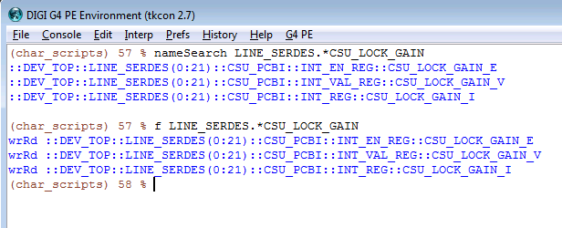
Register Namespace
Locate bits using “f” or “nameSearch” commands

Slide 11
Equipment Namespace
Most of the equipment code is encapsulated into TCL namespaces, the advantage is:
Makes it easy to locate procs
Multiple copies can be instantiated (control of multiple of the same type of equipment )
For the power supplies, a consistent API is provided - allows power supplies to be substituted easily.

Slide 12
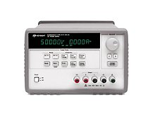
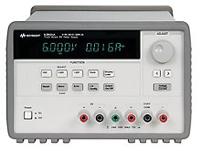
Equipment Namespace
Bench #1
Bench #2
E3631 is triple output
E3631
E3633
Incompatible SCPI commands
"apply P6V,1.0,0.3"
"apply 1.0,0.3"
::AVD::setVoltCurr 1.0,0.3
::AVD::setVoltCurr 1.0,0.3
Compatible tcl API

Slide 13
Equipment Namespace(2)
To instantiate an equipment, a “new” procedure is used, e.g
newE3633A ::AVD:: 5
newE3633A ::VDD:: 4
Some power supplies have multiple outputs, this is specified by an additional argument:
newE3631A ::AVD:: 5 P6V
newE3631A ::VDDO:: 5 P25V

Slide 14
Equipment Namespace(3)
Inside the namespace a consistent set of procedures are provided:
setVolt (output voltage)
setCurrent (current limit)
outputOn/outputOff
setCurrentProtection (if hardware is not available this is an empty proc)
Etc..

Slide 15
What is VISA?
User script
Virtual Instrument Software Architecture
VISA is an instrument control library that supports multiple I/O interfaces
Uses the familiar SCPI
TCL VISA wrapper
VISA
C-API
USB
PXI
GPIB
Ethernet
serial

Slide 16
TCL Visa Library
The TCL-VISA library is an open source library:
http://tclvisa.sourceforge.net/
Some in-house tcl wrapper code is provided to create backwards compatible ::gpib::* commands.
Prerequisites:
The visa32.dll needs to be installed on the lab PC. (Is installed by Agilent Connection Expert, or National Instrument’s software).

Slide 17
TCLVISA example
TCLVISA uses tcl’s channel I/O api
It has an open command which returns a file handle
You then use the familiar puts, gets, read & close commands
Example visa transaction:
set vi [::visa::open $::visa::rm $VisaAddress]
puts $vi "*IDN?"
set ret [gets $vi]
puts "Instrument IDN is: $ret"
close $vi

Slide 18
TCL Visa Library (PE enhancements)
The legacy IBWrite/IBQuery/IBRead command updates:
Now accepts visa addresses in addition to the raw GPIB address.
Variable ::gpib::disable_remote_mode, controls whether access to the GPIB equipment is done in remote mode (= 0, default) or local mode (=1)
Variable ::gpib::timeout_ms controls the timeout period (default is 5000ms).
New command ::gpib::send_all_to_local puts GPIB connected equipment into local mode.

Slide 19
TCL Visa Library(Visa addresses)
Example USB Visa address:
USB0::0x0957::0x5010::MY49101016::INSTR
USB0 == USB connected (other possibilities are GPIB, TCPIP, ASRL)
0x0957 == Agilent Mfg ID
0x5010 == J-BERT N4903B Model ID
MY49101016 == Serial number
INSTR == this is an instrument (other possibility is INTFC, for e.g. the gpib interface controller)

Slide 20
TCL Visa Library(Visa addresses)
Find Visa Address
This will return a list of all connected equipment:
::visa::find $::visa::rm "?*"
Or a convenient alternative:
::gpib::find_all
To match a specific instrument:
::visa::find $::visa::rm "USB?*::0x0957::0x5010?*" -> this finds all USB connected J-BERTS
(?* is VISA regexp syntax meaning match one or more chars)

Slide 21
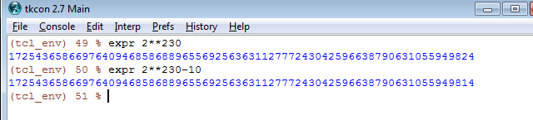
Bit manipulation
TCL internally represents integers using signed 32bit ints (2’s compliment)
For values too large for 32bits it uses a “bignum” format.
Values are converted between Bignum/int32 automatically as-need

Slide 22
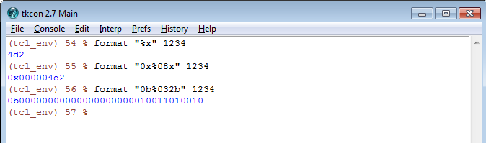
Bit manipulation
How to convert to “hex” or “binary”?
Hex and binary are ascii string representation
You need the tcl equivalent of sprintf: “format”
Format specified is almost identical to C’s
Tcl8.6.x adds %b for binary

Slide 23
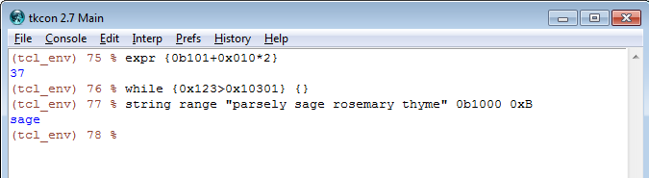
Bit manipulation
How to convert back from these string representation?
TCL accepts inputs like “0b0101” “0x1A32” almost everywhere a number is expected

Slide 24
Bit manipulation
Many legacy PMC integer formatting scripts are not needed
They are also buggy, slow, and don’t support Bignum
Some example names of these scripts that occasionally remake a reappearance:
dec2bin, bin2dec, dec2hex, hex2dec, hexNibble2binNibble, binNibble2hexNibble, hexReg2binReg, binReg2hexReg
For tcl 8.5.x, dec2bin is required as format did not have “%b”

Slide 25
2’s compliment
Functions are provided for 2’s compliment sign extension and contraction (“extend2scomp” and “contract2scomp”)
Contraction is straight forward (drop MSBs - AND with a mask).
Extension requires replication of the sign bit into the MSBs
Example sign extension:

Slide 26
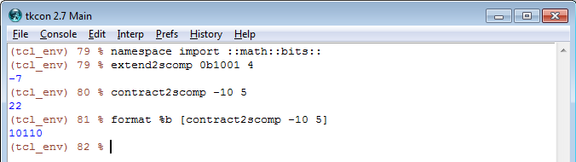
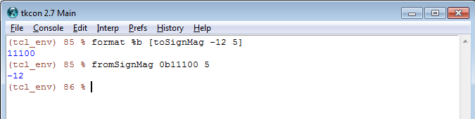
2’s compliment
Example usage:
Similar functions are provided for sign-magnitude formats

Slide 27
Other scripts in PE Vault
puts_colour.tcl -> colour printing to the console (you can also change font)
try.tcl -> a backport for tcl8.5.x of the “try” command (8.6.x)
simpleplot.tcl -> for making quick & dirty XY-plots, etc.
svn.tcl -> check and warn users if their local svn copy is outdated.
pe_tkcon.tcl -> adds improved tab-autocompletion, other tkcon improvements
Parse_args.tcl -> A copy of CBU PV’s command argument parser

Slide 28
Some additional TCL packages

Slide 29
Installing additional TCL Packages
ActiveState TCL has a large collection of optional packages
Manage these with windows “teacup.exe” command
It has subcommands for search, install, remove, update.
Example:
teacup search <search string>
teacup install <packagename>

Slide 30
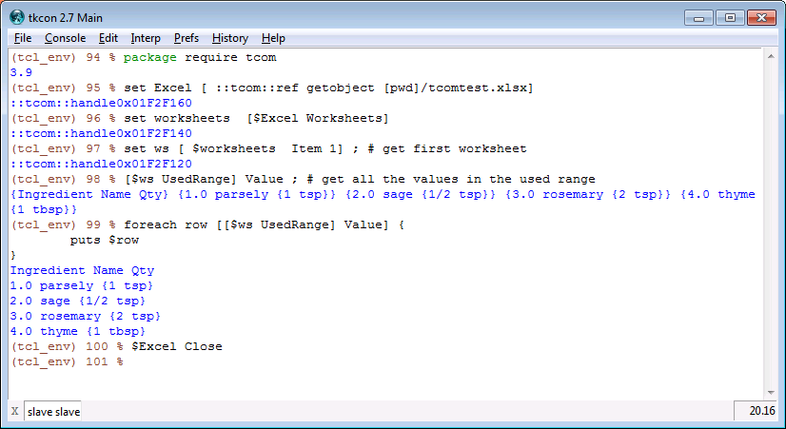
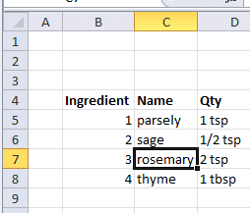
Control Windows Applications
TCOM - TCL interface to window’s COM interface
You can control windows apps (excel, word, etc) from tcl

Slide 31
Controlling another TCL instance
Example use case:
Digi120G char required automation of PV’s setup (for datapath timing screens)
PV comExpress
(Linux)
PE Char board
PE Lab PC
PCIe
JTAG/I2C
(Lab network)
TCL On Lab PC controlled 2nd TCL instance running on ComExpress

Slide 32
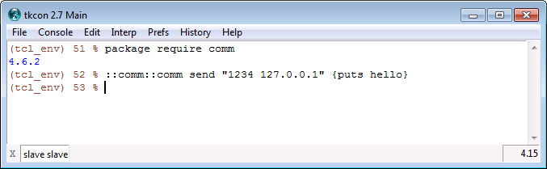
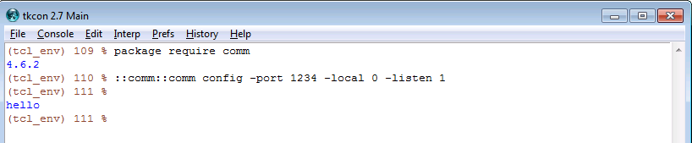
Controlling another TCL instance
“comm” package: commands from the top console are executed in the second console.
Note: May need to brace with { } to avoid substitution before sending

Slide 33
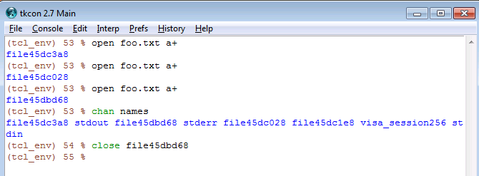
Closing opened Files
Common lab user frustration:
Script crashes before closing a file handle.
File is locked, unable to delete or move file without killing tcl
Solution: chan names

Slide 34
Questions?

