Slide 1
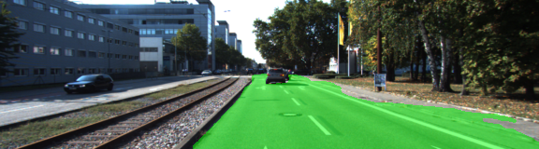
FCN Making Road segmentation
Justin Tian
University of Rochester, CS Department

Slide 2
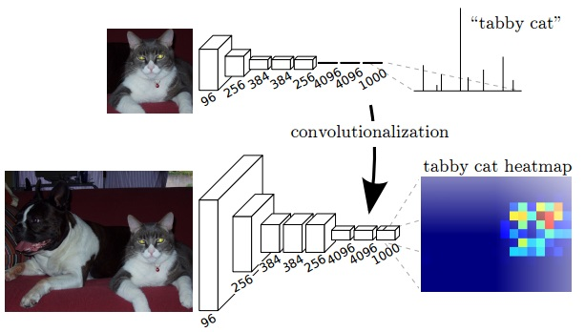
Fully Convolutional Networks (FCN)
Semantic segmentation: pixel-level implementation of image.
CNN vs. FCN output: class probability distribution vs. class heat map

Slide 3
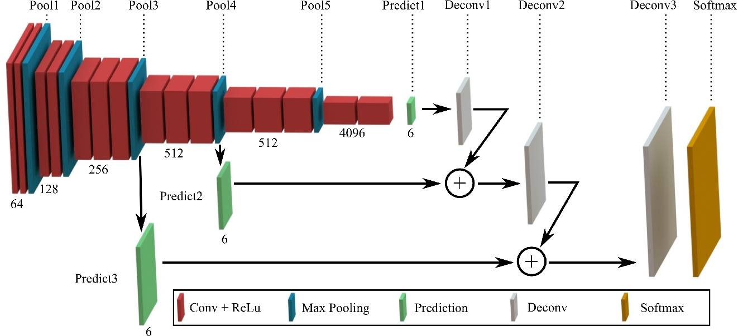
Up-sampling, from heat map to segmentation mask
Plot borrowed from L. Tai, H-Y. Ye, Q. Ye and M. Liu, 18th ICAR (2017).
In road segmentation task, the number of classes is 2 instead of 6.

Slide 4
Up-sampling (transpose convolution)

Slide 5
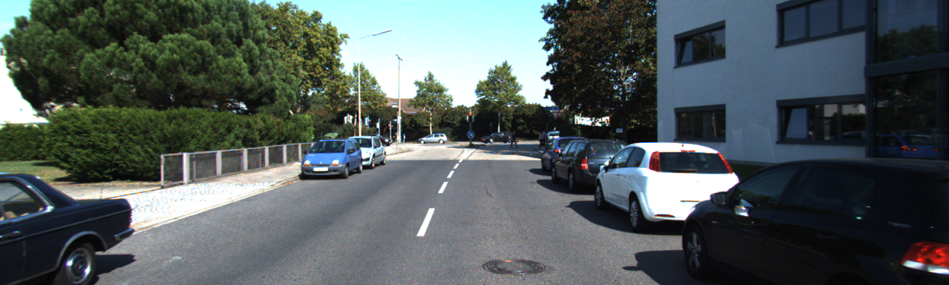

Data with Ground Truth

Slide 6
Training results and Mask R-CNN as next step

