Slide 1
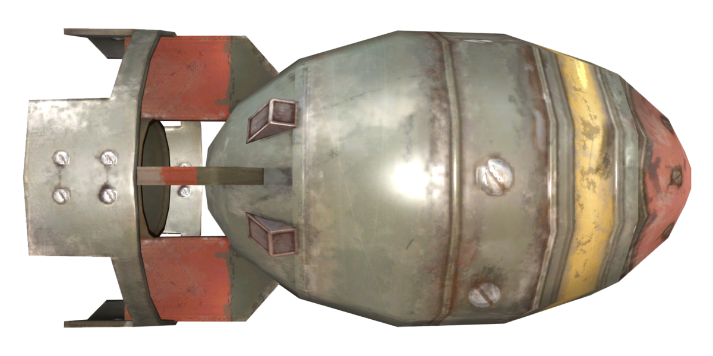
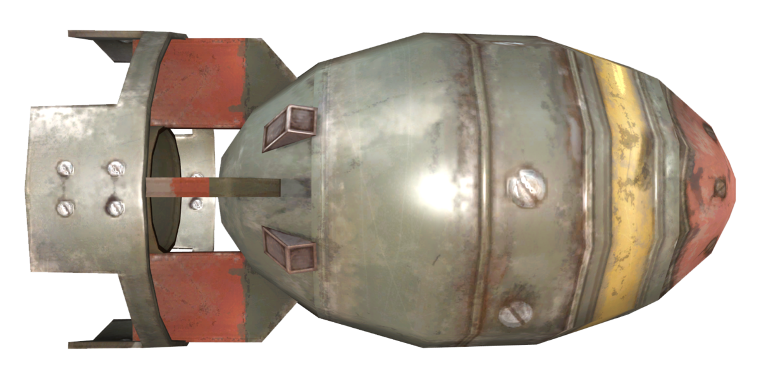
THE ATOMIC BOMB
A research on the history the atomic bomb

Slide 2
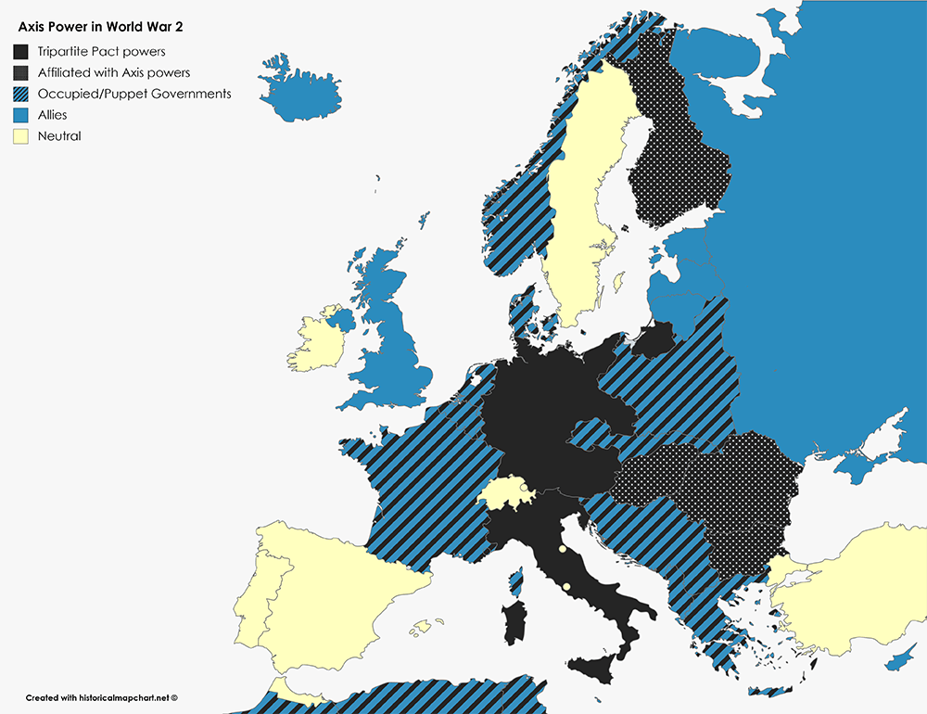
The story in detail
World war 2 started in 1939, when Hitler invaded Poland, Hitler and Stalin had both signed an agreement to each take a piece of Poland and not attack each other. What were the factors that started world war 2 you may ask?
To start, Benito Mussolini, an Italian fascist, had rebelled against the Italian government after gathering fellow fascist supporters and had allied with Hitler, together they began to ravage Europe, Africa and the middle east. Britain and France tried to appease them but to no avail and an invisible line was crossed when Hitler invaded Poland, therefore sparking WWII. Japan soon joined Germany and Italy, Hitler began to kick hundreds of thousands of people out of Germany and barricaded millions in concentration camps.
When Oppenheimer first heard of this, he became extremely angry as one of the groups impacted by these actions were jews and Oppenheimer was actually Opp(j)e(w)Nheimer (for those who don’t understand Oppenheimer was Jewish) but he didn’t know what to do. At that time, Otto Hans, a protestant Christian German scientist discovered fission and the world exploded, everyone wanted to build the city destroyer, the ultimate winner of wars, the Atomic bomb, America made a U-committee to research building bombs that use energy from fission. In 1941, Hitler began to invade the Soviets despite the Nazi Soviet non-aggression pact.
Map during world war II
This Photo by Unknown Author is licensed under CC BY-SA

Slide 3
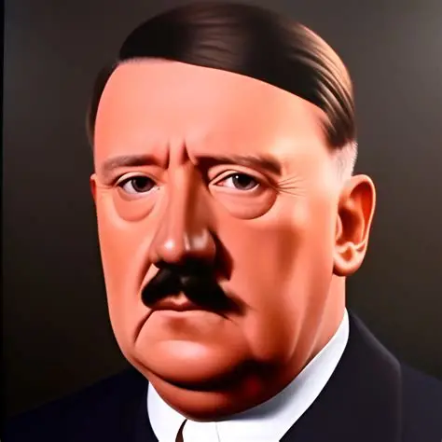
Around that time, America and the Soviets became allies, not because they liked each other, no, quite the opposite in fact, it was because their common enemy was Hitler. Even so, they kept certain secrets from each other, the Soviets were determined to find out America’s atomic secrets. They began to recruit and send spies, one of these spies was harry gold, who passed info on to the soviets to return the favor they had done him previously.
Oppenheimer was made the scientific director of Los Alamos laboratory in 1943 which was the main lab for the Manhattan project, despite this the FBI, internal military and Leslie groves, who was in charge of the whole project, decided to tail Oppenheimer due to his suspicious past.
In Norway, the Vermok heavy water factory, which the German’s needed for the atomic bomb research, became a target for the Norwegian resistance fighting Hitler’s occupation and they decided to sabotage it
(A strange picture of Hitler that is definitely AI and I felt deserves an honorable mention for being so ridiculous)

Slide 4
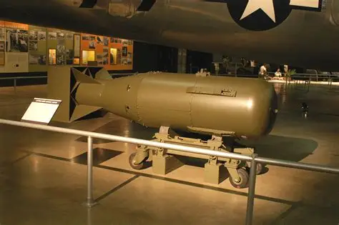
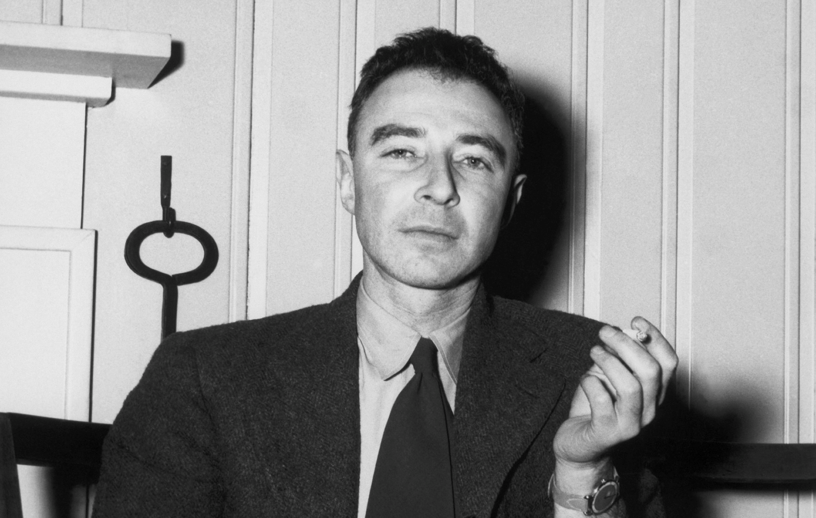

In 1941, the scientists working at the Los Alamos laboratory discovered plutonium. To explain what plutonium is we need to delve deeper in to uranium: uranium has two states, U-238 which was uranium with 238 neutrons and wouldn’t fission, not quickly, not at all then there was the other type of uranium, U-235 which was uranium with 235 neutrons, this uranium fissioned, but its problem was that it was rare and hard to produce, plutonium however, was U-238 bombarded with neutrons so it absorbed them and became plutonium, U-238 was more common than U-235, and plutonium fissioned faster than U-235, so it was more ideal.
Robert Oppenheimer
Little boy nuke shell

Slide 5
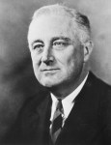
Around the time the first uranium 235 sample went to los Alamos (1944) they discovered something that would cause a crisis; they had to make a different Design for the bomb, why? Because the original design for the Bomb made it so that it would explode when two pieces of Uranium touched, plutonium would fission and explode before It touched and create the explosion power of a regular bomb which wasn’t the goal of the nuke, they had to find an alternative, of course they could just go back to U-235 but that was a problem too as it was only being produced fast enough to build 1 bomb and they needed more than just one, as their leader Leslie groves was demanding it
President Roosevelt

Slide 6
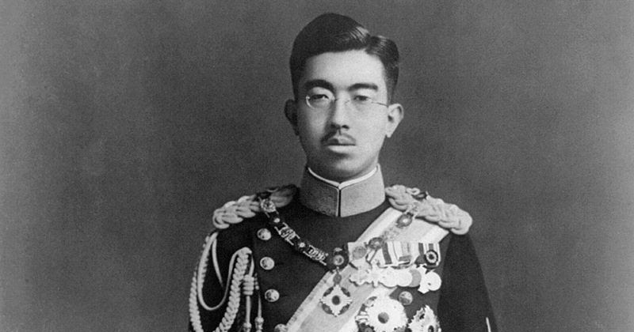
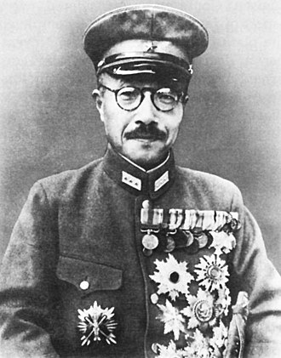




Finally, after painstaking research and work, the bomb was ready for testing, in 1945 they loaded up the bomb and built the metal tower where the bomb would be tested, all the scientists stayed 9-32 miles away depending on their role, and upon launch the metal tower was vaporized, completely gone, the scientists saw the fireball which had a temperature equivalent to 5,000–10,000 °C, they felt its heat, one scientist reported they couldn’t see for 30 seconds, which was ironic as almost 30 seconds later the soundwave hit, and many people living nearby felt their windows rattling and saw the fireball in the distance, the bomb was equivalent to 19,000 tons of TNT.
On 8:00 o’clock 6th 1945 of august on the city of Hiroshima the Enola gay B-29 bomber (named after the pilot’s mother) dropped the atomic bomb nicknamed little boy on the Aioi bridge, 70,000 people died from day one and another 100,000 would follow suit and die later from the nuke’s radiation, but Japan still wouldn’t surrender so on the ninth of august just 3 days later another bomb was dropped on Nagasaki and a third one was in preparation when Japan surrendered with no conditions, world war 2 was over.
Hirohito (Japanese emperor)
Hideki Tojo (Japanese prime minister)

Slide 7
The soviets however were fuming, they sent spies to steal the blueprints, appointed new scientists, created a bomb program and appointed a new leader for the project, essentially building a replica of the American atomic bomb program, and finally, they created an exact copy of the American bomb.
And…thus began…THE COLD WAR
Sources:
Wikipedia
BOMB: by Steve Sheinkin
HowStuffWorks

