Slide 1
Need a permit for the class? Make sure you’ve requested a permit on the CIS Waitlist. A small final batch will be available tomorrow on a first-come-first-served basis.
Welcome to the Course!

Slide 2


Welcome to CIS 4210/5210
Professor Chris Callison-Burch
My office hours are Mondays
Preferred method of contact: Ed Discussion
My Research Focus:
Natural Language Processing
How can we build artificial intelligence that understands human languages?
Can we combine large language models like GPT with classic symbolic AI to perform better reasoning?
Notes:
.

Slide 3
Welcome to CIS 4210/5210
Canvas contains everything
Syllabus with course policies and homework due dates
Homework assignments
Weekly quizzes
Discussion on Ed Discussion (linked from Canvas)
Homework submission via Gradescope
Lectures will be recorded using the Panopto system
Video recordings will be posted after lecture
Pre-recorded videos available now
Prerequisites:
Good knowledge of programming, data structures
Strong Python skills (we provide some optional lecture videos for Python review)
Introductory probability and statistics, and linear algebra will be very useful
Notes:
.

Slide 4
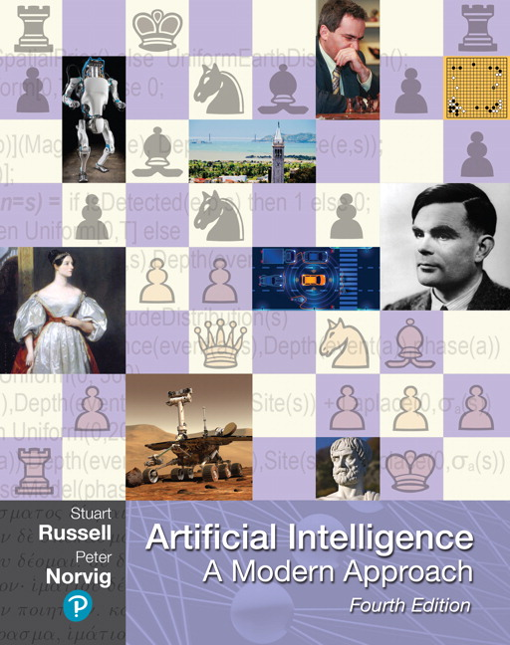
Course Textbook
Stuart Russell and Peter Norvig Artificial Intelligence: A Modern Approach Pearson Series in Artificial Intelligence, 2020, Fourth Edition
The textbook is 1000 pages long and covers core ideas that were developed as early as the 1950s.
This is a brand-new edition of the classic textbook which adds sections on deep learning, natural language processing, causality, and fairness in AI.
You can rent a digital copy from the Penn bookstore for $40.

Slide 5
Grading and Homework
Grading:
60% for homework assignments
10% for weekly quizzes
15% each for midterm 1 and 2
Up to 3% for optional Extra Credit Projects
Homework:
There is roughly one homework assignment per week, aside from weeks with exams. Students enrolled in CIS 4210 may skip one HW assignment, or they may discard their lowest scoring HW assignment. Students enrolled in CIS 5210 must complete all HW assignments and cannot discard their lowest scoring assignment.
Homework will be due at 11:59pm Eastern on specified dates (usually Mondays).
You may submit an extension request for HWs via Canvas. You must do so at least 24 hours in advance in order to have it approved.
If you observe religious holidays in the Fall, please request your extensions now.

Slide 6
Collaboration Policy
Unless otherwise noted, you are not allowed to work in groups on the homework assignments. You can discuss homework problems with others (you must explicitly list who you discussed problems with on each homework submission), but all code must be your own independent work. You are not allowed to upload your code to publicly accessible places (like public github repositories), and you are not allowed to access anyone else’s code. If you discover someone else’s code online, please report it to the course staff via a private note on the discussion forum.
All code will be run through a plagiarism check. Suspicions of plagiarism will be adjudicated by the Office of Student Conduct.
Last semester, I found someone selling assignment solutions
CIS 5XX | 2
Notes:
Tell anecdote about how all

Slide 7

Masking Policy: Masks Are Required in Lecture
Title: Eulogy For Karen
Poem:
In the year of the great plague
the people looked for a sign
and the gods sent them a dove
who became ill and flew away
disappearing from sight.
And so they began to die
by the thousands day by day.
On Memorial Day, I am thinking of Karen,
who died at the age of seventy-five,
four months ago today.
It was the peak of the plague,
and she was sick with it
and died alone in her apartment
without ever having seen a doctor
or even known for sure that she was ill.
It was her father who had taken her
when she was a girl to Assateague
to see the ocean for the first time.
She saw it coming,
she told me,
she saw it coming,
and I said that I saw it coming too
and that there was nothing to be done.
And so she died, a victim of the gods,
as the dove had done before her,
flying away, disappearing from sight,
the first of many.

Slide 8
CIS 4210/5210 compared to other Penn courses
There are many courses at Penn related to Artificial Intelligence:
CIS 4190/5190 – Applied Machine Learning
CIS 5200 – Machine Learning
CIS 5220 – Deep Learning
CIS 5300 – Natural Language Processing (and LLMs like ChatGPT)
CIS 5800 – Machine Perception
MEAM 4200/5200 – Introduction to Robotics
CIS 4210/5210 is “Good Old-Fashioned AI” which offers a broad overview of AI so parts of it will overlap with other courses. Also includes many topics not in other courses:
Search and Multi-Agent Planning
Probabilistic reasoning
Logical representations

Slide 9
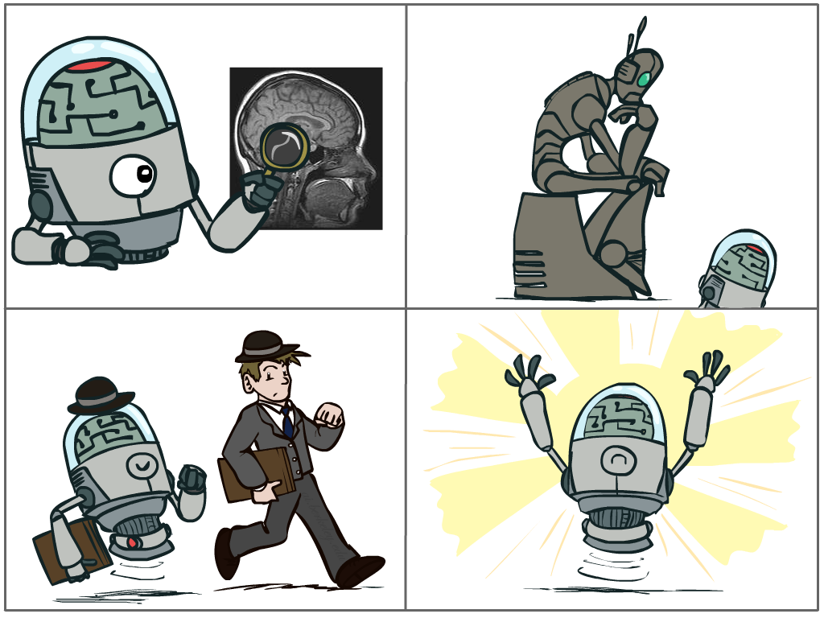
What is AI?
The science of making machines that:
Think like people
Think rationally
Act like people
Act rationally
Slide from Dan Klein and Pieter Abbeel of UC Berkeley
Notes:
Top left: Think like people --- cognitive science, neuroscience
Bottom left: act like people --- actually very early definition, dating back to Alan Turing --- Turing test; problem to do really well you start focusing on things like don’t answer too quickly what the square root of 1412 is, don’t spell too well, and make sure you have a favorite movie etc. So it wasn’t really leading us to build intelligence
Think rationally – long tradition dating back to Aristotle --- but not a winner, because difficult to encode how to think, and in the end it’s not about how you think, it’s about how you end up acting

