Slide 1
Constraint Satisfaction Problems
AIMA: Chapter 6

Slide 2
Big idea
Represent the constraints that solutions must satisfy in a uniform declarative language
Find solutions by GENERAL PURPOSE search algorithms with no changes from problem to problem
No hand built transition functions
No hand built heuristics
Just specify the problem in a formal declarative language, and a general purpose algorithm does everything else!

Slide 3
Constraint Satisfaction Problems
A CSP consists of:
Finite set of variables X₁, X₂, …, X_{n}
Nonempty domain of possible values for each variable D₁, D₂, … D_{n} where D_{i} = {v₁, …, v_{k}}
Finite set of constraints C₁, C₂, …, C_{m}
Each constraint C_{i} limits the values that variables can take, e.g., X₁ ≠ X₂ A state is defined as an assignment of values to some or all variables.
A consistent assignment does not violate the constraints.
Example problem: Sudoku

Slide 4
Constraint satisfaction problems
An assignment is complete when every variable is assigned a value.
A solution to a CSP is a complete, consistent assignment.
Solutions to CSPs can be found by a completely general purpose algorithm, given only the formal specification of the CSP.
Beyond our scope: CSPs that require a solution that maximizes an objective function.

Slide 5
Applications
Map coloring
Scheduling problems
Job shop scheduling
Scheduling the Hubble Space Telescope
Floor planning for VLSI
Sudoku
…

Slide 6
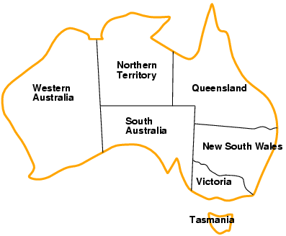
Example: Map-coloring
Variables: WA, NT, Q, NSW, V, SA, T
Domains: D_{i} = {red,green,blue}
Constraints: adjacent regions must have different colors
e.g., WA ≠ NT
So (WA,NT) must be in {(red,green),(red,blue),(green,red), …}

Slide 7
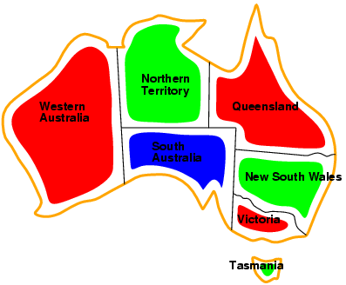
Example: Map-coloring
Solutions: complete and consistent assignments
e.g., WA = red, NT = green,Q = red, NSW = green, V = red, SA = blue, T = green
Notes:
Famous question: can any map be colored in with four colors?

Slide 8
Benefits of CSP
Clean specification of many problems, generic goal, successor function & heuristics
Just represent problem as a CSP & solve with general package
CSP “knows” which variables violate a constraint
And hence where to focus the search
CSPs: Automatically prune off all branches that violate constraints
(State space search could do this only by hand-building constraints into the successor function)

Slide 9
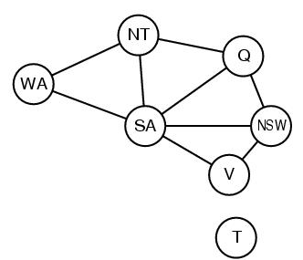
CSP Representations
Constraint graph:
nodes are variables
arcs are (binary) constraints
Standard representation pattern:
variables with values
Constraint graph simplifies search.
e.g. Tasmania is an independent subproblem.
This problem: A binary CSP:
each constraint relates two variables
WA ≠ NT
NT ≠ Q
NT ≠ SA
WA ≠ SA

Slide 10
Varieties of CSPs
Discrete variables
finite domains:
n variables, domain size d → O(d^{n}) complete assignments
e.g., Boolean CSPs, includes Boolean satisfiability (NP-complete)
infinite domains:
integers, strings, etc.
e.g., job scheduling, variables are start/end days for each job
need a constraint language, e.g., StartJob₁ + 5 ≤ StartJob₃
Continuous variables
e.g., start/end times for Hubble Space Telescope observations
linear constraints solvable in polynomial time by linear programming

Slide 11
Varieties of constraints
Unary constraints involve a single variable,
e.g., SA ≠ green
Binary constraints involve pairs of variables,
e.g., SA ≠ WA
Higher-order constraints involve 3 or more variables
e.g., crypt-arithmetic column constraints
Preference (soft constraints) e.g. red is better than green can be represented by a cost for each variable assignment
Constrained optimization problems.

Slide 12
Idea 1: CSP as a search problem
A CSP can easily be expressed as a search problem
Initial State: the empty assignment {}.
Successor function: Assign value to any unassigned variable provided that there is not a constraint conflict.
Goal test: the current assignment is complete.
Path cost: a constant cost for every step.
Solution is always found at depth n, for n variables
Hence Depth First Search can be used

Slide 13
Backtracking search
Note that variable assignments are commutative
Eg [ step 1: WA = red; step 2: NT = green ] equivalent to [ step 1: NT = green; step 2: WA = red ]
Therefore, a tree search, not a graph search
Only need to consider assignments to a single variable at each node
b = d and there are d^{n} leaves (n variables, domain size d )
Depth-first search for CSPs with single-variable assignments is called backtracking search
Backtracking search is the basic uninformed algorithm for CSPs
Can solve n-queens for n ≈ 25

Slide 14
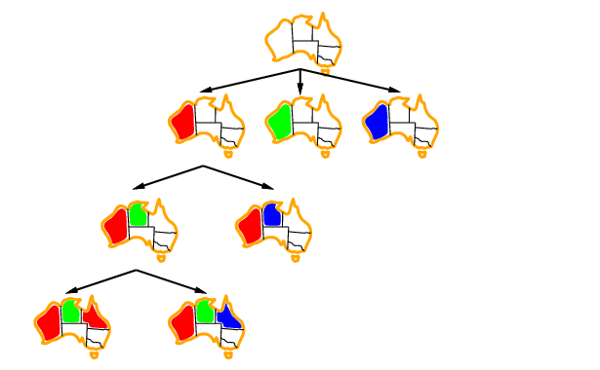
Backtracking example

Slide 15
Backtracking example
And so on….

Slide 16
Idea 2: Improving backtracking efficiency
General-purpose methods & general-purpose heuristics can give huge gains in speed, on average
Heuristics:
Q: Which variable should be assigned next?
Most constrained variable
(if ties:) Most constraining variable
Q: In what order should that variable’s values be tried?
3. Least constraining value
Q: Can we detect inevitable failure early? 4. Forward checking

Slide 17

Heuristic 1: Most constrained variable
Choose a variable with the fewest legal values
a.k.a. minimum remaining values (MRV) heuristic
3
3
2
3
1
3
2
3
2
1
3
3
3
2
3
3
3
3
3
3
3
3

Slide 18

Heuristic 2: Most constraining variable
Tie-breaker among most constrained variables
Choose the variable with the most constraints on remaining variables
These two heuristics together lead to immediate solution of our example problem

Slide 19
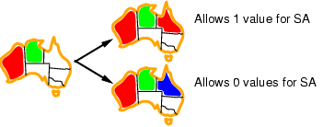
Heuristic 3: Least constraining value
Given a variable, choose the least constraining value:
the one that rules out the fewest values in the remaining variables
Note: demonstrated here independent of the other heuristics

Slide 20
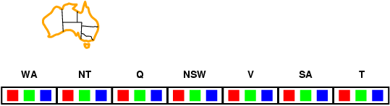
Heuristic 4: Forward checking
Idea:
Keep track of remaining legal values for unassigned variables
Terminate search when any unassigned variable has no remaining legal values
(A first step towards Arc Consistency & AC-3)
New data structure

Slide 21
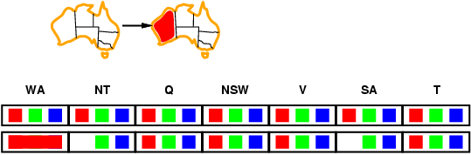
Forward checking
Idea:
Keep track of remaining legal values for unassigned variables
Terminate search when any unassigned variable has no remaining legal values

Slide 22
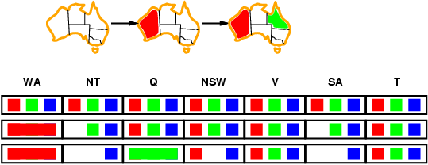

Forward checking
Idea:
Keep track of remaining legal values for unassigned variables
Terminate search when any unassigned variable has no remaining legal values

Slide 23
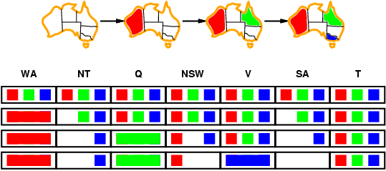
Forward checking
Idea:
Keep track of remaining legal values for unassigned variables
Terminate search when any unassigned variable has no remaining legal values
Terminate! No possible value for SA

Slide 24
Example: 4-Queens Problem
X1
{1,2,3,4}
X2
{1,2,3,4}
1
2
3
4
1
2
3
4
X3
{1,2,3,4}
X4
{1,2,3,4}
Assign value to unassigned variable

Slide 25
Example: 4-Queens Problem
X1
{1,2,3,4}
X2
{ , ,3,4}
1
2
3
4
1
2
3
4
X3
{ ,2, ,4}
X4
{ ,2,3, }
Forward check!

Slide 26
Example: 4-Queens Problem
X1
{1,2,3,4}
X2
{ , ,3,4}
1
2
3
4
1
2
3
4
X3
{ ,2, ,4}
X4
{ ,2,3, }
Assign value to unassigned variable

Slide 27
Example: 4-Queens Problem
X1
{1,2,3,4}
X2
{ , ,3,4}
1
2
3
4
1
2
3
4
X3
{ , , , }
X4
{ ,2, , }
Backtrack!!!
Forward check!

Slide 28
Example: 4-Queens Problem
Picking up a little later after two steps of backtracking….
X1
{ ,2,3,4}
X2
{1,2,3,4}
1
2
3
4
1
2
3
4
X3
{1,2,3,4}
X4
{1,2,3,4}
Assign value to unassigned variable

Slide 29
Example: 4-Queens Problem
X1
{ ,2,3,4}
X2
{ , , ,4}
1
2
3
4
1
2
3
4
X3
{1, ,3, }
X4
{1, ,3,4}
Forward check!

Slide 30
Example: 4-Queens Problem
X1
{ ,2,3,4}
X2
{ , , ,4}
1
2
3
4
1
2
3
4
X3
{1, ,3, }
X4
{1, ,3,4}
Assign value to unassigned variable

Slide 31
Example: 4-Queens Problem
X1
{ ,2,3,4}
X2
{ , , ,4}
1
2
3
4
1
2
3
4
X3
{1, , , }
X4
{1, ,3, }
Forward check!

Slide 32
Example: 4-Queens Problem
X1
{ ,2,3,4}
X2
{ , , ,4}
1
2
3
4
1
2
3
4
X3
{1, , , }
X4
{1, ,3, }
Assign value to unassigned variable

Slide 33
Example: 4-Queens Problem
X1
{ ,2,3,4}
X2
{ , , ,4}
1
2
3
4
1
2
3
4
X3
{1, , , }
X4
{ , ,3, }
Forward check!

Slide 34
Example: 4-Queens Problem
X1
{ ,2,3,4}
X2
{ , , ,4}
1
2
3
4
1
2
3
4
X3
{1, , , }
X4
{ , ,3, }
Assign value to unassigned variable

Slide 35
Towards Constraint propagation
Forward checking propagates information from assigned to unassigned variables, but doesn't provide early detection for all failures:
NT and SA cannot both be blue!
Constraint propagation goes beyond forward checking & repeatedly enforces constraints locally

Slide 36
Arc Consistency, Constraint Propagation & AC-3

Slide 37
Idea 3 (big idea): Inference in CSPs
CSP solvers combine search and inference
Search
assigning a value to a variable
Constraint propagation (inference)
Eliminates possible values for a variable if the value would violate local consistency
Can do inference first, or intertwine it with search
You’ll investigate this in the Sudoku homework
Local consistency
Node consistency: satisfies unary constraints
This is trivial!
Arc consistency: satisfies binary constraints
(X_{i} is arc-consistent w.r.t. X_{j} if for every value v in D_{i}, there is some value w in D_{j} that satisfies the binary constraint on the arc between X_{i} and X_{j})

Slide 38
Review: CSP Representations
Constraint graph:
nodes are variables
edges are constraints
WA ≠ NT
NT ≠ Q
NT ≠ SA
WA ≠ SA

Slide 39
Edges to Arcs: From Constraint Graph to DAG
Given a pair of nodes X_{i} and X_{j} connected by a constraint edge, we represent this not by a single undirected edge, but a pair of directed arcs.
For a connected pair of nodes X_{i} and X_{j} , there are two arcs that connect them: (i,j) and (j,i).
(i,j)
⇒
X_{i}
X_{j}
X_{i}
X_{j}
(j,i)

Slide 40
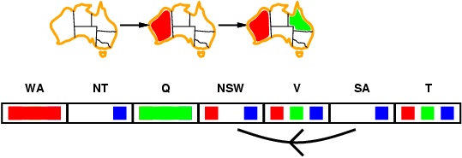
Arc consistency
Simplest form of propagation makes each arc consistent
X →Y is consistent iff for every value x of X there is some allowed y

Slide 41
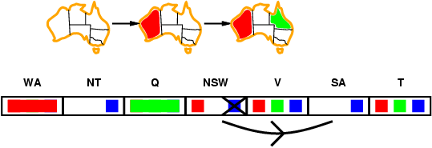
Arc consistency
Simplest form of propagation makes each arc consistent
X →Y is consistent iff for every value x of X there is some allowed y

Slide 42
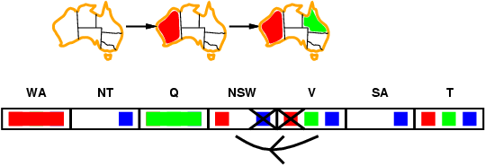
Arc consistency
Simplest form of propagation makes each arc consistent
X →Y is consistent iff for every value x of X there is some allowed y
If X loses a value, recheck neighbors of X

Slide 43
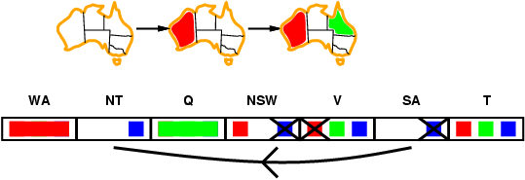
Arc consistency
Simplest form of propagation makes each arc consistent
X →Y is consistent iff for every value x of X there is some allowed y
If X loses a value, we need to recheck neighbors of X
Detects failure earlier than forward checking Can be run as a preprocessor or after each assignment

Slide 44
Arc Consistency
An arc (i,j) is arc consistent if and only if every value v on X_{i} is consistent with some label on X_{j}.
To make an arc (i,j) arc consistent, for each value v on X_{i} , if there is no label on X_{j} consistent with v
then remove v from X_{i}
Given d values, checking arc (i,j) takes O(d²) time worst case

Slide 45

Replacing Search: Constraint Propagation Invented…
Dave Waltz’s insight:
By iterating over the graph, the arc-consistency constraints can be propagated along arcs of the graph.
Search: Use constraints to add labels to find one solution
Constraint Propagation: Use constraints to eliminate labels to simultaneously find all solutions

Slide 46
The Waltz/Mackworth Constraint Propagation Algorithm
Assign every node in the constraint graph a set of all possible values
Repeat until there is no change in the set of values associated with any node:
For each node i:
For each neighboring node j in the picture:
Remove any value from i which is not arc consistent with j.

Slide 47
Inefficiencies: Towards AC-3
At each iteration, we only need to examine those X_{i} where at least one neighbor of X_{i} has lost a value in the previous iteration.
If X_{i} loses a value only because of arc inconsistencies with X_{j}, we don’t need to check X_{j} on the next iteration.
Removing a value on X_{i} can only make X_{j} arc-inconsistent with respect to X_{i} itself. Thus, we only need to check that (j,i) is still arc-consistent.
These insights lead a much better algorithm...

Slide 48
AC-3
function AC-3(csp) return the CSP, possibly with reduced domains
inputs: csp, a binary csp with variables {X₁, X₂, …, X_{n}}
local variables: queue, a queue of arcs initially the arcs in csp
while queue is not empty do
(X_{i}, X_{j}) ← REMOVE-FIRST(queue)
if REMOVE-INCONSISTENT-VALUES(X_{i}, X_{j}) then
for each X_{k} in NEIGHBORS[X_{i} ] – {X_{j}} do add (X_{k}, X_{i}) to queue
function REMOVE-INCONSISTENT-VALUES(X_{i}, X_{j}) return true iff we remove a value
removed ← false
for each x in DOMAIN[X_{i}] do
if no value y in DOMAIN[X_{j}] allows (x,y) to satisfy the constraints between X_{i} and X_{j}
then delete x from DOMAIN[X_{i}]; removed ← true
return removed

Slide 49
AC-3: Worst Case Complexity Analysis
All nodes can be connected to every other node,
so each of n nodes must be compared against n-1 other nodes,
so total # of arcs is 2*n*(n-1), i.e. O(n²)
If there are d values, checking arc (i,j) takes O(d²) time
Each arc (i,j) can only be inserted into the queue d times
Worst case complexity: O(n²d³)
(For planar constraint graphs, the number of arcs can only be linear in N and the time complexity is only O(nd³))

Slide 50
Local search for CSPs
Hill-climbing, simulated annealing typically work with "complete" states, i.e., all variables assigned
To apply to CSPs:
allow states with unsatisfied constraints
operators reassign variable values
Variable selection: randomly select any conflicted variable
Value selection by min-conflicts heuristic:
choose value that violates the fewest constraints
i.e., hill-climb with h(n) = total number of violated constraints

Slide 51
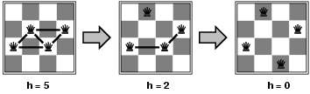
Example: n-queens
States: 4 queens in 4 columns (4⁴ = 256 states)
Actions: move queen in column
Goal test: no attacks
Evaluation: h(n) = number of attacks
Given random initial state, local min-conflicts can solve n-queens in almost constant time for arbitrary n with high probability (e.g., n = 10,000,000)

Slide 52
Beyond binary constraints: Path consistency
Generalizes arc-consistency from individual binary constraints to multiple constraints
A pair of variables X_{i}, X_{j} is path-consistent w.r.t. X_{m} if for every assignment X_{i}=a, X_{j}=b consistent with the constraints on X_{i}, X_{j} there is an assignment to X_{m} that satisfied the constraints on X_{i}, X_{m} and X_{j}, X_{m}
Global constraints
Can apply to any number of variables
E.g., in Sudoko, all numbers in a row must be different
E.g., in cryptarithmetic, each letter must be a different digit
Example algorithm:
If any variable has a single possible value, delete that variable from the domains of all other constrained variables
If no values are left for any variable, you found a contradiction

Slide 53
Simple CSPs can be solved quickly
Completely independent subproblems
e.g. Australia & Tasmania
Easiest
Constraint graph is a tree
Any two variables are connected by only a single path
Permits solution in time linear in number of variables
Do a topological sort and just march down the list
A E
\ /
B – D A ➔ B ➔ C ➔ D ➔E ➔ F
/ \
C F

Slide 54
Simplifying hard CSPs: Cycle Cutsets
Constraint graph can be decomposed into a tree
Collapse or remove nodes
Cycle cutset S of a graph G: any subset of vertices of G that, if removed, leaves G a tree
Cycle cutset algorithm
Choose some cutset S
For each possible assignment to the variables in S that satisfies all constraints on S
Remove any values for the domains of the remaining variables that are not consistent with S
If the remaining CSP has a solution, then you have are done
For graph size n, domain size d
Time complexity for cycle cutset of size c: O(d^{c *} d²(n-c)) = O(d^{c+2} (n-c))

Slide 55
Chronological backtracking
DFS does Chronological backtracking
If a branch of a search fails, backtrack to the most recent variable assignment and try something different
But this variable may not be related to the failure
Example: Map coloring of Australia
Variable order
Q, NSW, V, T, SA, WA, NT.
Current assignment:
Q=red, NWS=green, V=blue, T= red
SA cannot be assigned anything
But reassigning T does not help!

Slide 56
Backjumping: Improved backtracking
Find “the conflict set”
Those variable assignments that are in conflict
Conflict set for SA: {Q=red, NSW=green, V=blue}
Jump back to reassign one of those conflicting variables
Forward checking can build the conflict set
When a value is deleted from a variable’s domain, add it to its conflict set
But backjumping finds the same conflicts that forward checking does
Fix using “conflict-directed backjumping”
Go back to predecessors of conflict set

Slide 57
When to Iterate, When to Stop?
The crucial principle:
If a value is removed from a node X_{i},
then the values on all of X_{i}’s neighbors must be reexamined.
Why? Removing a value from a node may result in one of the neighbors becoming arc inconsistent, so we need to check…
(but each neighbor X_{j} can only become inconsistent with respect to the removed values on X_{i})

