Slide 1
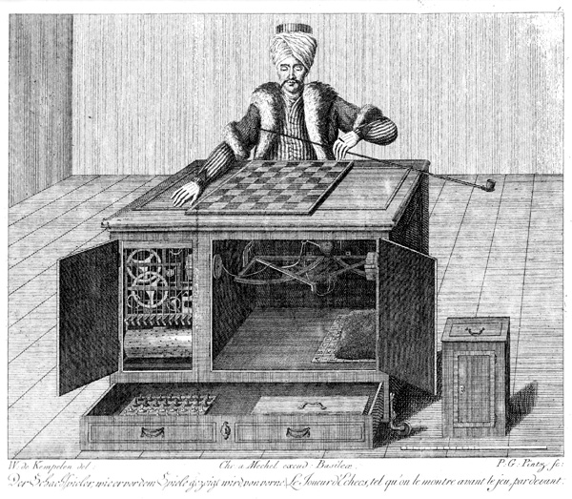
Game-playing AIs: Games and Adversarial Search
AIMA 5.1-5.5,
AIMA 16.1-16.3

Slide 2
Games: Outline of Unit
Part I: Games as Search
Motivation
Game-playing AI successes
Game Trees
Evaluation Functions
Part II: Adversarial Search
The Minimax Rule
Alpha-Beta Pruning

Slide 3
Why study games?
Multi-agent environments: environments with other agents, whose actions affect our success
Two general categories: Cooperative vs. competitive
Competitive multi-agent environments give rise to adversarial search a.k.a. games
Huge state spaces – Games are hard!
Historical role in AI
Games are fun!

Slide 4
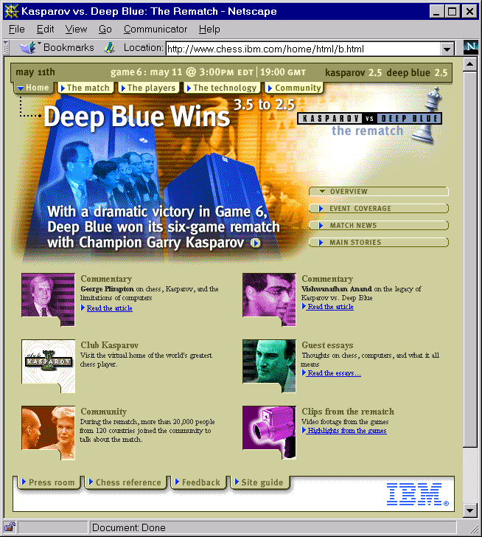
May 11, 1997

Slide 5
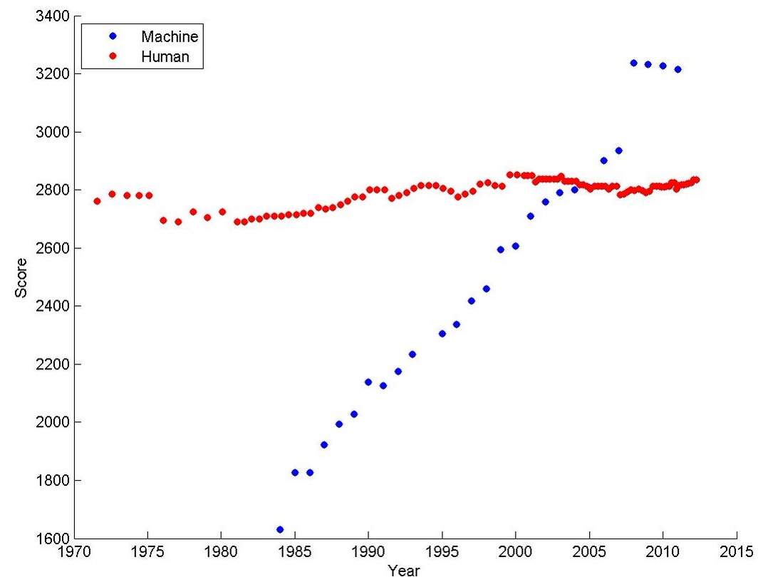
Ratings of human & computer chess champions
https://srconstantin.wordpress.com/2017/01/28/performance-trends-in-ai/

Slide 6
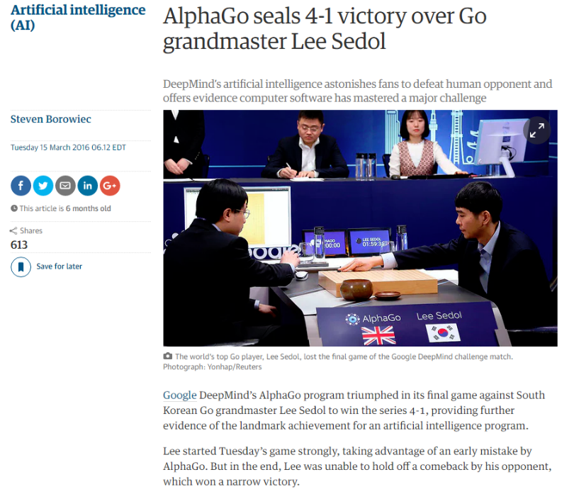
(from: The Guardian)

Slide 7
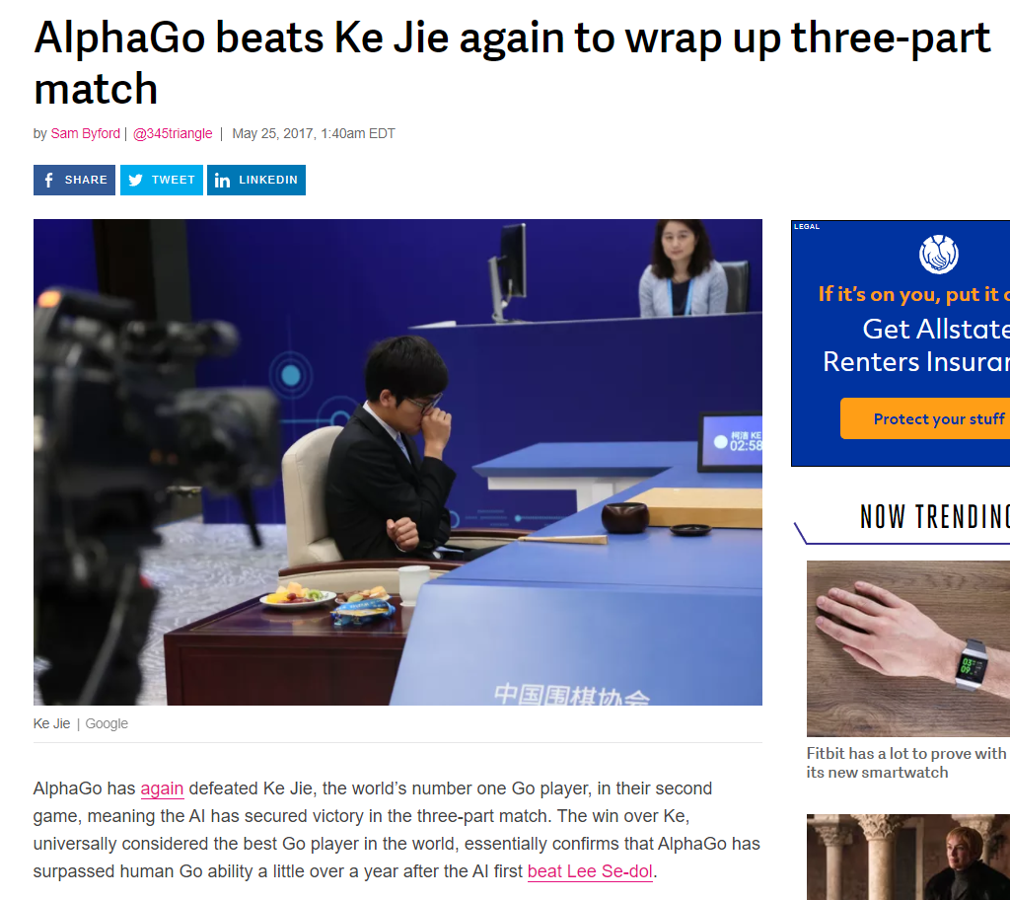
https://srconstantin.wordpress.com/2017/01/28/performance-trends-in-ai/

Slide 8

State of the art
•
How good are computer game players?
Chess:
1997 - Deep Blue beat Gary Kasparov
2006 - Vladmir Kramnik, the undisputed world champion, is defeated 4–2 by Deep Fritz ($58 on Amazon!)
Checkers: Chinook (an AI program with a very large
endgame database)
is the world champion. Checkers has been solved exactly - it's a draw!
Go:
May 2017 - AlphaGo used two different Deep Neural Networks to beat the world’s best go player Ke Jie in a 3 game match 3-0
Bridge: "Expert" computer players exist (but no world champions yet!)
Good place to learn more: http://www.cs.ualberta.ca/~games/

Slide 9
The Simplest Game Environment
Multiagent
Static: No change while an agent is deliberating
Discrete: A finite set of percepts and actions
Fully observable : An agent's sensors give it the complete state of the environment.
Strategic: The next state is determined by the current state and the action executed by the agent and the actions of one other agent.

Slide 10
Key properties of our sample games
Two players alternate moves
Zero-sum: one player’s loss is another’s gain
Clear set of legal moves
Well-defined outcomes (e.g. win, lose, draw)
Examples:
Chess, Checkers, Go,
Mancala, Tic-Tac-Toe, Othello,
Nim, …

Slide 11
More complicated games
Most card games (e.g. Hearts, Bridge, etc.) and Scrabble
Stochastic, not deterministic
Not fully observable: lacking in perfect information
Real-time strategy games (lack alternating moves). e.g. Warcraft
Cooperative games

Slide 12
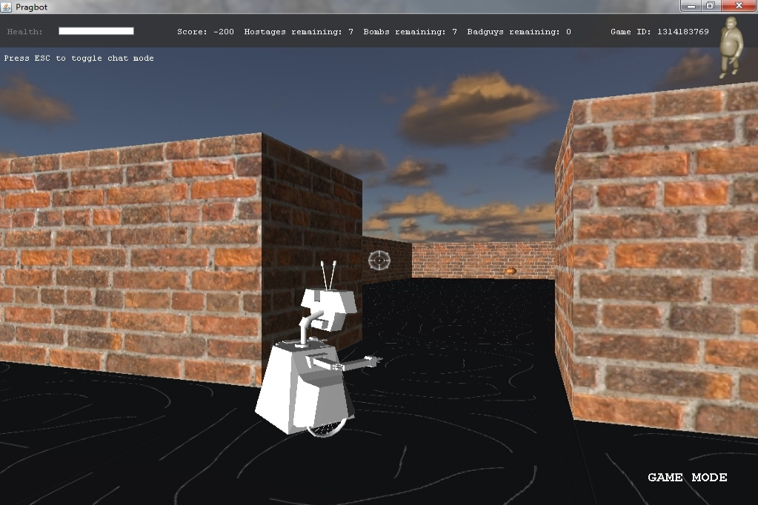
A cooperative multi-agent environment: Pragbot
Two players, Commander and Junior, must coordinate to:
Tasks:
Defuse bombs that can kill Commander
Defeat badguys before they flip Junior and/or escape
Rescue hostages

Slide 13
Formalizing the Game setup
Two players: MAX and MIN; MAX moves first.
MAX and MIN take turns until the game is over.
Winner gets award, loser gets penalty.
Games as search:
Initial state: e.g. board configuration of chess
Successor function: list of (move,state) pairs specifying legal moves.
Terminal test: Is the game finished?
Utility function: Gives numerical value of terminal states. e.g. win (+∞), lose (-∞) and draw (0)
MAX uses search tree to determine next move.

Slide 14
How to Play a Game by Searching
General Scheme
Consider all legal successors to the current state (‘board position’)
Evaluate each successor board position
Pick the move which leads to the best board position.
After your opponent moves, repeat.
Design issues
Representing the ‘board’
Representing legal next boards
Evaluating positions
Looking ahead

Slide 15
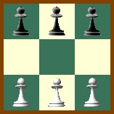
Hexapawn: A very simple Game
Hexapawn is played on a 3x3 chessboard
Only standard pawn moves:
A pawn moves forward one square onto an empty square
A pawn “captures” an opponent pawn by moving diagonally forward one square, if that square contains an opposing pawn. The opposing pawn is removed from the board.

Slide 16
Hexapawn: A very simple Game
Hexapawn is played on a 3x3 chessboard
Player P₁ wins the game against P₂ when:
One of P₁’s pawns reaches the far side of the board.
P₂ cannot move because no legal move is possible.
P₂ has no pawns left.
(Invented by Martin Gardner in 1962, with learning “program” using match boxes. Reprinted in “The Unexpected Hanging..)

Slide 17
Hexapawn: Three Possible First Moves
 |  | 
 |  | 
White moves
 |  | 

 |  | 
 |  | 
 | 
 |  | 
 |  | 
 |  | 
 | 

Slide 18
Game Trees
Represent the game problem space by a tree:
Nodes represent ‘board positions’; edges represent legal moves.
Root node is the first position in which a decision must be made.

Slide 19
Hexapawn: Simplified Game Tree for 2 Moves
 |  | 
 |  | 
White to move
 |  | 

 |  | 
 |  | 
 | 
 |  | 
 |  | 
 |  | 
 | 
Black to move
…..
 |  | 

 |  | 
 |  | 
 | 
 |  | 
 | 
 |  | 
 |  | 
 |  | 
 | 
 |  | 
 |  | 
 | 
 |  | 
 | 
 |  | 
 |  | 
 | 
 | 
 |  | 
White to move

Slide 20
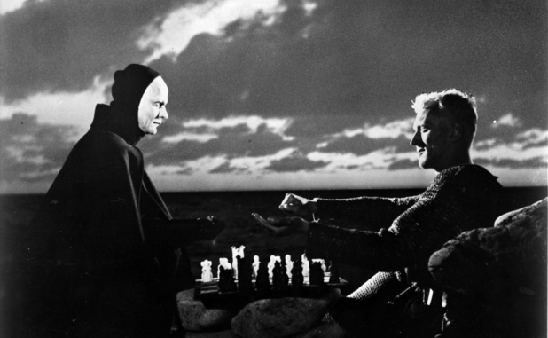
MAX & MIN Nodes : An egocentric view
Two players: MAX, MAX’s opponent MIN
All play is computed from MAX’s vantage point.
When MAX moves, MAX attempts to MAXimize MAX’s outcome.
When MAX’s opponent moves, they attempt to MINimize MAX’s outcome.
WE TYPICALLY ASSUME MAX MOVES FIRST:
Label the root (level 0) MAX
Alternate MAX/MIN labels at each successive tree level (ply).
Even levels represent turns for MAX
Odd levels represent turns for MIN
MAX (von Sydow) plays chess….

Slide 21
Game Trees
Represent the game problem space by a tree:
Nodes represent ‘board positions’; edges represent legal moves.
Root node is the first position in which a decision must be made.
Evaluation function f assigns real-number scores to `board positions’ without reference to path
Terminal nodes represent ways the game could end, labeled with the desirability of that ending (e.g. win/lose/draw or a numerical score)

Slide 22
Evaluation functions: f(n)
Evaluates how good a ‘board position’ is
Based on static features of that board alone
Zero-sum assumption lets us use one function to describe goodness for both players.
f(n)>0 if MAX is winning in position n
f(n)=0 if position n is tied
f(n)<0 if MIN is winning in position n
Build using expert knowledge,
Tic-tac-toe: f(n)=(# of 3 lengths open for MAX)- (# open for MIN)
(AIMA 5.4.1)

Slide 23
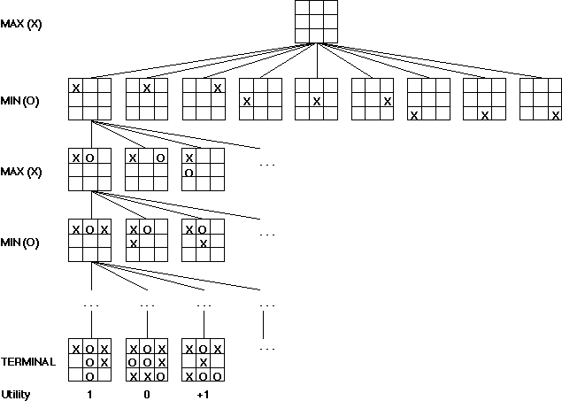
A Partial Game Tree for Tic-Tac-Toe
f(n)=8-8=0
f(n)=8-5=3
f(n)=2
f(n)=3
f(n)=2
f(n)=4
f(n)=2
f(n)=3
f(n)=2
f(n)=3
f(n)=6-5=1
f(n)=0
f(n)=1
f(n)=6-3=3
f(n)=6-2=4
f(n)=6-4=2
f(n)=# of potential three-lines for X –
# of potential three-line for Y if n is
not terminal
f(n)=0 if n is a terminal tie
f(n)=+ ∞ if n is a terminal win
f(n)=- ∞ if n is a terminal loss
-∞
0
+ ∞
Notes:
note that solution requires a move that seems to lose ground: computer doesn’t mind, but people sometimes balk:
331-310/220/320-321-300-311-110*-221-020-031-010-021-000
note that 320 is a useless state because can only go from there back to parent
costs: if equal for all routes then no difference between310 and 220 as second state, but if costs for moving M is 3 and costs for moving C is 1 then is a difference: draw out this part of path clearly and illustrate
331-(2)-310-(1)-321 so cost is 3
331-(4)-220-(3)-321 s0 cost is 7

Slide 24
Chess Evaluation Functions
Alan Turing’s f(n)=(sum of A’s piece values)-(sum of B’s piece values)
More complex: weighted sum of positional features:
Deep Blue has > 8000 features
Pawn | 1.0
Knight | 3.0
Bishop | 3.25
Rook | 5.0
Queen | 9.0
Pieces values for a simple Turing-style evaluation function often taught to novice chess players
Positive: rooks on open files, knights in
closed positions, control of the center,
developed pieces
Negative: doubled pawns, wrong-colored
bishops in closed positions, isolated pawns,pinned pieces
Examples of more complex features

Slide 25
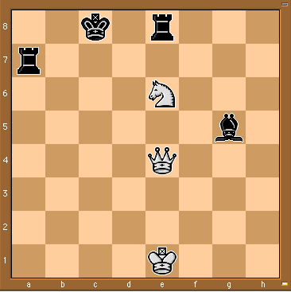
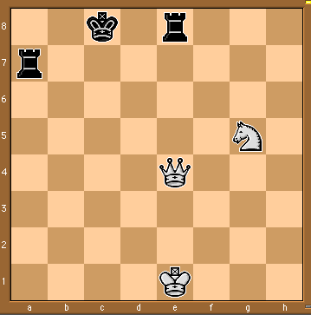
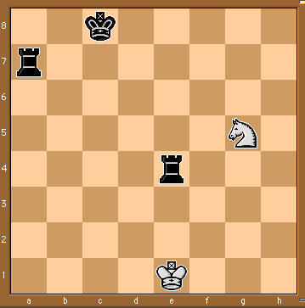
Some Chess Positions and their Evaluations
White to move
f(n)=(9+3)-(5+5+3.25)
=-1.25
… Nxg5??
f(n)=(9+3)-(5+5)
=2
Uh-oh: Rxg4+
f(n)=(3)-(5+5)
=-7
And black may
force checkmate
So, considering our opponent’s possible
responses would be wise.
Notes:
state space defined by initial state and operators, in book, states are implemented as nodes and actions as arcs.
a path represents a sequence of actions that (should) transform the intial world state into a world state that satisfies the goal. **trace on 8’s or VW**
solution: **trace on 8’s or VW**
the right representation can dramatically decrease the size of the state space, as we’ll see with the M&C problem.

Slide 26
The Minimax Rule (AIMA 5.2)

Slide 27
The Minimax Rule: `Don’t play hope chess’
Idea: Make the best move for MAX assuming that MIN always replies with the best move for MIN
Easily computed by a recursive process
The backed-up value of each node in the tree is determined by the values of its children:
For a MAX node, the backed-up value is the maximum of the values of its children (i.e. the best for MAX)
For a MIN node, the backed-up value is the minimum of the values of its children (i.e. the best for MIN)

Slide 28
The Minimax Procedure
Until game is over:
Start with the current position as a MAX node.
Expand the game tree a fixed number of ply.
Apply the evaluation function to the leaf positions.
Calculate back-up values bottom-up.
Pick the move assigned to MAX at the root
Wait for MIN to respond

Slide 29
MAX
2-ply Example: Backing up values
MIN
2
2
1
2
1
2
7
1
8
2
7
1
8
2
7
1
8
Evaluation function value
2
This is the move
selected by minimax
2
1
2
7
1
8

Slide 30
What if MIN does not play optimally?
Definition of optimal play for MAX assumes MIN plays optimally:
Maximizes worst-case outcome for MAX.
(Classic game theoretic strategy)
But if MIN does not play optimally, MAX will do even better. [Theorem-not hard to prove]

Slide 31
Comments on Minimax Search
Depth-first search with fixed number of ply m as the limit.
O(b^{m}) time complexity – As usual!
O(bm) space complexity
Performance will depend on
the quality of the static evaluation function (expert knowledge)
depth of search (computing power and search algorithm)
Differences from normal state space search
Looking to make one move only, despite deeper search
No cost on arcs – costs from backed-up static evaluation
MAX can’t be sure how MIN will respond to his moves
Minimax forms the basis for other game tree search algorithms.

Slide 32
Alpha-Beta Pruning (AIMA 5.3)
Some slides adapted from Richard Lathrop, USC/ISI, CS 271

Slide 33
Review: The Minimax Rule
Idea: Make the best move for MAX assuming that MIN always replies with the best move for MIN
Start with the current position as a MAX node.
Expand the game tree a fixed number of ply.
Apply the evaluation function to all leaf positions.
Calculate back-up values bottom-up:
For a MAX node, return the maximum of the values of its children (i.e. the best for MAX)
For a MIN node, return the minimum of the values of its children (i.e. the best for MIN
Pick the move assigned to MAX at the root
Wait for MIN to respond and REPEAT FROM 1

Slide 34
MAX
2-ply Example: Backing up values
MIN
2
2
1
2
1
2
7
1
8
2
7
1
8
2
7
1
8
Evaluation function value
2
This is the move
selected by minimax
2
1
New point: Actually calculated by DFS!
2
7
1
8

Slide 35
Minimax Algorithm
function MINIMAX-DECISION(state) returns an action
inputs: state, current state in game
v←MAX-VALUE(state)
return an action in SUCCESSORS(state) with value v
function MAX-VALUE(state) returns a utility value
if TERMINAL-TEST(state) then return UTILITY(state)
v ← -∞
for a,s in SUCCESSORS(state) do
v ← MAX(v, MIN-VALUE(s) )
return v
function MIN-VALUE(state) returns a utility value
if TERMINAL-TEST(state) then return UTILITY(state)
v ← ∞
for a,s in SUCCESSORS(state) do
v ← MIN(v, MAX-VALUE(s) )
return v

Slide 36
Alpha-Beta Pruning
A way to improve the performance of the Minimax Procedure
Basic idea: “If you have an idea which is surely bad, don’t take the time to see how truly awful it is” ~ Pat Winston
Assuming left-to-right tree traversal:
We don’t need to compute the value at this node!
No matter what it is it can’t effect the value of the root node.
>=2
=2
<=1
2
7
1
?

Slide 37
Alpha-Beta Pruning II
During Minimax, keep track of two additional values:
α: current lower bound on MAX’s outcome
β: current upper bound on MIN’s outcome
MAX will never choose a move that could lead to a worse score (for MAX) than α
MIN will never choose a move that could lead to a better score (for MAX) than β
Therefore, stop evaluating a branch whenever:
When evaluating a MAX node: a value v ≥ β is backed-up
MIN will never select that MAX node
When evaluating a MIN node: a value v ≤ α is found
MAX will never select that MIN node

Slide 38


Alpha-Beta Pruning IIIa
Based on observation that for all viable paths utility value f(n) will be α <= f(n) <= β
Initially, α = -infinity, β=infinity
As the search tree is traversed, the possible utility value window shrinks as α increases, β decreases

Slide 39

Alpha-Beta Pruning IIIb
Whenever the current ranges of alpha and beta no longer overlap (α ≥ β), it is clear that the current node is a dead end, so it can be pruned


Slide 40
Alpha-beta Algorithm: In detail
Depth first search (usually bounded, with static evaluation)
only considers nodes along a single path from root at any time
α = current lower bound on MAX’s outcome (initially, α = −infinity)
β = current upper bound on MIN’s outcome
(initially, β = +infinity)
Pass current values of α and β down to child nodes during search.
Update values of α and β during search:
MAX updates α at MAX nodes
MIN updates β at MIN nodes
Prune remaining branches at a node whenever α ≥ β
β
↓
↑
α

Slide 41
When to Prune
Prune whenever α ≥ β.
Prune below a Max node when its α value becomes ≥ the β value of its ancestors.
Max nodes update α based on children’s returned values.
Idea: Player MIN at node above won’t pick that value anyway, since MIN can force a worse value.
Prune below a Min node when its β value becomes ≤ the α value of its ancestors.
Min nodes update β based on children’s returned values.
Idea: Player MAX at node above won’t pick that value anyway; she can do better.
β
↓
↑
α

Slide 42
Pseudocode for Alpha-Beta Algorithm
function ALPHA-BETA-SEARCH(state) returns an action
inputs: state, current state in game
v←MAX-VALUE(state, - ∞ , +∞)
return an action in ACTIONS(state) with value v

Slide 43
Pseudocode for Alpha-Beta Algorithm
function ALPHA-BETA-SEARCH(state) returns an action
inputs: state, current state in game
v←MAX-VALUE(state, - ∞ , +∞)
return an action in ACTIONS(state) with value v
function MAX-VALUE(state,α , β) returns a utility value
if TERMINAL-TEST(state) then return UTILITY(state)
v ← - ∞
for a in ACTIONS(state) do
v ← MAX(v,MIN-VALUE(Result(s,a), α , β))
if v ≥ β then return v
α ← MAX(α ,v)
return v

Slide 44
Alpha-Beta Algorithm II
function MIN-VALUE(state, α , β) returns a utility value
if TERMINAL-TEST(state) then return UTILITY(state)
v ← + ∞
for a,s in SUCCESSORS(state) do
v ← MIN(v,MAX-VALUE(s, α , β))
if v ≤ α then return v
β ← MIN(β ,v)
return v

Slide 45
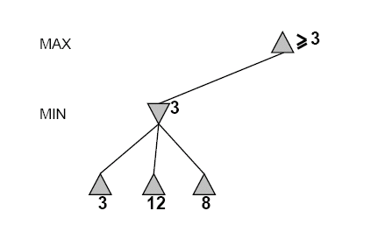
An Alpha-Beta Example
Do DF-search until first leaf
α, β, initial values
β
↓
↑
α
α=−∞
β =+∞
α, β, passed to kids
α=−∞
β =+∞

Slide 46
Alpha-Beta Example (continued)
β
↓
↑
α
α=−∞
β =+∞
α=−∞
β =3
MIN updates β, based on kids

Slide 47
Alpha-Beta Example (continued)
β
↓
↑
α
α=−∞
β =+∞
α=−∞
β =3
MIN updates β, based on kids.
No change.

Slide 48
Alpha-Beta Example (continued)
β
↓
↑
α
MAX updates α, based on kids.
α=3
β =+∞
3 is returned
as node value.

Slide 49
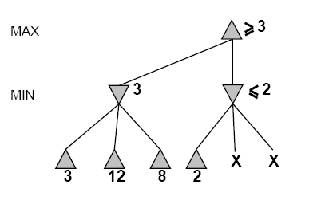
Alpha-Beta Example (continued)
α=3
β =+∞
β
↓
↑
α
α, β, passed to kids
α=3
β =+∞

Slide 50
Alpha-Beta Example (continued)
α=3
β =+∞
β
↓
↑
α
MIN updates β,
based on kids.
α=3
β =2

Slide 51
Alpha-Beta Example (continued)
α=3
β =+∞
β
↓
↑
α
α=3
β =2
α ≥ β,
so prune.

Slide 52
Alpha-Beta Example (continued)
MAX updates α, based on kids.
No change.
α=3
β =+∞
β
↓
↑
α
2 is returned
as node value.

Slide 53
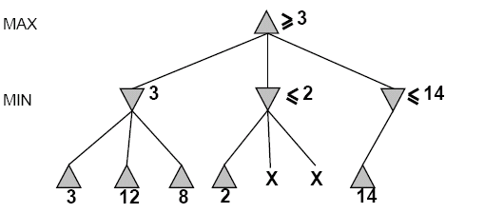
Alpha-Beta Example (continued)
β
↓
↑
α
α=3
β =+∞
,
α, β, passed to kids
α=3
β =+∞

Slide 54
Alpha-Beta Example (continued)
β
↓
↑
α
α=3
β =+∞
,
MIN updates β,
based on kids.
α=3
β =14

Slide 55
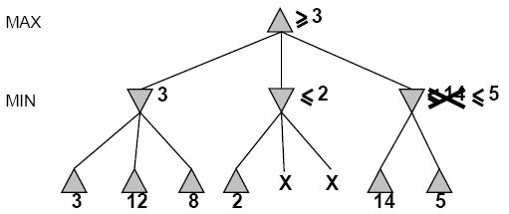

Alpha-Beta Example (continued)
β
↓
↑
α
α=3
β =+∞
,
MIN updates β,
based on kids.
α=3
β =5

Slide 56
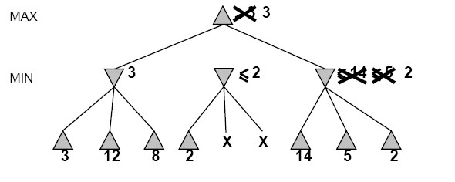
Alpha-Beta Example (continued)
β
↓
↑
α
α=3
β =+∞
2 is returned
as node value.
2

Slide 57
Alpha-Beta Example (continued)
Max now makes it’s best move, as computed by Alpha-Beta
β
↓
↑
α
2

Slide 58
Effectiveness of Alpha-Beta Pruning
Guaranteed to compute same root value as Minimax
Worst case: no pruning, same as Minimax (O(b^{d}))
Best case: when each player’s best move is the first option examined, examines only O(b^{d/2}) nodes, allowing to search twice as deep!

Slide 59
When best move is the first examined, examines only O(b^{d/2}) nodes….
So: run Iterative Deepening search, sort by value returned on last iteration.
So: expand captures first, then threats, then forward moves, etc.
O(b^{(d/2)}) is the same as having a branching factor of sqrt(b),
Since (sqrt(b))^{d} = b^{(d/2)}
e.g., in chess go from b ~ 35 to b ~ 6
For Deep Blue, alpha-beta pruning reduced the average branching factor from 35-40 to 6, as expected, doubling search depth

Slide 60
Real systems use a few more tricks
Expand the proposed solution a little farther
Just to make sure there are no surprises
Learn better board evaluation functions
E.g., for backgammon
Learn model of your opponent
E.g., for poker
Do stochastic search
E.g., for go

Slide 61
Chinook and Deep Blue
Chinook
the World Man-Made Checkers Champion, developed at the University of Alberta.
Competed in human tournaments, earning the right to play for the human world championship, and defeated the best players in the world.
Deep Blue
Defeated world champion Gary Kasparov 3.5-2.5 in 1997 after losing 4-2 in 1996.
Uses a parallel array of 256 special chess-specific processors
Evaluates 200 billion moves every 3 minutes; 12-ply search depth
Expert knowledge from an international grandmaster.
8000 factor evaluation function tuned from hundreds of thousands of grandmaster games
Tends to play for tiny positional advantages.

Slide 62
FOR STUDY….

Slide 63
Example
-which nodes can be pruned?
5
6
3
4
1
2
7
8

Slide 64
Answer to Example
-which nodes can be pruned?
Max
Min
Max
3
4
1
2
7
8
5
6
Answer: NONE! Because the most favorable nodes for both are explored last (i.e., in the diagram, are on the right-hand side).

Slide 65
Second Example (the exact mirror image of the first example)
-which nodes can be pruned?
3
4
6
5
8
7
2
1

Slide 66
Answer to Second Example (the exact mirror image of the first example)
Max
-which nodes can be pruned?
Min
Max
6
5
8
7
2
1
3
4
Answer: LOTS! Because the most favorable nodes for both are explored first (i.e., in the diagram, are on the left-hand side).

