Slide 1
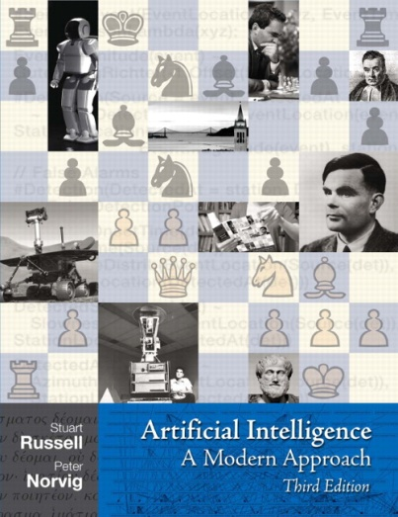
Adversarial Search
Read AIMA Chapter 5.1-5.5, and Chapter 16.1-16.3

