Slide 1
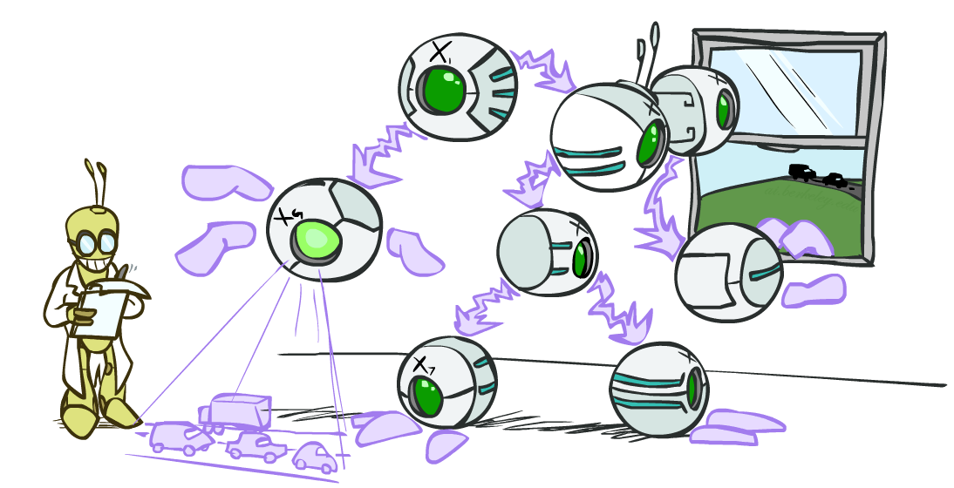
Bayes’ Nets – wrap up
Slides courtesy of Dan Klein and Pieter Abbeel --- University of California, Berkeley
[These slides were created by Dan Klein and Pieter Abbeel for CS188 Intro to AI at UC Berkeley. All CS188 materials are available at http://ai.berkeley.edu.]
Notes:
Please retain proper attribution, including the reference to ai.berkeley.edu. Thanks!

Slide 2
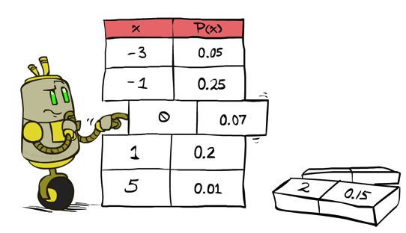
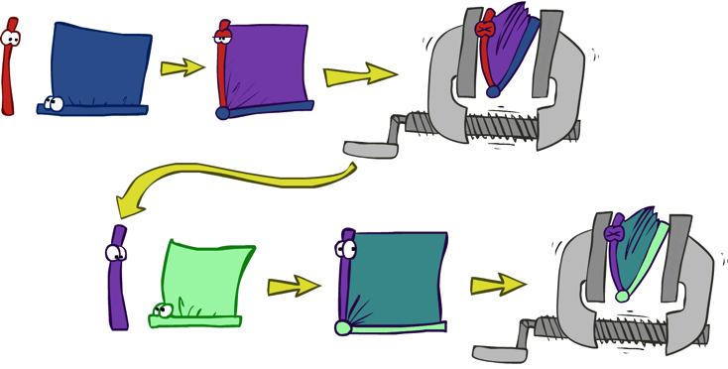


General Variable Elimination
Query:
Start with initial factors:
Local CPTs (but instantiated by evidence)
While there are still hidden variables (not Q or evidence):
Pick a hidden variable H
Join all factors mentioning H
Eliminate (sum out) H
Join all remaining factors and normalize
Notes:
Choice point is Pick a hidden variable H. Any ordering of hidden variables is valid. All will give you a correct answer. Some orderings will lead to very big factors being generated along the way. Others will lead to smaller factors. Algorithms can try to pick out orderings that will keep the factors small, to lessen the computation.

Slide 3
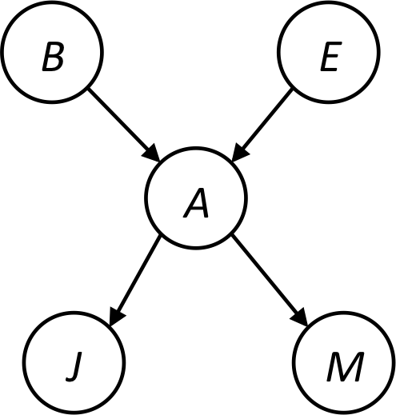










Example
Choose A
Notes:
Let’s take a look at different ordering without actually don’t the computation.
Initial factors are given by the Bayes Net in the top box.
Step 1: Choose a hidden variable to eliminate.
Here’s a rule about what appears in the what part of the conditioning sign: Anything that ever appeared in front the conditioning sign will appear in the front. Anything that only ever appeared in the back will be in the back. j,m,A appeared in the front some times. A appeared in the back, but appearing once in the front is enough to keep it here.
Step 2: Next we sum out A. Then we get our second factor which is only over j,m,B,E. How many rows in the table for P(j,m|B,E)? 4 since there are two variables (B and E) which are both binary.
Step 3: We’re left with these 3 factors. All the ones with Alarm in it are gone. We still have the hidden variable E.

Slide 4




Example
Choose E
Finish with B
Normalize
Notes:
Step 1: Join on E.
Step 2: Sum over E. This favor has 2 rows, one for +e one for –e.
Now we’re left with these.
Step 1: Join over them. We get the joint over j,m,B
Finally: normalize to get P(B|j,m).

Slide 5
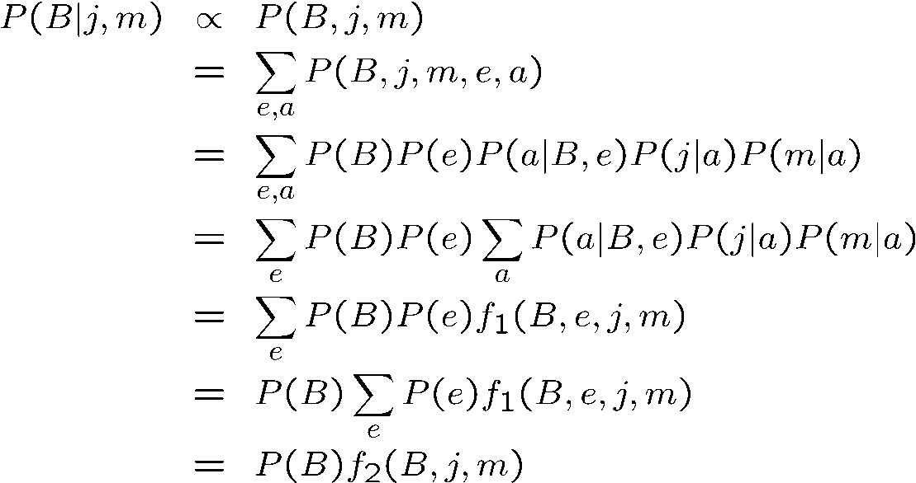
Same Example in Equations
marginal can be obtained from joint by summing out
use Bayes’ net joint distribution expression
use x*(y+z) = xy + xz
joining on a, and then summing out gives f₁
use x*(y+z) = xy + xz
joining on e, and then summing out gives f₂
All we are doing is exploiting uwy + uwz + uxy + uxz + vwy + vwz + vxy +vxz = (u+v)(w+x)(y+z) to improve computational efficiency!

Slide 6

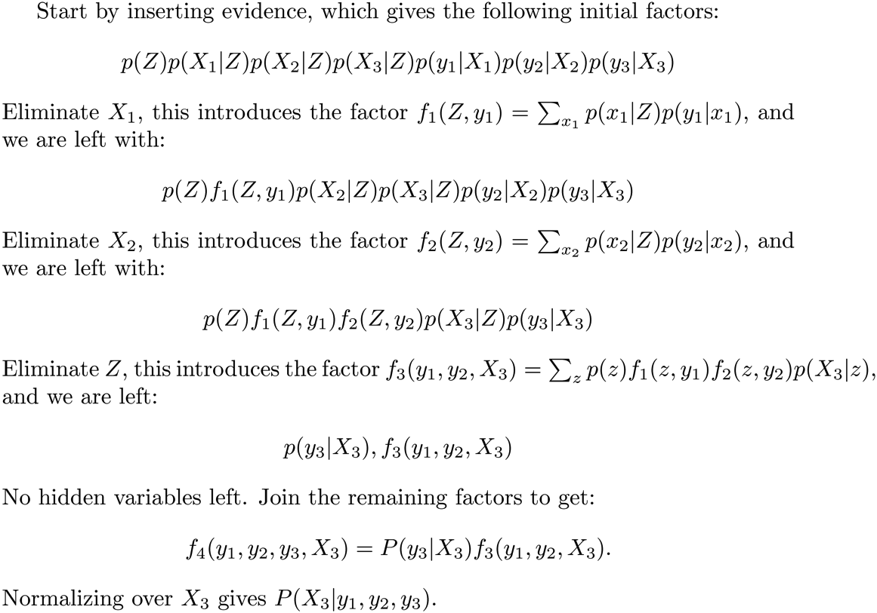






Another Variable Elimination Example
Computational complexity critically depends on the largest factor being generated in this process. Size of factor = number of entries in table. In example above (assuming binary) all factors generated are of size 2 --- as they all only have one variable (Z, Z, and X₃ respectively).

Slide 7




Variable Elimination Ordering
For the query P(X_{n}|y₁,…,y_{n}) work through the following two different orderings as done in previous slide: Z, X₁, …, X_{n-1} and X₁, …, X_{n-1}, Z. What is the size of the maximum factor generated for each of the orderings?
Answer: 2^{n+1} versus 2² (assuming binary)
In general: the ordering can greatly affect efficiency.
…
…

Slide 8
VE: Computational and Space Complexity
The computational and space complexity of variable elimination is determined by the largest factor
The elimination ordering can greatly affect the size of the largest factor.
E.g., previous slide’s example 2^{n} vs. 2
Does there always exist an ordering that only results in small factors?
No!

Slide 9















Worst Case Complexity?
CSP:
If we can answer P(z) equal to zero or not, we answered whether the 3-SAT problem has a solution.
Hence inference in Bayes’ nets is NP-hard. No known efficient probabilistic inference in general.
…
…

Slide 10
Polytrees
A polytree is a directed graph with no undirected cycles
For poly-trees you can always find an ordering that is efficient
Try it!!
Cut-set conditioning for Bayes’ net inference
Choose set of variables such that if removed only a polytree remains
Exercise: Think about how the specifics would work out!

Slide 11

Bayes’ Nets
Representation
Conditional Independences
Probabilistic Inference
Enumeration (exact, exponential complexity)
Variable elimination (exact, worst-case exponential complexity, often better)

Slide 12
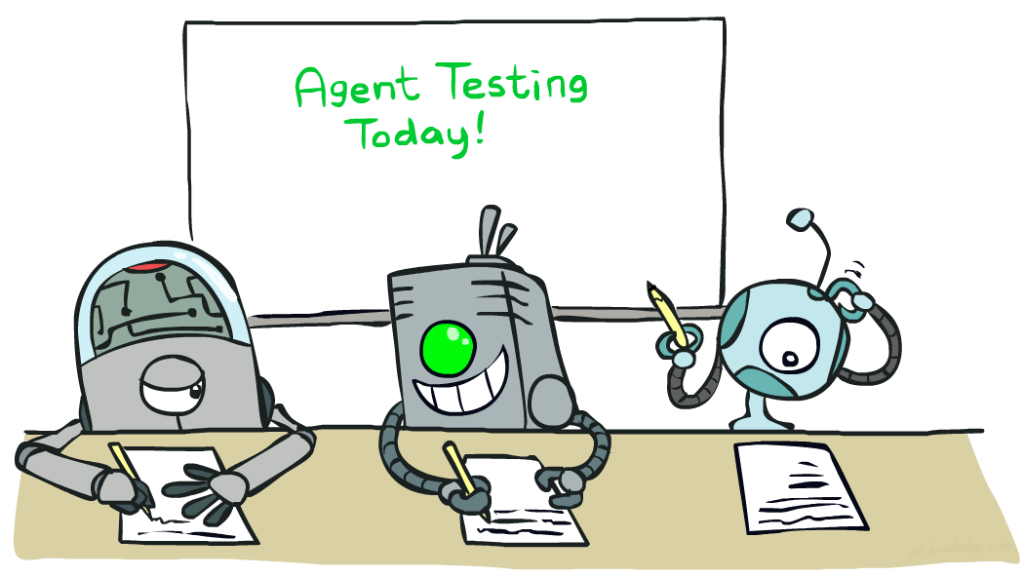

Naïve Bayes
Slides courtesy of Dan Klein and Pieter Abbeel --- University of California, Berkeley
[These slides were created by Dan Klein and Pieter Abbeel for CS188 Intro to AI at UC Berkeley. All CS188 materials are available at http://ai.berkeley.edu.]
Notes:
Please retain proper attribution, including the reference to ai.berkeley.edu. Thanks!

Slide 13
Machine Learning
Up until now: how use a model to make optimal decisions
Machine learning: how to acquire a model from data / experience
Learning parameters (e.g. probabilities)
Learning structure (e.g. BN graphs)
Learning hidden concepts (e.g. clustering)
Today: model-based classification with Naive Bayes

Slide 14

Classification

Slide 15
Example: Spam Filter
Input: an email
Output: spam/ham
Setup:
Get a large collection of example emails, each labeled “spam” or “ham”
Note: someone has to hand label all this data!
Want to learn to predict labels of new, future emails
Features: The attributes used to make the ham / spam decision
Words: FREE!
Text Patterns: $dd, CAPS
Non-text: SenderInContacts
…
Dear Sir.
First, I must solicit your confidence in this transaction, this is by virture of its nature as being utterly confidencial and top secret. …
TO BE REMOVED FROM FUTURE MAILINGS, SIMPLY REPLY TO THIS MESSAGE AND PUT "REMOVE" IN THE SUBJECT.
99 MILLION EMAIL ADDRESSES
FOR ONLY $99
Ok, Iknow this is blatantly OT but I'm beginning to go insane. Had an old Dell Dimension XPS sitting in the corner and decided to put it to use, I know it was working pre being stuck in the corner, but when I plugged it in, hit the power nothing happened.

Slide 16




Example: Digit Recognition
Input: images / pixel grids
Output: a digit 0-9
Setup:
Get a large collection of example images, each labeled with a digit
Note: someone has to hand label all this data!
Want to learn to predict labels of new, future digit images
Features: The attributes used to make the digit decision
Pixels: (6,8)=ON
Shape Patterns: NumComponents, AspectRatio, NumLoops
…
0
1
2
1
??

Slide 17
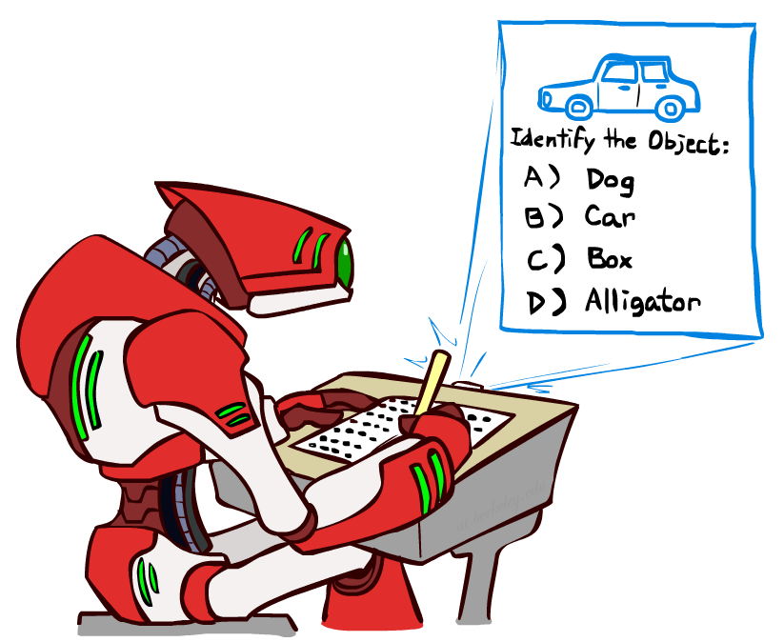
Other Classification Tasks
Classification: given inputs x, predict labels (classes) y
Examples:
Spam detection (input: document,
classes: spam / ham)
OCR (input: images, classes: characters)
Medical diagnosis (input: symptoms,
classes: diseases)
Automatic essay grading (input: document,
classes: grades)
Fraud detection (input: account activity,
classes: fraud / no fraud)
Customer service email routing
… many more
Classification is an important commercial technology!

Slide 18

Model-Based Classification

Slide 19
Model-Based Classification
Model-based approach
Build a model (e.g. Bayes’ net) where both the label and features are random variables
Instantiate any observed features
Query for the distribution of the label conditioned on the features
Challenges
What structure should the BN have?
How should we learn its parameters?

Slide 20


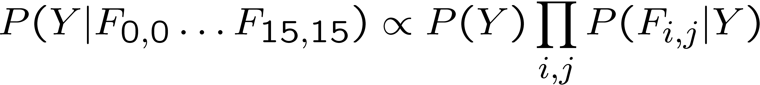
Naïve Bayes for Digits
Naïve Bayes: Assume all features are independent effects of the label
Simple digit recognition version:
One feature (variable) F_{ij} for each grid position <i,j>
Feature values are on / off, based on whether intensity
is more or less than 0.5 in underlying image
Each input maps to a feature vector, e.g.
Here: lots of features, each is binary valued
Naïve Bayes model:
What do we need to learn?
Y
F₁
F₂
F_{n}

Slide 21

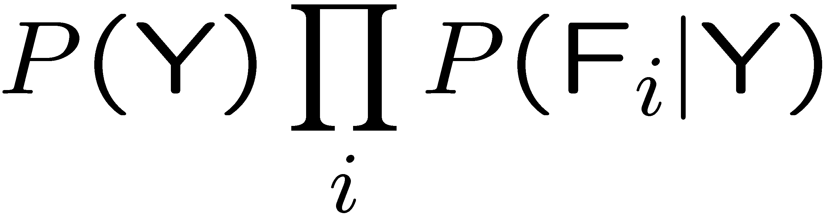
General Naïve Bayes
A general Naive Bayes model:
We only have to specify how each feature depends on the class
Total number of parameters is linear in n
Model is very simplistic, but often works anyway
Y
|Y| parameters
F₁
F₂
F_{n}
|Y| x |F|^{n} values
n x |F| x |Y| parameters

Slide 22
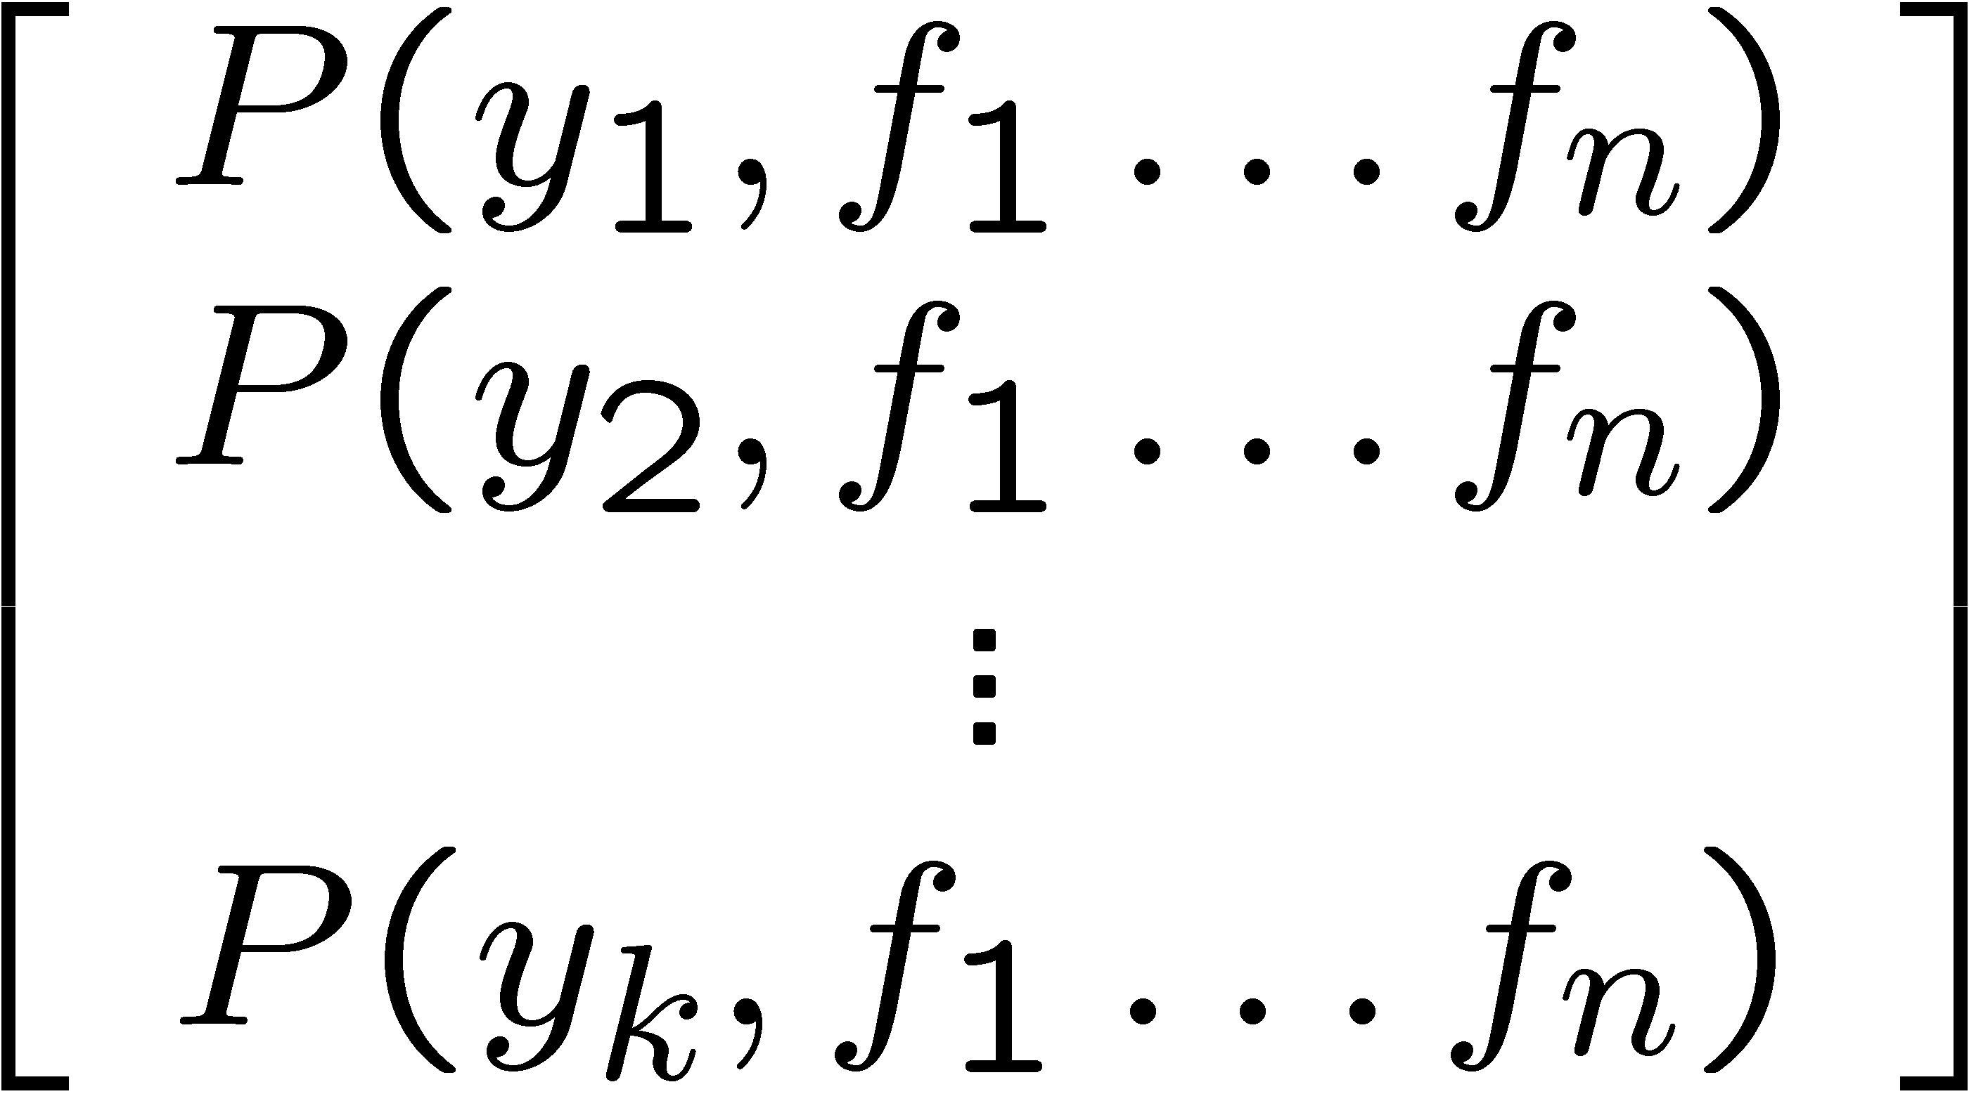
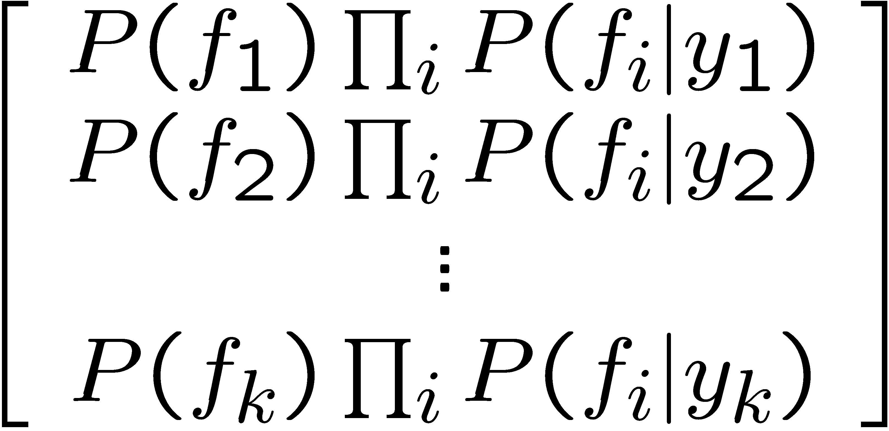

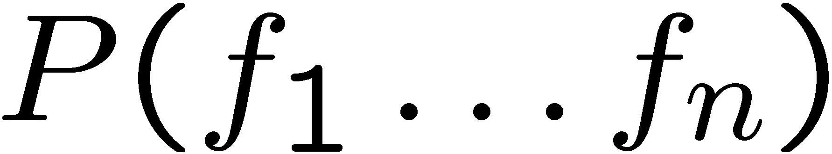
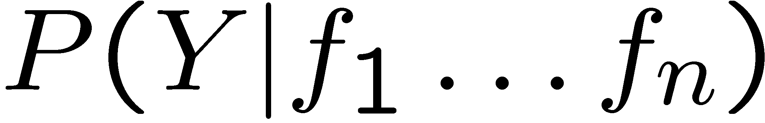
Inference for Naïve Bayes
Goal: compute posterior distribution over label variable Y
Step 1: get joint probability of label and evidence for each label
Step 2: sum to get probability of evidence
Step 3: normalize by dividing Step 1 by Step 2
+

Slide 23
General Naïve Bayes
What do we need in order to use Naïve Bayes?
Inference method (we just saw this part)
Start with a bunch of probabilities: P(Y) and the P(F_{i}|Y) tables
Use standard inference to compute P(Y|F₁…F_{n})
Nothing new here
Estimates of local conditional probability tables
P(Y), the prior over labels
P(F_{i}|Y) for each feature (evidence variable)
These probabilities are collectively called the parameters of the model and denoted by θ
Up until now, we assumed these appeared by magic, but…
…they typically come from training data counts: we’ll look at this soon

Slide 24
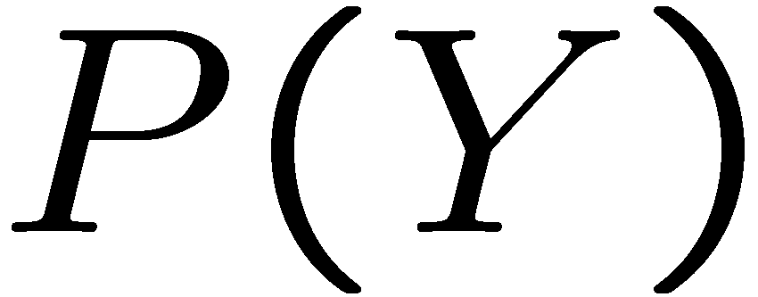


Example: Conditional Probabilities
1 | 0.1
2 | 0.1
3 | 0.1
4 | 0.1
5 | 0.1
6 | 0.1
7 | 0.1
8 | 0.1
9 | 0.1
0 | 0.1
1 | 0.01
2 | 0.05
3 | 0.05
4 | 0.30
5 | 0.80
6 | 0.90
7 | 0.05
8 | 0.60
9 | 0.50
0 | 0.80
1 | 0.05
2 | 0.01
3 | 0.90
4 | 0.80
5 | 0.90
6 | 0.90
7 | 0.25
8 | 0.85
9 | 0.60
0 | 0.80

Slide 25
A Spam Filter
Naïve Bayes spam filter
Data:
Collection of emails, labeled spam or ham
Note: someone has to hand label all this data!
Split into training, held-out, test sets
Classifiers
Learn on the training set
(Tune it on a held-out set)
Test it on new emails
Dear Sir.
First, I must solicit your confidence in this transaction, this is by virture of its nature as being utterly confidencial and top secret. …
TO BE REMOVED FROM FUTURE MAILINGS, SIMPLY REPLY TO THIS MESSAGE AND PUT "REMOVE" IN THE SUBJECT.
99 MILLION EMAIL ADDRESSES
FOR ONLY $99
Ok, Iknow this is blatantly OT but I'm beginning to go insane. Had an old Dell Dimension XPS sitting in the corner and decided to put it to use, I know it was working pre being stuck in the corner, but when I plugged it in, hit the power nothing happened.

Slide 26
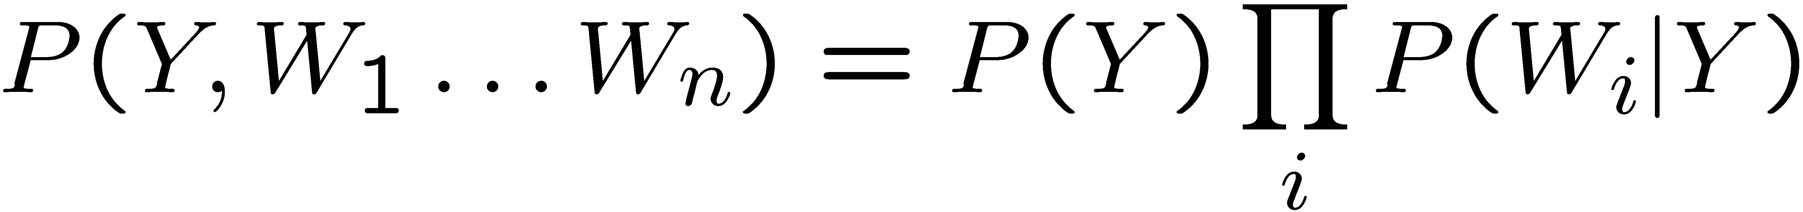
Naïve Bayes for Text
Bag-of-words Naïve Bayes:
Features: W_{i} is the word at positon i
As before: predict label conditioned on feature variables (spam vs. ham)
As before: assume features are conditionally independent given label
New: each W_{i} is identically distributed
Generative model:
“Tied” distributions and bag-of-words
Usually, each variable gets its own conditional probability distribution P(F|Y)
In a bag-of-words model
Each position is identically distributed
All positions share the same conditional probs P(W|Y)
Why make this assumption?
Called “bag-of-words” because model is insensitive to word order or reordering
Word at position i, not i^{th} word in the dictionary!

Slide 27

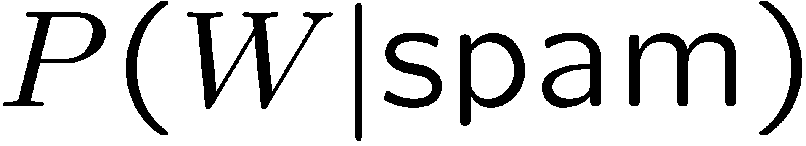
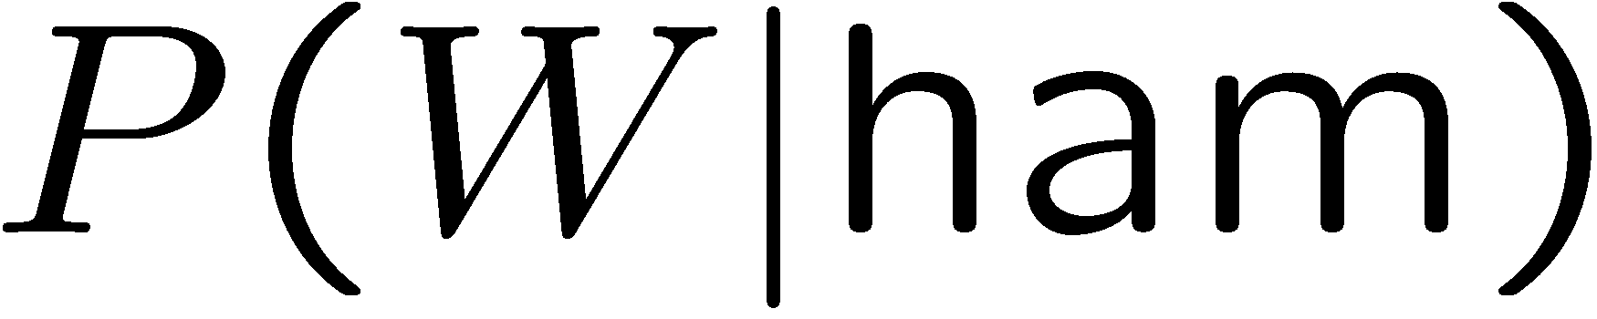
Example: Spam Filtering
Model:
What are the parameters?
Where do these tables come from?
ham : 0.66
spam: 0.33
the : 0.0156
to : 0.0153
and : 0.0115
of : 0.0095
you : 0.0093
a : 0.0086
with: 0.0080
from: 0.0075
...
the : 0.0210
to : 0.0133
of : 0.0119
2002: 0.0110
with: 0.0108
from: 0.0107
and : 0.0105
a : 0.0100
...

Slide 28
Spam Example
Word | P(w|spam) | P(w|ham) | Tot Spam | Tot Ham
(prior) | 0.33333 | 0.66666 | -1.1 | -0.4
Gary | 0.00002 | 0.00021 | -11.8 | -8.9
would | 0.00069 | 0.00084 | -19.1 | -16.0
you | 0.00881 | 0.00304 | -23.8 | -21.8
like | 0.00086 | 0.00083 | -30.9 | -28.9
to | 0.01517 | 0.01339 | -35.1 | -33.2
lose | 0.00008 | 0.00002 | -44.5 | -44.0
weight | 0.00016 | 0.00002 | -53.3 | -55.0
while | 0.00027 | 0.00027 | -61.5 | -63.2
you | 0.00881 | 0.00304 | -66.2 | -69.0
sleep | 0.00006 | 0.00001 | -76.0 | -80.5
P(spam | w) = 98.9

Slide 29
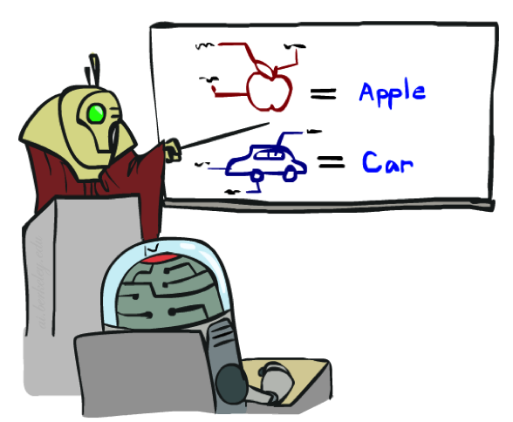

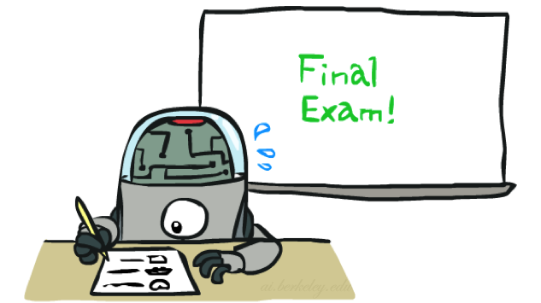
Training and Testing

Slide 30


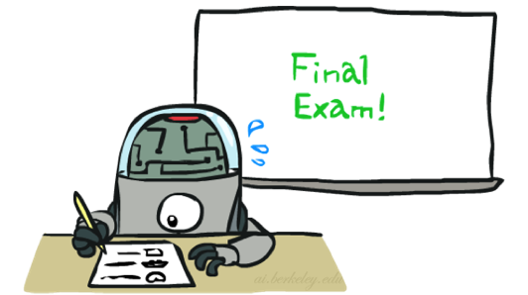
Important Concepts
Data: labeled instances, e.g. emails marked spam/ham
Training set
Held out set
Test set
Features: attribute-value pairs which characterize each x
Experimentation cycle
Learn parameters (e.g. model probabilities) on training set
(Tune hyperparameters on held-out set)
Compute accuracy of test set
Very important: never “peek” at the test set!
Evaluation
Accuracy: fraction of instances predicted correctly
Overfitting and generalization
Want a classifier which does well on test data
Overfitting: fitting the training data very closely, but not generalizing well
We’ll investigate overfitting and generalization formally in a few lectures
Training
Data
Held-Out
Data
Test
Data

Slide 31



Generalization and Overfitting

Slide 32
Overfitting
30
25
20
Degree 15 polynomial
15
10
5
0
-5
-10
-15
0
2
4
6
8
10
12
14
16
18
20

Slide 33












Example: Overfitting
2 wins!!

Slide 34
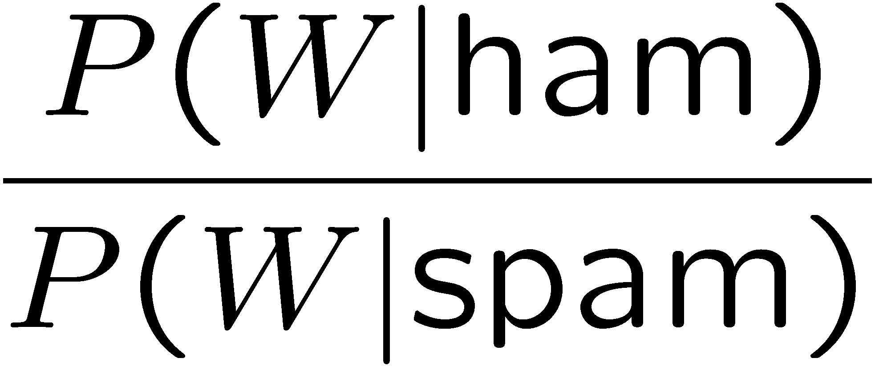
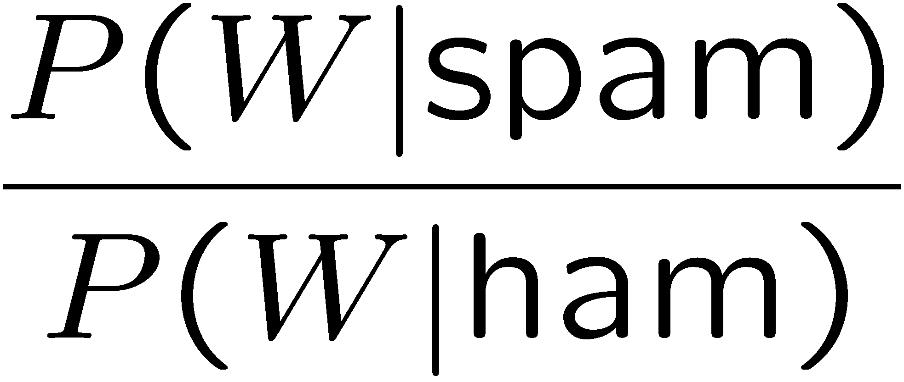
Example: Overfitting
Posteriors determined by relative probabilities (odds ratios):
south-west : inf
nation : inf
morally : inf
nicely : inf
extent : inf
seriously : inf
...
screens : inf
minute : inf
guaranteed : inf
$205.00 : inf
delivery : inf
signature : inf
...
What went wrong here?

Slide 35
Generalization and Overfitting
Relative frequency parameters will overfit the training data!
Just because we never saw a 3 with pixel (15,15) on during training doesn’t mean we won’t see it at test time
Unlikely that every occurrence of “minute” is 100% spam
Unlikely that every occurrence of “seriously” is 100% ham
What about all the words that don’t occur in the training set at all?
In general, we can’t go around giving unseen events zero probability
As an extreme case, imagine using the entire email as the only feature
Would get the training data perfect (if deterministic labeling)
Wouldn’t generalize at all
Just making the bag-of-words assumption gives us some generalization, but isn’t enough
To generalize better: we need to smooth or regularize the estimates

Slide 36
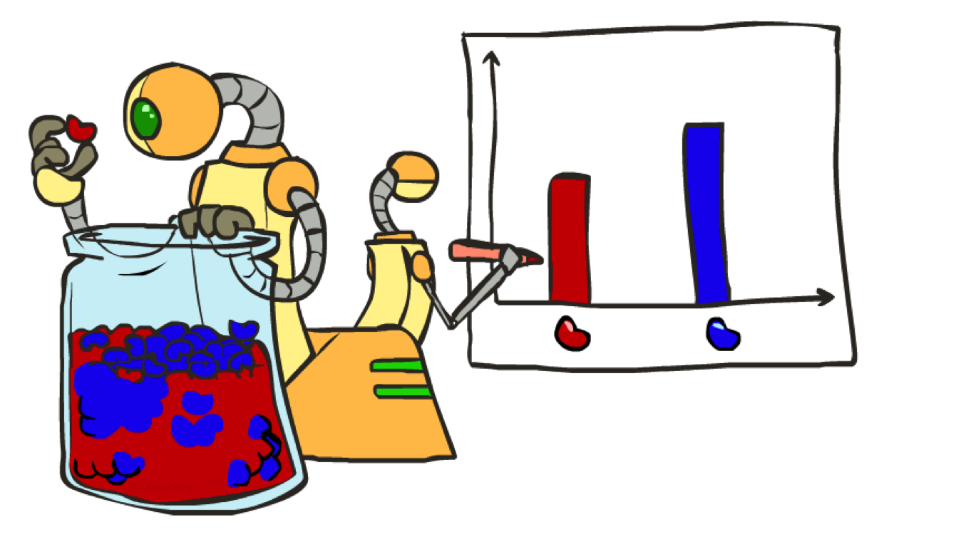
Parameter Estimation

Slide 37
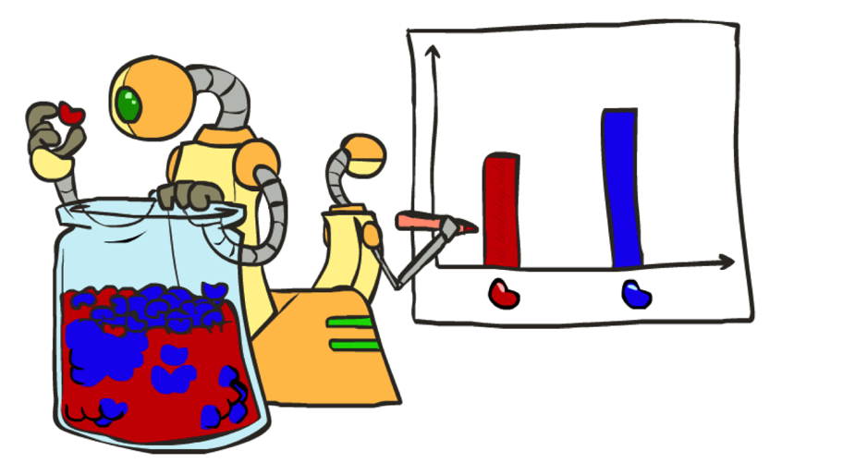
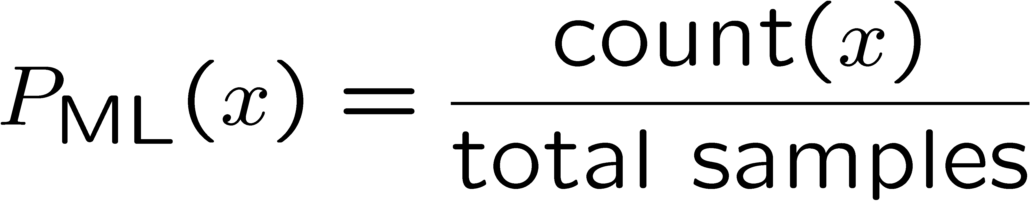

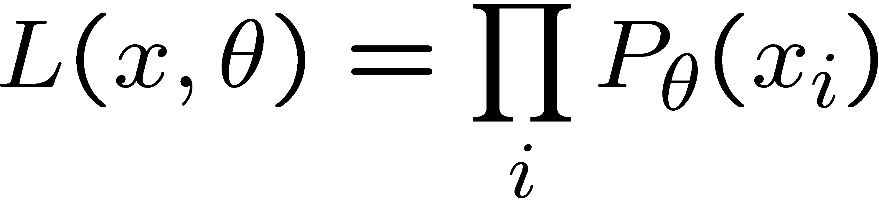
Parameter Estimation
Estimating the distribution of a random variable
Elicitation: ask a human (why is this hard?)
Empirically: use training data (learning!)
E.g.: for each outcome x, look at the empirical rate of that value:
This is the estimate that maximizes the likelihood of the data
r
b
b
b
r
r
b
b
b
r
r
b
b
b
b
r
r
b

Slide 38
Smoothing

Slide 39
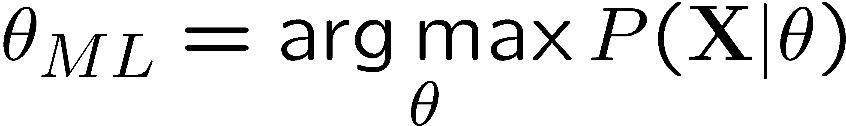
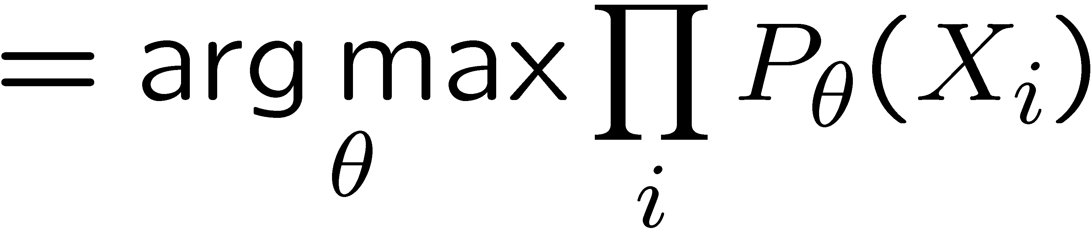
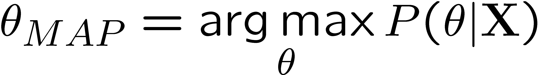
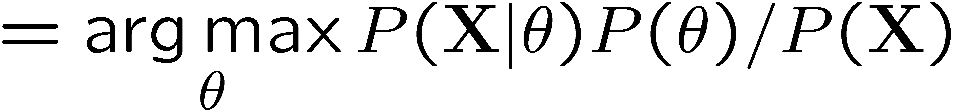
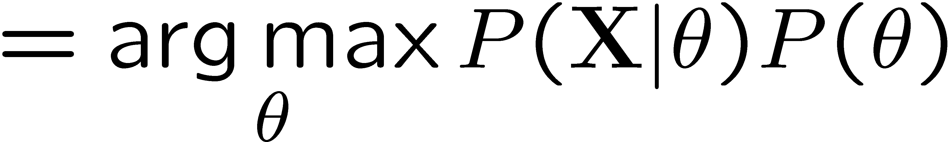
Maximum Likelihood?
Relative frequencies are the maximum likelihood estimates
Another option is to consider the most likely parameter value given the data
????

Slide 40

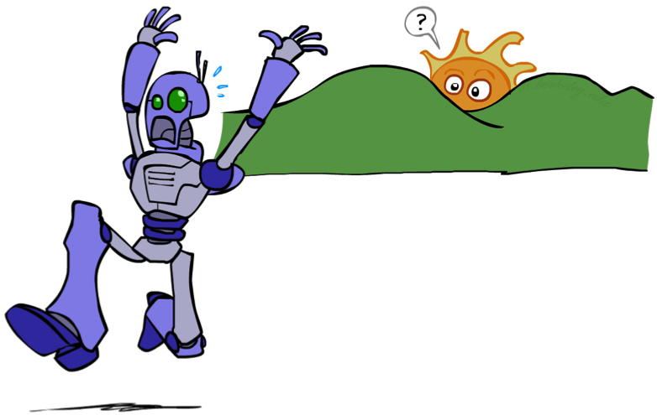
Unseen Events

Slide 41
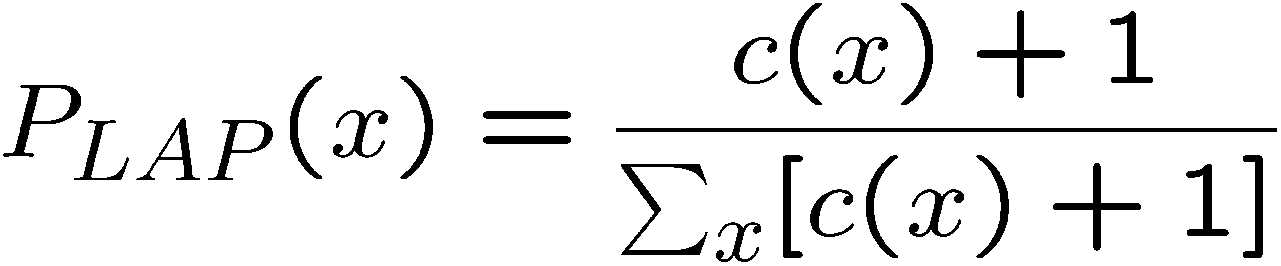
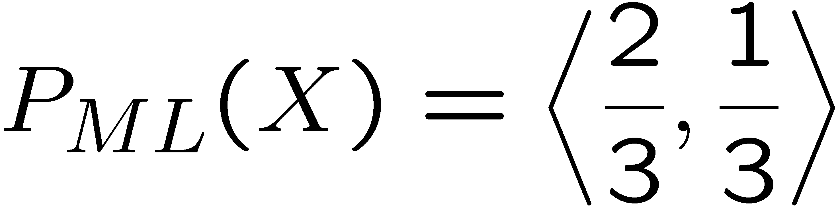
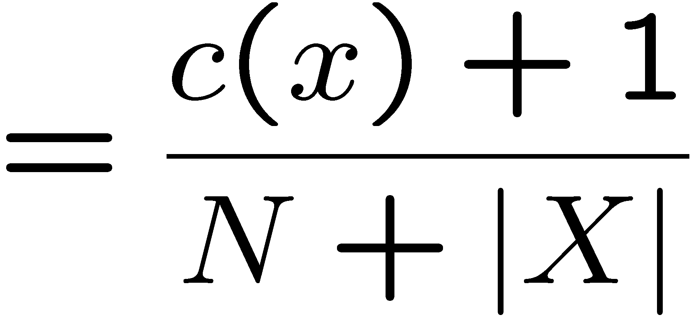
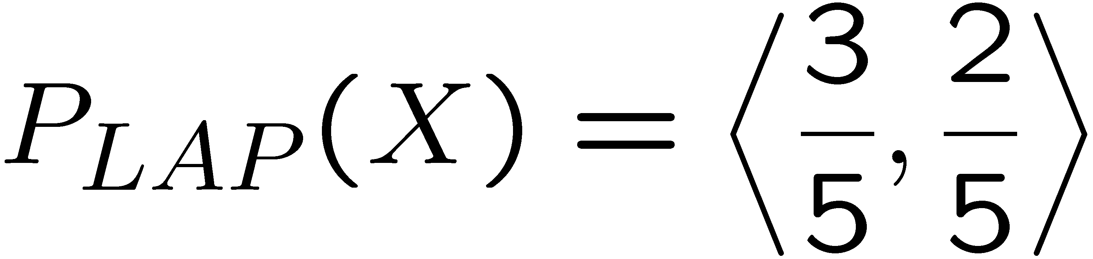
Laplace Smoothing
Laplace’s estimate:
Pretend you saw every outcome once more than you actually did
Can derive this estimate with Dirichlet priors (see cs281a)
r
r
b

Slide 42
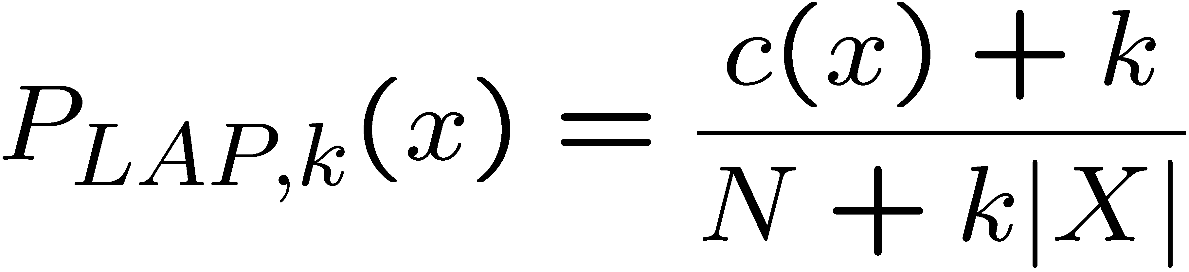
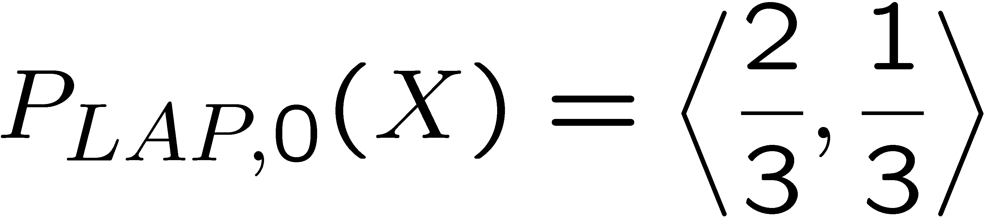
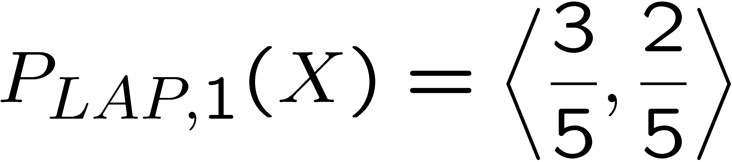
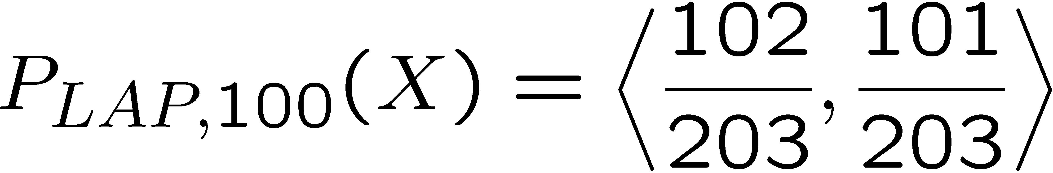
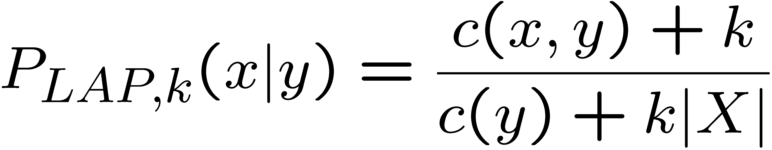
Laplace Smoothing
Laplace’s estimate (extended):
Pretend you saw every outcome k extra times
What’s Laplace with k = 0?
k is the strength of the prior
Laplace for conditionals:
Smooth each condition independently:
r
r
b

Slide 43
Estimation: Linear Interpolation*
In practice, Laplace often performs poorly for P(X|Y):
When |X| is very large
When |Y| is very large
Another option: linear interpolation
Also get the empirical P(X) from the data
Make sure the estimate of P(X|Y) isn’t too different from the empirical P(X)
What if α is 0? 1?
For even better ways to estimate parameters, as well as details of the math, see cs281a, cs288

Slide 44
Real NB: Smoothing
For real classification problems, smoothing is critical
New odds ratios:
helvetica : 11.4
seems : 10.8
group : 10.2
ago : 8.4
areas : 8.3
...
verdana : 28.8
Credit : 28.4
ORDER : 27.2
<FONT> : 26.9
money : 26.5
...
Do these make more sense?

Slide 45
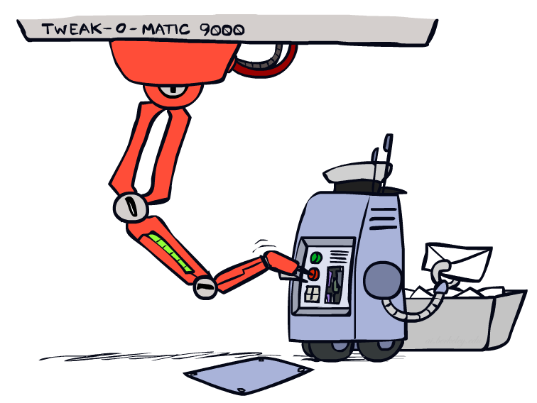
Tuning

Slide 46








Tuning on Held-Out Data
Now we’ve got two kinds of unknowns
Parameters: the probabilities P(X|Y), P(Y)
Hyperparameters: e.g. the amount / type of smoothing to do, k, α
What should we learn where?
Learn parameters from training data
Tune hyperparameters on different data
Why?
For each value of the hyperparameters, train and test on the held-out data
Choose the best value and do a final test on the test data

Slide 47
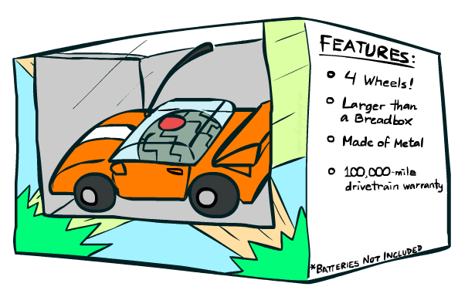
Features

Slide 48
Errors, and What to Do
Examples of errors
Dear GlobalSCAPE Customer,
GlobalSCAPE has partnered with ScanSoft to offer you the latest version of OmniPage Pro, for just $99.99* - the regular list price is $499! The most common question we've received about this offer is - Is this genuine? We would like to assure you that this offer is authorized by ScanSoft, is genuine and valid. You can get the . . .
. . . To receive your $30 Amazon.com promotional certificate, click through to
http://www.amazon.com/apparel
and see the prominent link for the $30 offer. All details are there. We hope you enjoyed receiving this message. However, if you'd rather not receive future e-mails announcing new store launches, please click . . .

Slide 49
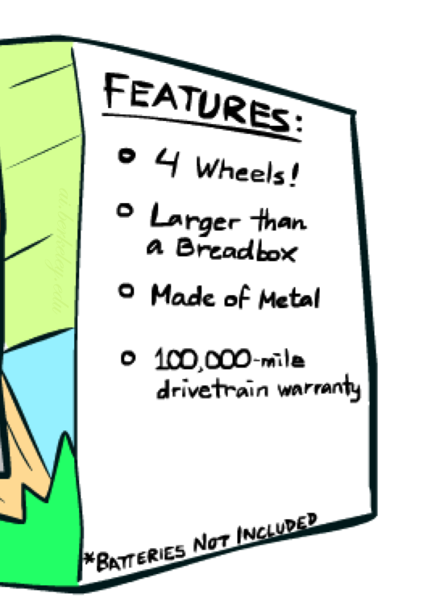
What to Do About Errors?
Need more features– words aren’t enough!
Have you emailed the sender before?
Have 1K other people just gotten the same email?
Is the sending information consistent?
Is the email in ALL CAPS?
Do inline URLs point where they say they point?
Does the email address you by (your) name?
Can add these information sources as new variables in the NB model
Next class we’ll talk about classifiers which let you easily add arbitrary features more easily

Slide 50
Baselines
First step: get a baseline
Baselines are very simple “straw man” procedures
Help determine how hard the task is
Help know what a “good” accuracy is
Weak baseline: most frequent label classifier
Gives all test instances whatever label was most common in the training set
E.g. for spam filtering, might label everything as ham
Accuracy might be very high if the problem is skewed
E.g. calling everything “ham” gets 66%, so a classifier that gets 70% isn’t very good…
For real research, usually use previous work as a (strong) baseline

Slide 51
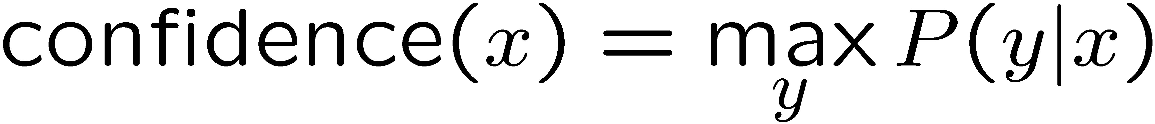

Confidences from a Classifier
The confidence of a probabilistic classifier:
Posterior over the top label
Represents how sure the classifier is of the classification
Any probabilistic model will have confidences
No guarantee confidence is correct
Calibration
Weak calibration: higher confidences mean higher accuracy
Strong calibration: confidence predicts accuracy rate
What’s the value of calibration?

Slide 52
Summary
Bayes rule lets us do diagnostic queries with causal probabilities
The naïve Bayes assumption takes all features to be independent given the class label
We can build classifiers out of a naïve Bayes model using training data
Smoothing estimates is important in real systems
Classifier confidences are useful, when you can get them

Slide 53
Next Time: Perceptron!

Slide 54
Precision vs. Recall
-
Let’s say we want to classify web pages as
homepages or not
In a test set of 1K pages, there are 3 homepages
Our classifier says they are all non-homepages
99.7 accuracy!
Need new measures for rare positive events
Precision: fraction of guessed positives which were actually positive
Recall: fraction of actual positives which were guessed as positive
Say we guess 5 homepages, of which 2 were actually homepages
Precision: 2 correct / 5 guessed = 0.4
Recall: 2 correct / 3 true = 0.67
Which is more important in customer support email automation?
Which is more important in airport face recognition?
actual +
guessed +

Slide 55



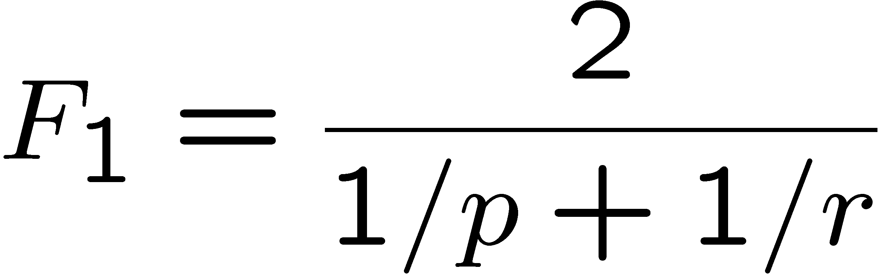
Precision vs. Recall
Precision/recall tradeoff
Often, you can trade off precision and recall
Only works well with weakly calibrated classifiers
To summarize the tradeoff:
Break-even point: precision value when p = r
F-measure: harmonic mean of p and r:

