Slide 1
Announcements
Midterm Exam #2 will be on Tuesday Nov 6 (same day as the US Midterm Elections).
Topics covered: Expectimax and Utilities, MDPs, Reinforcement Learning, Probability, Markov Models and HMMs, Bayes’ Nets.
You should review: AIMA chapters 5 and 13-17, plus Sutton and Barto chapters 3 and 6
I’ll try to release a practice exam by the weekend.
Extra credit: vote before you come, and bring in an “I voted sticker” AND/OR take a friend to the polls and get their sticker. More EC for more GOTV. Polls open at 7AM.

Slide 2
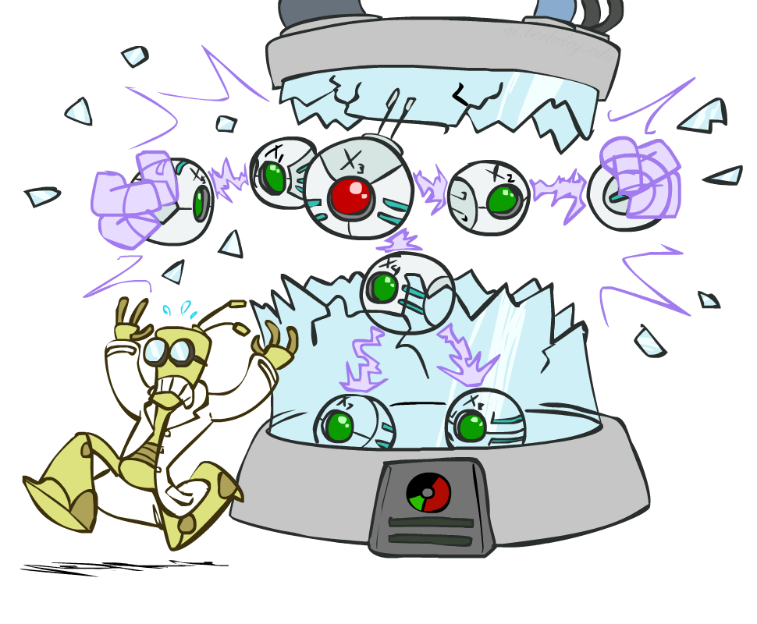
Bayes’ Nets part 2
Slides courtesy of Dan Klein and Pieter Abbeel --- University of California, Berkeley
[These slides were created by Dan Klein and Pieter Abbeel for CS188 Intro to AI at UC Berkeley. All CS188 materials are available at http://ai.berkeley.edu.]
Notes:
Please retain proper attribution, including the reference to ai.berkeley.edu. Thanks!

Slide 3
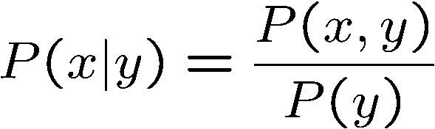

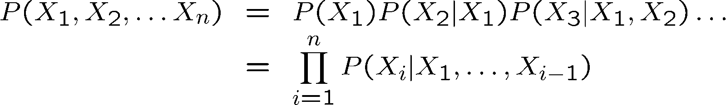

Probability Recap
Conditional probability
Product rule
Chain rule
X, Y independent if and only if:
X and Y are conditionally independent given Z if and only if:
Notes:
Conditional independence equation is essentially the same except that the conditioning on z is carried through everywhere.

Slide 4
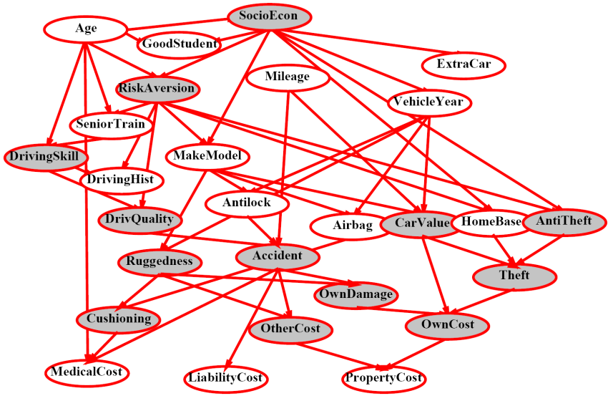
Bayes’ Nets
A Bayes’ net is an
efficient encoding
of a probabilistic
model of a domain
Questions we can ask:
Inference: given a fixed BN, what is P(X | e)?
Representation: given a BN graph, what kinds of distributions can it encode?
Modeling: what BN is most appropriate for a given domain?
Notes:
What is the probability that X can take on some value, given that evidence e has been observed?

Slide 5
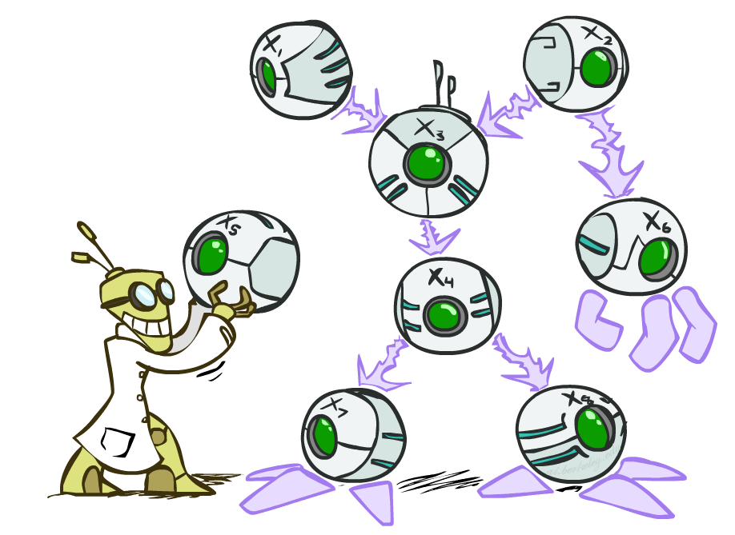

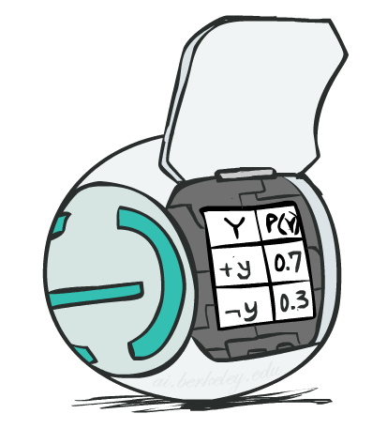
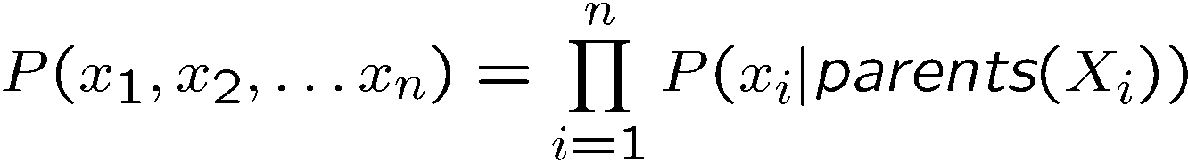
Bayes’ Net Semantics
A directed, acyclic graph, one node per random variable
A conditional probability table (CPT) for each node
A collection of distributions over X, one for each combination of parents’ values
Bayes’ nets implicitly encode joint distributions
As a product of local conditional distributions
To see what probability a BN gives to a full assignment, multiply all the relevant conditionals together:
Notes:
We draw a DAG

Slide 6
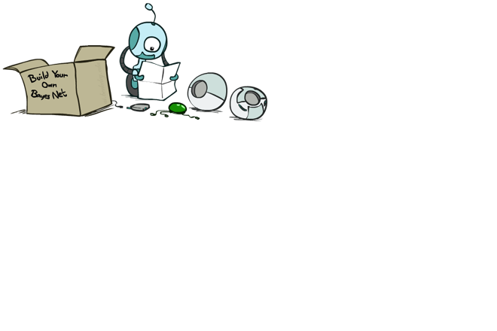
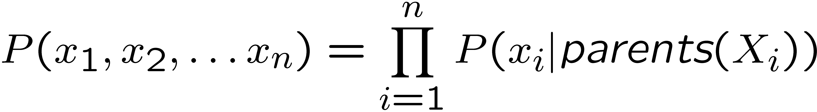
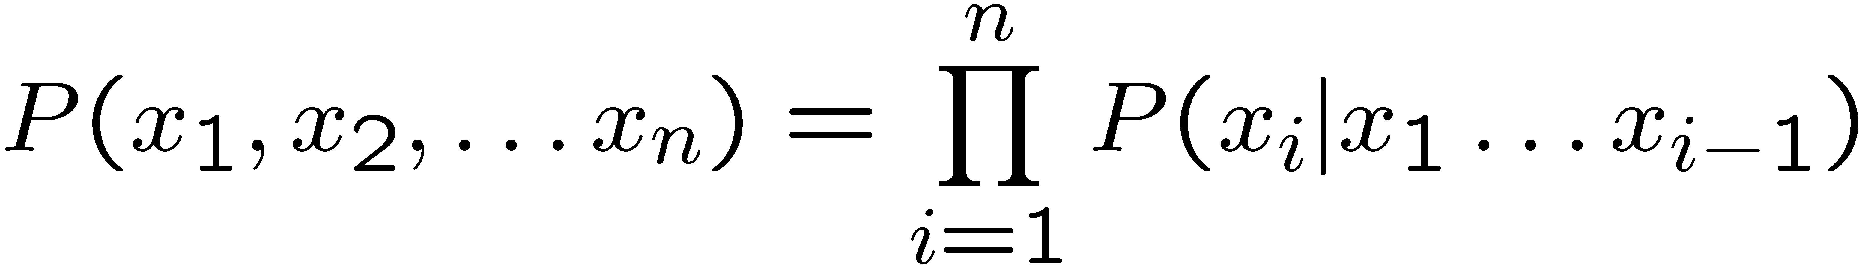
Probabilities in BNs
Why are we guaranteed that setting
results in a proper joint distribution?
Chain rule (valid for all distributions):
Assume conditional independences:
→ Consequence:
Not every BN can represent every joint distribution
The topology enforces certain conditional independencies
Notes:
All entries will be positive. Will they sum to one? Here’s the conditional independence assumptions that we’re making.
Xi _||_ {xi…Xi-q} – Parents(Xi) | Parents(Xi)
For example X1 → X2 and X1→ X3, so we’re assuming X3_||_X2, X1. For many joint distributions that doesn’t hold.

Slide 7
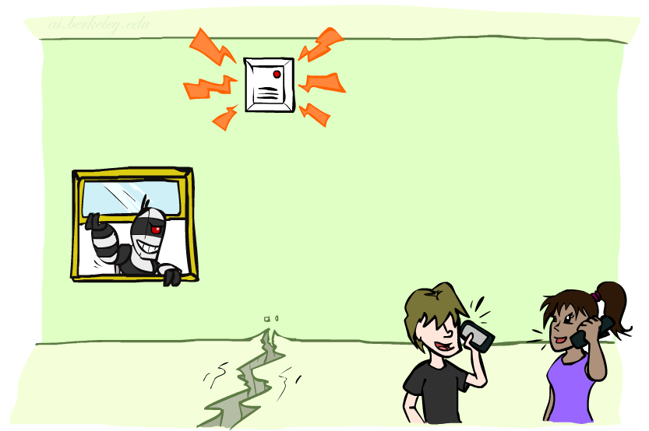
Example: Alarm Network
B | P(B)
+b | 0.001
-b | 0.999
E | P(E)
+e | 0.002
-e | 0.998
Burglary
Earthqk
Alarm
B | E | A | P(A|B,E)
+b | +e | +a | 0.95
+b | +e | -a | 0.05
+b | -e | +a | 0.94
+b | -e | -a | 0.06
-b | +e | +a | 0.29
-b | +e | -a | 0.71
-b | -e | +a | 0.001
-b | -e | -a | 0.999
John calls
Mary calls
A | J | P(J|A)
+a | +j | 0.9
+a | -j | 0.1
-a | +j | 0.05
-a | -j | 0.95
A | M | P(M|A)
+a | +m | 0.7
+a | -m | 0.3
-a | +m | 0.01
-a | -m | 0.99
Notes:
B E A J M,
E_||_B
J_||_B,E|A
M_||_ B,E,J|A.
These are the things that get left out of our linearization of the chain rule.
Here’s the Full BN including the tables. Should we be surprised that the alarm table is the biggest? No, that’s just the consequence of its having the most parents.
What if we wanted the probability of this? P(+b, -e +a, +j, +m)? We just select all rows that are consistent with it, and then we get the probability.

Slide 8
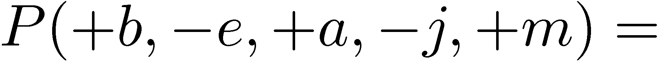
Example: Alarm Network
B | P(B)
+b | 0.001
-b | 0.999
B
E
E | P(E)
+e | 0.002
-e | 0.998
A
A | J | P(J|A)
+a | +j | 0.9
+a | -j | 0.1
-a | +j | 0.05
-a | -j | 0.95
A | M | P(M|A)
+a | +m | 0.7
+a | -m | 0.3
-a | +m | 0.01
-a | -m | 0.99
B | E | A | P(A|B,E)
+b | +e | +a | 0.95
+b | +e | -a | 0.05
+b | -e | +a | 0.94
+b | -e | -a | 0.06
-b | +e | +a | 0.29
-b | +e | -a | 0.71
-b | -e | +a | 0.001
-b | -e | -a | 0.999
J
M
Notes:
demo

Slide 9

Example: Alarm Network
B | P(B)
+b | 0.001
-b | 0.999
B
E
E | P(E)
+e | 0.002
-e | 0.998
A
A | J | P(J|A)
+a | +j | 0.9
+a | -j | 0.1
-a | +j | 0.05
-a | -j | 0.95
A | M | P(M|A)
+a | +m | 0.7
+a | -m | 0.3
-a | +m | 0.01
-a | -m | 0.99
B | E | A | P(A|B,E)
+b | +e | +a | 0.95
+b | +e | -a | 0.05
+b | -e | +a | 0.94
+b | -e | -a | 0.06
-b | +e | +a | 0.29
-b | +e | -a | 0.71
-b | -e | +a | 0.001
-b | -e | -a | 0.999
J
M
Notes:
demo

Slide 10
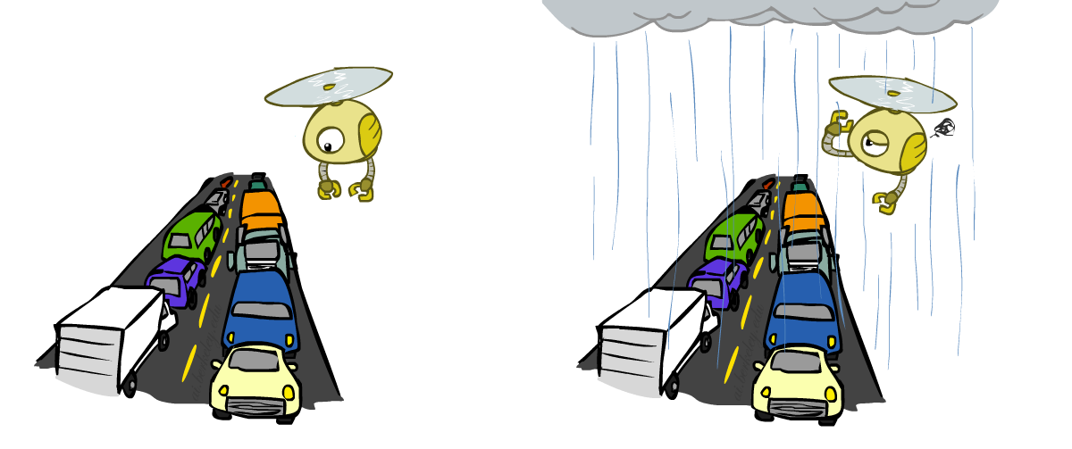
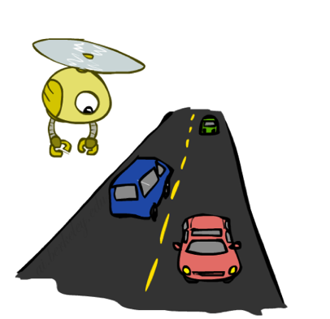

Example: Traffic
Causal direction
R
+r | 1/4
-r | 3/4
+r | +t | 3/16
+r | -t | 1/16
-r | +t | 6/16
-r | -t | 6/16
+r | +t | 3/4
 | -t | 1/4
T
-r | +t | 1/2
 | -t | 1/2
Notes:
Causality is not a mathematical necessity. You can use it in your BN, but you don’t have to. Mathematically it doesn’t play a role. Look at the joint prob. 3, 1, 6, 6.

Slide 11
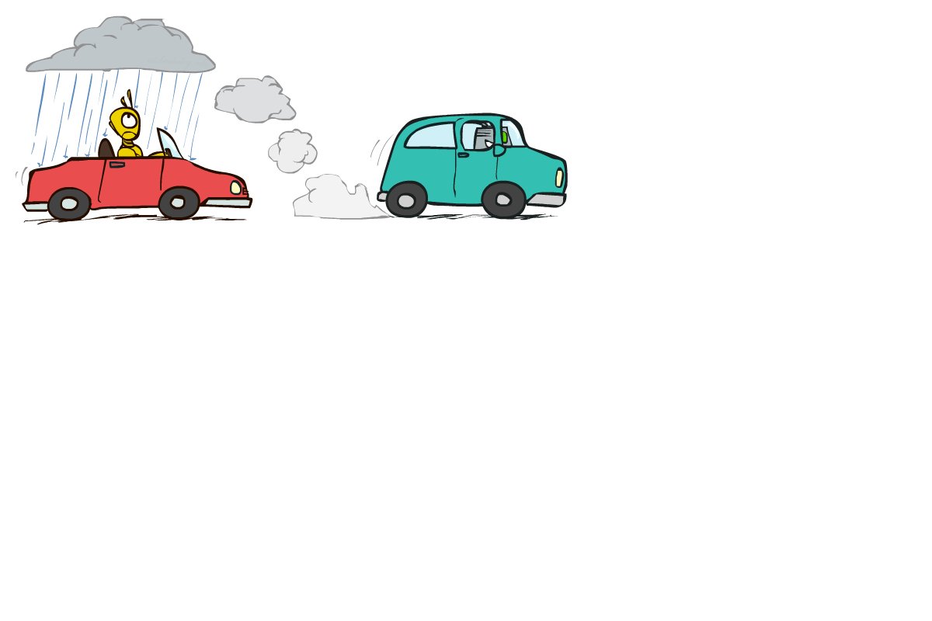

Example: Reverse Traffic
Reverse causality?
T
+t | 9/16
-t | 7/16
+r | +t | 3/16
+r | -t | 1/16
-r | +t | 6/16
-r | -t | 6/16
+t | +r | 1/3
 | -r | 2/3
R
-t | +r | 1/7
 | -r | 6/7
Notes:
Here? Specified by a different graph and a different set of tables, but we can still encode the same joint distribution as we had before: 3, 1, 6, 6.

Slide 12
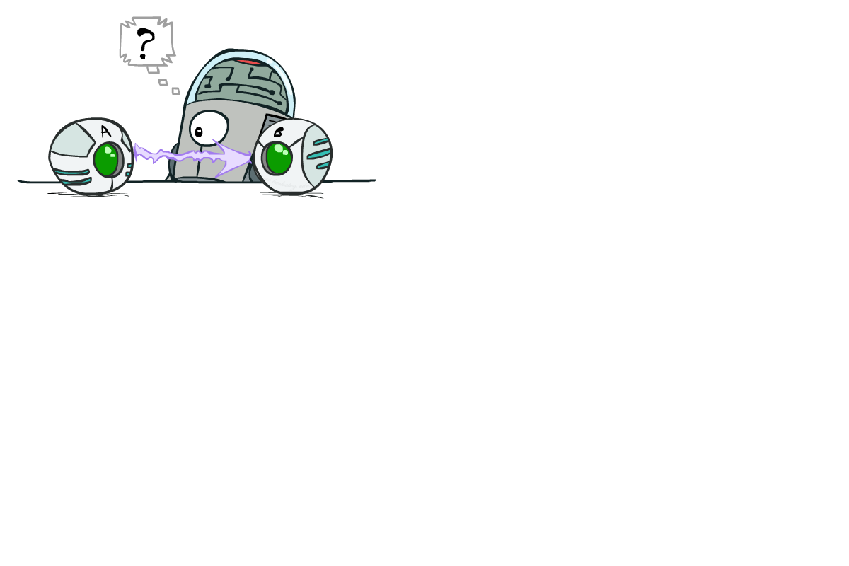
Causality?
When Bayes’ nets reflect the true causal patterns:
Often simpler (nodes have fewer parents)
Often easier to think about
Often easier to elicit from experts
BNs need not actually be causal
Sometimes no causal net exists over the domain (especially if variables are missing)
E.g. consider the variables Traffic and Drips
End up with arrows that reflect correlation, not causation
What do the arrows really mean?
Topology may happen to encode causal structure
Topology really encodes conditional independence
Notes:
BNs don’t have to be causal. Often times we do choose them to be causal, since it often uses fewer parents. It’s also easier to think about and to elicit from experts.
For non-causal ones, consider traffic and drips. In a casual BN we have R -> T and R-> D, but we could equally well have T->D (or vice versa) if that were an easier table to generate. That would reflect a correlation, not a causation.
So what do the arrows represent?

Slide 13

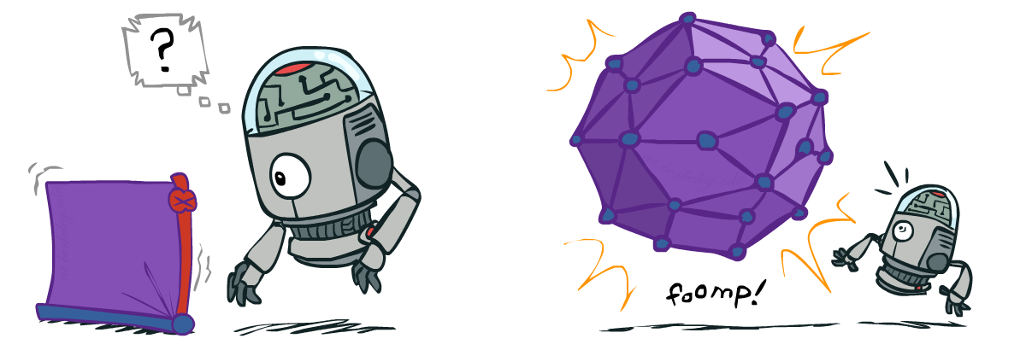
Size of a Bayes’ Net
How big is a joint distribution over N Boolean variables?
2^{N}
How big is an N-node net if nodes have up to k parents?
O(N * 2^{k+1})
Both give you the power to calculate
BNs: Huge space savings!
Also easier to elicit local CPTs
Also faster to answer queries (coming)
Notes:
Technically (2^N)-1, or (N*2^k+1)*2, since we either list out probabilities for both positive and negative outcomes, or we just do one and leave the other implicit since we know it will be 1-p(the other).

Slide 14

Bayes’ Nets
Representation
Conditional Independences
Probabilistic Inference
Learning Bayes’ Nets from Data

Slide 15

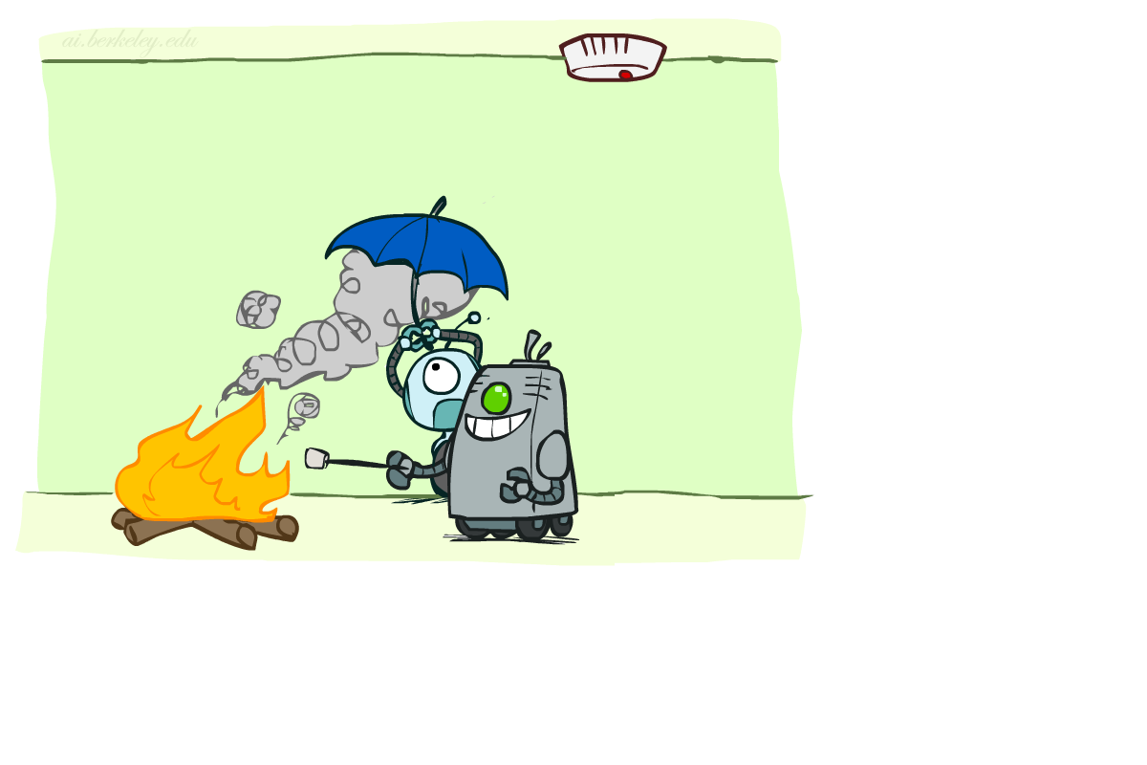

Conditional Independence
X and Y are independent if
X and Y are conditionally independent given Z
(Conditional) independence is a property of a distribution
Example:
Notes:
Alarm is independent of Fire given Smoke. The rationale is that the Alarm is triggered by Smoke, Fire causes Smoke, but Fire doesn’t directly trigger the alarm.

Slide 16
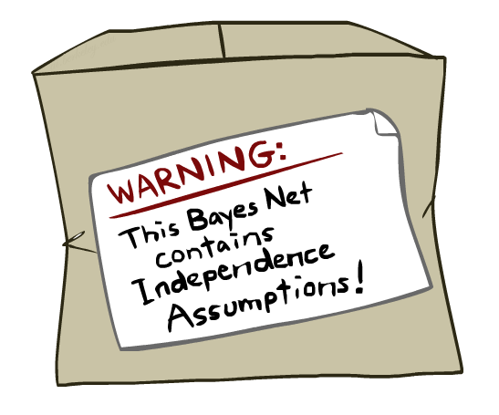
Bayes Nets: Assumptions
Assumptions we are required to make to define the Bayes net when given the graph:
Beyond above “chain rule → Bayes net” conditional independence assumptions
Often additional conditional independences
They can be read off the graph
Important for modeling: understand assumptions made when choosing a Bayes net graph
Notes:
We encode some conditional independencies explicitly.
However, there are almost always some additional conditional independence assumptions that are present. And they can be read off the graph.
Are there additional independence assumptions beyond what you put into the conditional probability tables? Almost always yes!
Important for modeling: understanding which assumptions you are making when you’re building a BN for the domain!

Slide 17
Example
X
Y
Z
W
Conditional independence assumptions directly from simplifications in chain rule:
Additional implied conditional independence assumptions?
Notes:
We go from what the chain rule gives us P(X,Y,Z,W) = P(X) P(Y|X) P(Z|X,Y) P(W|X,Y,Z) to P(X) P(Y|X) P(Z|Y) P(W|Z), which is what our BN assumptions are.
So Z_||_X|Y, W_||_X,Y|Z. Any other that are true given this Bayes Net? (Z is independent of X given Y).
Additional implied conditional independence assumptions?
W_||_X|Y. We need to show that P(W|X,Y) = P(W|Y). Don’t do it here. Maybe good exam question.
NO: Y_||_Z,W|X

Slide 18
Independence in a BN
Important question about a BN:
Are two nodes independent given certain evidence?
If yes, can prove using algebra (sometimes tedious)
If no, can prove with a counter example
Example:
Question: are X and Z necessarily independent?
Answer: no. Example: low pressure causes rain, which causes traffic.
X can influence Z, Z can influence X (via Y)
Addendum: they could be independent: how?
X
Y
Z
Notes:
Addendum: Uniform given the parent values. This just means that the parents are irrelevant. This means that by just looking at the graph structure we can’t always infer that they’re not independent. So why even build a BN with this structure?

Slide 19
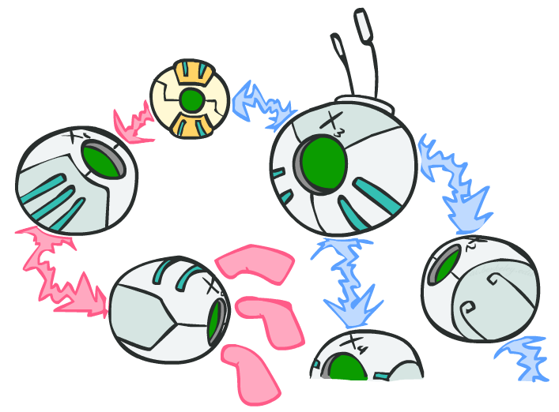
D-separation: Outline
Notes:
Study independence properties for triples
Analyze complex cases in terms of member triples
D-separation: a condition / algorithm for answering such queries

Slide 20
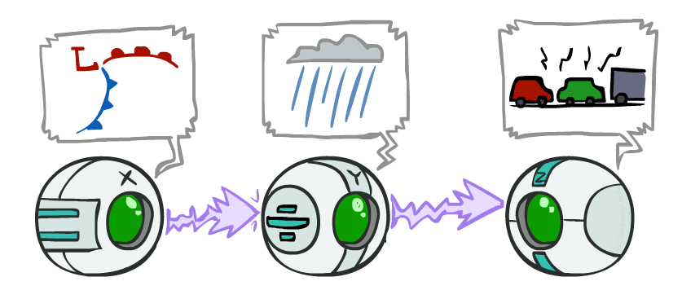
Causal Chains
This configuration is a “causal chain”
Guaranteed X independent of Z ? No!
One example set of CPTs for which X is not independent of Z is sufficient to show this independence is not guaranteed.
Example:
Low pressure causes rain causes traffic,
high pressure causes no rain causes no
traffic
In numbers:
P( +y | +x ) = 1, P( -y | - x ) = 1,
P( +z | +y ) = 1, P( -z | -y ) = 1
X: Low pressure Y: Rain Z: Traffic
Notes:
The numbers show a deterministic chain. It renders X and Z not independent. X is always == Z.

Slide 21
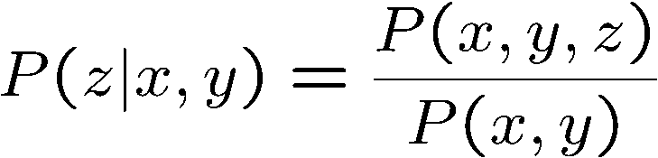
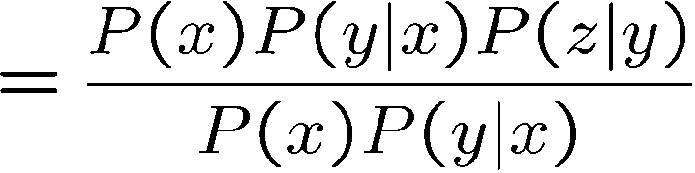

Causal Chains
This configuration is a “causal chain”
Guaranteed X independent of Z given Y?
Evidence along the chain “blocks” the influence
X: Low pressure Y: Rain Z: Traffic
Yes!
Notes:
Show what cancels out.
The assumptions that are available to us are given by P(X,Y,X) = P(X) P(Y|X) P(Z|Y)

Slide 22
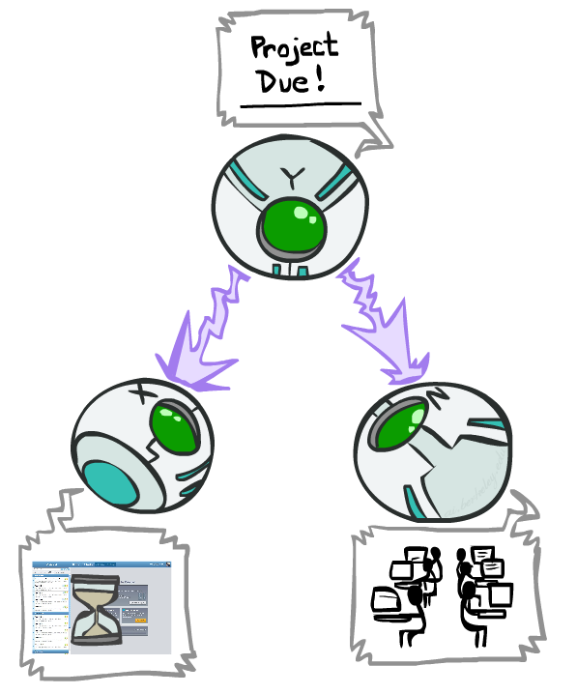
Common Cause
This configuration is a “common cause”
Guaranteed X independent of Z ? No!
One example set of CPTs for which X is not independent of Z is sufficient to show this independence is not guaranteed.
Example:
Project due causes both forums busy
and office hours to be full
In numbers:
P( +x | +y ) = 1, P( -x | -y ) = 1,
P( +z | +y ) = 1, P( -z | -y ) = 1
Y: Project due
X: Forums busy
Z: Office hours full
Notes:
If X is always equal to Y and Z is always equal to Y, then they’re not independent.

Slide 23
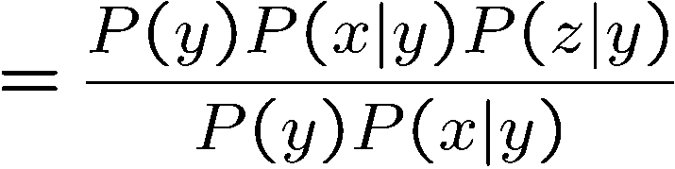
Common Cause
This configuration is a “common cause”
Guaranteed X and Z independent given Y?
Observing the cause blocks influence between effects.
Y: Project due
X: Forums busy
Z: Office hours full
Yes!

Slide 24
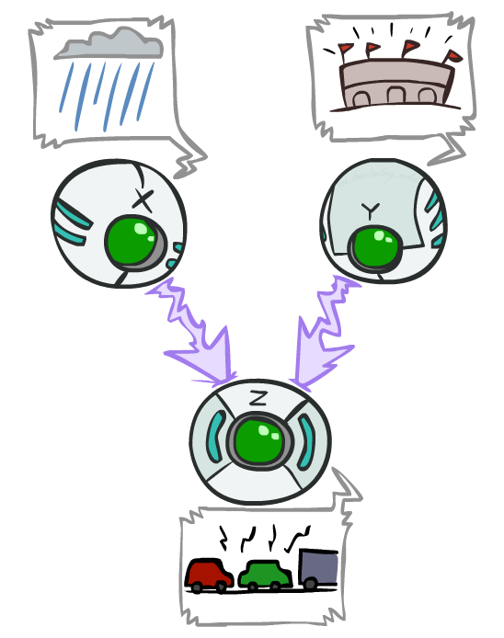
Common Effect
Last configuration: two causes of one effect (v-structures)
Are X and Y independent?
X: Raining
Y: Ballgame
Z: Traffic
Notes:
From the BN:
P(X,Y,Z) = P(X) * P(Y) * P(Z|X,Y)
Sum over Z P(X,Y,Z) = Sum over Z P(X) * P(Y) * P(Z|X,Y)
= P(X) * P(Y) Sum over Z P(Z|X,Y).
The last term sums to 1.
= P(X) * P(Y)

Slide 25
Common Effect
Last configuration: two causes of one effect (v-structures)
Are X and Y independent?
Yes: the ballgame and the rain cause traffic, but they are not correlated
Still need to prove they must be (try it!)
Are X and Y independent given Z?
No: seeing traffic puts the rain and the ballgame in competition as explanation.
This is backwards from the other cases
Observing an effect activates influence between possible causes.
X: Raining
Y: Ballgame
Z: Traffic
Notes:
Special case where observing the thing in the middle make things depend on each other. You have two causes. One of the causes must be true. Observing one of the causes to be true, means that the second cause doesn’t have to be true. Seeing one explains away the need for the other.

Slide 26
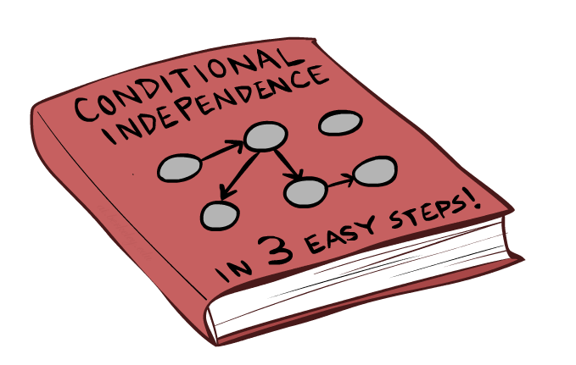
The General Case

Slide 27
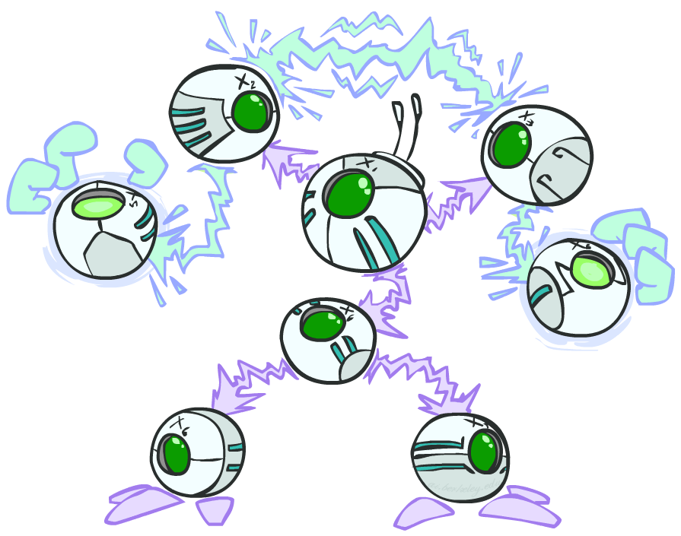
The General Case
General question: in a given BN, are two variables independent (given some evidence)?
Solution: analyze the graph
Any complex example can be broken
into repetitions of the three canonical cases
Notes:
Break the graph down to triples. Check if there is influence running along those triples. Analyze the graph. check everywhere in the graph where influence can run between two variables, or see if it is blocked.

Slide 28

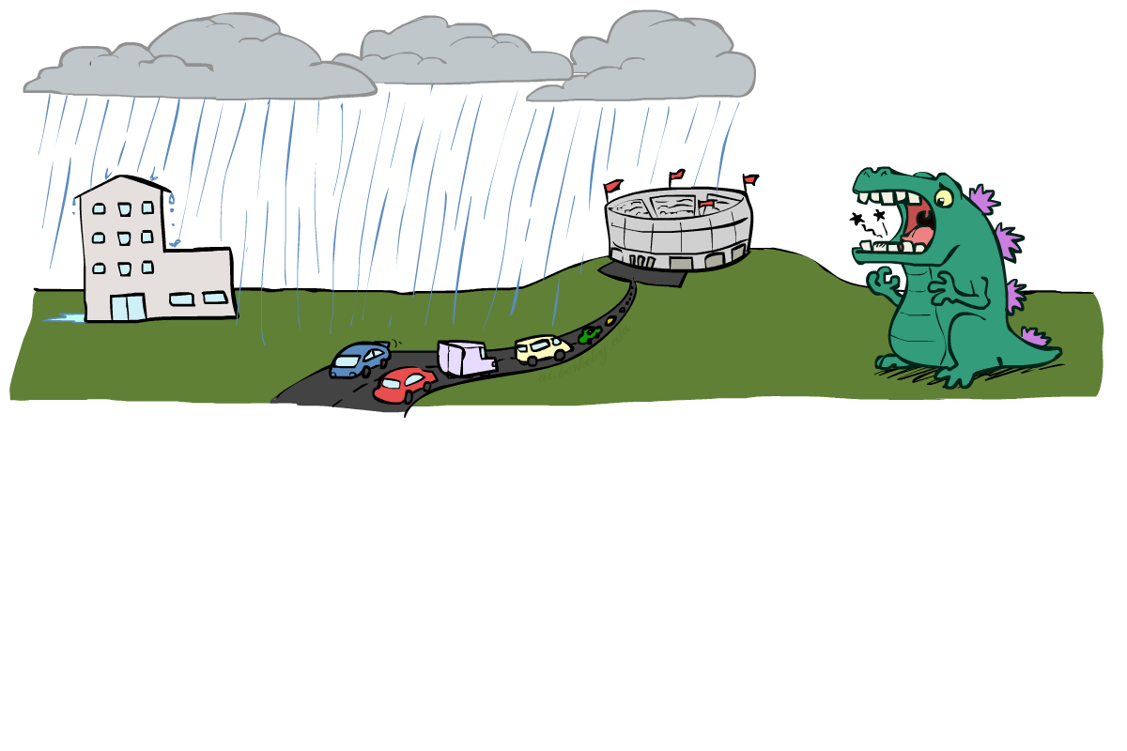
Reachability
L
Recipe: shade evidence nodes, look for paths in the resulting graph
Attempt 1: if two nodes are connected by an undirected path not blocked by a shaded node, they are conditionally independent
Almost works, but not quite
Where does it break?
Answer: the v-structure at T doesn’t count as a link in a path unless “active”
R
B
D
T
Notes:
First attempt: check whether there’s a path between two variables. Check whether it’s been blocked by some evidence. If not, then they are conditionally independent.
Too simple.
Observing T lets the influence run between R and B.

Slide 29
Active / Inactive Paths
Question: Are X and Y conditionally independent given evidence variables {Z}?
Yes, if X and Y “d-separated” by Z
Consider all (undirected) paths from X to Y
No active paths = independence!
A path is active if each triple is active:
Causal chain A → B → C where B is unobserved (either direction)
Common cause A ← B → C where B is unobserved
Common effect (aka v-structure)
A → B ← C where B or one of its descendents is observed
All it takes to block a path is a single inactive segment
Active Triples
Inactive Triples

Slide 30
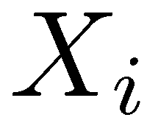
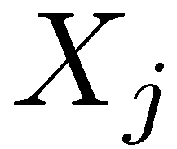

D-Separation
?
Query:
Check all (undirected!) paths between and
If one or more active, then independence not guaranteed
Otherwise (i.e. if all paths are inactive),
then independence is guaranteed

Slide 31


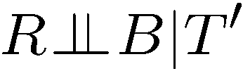
Example
Yes
R
B
T
T’
Notes:
T’: traffic report

Slide 32
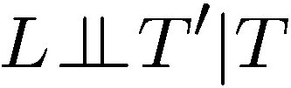


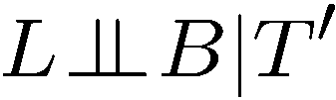

Example
L
Yes
R
B
Yes
D
T
Yes
T’

Slide 33



Example
Variables:
R: Raining
T: Traffic
D: Roof drips
S: I’m sad
Questions:
R
T
D
S
Yes

Slide 34

Structure Implications
Given a Bayes net structure, can run d-separation algorithm to build a complete list of conditional independences that are necessarily true of the form
This list determines the set of probability distributions that can be represented

Slide 35

Computing All Independences
Y
X
Z
Y
X
Z
X
Z
Y
Y
X
Z

Slide 36
Topology Limits Distributions
Given some graph topology G, only certain joint distributions can be encoded
The graph structure guarantees certain (conditional) independences
(There might be more independence)
Adding arcs increases the set of distributions, but has several costs
Full conditioning can encode any distribution
Y
Y
X
Z
X
Z
Y
X
Z
Y
X
Z
Y
Y
Y
X
Z
X
Z
X
Z
Y
Y
Y
X
Z
X
Z
X
Z

Slide 37
Bayes Nets Representation Summary
Bayes nets compactly encode joint distributions
Guaranteed independencies of distributions can be deduced from BN graph structure
D-separation gives precise conditional independence guarantees from graph alone
A Bayes’ net’s joint distribution may have further (conditional) independence that is not detectable until you inspect its specific distribution

Slide 38
Bayes’ Nets
Representation
Conditional Independences
Probabilistic Inference
Enumeration (exact, exponential complexity)
Variable elimination (exact, worst-case
exponential complexity, often better)
Probabilistic inference is NP-complete
Sampling (approximate)
Learning Bayes’ Nets from Data

Slide 39

Have a great Spring Break!

