Slide 1
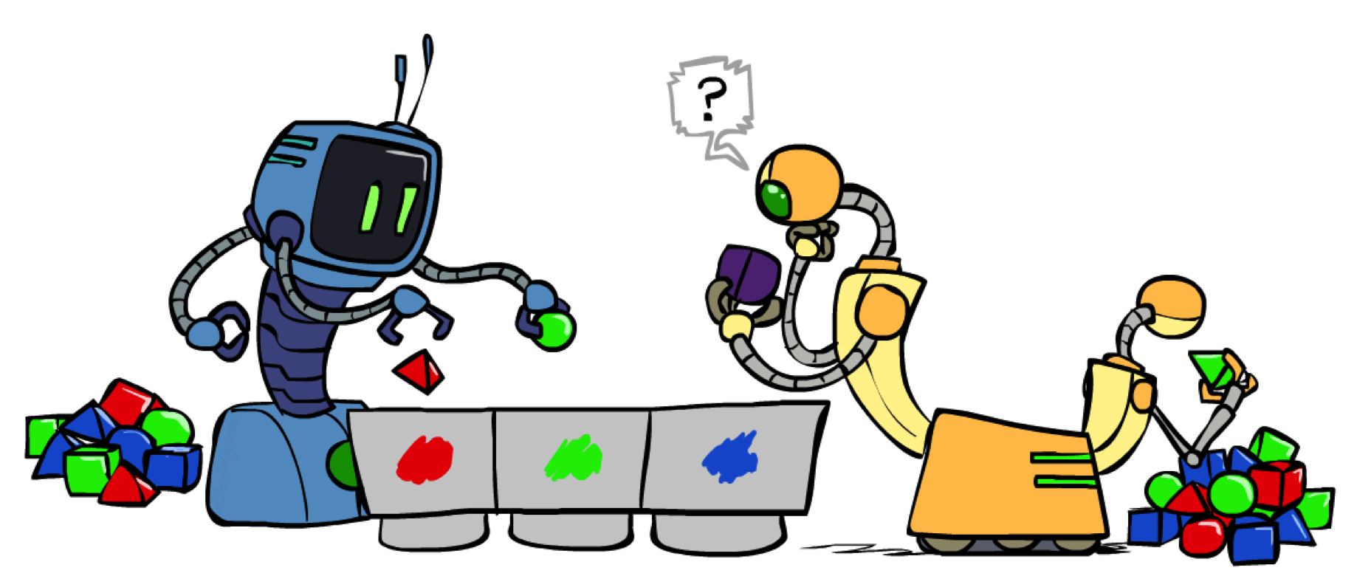
Clustering
Slides Courtesy of Dan Klein and Pieter Abbeel --- University of California, Berkeley
[These slides were created by Dan Klein and Pieter Abbeel for CS188 Intro to AI at UC Berkeley. All CS188 materials are available at http://ai.berkeley.edu.]

Slide 2
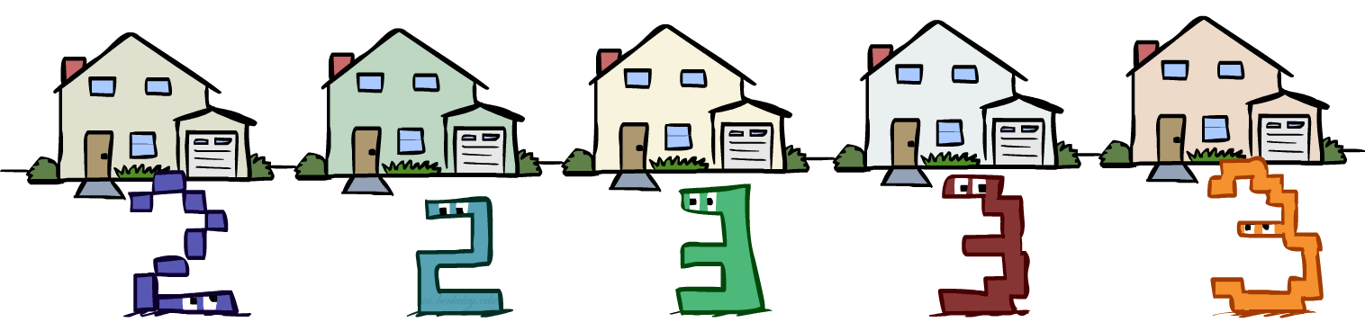
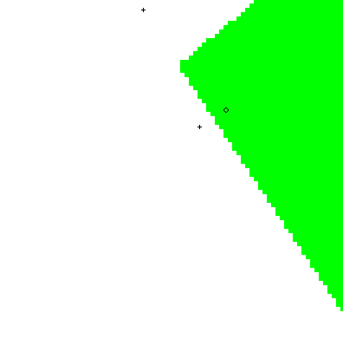
Recap: similarity based classification
Classification from similarity
Case-based reasoning
Predict an instance’s label using similar instances
Nearest-neighbor classification
1-NN: copy the label of the most similar data point
K-NN: vote the k nearest neighbors (need a weighting scheme)
Key issue: how to define similarity
Trade-offs: Small k gives relevant neighbors, Large k gives smoother functions
http://www.cs.cmu.edu/~zhuxj/courseproject/knndemo/KNN.html
Notes:
Case-based reasoning is different.
The simplest is to find the 1 nearest neighbor. He picture on the side gives an example. It’s no longer a linear decision boundary.

Slide 3
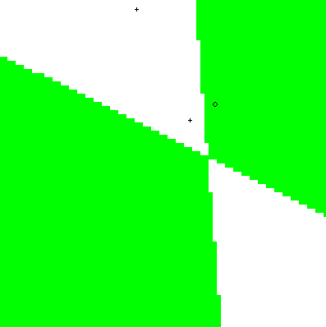
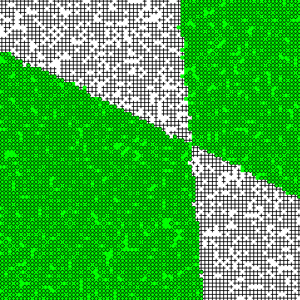
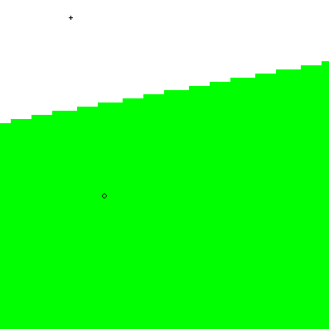
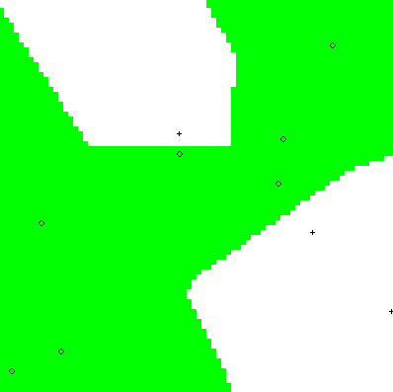
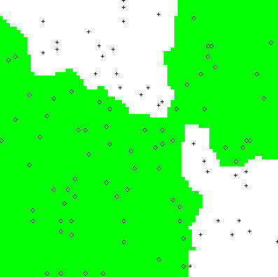
Recap: Parametric / Non-Parametric
Parametric models:
Fixed set of parameters
More data means better settings
Non-parametric models:
Complexity of the classifier increases with data
Better in the limit, often worse in the non-limit
(K)NN is non-parametric
Truth
2 Examples
10 Examples
100 Examples
10000 Examples
Notes:
This is the first example of a non-parametric approach to machine learning.
For parametric models, like naive Bayes or perceptron, we had a fixed number of parameters. As we got more data, we get better settings of those parameters.
For non-parametric models, we don’t have a fixed number of parameters. Instead, the complexity increases as we increase the amount of training data.

Slide 4





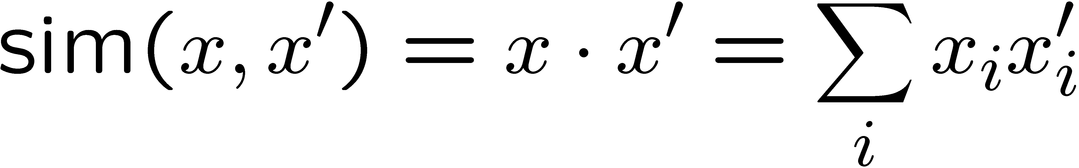


Recap: Nearest-Neighbor Classification
Nearest neighbor for digits:
Take new image
Compare to all training images
Assign based on closest example
Encoding: image is vector of intensities:
What’s the similarity function?
Dot product of two images vectors?
Usually normalize vectors so ||x|| = 1
min = 0 (when?), max = 1 (when?)
0
1
2
0
1
2
Notes:
Inner product / dot product.

Slide 5
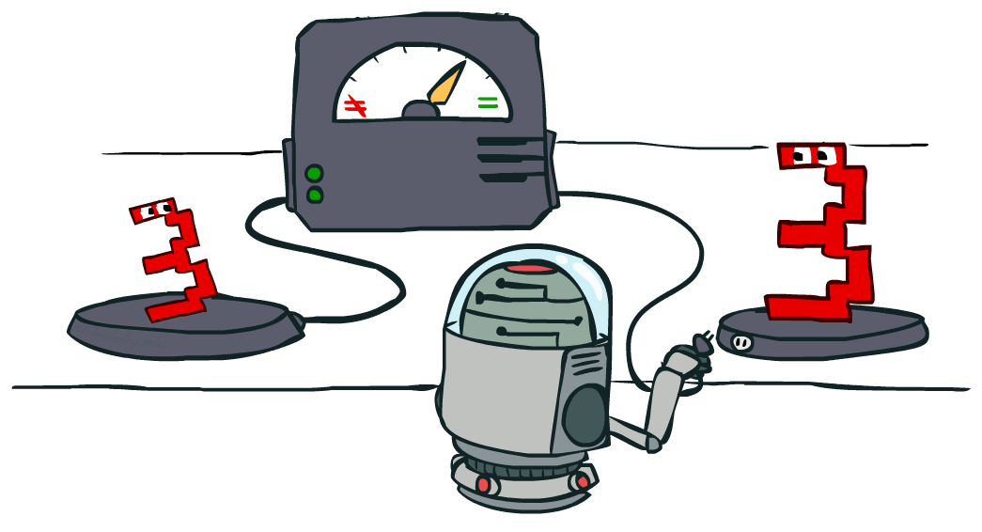
Recap: Similarity Functions

Slide 6
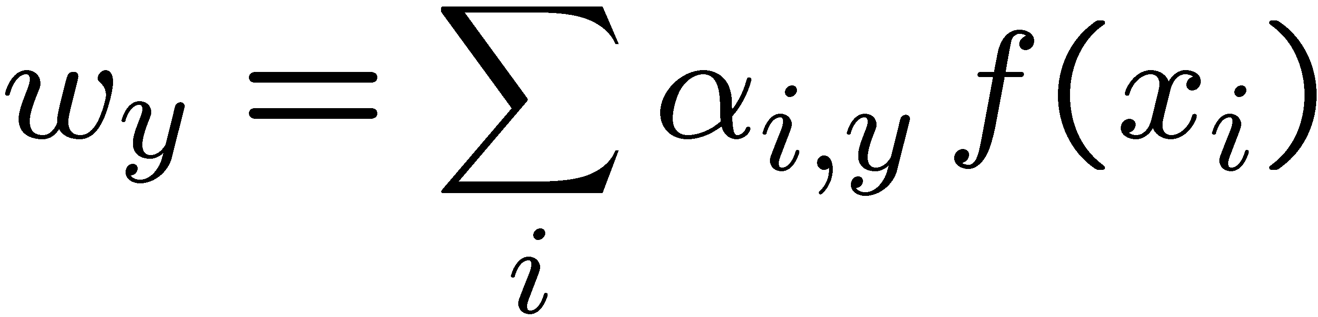
Recap: Dual Perceptron
What is the final value of a weight w_{y} of a perceptron?
Can it be any real vector?
No! It’s built by adding up inputs.
Can reconstruct weight vectors (the primal representation) from update counts (the dual representation)
Notes:
Alpha i,y is the contribution./weight of training example i and how much it contributes to weight vector w_y.
i indexes into training examples.
Alpha i,y will all be integers. Example i will be +1, -1 or 0, based on how often item_i is misclassified and has to adjust w_y.

Slide 7
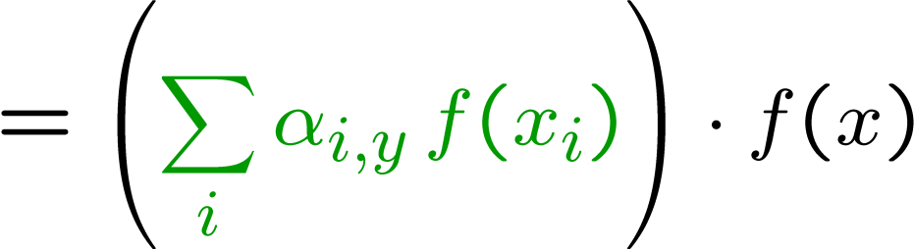
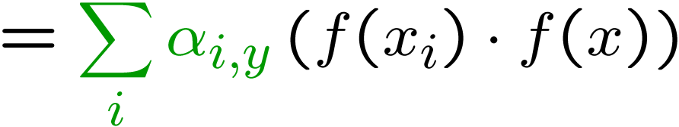
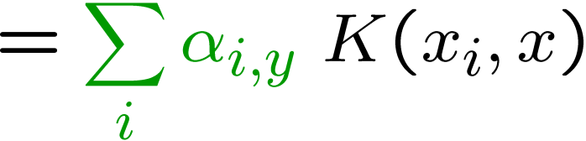
Recap: Dual Perceptron
How to classify a new example x?
If someone tells us the value of K for each pair of examples, never need to build the weight vectors (or the feature vectors)!
Notes:
W_y isn’t retaomed.
Instead we ca compute it with alpha_i,y and all training examples x_i.
We can compute this same quantity like this (#3).
Now replace this inner product with K(xi, x).
K is a function that takes in two training examples, and outputs the inner product f(x_i)*f(x).
We need to compute K between each item in the training set, with the new item we want to classify
Therefore we can compute the perceptron without using the weight vectors.
What is K? K is a similarity function! We can use any similarity function that you want!

Slide 8
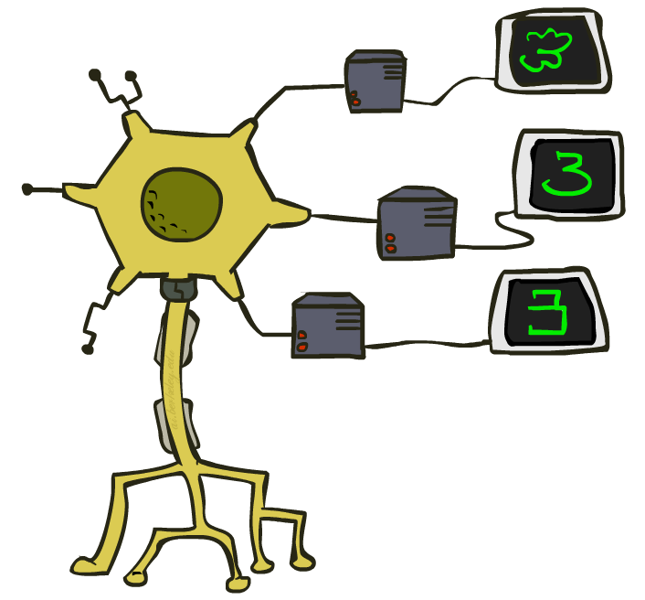
Recap: Kernelized Perceptron
If we had a black box (kernel) K that told us the dot product of two examples x and x’:
Could work entirely with the dual representation
No need to ever take dot products (“kernel trick”)
Like nearest neighbor – work with black-box similarities
Notes:
This is also called a kernelized perceptron, because the similarity K(x_i, x) is often called a Kernel function.
The fact that we can substitute the kernel in for the dot product of the weight vector and feature is called the “kernel trick”.
You can apply the Kernel Trick to any algorithm where you were to learn a weight vector multiplied by the feature vector, if you can show that the weight vector is equivalent to a weighted sum of training example feature vectors. You can apply the trick and then work in the duel space.
This allows us to run the kernelized perceptron with any similarity function. That means we get the benefits of the KNN and the perceptron.

Slide 9
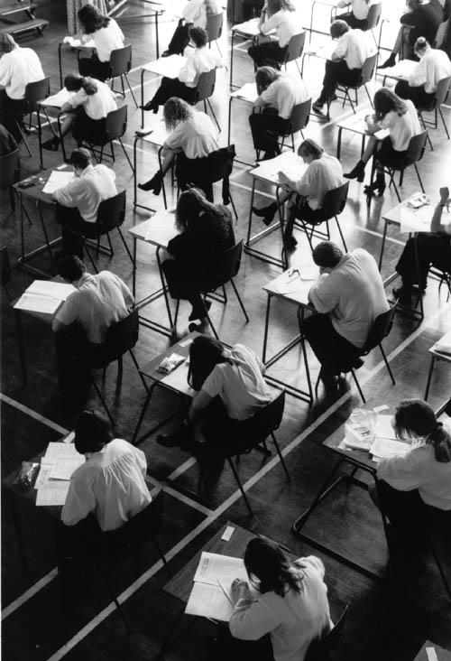
Recap: Classification
Classification systems:
Supervised learning
Make a prediction given evidence
We’ve seen several methods for this
Useful when you have labeled data

Slide 10
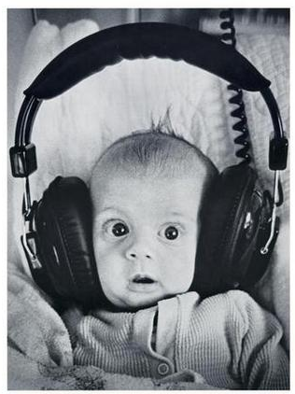
Clustering
Clustering systems:
Unsupervised learning
Detect patterns in unlabeled data
E.g. group emails or search results
E.g. find categories of customers
E.g. detect anomalous program executions
Useful when don’t know what you’re looking for
Requires data, but no labels
Often get gibberish

Slide 11
Clustering

Slide 12
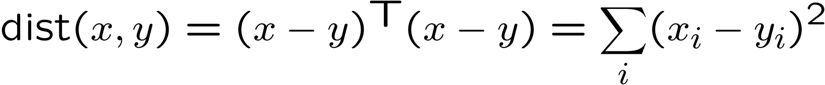
Clustering
Basic idea: group together similar instances
Example: 2D point patterns
What could “similar” mean?
One option: small (squared) Euclidean distance

Slide 13
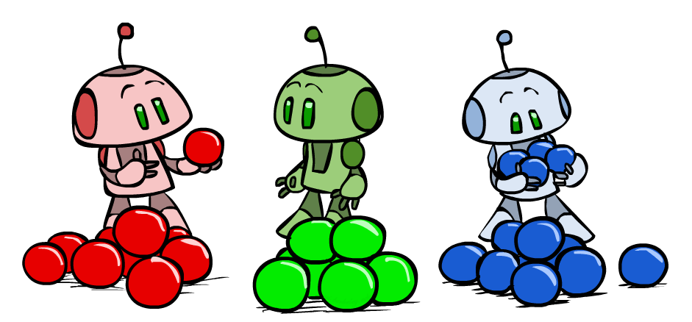
K-Means

Slide 14
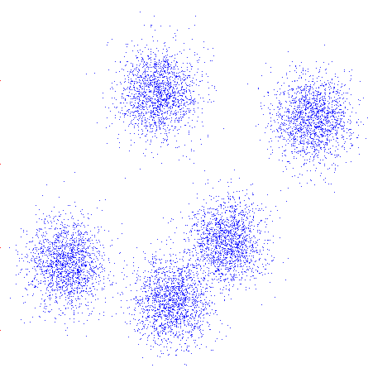
K-Means
An iterative clustering algorithm
Pick K random points as cluster centers (means)
Alternate:
Assign data instances to closest mean
Assign each mean to the average of its assigned points
Stop when no points’ assignments change
Notes:
Representative centers for your data.
In high dimensional data, you can find dense regions. You would hope that for digit classification, that one cluster would represent one digit like all 3s. No guarantee, since you didn’t pick that.

Slide 15
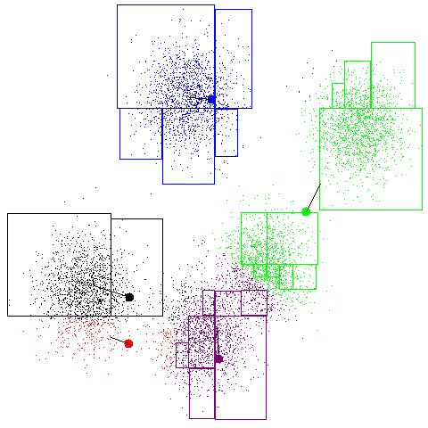
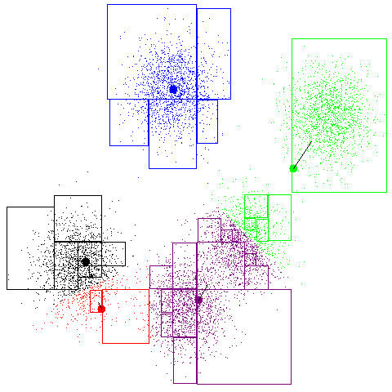
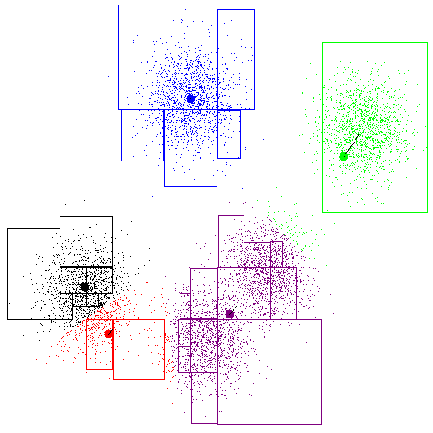
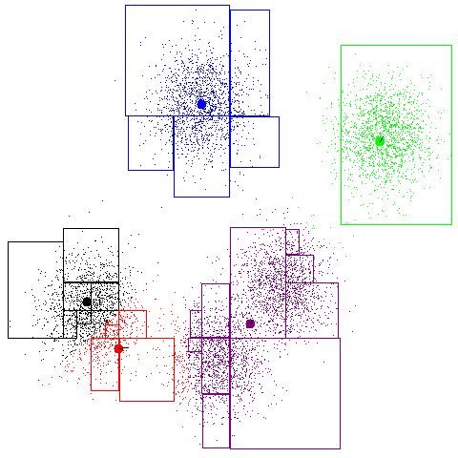
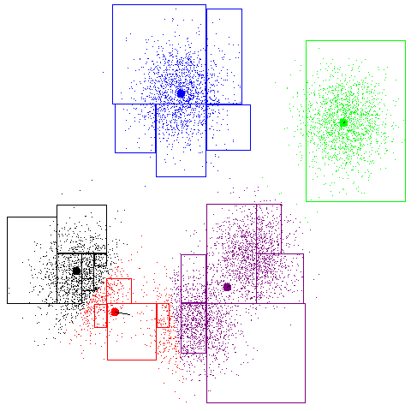
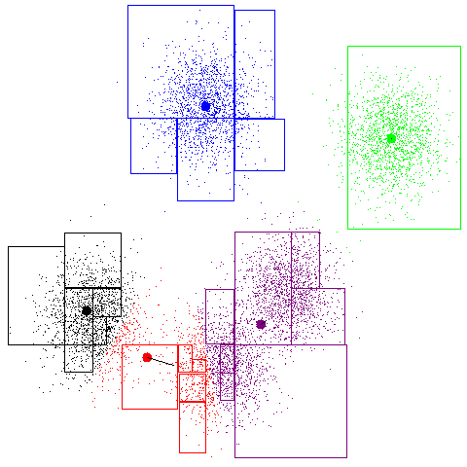
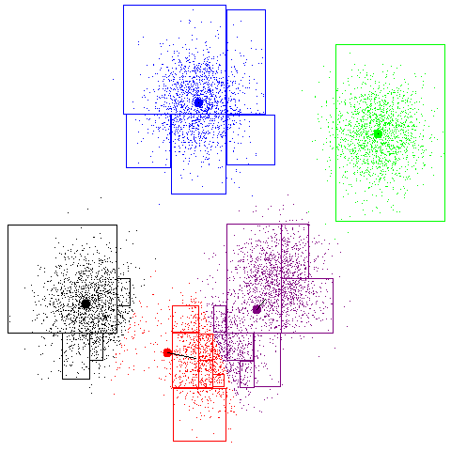
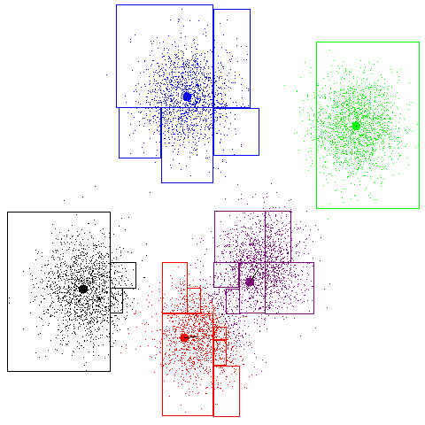
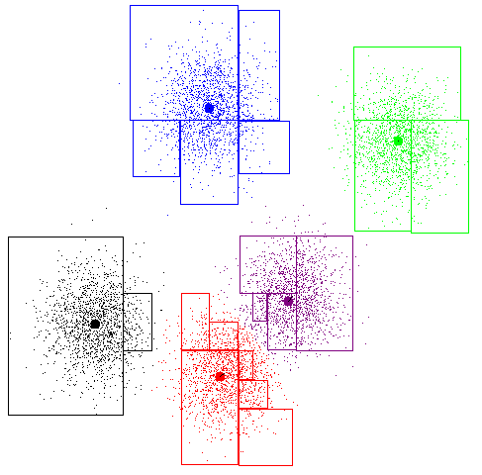
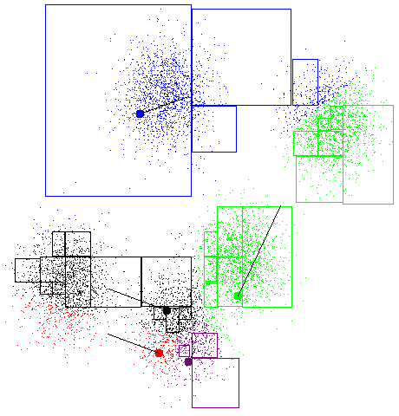
K-Means Example
Notes:
As the algorithm iterates, the center move and the assignments of points to clusters change.
Very sensitive to the distance metric of similarity measure that you use.

Slide 16
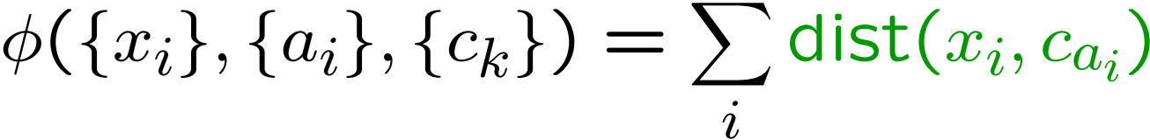
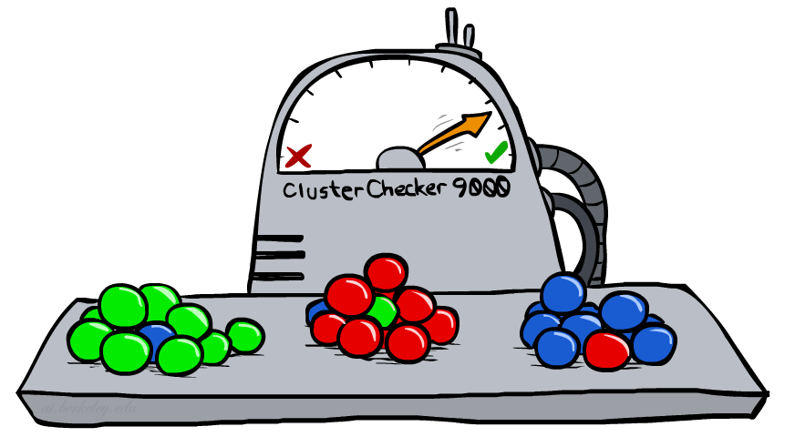
K-Means as Optimization
Consider the total distance to the means:
Each iteration reduces phi
Two stages each iteration:
Update assignments: fix means c, change assignments a
Update means: fix assignments a, change means c
points
means
assignments
Notes:
This procedure can be interpreted as an optimization function.
Minimizes the average squared distance of each point to its senter.

Slide 17
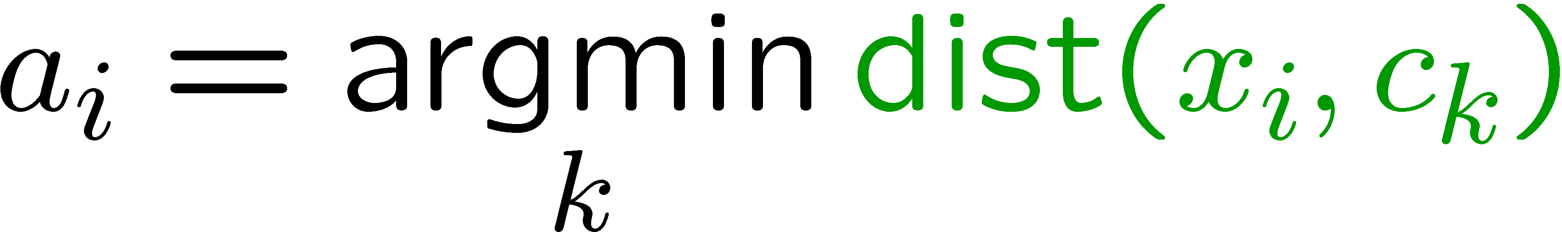
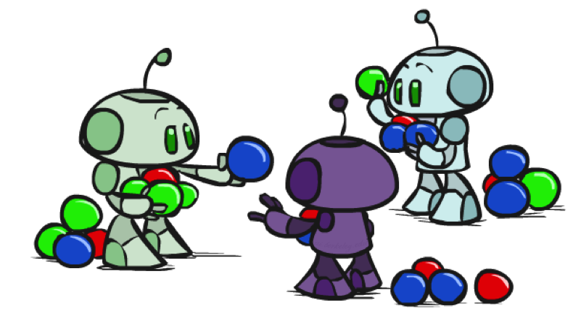

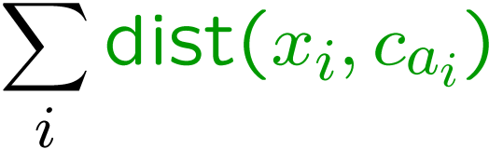
Phase I: Update Assignments
For each point, re-assign to closest mean:
Can only decrease total distance phi!

Slide 18
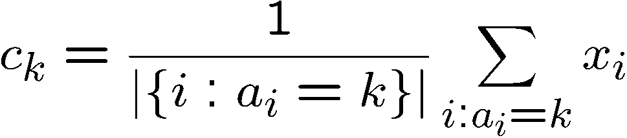
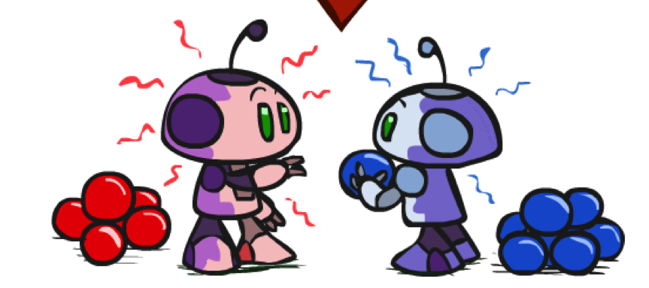
Phase II: Update Means
Move each mean to the average of its assigned points:
Also can only decrease total distance… (Why?)
Fun fact: the point y with minimum squared Euclidean distance to a set of points {x} is their mean

Slide 19
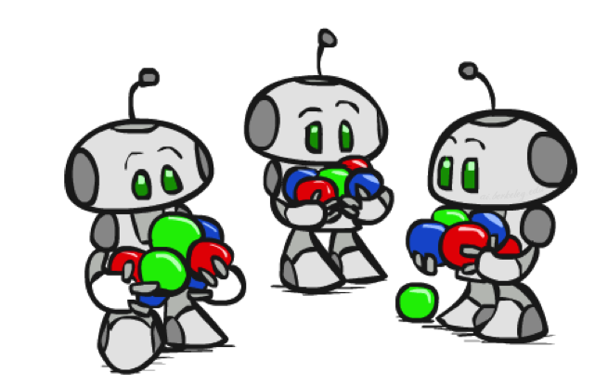
Initialization
K-means is non-deterministic
Requires initial means
It does matter what you pick!
What can go wrong?
Various schemes for preventing this kind of thing: variance-based split / merge, initialization heuristics

Slide 20
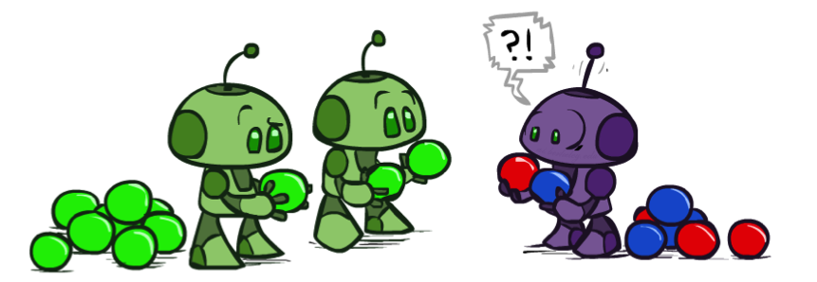
K-Means Getting Stuck
A local optimum:
Why doesn’t this work out like the earlier example, with the purple taking over half the blue?

Slide 21
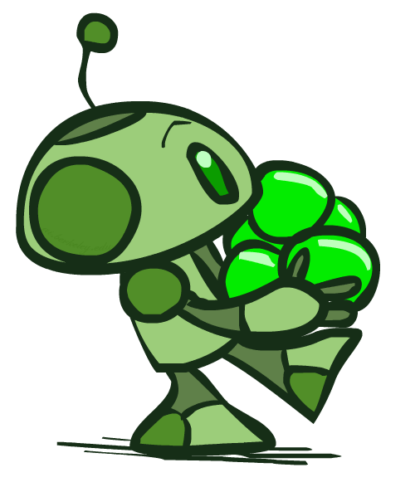
K-Means Questions
Will K-means converge?
To a global optimum?
Will it always find the true patterns in the data?
If the patterns are very very clear?
Will it find something interesting?
Do people ever use it?
How many clusters to pick?

Slide 22
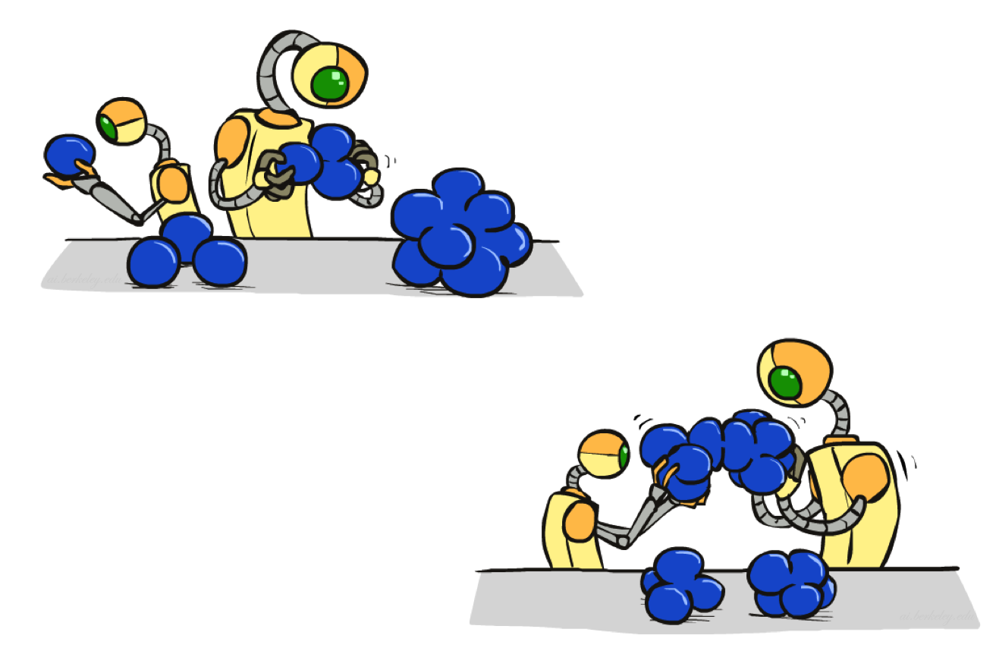
Agglomerative Clustering

Slide 23
Agglomerative Clustering
Agglomerative clustering:
First merge very similar instances
Incrementally build larger clusters out of smaller clusters
Algorithm:
Maintain a set of clusters
Initially, each instance in its own cluster
Repeat:
Pick the two closest clusters
Merge them into a new cluster
Stop when there’s only one cluster left
Produces not one clustering, but a family of clusterings represented by a dendrogram
Notes:
First, start with each point in its own cluster
den·dro·gram=
a tree diagram, especially one showing taxonomic relationships.

Slide 24
Agglomerative Clustering
How should we define “closest” for clusters with multiple elements?
Many options
Closest pair (single-link clustering)
Farthest pair (complete-link clustering)
Average of all pairs
Ward’s method (min variance, like k-means)
Different choices create different clustering behaviors

Slide 25
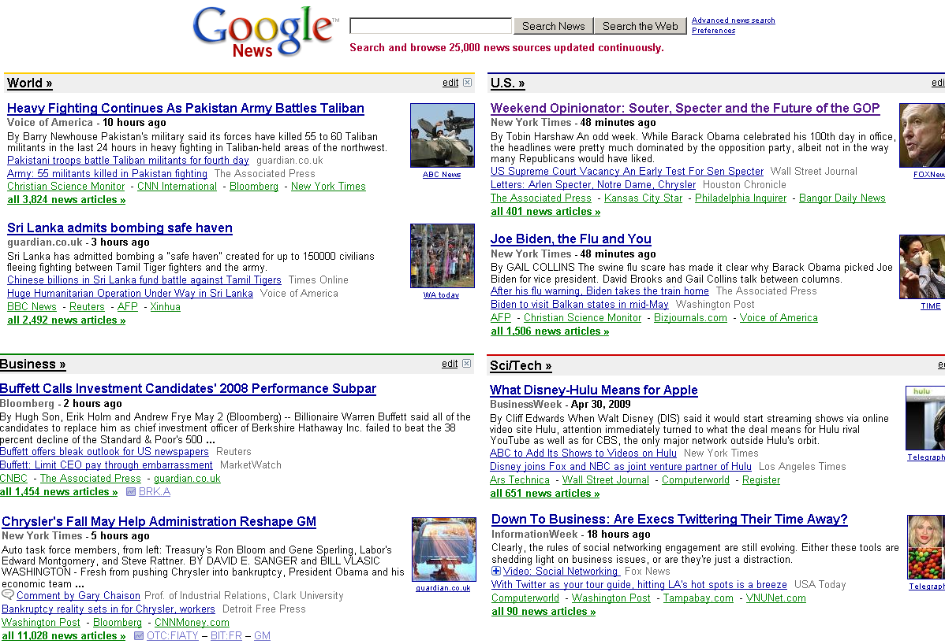
Example: Document clustering
Top-level categories: supervised classification
Story groupings:
unsupervised clustering

