Slide 1
Introduction to Markov Models
Estimating the probability of phrases of words, sentences, etc.…
TexPoint fonts used in EMF.
ARead the TexPoint manual before you delete this box.: AAAAAAAAAAAAAAAAA

Slide 2
Language models
A language model assigns a probability to a sequence of words
Applications include:
Autocomplete for texting
Spelling correction
Speech recognition
Machine translation
Other natural language generation tasks
Notes:
Speech recognition example: p(It’s hard to wreck a nice beach)
Machine translation example: foreign word goes to high or large. P(high winds) > P(large winds), and P(high gusts) < P(large gusts)
Other NLG applications: summarization, question answering, dialog systems, etc.

Slide 3
Language models
Goal: compute the probability of a sentence or sequence of words W = w₁, w₂, w₃, w₄, w₅,…, w_{N.} P(W) = p(w₁, w₂, w₃, w₄, w₅,…, w_{N}) p(the underdog Philadelphia Eagles won the Superbowl)
We also want to calculate the probability of an upcoming word: p(w₅ | w₁, w₂, w₃, w₄)
What kinds of probabilities are these?
Notes:
P(w) is a joint probability
P(w5|…) is a conditional probability

Slide 4
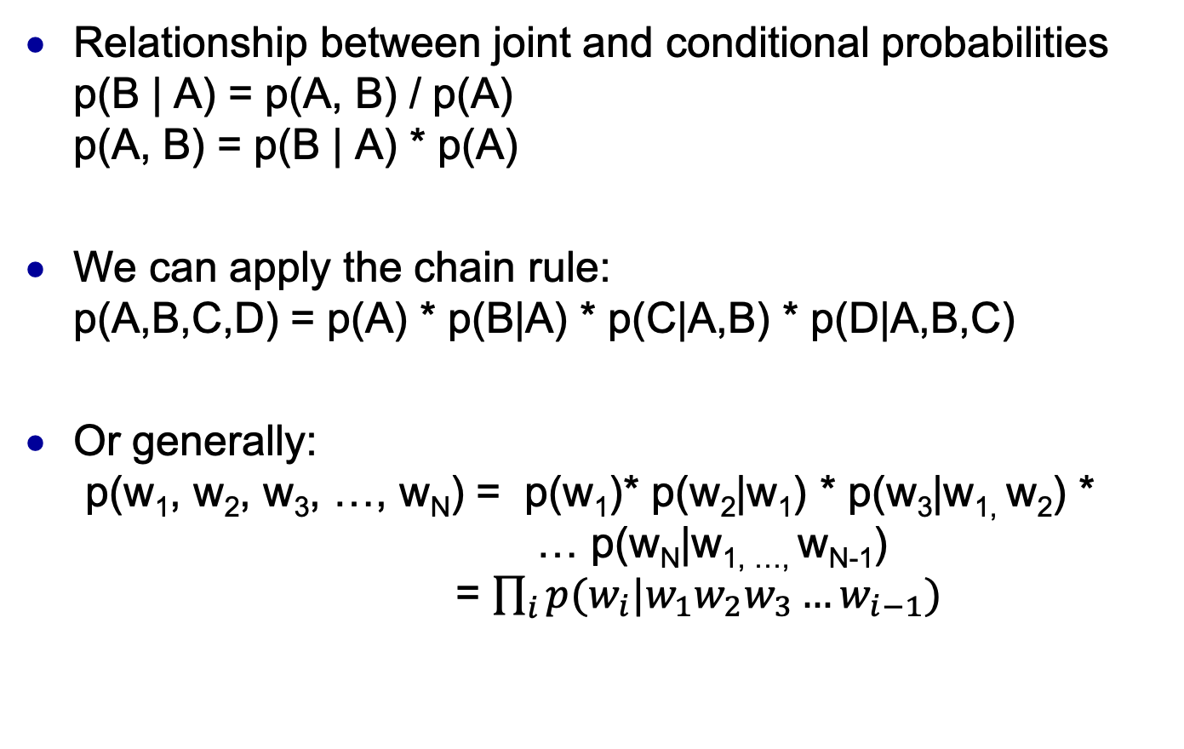
Manipulating probabilities
Relationship between joint and conditional probabilities p(B | A) = p(A, B) / p(A) p(A, B) = p(B | A) * p(A)
We can apply the chain rule: p(A,B,C,D) = p(A) * p(B|A) * p(C|A,B) * p(D|A,B,C)
Or generally: p(w₁, w₂, w₃, …, w_{N}) = p(w₁)* p(w₂|w₁) * p(w₃|w_{1,} w₂) * … p(w_{N}|w_{1, …,} w_{N-1}) = $\prod_{i}{p(w_{i}|w_{1}w_{2}w_{3}…w_{i−1})}$
Notes:
Conditional probability is the joint probability divided by the prior or marginal probaility

Slide 5
Estimating probabilities
How do we estimate these probabilities for a sentence? p(the underdog team won)
Maximum likelihood estimation (MLE):
Count a divide
p(the) = count(the) / length of whole training data
p(underdog | the) = count(the underdog) / count(the)
p(team | the underdog) = count(the underdog team) / count(the underdog)
p(won | the underdog team) = count(the underdog team won) / count(the underdog team)

Slide 6

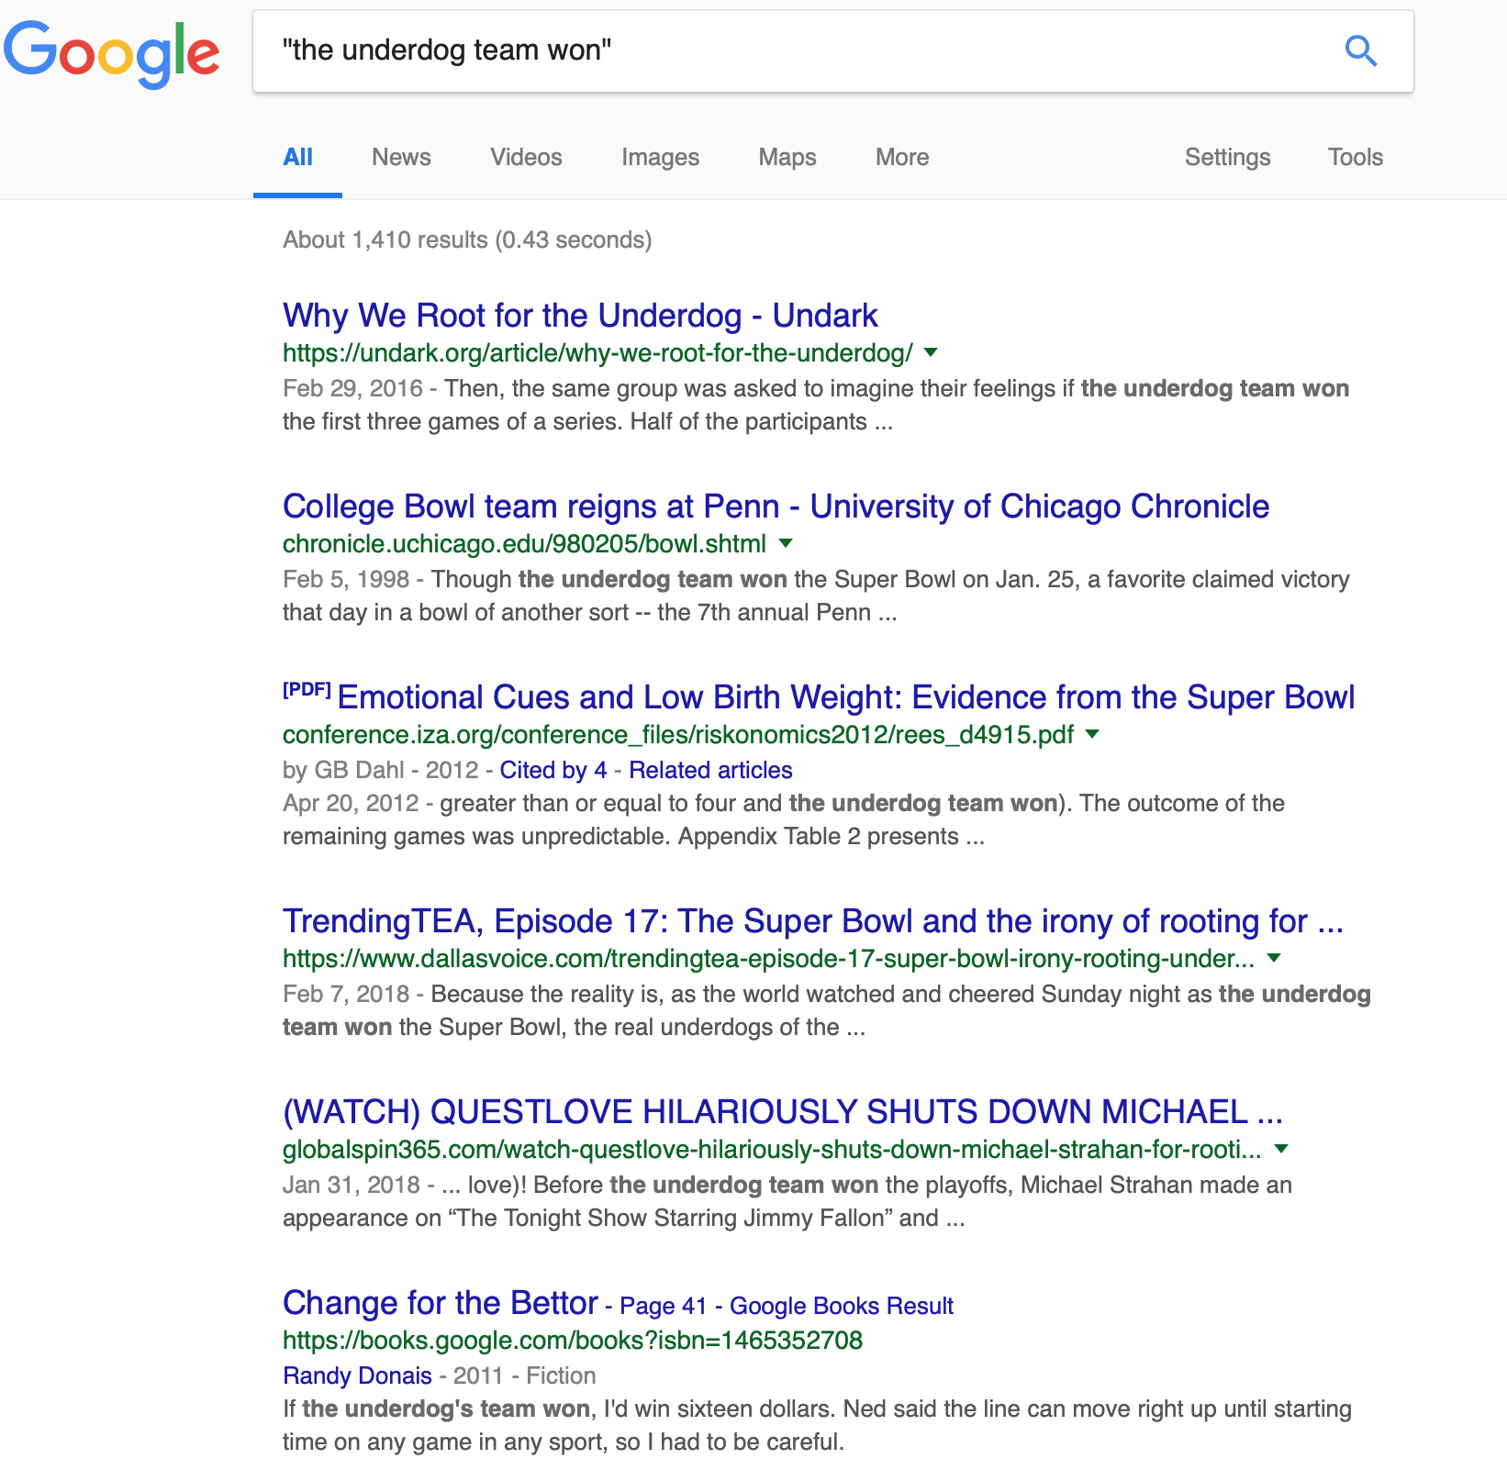
The Web is HUGE!
1410/30600=0.046

Slide 7
MLE is Problematic
Sentences may never appear
Need a large data set
Many ways of combining words into sentences
Never going to have enough data to estimate the probability of a whole sentence

Slide 8
But what if we have “only” 100 million words for our estimates?

Slide 9
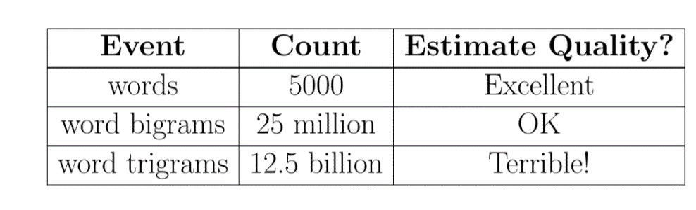

A BOTEC Estimate of What We Can Estimate
What parameters can we estimate with 100 million words of training data??
Assuming (for now) uniform distribution over only 5000 words
So even with 10⁸ words of data, for even trigrams we encounter
the sparse data problem…..
Notes:
10^8=100 million words

Slide 10
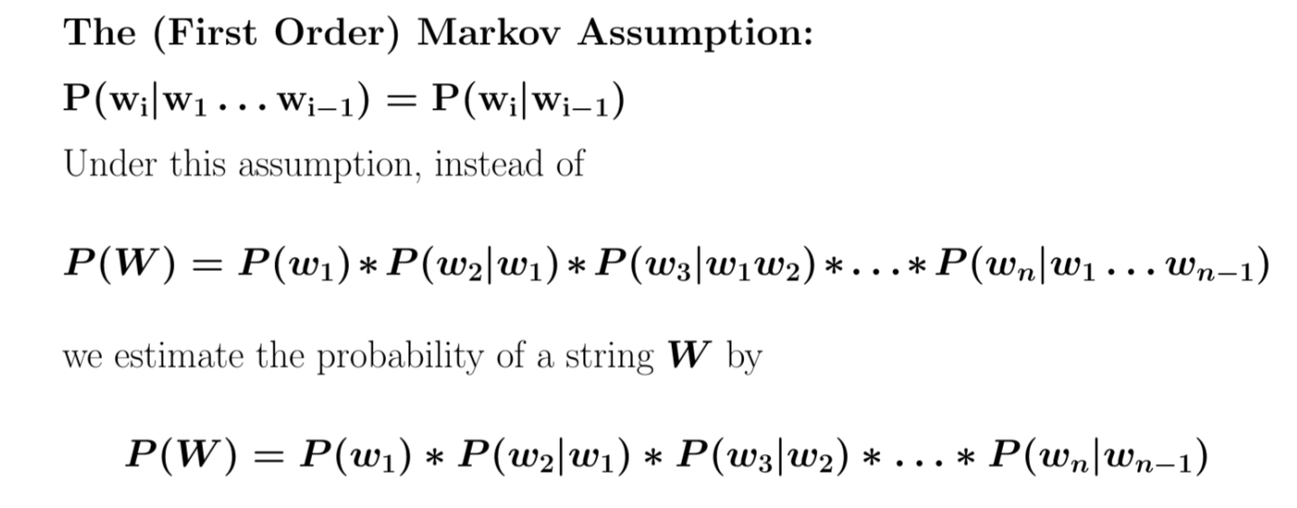
The Markov Assumption: Only the Immediate Past Matters

Slide 11
The Markov Assumption: Estimation
We estimate the probability of each w_{i} given previous context by
which can be estimated by
So we’re back to counting only unigrams and bigrams!!
AND we have a correct practical estimation method for P(W) given the Markov assumption!
P(w_{i}|w₁w₂…w_{i-1}) = P(w_{i}|w_{i-1})

Slide 12
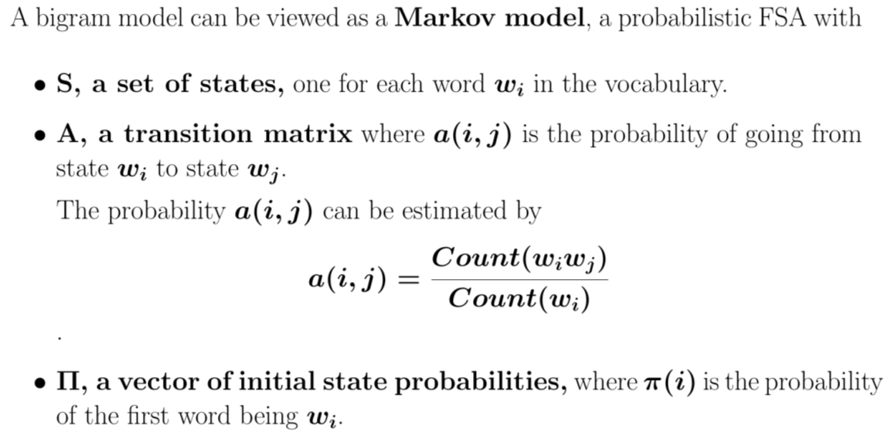
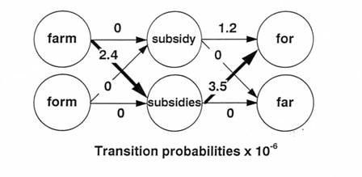
Markov Models

Slide 13
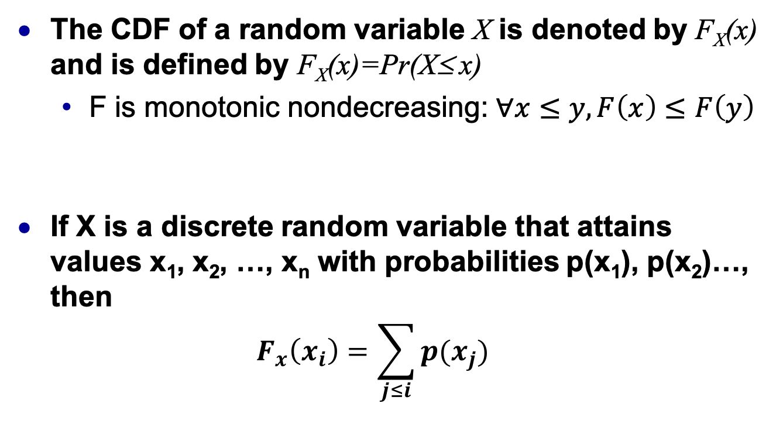
Review (and crucial for upcoming homework): Cumulative distribution Functions (CDFs)
The CDF of a random variable X is denoted by F_{X}(x) and is defined by F_{X}(x)=Pr(X≤ x)
F is monotonic nondecreasing: $∀x≤y, F\left(x\right)≤F\left(y\right)$
If X is a discrete random variable that attains values x₁, x₂, …, x_{n} with probabilities p(x₁), p(x₂)…, then $F_{x}\left(x_{i}\right)=\sum_{j≤i}{p(x_{j})}$

Slide 14
CDF for a very small English corpus
Corpus: “the mouse ran up the clock. The spider ran up the waterspout.”
P(the)=4/12, P(ran)=P(up)=2/12
P(mouse)=P(clock)=P(spider)=P(waterspout)=1/12
Arbitrarily fix an order: w1=the, w2=ran, w3=up, w4=mouse, …
1
11/1
10/1
9/12
8/12
7/12
6/12
5/12 |  | `
4/12
3/12
2/12
1/12
 | The | Ran | Up | Mouse | Clock | Spider | waterspout
F(the)=4/12
F(ran)=6/12
F(up)=8/12
F(mouse)=9/12
…`

Slide 15
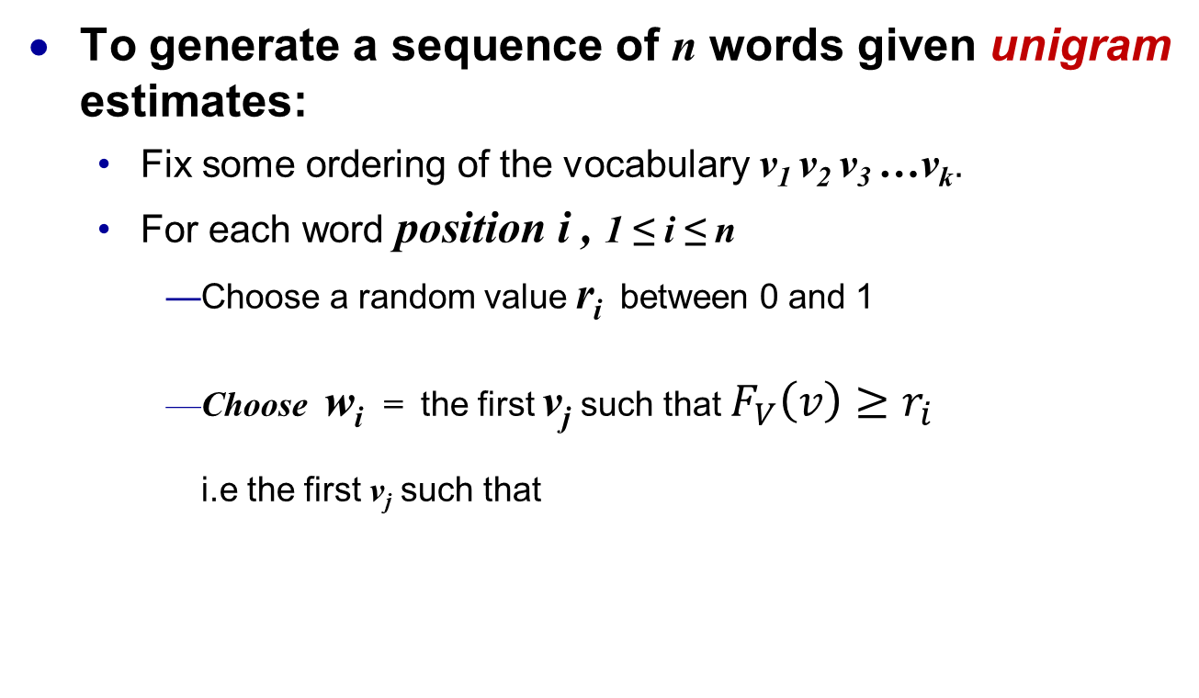
Visualizing an n-gram based language model: the Shannon/Miller/Selfridge method
To generate a sequence of n words given unigram estimates:
Fix some ordering of the vocabulary v₁ v₂ v₃ …v_{k}.
For each word position i , 1 ≤ i ≤ n
Choose a random value r_{i} between 0 and 1
Choose w_{i} = the first v_{j} such that $F_{V}\left(v\right)≥r_{i}$ i.e the first v_{j} such that

Slide 16
Visualizing an n-gram based language model: the Shannon/Miller/Selfridge method
To generate a sequence of n words given a 1st order Markov model (i.e. conditioned on one previous word):
Fix some ordering of the vocabulary v₁ v₂ v₃ …v_{k}.
Use unigram method to generate an initial word w₁
For each remaining position i , 2 ≤ i ≤ n
Choose a random value r_{i} between 0 and 1
Choose w_{i} = the first v_{j} such that

Slide 17
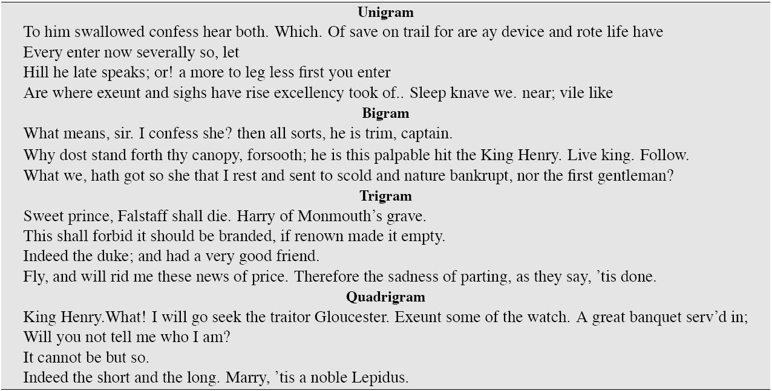
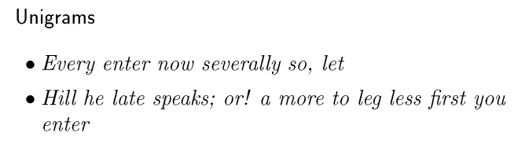
The Shannon/Miller/Selfridge method trained on Shakespeare
(This and next two slides from Jurafsky)

Slide 18
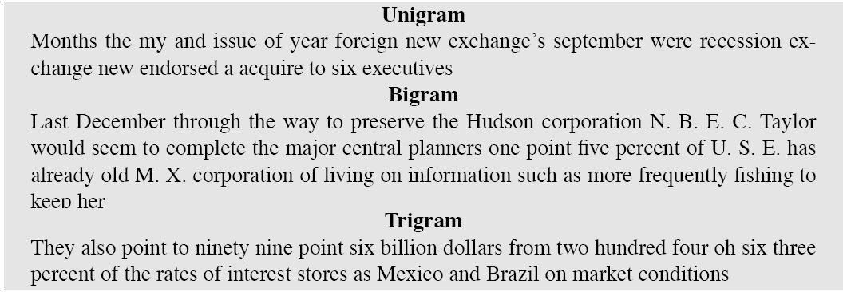
Wall Street Journal just isn’t Shakespeare

Slide 19
Shakespeare as corpus
N=884,647 tokens, V=29,066
Shakespeare produced 300,000 bigram types out of V²= 844 million possible bigrams.
So 99.96% of the possible bigrams were never seen (have zero entries in the table)
4-grams are worse: What's coming out looks like Shakespeare because it is Shakespeare

Slide 20

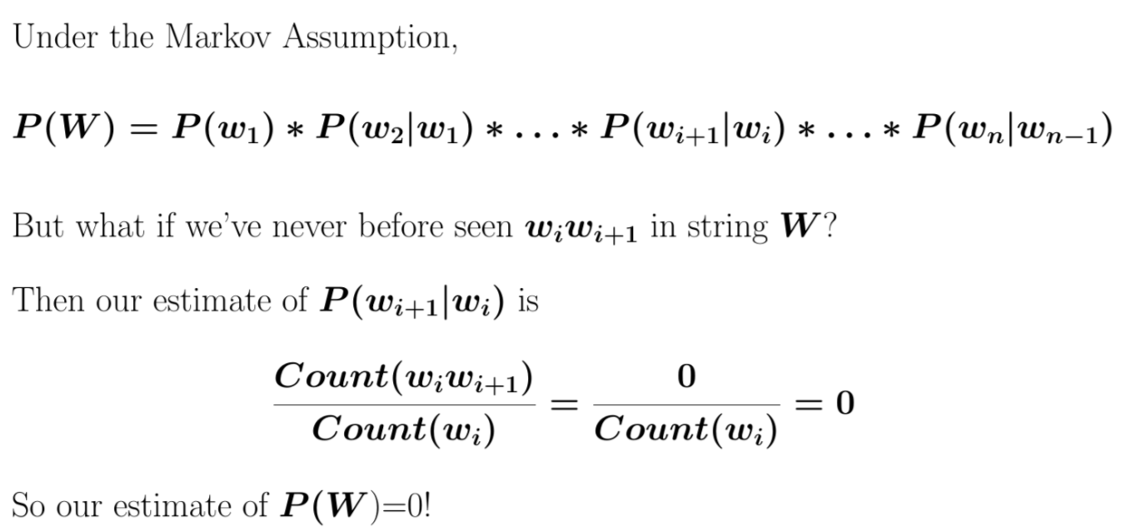
The Sparse Data Problem Again
How likely is a 0 count? Much more likely than I let on!!!
So we use a technique called smoothing

Slide 21
Smoothing
How do we avoid zero probabilities?
Add one! P_{add1}(w_{i}|w_{i-1}) = count(w_{i-1}, w_{i}) + 1 / count(w_{i-1} ) + V Where v is the size of the vocabulary

Slide 22
English word frequencies well described by Zipf’s Law
Zipf (1949) characterized the relation between word frequency and rank as:
Purely Zipfian data plots as a straight line on a log-log scale
*Rank (r): The numerical position of a word in a list sorted by decreasing frequency (f ).

Slide 23
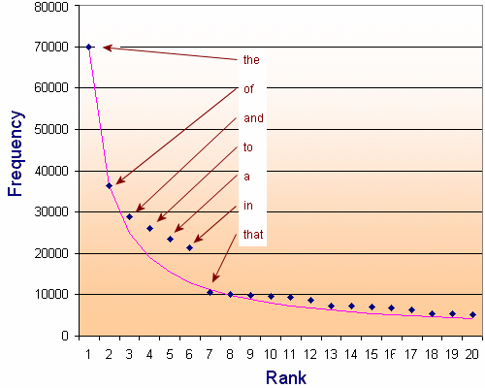
Word frequency & rank in Brown Corpus vs Zipf
Lots of area
under the tail
of this curve!
From: Interactive mathematics http://www.intmath.com

Slide 24
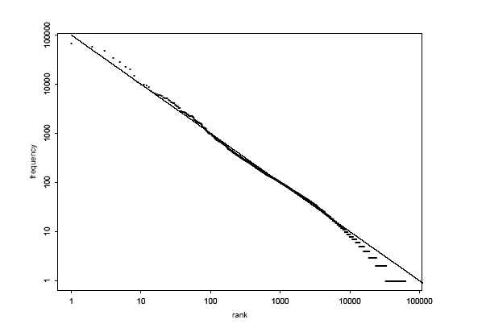
Zipf’s law for the Brown corpus

