Slide 1
Hidden Markov Models
Mitch Marcus
CIS 421/521

Slide 2
An NLP task– Determining Part of Speech Tags
Given a text, assign each token its correct part of speech (POS) tag, given its context and a list of possible POS tags for each word type
Word | POS listing in Brown Corpus
heat | noun | verb
oil | noun
in | prep | noun | adv
a | det | noun | noun-proper
large | adj | noun | adv
pot | noun

Slide 3
What is POS tagging good for?
Speech synthesis:
How to pronounce “lead”?
INsult inSULT
OBject obJECT
OVERflow overFLOW
DIScount disCOUNT
CONtent content
Machine Translation
translations of nouns and verbs are different
Stemming for search
Knowing a word is a V tells you it gets past tense, participles, etc.
Can search for “walk”, can get “walked”, “walking,…

Slide 4
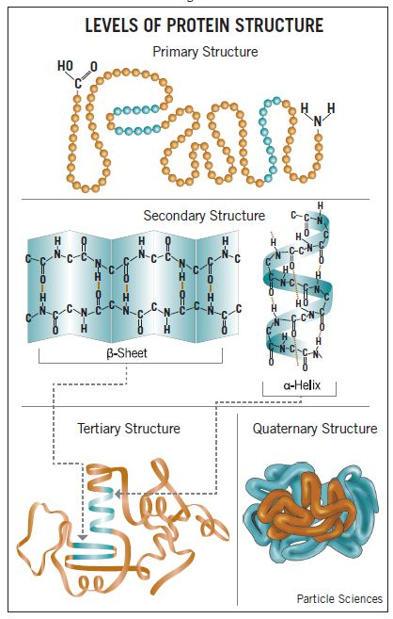
Equivalent Problem in Bioinformatics
From a sequence of amino acids (primary structure): ATCPLELLLD
Infer secondary structure (features of the 3D structure, like helices, sheets, etc.): HHHBBBBBC..
Figure from:
http://www.particlesciences.com/news/technical-briefs/2009/protein-structure.html

Slide 5
Methods to Determine Part of Speech Tags
The Old Solution: Depth First search.
If each of n word tokens has k tags on average, try the k^{n} combinations until one works.
Machine Learning Solutions: Automatically learn Part of Speech (POS) assignment.
The best techniques achieve 97+% accuracy per word on new materials,
given a POS-tagged training corpus of 10⁶ tokens
with 3% inconsistency in the training corpus
on a set of ~40 POS tags (Penn Treebank Tag Set)

Slide 6
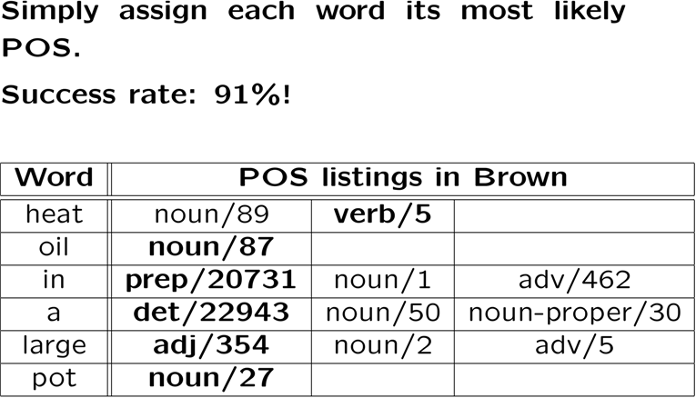
Statistical Approaches: Idea 1

Slide 7
Statistical Approaches: Idea 2
For a string of words
W = w₁w₂w₃…w_{n}
find the string of POS tags
T = t₁ t₂ t₃ …t_{n}
which maximizes P(T|W)
i.e., the most likely POS tag t_{i} for each word w_{i} given its surrounding context

Slide 8
The Sparse Data Problem …
A Simple, Impossible Approach to Compute P(T|W):
Find all instances of the string "heat oil in a large pot" in a tagged training corpus
Pick the most common tag assignment for that string.

Slide 9
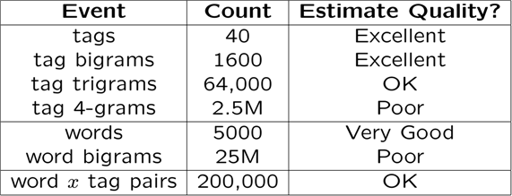
One more time: A BOTEC Estimate of What Works
What parameters can we estimate with a million words of hand tagged training data?
Assume the best case: a distribution of 5000 words and 40 part of speech tags with a distribution not far from uniform
We can get reasonable estimates of
Tag bigrams
Word x tag pairs

Slide 10
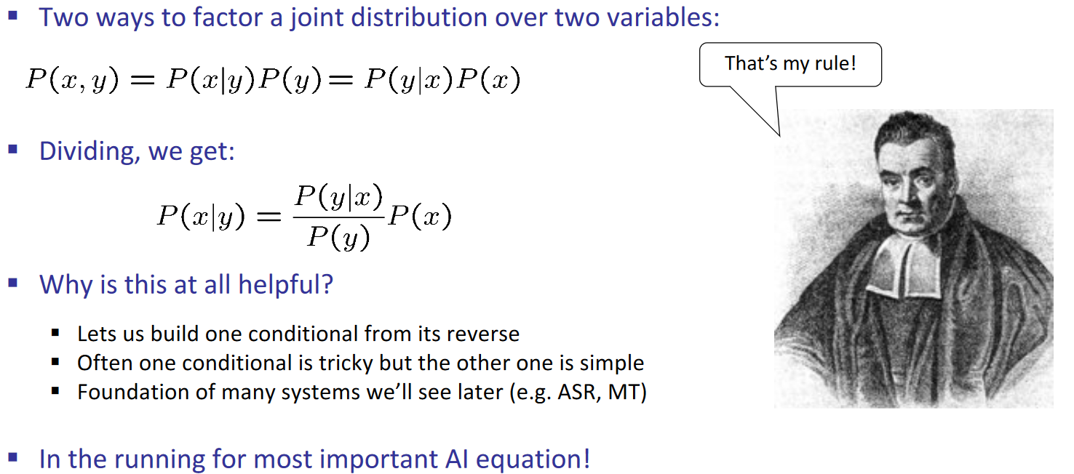
Review: Bayes’ Rule

Slide 11
Bayes Rule plus Markov Assumptions yields a practical POS tagger!
By Bayes Rule where W = w₁w₂w₃…w_{n,} T = t₁ t₂ t₃ …t_{n}
So we want to find
To compute P(W|T):
Use the chain rule + a Markov assumption (like last time!!)
To compute P(T):
Use the chain rule + a slightly different Markov assumption

Slide 12
II. Compute P(T) just like P(W) last lecture
By the chain rule,
Applying the 1st order Markov Assumption

Slide 13
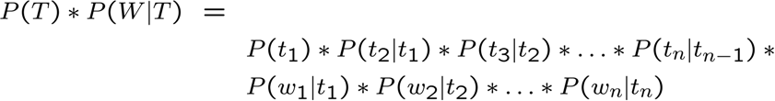
III. To compute P(W|T):
Assume that the words w_{i} are conditionally independent given the tag sequence T=t₁ t₂ … t_{n}:
Applying a zeroth-order Markov Assumption: by which
So, for a given string W = w₁w₂w₃…w_{n,} the tagger needs to find the string of tags T which maximizes

Slide 14
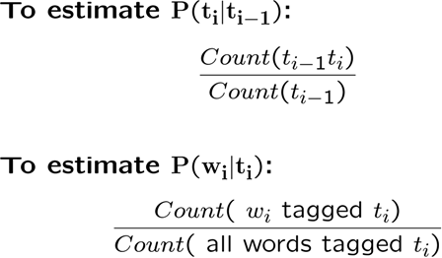
Training and Performance
To estimate the parameters of this model, given an annotated training corpus use the MLE:
Because many of these counts are small, smoothing is necessary for best results…
Such taggers typically achieve about 95-96% correct tagging, for the standard 40-tag POS set.
A few tricks for unknown words increase accuracy to 97%.

Slide 15
Hidden Markov Models
This model is an instance of a Hidden Markov Model. Viewed graphically:
.02
.3
.3
Det
.47
Adj
.6
Noun
.7
Verb
.51
.1
P(w|Det)
a | .4
the | .4
P(w|Adj)
good | .02
low | .04
P(w|Noun)
price | .001
deal | .0001

Slide 16
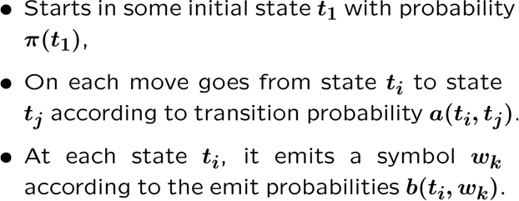
Viewed as a generator, an HMM:
.02
.3
.3
Det
.47
Adj
.6
Noun
.7
Verb
.51
.1
P(w|Det)
P(w|Adj)
P(w|Noun)
a
.4
good
.02
price
.001
the
.4
low
.04
deal
.0001

Slide 17
Summary: Recognition using an HMM
By Bayes Rule
We select the Tag sequence T that maximizes P(T|W):

Slide 18
Practical Tagging using HMMs
Finding this maximum can be done using an exponential search through all strings for T.
However, there is a linear time solution using dynamic programming called Viterbi decoding.

Slide 19
The three basic HMM problems
(These slides follow the classic formulation by Ferguson, as published by Rabiner and Juang, as adapted by Manning and Schutze.
Note the change in notation from the last lecture!!)

Slide 20
Parameters of an HMM
States: A set of states S=s₁, … s_{n}
Transition probabilities: A= a_{1,1}, a_{1,2}, …, a_{n,n} Each a_{i,j} represents the probability of transitioning from state s_{i} to s_{j}.
Emission probabilities: a set B of functions of the form b_{i}(o_{t}) which is the probability of observation o_{t} being emitted by s_{i}
Initial state distribution: is the probability that s_{i} is a start state

Slide 21
The Three Basic HMM Problems
Problem 1 (Evaluation): Given the observation sequence O=o₁,…,o_{T} and an HMM model , how do we compute the probability of O given the model?
Problem 2 (Decoding): Given the observation sequence O and an HMM model , how do we find the state sequence that best explains the observations?
Problem 3 (Learning): How do we adjust the model parameters , to maximize ?

Slide 22
Problem 1: Probability of an Observation Sequence
Q: What is ?
A: the sum of the probabilities of all possible state sequences in the HMM.
Naïve computation is very expensive. Given T observations and N states, there are N^{T} possible state sequences.
(for T=10 and N=10, 10 billion different paths!!)
Solution: linear time dynamic programming!

Slide 23
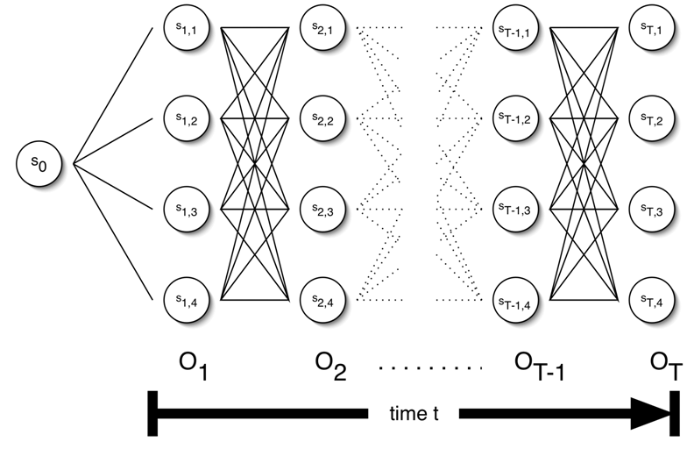
The Crucial Data Structure: The Trellis

Slide 24
Forward Probabilities: α
For a given HMM , for some time t, what is the probability that the partial observation o₁ … o_{t} has been generated and that the state at time t is i ?
Forward algorithm computes α_{t}(i) 0<i<N, 0<t<T in time 0(N²T) using the trellis

Slide 25
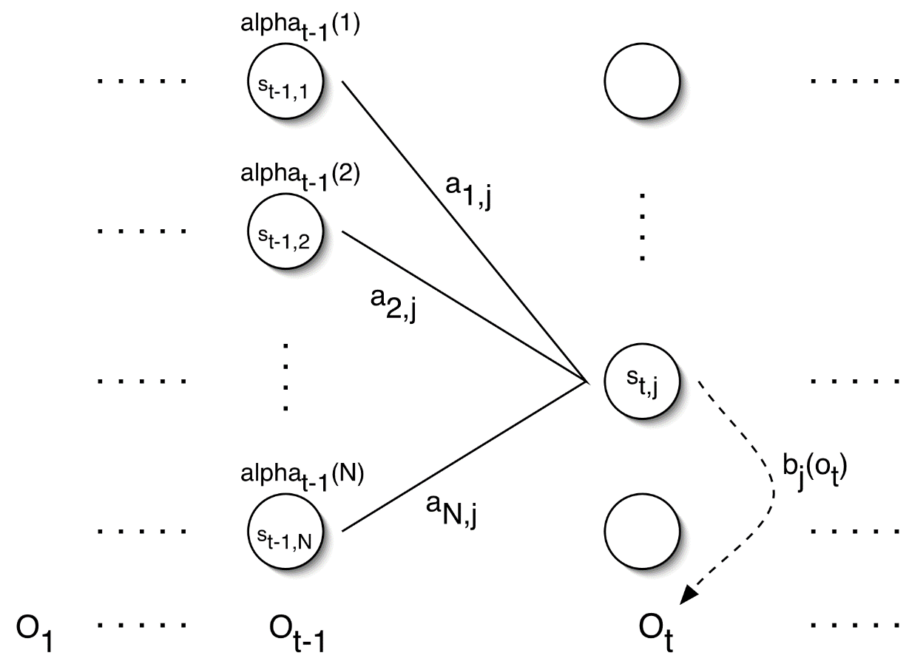
Forward Algorithm: Induction step

Slide 26
Forward Algorithm
Initialization (probability that o₁ has been generated and that the state is i at time t=1:
Induction:
Termination:

Slide 27
Forward Algorithm Complexity
Naïve approach requires exponential time to evaluate all N^{T} state sequences
Forward algorithm using dynamic programming takes O(N²T) computations

Slide 28
Problem 2: Decoding
The Forward algorithm gives the sum of all paths through an HMM efficiently.
Here, we want to find the highest probability path.
We want to find the state sequence Q=q₁…q_{T}, such that

Slide 29
Viterbi Algorithm: Recursion step
Just like the Forward algorithm, but instead of summing over transitions from incoming states, compute the maximum
Forward:
Viterbi Recursion:

Slide 30
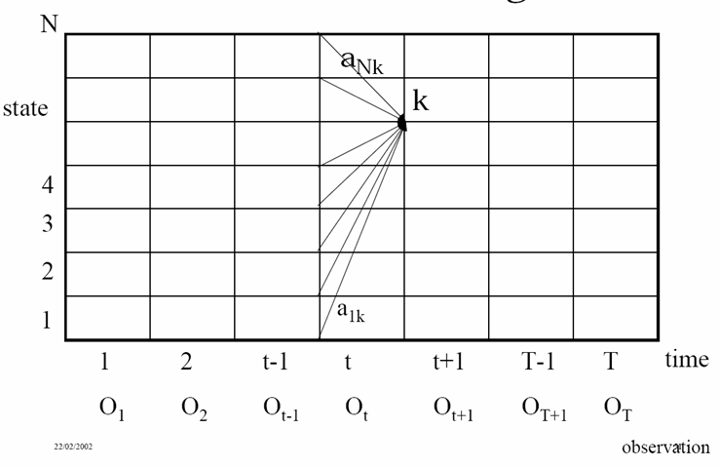
Core Idea of Viterbi Algorithm

Slide 31
Not quite what we want….
Viterbi recursion computes the maximum probability to state j at time t given that the partial observation o₁ … o_{t} has been generated
But we want the path itself that gives the maximum probability
Solution:
Keep backpointers
Find , i.e. the most probable final state
Chase backpointers from state j at time T to find state sequence (backwards)

Slide 32
Viterbi Algorithm (For Notes)
Initialization:
Induction:
(Backpointers)
`
Termination: (Final state!)
Backpointer path:

