Slide 1
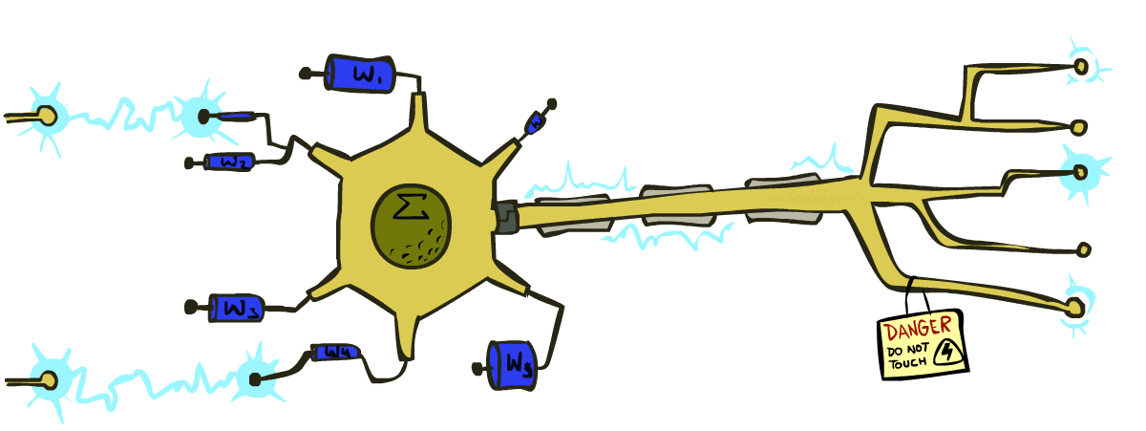
Perceptrons
Slides Courtesy of Dan Klein and Pieter Abbeel --- University of California, Berkeley
[These slides were created by Dan Klein and Pieter Abbeel for CS188 Intro to AI at UC Berkeley. All CS188 materials are available at http://ai.berkeley.edu.]

Slide 2
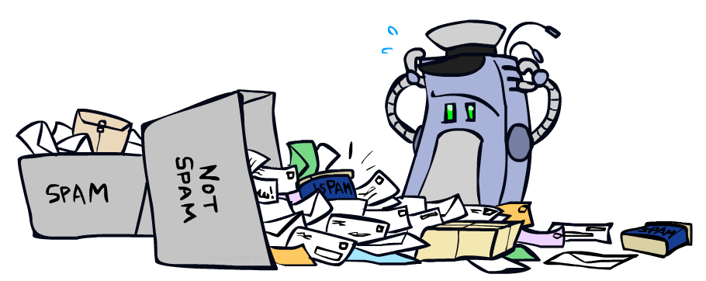
Error-Driven Classification

Slide 3
Errors, and What to Do
Examples of errors
Dear GlobalSCAPE Customer,
GlobalSCAPE has partnered with ScanSoft to offer you the latest version of OmniPage Pro, for just $99.99* - the regular list price is $499! The most common question we've received about this offer is - Is this genuine? We would like to assure you that this offer is authorized by ScanSoft, is genuine and valid. You can get the . . .
. . . To receive your $30 Amazon.com promotional certificate, click through to
http://www.amazon.com/apparel
and see the prominent link for the $30 offer. All details are there. We hope you enjoyed receiving this message. However, if you'd rather not receive future e-mails announcing new store launches, please click . . .

Slide 4
What to Do About Errors
Problem: there’s still spam in your inbox
Need more features – words aren’t enough!
Have you emailed the sender before?
Have 1M other people just gotten the same email?
Is the sending information consistent?
Is the email in ALL CAPS?
Do inline URLs point where they say they point?
Does the email address you by (your) name?
Naïve Bayes models can incorporate a variety of features, but tend to do best in homogeneous cases (e.g. all features are word occurrences)

Slide 5
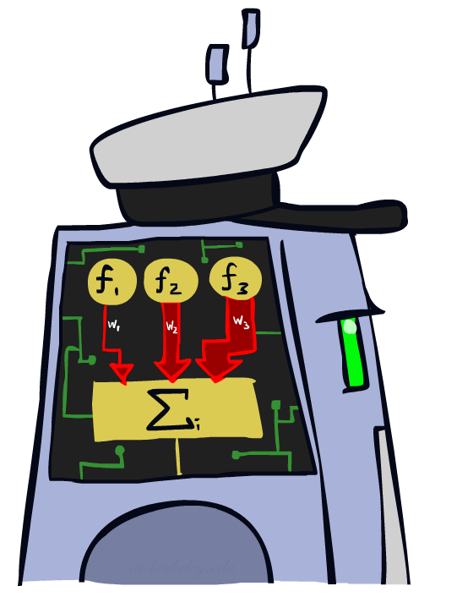
Linear Classifiers
Notes:
2d: line
3d: plane
Many-d: hyperplane.

Slide 6
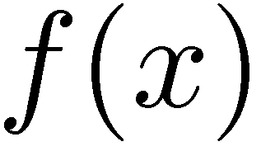

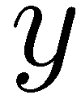

Feature Vectors
Hello,
Do you want free printr cartriges? Why pay more when you can get them ABSOLUTELY FREE! Just
# free : 2
YOUR_NAME : 0
MISSPELLED : 2
FROM_FRIEND : 0
...
SPAM
or
+
PIXEL-7,12 : 1
PIXEL-7,13 : 0
...
NUM_LOOPS : 1
...
“2”

Slide 7

Some (Simplified) Biology
Very loose inspiration: human neurons

Slide 8
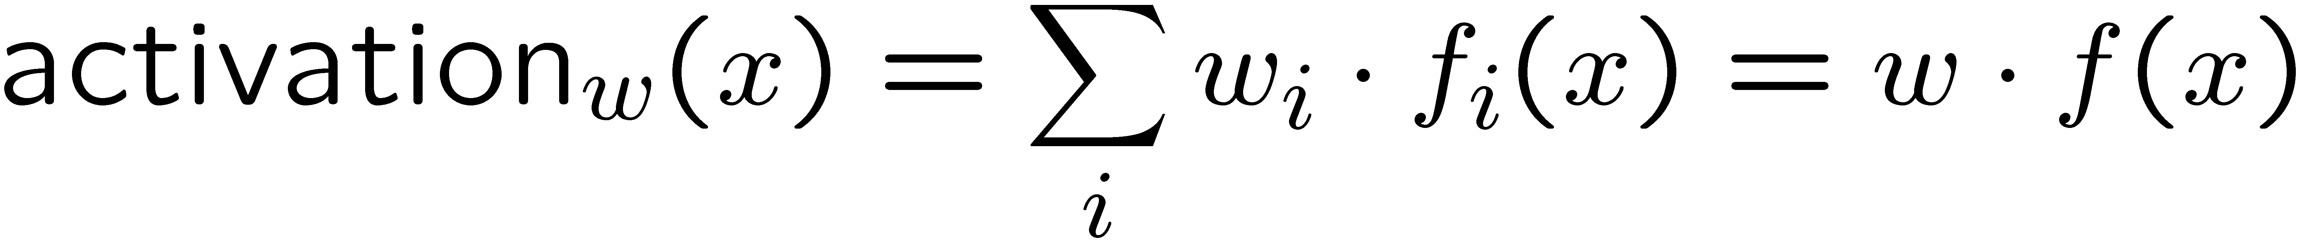
Linear Classifiers
Inputs are feature values
Each feature has a weight
Sum is the activation
If the activation is:
Positive, output +1
Negative, output -1
w₁
f₁
Σ
w₂
>0?
f₂
w₃
f₃
Notes:
The activation for some weight vector w given some input x is the Sum for each weight w_i in the weight vector with the corresponding entry in the feature vector representing x, f_i(x).
We also write this as w * f(x), which is the inner product of the weight vector and the feature vector.
Depending on whether the sum is positive, or the sum is negative, we output a positive class label or a negative class label (for the binary classification case).
This is the generic picture that represents the perceptron..
This is called the “dot product” or sometimes the “inner product”

Slide 9

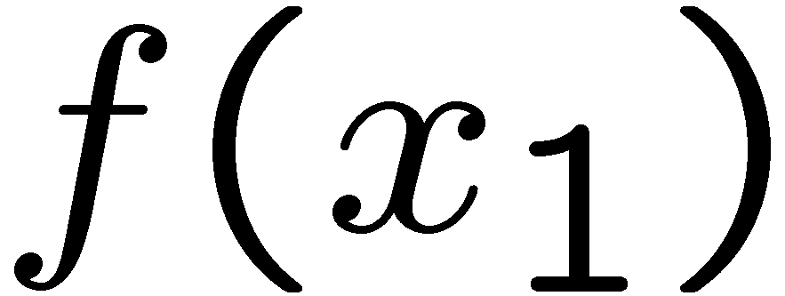
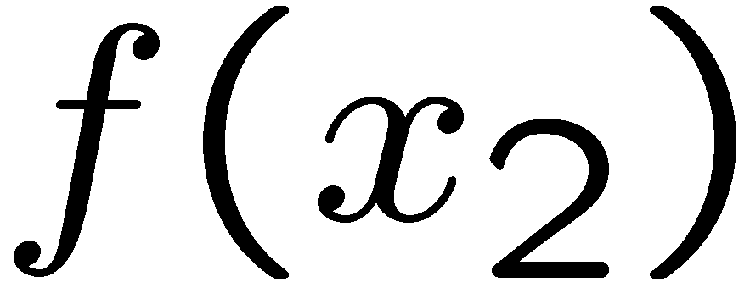
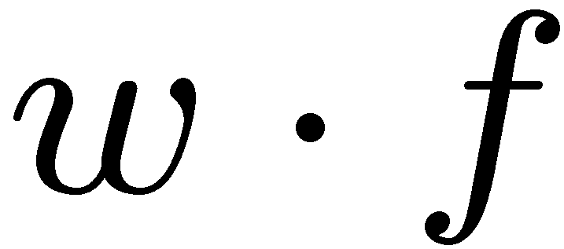
Weights
Binary case: compare features to a weight vector
Learning: figure out the weight vector from examples
# free : 4
YOUR_NAME :-1
MISSPELLED : 1
FROM_FRIEND :-3
...
# free : 2
YOUR_NAME : 0
MISSPELLED : 2
FROM_FRIEND : 0
...
# free : 0
YOUR_NAME : 1
MISSPELLED : 1
FROM_FRIEND : 1
...
Dot product positive means the positive class
Notes:
The feature values for inputs are fixed, but we can choose different weight vectors. Depending on the weight vector that we pick, we will get a different classifier.
Let’s look at an example, with the following weight vector. The first entry is a weight based on how often the word free appears. We get a high value for that. The next one is whether your name appears. This weight vector will lower the value. If there are misspelled words, the activation will go up. If the email comes from a friend then the activation will go up.
The weight vector always represents the positive class, so what is it in this case? It’s SPAM.
The weight vector lives in the same vector space as the feature vectors. Here’s are two feature vectors representing two emails that we want to classify.
For linear classification, we have a separating hyperplane. Separation is orthogonal to w. ((Draw this at a right angle to w)). Everything on the same side as w is the positive class Everything on the other side is the negative class.
For x2, the angle between w and f(x2) > 90 degrees, so it is negative.
If we compute the inner product then we’ll get a negative class when the angle is > 90 degrees like f(x_2).

Slide 10
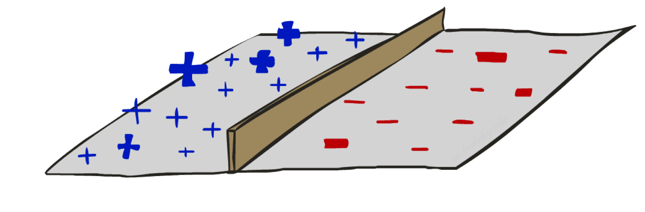
Decision Rules
Notes:
The goal is to move the decision boundary so that the decisions are usually correct.
2d: line
3d: plane
Many-d: hyperplane.

Slide 11


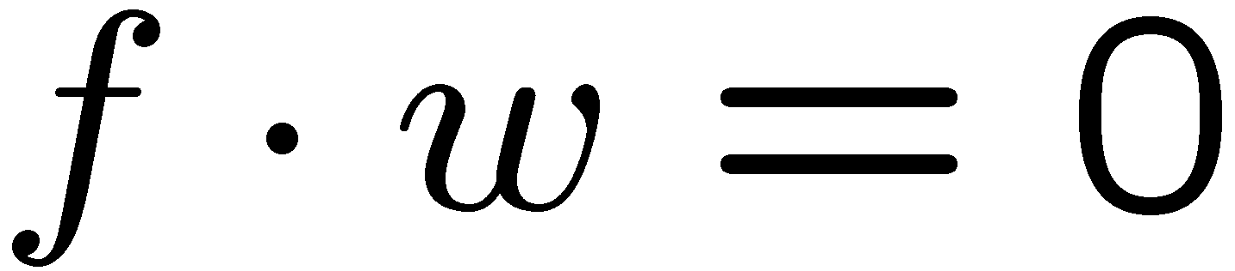
Binary Decision Rule
In the space of feature vectors
Examples are points
Any weight vector is a hyperplane
One side corresponds to Y=+1
Other corresponds to Y=-1
money
2
+1 = SPAM
1
BIAS : -3
free : 4
money : 2
...
0
-1 = HAM
0
1
free
Notes:
Here’s a simple 2-dim example to give some intuition.
Let’s say our weight vector looks like this.
We want to find the set of points where w*f(x) = 0. That’s the boundary.
Here’s the point for free, money ((draw point) ).
What does the bias term do? It allows us to shift the boundary away from the origin. In this case the Bias is -3. So w*featrures=3.

Slide 12
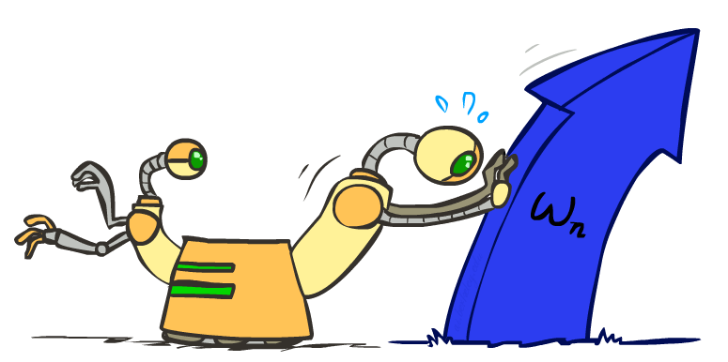
Weight Updates

Slide 13
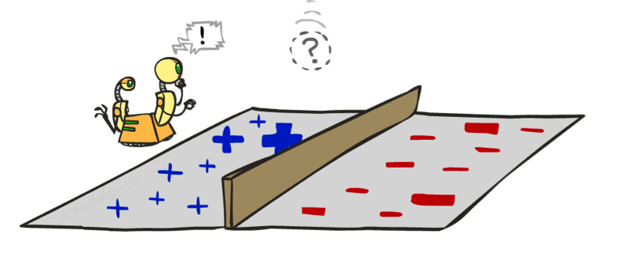
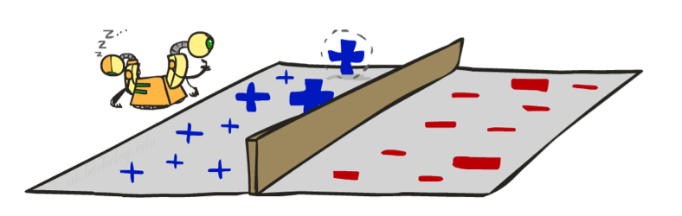
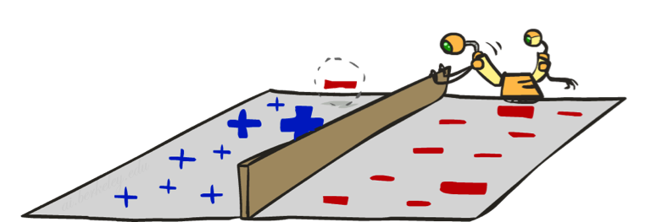
Learning: Binary Perceptron
Start with weights = 0
For each training instance:
Classify with current weights
If correct (i.e., y=y*), no change!
If wrong: adjust the weight vector
Notes:
Loop through every training example.
Try to classify that point with the current weights.
If the prediction is correct (e.g. y = y*) then you don’t make any change.
If the prediction is wrong, then let’s nudge the weight vector. This is just like with Q-learning where we nudged things in the direction of the correct value. Since it’s just one sample, we don’t want to dramatically change. So this is what we want to do with the perceptron too.

Slide 14
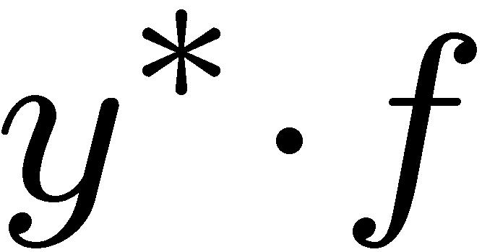
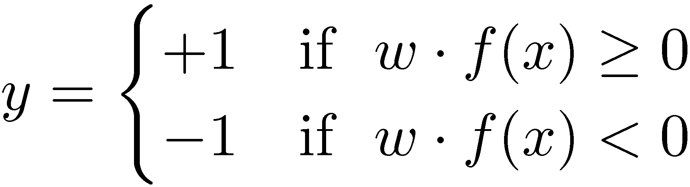

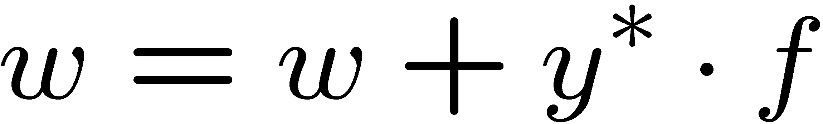
Learning: Binary Perceptron
Start with weights = 0
For each training instance:
Classify with current weights
If correct (i.e., y=y*), no change!
If wrong: adjust the weight vector by adding or subtracting the feature vector. Subtract if y* is -1.
Notes:
Mathematically what does it look like? You start with zero weights, and then for each thing you classify by running this computation here: w*f(x) and checking whether that inner product is positive or negative. You classify x as positive if the inner product is >= 0, and negative if it is <0.
You then check the correct label y* in the training example. The training example will tell you whether it should be positive or negative. If you’re correct, then no change.
If you’re wrong, then we will make an adjustment. For the picture here, f(x) get’s a positive classification. Let’s say that the training data tells us that it should be negative. Then we need to somehow adjust this. We need to rotate w and f apart, so that they hopefully now have a negative inner product.
F is fixed. W is the thing that we can change. We want to change is so that it is less aligned with f. If we want to make it less aligned with f, then we add the negative of f to w. ((draw it)). If we add the negative of F to W, then we get a new W ((draw it), and our decision boundary changes ((Draw it as at a right angle to the new W)).
The f is now of the other side of the decision boundary than it was before, which is our goal).
So here’s the update that we use if the update is wrong: we add y* (+1 or -1) * f to w

Slide 15
3Blue1Brown
Need a refresher on linear algebra topics like vector addition and matrix multiplication?
I recommend the wonderful YouTube series by Grant Sanderson. His channel is called 3Blue1Brown.
Grant gives intuitive visual tutorials to a ton of math concepts
Here is his “Essence of Linear Algebra” series:
https://www.youtube.com/playlist?list=PLZHQObOWTQDPD3MizzM2xVFitgF8hE_ab

Slide 16
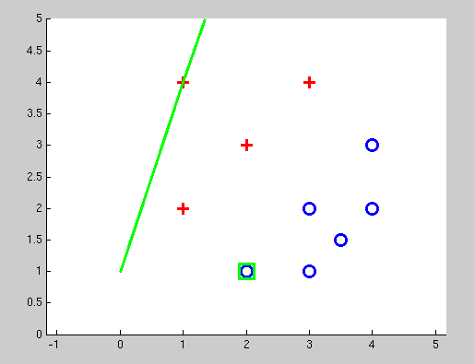
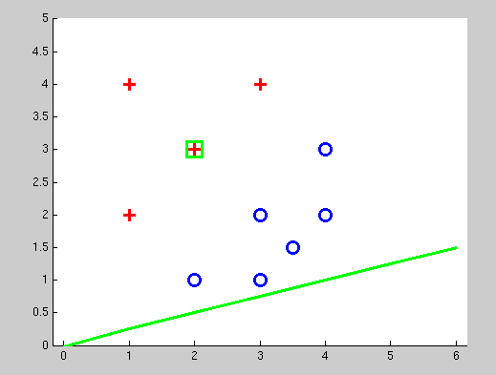
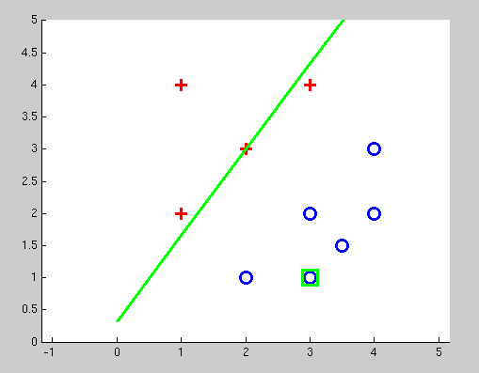
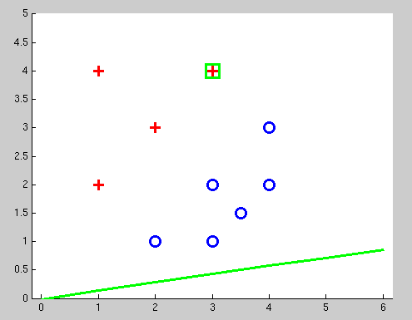
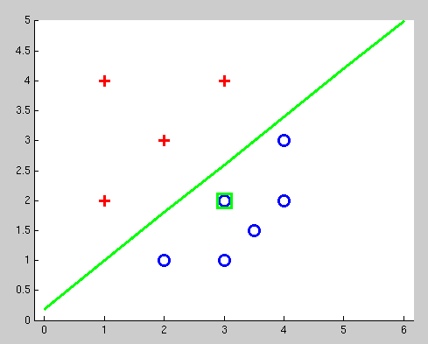
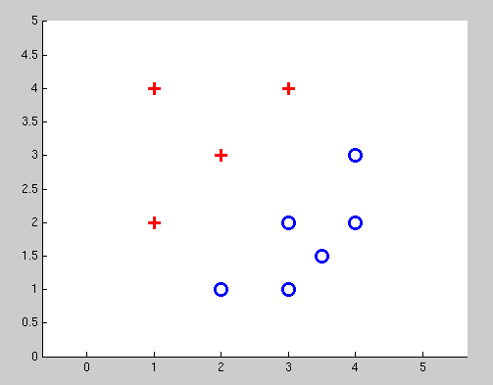
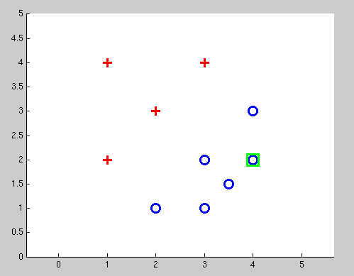
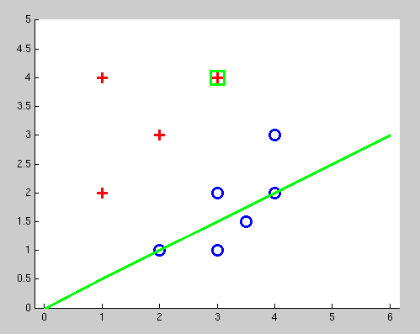
Examples: Perceptron
Separable Case
Notes:
Here’s the perceptron in action.
Initially we have the weight vector with this hyperplane as its decision boundary.
We have a negative point that we get wrong, so we shift the decision boundary. At first we do this way too much.
Next we get another example, which we get wrong. We nudge again way too much (this has to do with learning rate, which we’ll get to later).
Eventually it lands here.
If your data is separable (there exists a hyperplane that separates your cases), then the perceptron will find a decision boundary that gets everythign right.
Can there be more than one such decision boundary? YES! Many!

Slide 17
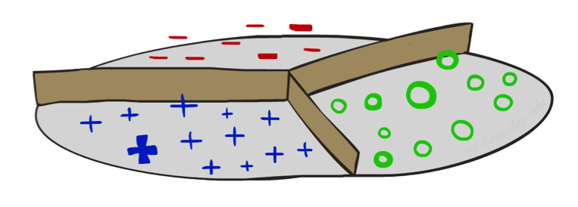
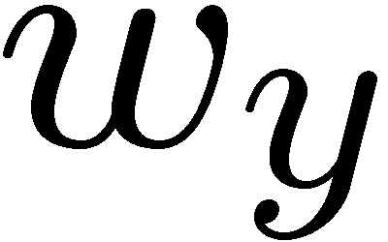

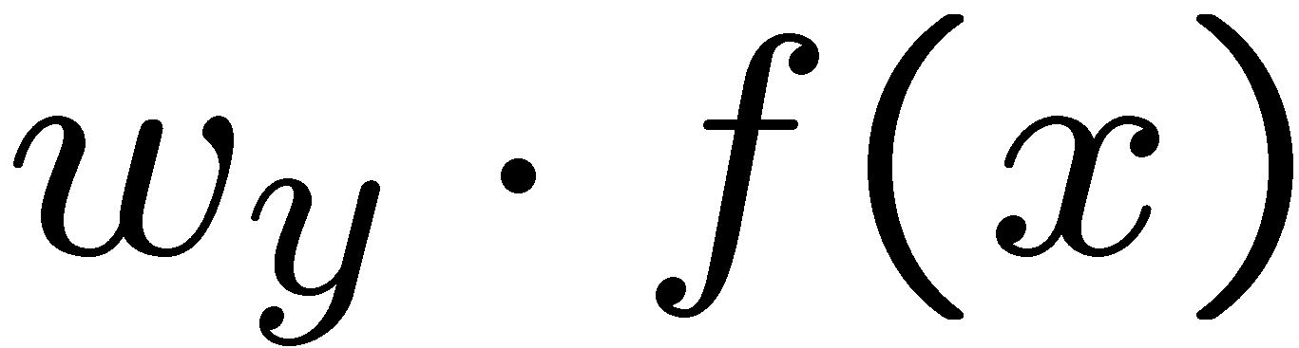

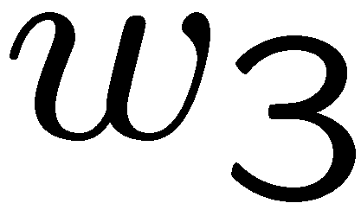
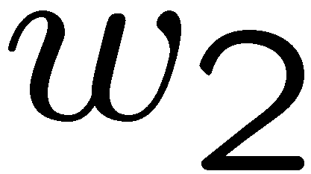
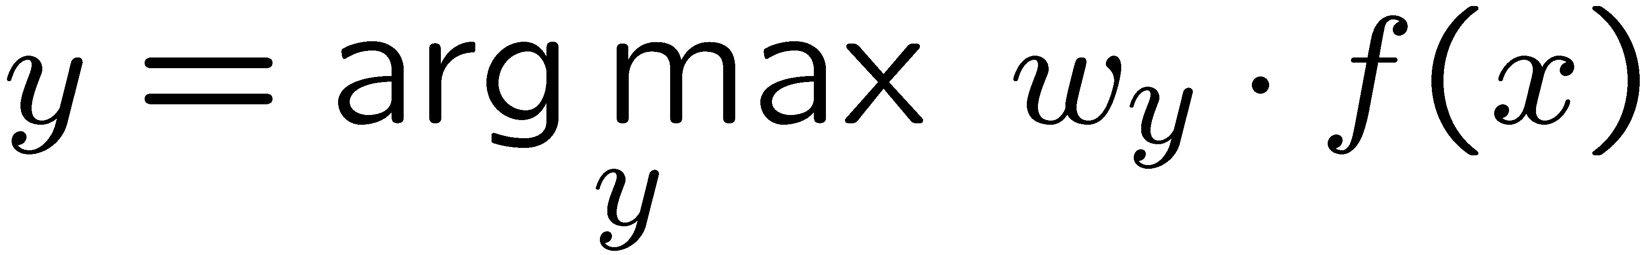
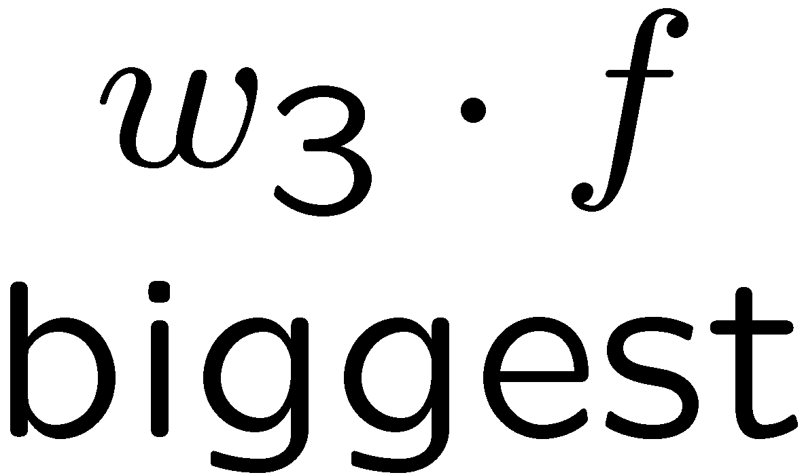
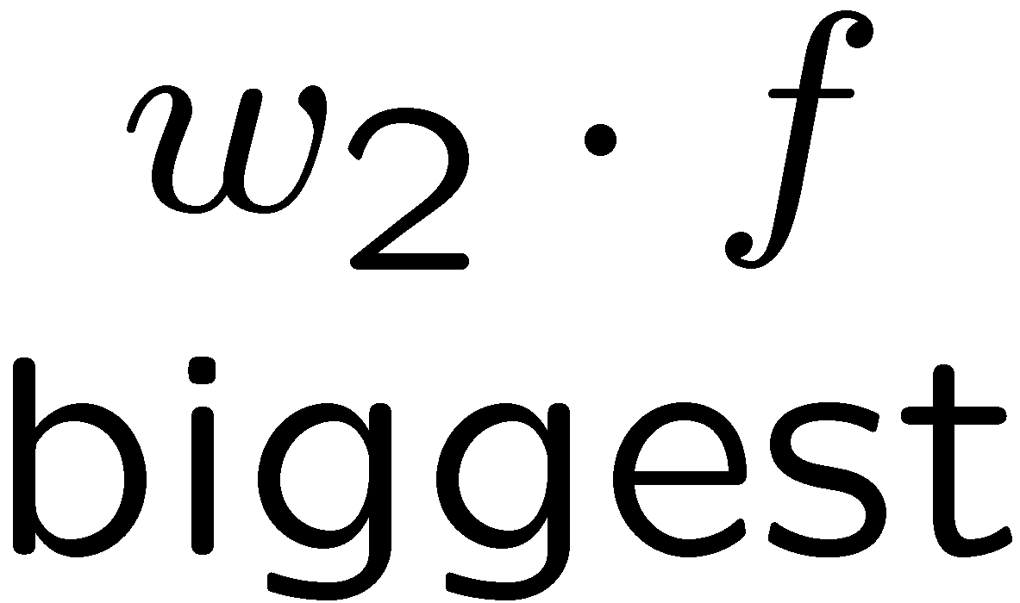
Multiclass Decision Rule
If we have multiple classes:
A weight vector for each class:
Score (activation) of a class y:
Prediction highest score wins
Binary = multiclass where the negative class has weight zero
Notes:
Here we’ll look at 3 classes on the slides, but this applies to any number of classes.
We have weight vector for each class.
If these are equal length, then the decision boundaries will be at the place that bisects the weight vectors (typically they won’t be equal length, which makes things a bit more complicated, but not much).
Now there is a w for each class (we index the classes by y). We compute w_y * f(x) for each class Y. Whichever one is the highest becomes our prediction for what class X should have.

Slide 18

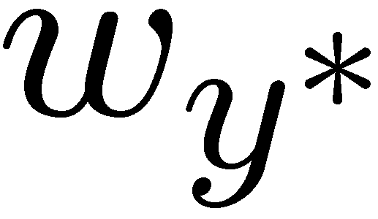
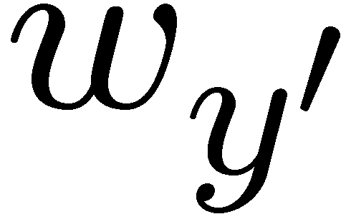
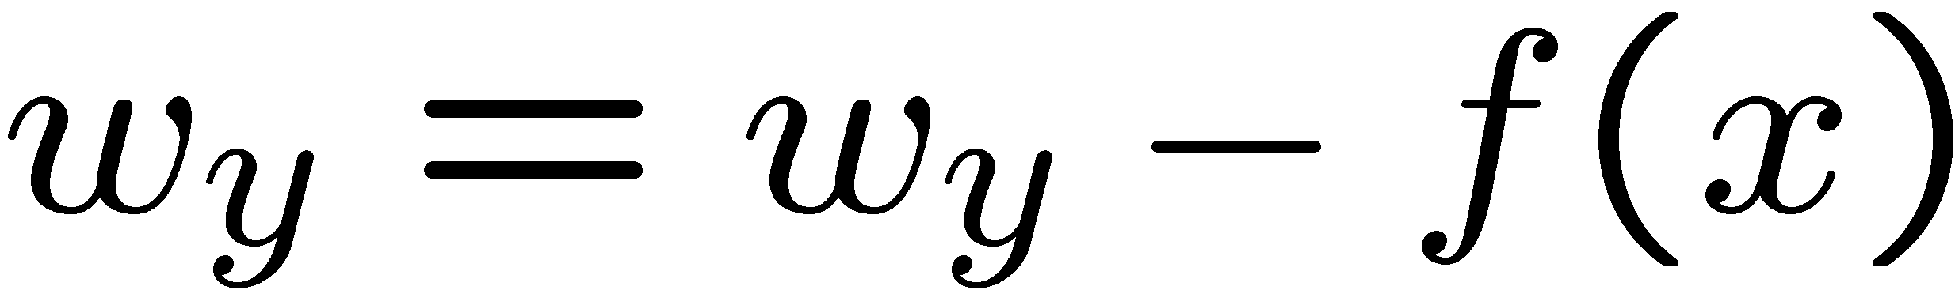
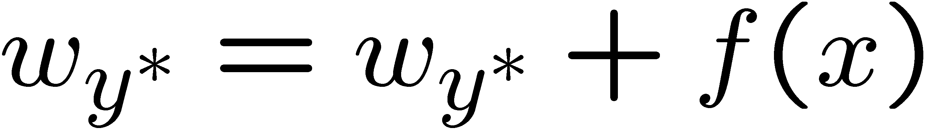
Learning: Multiclass Perceptron
Start with all weights = 0
Pick up training examples one by one
Predict with current weights
If correct, no change!
If wrong: lower score of wrong answer, raise score of right answer

Slide 19
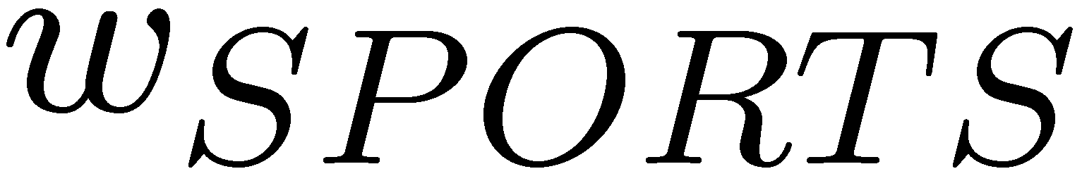
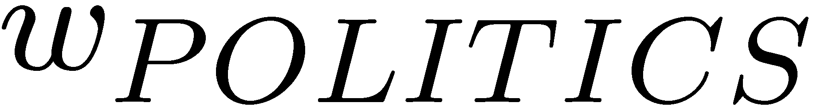
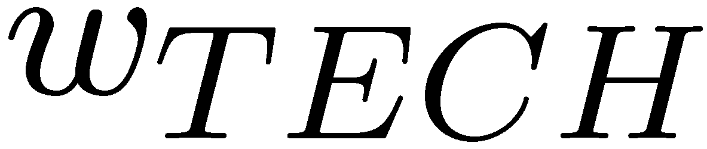
Example: Multiclass Perceptron
“win the vote”
“win the election”
“win the game”
BIAS : 1
win : 0
game : 0
vote : 0
the : 0
...
BIAS : 0
win : 0
game : 0
vote : 0
the : 0
...
BIAS : 0
win : 0
game : 0
vote : 0
the : 0
...
Notes:
Here are the initial weight vectors for each of our three classes. Now we have 3 inputs that we want to classify.
Let’s compute the values for each of the classes. It’s the inner product. Since sports has the bias term of 1, it wins. However, Let’s say that y* is poiitics.
We add f(x) to politics, which gives us a new w_politics of (1, 1, 0, 1, 1).
We subtract f(x) from sports, so we get a new w_sports of (0, -1, 0, -1, -1).
So that’s our first training example.
Let’s compute the score for “win the election”. The feature vector is 1, 1, 0, 0, 1.
For the inner products we get -2 for w_sports, 3 for w_politics and 0 for w_tech.
So the highest score is politics. That’s the correct label, so we don’t need to do any updates.
For win the game our f(x) is (1, 1, 1, 0, 1).
For the inner products we get -2 for w_sports, 3 for w_politics and 0 for w_tech.
Now we have to update by subtracting this f(x) from the politics weight vector, and add it to the sports weight vector.
Subtracting it out fom w_politics gives us new w_politics of (0, 0, -1, 1, 0).
We add f(x) tp sports, so we get a new w_sports of (1, 0, 1, -1, 0).
Then we go back to the first example. We keep looping until at some point, we run through all examples and nothing changes. If that’s the case then nothing will change in the future.

Slide 20
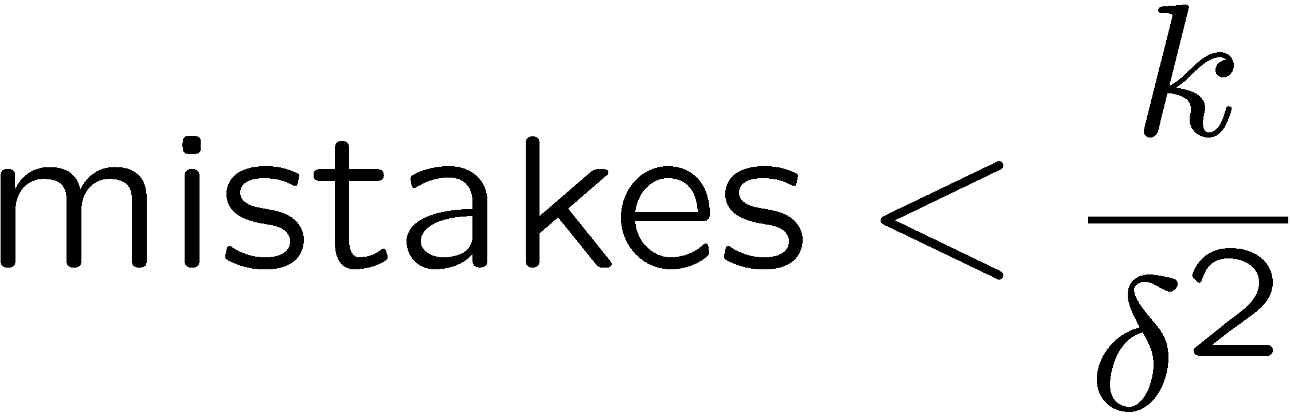
Properties of Perceptrons
Separable
Separability: true if some parameters get the training set perfectly correct
Convergence: if the training is separable, perceptron will eventually converge (binary case)
Mistake Bound: the maximum number of mistakes (binary case) related to the margin or degree of separability
Non-Separable
Notes:
You need to do at most this many passes.
K is the number of features. The more features that you have the longer it will take to converge.
Delta squared is the margin. If you have a separable data set, then you can compute the margin (the distance between the positive and negative class). If that margin (delta) is large, then it’s an easy cases, since there are many decision boundaries. If it’s small, then you have to be very precise before you find a separating hyperplane.

Slide 21
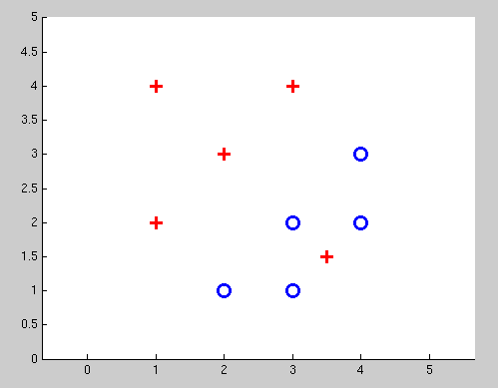
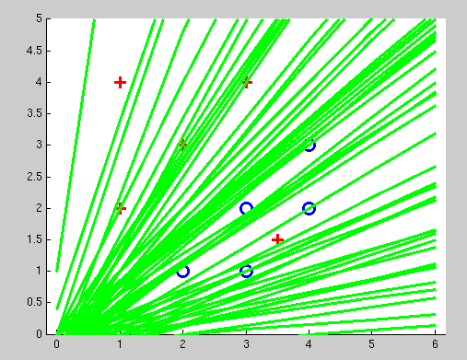
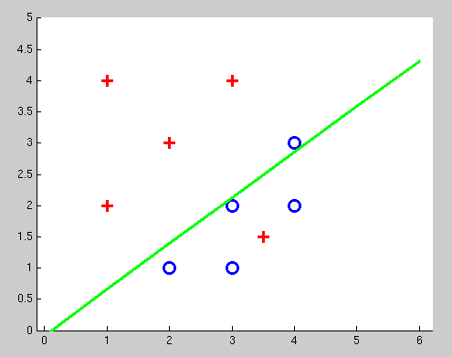
Examples: Perceptron
Non-Separable Case

Slide 22
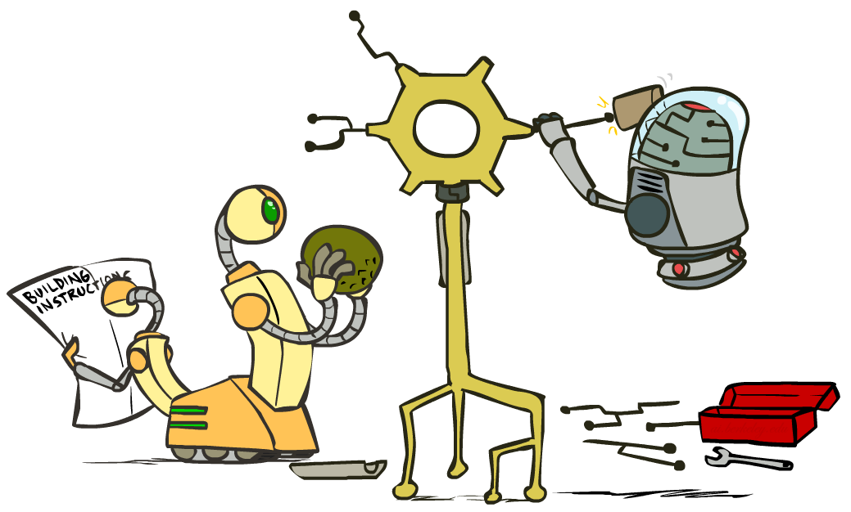
Improving the Perceptron

Slide 23
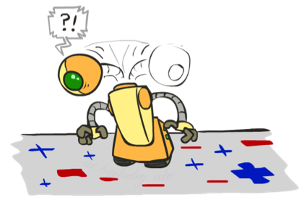
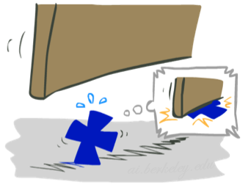

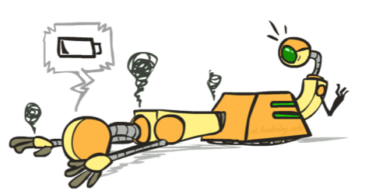




Problems with the Perceptron
Noise: if the data isn’t separable, weights might thrash
Averaging weight vectors over time can help (averaged perceptron)
Mediocre generalization: finds a “barely” separating solution
Overtraining: test / held-out accuracy usually rises, then falls
Overtraining is a kind of overfitting
Notes:
3. Overtraining is easy to fix. Use held-out data to avoid overtraining via “early stopping”.
Next, we will turn to an algorithm that helps the first two problems. It will help us find a better decision boundary, and it will help us avoid thrashing around.

Slide 24
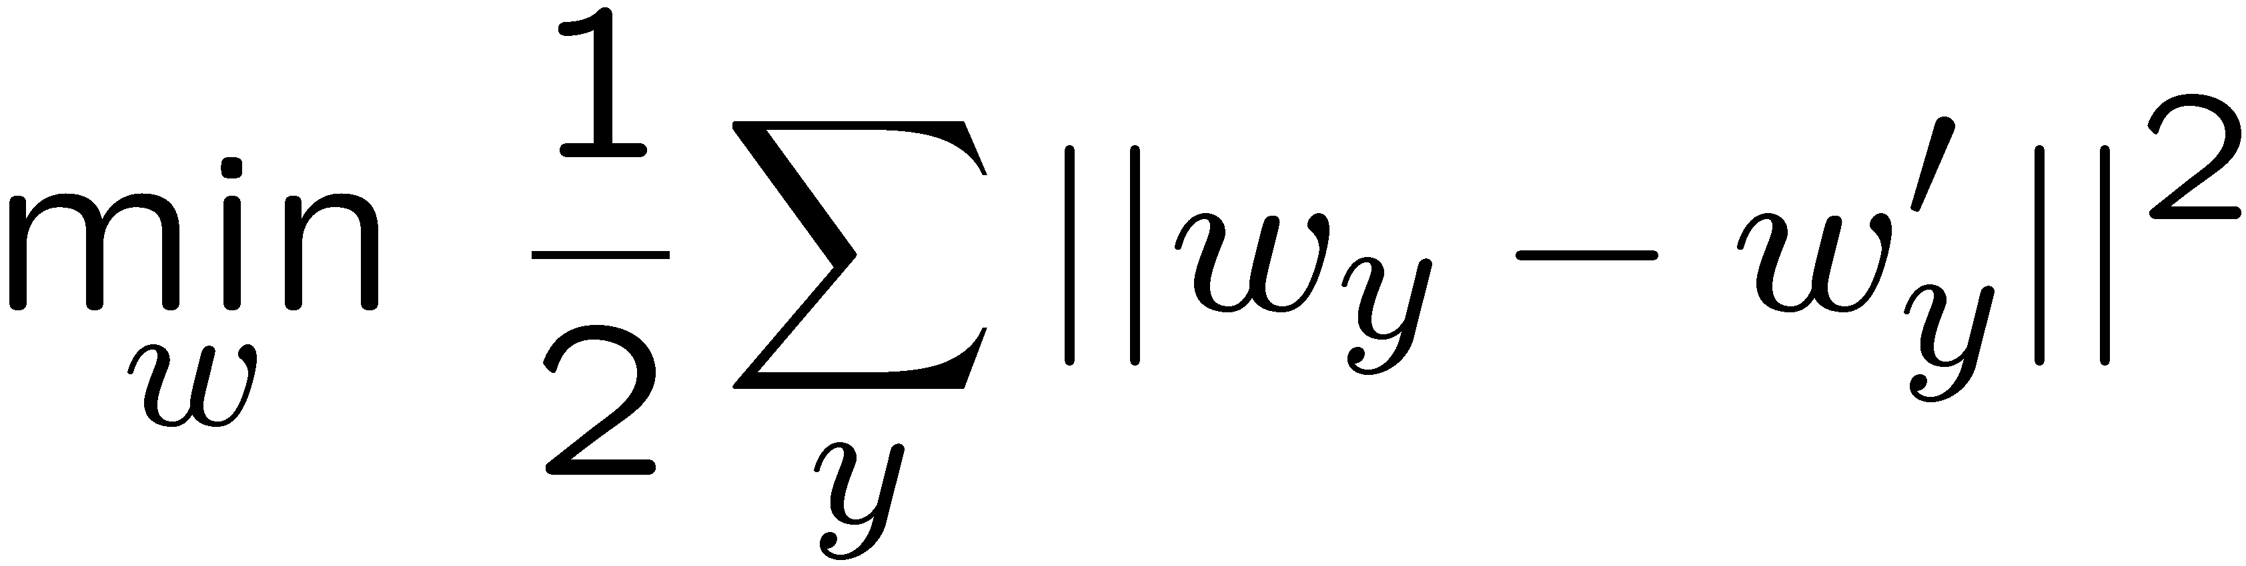



Fixing the Perceptron
Idea: adjust the weight update to mitigate these effects
MIRA*: choose an update size that fixes the current mistake…
… but, minimizes the change to w
The +1 helps to generalize
* Margin Infused Relaxed Algorithm
Notes:
MIRA does the following when you make an error:
You re-scale your features by some value Tau. This is like the alpha that we saw in Q-learning. It is a learning rate in some sense. Unlike in Q-learning where this was set heuristically, we are going to have a principled way of setting Tau.
Let’s take a look at it pictorially. We wanted to classify the current thing as y*, but we came up with y as our prediction. What we normally do is subtract out f from wy, and add it to w*, and that would be the perceptron update.
Now we’re going to allow some scaling via tau. Not too much, not too little.
So here’s the equation that we use to choose an update size. We want to pick a new update that has the weight vector for each class (w_y’) to be as close as possible to w_y. You could make that true by just setting w_y’ to be w_y.
But there’s a constraint. We want the w_y to be better for the current item f(x). That’s the second term. And not only do we want it to be better than our previous prediction, and we want it to be correct by a margin of at least +1. This is saying that y* has to be getting a higher score than y +1.
The plus one gives us some margin.
Now we need to solve this. The next slide shows the optimization problem.

Slide 25





Minimum Correcting Update
min not τ=0, or would not have made an error, so min will be where equality holds
Notes:
Now we need to solve the problem.
We have a mistake. We predicted y, we should have predicted y*. We need to find the Tau to see how much we should adjust the weights for the current intput item.
So here’s the decision problem. (two equations from previous slide). The problem doesn’t say that it has to be the same as the thing on the left.
If all the thing we care about is y and y*, then only the weight vectors for those two will change. So we don’t have to pay attention to weights for all the other classes.
The minimal way to change them is by adding some scaled version of f(x). Anything else that you add, is going to make the change bigger without affecting these decisions.
Therefore we get this new optimization problem. Min Tau.
If we just minimized Tau, it would be Tau = 0. We need the same constraint as before.
That’s a linear constraint in tau. So Tau has to be bigger than something. We get the value of Tau where the value of the second item holds true with equlity.
That’s our closed form calculation. Here.(3rd part). Plugging in the updates from the box in the upper righthand corner.
The moving things around so that we get Tau on one side.

Slide 26




Maximum Step Size
In practice, it’s also bad to make updates that are too large
Example may be labeled incorrectly
You may not have enough features
Solution: cap the maximum possible value of τ with some constant C
Corresponds to an optimization that assumes non-separable data
Usually converges faster than perceptron
Usually better, especially on noisy data

Slide 27
Linear Separators
Which of these linear separators is optimal?

Slide 28


Support Vector Machines
Maximizing the margin: good according to intuition, theory, practice
Only support vectors matter; other training examples are ignorable
Support vector machines (SVMs) find the separator with max margin
Basically, SVMs are MIRA where you optimize over all examples at once
MIRA
SVM

Slide 29
Classification: Comparison
Naïve Bayes
Builds a model training data
Gives prediction probabilities
Strong assumptions about feature independence
One pass through data (counting)
Perceptrons / MIRA:
Makes less assumptions about data
Mistake-driven learning
Multiple passes through data (prediction)
Often more accurate

