Slide 1

Constraint Satisfaction Problems II
AIMA: Chapter 6

Slide 2
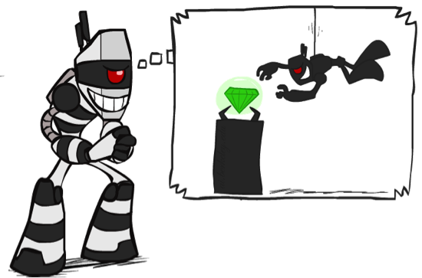

What is Search For?
Assumptions about the world: a single agent, deterministic actions, fully observed state, discrete state space
Planning: sequences of actions
The path to the goal is the important thing
Paths have various costs, depths
Heuristics give problem-specific guidance
Identification: assignments to variables
The goal itself is important, not the path
All paths at the same depth (for some formulations)
CSPs are specialized for identification problems
Slide credit: Dan Klein and Pieter Abbeel
http://ai.berkeley.edu

Slide 3
Review: Constraint Satisfaction Problems
A CSP consists of:
Finite set of variables X₁, X₂, …, X_{n}
Nonempty domain of possible values for each variable D₁, D₂, … D_{n} where D_{i} = {v₁, …, v_{k}}
Finite set of constraints C₁, C₂, …, C_{m}
Each constraint C_{i} limits the values that variables can take.
A state is defined as an assignment of values to some or all variables.
A solution to a CSP is a complete, consistent assignment, where
A consistent assignment does not violate the constraints.
An assignment is complete when every variable is assigned a value.

Slide 4
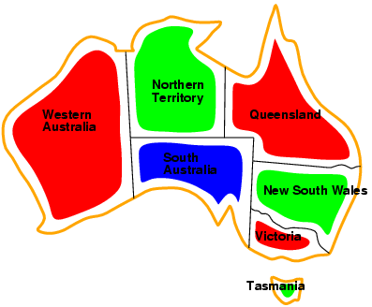
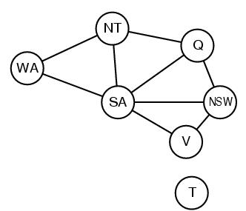
Review: CSP Representations
Constraint graph:
nodes are variables
edges are (binary) constraints
Standard representation pattern:
variables with values
Constraint graph simplifies search.
e.g. Tasmania is an independent subproblem.
This problem: A binary CSP:
each constraint relates two variables
WA ≠ NT
NT ≠ Q
NT ≠ SA
WA ≠ SA

Slide 5
Idea 1: CSP as a search problem
A CSP can easily be expressed as a search problem
Initial State: the empty assignment {}.
Successor function: Assign value to any unassigned variable provided that there is not a constraint conflict.
Goal test: the current assignment is complete.
Path cost: a constant cost for every step.
Solution is always found at depth n, for n variables
Hence Depth First Search can be used

Slide 6
Idea 2: Improving backtracking efficiency
General-purpose methods & general-purpose heuristics can give huge gains in speed, on average
Heuristics:
Q: Which variable should be assigned next?
Most constrained variable
(if ties:) Most constraining variable
Q: In what order should that variable’s values be tried?
3. Least constraining value
Q: Can we detect inevitable failure early? 4. Forward checking

Slide 7

Heuristic 1: Most constrained variable
Choose a variable with the fewest legal values
a.k.a. minimum remaining values (MRV) heuristic
3
3
2
3
1
3
2
3
2
1
3
3
3
2
3
3
3
3
3
3
3
3

Slide 8

Heuristic 2: Most constraining variable
Tie-breaker among most constrained variables
Choose the variable with the most constraints on remaining variables
3
3
2
2
2
1
1
4
1
0
1
0
3
2
2
1
2
1
1
1
0
0
0
0
(These two heuristics each lead to immediate solution of our example problem)

Slide 9
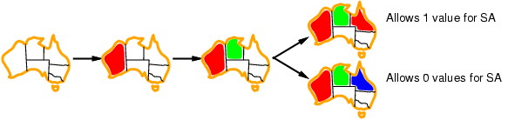
Heuristic 3: Least constraining value
Given a variable, choose the least constraining value:
the one that rules out the fewest values in the remaining variables
Combining these heuristics makes 1000 queens feasible
Note: demonstrated here independent of the other heuristics

Slide 10
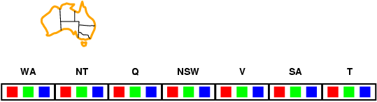
Heuristic 4: Forward checking
Idea:
Keep track of remaining legal values for unassigned variables
Terminate search when any unassigned variable has no remaining legal values
(A first step towards Arc Consistency & AC-3)
New data structure

Slide 11
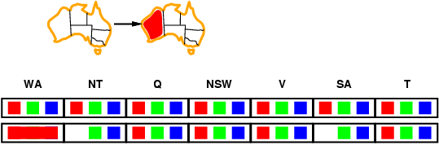
Forward checking
Idea:
Keep track of remaining legal values for unassigned variables
Terminate search when any unassigned variable has no remaining legal values

Slide 12
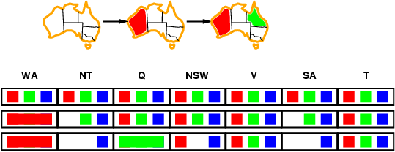

Forward checking
Idea:
Keep track of remaining legal values for unassigned variables
Terminate search when any unassigned variable has no remaining legal values

Slide 13
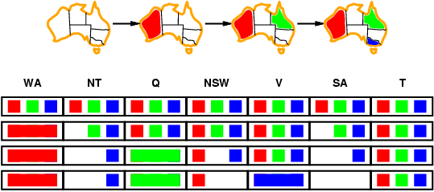
Forward checking
Idea:
Keep track of remaining legal values for unassigned variables
Terminate search when any unassigned variable has no remaining legal values
Terminate! No possible value for SA

Slide 14
Towards Constraint propagation
Forward checking propagates information from assigned to unassigned variables, but doesn't provide early detection for all failures:
NT and SA cannot both be blue!
Constraint propagation goes beyond forward checking & repeatedly enforces constraints locally

Slide 15
Arc Consistency, Constraint Propagation & AC-3
Notes:
AC-3 is the name of the algorithm because it was the third algorithm developed in the paper.

Slide 16
Idea 3 (big idea): Inference in CSPs
CSP solvers combine search and inference
Search
assigning a value to a variable
Constraint propagation (inference)
Eliminates possible values for a variable if the value would violate local consistency
Can do inference first, or intertwine it with search
You’ll investigate this in the Sudoku homework
Local consistency
Node consistency: satisfies unary constraints
This is trivial!
Arc consistency: satisfies binary constraints
(X_{i} is arc-consistent w.r.t. X_{j} if for every value v in D_{i}, there is some value w in D_{j} that satisfies the binary constraint on the arc between X_{i} and X_{j})

Slide 17
Review: CSP Representations
Constraint graph:
nodes are variables
edges are constraints
WA ≠ NT
NT ≠ Q
NT ≠ SA
WA ≠ SA

Slide 18
Edges to Arcs: From Constraint Graph to Directed Graph
Given a pair of nodes X_{i} and X_{j} connected by a constraint edge, we represent this not by a single undirected edge, but a pair of directed arcs.
For a connected pair of nodes X_{i} and X_{j} , there are two arcs that connect them: (i,j) and (j,i).
(i,j)
⇒
X_{i}
X_{j}
X_{i}
X_{j}
(j,i)

Slide 19
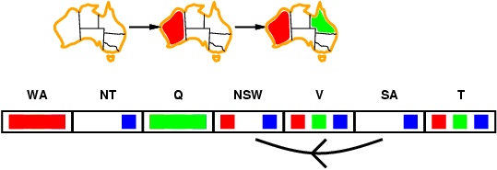
Arc consistency
Simplest form of propagation makes each arc consistent
X →Y is consistent iff for every value x of X there is some allowed y

Slide 20
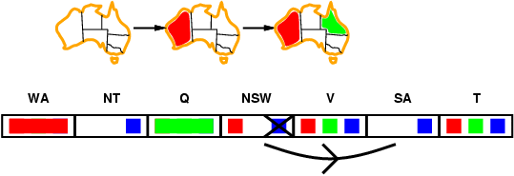
Arc consistency
Simplest form of propagation makes each arc consistent
X →Y is consistent iff for every value x of X there is some allowed y

Slide 21
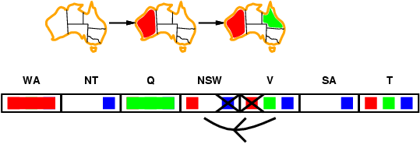
Arc consistency
Simplest form of propagation makes each arc consistent
X →Y is consistent iff for every value x of X there is some allowed y
If X loses a value, recheck neighbors of X

Slide 22
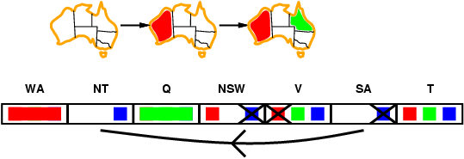
Arc consistency
Simplest form of propagation makes each arc consistent
X →Y is consistent iff for every value x of X there is some allowed y
If X loses a value, we need to recheck neighbors of X
Detects failure earlier than forward checking Can be run as a preprocessor or after each assignment

Slide 23
Arc Consistency
An arc (i,j) is arc consistent if and only if every value v on X_{i} is consistent with some label on X_{j}.
To make an arc (i,j) arc consistent, for each value v on X_{i} , if there is no label on X_{j} consistent with v
then remove v from X_{i}
Given d values, checking arc (i,j) takes O(d²) time worst case

Slide 24
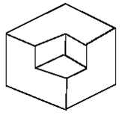

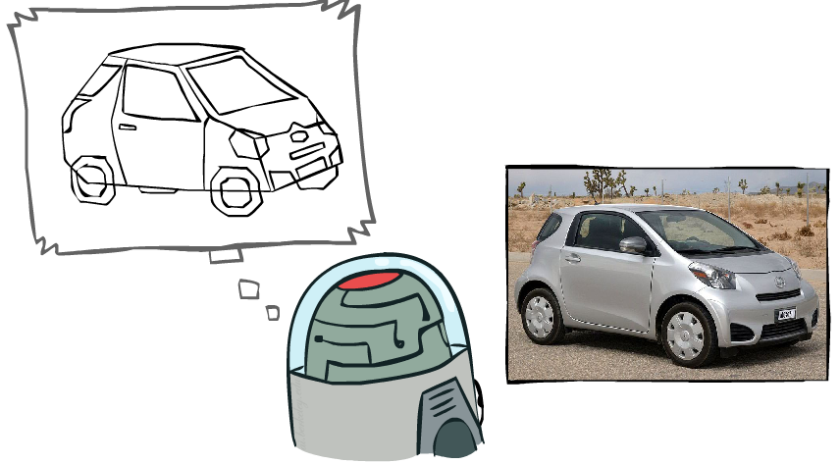
Example: The Waltz Algorithm
The Waltz algorithm is for interpreting line drawings of solid polyhedra as 3D objects
An early example of an AI computation posed as a CSP
?
Approach:
Each intersection is a variable
Adjacent intersections impose constraints on each other
Solutions are physically realizable 3D interpretations
Slide credit: Dan Klein and Pieter Abbeel
http://ai.berkeley.edu

Slide 25

Replacing Search: Constraint Propagation Invented…
Dave Waltz’s insight:
By iterating over the graph, the arc-consistency constraints can be propagated along arcs of the graph.
Search: Use constraints to add labels to find one solution
Constraint Propagation: Use constraints to eliminate labels to simultaneously find all solutions

Slide 26
The Waltz/Mackworth Constraint Propagation Algorithm
Assign every node in the constraint graph a set of all possible values
Repeat until there is no change in the set of values associated with any node:
For each node i:
For each neighboring node j in the picture:
Remove any value from i which is not arc consistent with j.

Slide 27
Inefficiencies: Towards AC-3
At each iteration, we only need to examine those X_{i} where at least one neighbor of X_{i} has lost a value in the previous iteration.
If X_{i} loses a value only because of arc inconsistencies with X_{j}, we don’t need to check X_{j} on the next iteration.
Removing a value on X_{i} can only make X_{j} arc-inconsistent with respect to X_{i} itself. Thus, we only need to check that (j,i) is still arc-consistent.
These insights lead a much better algorithm...

Slide 28
AC-3
function AC-3(csp) return the CSP, possibly with reduced domains
inputs: csp, a binary csp with variables {X₁, X₂, …, X_{n}}
local variables: queue, a queue of arcs initially the arcs in csp
while queue is not empty do
(X_{i}, X_{j}) ← REMOVE-FIRST(queue)
if REMOVE-INCONSISTENT-VALUES(X_{i}, X_{j}) then
for each X_{k} in NEIGHBORS[X_{i} ] – {X_{j}} do add (X_{k}, X_{i}) to queue
function REMOVE-INCONSISTENT-VALUES(X_{i}, X_{j}) return true iff we remove a value
removed ← false
for each x in DOMAIN[X_{i}] do
if no value y in DOMAIN[X_{j}] allows (x,y) to satisfy the constraints between X_{i} and X_{j}
then delete x from DOMAIN[X_{i}]; removed ← true
return removed
Notes:
Here the queue is actually a set.

Slide 29
AC-3: Worst Case Complexity Analysis
All nodes can be connected to every other node,
so each of n nodes must be compared against n-1 other nodes,
so total # of arcs is 2*n*(n-1), i.e. O(n²)
If there are d values, checking arc (i,j) takes O(d²) time
Each arc (i,j) can only be inserted into the queue d times
Worst case complexity: O(n²d³)
(For planar constraint graphs, the number of arcs can only be linear in N and the time complexity is only O(nd³))

Slide 30
Local search for CSPs
Hill-climbing, simulated annealing typically work with "complete" states, i.e., all variables assigned
To apply to CSPs:
allow states with unsatisfied constraints
operators reassign variable values
Variable selection: randomly select any conflicted variable
Value selection by min-conflicts heuristic:
choose value that violates the fewest constraints
i.e., hill-climb with h(n) = total number of violated constraints

Slide 31
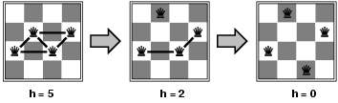
Example: n-queens
States: 4 queens in 4 columns (4⁴ = 256 states)
Actions: move queen in column
Goal test: no attacks
Evaluation: h(n) = number of attacks
Given random initial state, local min-conflicts can solve n-queens in almost constant time for arbitrary n with high probability (e.g., n = 10,000,000)

Slide 32
Problem Structure
Extreme case: independent subproblems
Example: Tasmania and mainland do not interact
Independent subproblems are identifiable as connected components of constraint graph
Suppose a graph of n variables can be broken into subproblems – could that help us speed up the computation?
Slide credit: Dan Klein and Pieter Abbeel
http://ai.berkeley.edu

Slide 33
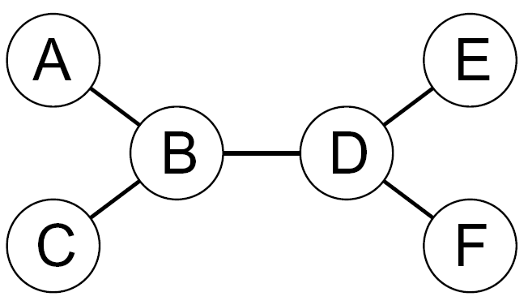
Tree-Structured CSPs
Theorem: if the constraint graph has no loops, the CSP can be solved in O(n d²) time
This property also applies to probabilistic reasoning (later): an example of the relation between syntactic restrictions and the complexity of reasoning
Slide credit: Dan Klein and Pieter Abbeel
http://ai.berkeley.edu

Slide 34
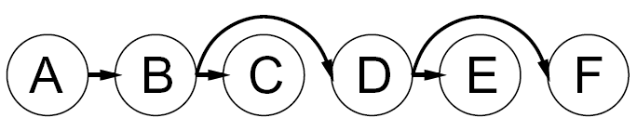


Tree-Structured CSPs
Algorithm for tree-structured CSPs:
Order: Choose a root variable, order variables so that parents precede children
Remove backward: For i = n : 2, apply RemoveInconsistent(Parent(X_{i}),X_{i})
Assign forward: For i = 1 : n, assign X_{i} consistently with Parent(X_{i})
Runtime: O(n d²) (why?)
Slide credit: Dan Klein and Pieter Abbeel
http://ai.berkeley.edu

Slide 35
Tree-Structured CSPs
Claim 1: After backward pass, all root-to-leaf arcs are consistent
Proof: Each X→Y was made consistent at one point and Y’s domain could not have been reduced thereafter (because Y’s children were processed before Y)
Claim 2: If root-to-leaf arcs are consistent, forward assignment will not backtrack
Proof: Induction on position
Why doesn’t this algorithm work with cycles in the constraint graph?
Slide credit: Dan Klein and Pieter Abbeel
http://ai.berkeley.edu

Slide 36
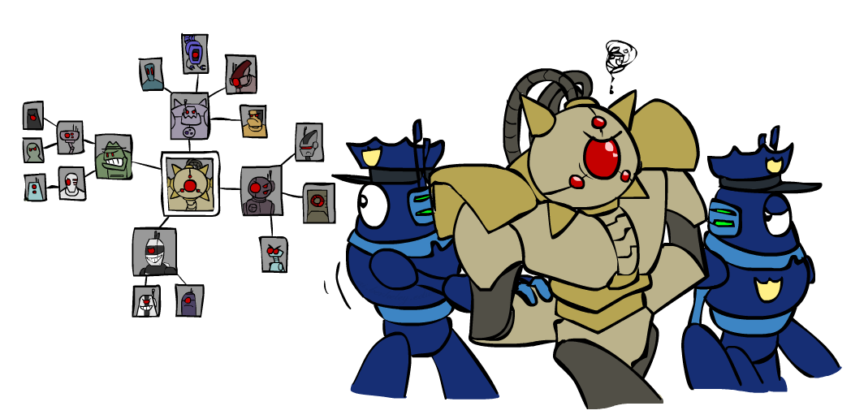
Improving Structure
Slide credit: Dan Klein and Pieter Abbeel
http://ai.berkeley.edu

Slide 37
Nearly Tree-Structured CSPs
Conditioning: instantiate a variable, prune its neighbors' domains
Cutset conditioning: instantiate (in all ways) a set of variables such that the remaining constraint graph is a tree
Cutset size c gives runtime O( (d^{c}) (n-c) d² ), very fast for small c
Slide credit: Dan Klein and Pieter Abbeel
http://ai.berkeley.edu

Slide 38
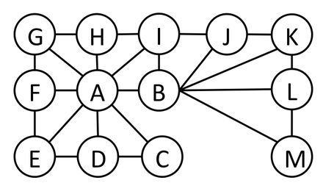
Cutset Quiz
Find the smallest cutset for the graph below.
Slide credit: Dan Klein and Pieter Abbeel
http://ai.berkeley.edu

Slide 39
Cutset Conditioning
Choose a cutset
SA
Instantiate the cutset (all possible ways)
SA
SA
SA
Compute residual CSP for each assignment
Solve the residual CSPs (tree structured)
Slide credit: Dan Klein and Pieter Abbeel
http://ai.berkeley.edu

Slide 40
Tree Decomposition*
Idea: create a tree-structured graph of mega-variables
Each mega-variable encodes part of the original CSP
Subproblems overlap to ensure consistent solutions
M1
M2
M3
M4
WA
≠
NT
NT
≠
Q
Q
≠
NSW
NSW
≠
V
≠
≠
≠
≠
≠
≠
≠
≠
SA
SA
SA
SA
Agree on shared vars
Agree on shared vars
Agree on shared vars
{(WA=r,SA=g,NT=b),
(WA=b,SA=r,NT=g),
…}
{(NT=r,SA=g,Q=b),
(NT=b,SA=g,Q=r),
…}
Agree: (M1,M2) ∈
{((WA=g,SA=g,NT=g), (NT=g,SA=g,Q=g)), …}
Slide credit: Dan Klein and Pieter Abbeel
http://ai.berkeley.edu

Slide 41
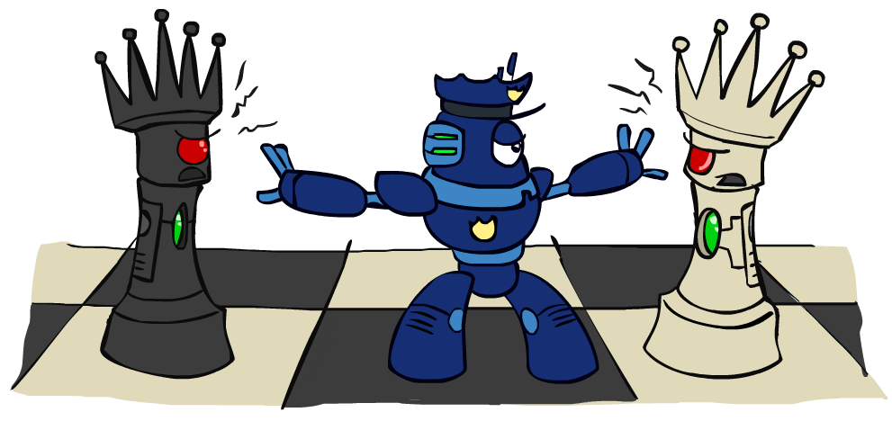
Iterative Improvement
Slide credit: Dan Klein and Pieter Abbeel
http://ai.berkeley.edu

Slide 42
Iterative Algorithms for CSPs
Local search methods typically work with “complete” states, i.e., all variables assigned
To apply to CSPs:
Take an assignment with unsatisfied constraints
Operators reassign variable values
No fringe! Live on the edge.
Algorithm: While not solved,
Variable selection: randomly select any conflicted variable
Value selection: min-conflicts heuristic:
Choose a value that violates the fewest constraints
I.e., hill climb with h(n) = total number of violated constraints
Slide credit: Dan Klein and Pieter Abbeel
http://ai.berkeley.edu

Slide 43
Simple CSPs can be solved quickly
Completely independent subproblems
e.g. Australia & Tasmania
Easiest
Constraint graph is a tree
Any two variables are connected by only a single path
Permits solution in time linear in number of variables
Do a topological sort and just march down the list
A E
\ /
B – D A ➔ B ➔ C ➔ D ➔E ➔ F
/ \
C F

Slide 44
Beyond binary constraints: Path consistency
Generalizes arc-consistency from individual binary constraints to multiple constraints
A pair of variables X_{i}, X_{j} is path-consistent w.r.t. X_{m} if for every assignment X_{i}=a, X_{j}=b consistent with the constraints on X_{i}, X_{j} there is an assignment to X_{m} that satisfied the constraints on X_{i}, X_{m} and X_{j}, X_{m}
Global constraints
Can apply to any number of variables
E.g., in Sudoko, all numbers in a row must be different
E.g., in cryptarithmetic, each letter must be a different digit
Example algorithm:
If any variable has a single possible value, delete that variable from the domains of all other constrained variables
If no values are left for any variable, you found a contradiction

Slide 45
Simplifying hard CSPs: Cycle Cutsets
Constraint graph can be decomposed into a tree
Collapse or remove nodes
Cycle cutset S of a graph G: any subset of vertices of G that, if removed, leaves G a tree
Cycle cutset algorithm
Choose some cutset S
For each possible assignment to the variables in S that satisfies all constraints on S
Remove any values for the domains of the remaining variables that are not consistent with S
If the remaining CSP has a solution, then you have are done
For graph size n, domain size d
Time complexity for cycle cutset of size c: O(d^{c *} d²(n-c)) = O(d^{c+2} (n-c))

Slide 46
Chronological backtracking
DFS does Chronological backtracking
If a branch of a search fails, backtrack to the most recent variable assignment and try something different
But this variable may not be related to the failure
Example: Map coloring of Australia
Variable order
Q, NSW, V, T, SA, WA, NT.
Current assignment:
Q=red, NWS=green, V=blue, T= red
SA cannot be assigned anything
But reassigning T does not help!

Slide 47
Backjumping: Improved backtracking
Find “the conflict set”
Those variable assignments that are in conflict
Conflict set for SA: {Q=red, NSW=green, V=blue}
Jump back to reassign one of those conflicting variables
Forward checking can build the conflict set
When a value is deleted from a variable’s domain, add it to its conflict set
But backjumping finds the same conflicts that forward checking does
Fix using “conflict-directed backjumping”
Go back to predecessors of conflict set

Slide 48
When to Iterate, When to Stop?
The crucial principle:
If a value is removed from a node X_{i},
then the values on all of X_{i}’s neighbors must be reexamined.
Why? Removing a value from a node may result in one of the neighbors becoming arc inconsistent, so we need to check…
(but each neighbor X_{j} can only become inconsistent with respect to the removed values on X_{i})

