Slide 1
Textual Sentiment Analysis, Unveiling Emotions Through Natural Language Processing and Machine Learning Methods from tweets.
Talha Ahmed Khan

Slide 2
List of contents
Aims and objectives
Research findings
Theory
Analysis and design
Implementation
Evaluation
Knowledge Contribution
Future work
Lessons learned

Slide 3
Aims and objectives
The Goal is to detect five emotions and remaining types of emotions in a class named other on a limited dataset of 40,000 excerpts.
Aims
Improve the accuracy of emotion detection in Twitter data by developing a model capable of identifying more emotions rather than neutral, positive and negative emotions.
Recognize and classify a wide range of emotions, other than nuanced emotions beyond the traditional positive, negative, and neutral sentiments.
Develop a solution that can be applied to various domains, including marketing, customer service, mental health, and social research.
Objectives
Better data pre-processing: Clean and preprocess the Twitter data, including text tokenization, removing noise, and handling special characters. With a different approach to achieve better model accuracy and also optimize the model
Select an appropriate machine learning or deep learning model for emotion detection, considering factors like model architecture and pre-trained embeddings.
Train the model on the data which does not have biased selection of audience e.g tweets related to COVID-19 only consists of information of a closed target group hence it limits the ability of the model to perform in other sectors.

Slide 4
Research findings
Covid-19 tweets sentiment analysis
Tweets Sentiment analysis for ecommerce
Twitter sentiment classification for public health concerns
Classes: Classifying Three emotions
Data pre-processing: removal of usernames, links, punctuations and numeric values from tweets , stopwords and apply stemming techniques. For feature extraction, techniques such as term frequency-inverse document frequency (TF-IDF), bag-of-words (BoW) and GloVe are used.
Model: SVC, DT, XGBoost & RF
Accuracy: Excellent accuracy due to less classes 98%
Application Flexibility: yes it can also be used by certain businesses to promote their product to COVID-19 affected people.
Classes: three emotions
Data pre-processing: URLs, tags, punctuation, convert negative words, lower case, convert emoticons, tokenization, stopwords removal & stemming
Model:DT, NB, K-NN
Accuracy: 77%
Application flexibility: not flexible
Classes: three classes
Data pre-processing: URLs, tags, punctuation, convert negative words, lower case, convert emoticons, tokenization,
Model: NB, SVM & RF
Accuracy: 77%
Application flexibility: yes this classification can be used to target clinical researches and approach people with negative thoughts

Slide 5
Theory
Sentiment analysis
Lexicon
Advantages
Disadvantages
Machine Learning
Advantages
disadvantages
Hypothesis:
Better results are achievable by implementing the followed techniques.
Punctuations: Retain punctuation (exclamation, question marks) for sentiment details..
Spellings: Address Twitter dataset's grammar issues, misspellings, contractions for enhanced quality.
Number removal: Reconsider removing numbers instead opt for numerical conversion to preserve context.
Name tag removal: In Twitter data, usernames directing tweets add noise. Removing them might enhance emotional signal purity.
Stop words: In informal Twitter sentiment analysis, retaining certain common stopwords, such as emoticons and abbreviations, is vital. Stopword selection should align with your dataset and analysis objectives.
Lexicon-based approaches can perform reasonably well on general sentiment analysis tasks, especially when the lexicon is well-curated and the text follows standard grammar and conventions.
Lexicon-based approaches are computationally less intensive and suitable for real-time processing.
They may struggle with detecting sentiment in texts that contain slang, neologisms, or domain-specific terms not present in the lexicon.
less effective for domain-specific sentiment analysis, as they may not contain domain-specific terms or understand context-specific sentiments.
Machine learning-based approaches are more adaptable to different domains and languages. They can learn from data and adapt to changing language trends and nuances.
They can capture complex relationships and contextual nuances.
Machine learning-based approaches require a substantial amount of labeled training data to train accurate models.
Machine learning-based approaches can be computationally demanding, especially deep learning models. They may require substantial computing resources.

Slide 6
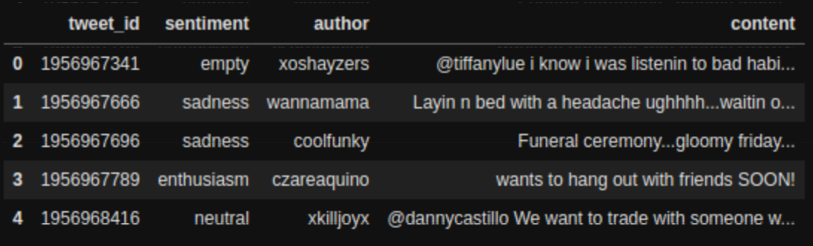
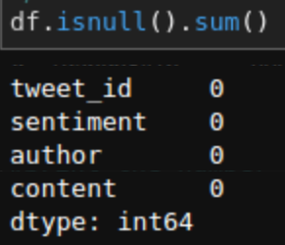
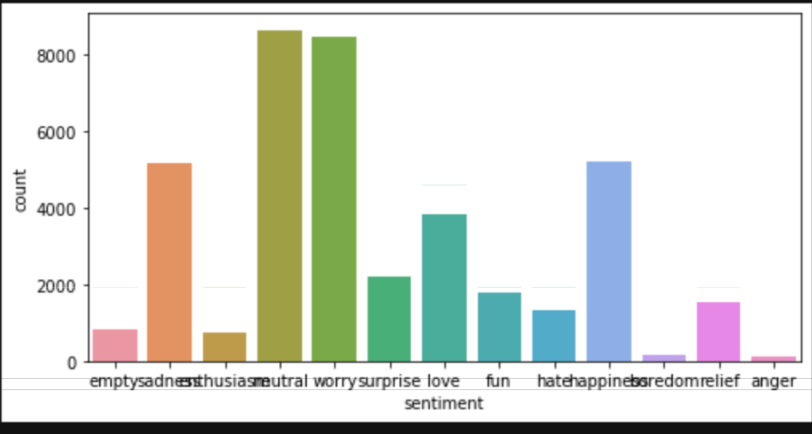
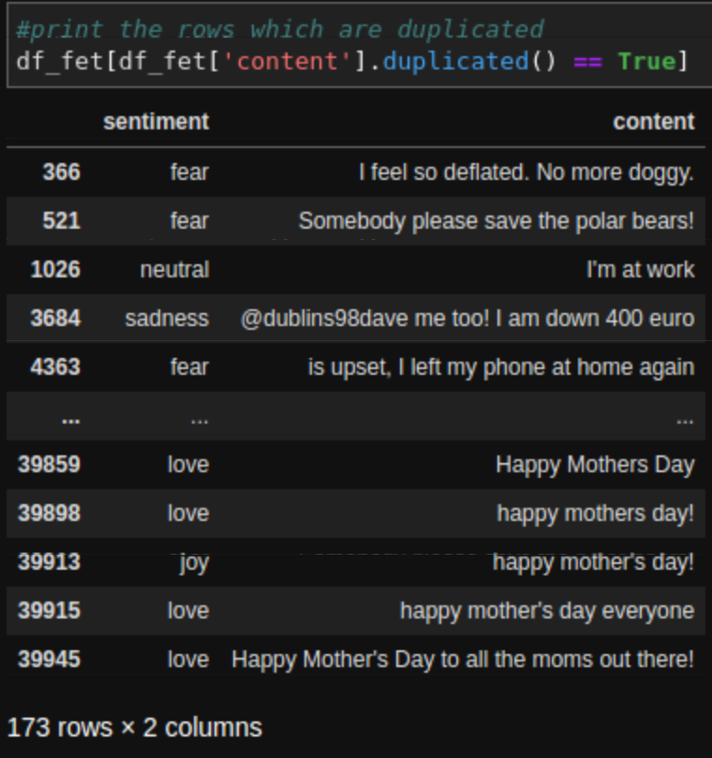
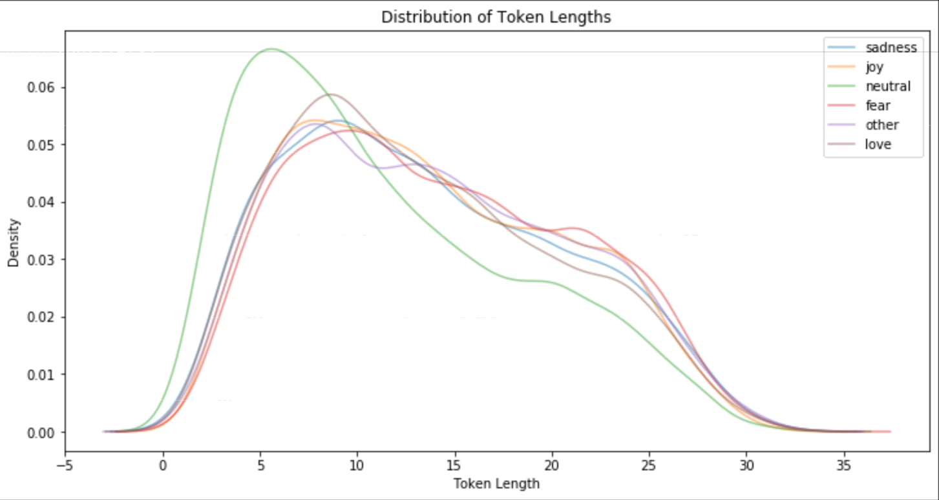
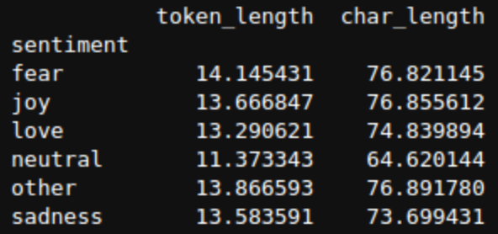
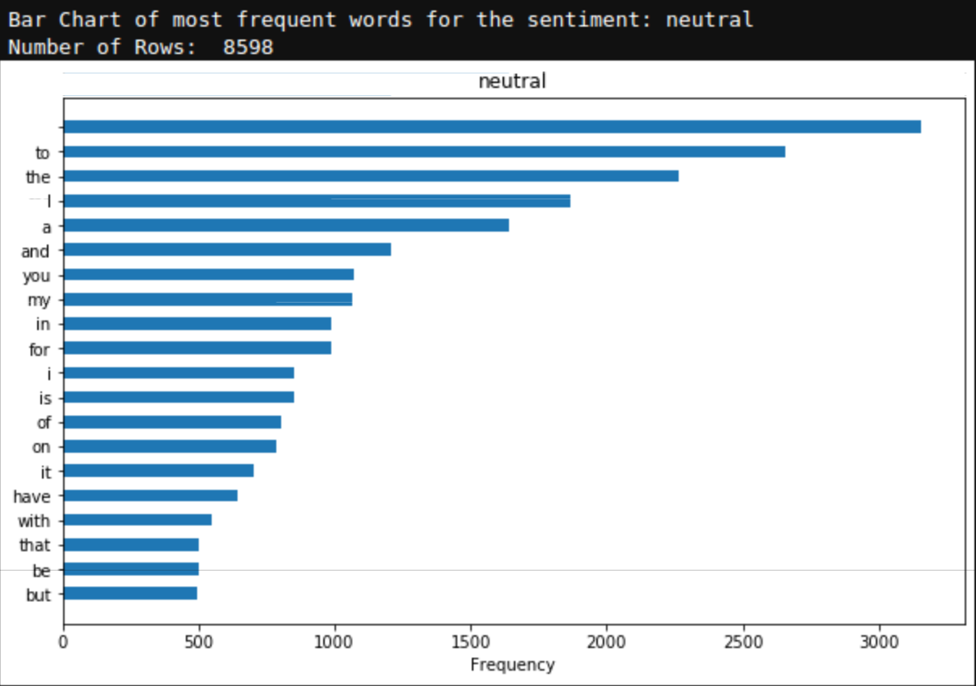
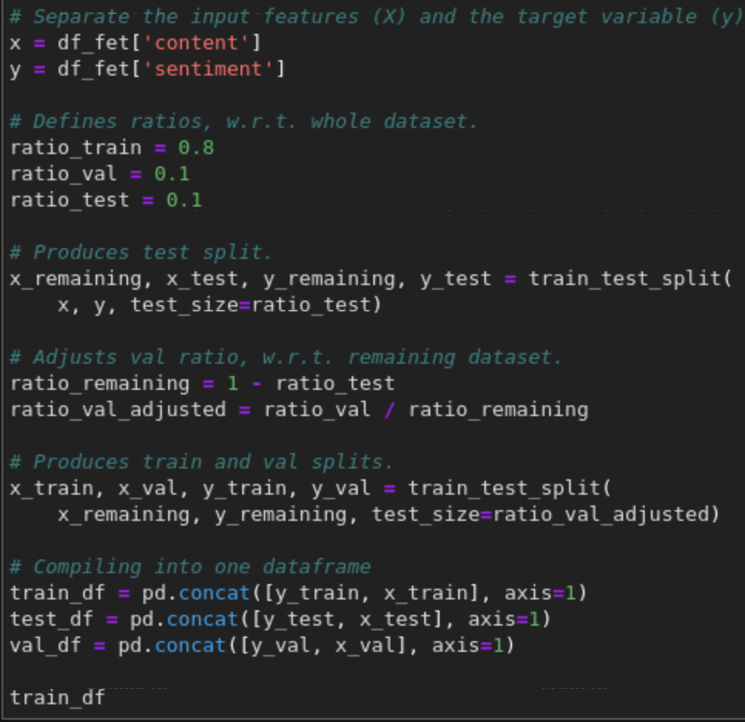
Analysis
Review the dataframe
Look for missing values
Check Class Balance
Check for duplicate records
Detect Outlier using token and character length
Values of token character length
Stopword count
Datasplit

Slide 7
Design

Slide 8
Implementation
Data Pre-processing
Text Normalization(spellings textblob, beautifulsoup and contractions are used to de-noise, name tags punctuations & Urls are removed using regex library, stopwords are removed using NLTK corpus, lemmatization is performed using NLTK and then the dataframe is cleaned for nan values )
Data Post-processing
TF-IDF for Decision tree
Label encoding, tokenization, padding or truncating to normalize sequence length, Glove embeddings for transfer learning these post processing are for RNN model.
Autotokenizer, input ids and attention mask, padding or truncating,
Model Development
Decision tree algorithm
Bi-directional GRU with word embeddings(next page)
DistilBERT(Next page)
Model Training
Batch size was set to 32 and the learning rates are selected as 0.0005 with adam optimizer.
I have selected softmax activation for all of the models because of multi-class classification.
Decision tree model was optimized using Gridsearch and other two model architectures were optimized using keras tuner due to the model complexity it required a lot of time to optimize.

Slide 9
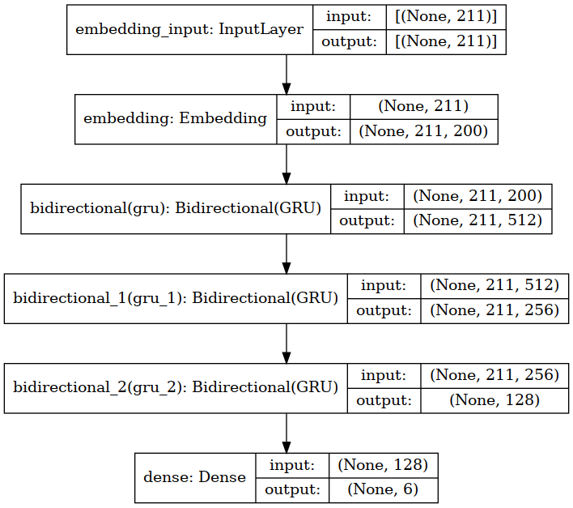
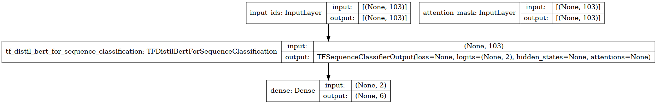
Model Architecture
Bi-directional GRU with Word embeddings
DistilBERT

Slide 10
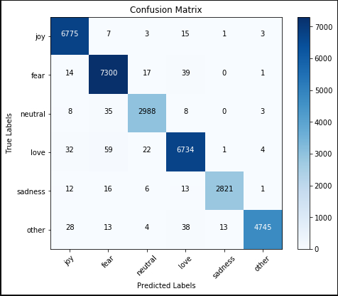
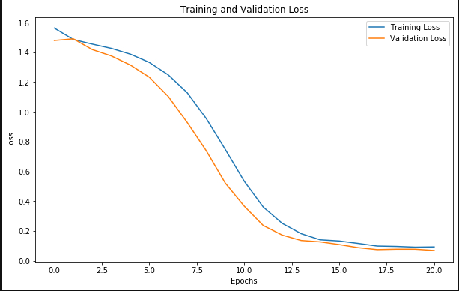
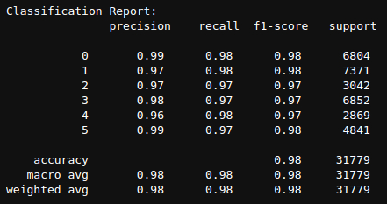
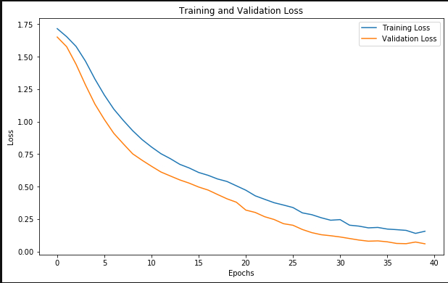
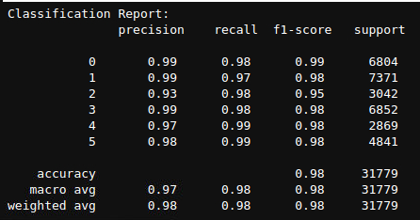
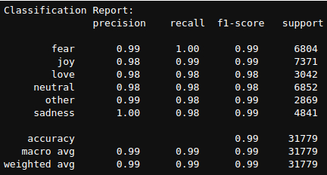
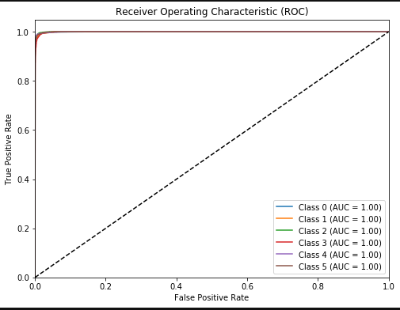
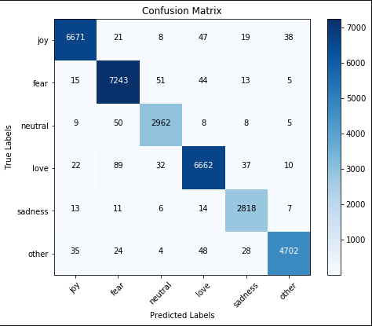
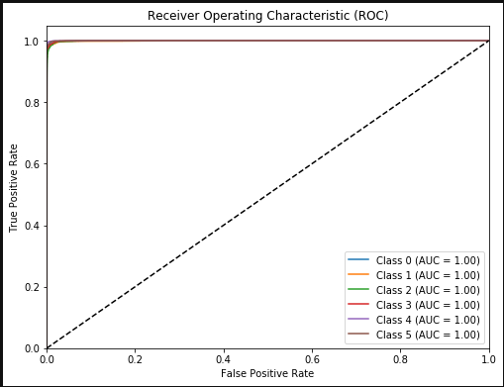
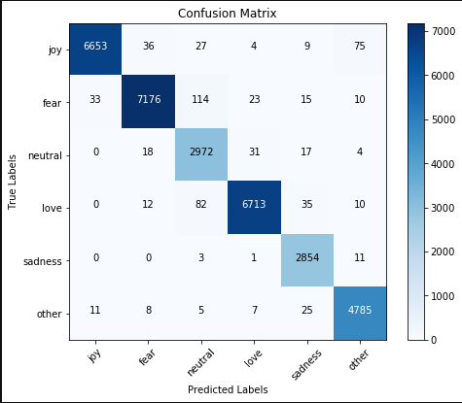
Evaluation
Decision Tree
DistilBERT
Bidirectional GRU with wordembeddings

Slide 11
Future Work
The aims & objectives were not completely achieved as the results evaluated provide us with models that are overfitting and data augmentation in text data is not effective and leads to wrong classification to to change in context after augmentation hence in future we can gather
more data using data crawler and try to train the same models as well as move towards
unsupervised learning techniques which can allow us to have real-time collection of data which would be tagged.

Slide 12
Knowledge contribution and Lessons learned
Data pre-processing plays and important in model performance yet the data size cannot be ignored.
Data augmentation is a way to counter overfitting as long as the augmented data has the same context as their labelled class
Model architectures play an important part in sentiment analysis but upto a certain point they cannot identify mis-labelled data.
NLP has a lot of potential in terms of Natural language understanding but the limitations of these should be recorded and shared amongst the enthusiasts to prosper in a direction of positive development.

Slide 13
THANK YOU
Talha A. Khan

