Slide 1
Alcohol dependence in university students
Artin Kiany # 219 457 969
Bardiya Ameri # 220 108 684
Japnam Bhangu # 220 333 829
Jeduson Kawleswaran # 220 698 403
Jordan Hendriks # 220 402 277
Nithin Balamurugan # 220 568 952

Slide 2


SDG #3
Good Health and Wellbeing Target 3.5:
Strengthen the prevention and treatment of substance abuse, including narcotic drug abuse and harmful use of alcohol
3.5.2
Alcohol per capita consumption (aged 15 years and older) within a calendar year in litres of pure alcohol

Slide 3
What are some user needs with alcohol addiction?

Slide 4
Why need alcohol?
Nature of Alcohol
Alcohol is a depressant
Accessibility
Relatively cheap and easily accessible compared to other harmful substances
Emotional/mental dependence
Grow unconventional attachment that develops into a need for it

Slide 5
Why need alcohol?
Escapism
Accept the delusion that they’re free from their responsibilities
Habits
Comfort in conventional routine
Social Norms
See others depend on alcohol and develop the same belief

Slide 6

Attributes (Objectives, Constraints, etc)

Slide 7
What is Our Objective?
Identify Trigger Points
Reduce Student Drinking
Determine specific stressors that lead to high levels of student anxiety.
Reduce student drinking both on and off campus
Mental Health Education
Establish Support Systems
Equip students with coping mechanisms and resilience skills.
Establish institutions within educational facilities to support affected students.

Slide 8
What are some Constraints?
01
Lack of Awareness
Many individuals may be hesitant to seek help. This may be due to many factors.
01
02
02
Resource limitations
Educational facilities may face limitations due to lack of funding, personnel, or time.
04
03
College/ University Culture
Many students in college/university spend time clubbing. This promotes bad drinking habits.
03
04
Legal/ Ethical Considerations
Ensure that intervention methods adhere to legal and ethical standards, respecting privacy and cultural backgrounds.

Slide 9
Research, brainstorming, ideation methods, & tools used

Slide 10
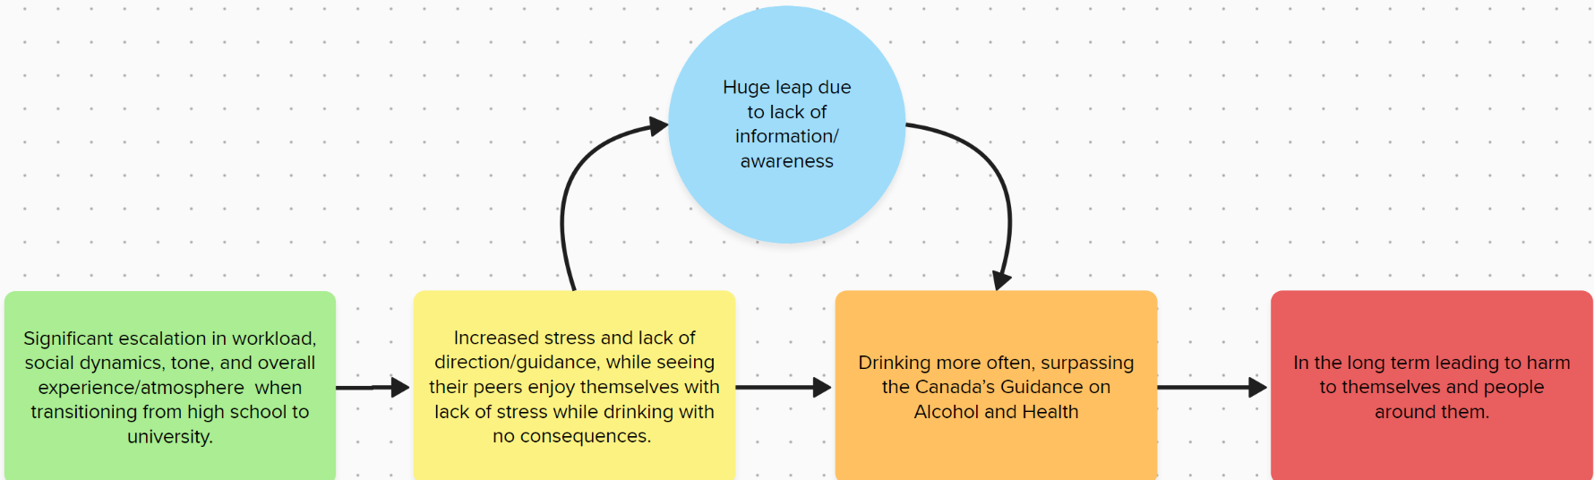
Get to the root cause: Why do university students start drinking heavily to being with?
Information and education is our strongest tool
https://forms.gle/UK3DKHcT3Co2HqY18
https://health-infobase.canada.ca/
Notes:
Used peer reviewed research, and the canadian government website for statistics and research on alcohol dependence.
Went through the health infobase (health data in canada: https://health-infobase.canada.ca/) and found out that the age range 20 to 24 Yrs has the highest alcohol consumptions in all categories

Slide 11
Our Initial Problem Statement
How might we prevent and support university students grappling with alcohol dependency affecting their life in university environment?

Slide 12
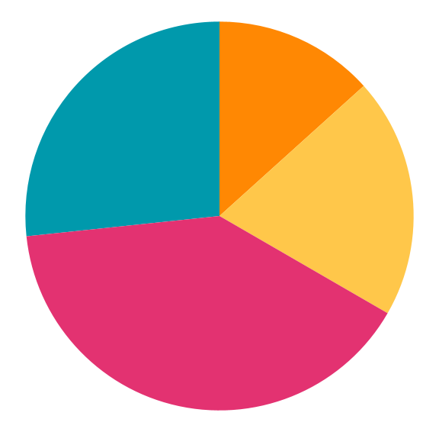
Evidence that the formulated problem exists.

Slide 13
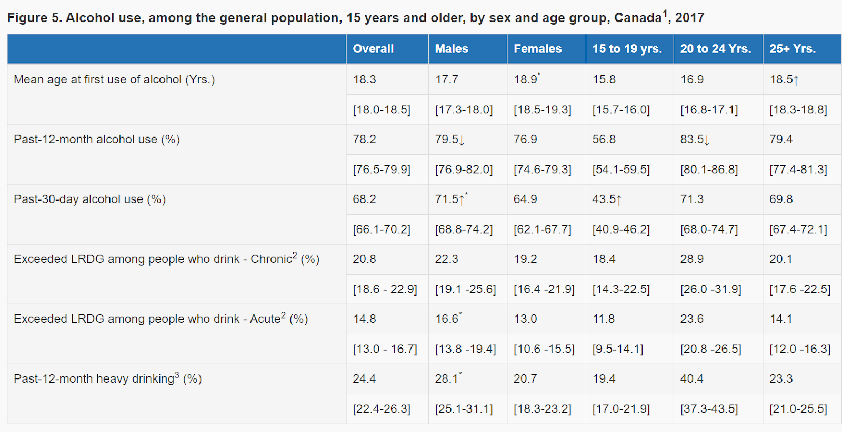
As stress increases for university students so does alcohol consumption (National Library of Medicine)
28.9% of people aged 20-24 exceeded the Low-Risk Alcohol Drinking Guidelines

Slide 14
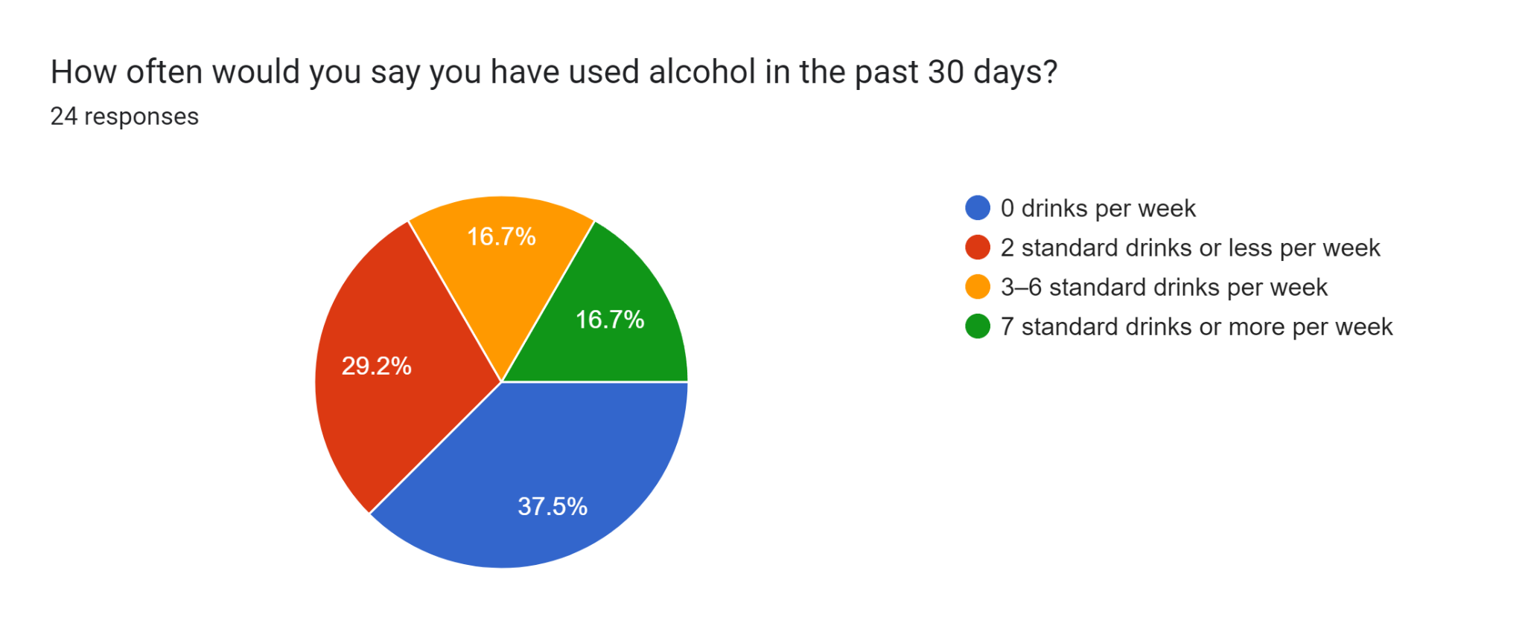
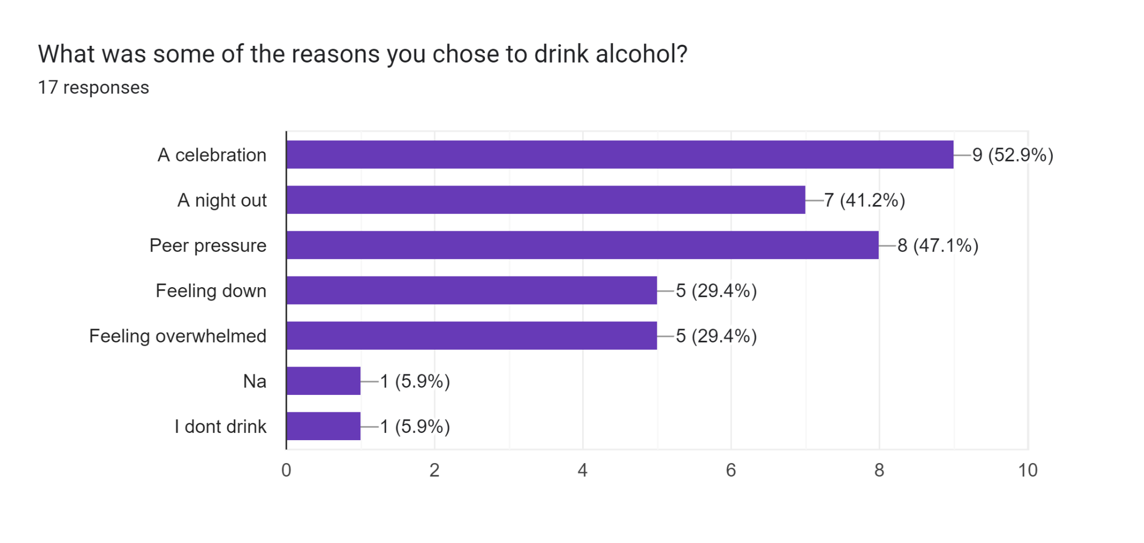

Slide 15
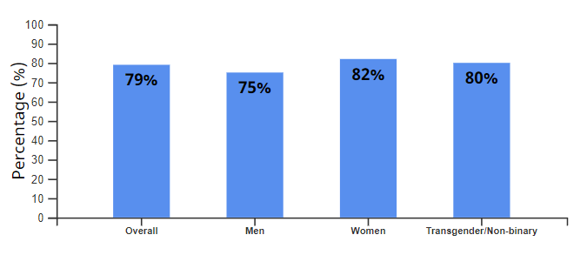
Evidence of Students Leading to Alcohol Addiction
Many students across the country are stressed and have anxiety from immense schoolwork. Which leads the majority of students to rely on alcohol to cope with their stress and anxiety. There is a multitude of evidence that shows when students have an increasing amount of stress and anxiety they start coping with alcohol.
This image is from Canadian Postsecondary Education Alcohol and Drug Use Survey. Which was conducted from 31,643 students. Thus, meaning 79% of the students are addicted to alcohol. As show in the graph.

Slide 16
What a Successful Project Will Look Like
We look to implement our goals into a functioning system for students to easily access if needed.
Our main source of assistance to help identify triggers, developing intervention strategies, and, providing a help system and mental health education is through allotted therapy and professionals for this exact situation.
The main issue is being there for them the moment they need it, rather than them having to come find help. To avoid this we will try our best to keep the word near them at all times.
Busiest Halls
How do we make ourselves accessible?
Dorm Elevators
York Main Tunnels
Announcements in dorms
QR CODES
School Email
Social Media
Campus Elevators
Notes:
Used peer reviewed research, and the canadian government website for statistics and research on alcohol dependence.

Slide 17
What Services are Available?
Online consultation
Bookings for therapy sessions
Any form of communication that suits you in the time you most need it

Slide 18
Resources
“Alcohol Use among Canadians.” CTADS - Data Blog - Public Health Infobase | Public Health Agency of Canada, Government of Canada, 21 Dec. 2020, health-infobase.canada.ca/alcohol/ctads/.
Canada, Health. “Canadian Alcohol and Drugs Survey (CADS): Summary of Results for 2019.” Canada.Ca, Government of Canada, 28 June 2023, www.canada.ca/en/health-canada/services/canadian-alcohol-drugs-survey/2019-summary.html.
Canada, Public Health Agency of. “Canadian Postsecondary Education Alcohol and Drug Use Survey, 2021-2022: Summary.” Canada.Ca,
12 Jan. 2024, health-infobase.canada.ca/alcohol/cpads/
Canada, Public Health Agency of. “Government of Canada.” Canada.Ca, / Gouvernement du Canada, 26 July 2021, www.canada.ca/en/public-health/services/publications/healthy-living/communicating-about-substance-use-compassionate-safe-non-stigmatizing-ways-2019.html#_4.
“Canada’s Guidance on Alcohol and Health.” Canadian Centre on Substance Use and Addiction, www.ccsa.ca/canadas-guidance-alcohol-and-health. Accessed 3 Feb. 2024.
“How Can Alcohol Affect the Brain? Presentation.” Slidesgo, slidesgo.com/theme/how-can-alcohol-affect-the-brain#search-alcohol&position-5&results-13&rs=search&rs=search. Accessed 5 Feb. 2024.

Slide 19
Resources
“How to Reduce High-Risk College Drinking.” How To Reduce High-Risk College Drinking: Use Proven Strategies, Fill Research Gaps , collegedrinkingprevention.gov, Apr. 2002, www.collegedrinkingprevention.gov/sites/cdp/files/documents/FINALPanel2.pdf.
Kassis, Sylvia Baedorf, and Mary-Tara Roth. “Obtaining Informed Consent for Research from People with Alcohol and Other Drug Dependence.” Alcohol, Other Drugs, and Health: Current Evidence, www.bu.edu/aodhealth/2012/03/01/obtaining-informed-consent-for-research-from-people-with-alcohol-and-other-drug-dependence/. Accessed 3 Feb. 2024.
Saltz, Robert F., and William DeJong. “Reducing Alcohol Problems on Campus - Collegedrinkingprevention.Gov.” Collegedrinkingprevention.Gov, collegedrinkingprevention.gov, Apr. 2002, https://www.collegedrinkingprevention.gov/sites/cdp/files/documents/FINALHandbook.pdf
Statistics Canada. “Dry February, You Say?” Statistics Canada, Government of Canada, 2 Feb. 2023, www.statcan.gc.ca/o1/en/plus/2877-dry-february-you-say.
University, York. Undergraduate Programs - Sessions, York University, futurestudents.yorku.ca/programs/sessions. Accessed 3 Feb. 2024.

Slide 20
Thanks!
Do you have any questions?
Credits: This presentation template was created by Slidesgo, including icons by Flaticon, infographics & images by Freepik

