Slide 1


AI and the Future of Continuous Health Learning & Improvement: A publication of the NAM Digital Learning Collaborative
March 21, 2019
Leadership Consortium for a Value & Science-Driven Health System
Advancing the Learning Health System
Vision • Research • Evidence • Effectiveness • Trials • IT Platform • Data Quality & Use • Health Costs • Value • Complexity • Best Care • Patients • Systems • Measures • Leadership
The Learning Health System Series
Notes:
Today I will provide a brief overview of a special publication that a working group of experts on artificial intelligence and its use in health care have been working on for the past year.
Thank Michael and Sonoo for joining by phone.

Slide 2


DLC meeting – November 30, 2017
Meeting objective: Consider the nature, elements, applications, state of play, and implications of AI/ML in health and health care, and ways in the NAM might enhance collaborative progress.
Meeting outcome: Identification of major barriers & establishment of a NAM working group
Facilitating workflow integration
Enhancing explainability & interpretability
Workforce education
Oversight & regulation
Problem identification & prioritization
Clinician & patient engagement
Data quality & access
Additional Information: https://nam.edu/event/digital-learning-collaborative-4/
@theNAMedicine
Notes:
In 2017, participants in the DLC identified issues related to the introduction of ML algorithms into health care as an important priority so on November 30, 2017, the NAM hosted a meeting to consider…
By the end of the meeting, the participants had identified the following as the major barriers to the routine use of ML algorithms in HC settings and the participants called for the formation of a working group to continue to address these issues.

Slide 3
Working Group
Original charter: To explore the fields of AI & their applications in health and health care, & to consider approaches to addressing the barriers identified at the DLC meeting
strategies to enhance data integration to advance AI
practical challenges to AI model development & implementation
opportunities for accelerating progress
@theNAMedicine
Notes:
In early 2018, we formed the working group, whose goal was to…

Slide 4
Working Group: Membership
Andrew Auerbach, MD, University of California San Francisco
Andy Beam, Harvard University
Paul Bleicher, MD, PhD, OptumLabs
John Burch, MBA, JLB Associates
Wendy Chapman, PhD, University of Utah
Jonathan Chen, Stanford University
Lenard D’Avolio, PhD, Cyft
Hossein Estiri, PhD, Harvard Medical School
James Fackler, MD, John Hopkins School of Medicine
Steve Fihn, MD, MPH, FACP, University of Washington
Anna Goldenberg, PhD, University of Toronto
Seth Hain, MS, Epic
Jaimee Heffner, Fred Hutchinson Cancer Research Center
Michael Howell, MD, MPH, Google Research
Edmund Jackson, PhD, Hospital Corporation of America
Hongfang Liu, PhD, FACMI, Mayo Clinic
Michael Matheny, MD, MS, MPH, Vanderbilt University *
Doug McNair, MD, PhD, Cerner
Eneida Mendonca, MD, PhD, University of Wisconsin Madison
Wendy Nilsen, PhD, National Science Foundation
Nicholson Price, University of Michigan
Joachim Roski, PhD, MPH, Booz Allen Hamilton
Suchi Saria, Johns Hopkins University
Nigam Shah, MBBS, PhD, Stanford University
Sonoo Thadaney, MBA, Stanford University *
Ranak Trivedi, Stanford University
Reed Tuckson, MD, FACP, Tuckson Health Connections
Charlene Weir, University of Utah
Jenna Wiens, University of Michigan
Daniel Yang, MD, Moore Foundation
@theNAMedicine
Notes:
Hard to read but I will provide a copy of the slides if you would like to take a closer look.
The working group is co-chaired by Michael Matheny from Vanderbilt and Sonoo Thadaney from Stanford

Slide 5
Publication: Overview
Objectives and scope: Develop a reference document for model developers, clinical implementers, clinical users, and regulatory and policy makers to:
understand the strengths & limitations of AI/ML
promote the appropriate use of these methods & technologies within the healthcare system
highlight areas of future work needed in research, implementation science, & regulatory bodies to facilitate the broader use of AI/ML in healthcare
@theNAMedicine
Notes:
Early on in there deliberations the working group decided that the best way to begin to approach the barriers identified was to develop a reference document…
And the group has been working and meeting monthly by phone to develop the publication.

Slide 6
Publication: Organization
TOPIC LEADS
NAM DLC Jonathan Perlin, Reed Tuckson
NAM Program Office Danielle Whicher, Mahnoor Ahmed
Publication Editors and Workgroup Chairs Sonoo Thadaney, Michael Matheny
Chapter 1: Introduction Sonoo Thadaney, Michael Matheny
Chapter 2: History of AI Edmund Jackson, Jim Fackler
Chapter 3: Promise/Opportunities for AI Joachim Roski, Wendy Chapman
Chapter 4: Pitfalls/Challenges for AI Eneida Mendonca, Jonathan Chen
Chapter 5: AI Development & Validation Hongfang Liu, Nigam Shah
Chapter 6: AI Deployment in Clinical Settings Steve Fihn, Andy Auerbach
Chapter 7: Regulatory & Policy Issues Doug McNair, Nicholson Price
Chapter 8: Conclusions & Key Needs Sonoo Thadaney, Michael Matheny
@theNAMedicine
Notes:
So here is an overview of the way the publication is organized

Slide 7
Publication: Scope
Direct Encounter-Based Care
“Non-Traditional” Settings: CVS, Home
Population Health Management
Healthcare Administration
Patient/Consumer Facing Technologies
@theNAMedicine
Notes:
We are including all of the following

Slide 8
Questions and Discussion
@theNAMedicine
Notes:
Ask Michael if he has anything to add before the discussion!

Slide 9
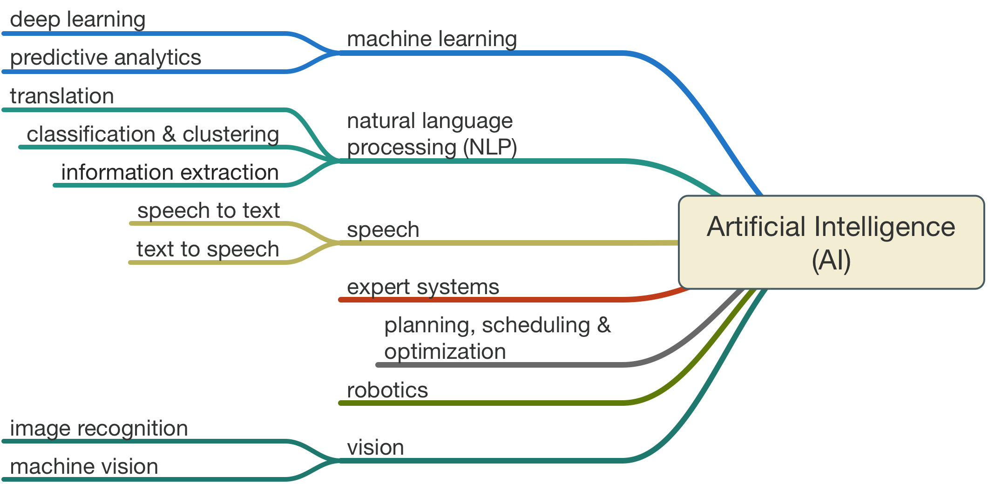
AI: What do we mean?
https://www.legaltechnology.com/latest-news/artificial-intelligence-in-law-the-state-of-play-in-2015/
@theNAMedicine

Slide 10
Publication: Target Audiences
Direct Care Providers
Patients & their Caregivers
Healthcare System Leadership & Admin
Data Scientists (Developers)
Clinical Informatics (Implementers)
Legislative & Regulatory Bodies
Third Party Payors
@theNAMedicine

