Slide 1
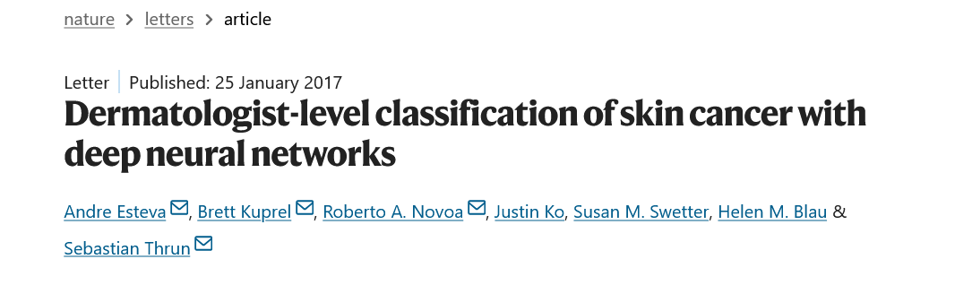
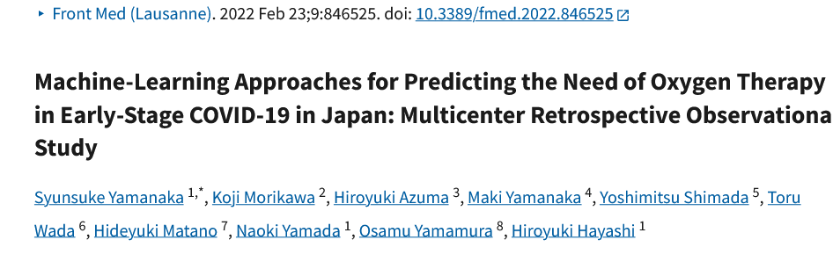

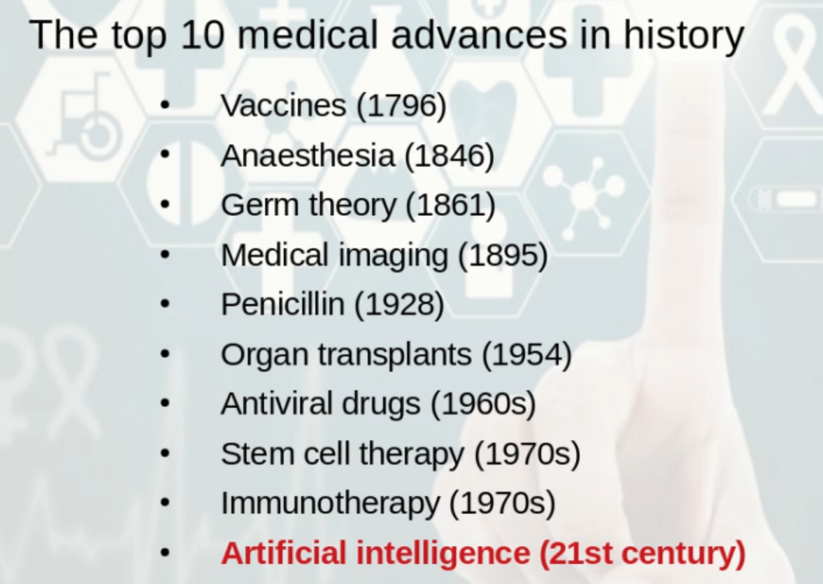



Artificial Intelligence & Medicine

Slide 2

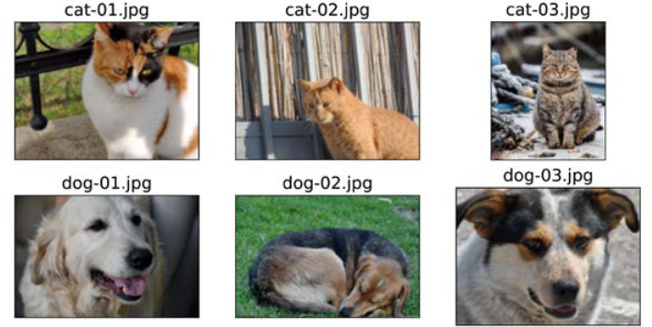
How would you teach a computer to tell a cat from a dog?
Dog or Cat ?

Slide 3
What is AI, Machine Learning, and Deep Learning?
Artificial intelligence is the broad concept of machines performing tasks that normally require human intelligence.
Machine learning is a part of AI in which models learn from data instead of following only fixed rules.
Deep learning is a more advanced branch of machine learning that uses multi-layer neural networks and is especially powerful for complex data such as medical images and signals.

Slide 4
4 Types of Machine Learning:
Supervised learning
Semi-supervised learning
Unsupervised learning
Reinforcement learning

Slide 5
Supervised Learning:
KNN
Multiple Linear Regression
Decision Tree
Regression
Simple Linear Regression
Classification
Logistic Regression
Polynomial Regression
SVM

Slide 6
Common Steps in ML Usage
Data collection
Data engineering
Preprocessing
Reinforcement learning
Train / validation / test split
Semi-supervised learning
Validation and tuning
Model training
Deep learning doesn't require human interference
Testing
Evaluation
Deployment
Monitoring and improvement

Slide 7
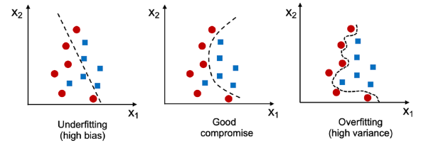
Overfitting happens when a model learns the training data too closely, including noise and unimportant details, so it performs very well on training data but poorly on new unseen data.
Underfitting happens when a model is too simple to learn the real patterns in the data, so it performs poorly on both training data and test data.

Slide 8
What Types of Medical Data Can AI Use?
Patient records and history
Lab and diagnostic test results
Medical imaging
Clinical notes and reports
Vital signs and wearable data
Genetic information
AI combines structured and unstructured medical data to detect patterns, support diagnosis, and improve treatment decisions.

Slide 9
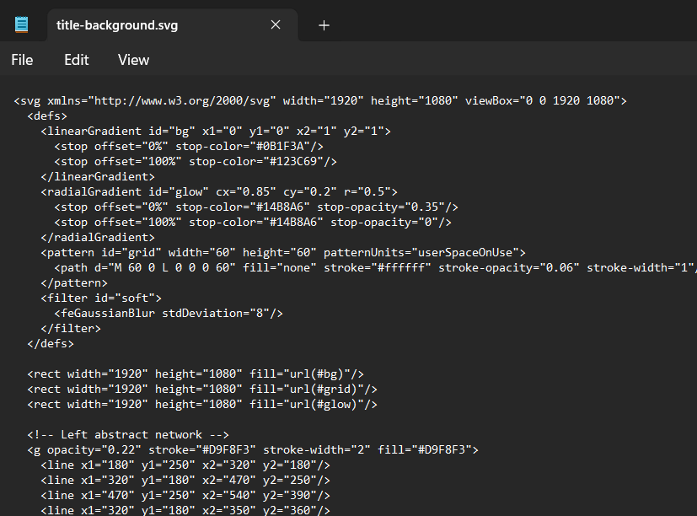
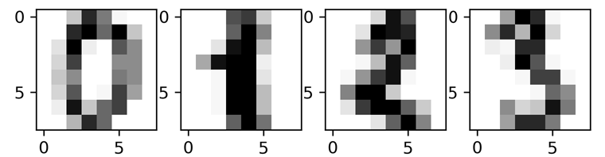

Scalable Vector Graphics (SVG): vector files store images via mathematical formulas based on points and lines on a grid
Pixel based images(JPEG, PNG ,…): Pixels arranged in a grid to form an image. Each pixel holds color and position information

Slide 10
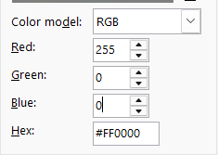
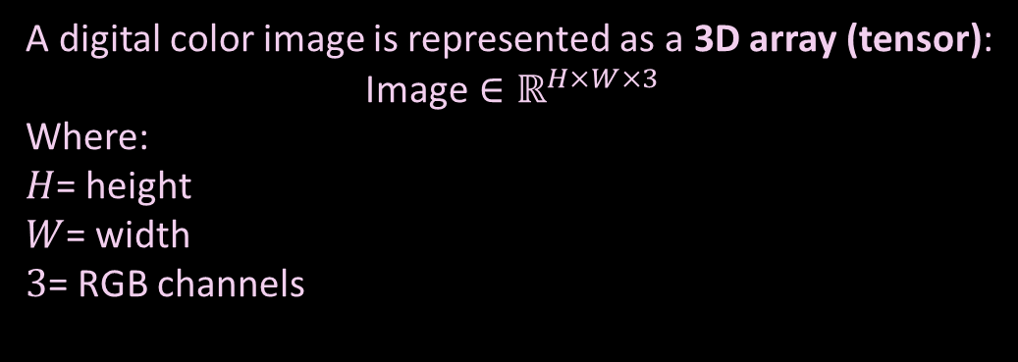
Computers see an image as a grid of pixels.
Each pixel has:
a position in the image, such as row and column
color values
(if colored) usually 3 channels: R, G, B (Red, Green, Blue)
[
[0, 0, 0],
[255, 0, 0],
[0, 255, 0],
[0, 0, 255],
[255, 255, 255],
[128, 128, 128],
[255, 255, 0],
[0, 255, 255],
[255, 0, 255],
[100, 50, 200],
…
]
Pixel at (x=10, y=20) = [255, 0, 0]
R G B
A digital color image is represented as a 3D array (tensor):
$$\text{Image}∈ℝ^{H×W×3}$$
Where:
$H$= height
$W$= width
$3$= RGB channels
*Calculations for each color image are 5 dimensional equations

Slide 11
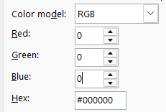
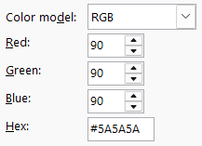
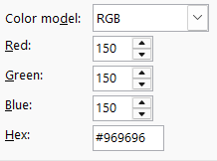
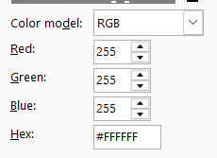
A digital B&W image is represented as a 3D array (tensor):
"Image"∈ℝ^(𝐻×𝑊×1)
Where:
𝐻= height
𝑊= width
1 = B&W sacle
*Here we only need to do 3 dimensional Linear Algebra calculations
[0, 34, 87, 120, 255, 200, 15, 90, 180, 60, …]

Slide 12
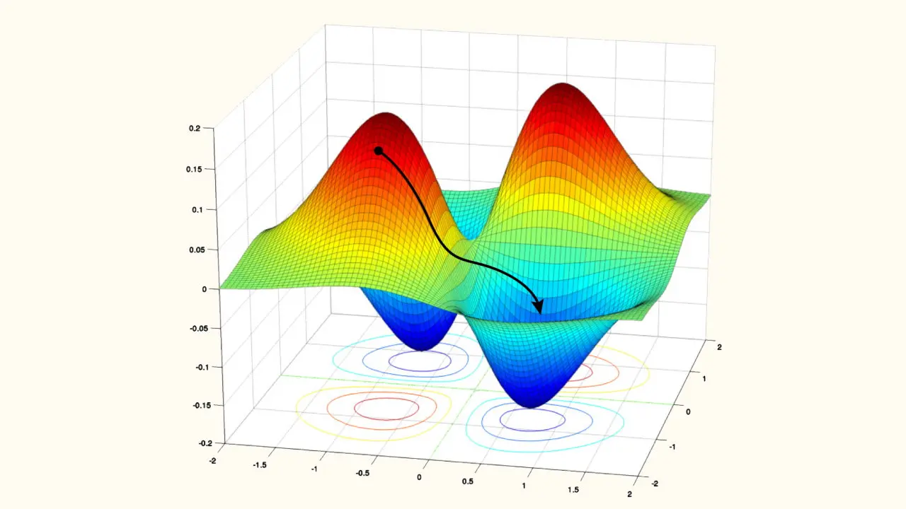
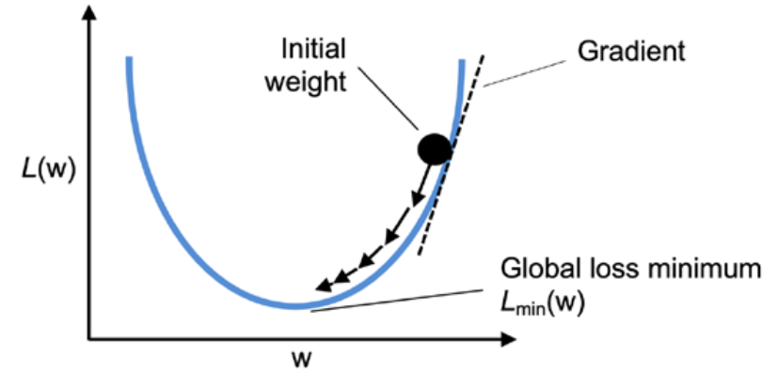
Basic Mathematics Behind Machine Learning
machine learning learns by minimizing error.
Loss Functions:
MSE=n1​∑(y−y^​)2
L=−[ylog(y^​) + (1−y)log(1−y^​)]
Training objective: minimize the loss
Loss function: measures prediction error
Gradient descent: moves parameters toward lower loss

Slide 13
How AI Understands and Processes Medical Images
AI sees an image as a matrix of numbers.
It learns by detecting important patterns such as edges, shapes, textures, lesions, and anatomical structures.
This process reduces the data dimensionality while preserving clinically important information.

Slide 14
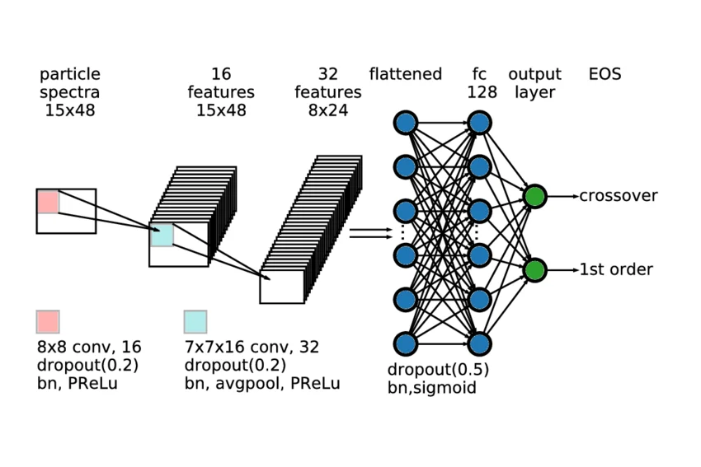
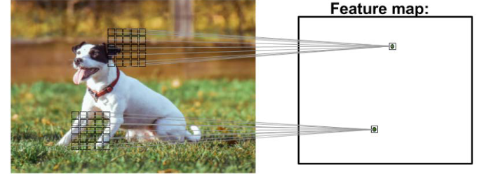
Convolutional Neural Networks (CNNs):
Deep learning models, especially CNNs, process them through convolution, pooling, and hierarchical feature extraction.
CNNs are a family of models that were originally inspired by how the visual cortex of the human
brain works when recognizing objects.

Slide 15

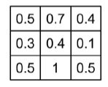
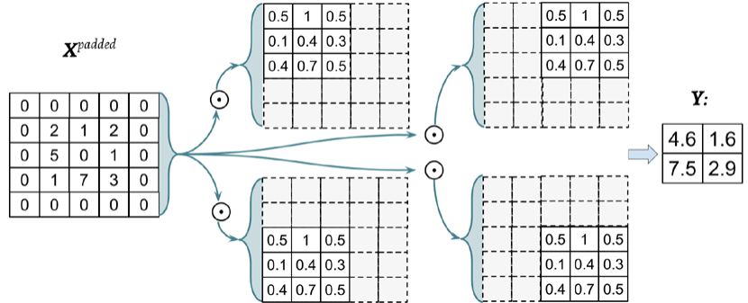


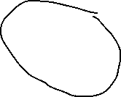
Discrete convolution:
3*3 W kernel matrix
0.0 0.9 0.0
0.8 0.7 0.8
0.7 0.6 0.7
Computing the sum of the element-wise product

Slide 16
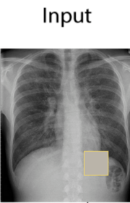
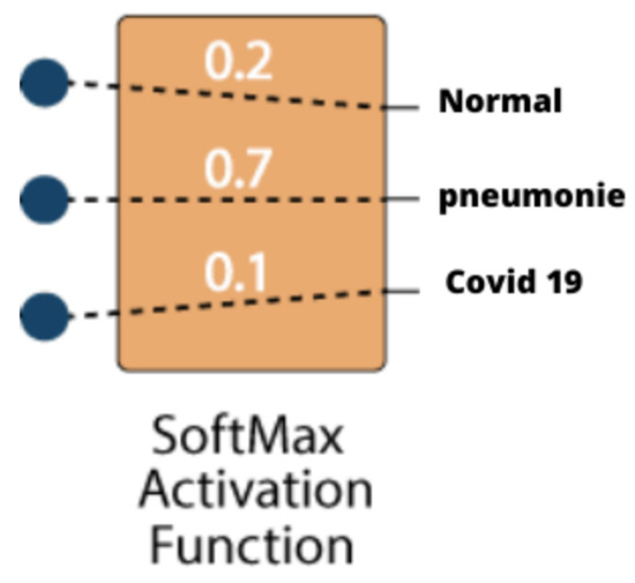
CNN for Medical Imaging Diagnostic
This paper is useful because it does not only describe how CNNs classify medical images, but also how we can explain their decisions.
making CNN-based medical diagnosis more transparent and clinically trustworthy.
https://doi.org/10.3390/electronics11111775
CXAI: Explaining Convolutional Neural Networks for Medical Imaging Diagnostic

Slide 17


Slide 18
Example Models Used in Medicine
Convolutional Neural Networks (CNNs): used for medical image analysis such as X-rays, CT scans, MRI, and pathology slides
Recurrent Neural Networks (RNNs) / LSTMs: used for time-series medical data such as ECG, EEG, and patient monitoring signals
Autoencoders: used for anomaly detection, feature extraction, and medical data compression

Slide 19
How We Evaluate AI in Healthcare:
In healthcare, evaluation matters more than in many other fields because mistakes can directly affect diagnosis, treatment, and patient safety.
We must measure not only accuracy, but also reliability, fairness, clinical usefulness, and performance on real-world data.
A strong healthcare AI evaluation usually includes:
Performance metrics : accuracy, sensitivity, specificity, precision, recall, F1-score, AUC
Clinical relevance: whether the model helps doctors make better decisions
Safety(whether errors could harm patients)
Fairness: whether performance is consistent across age, gender, ethnicity, and population groups
Robustness: whether the model still works with noisy, incomplete, or different real-world data
External validation: whether it performs well on data from other hospitals or populations

Slide 20
Let’s look at an example.

Slide 21
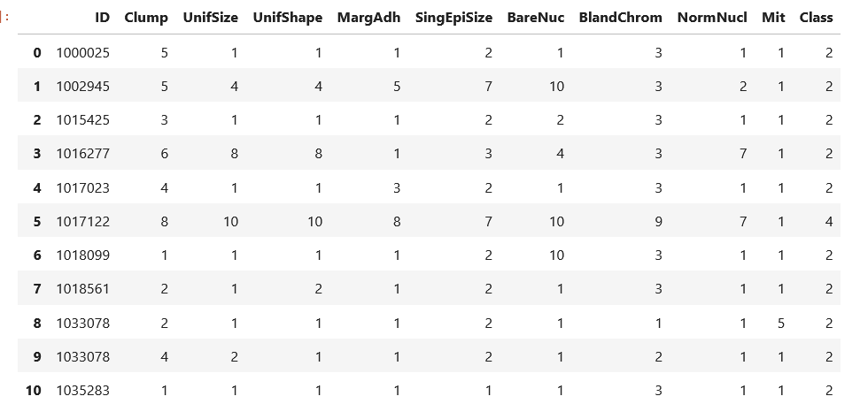
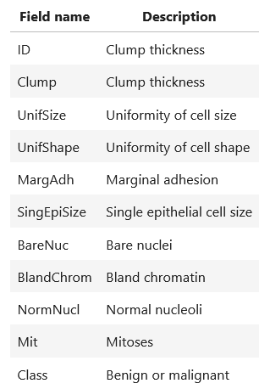
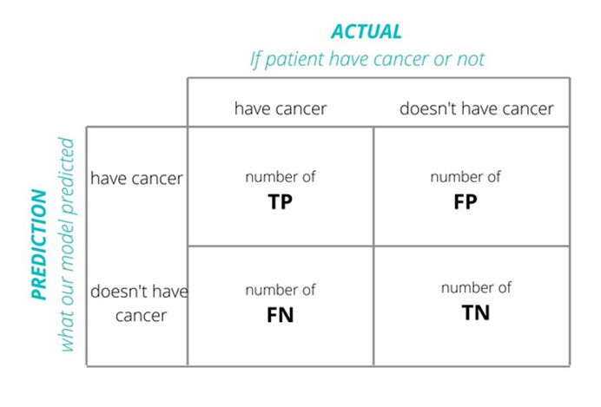
Our task is to filter features and make a model to predict whether given sample is Benign or Malignant.
We’ll use SVM model
Our Evaluation technique will be Confusion Matrix:
The dataset consists of several hundred human cell sample records, each of which contains the values of a set of cell characteristics.

Slide 22
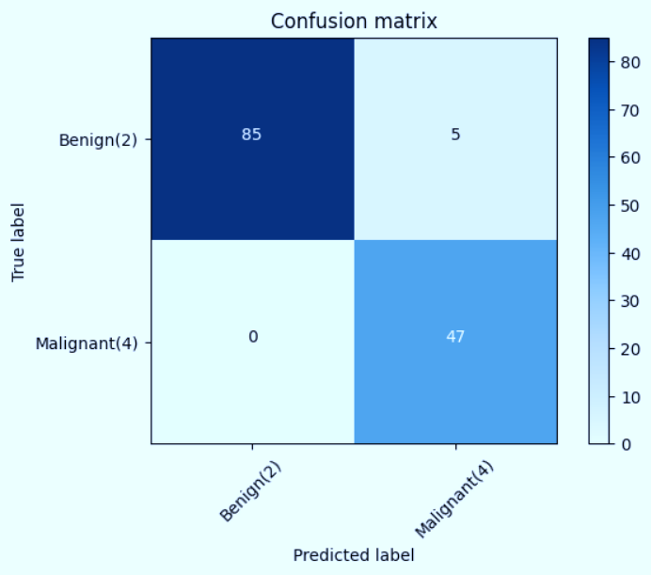
Evaluation of our ML model’s prediction:
TN
FP
“In this case, ‘Positive’ means a Malignant result, which is more clinically important.”
FN
TP
TP + TN
Accuracy :
TP+TN+FN+FP
=(85+47)/(85+47+5)=96.3%
TP
Recall :
TP+FN
=(47)/(47+0)=100%

Slide 23

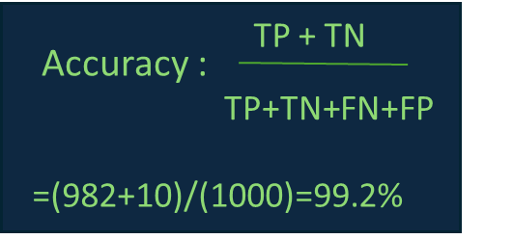
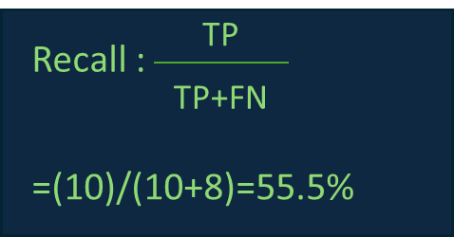
Now, let’s look at a more practical case.
982
0
“Assuming the prevalence of cancer is 1%”
8
10
So, if we build a model with 99% accuracy, it is basically no better than pure randomness.
This shows why selecting the right evaluation metric matters.

Slide 24
Applications and Recent Advances of AI in Medicine

Slide 25
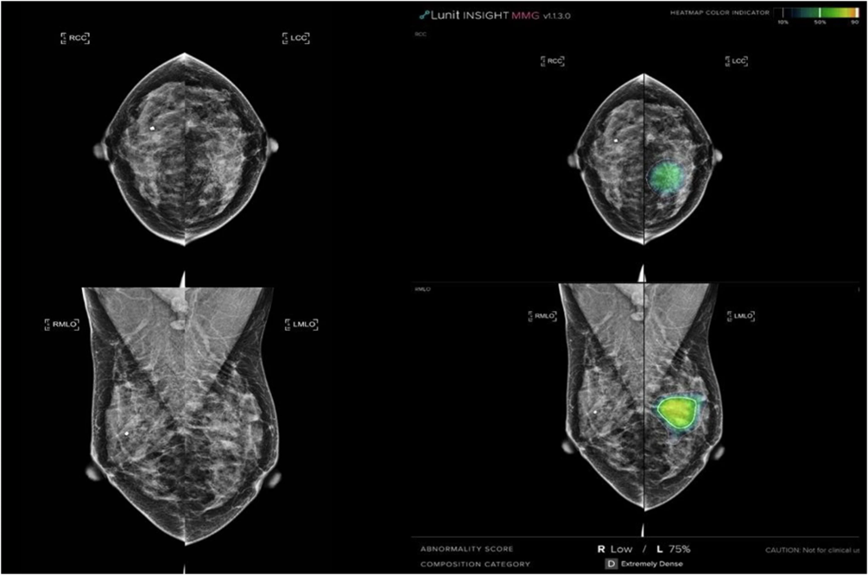
Breast Cancer Detection in Mammography
Artificial intelligence (AI) improves the accuracy of mammography screening, but prospective evidence, particularly in a single-read setting, remains limited.
This study compares the diagnostic accuracy of breast radiologists with and without AI-based computer-aided detection (AI-CAD) for screening mammograms in a real-world, single-read setting.
with a focus on cancer detection rates (CDRs) and recall rates (RRs) of radiologists

Slide 26
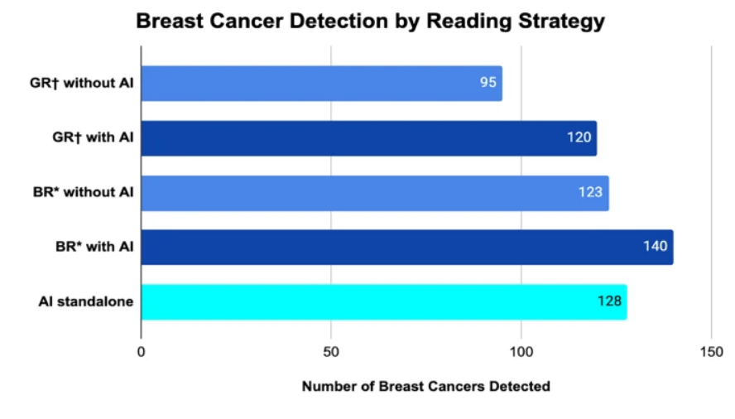
The CDR is significantly higher by 13.8% for breast radiologists using AI-CAD (n = 140 [5.70‰]) compared to those without AI (n = 123 [5.01‰]; p < 0.001), with no significant difference in RRs (p = 0.564)
These preliminary results show a significant improvement in CDRs without affecting RRs in a radiologist’s standard single-reading setting

Slide 27
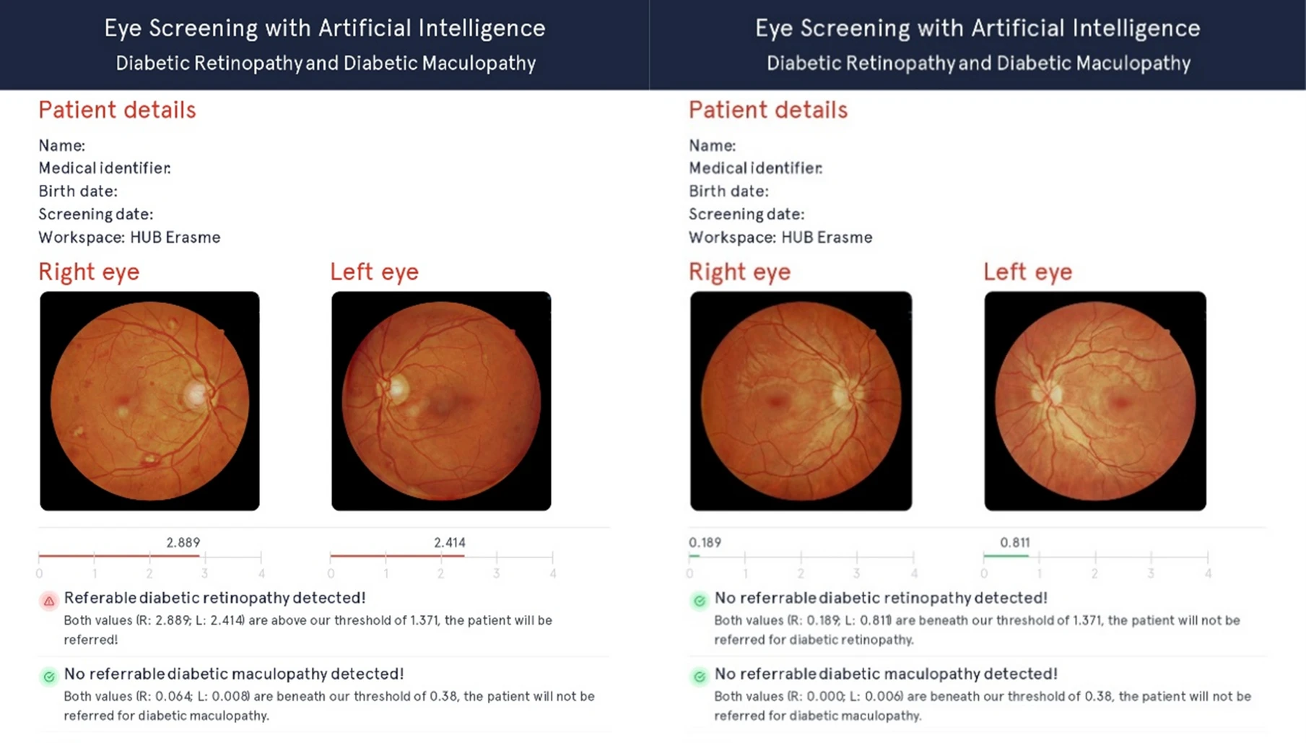
Diabetic Retinopathy Screening
Diabetic retinopathy (DR) is a leading cause of preventable blindness, and the growing global burden of diabetes is placing increasing pressure on ophthalmic services.
The AI system achieved an area under the curve of 96.5%, sensitivity of 88.9%, specificity of 98.7%, and high predictive values for referable DR detection.

Slide 28
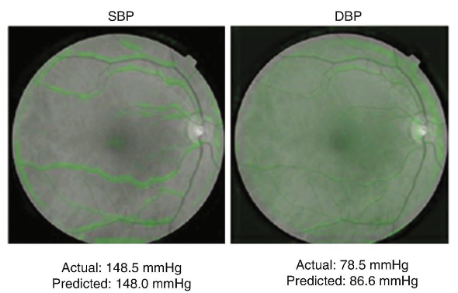
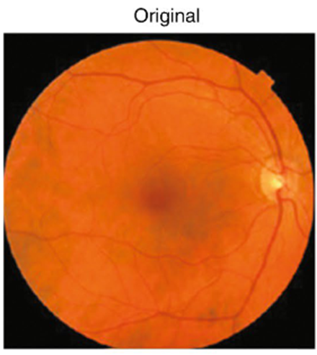
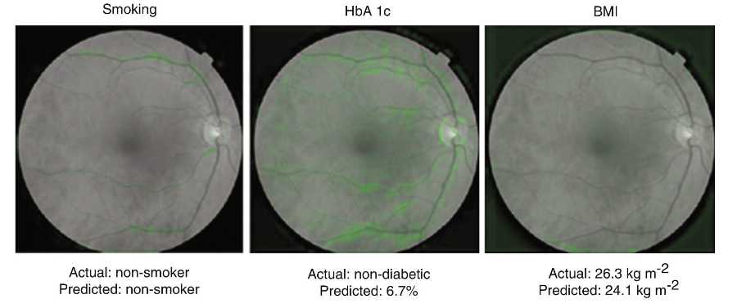
The best-known, FDA-approved, AI-based medical devices in the field of ophthalmology are IDx-DR (2018), the first software to provide screening decisions that do not have to be interpreted by a
clinician, and Eyenuk (2020), which, like IDx-DR,
screens fordiabetic retinopathy.
images show the same retinal image in black-and-white. The soft attention heat map for each prediction is overlaid in green, indicating the areas of the heat map that the neural-network model is using to make the prediction for the image.

Slide 29
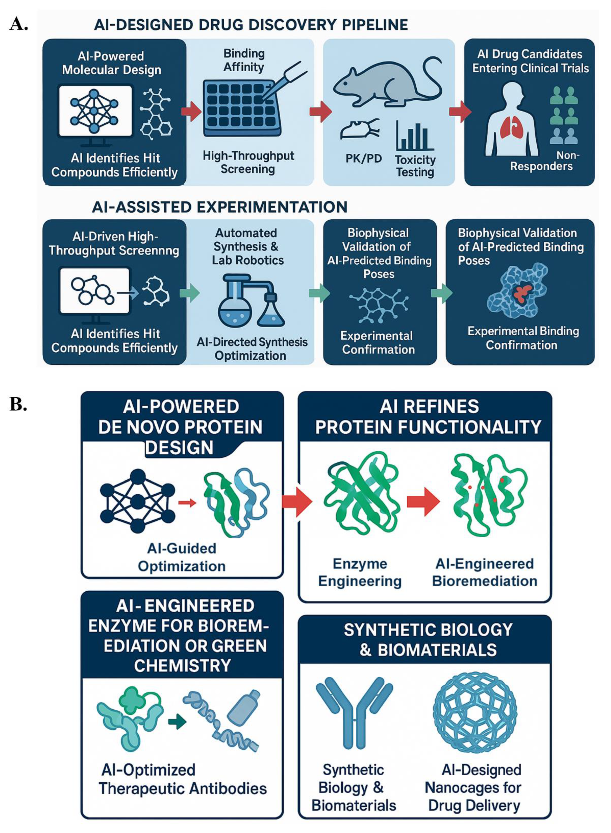
Drug Discovery and Protein Structure
Recent advancements in AI-driven technologies, particularly in protein structure prediction, are significantly reshaping the landscape of drug discovery and development
By enhancing the precision and speed at which drug targets are identified and drug candidates can be designed and optimized, these technologies are streamlining the entire drug development process.

Slide 30
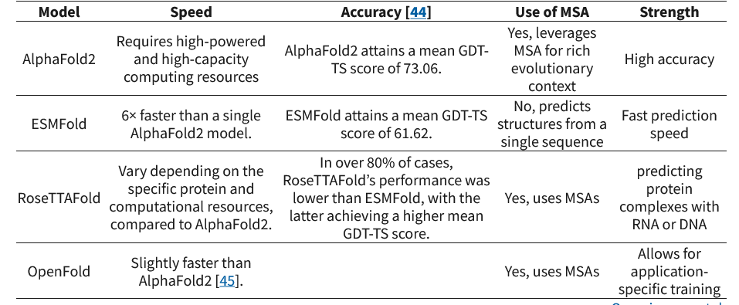
Comparing AlphaFold2 vs. ESMFold vs. RoseTTAFold vs. OpenFold:
The contrasting approaches among AF2, ESMFold, RoseTTAFold and OpenFold highlight the trade-offs between prediction speed and accuracy and need for additional input data
It also shows how much room there still is for improvements.

Slide 31
References:
Machine.Learning.with.PyTorch.and.Scikit-Learn.Sebastian.Raschka.Packt
Hands.on.Machine.Learning.with.Scikit.Learn.Keras.and.TensorFlow.OReilly.Media
IBM Machine Learning course
Andrew NG Machine Learning course
Artificial Intelligence in Ophthalmology Second Edition
Artificial intelligence for breast cancer screening in mammography (AI-STREAM): preliminary analysis of a prospective multicenter cohort study
Advances in AI for Protein Structure Prediction: Implications for Cancer Drug Discovery and Development
Poplin R, Varadarajan AV, Blumer K, Liu Y, McConnell MV, Corrado GS, Peng L, Webster DR. Prediction of cardiovascular risk factors from retinal fundus photographs via deep learning. Nat Biomed Eng. 2018 Mar;2(3):158–164
CXAI: Explaining Convolutional Neural Networks for Medical Imaging Diagnostic

