Slide 1

AP Physics Programming Unit
A programming unit designed for AP physics in high school
Phys 177 University California Riverside
By: Chris Cosio

Slide 2
Introduction Pt.1
Introduction and presentation overview
Motivations for the project
How the labs work
Summary of lab topics

Slide 3
Introduction Pt.2
An analysis: Labs 1-6
Video demo for each lab
Summary
Questions

Slide 4
Motivations for the Labs
Differentiated instruction
Programming exposure
Emphasize programming in python
For Visualizations: vPython

Slide 5
Lab Synopsis
Six Labs over one year
One lab per month
Mechanics emphasized in each lab
Final programming project included

Slide 6
Lab Synopsis
Six labs in total
Labs focus on:
  New Techniques
  Reviewing Physics
  Analysis
  Synthesis
Labs also contain writing components
Roughly 30 hours of in-class lab
Labs to be completed at home
Grading is effort based and less results based

Slide 7
Lab Topics
Introduction to python and 1D kinematics
Fan cart sim and momentum
Free fall sim and energy
Data analysis and fan cart revisited
Satellite orbit
A space voyage

Slide 8
Lab 1: Intro/1D Kinematics
Three parts:
  Introduction and installation
  “Hello World”
  Kinematic Calculator
A simple introductory lab.
Topics include input, output, variables, and math operations

Slide 9
Lab 2: Fan Cart Sim
Three parts:
  Loops and vPython Objects
  1st Sphere
  Fan Cart Sim
Highlights velocity, momentum and impulse
Topics include libraries, attributes, and vectors

Slide 10
Lab 3: Free Fall Sim and Energy
Three parts:
  Programming functions and graphs
  Function practice
  Free fall sim & graphs
Highlights potential and kinetic energy
Topics include how to write and use functions in addition to updating graph attributes

Slide 11
Lab 4: Data Analysis
Three parts:
  Reading text files and using arrays
  Revisiting the fan cart data
  Data Analysis from .txt file
Highlights new programming techniques
Topics include how to use built-in numpy functions and how to read .txt files into arrays

Slide 12
Lab 5: Satellite Orbit
Four Parts:
  No new programming techniques
  Reviews gravitational forces
  Very little sample code given
A lab to test how well the class can program
This lab serves as a build up to the final project

Slide 13
Lab 6: A Space Voyage
One part:
  No new programming techniques
  Reviews the entire unit
  Very little sample code given
A final programming project done in groups
This lab allows for synthesis from the previous five labs

Slide 14
Video Demo
I am now going to show you a demo video of the final solution of each lab

Slide 15
Summary
This lab unit utilizes many introduction vPython techniques
Early year concepts are reviewed
Sufficient “Scaffolding” is provided
Lab is ready to be used, but needs polish
Any future teachers here are welcome to the files on github, look for:
ChrisCvPythonLabs

Slide 16
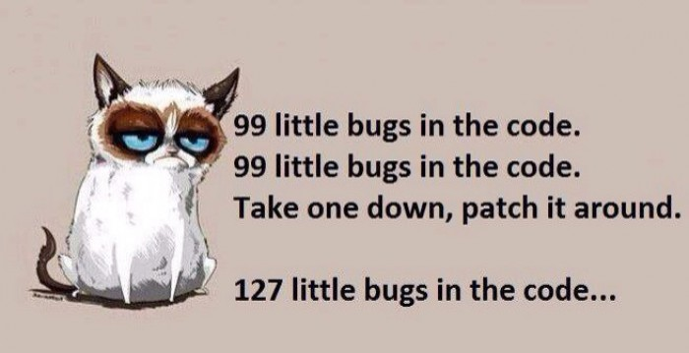
Questions?

Slide 17
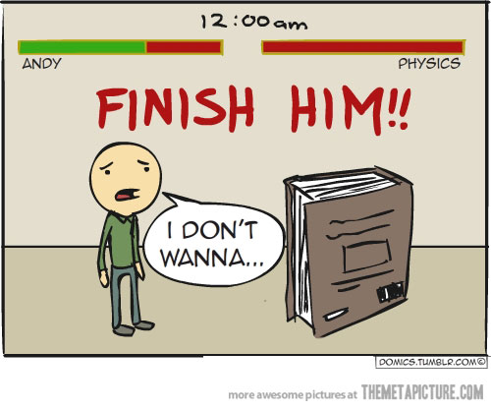
\0/~End

