Slide 1
backend
By miss. Artittiya Meejarurnphon computer engineering

Slide 2
System
Sever
Mongodb
Broker MQTT
Publisher
Subscliber

Slide 3
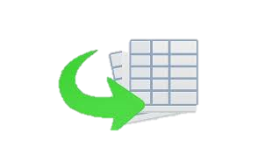
Publisher
Topic:test
JSON
MQTT
Data
(Name,country)

Slide 4

Subscriber
Topic:test
MQTT
JSON
JSON
Subscriber
dataset

Slide 5
Server
server

Slide 6
THANK YOU
Insert the Subtitle of Your Presentation

