Slide 1
Authentication Protocols II
Security
Computer Science Tripos part 2
Ross Anderson

Slide 2
Offline PIN Problem, 1993
IBM system for ATMs:
  PIN = {PAN}_{KP}
Offline operation: write {PIN}_{KA} to the card track and give KA to all ATMs
What’s wrong with this? (the crooks found out in 1993 and offline operations had to be suspended)

Slide 3
Chip Authentication Program (CAP)
Introduced by UK banks to stop phishing
Each customer has an EMV chipcard
Easy mode:
  U → C: PIN
  C → U: {N, PIN}_{KC}
Serious mode:
  U → C: PIN, amt, last 8 digits of payee A/C…

Slide 4
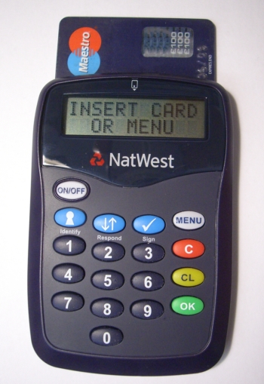
CAP (2)

Slide 5
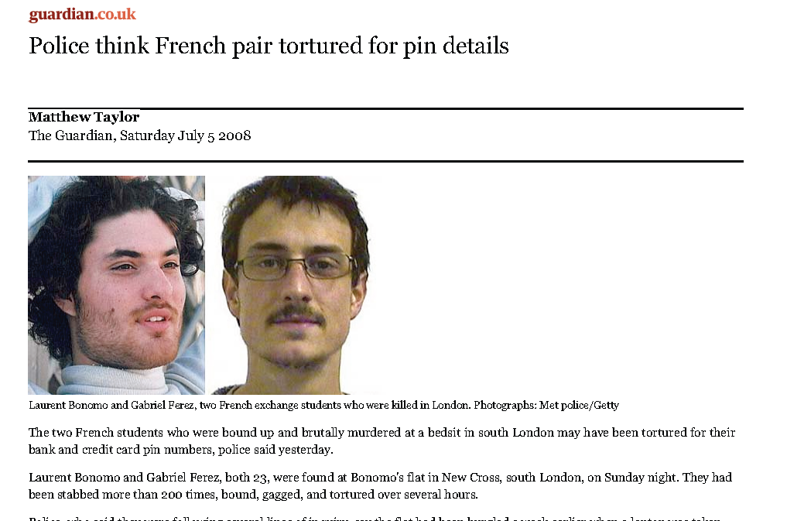
What goes wrong…

Slide 6
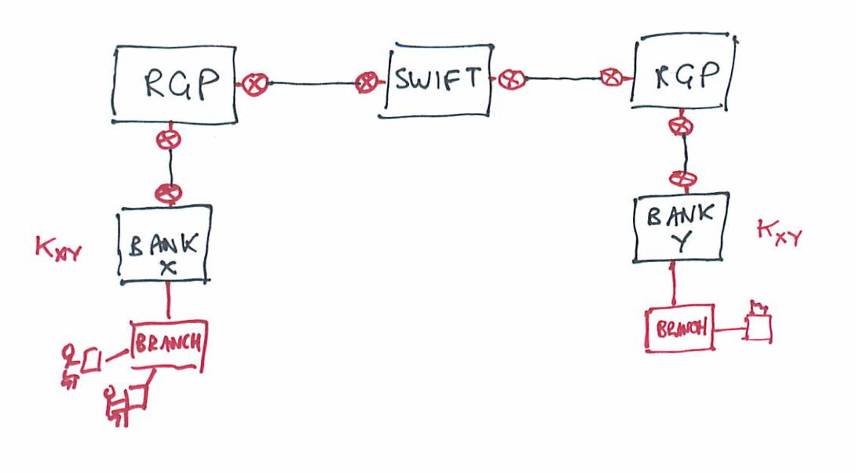
SWIFT

Slide 7
Key Management Protocols
HomePlug AV has maybe the simplest…
Secure mode: type the device key KD from the device label into the network hub. Then
  H → D: {KM}_{KD}
Simple-connect mode: hub sends a device key in the clear to the device, and user confirms whether it’s working
Optimised for usability, low support cost

Slide 8
Key management protocols (2)
Suppose Alice and Bob share a key with Sam, and want to communicate?
  Alice calls Sam and asks for a key for Bob
  Sam sends Alice a key encrypted in a blob only she can read, and the same key also encrypted in another blob only Bob can read
  Alice calls Bob and sends him the second blob
How can they check the protocol’s fresh?

Slide 9
Key management protocols (2)
Here’s a possible protocol
  A → S: A, B
  S → A: {A, B, K_{AB},T}_{KAS}, {A, B, K_{AB},T}_{KBS}
  A → B: {A, B, K_{AB},T}_{KBS}
She finally sends him whatever message she wanted to send, encrypted under K_{AB}
  A → B: {M}_{KAB}

Slide 10
A Quick Test
The following protocol was proposed by Woo and Lam for logon authentication
  A → B: A
  B → A: NB
  A → B: {NB}_{KAS}
  B → S: {A, {NB}_{KAS}}_{KBS}
  S → B: {NB}_{KBS}
Is it OK?

Slide 11
Needham-Schroder
1978: uses nonces rather than timestamps
  A → S: A, B, NA
  S → A: {N_{A}, B, K_{AB},{K_{AB}, A} _{KBS}}_{KAS}
  A → B: {K_{AB}, A}_{KBS}
  B → A: {NB}_{KAB}
  A → B: {NB - 1}_{KAB}
The bug, and the controversy…

Slide 12
Otway-Rees
Proposed fix for NS – also allows nested RPCs
  A → B: M A, B, {N_{A},M,A,B}_{KAS}
  B → S: M A, B, {N_{A},M,A,B}_{KAS,}{N_{B},M,A,B}_{KBS}
  S → B: M, {N_{A}, K_{AB}}_{KAS},{N_{B}, K_{AB}}_{KBS}
  B → A: {N_{A}, K_{AB}}_{KAS}
Passes formal verification…
But can still break with poor implementation (e.g. if you use CBC encryption with block boundaries aligned with the protocol element boundaries)

Slide 13
Kerberos
The ‘revised version’ of Needham-Schroder – nonces replaced by timestamps
  A → S: A, B
  S → A: {T_{S}, L, K_{AB}, B,{T_{S}, L, K_{AB}, A}_{KBS}}_{KAS}
  A → B: {T_{S}, L, K_{AB}, A}_{KBS,} {A, T_{A}}_{KAB}
  B → A: {A, T_{A}}_{KAB}
Now we have to worry about clock sync!
Kerberos variants very widely used…

Slide 14
GSM
Each handset SIM has an individual key Ki
Home network sends visited network (RAND, SRES, Kc) where (SRES | Kc) = {RAND}_{Ki}
Handset → Network: IMSI
Network → Handset: RAND
Handset → Network: SRES, {traffic}_{Kc}
Attacks?

Slide 15
3g
3g (UMTS) protocol fixes the weak ciphers and vulnerability to rogue base stations
{RAND}_{K} = (RES|CK|IK|AK), giving keys for confidentiality, integrity and anonymity
  USIM → HE: IMSI
  HE → VLR: RAND,RES,CK,IK, SEQ⊕AK, MAC
  VLR → USIM: RAND, SEQ⊕AK, MAC
  USIM→ VLR: RES

Slide 16
Formal methods
Many protocol errors result from using the wrong key or not checking freshness
Formal methods used to check all this!
The core of the Burrows-Abadi-Needham logic:
  M is true if A is an authority on M and A believes M
  A believes M if A once said M and M is fresh
  B believes A once said X if he sees X encrypted under a key B shares with A
See book chapter 3 for a worked example

Slide 17
Another Quick Test
In the ‘wide-mouthed frog’ protocol – Alice and Bob each share a key with Sam, and use him as a key-translation service
A → S: {T_{A}, B, K_{AB}}K_{AS}
S → B: {T_{S}, A, K_{AB}}K_{BS}
Is this protocol sound, or not?

Slide 18
What is a Security API ?
An API that allows users to work with sensitive data and keys, and uses cryptography to enforce a policy on the usage of data
Host
PC or Mainframe
VDU
Security Module
PCI Card or Separate Module
I/O Devs
Network
Security API

Slide 19
Hardware Security Modules
An instantiation of a security API
Often physically tamper-resistant
(epoxy potting, temperature & x-ray sensors)
May have hardware crypto acceleration
(not so important with speed of modern PC)
May have special ‘trusted’ peripherals
(key switches, smartcard readers, key pads)
(referred to as HSMs subsequently)

Slide 20
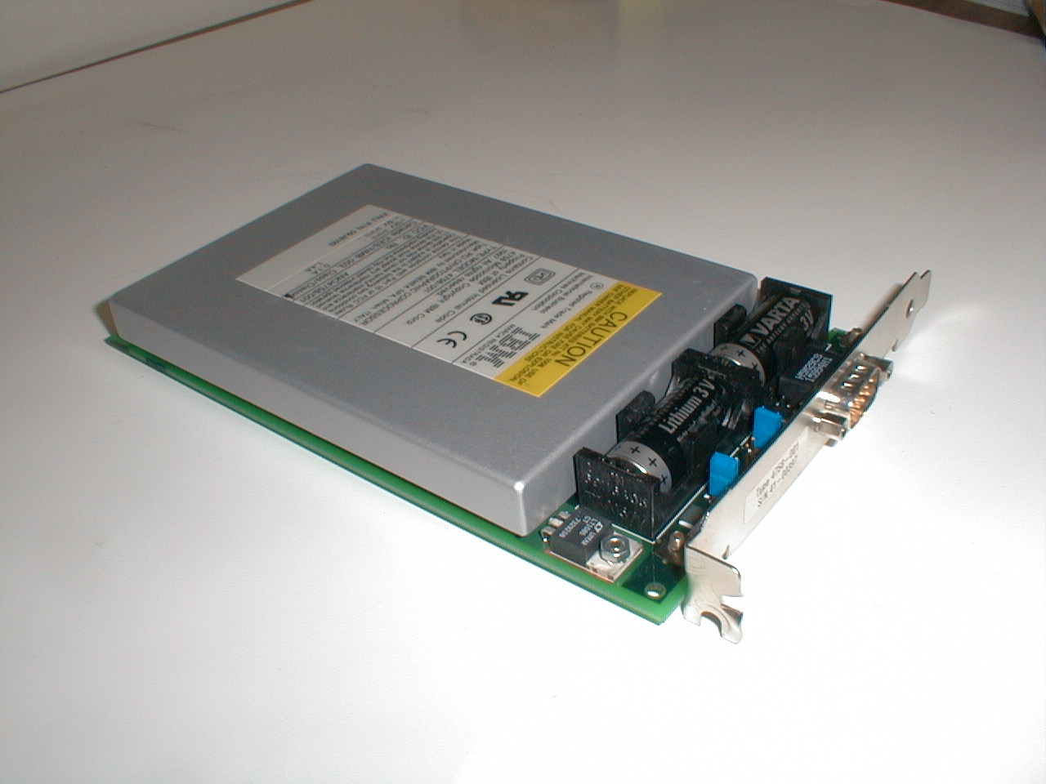
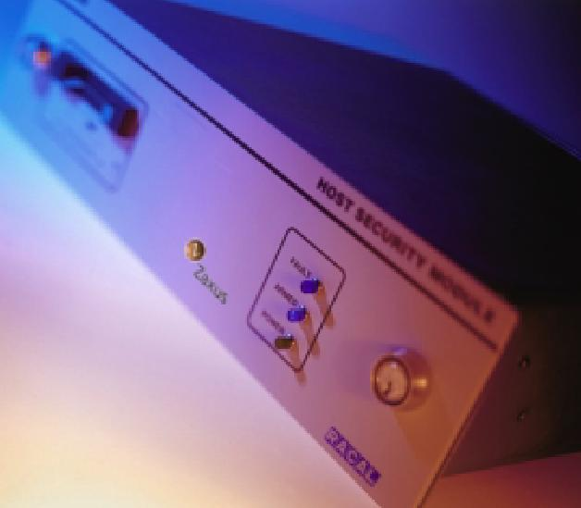
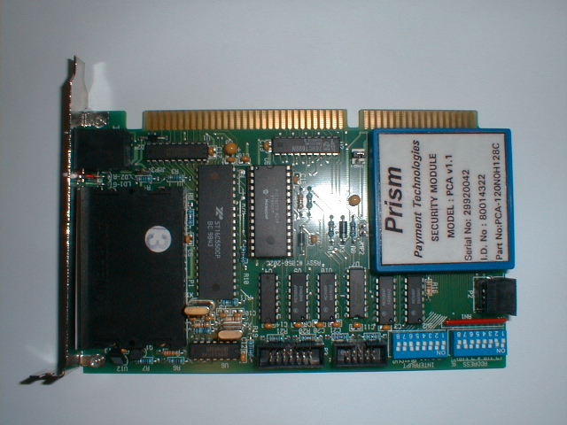
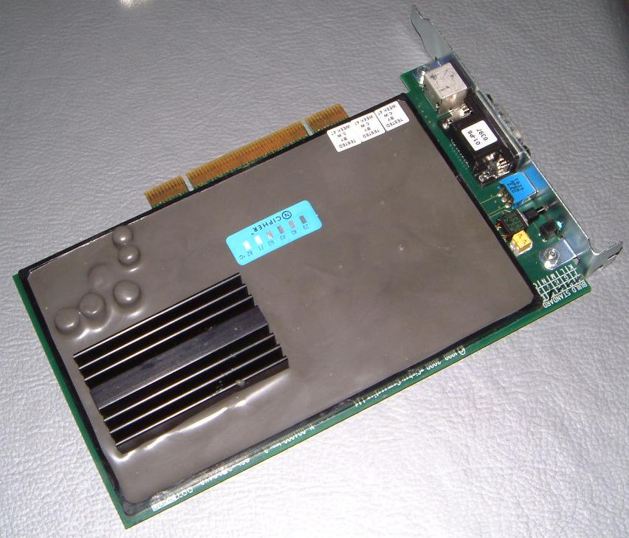
Hardware Security Modules

Slide 21
ATM Network Security
ATM security was the “killer app” that brought cryptography into the commercial mainstream
Concrete security policy for APIs:
“Only the customer should know her PIN”
Standard PIN processing transactions, but multiple implementations from different vendors using hardware to keep PINs / keys from bank staff
IBM made CCA manual available online
  Excellent detailed description of API
  Good explanation of background to PIN processing APIs
  Unfortunately: lots of uncatalogued weaknesses.

Slide 22

HSM Use in Banks
ATM Network
Acquiring
Bank
Issuing
Bank
HSM
HSM
HSM
HSM
HSM
HSM with
keypad
HSM
Issuing Bank
Regional HQ
ATM
HSM
HSM

Slide 23
How are PINs Generated ?
Start with your bank account number (PAN)
5641 8203 3428 2218
Encrypt with PIN Derivation Key
22BD 4677 F1FF 34AC
Chop off the (B->1)
End 2213 (D->3)
decimalise

Slide 24
How do I change my PIN?
Default is to store an offset between the original derived PIN and your chosen PIN
Example bank record…
  PAN 5641 8233 6453 2229
  Name Mr M K Bond
  Balance £1234.56
  PIN Offset 0000
If I change PIN from 4426 to 1979, offset stored is 7553 (digit-by-digit modulo 10)

Slide 25
Offset Calculation Attack (1989)
Bank adds a new command to the API to calculate the offset between a new generated PIN and the customer’s chosen PIN
Possessing a bank account gives knowledge of one generated PIN. Any customer PIN could be revealed by calculating the offset between it and the known PIN
U → C : Old PAN, Old offset, New PAN
C → U : New offset

Slide 26
VSM Attack (2000)
Top-level crypto keys exchanged between banks in several parts carried by separate couriers, which are recombined using the exclusive-OR function
Source
HSM
KP1
Dest
HSM
KP2
Repeat twice…
User→ HSM : Generate Key Component
HSM → Printer: KP1
HSM → User : {KP1}_{ZCMK}
Combine components…
User→ HSM : {KP1}_{ZCMK} ,{KP2}_{ZCMK}
HSM → User : {KP1 ⊕ KP2}_{ZCMK}
Repeat twice…
User→ HSM : KP1
HSM → User : {KP1}_{ZCMK}
Combine components…
User→ HSM : {KP1}_{ZCMK} ,{KP2}_{ZCMK}
HSM → User : {KP1 ⊕ KP2}_{ZCMK}

Slide 27
Idea: XOR To Null Key
A single operator could feed in the same part twice, which cancels out to produce an ‘all zeroes’ test key. PINs could be extracted in the clear using this key
Combine components…
User→ HSM : {KP1}_{ZCMK} , {KP1}_{ZCMK}
HSM → User : {KP1 ⊕ KP1}_{ZCMK}
KP1 xor KP1 = 0

Slide 28
Type System Attack (2001)
ATMs are simpler than HSMs and have only one master key. ATMs need to be sent Terminal Communications keys (session keys) for link cryptography.
HSM
ATM
TC1
Master Keys
TC – terminal communications
TMK – terminal master keys & PIN derivation keys
ZCMK – zone control master keys (between HSMs)
WK – working keys (session keys)
LP – local PIN storage key
Master Key
TMK-ATM - used for everything
{ TC1 }_{TC}
but how?
{ TC1 }_{TMK-ATM}

Slide 29
Type System Attack (2)
PIN derivation keys (PDKs) share the same type as Terminal Master Keys (TMKs), and encrypting communication keys for transfer to an ATMs uses exactly the same process as calculating a customer PIN – encryption with single DES.
User->HSM : TC1
HSM->User : { TC1 }_{TC}
User->HSM : { TC1 }_{TC} , { TMK-ATM }_{TMK}
HSM->User : { TC1 }_{TMK-ATM}
The attack:
User->HSM : PAN
HSM->User : { PAN }_{TC}
User->HSM : { PAN }_{TC} , { PDK1 }_{TMK}
HSM->User : { PAN }_{PDK1}

Slide 30
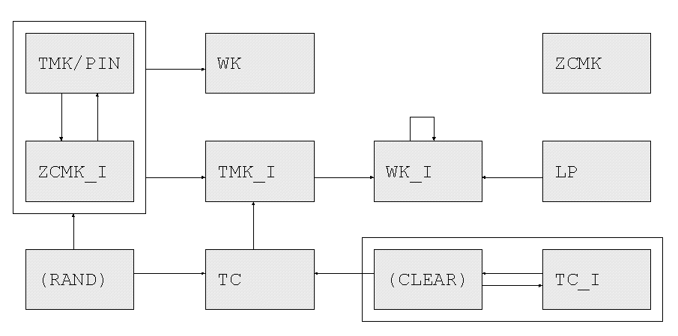
VSM Type Diagram

Slide 31
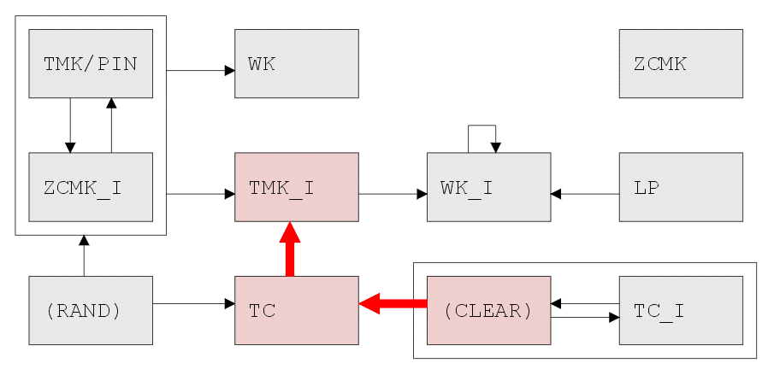
How Type-System Attack Was Found

Slide 32
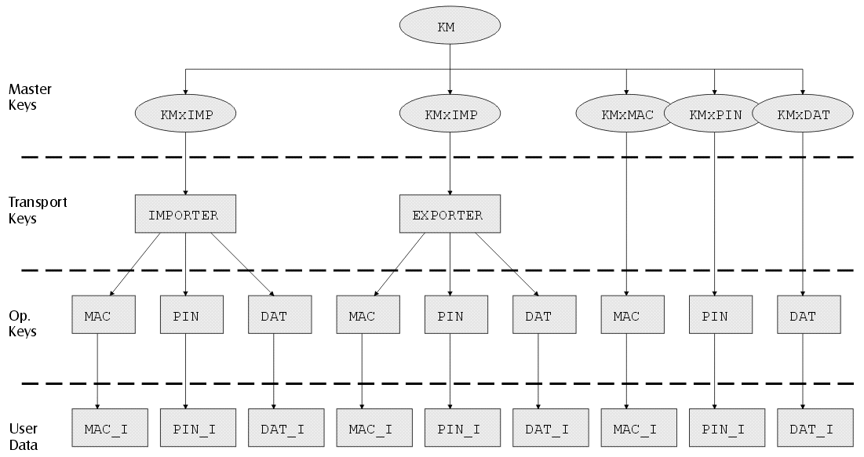
IBM 4758 Key Hierarchy

Slide 33
Control Vectors
IBM implementation, across many products since 1992, of the concept of ‘type’
An encrypted key token looks like this :
E_{Km⊕TYPE}( KEY ), TYPE

Slide 34
Key Part Import
Thee key-part holders, each have KPA, KPC, KPC
Final key K is KPA ⊕ KPB ⊕ KPC
All must collude to find K, but any one key-part holder can choose difference between desired K and actual value.

Slide 35
4758 Key Import Attack
KEK1 = KORIG
KEK2 = KORIG ⊕ (old_CV ⊕ new_CV)
Normally ...
D_{KEK1⊕old_CV}(E_{KEK1⊕old_CV}(KEY)) = KEY
Attack ...
D_{KEK2⊕new_CV}(E_{KEK1⊕old_CV}(KEY)) = KEY
IBM had known about this attack, documented it
obscurely, and then forgotten about it!

Slide 36
Collision-Search Attacks
A thief walks into a car park and tries to steal a car...
How many keys must he try?

Slide 37
Car Park 1929

Slide 38



Car Park 2009

Slide 39
Collision-Search Attacks (2)
Capture-recapture statistics; also ‘meet in the middle’
Attack multiple keys in parallel, given a ‘test vector’ (same plaintext encrypted under each key)
Typical case: A 2⁵⁶ search for one key becomes a 2⁴⁰ search for any one of 2¹⁶ keys
Any one key of a given type is usually enough - typical HSMs translate between keys of one type
Poor implementations of 3DES (EK1, DK2, EK1) allow 3DES key halves to be attacked individually

Slide 40
Collision Search Attack on HSMs
Generate 2¹⁶ keys
Encrypt test vectors
U->C : { KEY1 }_{KM}
C->U : { 0000000000000000 }_{KEY1}
Do 2⁴⁰ search
Cryptoprocessor’s Effort
Search Machine’s Effort
16 bits
40 bits
56 bit key space

Slide 41
Collision Search on 3DES
E_{K}(D_{K}(E_{K}( KEY ) = E_{K}(KEY)
A
Single Length Key
A
A
Double Length “Replicate”
X
Y
Double Length
A
A
B
B
A
B

Slide 42
