Slide 1

Customer Segmentation in E-Commerce: A Data-Driven Approach
Arti Govardhan Yadav
Colorado State University Global
MIS581- Capstone - Business Intelligence and Data Analytics
Dr. Justin Bateh
Notes:
Hello everyone. My name is Arti Yadav and today, I will present the key findings from my Capstone Project on customer segmentation in e-commerce.
This project analyzes customer purchasing behaviors using the Amazon Sales Report data to help the organization develop more targeted marketing strategies.

Slide 2
Introduction
Purpose of the study: Understand customer purchasing behavior and segment customers.
Importance of customer segmentation for e-commerce.
Overview of the dataset: Amazon Sales Report (128,975 entries, 24 variables).
Notes:
To start, this project explores customer segmentation, which is essential for creating targeted marketing campaigns.
The dataset used comes from the Amazon Sales Report, containing over 128,000 entries with variables such as order amount, product category, and sales channels. Segmentation is key for e-commerce businesses that need to refine their marketing strategies in today's competitive market.

Slide 3
Problem Statement
Difficulty in identifying customer segments in e-commerce.
01
Generic marketing leads to lower engagement.
02
The need for data-driven marketing strategies based on purchasing behaviors.
03
\
Notes:
One of the primary challenges in e-commerce is identifying distinct customer segments. Generic marketing approaches often fail to engage customers effectively.
This project addresses the need to create specific customer segments based on data analysis to improve customer engagement and marketing outcomes

Slide 4
Research Objectives
Analyze customer purchasing behaviors.
Segment customers based on key variables like order amount, product category, and sales channel.
Develop insights to support personalized marketing efforts.
Use data to inform future business strategies.
Notes:
The main objective of this project is to analyze customer purchasing behaviors using the available dataset, then segment customers based on these behaviors.
By doing so, we aim to generate actionable insights that can guide the organization in creating more personalized marketing strategies.

Slide 5
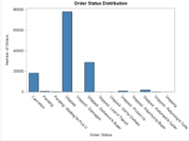
Dataset Overview
Overview of key variables: Order Amount, Quantity Ordered, Sales Channel, Product Category.
Missing data in some variables (e.g., Promotion-IDs, Fulfillment).
Notes:
On this slide, we have a bar chart illustrating the distribution of order statuses from the dataset. The x-axis lists different order statuses, such as 'Shipped,' 'Cancelled,' 'Pending,' and 'Returned,' while the y-axis represents the number of orders for each status.
The most prominent finding from this chart is that the majority of orders fall under the 'Shipped' status, indicating that the fulfillment and delivery processes are functioning well for most transactions. This is a positive outcome, as it shows that a large proportion of our orders are successfully processed and delivered to customers.
However, we also notice a significant number of 'Pending' orders. This could highlight areas where there may be delays or inefficiencies in processing, which could impact customer satisfaction if not addressed promptly.
On the other hand, the chart shows a relatively smaller number of 'Cancelled' and 'Returned' orders. While this is generally a good sign, indicating a lower incidence of problems, it is important to investigate why these cancellations and returns occur and see if there are opportunities to reduce them further.
In summary, this chart provides a clear picture of the fulfillment status across all orders, highlighting both strengths and areas for improvement. By focusing on reducing 'Pending' orders and further understanding the causes of 'Cancelled' orders, the organization can enhance its fulfillment process and boost overall customer satisfaction."

Slide 6
Methodology
Data preprocessing: Handling missing values, normalizing data, etc.
Descriptive statistics to summarize key features.
Hypothesis testing using correlation and ANOVA.
K-Means clustering for customer segmentation.
Notes:
I began the analysis by preprocessing the data to handle missing values and ensure the data was ready for analysis. Descriptive statistics were calculated to summarize key features.
Hypothesis tests, such as correlation and ANOVA, were performed to analyze relationships between variables.
Finally, I applied K-Means clustering to segment customers based on their purchasing behavior.

Slide 7
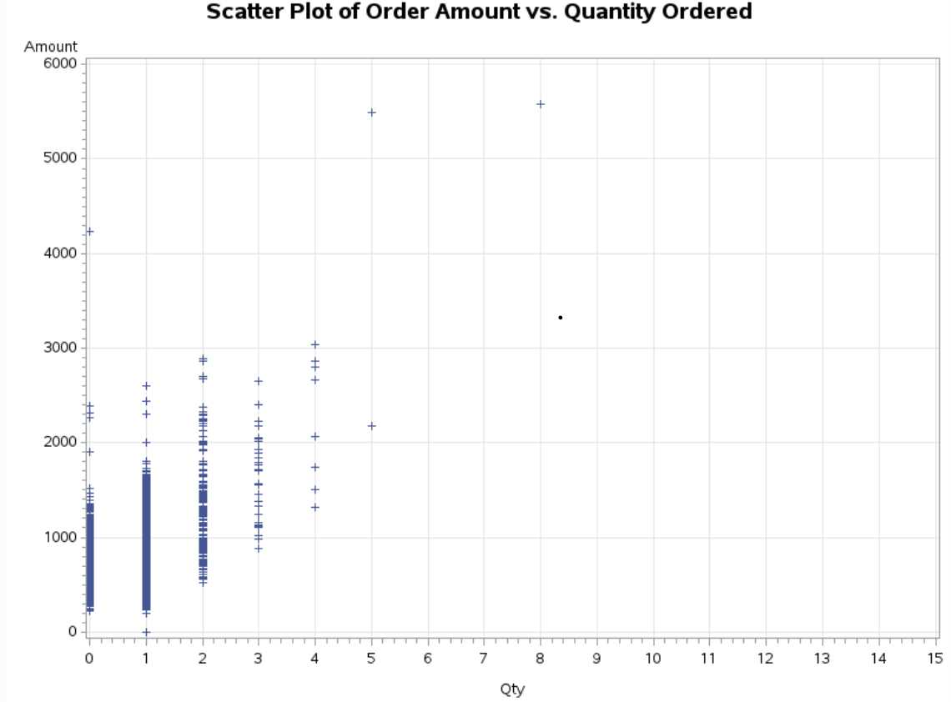
Key Findings
Strong positive correlation between Order Amount and Quantity Ordered (r = 0.68, p < 0.001).
Significant differences in Order Amount across Product Categories and Sales Channels (ANOVA results).
Identified segments: high-value frequent buyers, low-value occasional buyers, discount-driven buyers.
Notes:
The analysis showed a strong positive correlation between Order Amount and Quantity Ordered, meaning customers who purchase more items tend to spend more.
Additionally, there were significant differences in spending across Product Categories and Sales Channels. Using K-Means clustering, we identified several customer segments, including high-value frequent buyers and discount-driven buyers.

Slide 8
Prioritize
Prioritize high-value product categories.
Develop
Develop targeted marketing strategies for different sales channels.
Cross
Cross-sell and upsell to increase order value.
Use
Use promotions to engage discount-driven customers.
Insights and Recommendations
Notes:
Based on the findings, I recommend prioritizing high-value product categories and focusing marketing efforts on high-spending customers.
Different sales channels require different marketing strategies to maximize revenue.
Additionally, cross-selling and upselling techniques can be used to increase order values, while targeted promotions can be used to engage discount-driven buyers

Slide 9
Handling missing values in some key variables (e.g., Promotion-IDs).
Difficulty in selecting the most appropriate segmentation model.
Time constraints for model optimization and validation.
Challenges Encountered
Notes:
There were a few challenges encountered during the project.
Missing values in key variables such as Promotion-IDs required careful handling to avoid bias in the results.
Deciding on the best segmentation model was also a challenge, as several models needed to be evaluated. Lastly, time constraints limited the extent to which the models could be optimized

Slide 10

Conclusion and Next Steps
Customer segmentation provides actionable insights.
Future work: include demographic and seasonal data.
Recommendations for data-driven marketing.
Notes:
To conclude, the customer segmentation analysis provides valuable insights that can be used to implement more effective marketing strategies.
Moving forward, future analyses could include demographic and seasonal data to refine these segments even further.
Overall, data-driven segmentation is crucial to creating personalized customer experiences and improving engagement.

Slide 11
References
Hair, J. F., Black, W. C., Babin, B. J., & Anderson, R. E. (2018). Multivariate Data Analysis (8th ed.). Cengage Learning.
Kotler, P., & Keller, K. L. (2016). Marketing Management (15th ed.). Pearson Education.
Neslin, S. A., Grewal, D., Leghorn, R. A., Shankar, V., Teerling, M. L., Thomas, J. S., & Verhoef, P. C. (2006). Challenges and opportunities in multichannel customer management. Journal of Service Research, 9(2), 95-112.
Rust, R. T., & Verhoef, P. C. (2005). Optimizing the marketing interventions mix in intermediate-term CRM. Marketing Science, 24(3), 477-489.
Verhoef, P. C., & Lemon, K. N. (2013). Successful customer value management: Key lessons and emerging trends. European Management Journal, 31(1), 1-15.
Villanueva, J., Yoo, S., & Hanssens, D. M. (2008). The impact of marketing-induced versus word-of-mouth customer acquisition on customer equity growth. Journal of Marketing Research, 45(1), 48-59.
Wedel, M., & Kamakura, W. A. (2012). Market Segmentation: Conceptual and Methodological Foundations. Springer Science & Business Media.
Winer, R. S. (2017). Marketing Management: A Data-Driven Approach. Pearson Education.
Notes:
Here are the references that supported the research throughout this project.
These include studies on data preprocessing, customer segmentation, and machine learning techniques that informed the methodology and analysis

