Slide 1
NLP Team14
Relation Extraction - FoodDisease Dataset
Ganellari Artjola Godun Alina Habenicht Richard Kiassa Ouassim
Notes:
Artjola

Slide 2
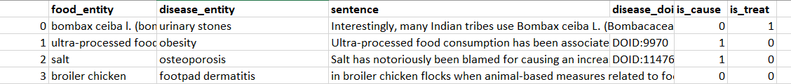
FoodDisease Dataset
Contains 608 sentences with cause and treat relations between food and disease entities
Extracted from biomedical research papers
323 treat, 144 neutral, 141 cause labels => small and unbalanced dataset
is_cause and is_treat transformed into label variable with 3 levels: cause, treat, neutral
Only sentence and label variable was used for modelling
Notes:
Artjola

Slide 3
Dataset preprocessing
Problems with greek letters in dataset
not readable (tested with different encodings)
replaced greek letters manually in csv file with written version (ɑ → alpha)
Stopwords removed
Using lemmatization on word in sentences
For Naive Bayes (nltk package): transform into dictionary format
For RNN and LSTM model:
Use of older Torchtext package version (0.6) for usage of Fields and LabelFields
Fields and Labelfields easier to use for us for building Loaders
Usage of spacy tokenizer (en_core_web_sm)
Notes:
Artjola

Slide 4
Milestone 1
Different approaches:
Naive Bayes (nltk package)
Multinomial Naive Bayes (sklearn)
using 3 classes (treat, cause, neutral)
using 2 classes (treat, cause)
using 3 classes, undersampling treat class
SVM (sklearn)
using 3 classes (treat, cause, neutral)
using 2 classes (treat, cause)
using 3 classes, undersampling treat class
Notes:
Alina

Slide 5
Milestone 1
Different approaches:
Training on 3 classes: treat, cause, neutral
Training on 2 classes: treat and cause
Undersampling treat dataset, because the model clearly preferred the overrepresented treat class
Notes:
Alina

Slide 6
Performance of Models from M1
 | Cause |  |  | Treat |  |  | Neutral
Model | Precision | Recall | F | Precision | Recall | F | Precision | Recall | F
NB (nltk) | 0.75 | 0.55 | 0.63 | 0.77 | 0.92 | 0.84 | 0.73 | 0.53 | 0.62
Multi NB | 0.80 | 0.17 | 0.29 | 0.50 | 1.00 | 0.68 | 1.00 | 0.16 | 0.28
SVM | 0.74 | 0.69 | 0.71 | 0.72 | 0.91 | 0.80 | 0.83 | 0.54 | 0.66
Multi NB binary | 1.00 | 0.52 | 0.68 | 0.85 | 1.00 | 0.92 | - | - | -
SVM binary | 0.82 | 0.72 | 0.77 | 0.90 | 0.94 | 0.92 | - | - | -
Multi NB undersampled | 0.70 | 0.56 | 0.63 | 0.49 | 0.91 | 0.64 | 0.76 | 0.43 | 0.55
SVM undersampled | 0.74 | 0.68 | 0.71 | 0.59 | 0.87 | 0.70 | 0.77 | 0.57 | 0.65
Notes:
Alina

Slide 7
Milestone 2
Different approaches:
RNN
Single RNN Layer
Multiple RNN Layers
Stacking Multiple RNN Layers
Multiple Bidirectional RNN Layers
LSTM
Bi-directional
Basic LSTM (one direction)
Baseline NN model (for binary classification, using Tensorflow)
Notes:
Richard

Slide 8
RNN Models
nn.RNN layer with embedding layer and linear layer
Embedding length=20, hidden dimensions = tested with 20, 30, 40 and 50
Layers (for multiple layers) = 3
Optimizer = Adam, epochs=15, learning rate = 0.01, 0.001 , loss function = nn.CrossEntropyLoss()
 | Cause |  |  | Treat |  |  | Neutral
Model | Precision | Recall | F | Precision | Recall | F | Precision | Recall | F
Single layer | 0.13 | 0.07 | 0.09 | 0.54 | 0.85 | 0.66 | 0.33 | 0.07 | 0.11
Multiple layers | 0.26 | 0.25 | 0.25 | 0.58 | 0.65 | 0.61 | 0.36 | 0.28 | 0.31
Stacked layers | 0.22 | 0.21 | 0.22 | 0.57 | 0.63 | 0.60 | 0.43 | 0.34 | 0.38
Multiple layers bidirectional | 0.90 | 0.32 | 0.47 | 0.62 | 1.00 | 0.76 | 1.00 | 0.24 | 0.39
Notes:
Richard

Slide 9
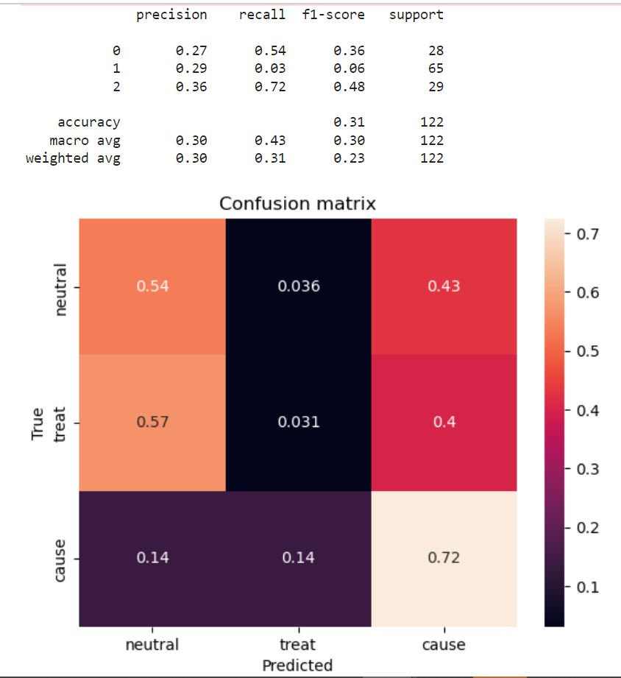
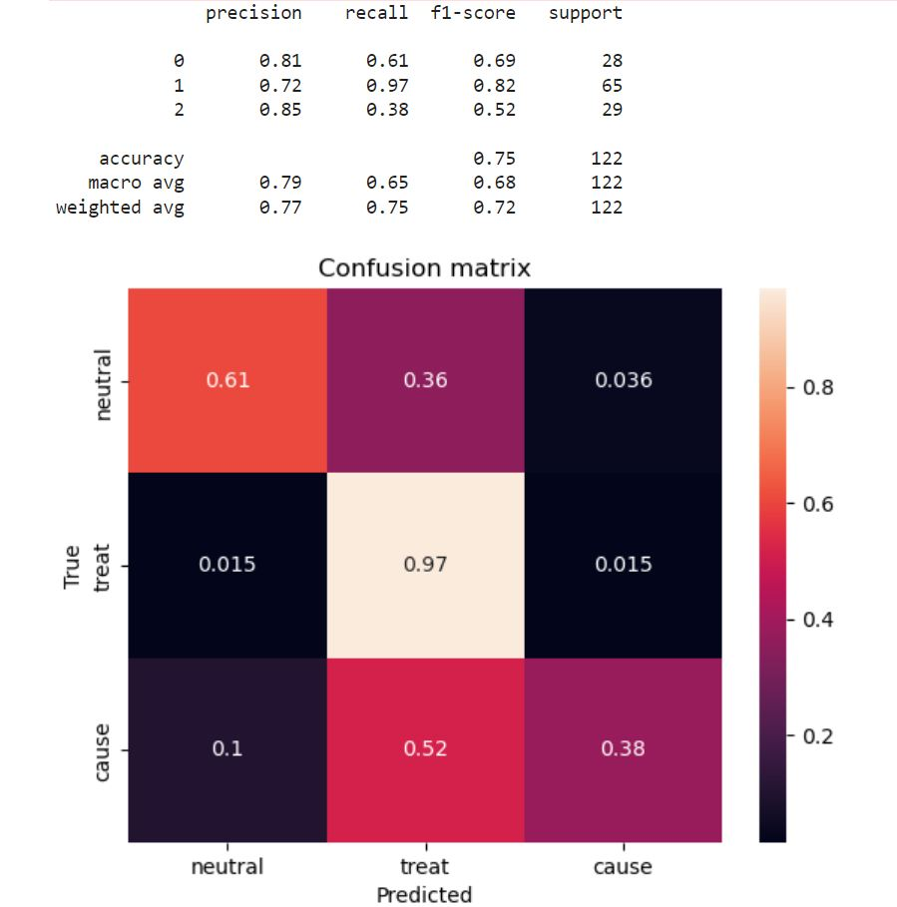
LSTM models
Basic LSTM
Bi-directional LSTM
Notes:
Artjola

Slide 10
Baseline NN model (binary)
Embedding layer
Global average pooling 1D and 2 dense layers
 | is_cause
accuracy | 84%
Notes:
Ouassim

Slide 11
Findings from milestone 2
Many words from test dataset never occur in train dataset
Reason = small dataset
Possible solution = include ground truth dataset to increase dataset size and vocabulary size
There are still numbers and single letters in the dataset
Provide no information (e.g. single letters are often first names from paper references)
Solution: Regex in preprocessing that filters numbers and single letters
Notes:
Ouassim

Slide 12
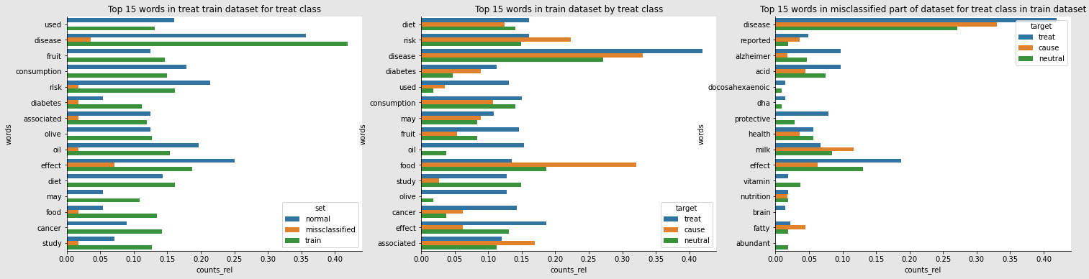
Findings from milestone 2 (continued)
Example for important and misclassified words in treat class
Notes:
Alina

Slide 13
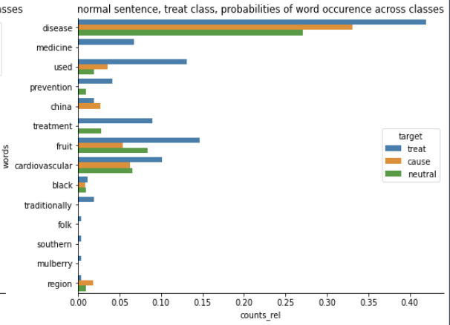
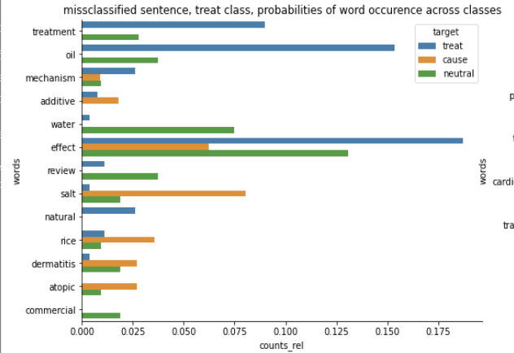
Findings from milestone 2 (continued)
Example for word distribution in correctly and incorrectly classified sentences:
Misclassified sentence: review summarizes mechanism effect dead sea salt hard water commercial baby cleanser oatmeal rice natural oil bathing additive treatment atopic dermatitis
Correctly classified sentence:black mulberry fruit traditionally used uyghur folk medicine prevention treatment cardiovascular disease southern xinjiang region china
Notes:
Alina

Slide 14
Milestone 3
Different approaches:
Using bigrams and trigrams
Transfer learning with CrowdTruth dataset
Use two binary models (neutral vs non-neutral, cause vs treat)
Part of speech tagging (POS tagging)
Notes:
Ouassim

Slide 15
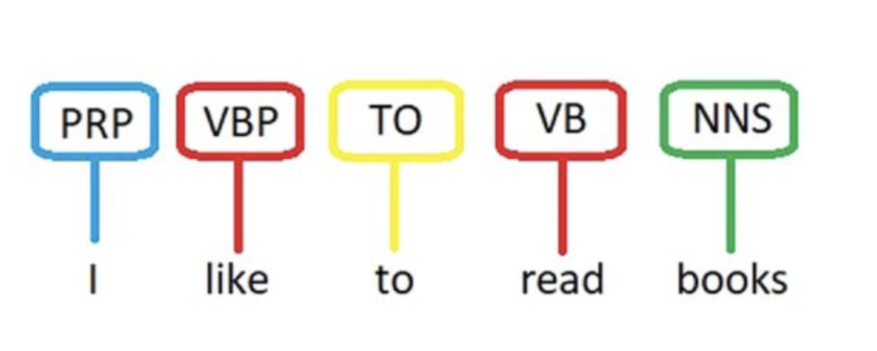
POS tagging
We used POS tagging to our model
POS is the process of assigning mark up words according to their definition and context
Labels like VERB/NOUN/ADJ
Example:
Notes:
Ouassim

Slide 16
Performance of POS tagging on the models
Unfortunately the RNN models had no improvement
Baseline NN binary classification had small improvement to 86% from 84%
Was not working on LSTM model
Notes:
Ouassim

Slide 17
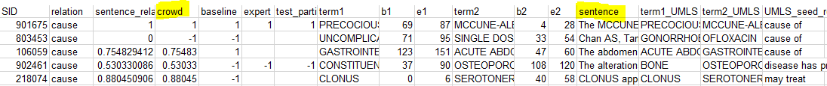
Crowd Truth dataset
we use crowd score (range [-1, 1]) for binary labels for separate cause and treat datasets
Crowd score < 0 → label: 0; ≥0 → 1
Dataset is also unbalanced
treat: 1406 positive, 2578 negative
cause: 1429 positive, 2555 negative
Separate binary classifiers for cause and treat datasets
Same transformation done for FoodDisease dataset (using is_treat and is_cause)
Notes:
richard

Slide 18
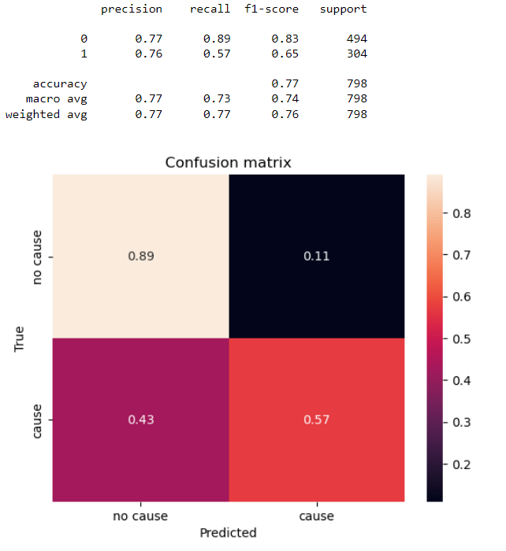
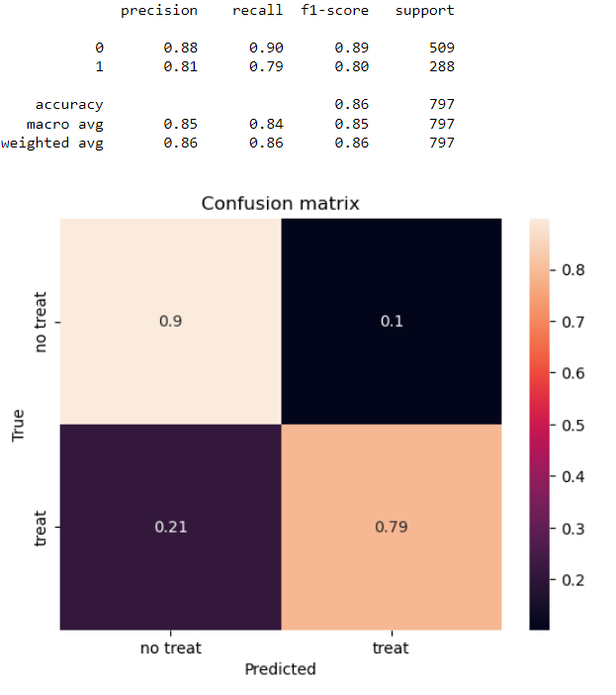
Performance of LSTM model on Crowd Truth dataset
Cause vs no cause
Treat vs no treat
Notes:
richard

Slide 19
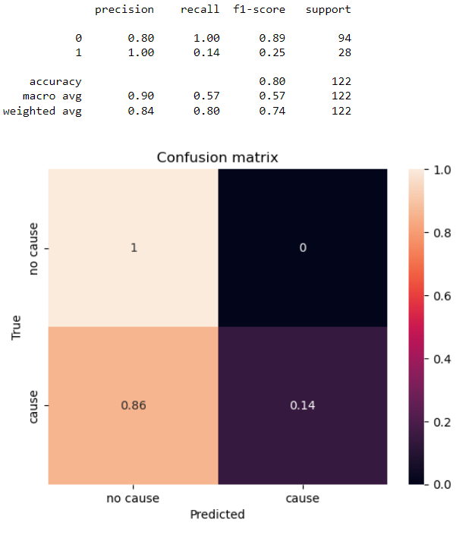

Performance of LSTM model on Food Disease binary targets
Cause vs no cause
Treat vs no treat
Notes:
richard

Slide 20
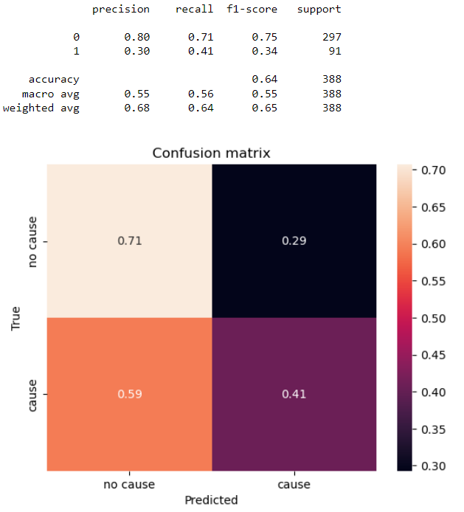
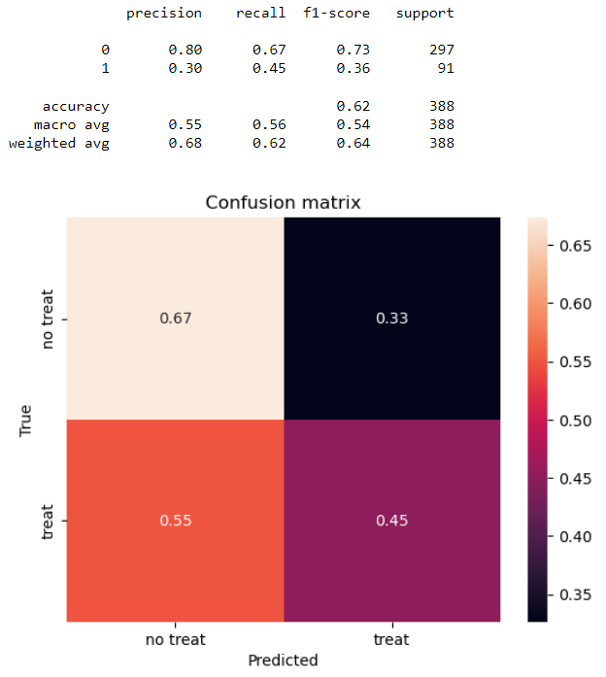
LSTM model trained on Crowd Truth tested on Food Disease
Cause vs no cause
Treat vs no treat
Notes:
richard

Slide 21
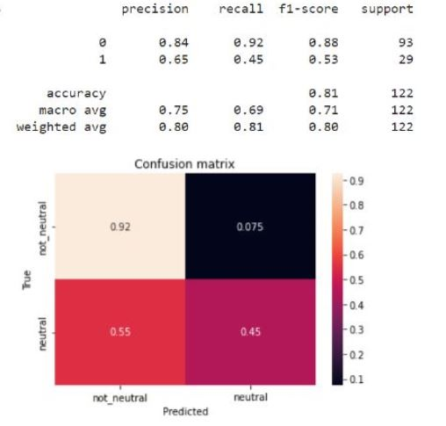
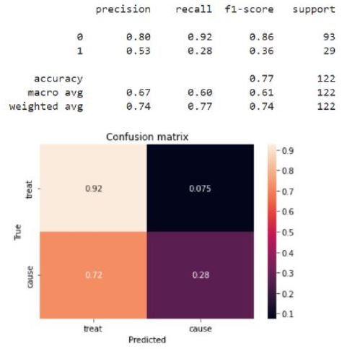
Binary classification on Bi-LSTM model on balanced Food disease dataset
Neutral vs Not-neutral
Cause vs Treat
Notes:
Richard

Slide 22
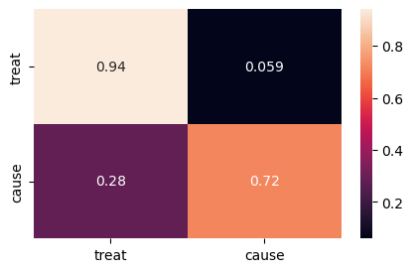

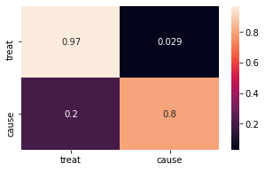
Trigrams & bigrams & cut sentence
before:
Using bigrams & trigrams additionally as input
Using only words between entities plus 5 words before and after (as in paper)
Tried out different combinations of baseline models, different number of target classes, undersampling
Slight improvement in model with binary classes, otherwise performance stays pretty much the same
after:
Notes:
Alina

Slide 23
Further ideas
Ideas for improving performance we did not have enough time to test:
Dependency parsing
Position indicators
Knowledge/Dependency graphs (e.g. with POTATO package)
Would add more explainability
Word windows: reduce redundant text
including only 5 words before first entity and 5 words after last entity
Using transformers (e.g. BioBERT) and fine tune on dataset
Is more or less a blackbox => we did not use it because explainability was important
Notes:
Artjola

Slide 24
Contributions of each person
Richard:
NLTK Baseline Model (MS1)
RNN Model (MS2)
Transfer learning with CrowdTruth (MS3)
Alina:
Naive Bias & SVM Baseline Models (MS1)
Undersampling & binary classifiers (MS1)
Bi-LSTM (MS2)
Trigram & Bigram approach (MS3)
Artjola:
Basic LSTM model (MS2)
Binary classification on bi-LSTM model (MS3)
Ouassim:
Baseline model(MS2) with tensorflow
POS tagging on 3 different models(MS3)
Notes:
Artjola

