Slide 1
ORDERCAPTURE PROJECT

Slide 2
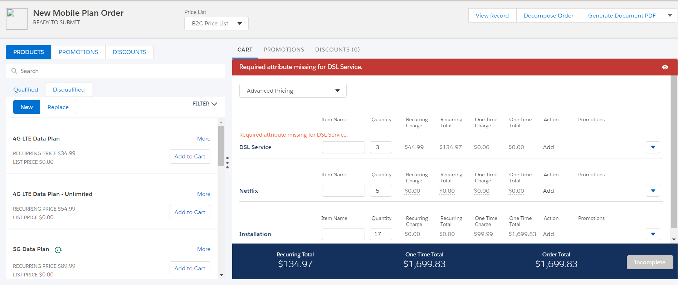
Vlocity HybridCPQ

Slide 3
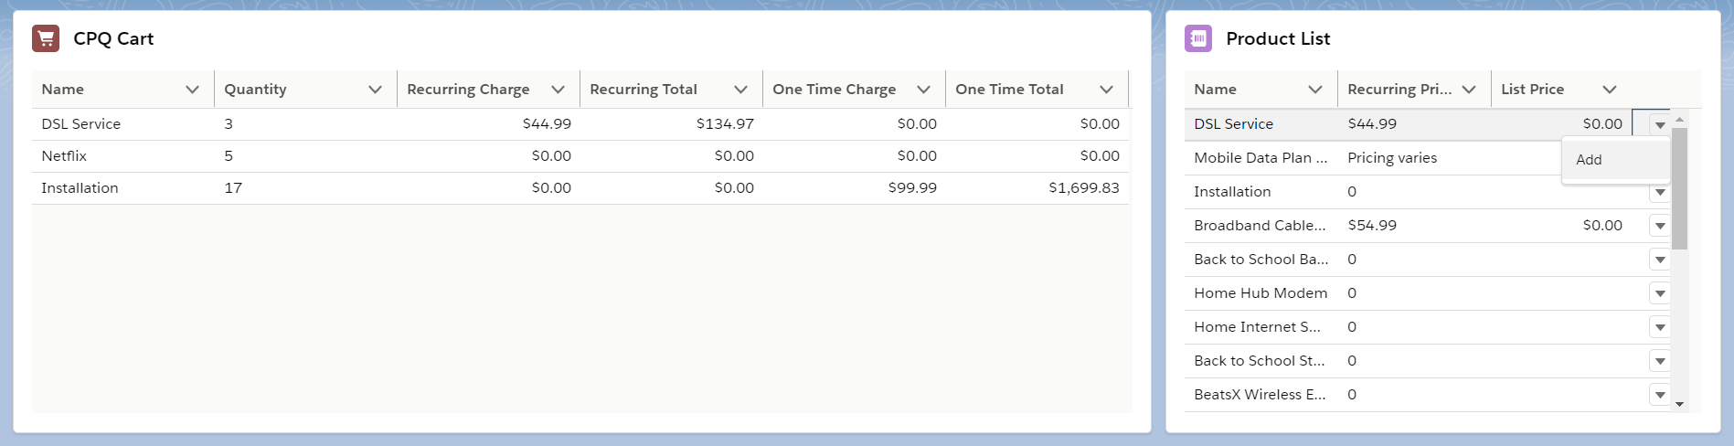
LWC components
cpqProductCart:
cpqProductCart.html
cpqProductCart.js
cpqProductCart.js-meta.xml
cpqProductList:
cpqProductList.html
cpqProductList.js
cpqProductList.js-meta.xml

Slide 4
Communicate Across the DOM with Lightning Message Service
CPQAddProductChannel:
force-app\main\default\messageChannels\CPQAddProductChannel.messageChannel-meta.xml
<description>This Lightning Message Channel sends selected product details from Product List to CPQ Cart</description>
<fieldName>priceBookEntryId</fieldName>
<fieldName>actions</fieldName>

Slide 5
Vlocity CPQ's Cart-Based API calls
CPQCaller.cls Apex Class with @AuraEnabled marked callCpqAppHandler method
calls to Apex method happen imperatively. When:
elements are inserted into a document (connectedCallback() lifecycle hook)
CPQAddProductChannel message is provisioned

Slide 6
Decisions
Use Datatable component
+ OOTB
- Requires flatten the data coming from Vlocity CPQ's Cart-Based API calls
Use Lightning Message Service
Do not refresh the Cart with additional getCartsItems method call
Use of ES6 spread operator allowed LWC to track changes in array
Example: this.data = [...this.data]
Utilize Roundtrip Serialization and Deserialization of parameters sent to callCpqAppHandler method
was needed to ensure data type consistency of complex parameters for different CPQ actions
-

Slide 7
Considerations
Pagination or “load-more” capability of cpqProductList component
Bullet-proof error-handling
Consider building reusable <c-cpq-api> child component
Consider get rid of CPQCaller.cls (if/when Vlocity CPQ's Cart-Based API is exposed to LWC OOTB)
Consider refreshing the Cart with getCartsItems after each action

Slide 8
Thank you for interesting challenge!

