Slide 1

Lab 8: VOTING machines
CSE 2301 – Fall 2024

Slide 2
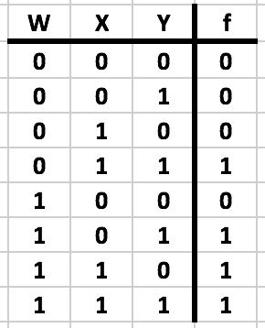
Concept of the lab Part 1: majority out of 3
You will be building a circuit that indicates majority. In this case, since you’ll be using a 4-1 multiplexor, you can only input 3 votes.
That means a majority is 2 out of 3.

Slide 3
Concept of the lab The SN74153
This will be implemented with a 74153, which contains two MUXes.
For our purposes, you can only use one MUX on any given chip. As you can see, there is only one pair of selectors for both sets of inputs.

Slide 4
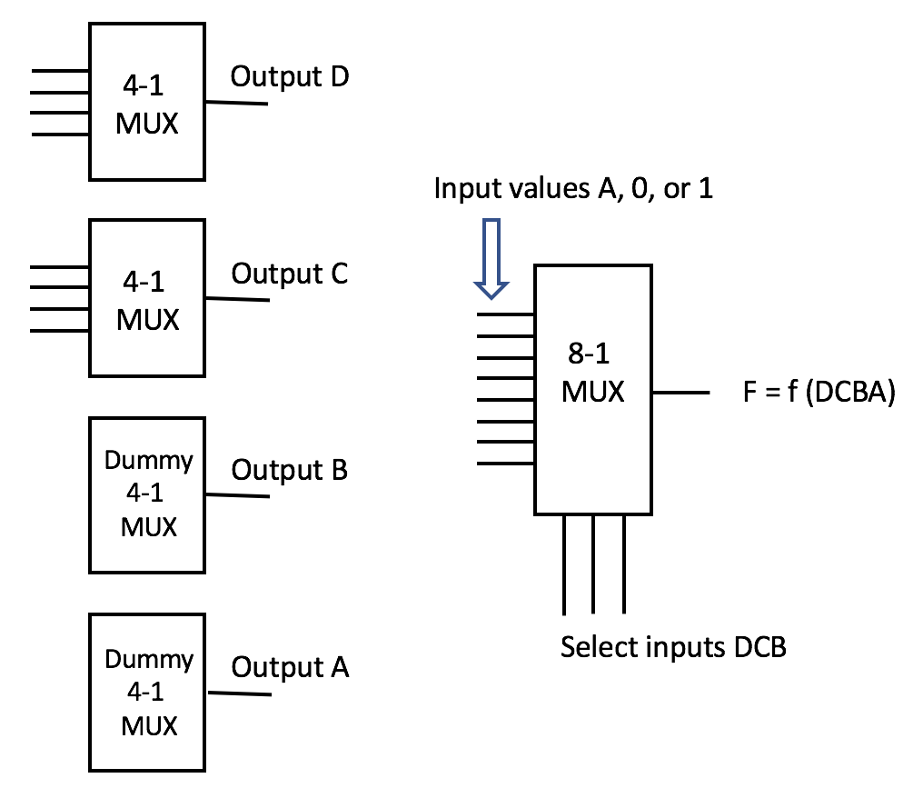
Concept of the lab PART 2: majority out of 12
In order to get the majority out of 12 required for this lab, you must use four 4-1 MUXes (3x4 = 12), and wire their outputs to an 8-1 MUX.
We only have enough switches (and chips) to make two real MUXes, so the other two we need will be artificially represented by a single switch.

Slide 5
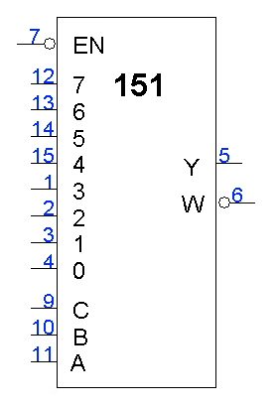
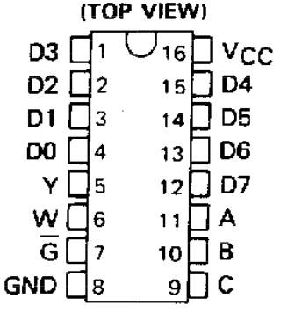
Concept of the lab The SN74151
The 8-1 multiplexor is a 74151.
You may have noticed the “EN” or “G” and W pins. The EN, or sometimes G, is a strobe. These should be grounded, or your circuit will not work.
The W pin is the inversion of Y, your output.

Slide 6
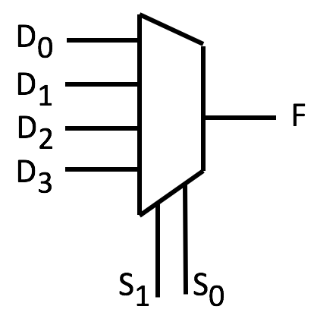
Design component finding the pin inputs
Define f for all rows, then create 2-row pairs to find the input.
Note that we have 3 variables but only 2 control pins. The third variable is used as input (this is typically the rightmost variable on the table).

Slide 7
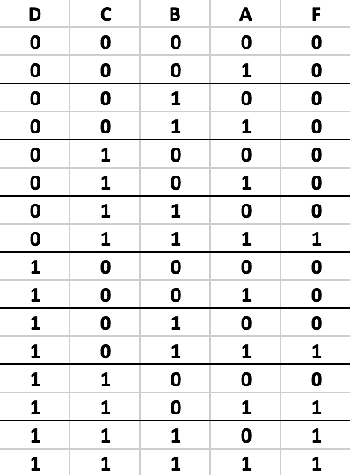
You’ll be finding f for the 8-1 multiplexor and then defining the inputs based on the same strategy.
Use A as the input value, similar to how Y was used in the example. Pairs!

Slide 8

The End

