Slide 1

Taxi Company Car Allocation
Artem Korenev
Andrei Kvasov
Anton Marin
Oleg Sudakov

Slide 2



Problem Formulation
Inefficient taxi allocation leads to underperformance
Fuel consumption rises
Clients wait more

Slide 3



Problem Formulation
Using Uber pickups data from Kaggle we aim to find a routing that minimizes:
Client waiting time
Taxi car downtime
Fuel consumption

Slide 4



Dataset Preprocessing
Only records, for 4 Dec, 2014
Half of the points are used as destination points
Latitude and longitude were converted into distance between points
Finally there are 9000 rides

Slide 5
Taxi Car Work Shift Schedule
Taxi starts from a depot
Taxi drives to pickup location and waits for the client, if needed
Taxi delivers the client to his/her destination point
If all clients are delivered, taxi heads to depot, otherwise go to step 2

Slide 6
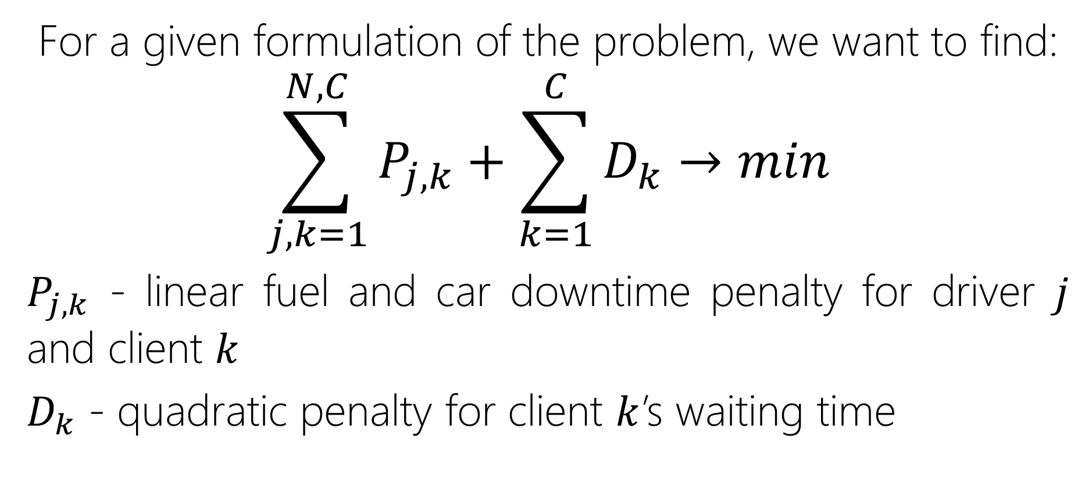
Target Function
For a given formulation of the problem, we want to find:
$$\sum_{j,k=1}^{N, C}{P_{j,k}+\sum_{k=1}^{C}{D_{k}→min}}$$
$P_{j,k}$ - linear fuel and car downtime penalty for driver $j$ and client $k$
$D_{k}$ - quadratic penalty for client $k$’s waiting time

Slide 7
Used Methods
Several methods were used to solve the given problem:
Greedy algorithms:
Basic greedy algorithm
Local search
Simulated annealing
(Greedy) Dynamic programming
Column generation

Slide 8
Basic Greedy Algorithm
The clients are sorted by pickup time
Find the best taxi to assign to
The client is visited by the driver at the end of route
If all clients were assigned to taxis, the greedy solution had been found

Slide 9
Local Search and Simulated Annealing
Neighborhood step
a random client is assigned to a random driver in a random place in route

Slide 10
(Greedy) Dynamic Programming
Clients are assigned by the pickup time
C
N

Slide 11
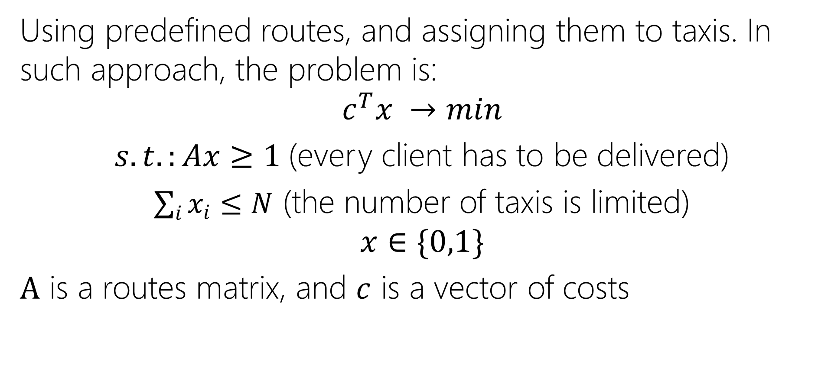
Column Generation
Using predefined routes, and assigning them to taxis. In such approach, the problem is:
$$c^{T}x →min$$ $s.t.:Ax≥1$(every client has to be delivered)
$\sum_{i}{x_{i}}≤N$ (the number of taxis is limited)
$$x∈\{0,1\}$$
$A$ is a routes matrix, and $c$ is a vector of costs

Slide 12
Finding Route “Patterns”
Is NP-hard problem
ESPPRC algorithm can help
Bellman’s algorithm modification
Need an extremely efficient algorithm

Slide 13
ESPPRC Overview
Shortest path algorithm
Find paths to vertices considering wasting resources and constraints on them (time in our case)
Discard paths that are not effective (similar to branch-and-bound)
Application to our problem: find best routes from depot to depot (with prohibiting the direct path)

Slide 14
Other Approaches
Google Operations Research Tools
Even with it is not computable on our laptops

Slide 15
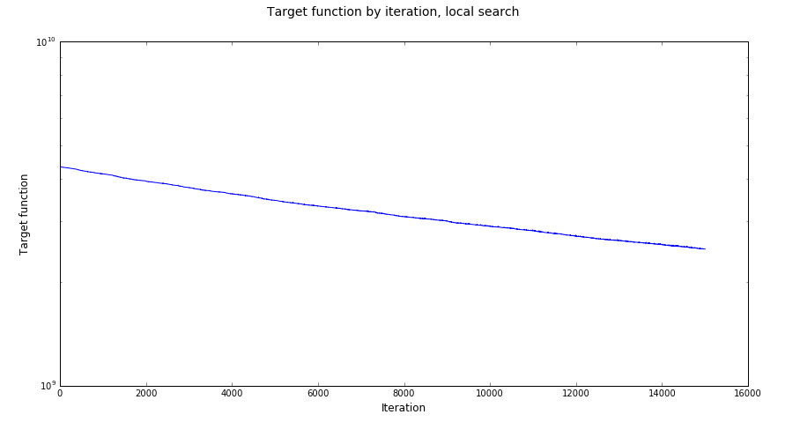
Results & Conclusions
Local search based on a random initial solution allows to get a decrease to random initial solution, but it is still worse than the greedy one

Slide 16
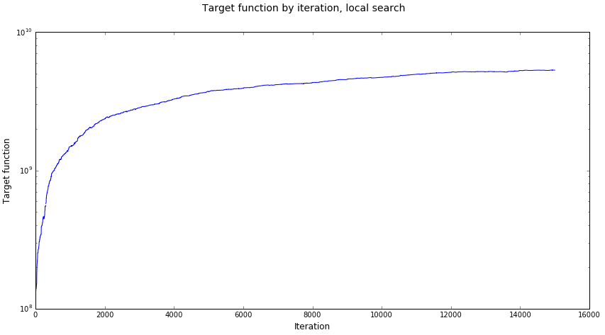
Results & Conclusions
Simulated annealing was found to be useless for given problem as the probability to find a local step which reduces the target function is extremely low

Slide 17
Results & Conclusions
Found values of target function for different methods:
Basic greedy algorithm: 1.3e+08
Local search: 2.5e+09
Simulated annealing: 5.3e+09
Dynamic programming: 1.3e+08
Column Generation: Unknown for initial problem

Slide 18
Future Prospects
Feasible CG Implementation
More real problem
Adding a graph of New York City
Adding distinct salaries, variable fares
Dataset Splitting (time, area etc.)

Slide 19
References
Dominique Feillet – A tutorial on column generation and branch-and-price for vehicle routing problems, 4OR, 2010, Volume 8, Issue 4, pp 407–424;
Dominique Feillet, Pierre Dejax, Michel Gendreau, Cyrille Gueguen – An exact algorithm for the elementary shortest path problem with resource constraints: Application to some vehicle routing problems, Networks, Volume 44, Issue 3, October 2004, Pages 216–229;
Federico Liberatore, Giovanni Righini, Matteo Salani - A column generation algorithm for the vehicle routing problem with soft time windows, 4OR, March 2011, Volume 9, Issue 1, pp 49–82;
Vehicle Routing Problem with Time Windows - Google Optimization Tools – Developers. A guide for solving vehicle routing problem with time windows using OR tools;
Uber Pickups in New York City | Kaggle.

Slide 20
Thank you for attention

