Slide 1
CS 352 Introduction to Usability Engineering
Perception

Slide 2
Perception and the Senses
Senses: smell, taste, sight, hearing, touch, proprioception (body position awareness), pain, temperature, balance, …
Change:
Adaption: sense physically react to change
Absence of change loses sensitivity
Eye compensates, nose can’t
There is a “just noticeable difference” (jnd)
Doubling # of photons does not increase perceived intensity of a picture

Slide 3
Perception
How information is acquired by senses
There are many inputs to the brain
If doesn’t make it thru the senses it doen’t make it to the brain
Obvious implication- design representations that are readily perceivable
Question:
How can we tell when they are and when they are not?

Slide 4
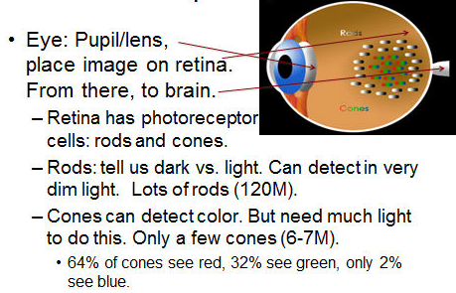
Visual Perception

Slide 5
Colors
Color-blindness
Red/green color blindness most common
7-8% of males, 0.4% of women
Excessive/gratuitous colorings
Distracting
Unprofessional
Impart meaning where none is intended

Slide 6
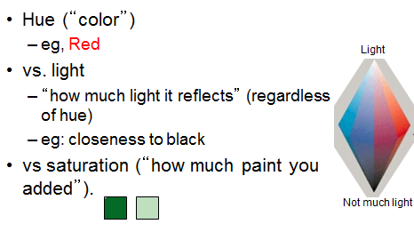
Basic Principles

Slide 7
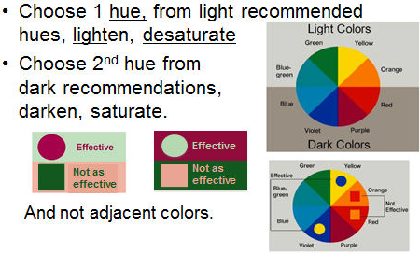
Contrast– Howto’s

Slide 8
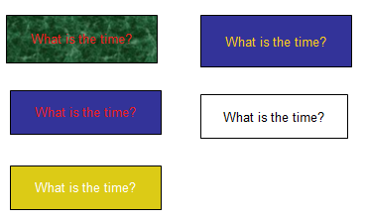
Which is easiest to read?
Why?

Slide 9
Other Senses
Sound (hearing):
Pitch- frequency, loudness (amplitude)
We are good at sound!
UIs can use when appropriate
But can hog our attention
Touch:
Pressure, pain, temperature
Motor system
Frequent errors- wrong button, double vs single click

Slide 10
Perception Takeaways 1
Some UI devices/paradigms leverage more senses than others
e.g. WIMP?
e.g. mobile phone
e.g. Wii?
e.g.

Slide 11
Perception Takeaways 2
These are pre-brain!
Must go through senses to get to brain
These are the human UI to the brain
Must b:
Discernable
Distinguishable from similar
If combined with change will be more likely to be perceived, but can steal your attention
e.g. banner ads

Slide 12
Attention
Selecting what to focus on, at a point in time, from the range of possibilities
Banner ads steal attention, pre-brain
Attention can also be in brain
We focus on what we think is relevant to our task
HOWEVER- if it doesn’t make it thru our senses we will not focus on it
here it comes…

Slide 13
Brain Attention
Can a brain multi-task?
NO.
I thought? Then? …
Like an OS: interrupts with a context switch
Cost of context switch
Missed triggers
Uis should encourage this with care
Hands-free cells while driving?
Emails while in talks/meetings/classes?

Slide 14
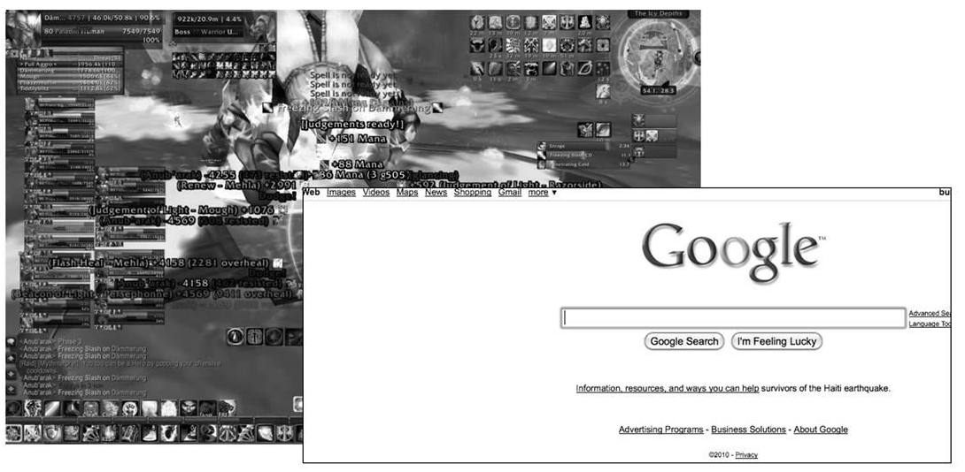
So…
Avoid cluttered UI

Slide 15
Demanding Brains’ Attention: Interruptions
When the computer decides to call attention to something
Four important kinds:
Immediate
Mediated
Computer decides when to interrupt
Scheduled
Negotiated
Best for productivity and learning

Slide 16
Attention Takeaways
Users can’t attend to everything at once
If information does not make it thru the senses then the brain can’t attend to it
Once in the brain:
Users attend to what they think is more relevant
User has a right to their own attention
There is a cost to making them switch
Do not steal it arbitrarily

