Slide 1

Basic Definitions: Testing
What is software testing?
Running a program
In order to find faults
a.k.a. defects
a.k.a. errors
a.k.a. flaws
a.k.a. faults
a.k.a. BUGS

Slide 2
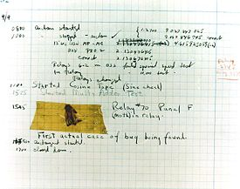


Bugs
Hopper’s “bug” (moth stuck in a relay on an early machine)
“an analyzing process must equally have been performed in order to furnish the Analytical Engine with the necessary operative data; and that herein may also lie a possible source of error. Granted that the actual mechanism is unerring in its processes, the cards may give it wrong orders. ” – Ada, Countess Lovelace (notes on Babbage’s Analytical Engine)
“It has been just so in all of my inventions. The first step is an intuition, and comes with a burst, then difficulties arise—this thing gives out and [it is] then that 'Bugs'—as such little faults and difficulties are called—show themselves and months of intense watching, study and labor are requisite. . .” – Thomas Edison

Slide 3
Testing
What isn’t software testing?
Purely static analysis: examining a program’s source code or binary in order to find bugs, but not executing the program
Good stuff, and very important, but it’s not testing

Slide 4

Why Testing?
Ideally: we prove code correct, using formal mathematical techniques (with a computer, not chalk)
Extremely difficult: for some trivial programs (100 lines) and many small (5K lines) programs
Simply not practical to prove correctness in most cases – often not even for safety or mission critical code

Slide 5
Why Testing?
Nearly ideally: use symbolic or abstract model checking to prove the system correct
Automatically extracts a mathematical abstraction from a system
Proves properties over all possible executions
In practice, can work well for very simple properties (“this program never crashes in this particular way”), but can’t handle complex properties (“this is a working file system”)
Doesn’t work well for programs with complex data structures (like a file system)

Slide 6
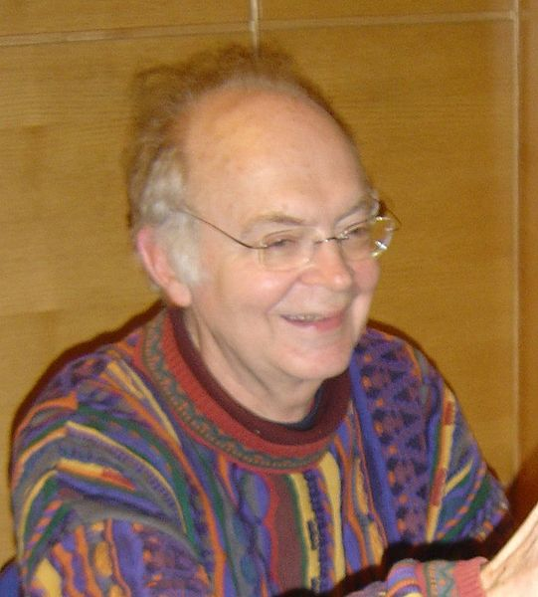
As a last resort…
… we can actually run the program, to see if it works
This is software testing
Always necessary, even when you can prove correctness – because the proof is seldom directly tied to the actual code that runs
“Beware of bugs in the above code; I have only proved it correct, not tried it” – Knuth

Slide 7

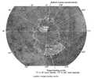
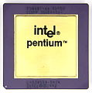

Why Does Testing Matter?
Ariane 5: exception-handling bug : forced self destruct on maiden flight (64-bit to 16-bit conversion: about 370 million $ lost)
NIST report, “The Economic Impacts of Inadequate Infrastructure for Software Testing” (2002)
Inadequate software testing costs the US alone between $22 and $59 billion annually
Better approaches could cut this amount in half
Major failures: Ariane 5 explosion, Mars Polar Lander, Intel’s Pentium FDIV bug
Insufficient testing of safety-critical software can cost lives: THERAC-25 radiation machine: 3 dead
We want our programs to be reliable
Testing is how, in most cases, we find out if they are
Mars Polar Lander crash
THERAC-25 design

Slide 8
Why is Testing Hard?
Because the only way to be SURE a program has no bugs is to run all possible executions
We can’t do that

Slide 9
Example: File System Testing
File system is a library, called by other components of the flight software
Accepts a fixed set of operations that manipulate files:
Operation Result
mkdir (“/eng”, …) SUCCESS
mkdir (“/data”, …) SUCCESS
creat (“/data/image01”, …) SUCCESS
creat (“/eng/fsw/code”, …) ENOENT
mkdir (“/data/telemetry”, …) SUCCESS
unlink (“/data/image01”) SUCCESS
File system
/
/eng
/data
image01
/telemetry

Slide 10
Example: File System Testing
Easy to detect many errors: we have access to many working file systems, and can just compare results
Choose operation F
Perform F on Tested FS
Perform F on Reference
(if applicable)
Compare return values
(inject a fault, possibly: timed reset, hardware failure, etc.)
Compare error codes
Compare file systems
Check invariants

Slide 11
Example: File System Testing
How hard would it be to just try “all” the possibilities?
Consider only core 7 operations (mkdir, rmdir, creat, open, close, read, write)
Most of these take either a file name or a numeric argument, or both
Even for a “reasonable” (but not provably safe) limitation of the parameters, there are 266¹⁰ executions of length 10 to try
Not a realistic possibility (unless we have 10¹² years to test)

Slide 12
The Testing Problem
This is a primary topic of this class: what “questions” do we pose to the software, i.e.,
How do we select a small set of executions out of a very large set of executions?
Fundamental problem of software testing research and practice
An open (and essentially unsolvable, in the general case) problem

Slide 13
Faults, Errors, and Failures
Fault: a static flaw in a program
What we usually think of as “a bug”
Error: a bad program state that results from a fault
Not every fault always produces an error
Failure: an observable incorrect behavior of a program as a result of an error
Not every error ever becomes visible

Slide 14
To Expose a Fault with a Test
Reachability: the test much actually reach and execute the location of the fault
Infection: the fault must actually corrupt the program state (produce an error)
Propagation: the error must persist and cause an incorrect output – a failure
Which tests will achieve all three?

Slide 15
What is Testing?
What is software testing?
Running a program
In order to find faults
But also, in order to
Increase our confidence that the program has high quality and low risk
Because we can never be sure we caught all bugs
How does a set of executions increase confidence?
Sometimes, by algorithmic argument
Sometimes by less formal arguments

