Slide 1
How to Write a Simple Random Tester

Slide 2
Building a Simple Random Tester
Identify the interface to test
Is it a file interface?
Network interface?
Calls to a function?
Write code to generate random inputs
What values is the code expected to handle?
Are all of these values interesting?
Write code to check behavior on random inputs
How can you tell if it worked?

Slide 3
Recipe for Refining a Random Tester
Gather code coverage
Is everything interesting being covered?
Is important code not covered?
Adjust the code to generate inputs
Try to “stay random” but shift the probability space
Augment random with fixed inputs of interest
Break the code and see if your tests detect the problem
If not, why not?
Improve your oracle code until all problems that should be caught are caught
Repeat until coverage and “fake bugs” both show the testing is rock solid

Slide 4
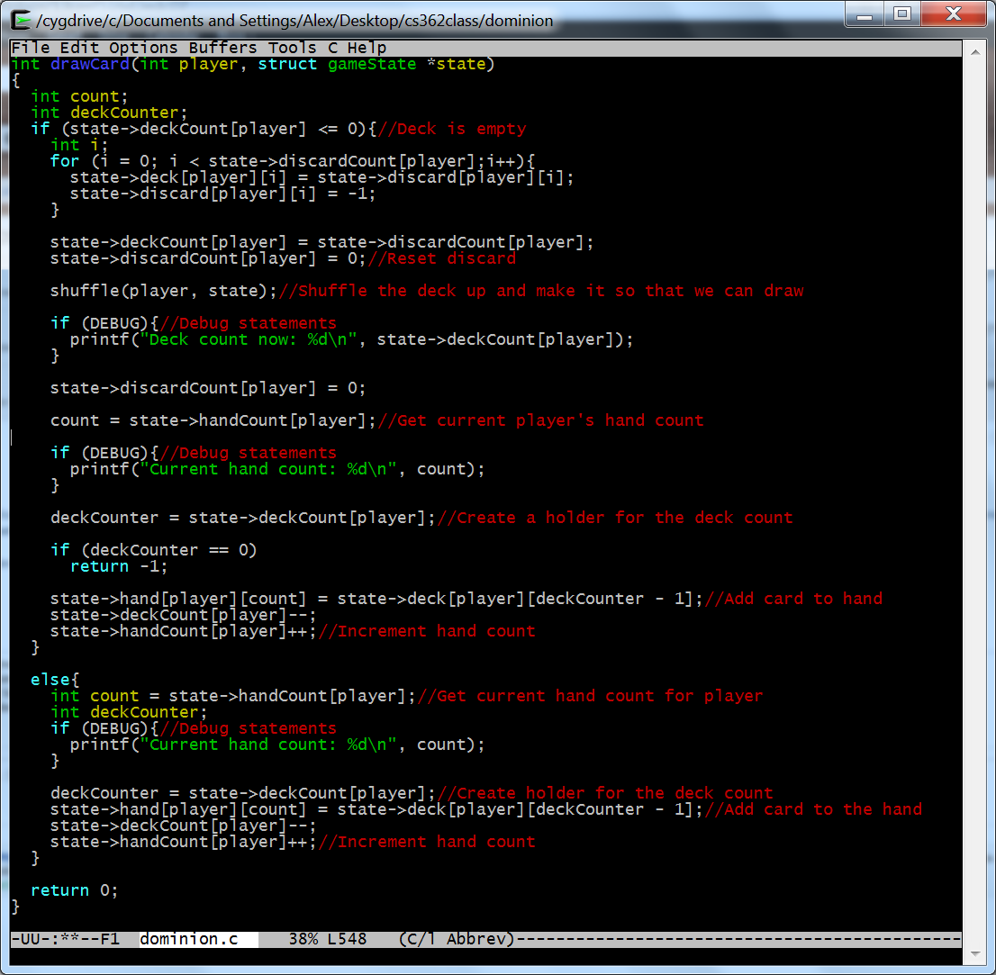
What code are we testing?

Slide 5
What inputs does it take?
int drawCard(
int player,
struct gameState *state
);

Slide 6
Can we randomly generate these inputs?
int drawCard(
int player,
struct gameState *state
);
Yes…

Slide 7
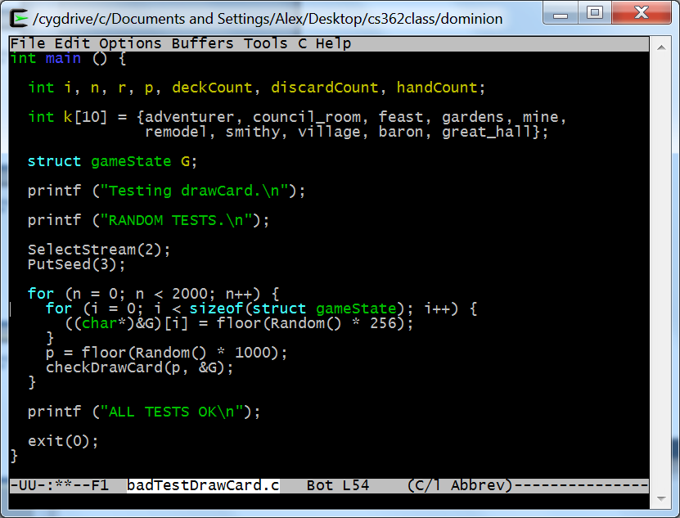
This code is generating random tests: 1. Create a gameState G filled with random bytes 2. Choose a number of players randomly 3. Call a function to test drawCard with these inputs

Slide 8
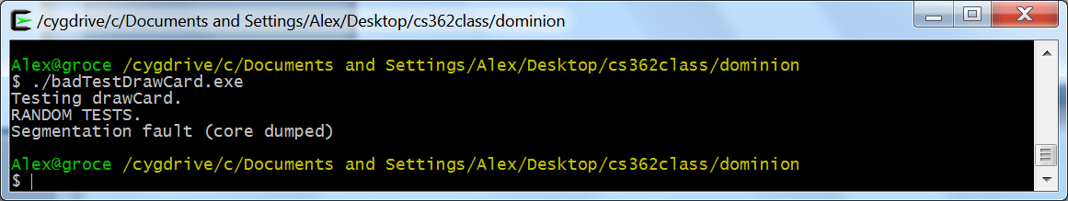
What happens when we run this tester?

Slide 9
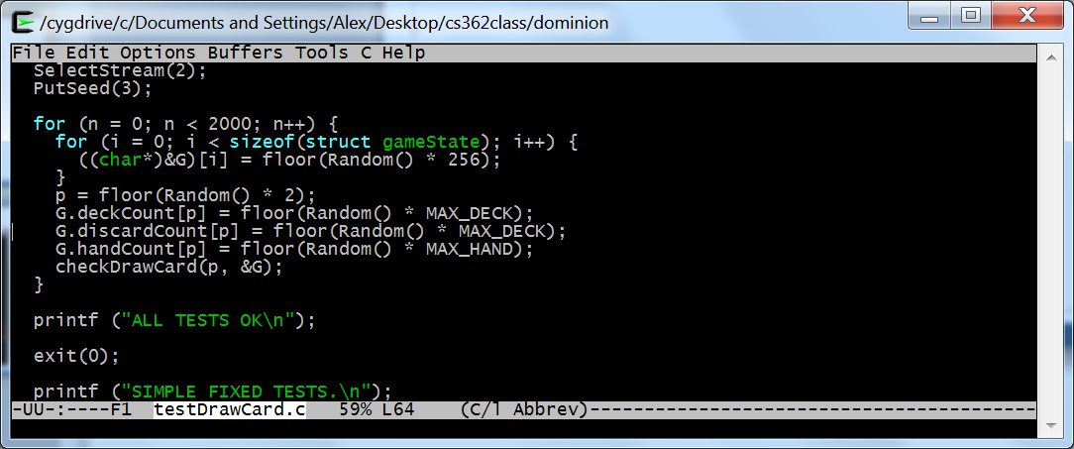
Pure Random Seldom Works!
Need to think about preconditions
drawCard expects
a valid number of players
a somewhat “sane” gameState
Can we generate that?

Slide 10
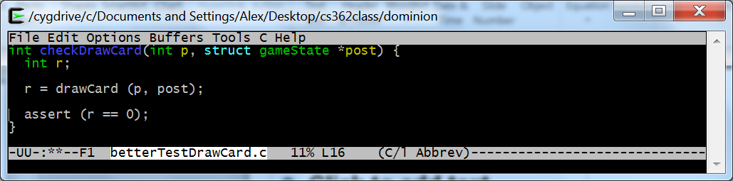
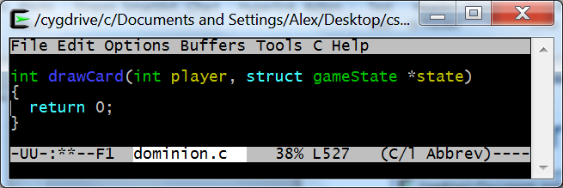
Check Your Test Oracle

Slide 11
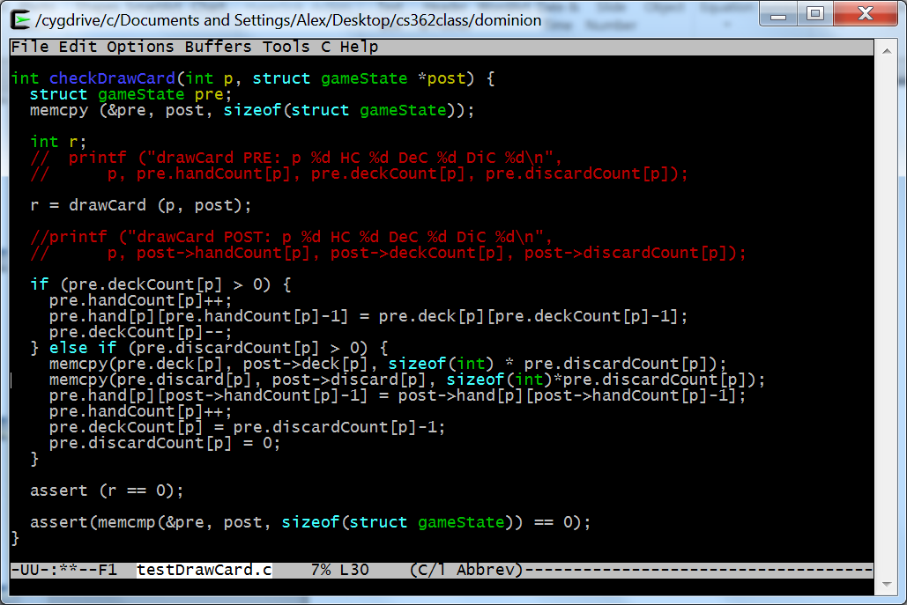
Revise Your Test Oracle

Slide 12
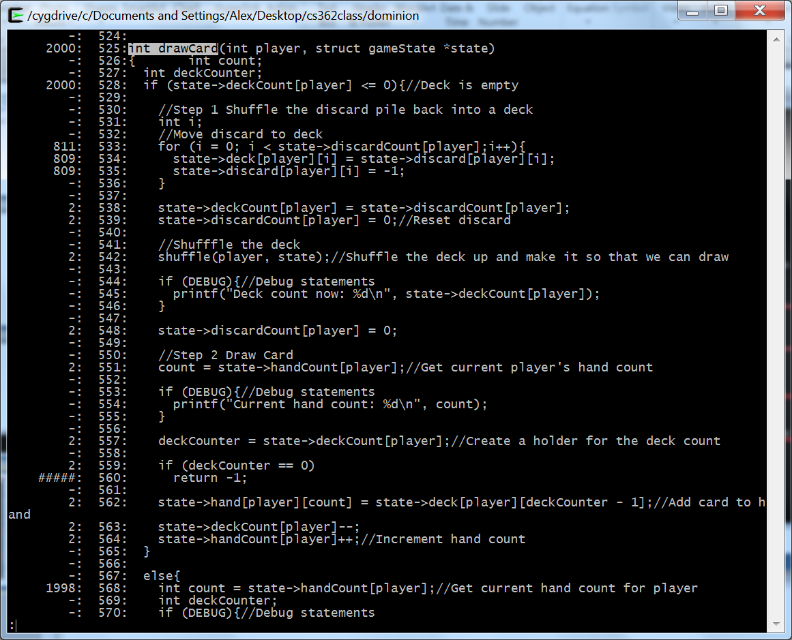
Check Coverage

Slide 13
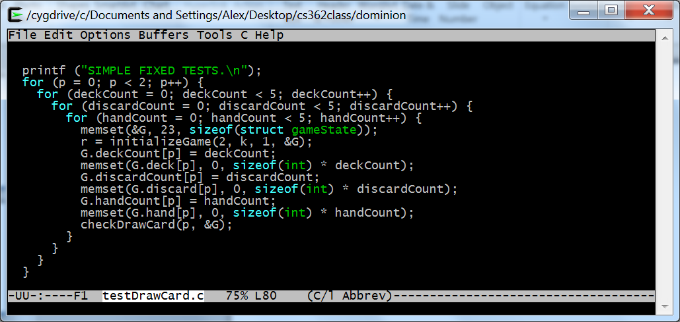
Add Fixed Tests if Needed
Final testDrawCard.c gets coverage of every line of drawCard, including the empty-deck and discard case (10 times). You can also get this result by going from 2,000 tests to 2,000,000 – which covers the empty case 23 times and only takes half an hour to run. You also get more coverage of everything else.

Slide 14
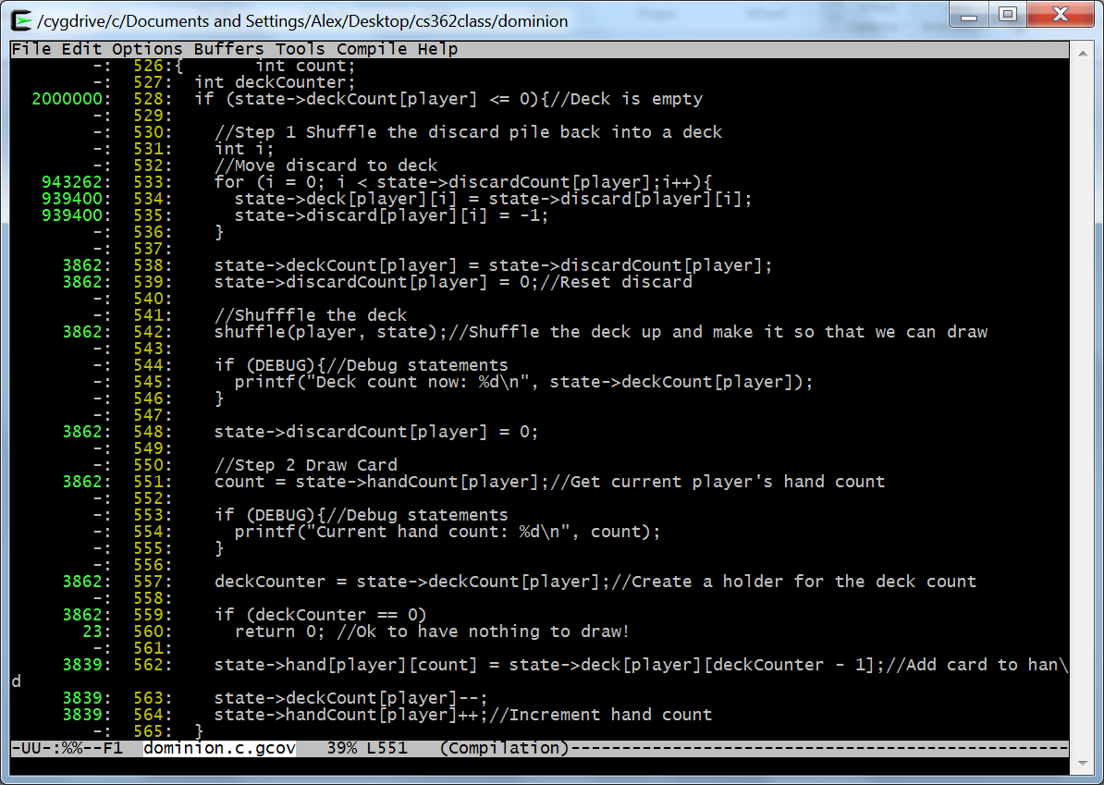
Don’t Work Smarter, Just Work Harder?

