Slide 1

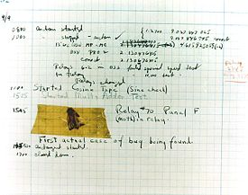

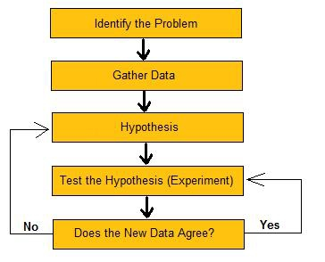
Debugging

Slide 2

Debugging, in the Trenches
Rasala put his hands on his desk and buried his face in them.
It was just another routine day down at debugging headquarters.
In the back of Veres’s mind still lies a small suspicion that the problem might after all be noise. And now – much to Guyer’s delight, when he finds out later on – it is Veres himself who disconnects the I-cache. Then he runs the program past the point of failure, and everything works. He puts the I-cache back in and once again Gollum fails. This doesn’t prove the IP is to blame, but it does tend to eliminate noise as a suspect, once and for all. . .
from THE CASE OF THE MISSING NAND GATE (Chapter 10 of Kidder’s The Soul of a New Machine)

Slide 3

(The Soul of a New Machine)
Kidder’s book tells the story of the development of a micro- computer in the early 80s.
The book’s a classic – won the American Book Award for non- fiction. Anyone who cares how computers are made (or how people work) should read it.
Chapter 10 is a classic story of debugging a hardware problem. The ideas apply just as well to software, and this is the best description of heavy-duty debug I’ve ever seen.

Slide 4
Debugging
Debugging is really hard – even with a good failing test case in hand
One of the most time-consuming tasks in software development
Locating the fault is the most time-consuming part of debugging

Slide 5

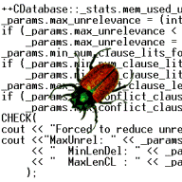

Debugging
Takes as much as 50% of development time on some projects
Arguably the most scientific part of “computer science” practice
Even though it’s usually done in a totally ad hoc, haphazard way!
“Debugging is twice as hard as writing the code in the first place. Therefore, if you write the code as cleverly as possible, you are, by definition, not smart enough to debug it.” - Brian Kernighan

Slide 6
Debugging and Testing
What are test cases for, anyway?
Often: so we can locate and fix a fault
Or: so we can understand how serious the failure is, and triage / “flight rule” it away
If we have many bugs, and some may not be important enough to merit resources
Or if there is a reason we can’t change the code and have to work around the problem
In either case, we have a “debugging” task at hand – must at least understand the failure, even if only to triage

Slide 7
Scientific Debugging
Test cases (ones that fail and ones that succeed) can be the experiments we perform to verify our hypotheses
The failing test case informs us that there is a phenomenon to explain (apple on the head)
Generate (or examine) more test cases to find out more about what is going on in the program

Slide 8
Scientific Debugging

Slide 9

Testing for Debugging
Several ways to use test cases in debugging:
Test case minimization
Shrink the test case so we don’t have to look at lots of irrelevant or redundant operations
Fault localization
Give suggestions about where the fault may be (based on test case executions)
Error explanation
Give a “story” of causality
(A causes B; B causes C; C causes failure)
attempt to automate part of scientific debugging

