Slide 1
Web Security
Defense Against The Dark Arts
TBD, 2015
Cedric Cochin + 1 TBD
Intel Security - McAfee Labs

Slide 2
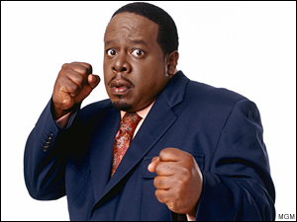
Who’s this guy?!
Hi, I’m @cedric
hasn’t changed…

Slide 3
Agenda – SESSION 1
Topics
Web as a threat delivery mechanism
Anatomy of the modern user agent
Web attack vectors and common defenses
User
Browser and plugin
Web security research tools
Lab 1
WebGoat
Attack a poorly-secured web application, using three common attack types.

Slide 4
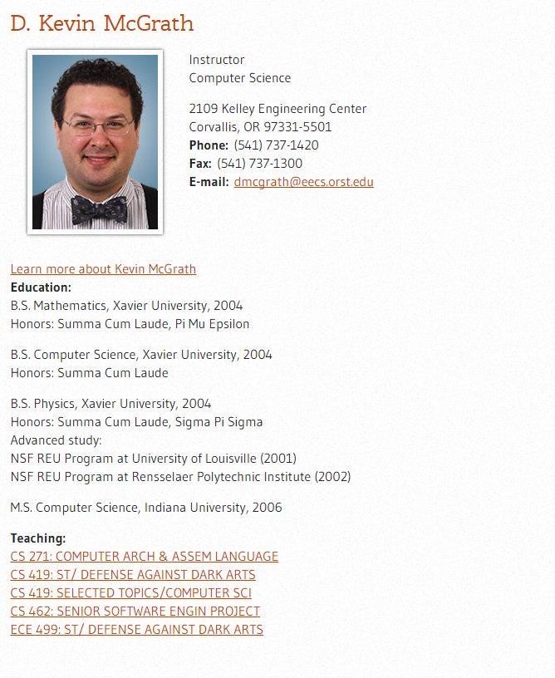
DEMO – SQL Injection
Using a web server with content specially crafted to be vulnerable
Demonstrate SQL injection manually using Firefox
Demonstrate more advanced capabilities using some cmd line tools (SQLiX)
Real life – BONUS --

Slide 5
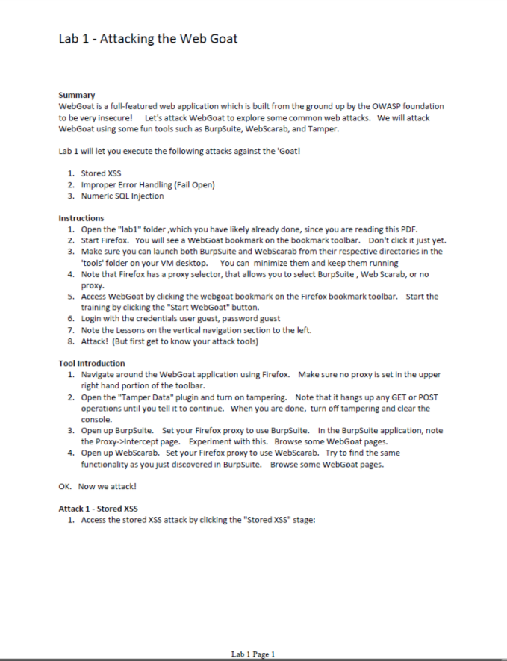
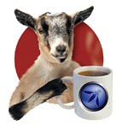
Lab 1 – ATTACK THE WEB GOAT!

Slide 6
Agenda – SESSION 2
Topics
Web security research tools (extra time and questions)
URL Classification
Content-based
Host/Lexical-based
Graph-based
Feature Extraction
Expert Systems
Lab 2
Build a micro URL classification system
Feature Extractor
Rule engine

Slide 7
Session 1 – QUESTIONs?
… answers

Slide 8
WEB MALWARE - TOOLBOX
FIGHTING BACK

Slide 9
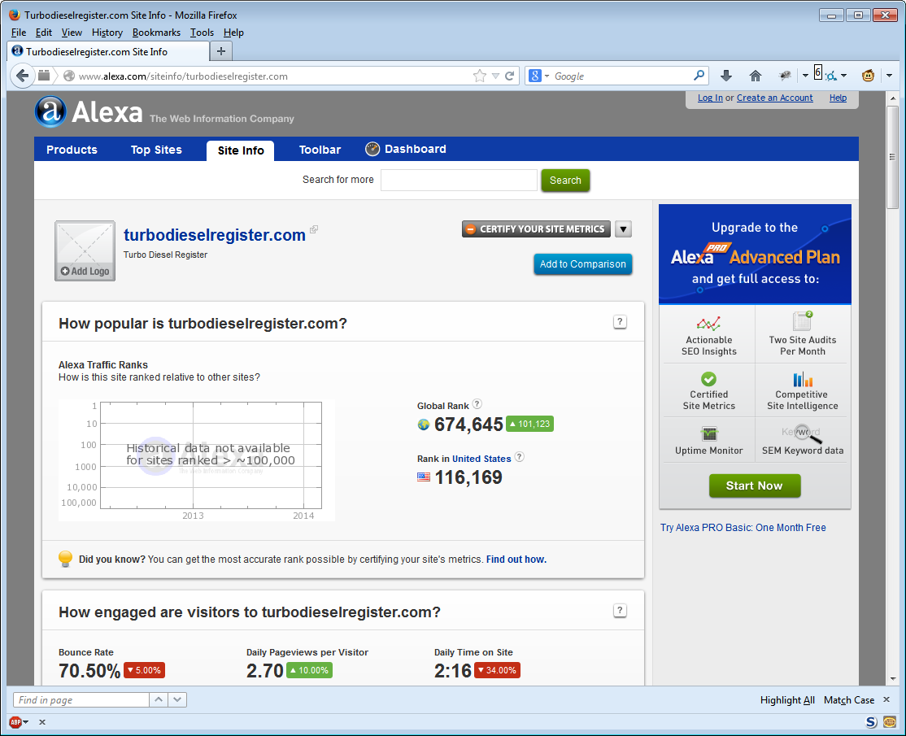
Alexa
Useful for determining general site popularity and prevalence.
Data collected via end-user toolbars
Domain-based (not URL-based)

Slide 10
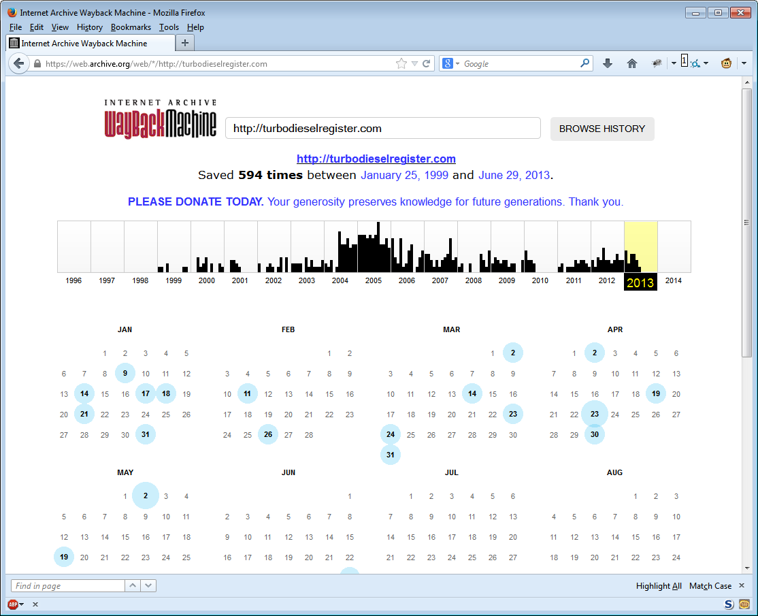
Archive.org
May be useful for determining site changes over time.
Not useful for short-lived malware content

Slide 11
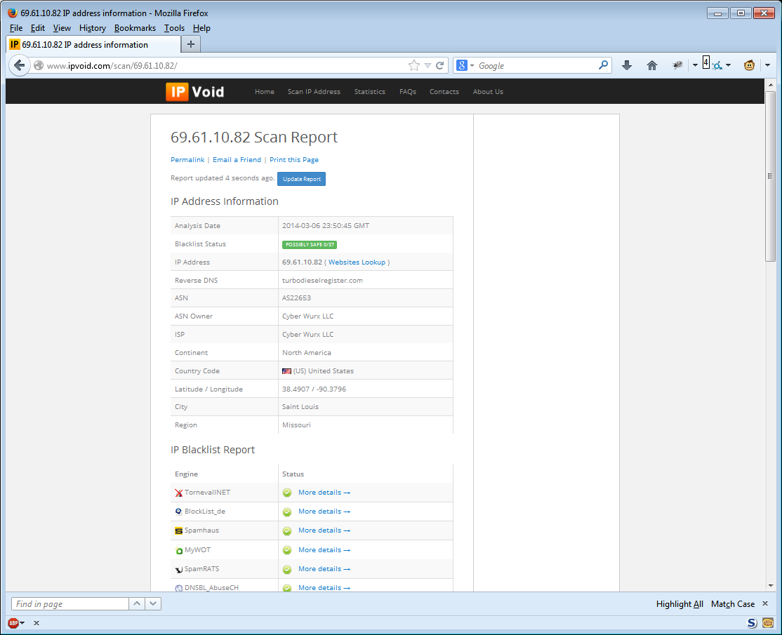
IPVOID
Check an IP against a large list of IP blacklists.
35+ blacklists:
Anti-spam
Anti-phishing
Anti-malware

Slide 12
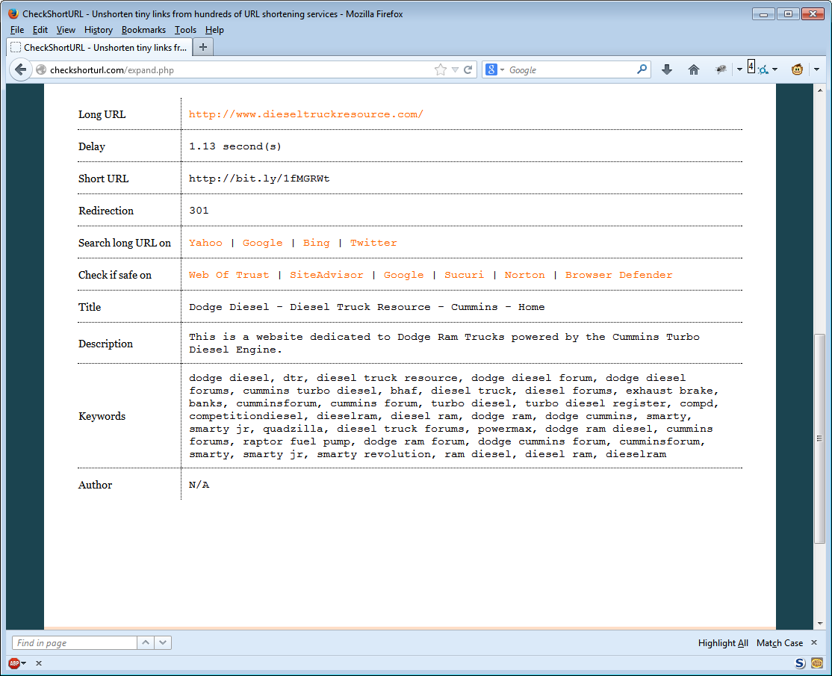
CHECKSHORTURL
URL Expander Service for most short URL services.
Single clearing house, many services supported at single location.

Slide 13
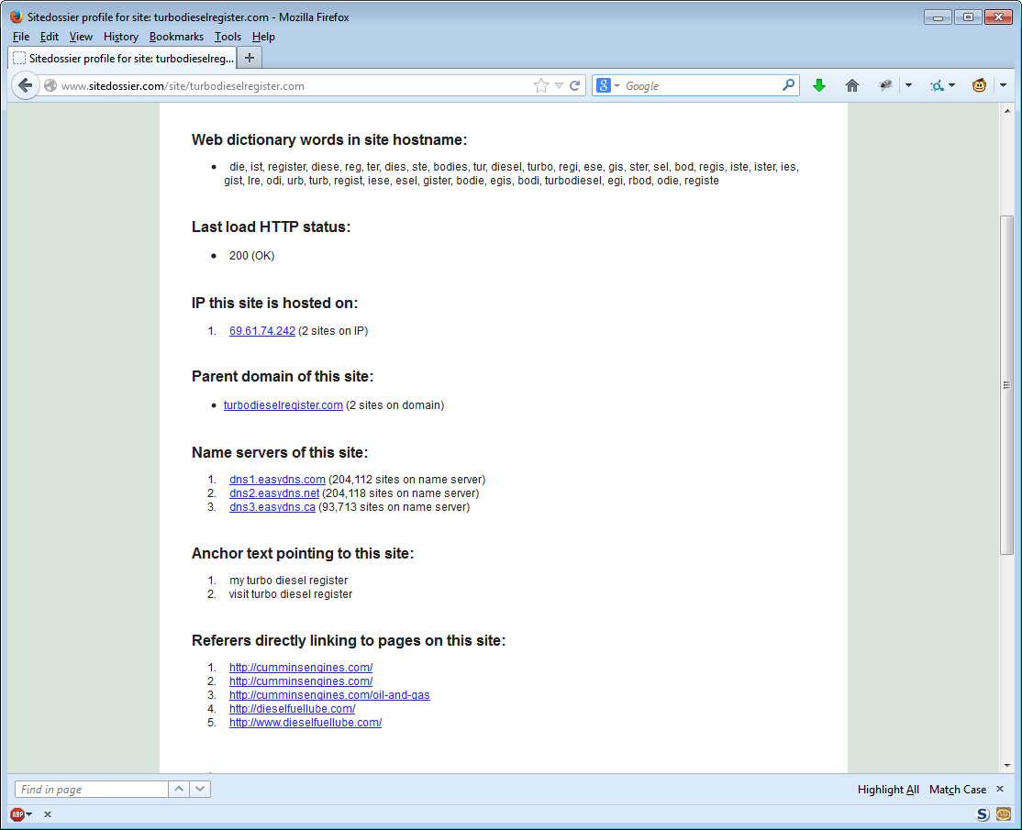
Site DOSSIER
General Site Information
IP
Parent
DNS Servers
Inbound Links

Slide 14
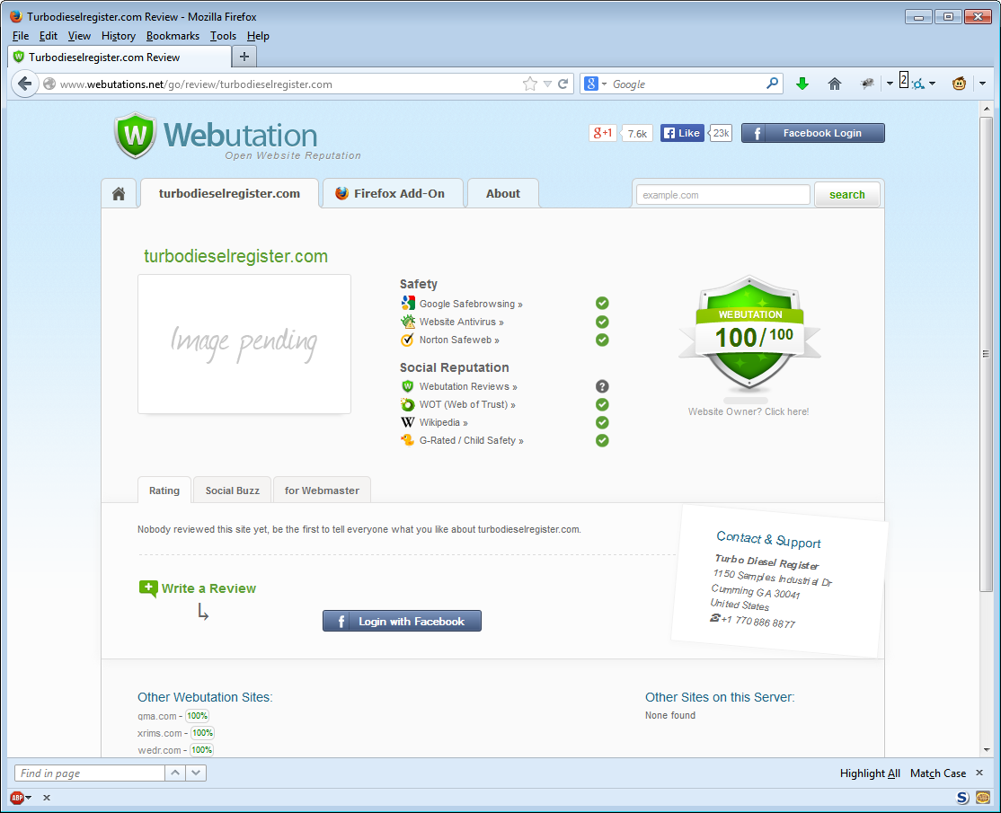
Webutation
URL Reputation Clearinghouse
Google Safebrowse
Norton Safeweb
WebAV
Web of Trust

Slide 15
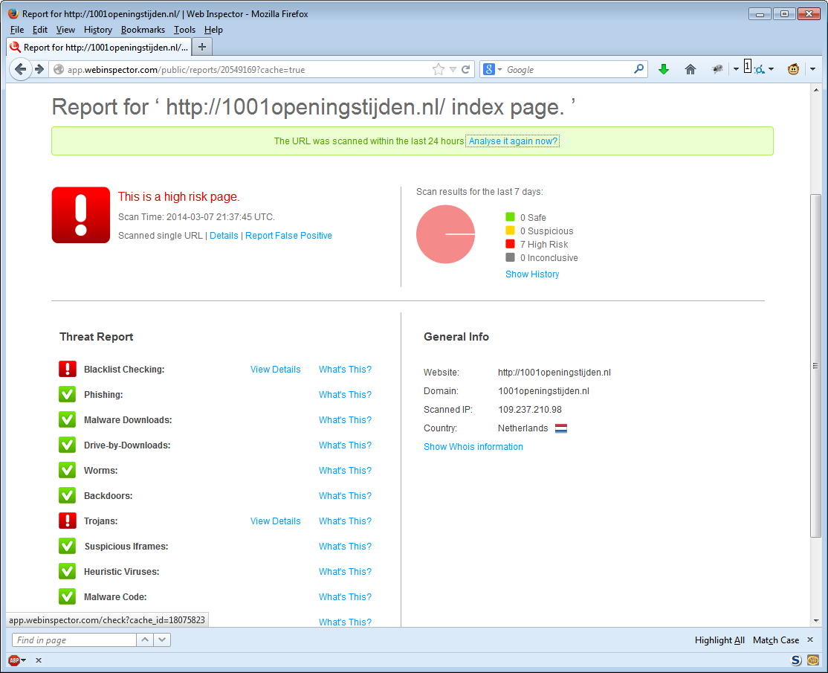
Web inspector
Online web scanning tool
Also provides list of recently detected malicious sites.
Classification techniques
Blacklist membership
AV scanning
Static analysis
Dynamic analysis

Slide 16
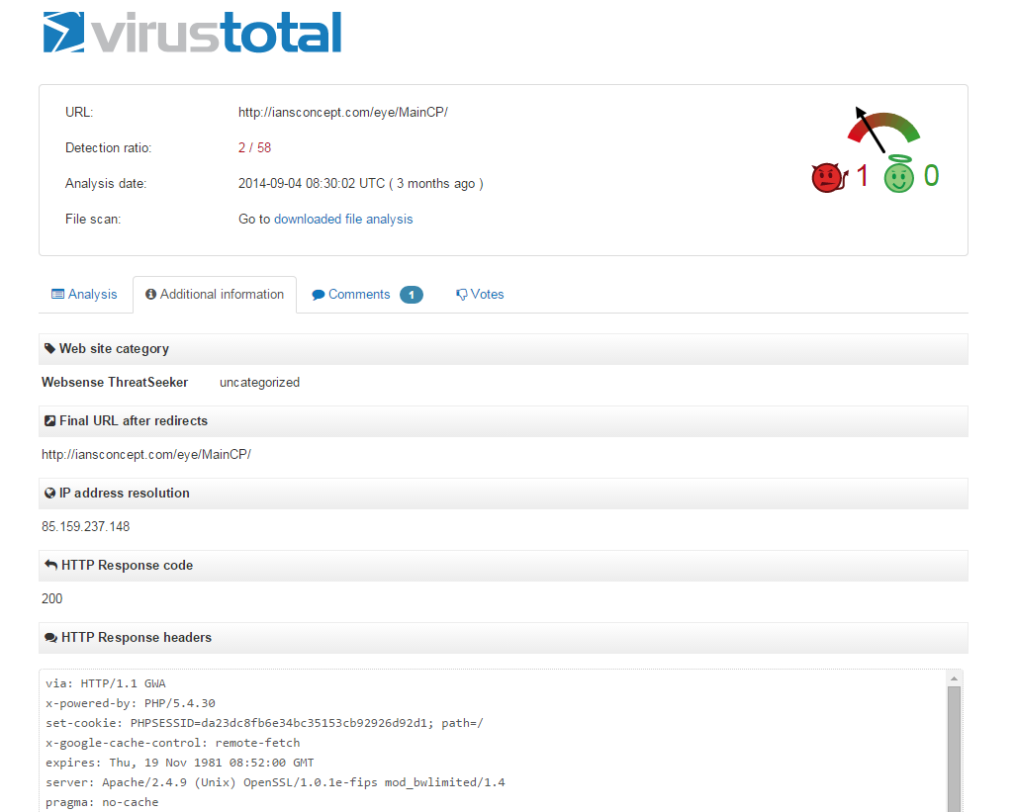
Virus Total (URL search)
Online web scanning tool
Also provides list of malware files.
Classification techniques
Blacklist membership
AV scanning
Static analysis
Dynamic analysis

Slide 17
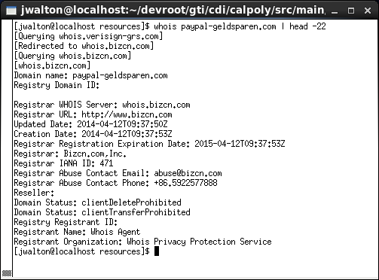
Linux JWHOIS
Domain registration data client
For a given name, can provide
Registrar
Registration date
Expiration date
Contact name
No standard format. Boo!
Can be very telling
Responses can be unreliable and/or throttled

Slide 18
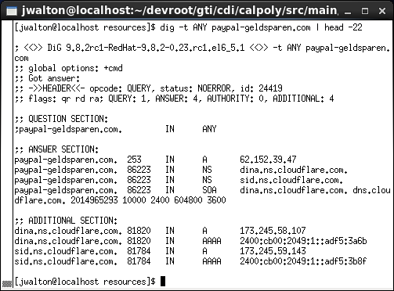
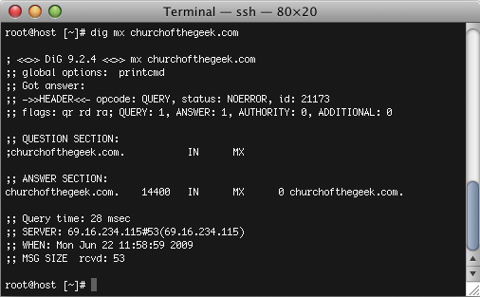
Linux Dig
DNS resolver utility
For a given domain
SOA
A records
MX records
CNAME records
NS records
AAAA records
TXT records
Standard result format Yay!

Slide 19
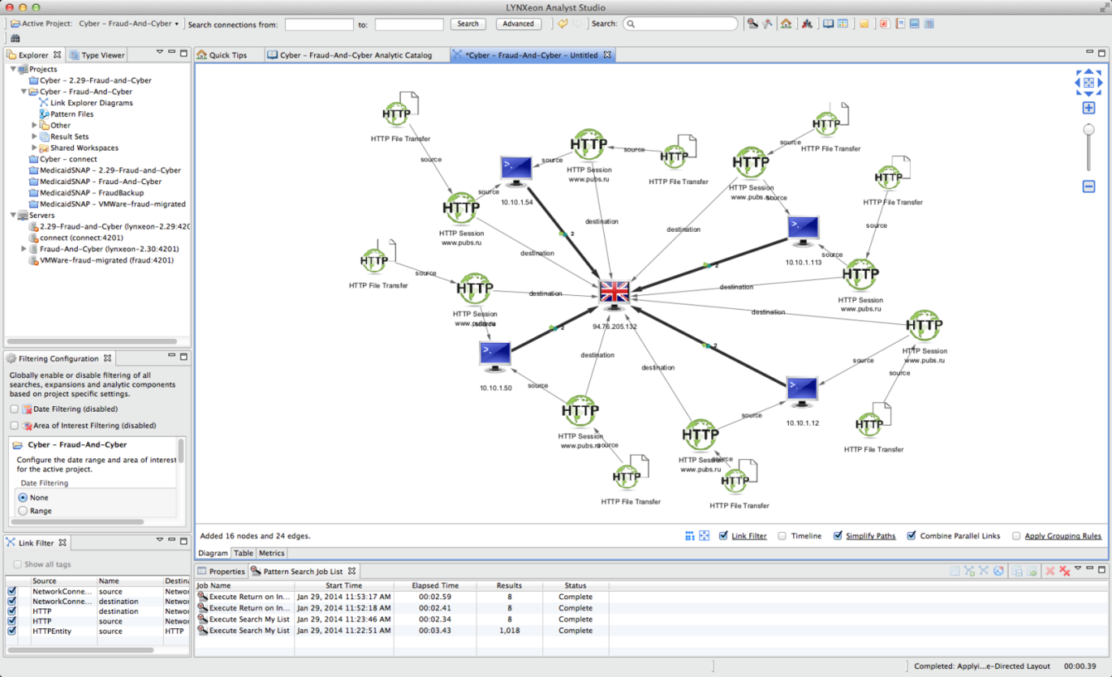
IoC (Indicators of COMPROMISE)
Also known as Threat feeds
Connects the DOTs
Provides contextual data around different malicious objects:
URL/Domain
IP/ASN
File Hash
Actor
Shareable
Many standards
Stix/Cybox/MAEC
OpenIoC
CAPEC
Notes:
MAEC: Malware Attribute Enumeration and Characterization
Cybox: Cyber Observable eXpression
Stix: Structured Threat Information eXpression
CAPEC: Common Attack Pattern Enumeration and Classification

Slide 20
WEB MALWARE – Research TOOLS
FIGHTING BACK

Slide 21
Client-side WEB RESEARCH TOOLS
PhantomJS
Headless, scriptable browser
http://phantomjs.org/
Burp Suite
Graphical deconstruction tool
http://www.portswigger.net/burp/
Web Scarab
Graphical deconstruction tool
https://www.owasp.org/index.php/Category:OWASP_WebScarab_Project
JSUnpack
Script de-obfuscator
https://code.google.com/p/jsunpack-n/
Firebug
Multi-feature Firefox plugin
http://getfirebug.com/

Slide 22

PhantomJS
Scriptable, headless, Webkit browser
Executes all scripts and fully renders page
Full DOM support
Page thumbnail dump support
Can be driven by many scripting languages
Allows for interaction with the page’s JavaScript
Accepts user-defined handlers/callbacks
Very active open source project
http://phantomjs.org/

Slide 23
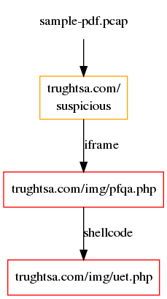
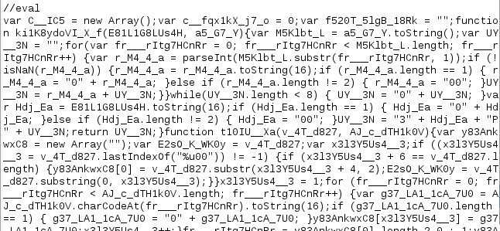
JSUNPACK
Open source command-line utility or service (http://jsunpack.jeek.org currently offline)
Detects exploits that target browser and browser plug-in vulnerabilities
De-obfuscates/unpacks JavaScript
Input Supported:
PDF files
Packet Captures
HTML files
JavaScript files
SWF files

Slide 24
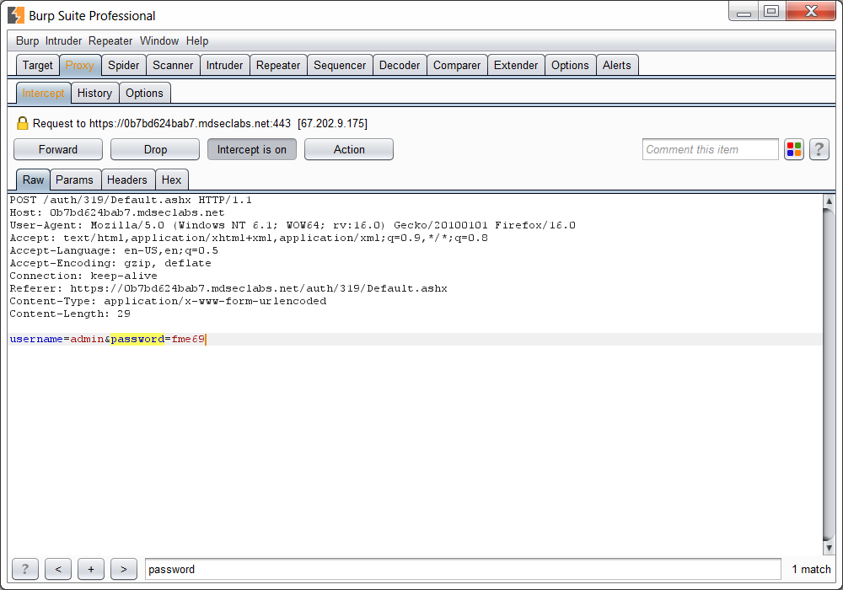
BURP SUITE
Intercept and modify traffic to/from the remote web site.
Log resource requests
Spidering

Slide 25
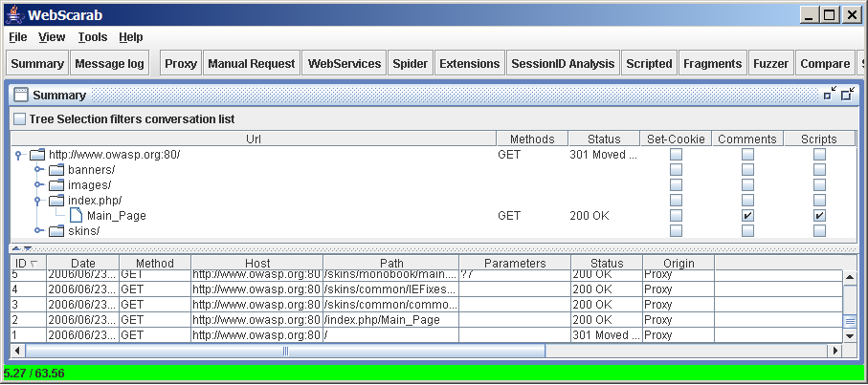
WebScarab
Intercept/modify requests
Submission parameter fuzzing
Spider
Session analysis

Slide 26
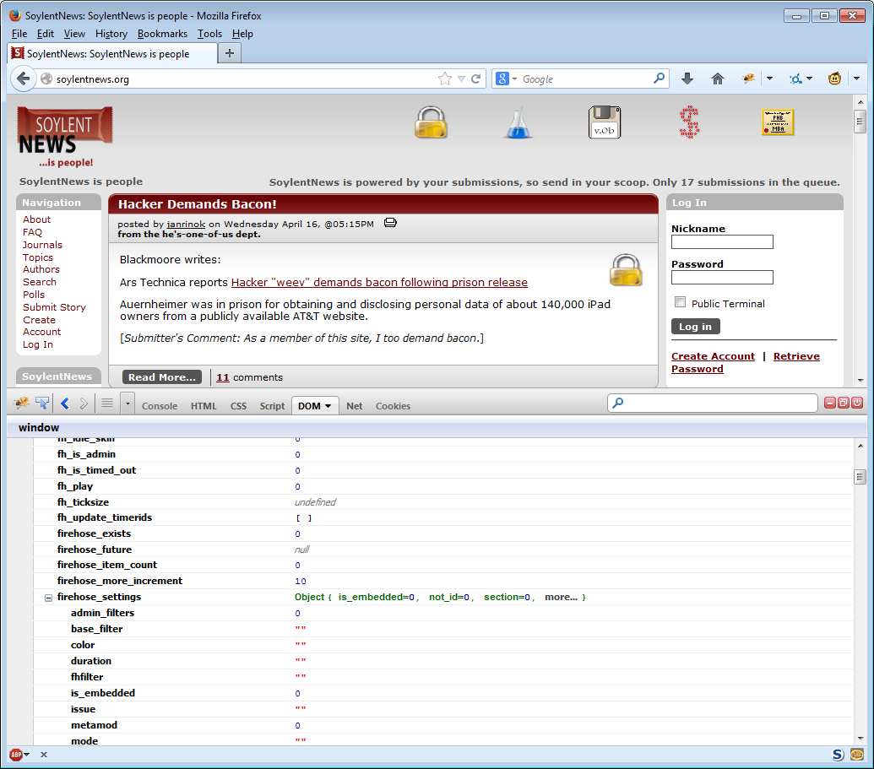
FIREBUG
Inspect HTML elements
Explore page script
Modify the DOM
Set breakpoints

Slide 27
URL CLASSIFICATION
The Good, the Bad, and the Ugly.

Slide 28
CONTENT-based classification
Manual
Using web research tools, secure environment, and your brain, classify the URL.
Will always be needed, especially for new and evolving threats, trend identification, and security blog write-ups.
Throughput: Very Low
Static
Using automated methods, look at page content for malicious features. Do not execute content.
Useful as a prioritization / triage phase
Throughput: Very High
Low-interaction
Using tools such as PhantomJS, automatically render and execute content, noting features.
Should catch most of the remaining malicious sites
Throughput: High
High-Interaction
Using a sandboxed or virtual environment, render and execute content with a real browser, letting full OS be compromised. Automatically process state delta to classify.
Useful for zero-day
Throughput: Low

Slide 29
Host/Lexical Url Classification
Classify a URL without access to its content
Why?
Content may not be available
Single-shot malware
Auto-cloaking malware
Short-lived malware
Crawling billions of URLs is very expensive.
We can classify URLs before any malicious content is served
How?
Human-authored rules
Machine Learning
Both, in a complementary manner

Slide 30
Pick a URL
WWW prefix
6-char domain
File extension in path.
http://www.rarlab.com/rar/winrar-x64-501.exe
.COM domain
rarlab.com has address 188.138.17.58
rarlab.com has address 188.138.17.57
rarlab.com mail is handled by 10 mx1.rarlab.com.
2 A records
IPs are consecutive
German Registrant
13-year old domain
German IP
Has MX Record
20-char domain
Non-alpha in domain
.RU domain
Has CGI
http://downloads-finereader.ru/download.php?file=winrar
downloads-finereader.ru has address 95.211.224.170
IP in Netherlands
Privately-registered domain
3-day old domain
No MX record
1 A record

Slide 31
Lexical-based Classification
Features extracted from the URL string
Domain
Domain length
Ratio of alpha to numeric characters
IDN encoding
Number of subdomains
Ratio of domain tokens to dictionary words
TLD
Path
Length
Number of segments
Ratio of percent-escaped characters to standard characters
CGI
Number of key/value pairs
Other
Markov chaining of characters
Advanced M/L techniques
Notes:
Markov chain: a stochastic model describing a sequence of possible events in which the probability of each event depends only on the state attained in the previous event.
Stochastic: randomly determined, having a random probability distribution or pattern that may be analyzed statistically but may not be predicted precisely
M/L Maximum likelihood estimation for Markov Chains

Slide 32
Host-Based Classification
IP Addresses
Autonomous System
Geo-location
Number of IPs/Networks
DNS Data
MX Server to A record relationship
DNS Server reputation
DNS Server flux
Domain Registration
Autonomous System
Geo-location
Number of IPs
Consecutive Ips
SSL Server Certificate
Certificate Authority
Certificate Age
EV (Extended Validation)

Slide 33
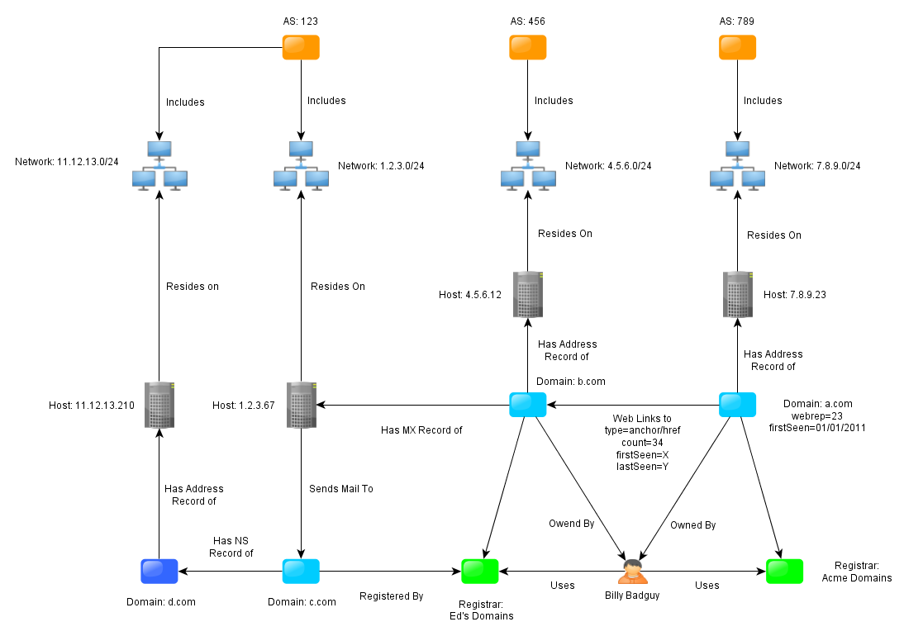
GRAPH-BASED URL CLASSIFICATION
New graph database engines are filling a relevant need.
Examples
Neo4J
Titan
Ability to traverse a directed graph quickly and efficiently
Ability to store very large data sets
Classify URLs by “guilt by association”

Slide 34
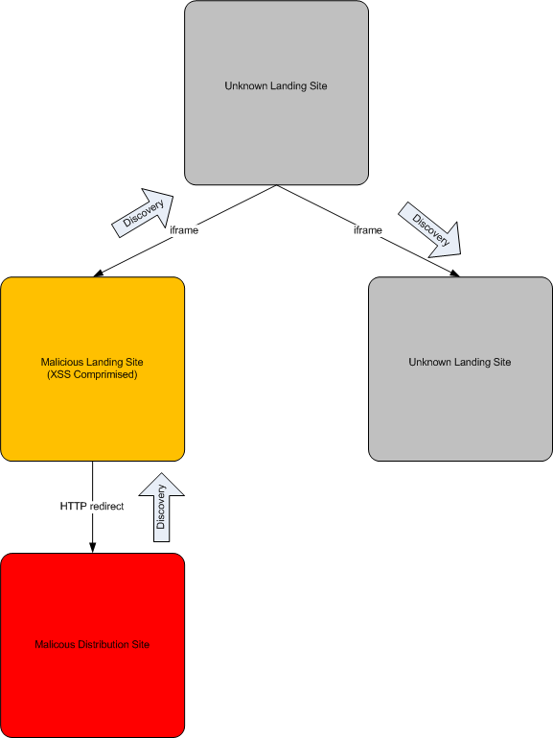
GRAPH-BASED URL CLASSIFICATION - Example
We know about malicious landing site and malicious distribution site.
Traverse the graph to find other inbound and outbound links to new entities
Requires Automated crawling and link/feature storage

Slide 35
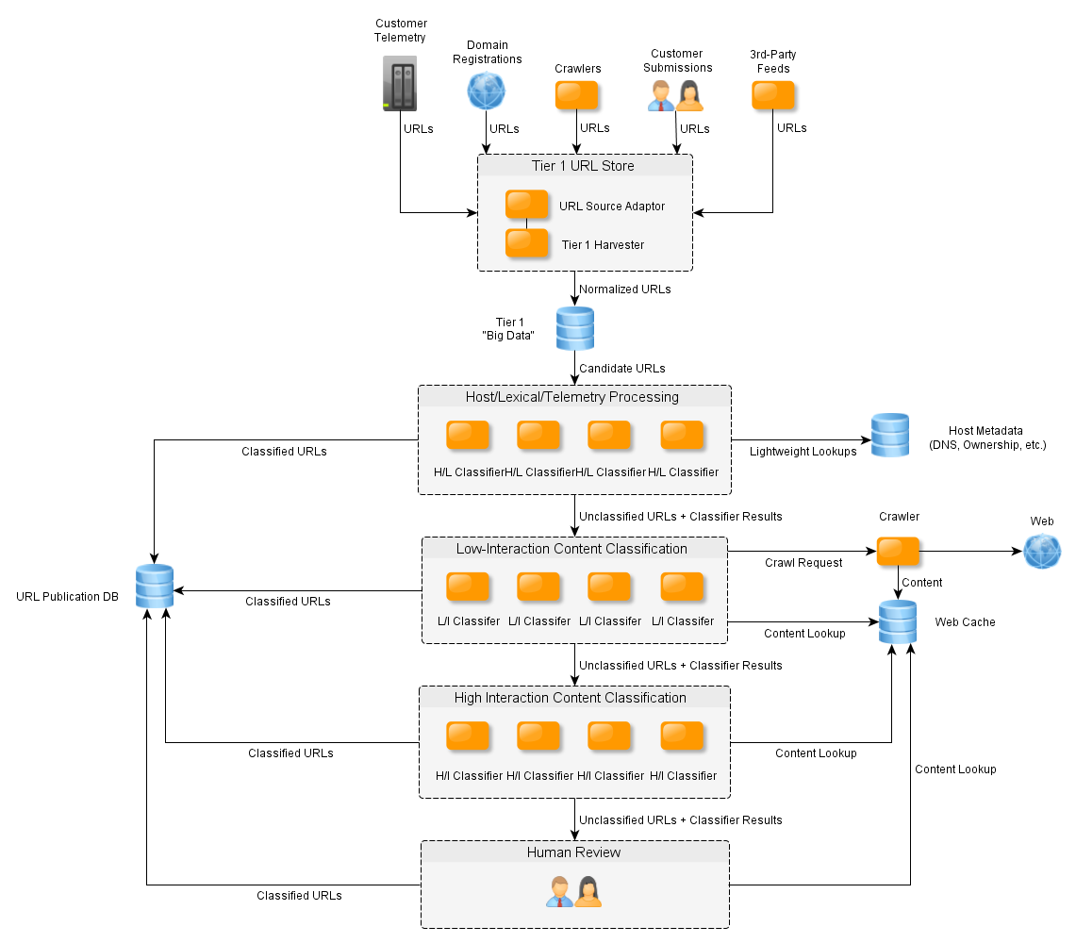
The EXPERT SYSTEM
Too many URLs to hand classify, or even crawl automatically.
Modern research systems classify most URLs *without* ever seeing content
Layer the approach from light to heavy
You may be asked to classify millions of URLs per day
How would YOU do it?

Slide 36
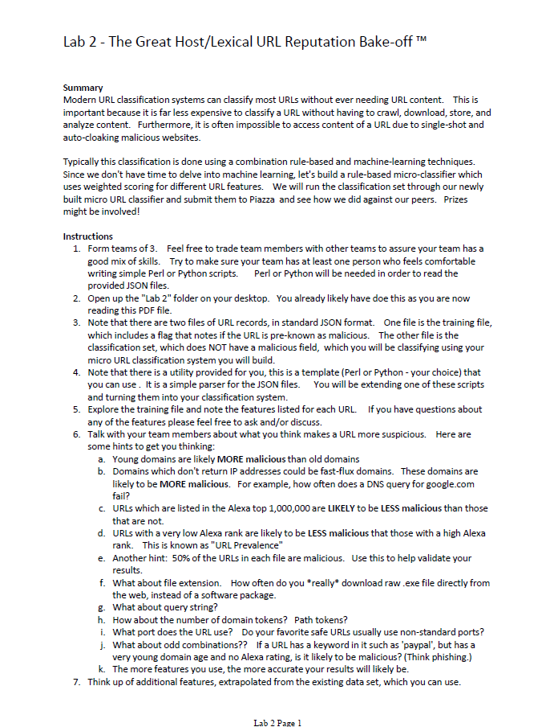
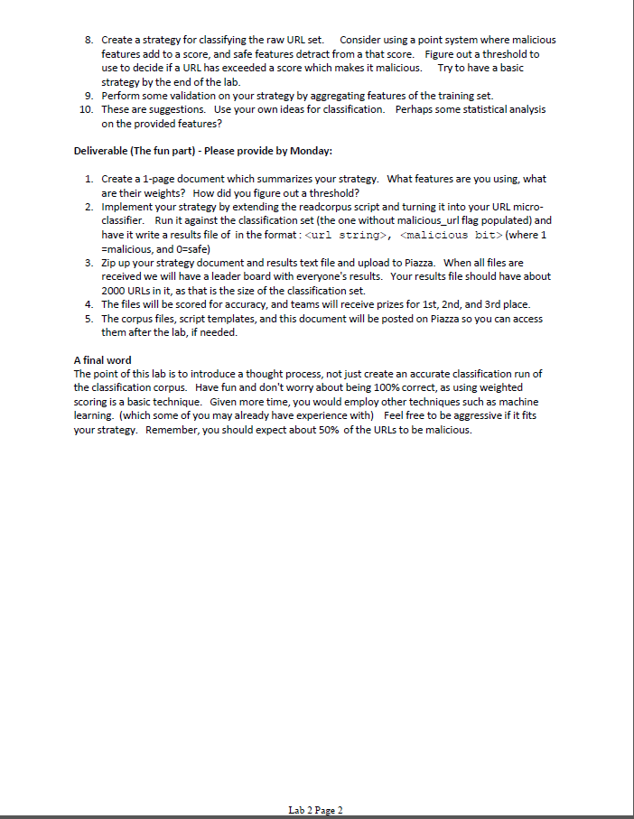
Lab 2 – Host/Lexical URL Reputation Bake-off ™

Slide 37
Questions?
cedric_cochin@mcafee.com

