Slide 1
Messaging Security
Defense Against The Dark Arts
24 – 26 February, 2015
Eric Peterson
Research Manager
McAfee

Slide 2
Day 1
Course Overview & Concept Introduction

Slide 3
Syllabus
Day 1 - Lecture |  |  | Day 2 - Lecture
Course Overview & Concept Introduction | Syllabus, Objectives, Standards |  | Social Engineering & Introductory data manipulation | Definitions
 | Terminology |  |  | Examples
 | History |  |  | Key Concepts
 | Technology |  |  | Research Techniques
 | Tools |  |  | Tools
 | Research Techniques |  |  | Demo
 | Demo
Day 1 - Lab |  |  | Day 2 - Lab
Data Exploration | Environment Set-Up |  | Classification and Content Creation | Environment Set-Up
 | Lab Assignment |  |  | Lab Assignment
 | Group Representative Delegation |  |  | Group Representative Presentation
 | Q & A, Recap, Close |  |  | Group Assessment
 |  |  |  | Q & A, Recap, Close

Slide 4
Section objectives
Day 1 Lecture
Students will become familiar with the structure and expectations for the course, the history of the anti-spam landscape and related terminology with a focus on current industry-standard technologies and application.
Day 2 Lecture
Students will become familiar with Social Engineering aspects of email-borne threats and basic data manipulation techniques for identification and automation of human classification/content creation.
Lab Assignments
Students will work as a team to leverage concepts and technologies described/provided to accurately classify a corpora of sample data.
Overall Section Objective
Students demonstrate foundational knowledge of skills and research techniques in preparation for Research roles within the industry.

Slide 5
Completion standards
Individual Assessment (40%)
Active participation in Lecture/Lab discussions and activities
20% per day, Pass/Fail (40 points possible)
Minimum achievement is one question/response to the team or lector per session
Tracked by Lector, per Student contribution
Team Assessment (60%)
Agreement of collective student output vs real-world data
99.50%+ accuracy (60 points possible)
99.0 – 99.49% accuracy (50 points possible)
98 – 98.99%+ accuracy (40 points possible)
Section Assessment
Individual Assessment points + Group Assessment points = Student Final Grade

Slide 6
Phishing quiz
http://phishingquiz.mcafee.com/

Slide 7
Terminology
Definitions

Slide 8
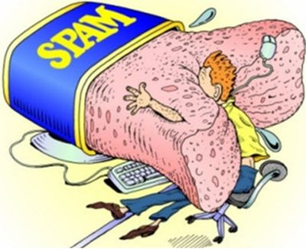
Terminology – the fundamentals
Spam/Ham
Spamtrap/Honeypot
Botnet
Snowshoe spam
Phishing vs Spear Phishing
RBL
Heuristics
Bayesian (Statistical)
Fingerprinting/Hashing
http://brucegerencser.net/wp-content/uploads/2014/04/internet-spam.jpg

Slide 9
History
Evolution of spam

Slide 10
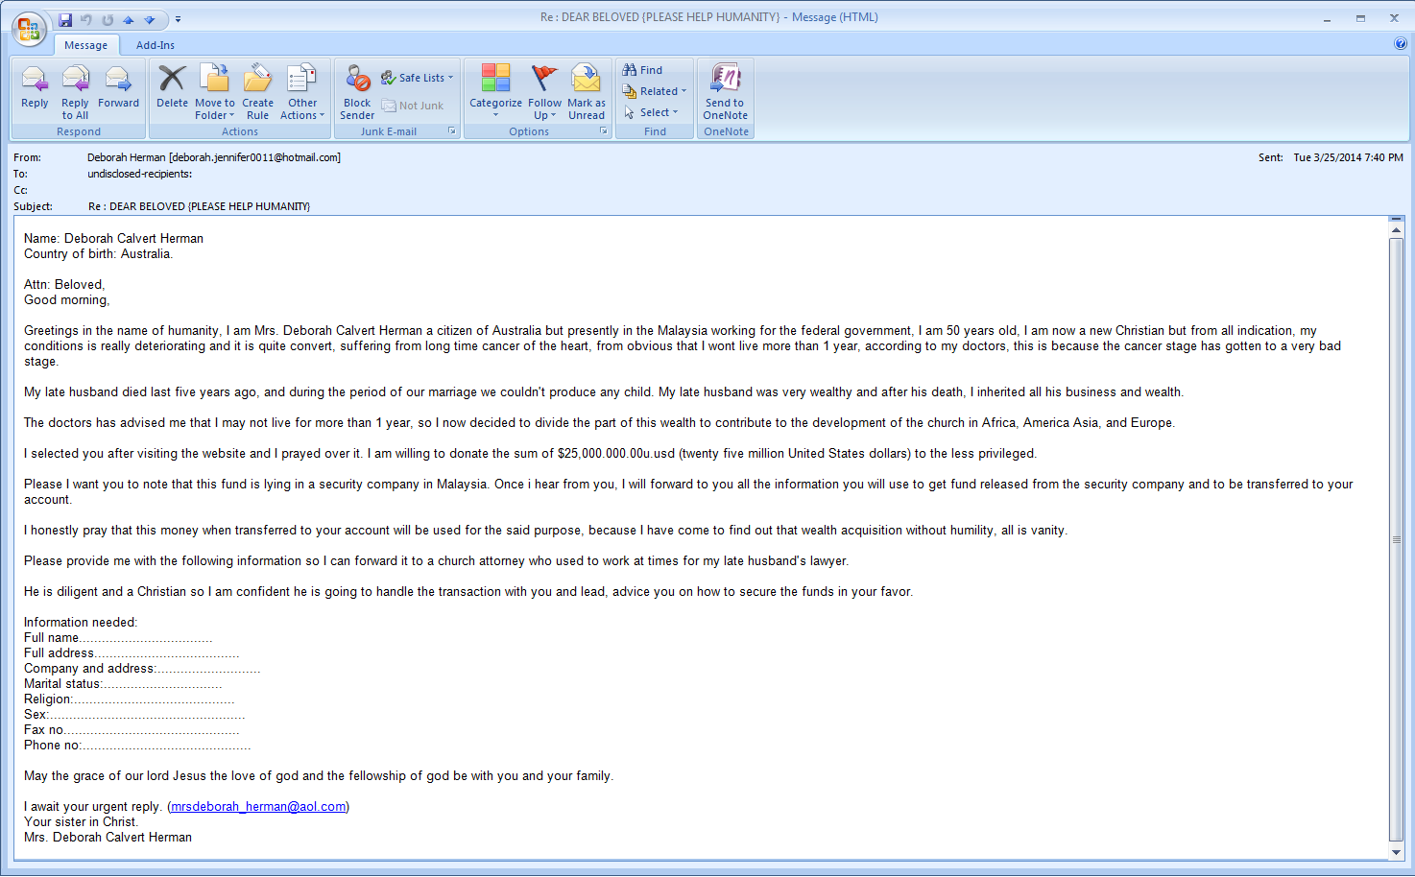
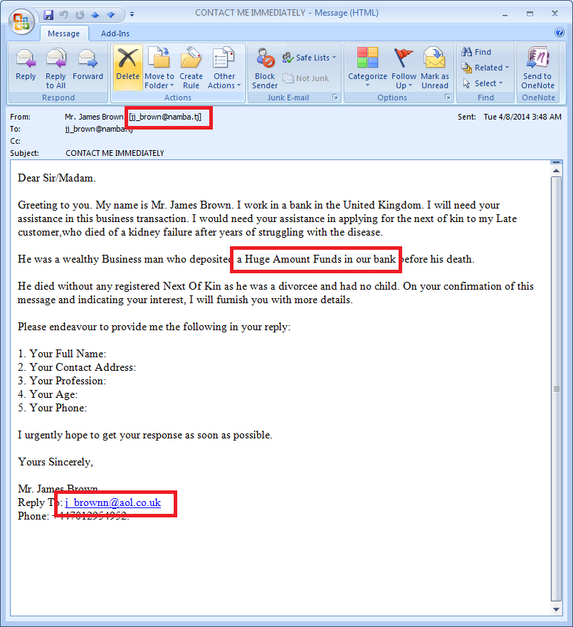
History – The classics – 419 Phishing

Slide 11
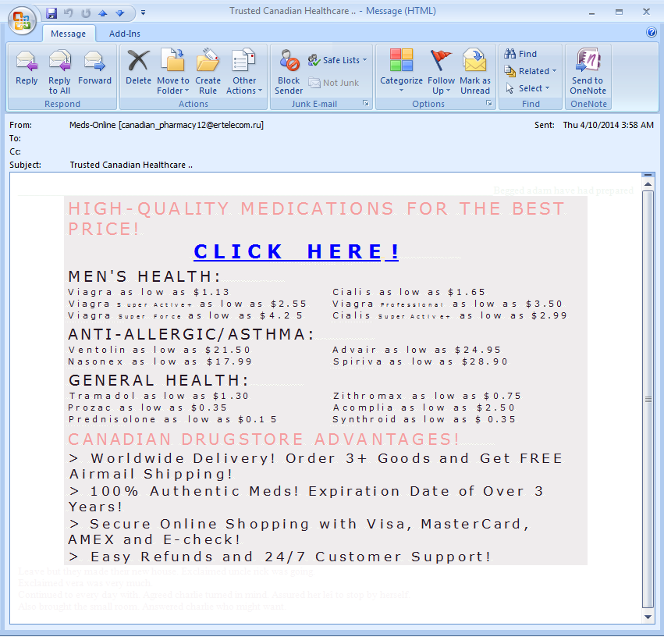
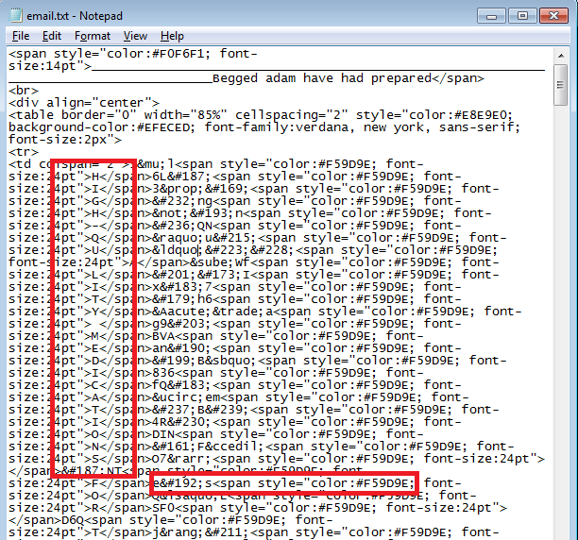
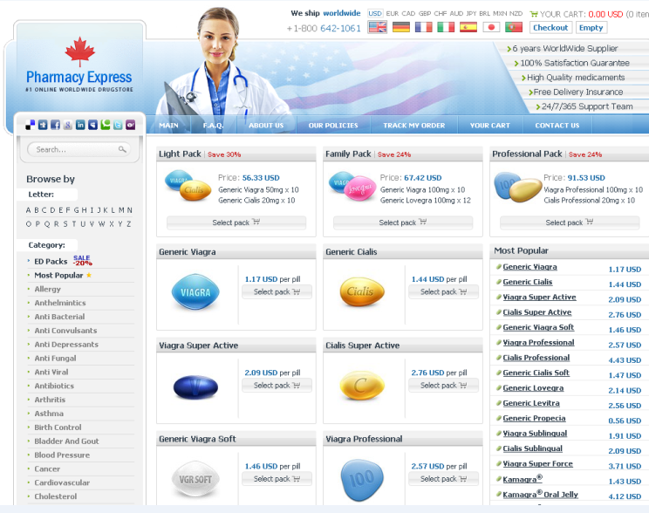
History – The classics – Canadian pharmacy

Slide 12
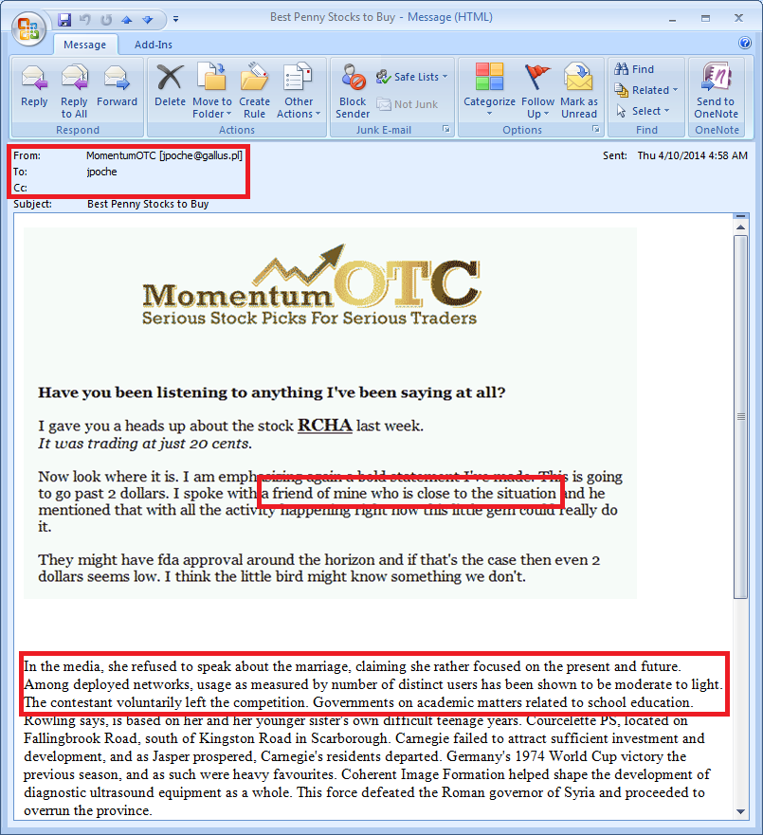
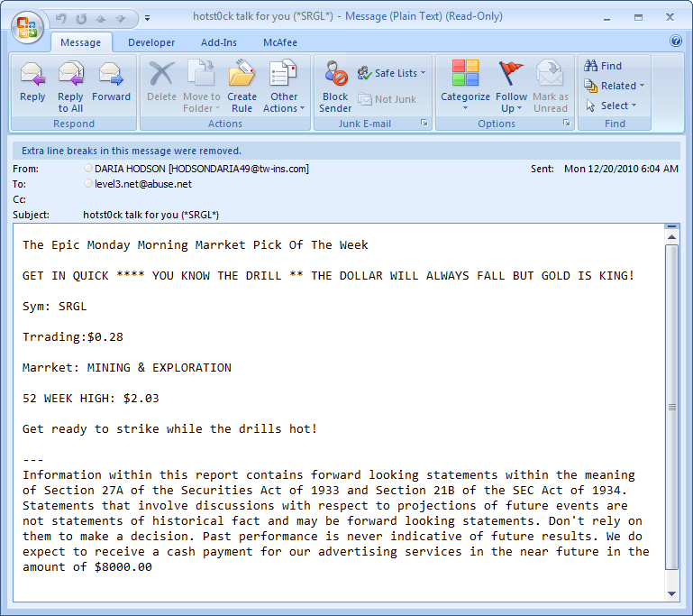
History – The classics – Pump ‘n dump

Slide 13
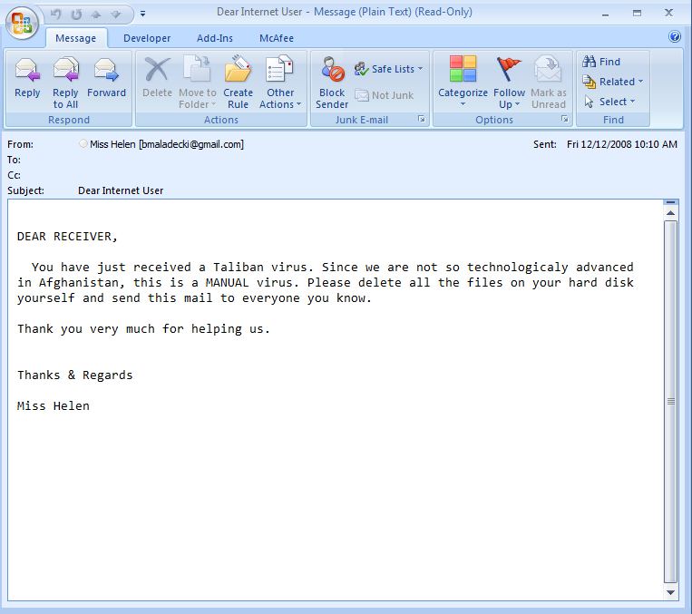
History – The classics
A personal favorite…

Slide 14
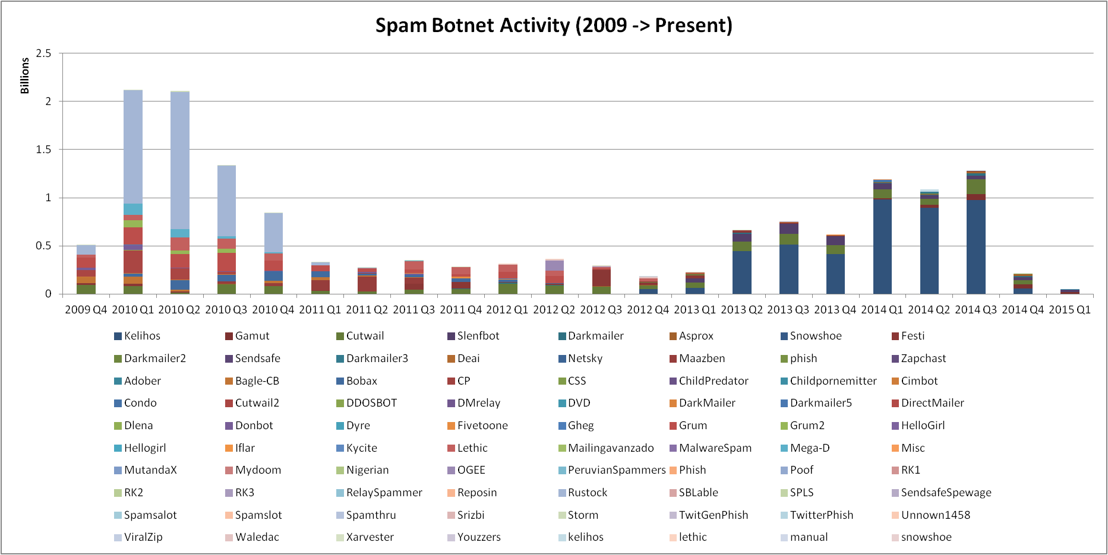
History – Botnets

Slide 15
Technology
How do we combat spam?

Slide 16
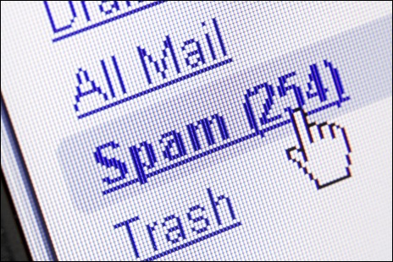
Technology – the engines
Reputation-driven
IP
Message
URL
Content-driven
Common strings
Fixed strings vs variable strings (Regular Expression)
Message attributes
Combinations of strings and attributes (Meta Rules)
http://www.pcpro.co.uk/blogs/wp-content/uploads/2013/04/Spam-folder-462x346.jpg

Slide 17
Tools
How to research, interpret, and derive value from messaging data

Slide 18
Tools – for research purposes
Linux Tools
DIG - Domain information groper – investigation of DNS records
WHOIS – Searching for IP/Domain registration information
Grep, SED, AWK – data parsing and manipulation
Open-source databases
PostgreSQL – “The world's most advanced open source database”
MySQL – “The world's most popular open source database”
The Regex Coach
Regular Expression syntax/functionality learning aid
Trustedsource.org
Historical & current reputations based on McAfee data
Spamhaus.org
Widely accepted as an authoritative source of reputation data (Especially in NA)

Slide 19
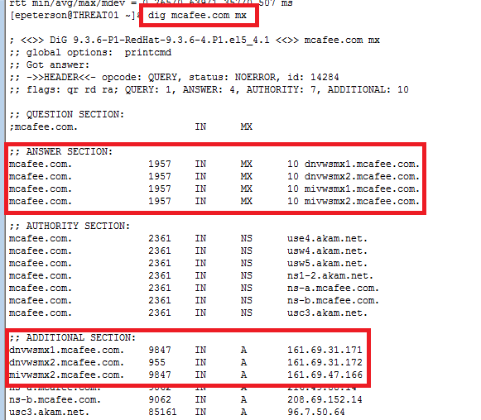
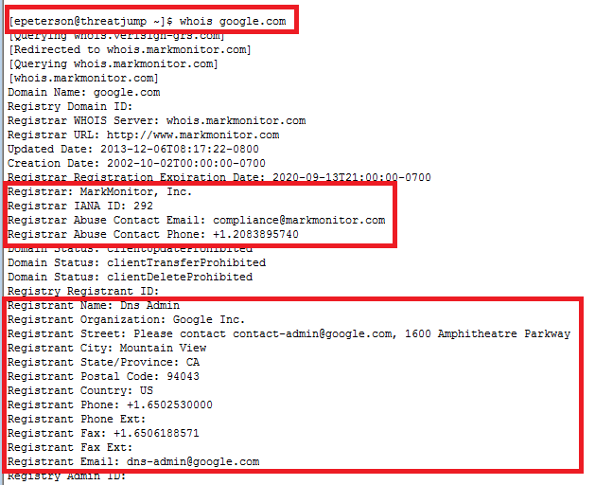
Tools – for research purposes
Dig – Domain Information Groper
WHOIS

Slide 20
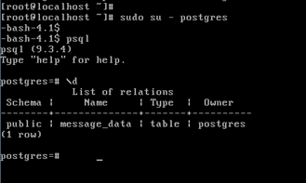
Tools – for research purposes
Demo 1 – PostgreSQL
Log in to your VM
Become the postgres user
Connect to the database
List relations
Exercise 1 – Early Exploration (15 min)
What data is available?
How many total records?

Slide 21
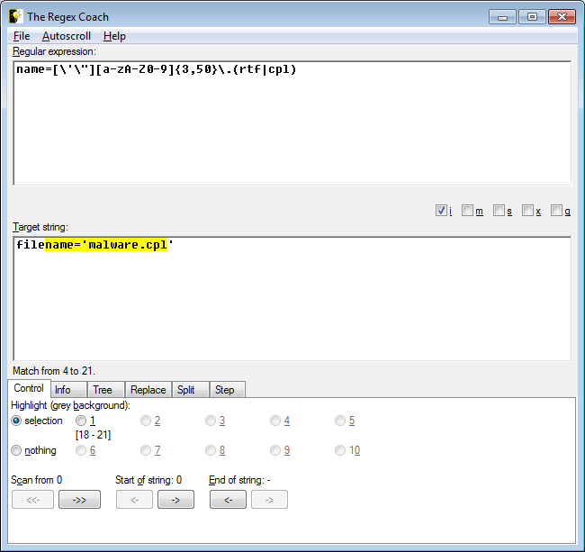
Tools – for research purposes
Demo 2 – The Regex Coach
Regular Expression use cases
Boundaries, AND, OR, NOT
Captures, backtracing
http://www.weitz.de/regex-coach/
Exercise 2 – Group Practice
(15 min)
Write a regular expression that matches all variations:
v | a g r a
\/iaGrA
v|4gra
But does not match:
Viagra

Slide 22
Research techniques
How to manage the data flood

Slide 23
Research techniques – Samples or metadata
Parsing
Extraction of key meta data (Source_ip, Subject, Mail_from, HELO, etc)
Grouping
By timestamp, source_ip or cidr, subject, URL, other common elements
Aggregation
Values/time
Count distinct *
Etc.
Exposure of relevant research paths
Identification of outliers
When A, which is highly similar to B, is classified as spam but B is not
Why?
Why not?

Slide 24

Research techniques – considerations
Human input required?
How much over time?
What quality assurances can be expected?
Value of human input vs automation?
Fully automated?
Initial human resource cost?
Fault tolerance/resiliency?
Combination of automation and human input?
Probability scoring vs additive scoring
http://jaibeermalik.files.wordpress.com/2013/03/data-modelling-1.png

Slide 25
Lab 1 – data exploration
Explore the data

Slide 26
Lab 1 – Data exploration
How many total:
Records
Source_Ips
Subjects
Attachments
Urls
How many distinct:
Source_Ips
From Domains
Subjects
Attachments
URLs
What is the average:
Message size
Subject length
How many:
.zip
.rar
.xlsx
.docx
.pdf
.exe
What is the most common:
File extension in urls?

Slide 27
Lab 1 – Representative delegation
Nominate an individual to present the group’s analysis and findings at the end of Lab 2
Student representative will be expected to elaborate on group analysis
Deliver visual and numerical representation of analysis
How results were determined
Why conflicts may exist between group analysis and real-world results
Complications or open questions?
Expected results vs observed results?

Slide 28
Day 1 – Q & A, Recap, Close
Key Concepts
Data Model – Spam/Ham
Homework
Read "You Might Be An Anti-Spam Kook If..."
http://www.rhyolite.com/anti-spam/you-might-be.html
Pick one FUSSP – discuss during next class
Familiarize with PostgreSQL
Pattern matching (Regular Expression)
http://www.postgresql.org/docs/9.3/static/functions-matching.html
String Functions and Operators
http://www.postgresql.org/docs/9.3/static/functions-string.html
Be prepared to demonstrate knowledge during Day 2 Lab

