Slide 1
Messaging Security
Defense Against The Dark Arts
24 – 26 February, 2015
Eric Peterson
Research Manager
McAfee

Slide 2
Day 2
Lecture Wrap-up, Classification Lab

Slide 3
Day 2 agenda
Lecture wrap-up
SMTP conversation
Email Header Reading
Data Model – Spam/Ham
The “Data Scientific Method”
Classification Lab
Break out into groups
Pass classifications to team delegates
Delegates present results
How many ham? How many spam?
What were the 3 most effective classifications?
Discuss the process – what worked and what didn’t?
Identify areas of subjectivity/ambiguity

Slide 4
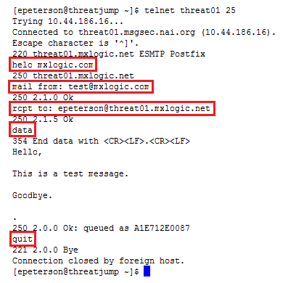
Smtp conversation - ham

Slide 5
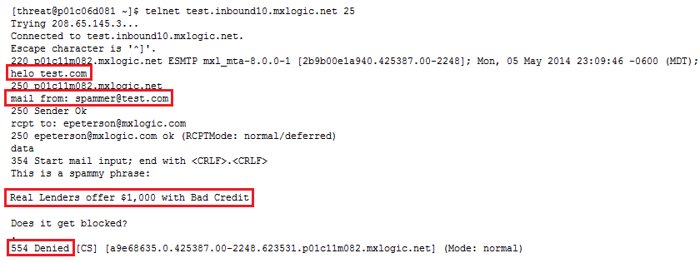
Smtp conversation - spam

Slide 6
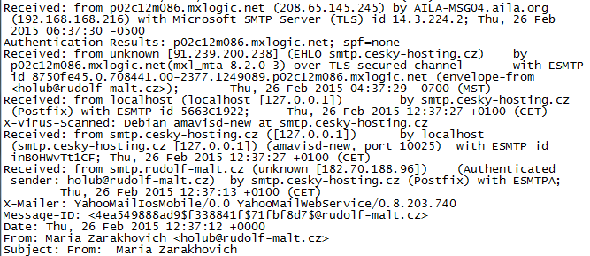
Email header reading

Slide 7
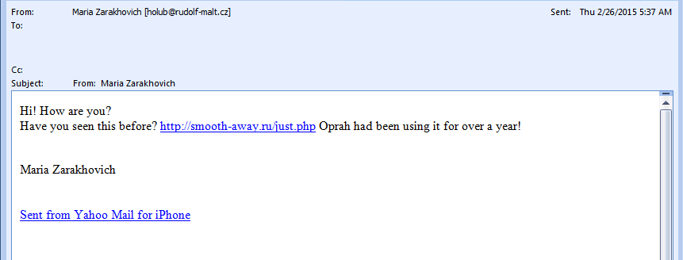
Data model - spam

Slide 8
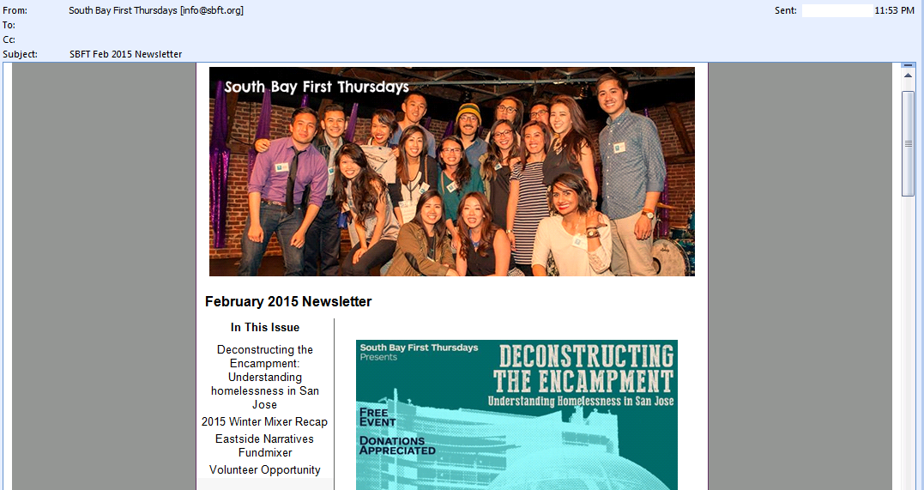
Data model - ham

Slide 9
The data scientific method
1. Start with data.
2. Develop intuitions about the data and the questions it can answer.
3. Formulate your question.
4.Leverage your current data to better understand if it is the right
question to ask. If not, iterate until you have a testable hypothesis.
5. Create a framework where you can run tests/experiments.
6. Analyze the results to draw insights about the question.
Credit: “Data Driven” – DJ Patil & Hilary Mason

Slide 10
Classification lab
Classify the data

Slide 11
Classification lab:
The provded message_data table has 100k rows of real-world message meta data
Use the tools and techniques covered to make spam/ham decisions for all records
Open-book (team, google, peers, instructor)
At the end of the lab session, we will:
Discuss the process – what worked and what didn’t?
Identify areas of subjectivity/ambiguity
Present the data for comparison to real-world results

Slide 12
Classification lab: Sql examples and Bonus questions
Useful operators:
COUNT()
DISTINCT()
SPLIT_PART()
GROUP BY $col
ORDER BY $col
Classify by subject:
update message_data set is_spam = 'x'
where subject ~ E'regex'
Classify by source_ip:
update message_data set is_spam = 'x'
where source_ip in ('1.2.3.4', '5.6.7.8' ... )
Bonus Questions:
How many distinct rules fired on messages in the sample set?
What was the most prevalent TLD in from addresses?
What were the top 25 rules, by hit count?

Slide 13
Classification lab
Present your results!

Slide 14
Day 2 – Q & A, Recap, Close
Day 1
History
Botnets
419, Canadian Pharm, P&D
Terminology/Technology
Spam/Ham
RBL
Heuristics
Bayesian/Probability
Tools
SQL
Regular Expression
DIG/WHOIS
Day 2
Research Techniques
Parsing/Aggregation
Intro to SQL for Research
SELECTs
Intro to Regular Expression
The Regex Coach

Slide 15

Day 2 – Q & A, Recap, Close
Spam is pervasive - Digital & Printed media, Audio/Visual
Many aspects of Security can be reduced to finding the least common denominator among large data sets
Automate “Finding the needle”
Classification accuracy is directly tied to the depth in which we are able to describe samples
Education is key – share your knowledge!

Slide 16
Questions?
Eric_Peterson@mcafee.com

Slide 17
Supplemental slides
Eric_Peterson@mcafee.com

Slide 18
Tools
Spamhaus RBL
McAfee RBL
The Regex Coach
Trustedsource.org
Domaintools.net
Reputationauthority.org
Yougetsignal.com/tools/web-sites-on-web-server/
Spamassassin.apache.org
PostgreSQL

Slide 19
CTE example
SQL CTE – Common Table Expression
WITH a as (
SELECT b from table
WHERE b ~ E’[regex]’)
LIMIT 10)
SELECT a.b, count(*)
FROM a
GROUP BY 1
ORDER BY 2 DESC
LIMIT 10

Slide 20
CTE example
Top100 Rules
WITH rules as (
SELECT heur_symbols as rule_id
FROM message_data
WHERE heur_symbols is not null
limit 100000)
SELECT regexp_split_to_table(rules.rule_id, ','), count(*)
FROM rules
GROUP BY 1
ORDER BY 2 DESC
LIMIT 100

