Slide 1
Midterm Exam
Closed book exam
Cheat sheet: you are allowed 8.5x11 sheet, both sides
Calculator allowed

Slide 2
Topics covered
Asymptotic Growth
Compare order of growth
Prove asymptotic notation using basic definition
Worst case and average case analysis
Analyzing non-recursive algorithms
Sum of arithmetic series
Sum of geometric series
Analyzing recursive algorithms
Defining recurrence
Solving recurrence
Master theorem
Muster method
Iteration
Divide and Conquer algorithms
Mergesort,
Towers of Hanoi
Binary search
Dynamic Programming
LCS, LIS, Knapsack,
Coin Change, Rod Cutting,
Palindrome
Greedy Algorithms
Knapsack,
Scheduling
Huffman Codes
Coins

Slide 3
Formulas in Canvas
Don’t use equation editors . Use
Theta(n^2)
Sum(i=1..n)(i) =Theta(n^2)
Sum(j=1..n)(aj)
log, lg

Slide 4
Read all questions first
You can make notes in Canvas.
Show all work
Indicate final answer

Slide 5
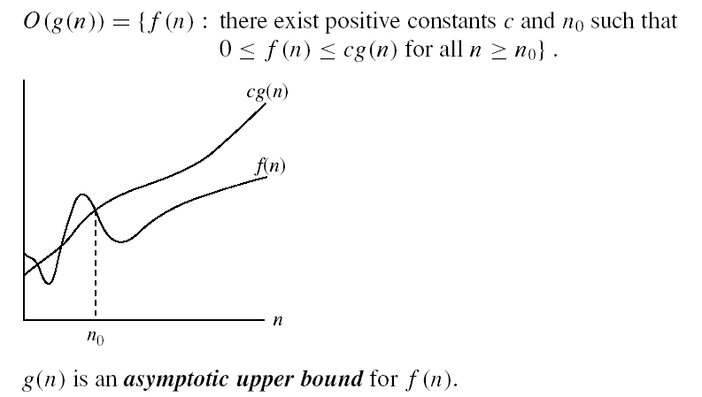
Asymptotic notations
O-notation

Slide 6
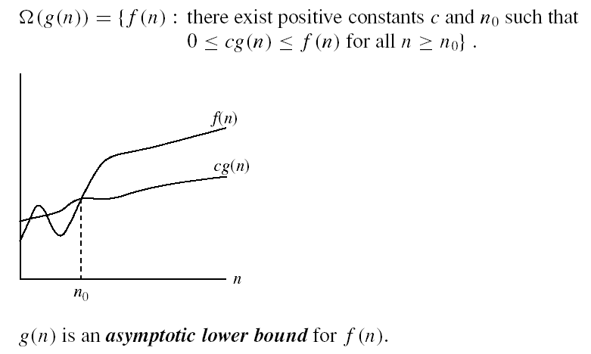
Asymptotic notations (cont.)
Ω - notation
Ω(g(n)) is the set of functions with larger or same order of growth as g(n)

Slide 7

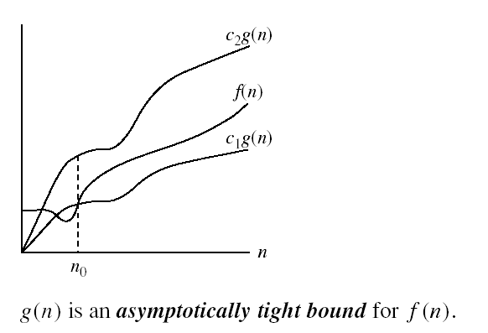
Asymptotic notations (cont.)
Θ-notation
Θ(g(n)) is the set of functions with the same order of growth as g(n)
O( ) = set or equivalence class

Slide 8
Prove or give counter example
If f₁(n)=O(g₁(n)) and f₂(n)=O(g₂(n)) then f₁(n)*f₂(n) = O(g₁(n)g₂(n))

Slide 9
If f₁(n)=O(g₁(n)) and f₂(n)=O(g₂(n)) then f₁(n)*f₂(n) = O(g₁(n)g₂(n))

Slide 10
Limit Method: The Process
Say we have functions f(n) and g(n). We set up a limit quotient between f and g as follows
The above can be proven using calculus, but for our purposes, the limit method is sufficient for showing asymptotic inclusions
Always try to look for algebraic simplifications first
If f and g both diverge or converge on zero or infinity, then you need to apply the l’Hôpital Rule
 | 0 | Then f(n)∈O(g(n))
lim_{n→∞} f(n)/g(n) = | c>0 | Then f(n)∈Θ(g(n))
 | ∞ | Then f(n)∈Ω(g(n))

Slide 11
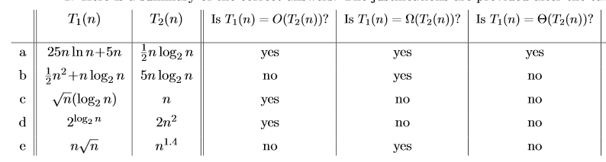

Slide 17
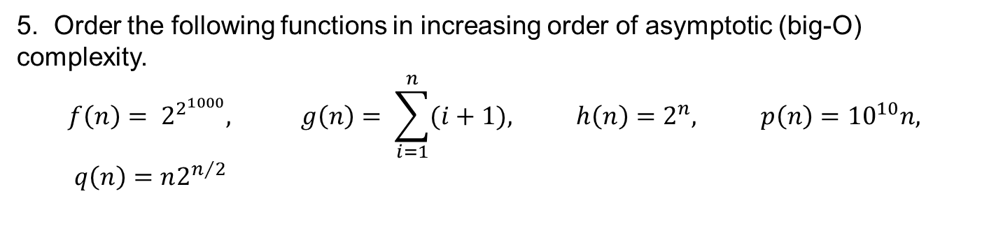
5. Order the following functions in increasing order of asymptotic (big-O) complexity.
$$f\left(n\right)= 2^{2^{1000}}, g\left(n\right)= \sum_{i=1}^{n}{(i}+1), h\left(n\right)=2^{n}, p\left(n\right)={10}^{10}n, q\left(n\right)=n2^{n/2}$$

Slide 18
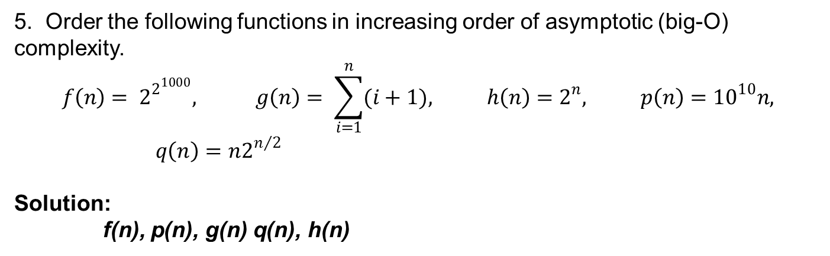
5. Order the following functions in increasing order of asymptotic (big-O) complexity.
$$f\left(n\right)= 2^{2^{1000}}, g\left(n\right)= \sum_{i=1}^{n}{(i}+1), h\left(n\right)=2^{n}, p\left(n\right)={10}^{10}n, q\left(n\right)=n2^{n/2}$$
Solution:
f(n), p(n), g(n) q(n), h(n)

Slide 19
Theoretical Running times
Iterative algorithm
Translate loops in code to summations
Find closed form of summation (solve)
Recursive Algorithm
Translate recursion into a recurrence
Find a closed form for recurrence (solve)

Slide 20
Find running time
Foo(n) {
total = 0
if n = 1 return 2
else {
total = Foo(n/2) + Foo(n/2)
for i = 1 to n do
for j = 1 to n do
for k = 1 to n do
total = total + k
return total }
}

Slide 21
Master’s method
“Cookbook” for solving recurrences of the form:
where, a ≥ 1, b > 1, and f(n) > 0
Case 1: if f(n) = O(n^{log}_{b}^{a -ε}) for some ε > 0, then: T(n) = Θ(n^{log}_{b}ª)
Case 2: if f(n) = Θ(n^{log}_{b}ª), then: T(n) = Θ(n^{log}_{b}ª lgn)
Case 3: if f(n) = Ω(n^{log}_{b}^{a +ε}) for some ε > 0, and if
af(n/b) ≤ cf(n) for some c < 1 and all sufficiently large n, then:
T(n) = Θ(f(n))
regularity condition

Slide 22
Recurrence

Slide 23
Master Method
Case 3

Slide 24
Master Method
Case 1

Slide 25
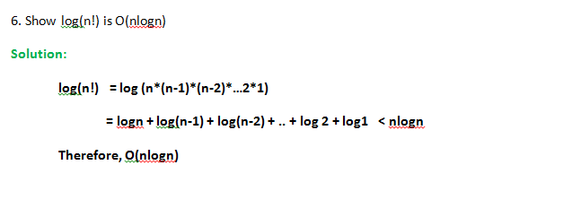

Slide 27
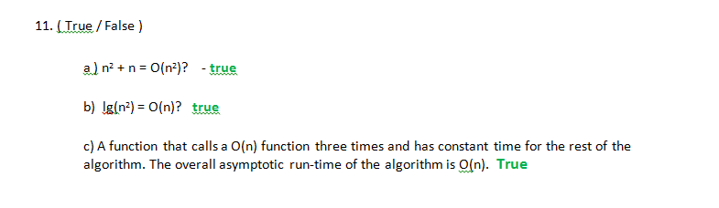

Slide 28
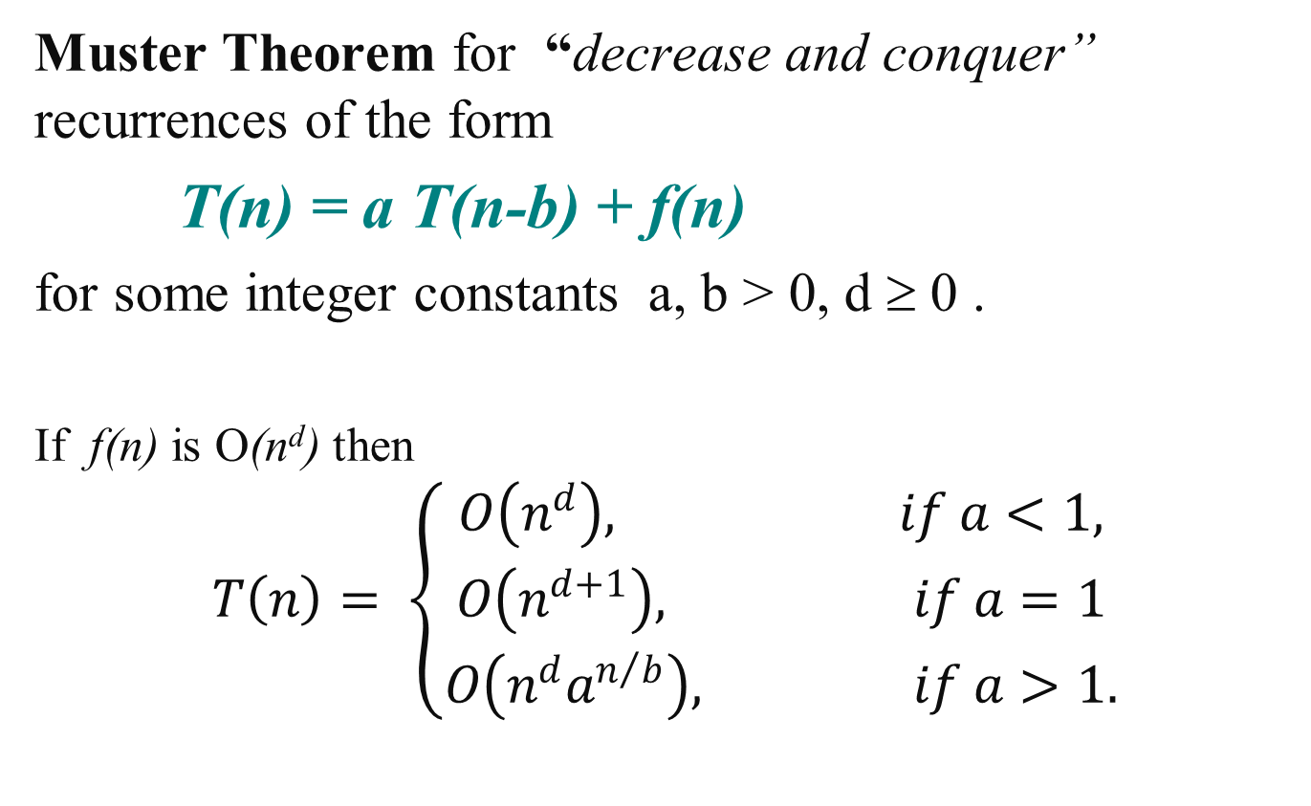
Decrease and Conquer
Muster Theorem for “decrease and conquer” recurrences of the form
T(n) = a T(n-b) + f(n)
for some integer constants a, b > 0, d ≥ 0 .
If f(n) is O(n^{d}) then
$$T\left(n\right)= \left\{\begin{aligned}O\left(n^{d}\right), if a<1, \\ O\left(n^{d+1}\right), if a=1 \\ O\left(n^{d}a^{n/b}\right), if a>1.\end{aligned}\right.$$

Slide 29
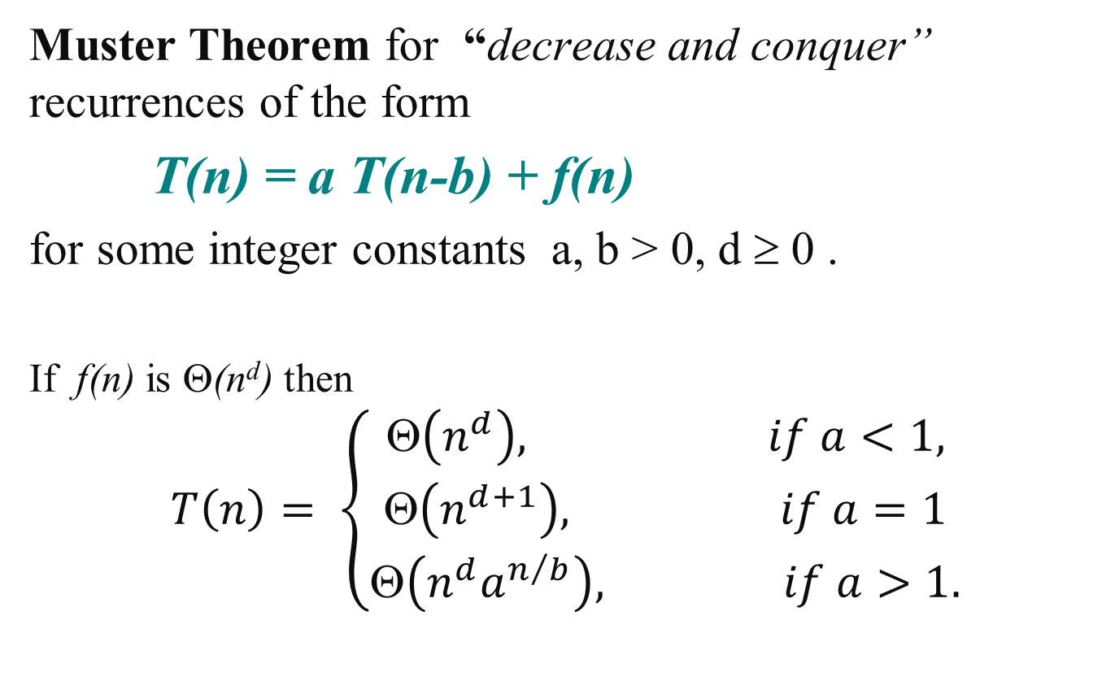
Decrease and Conquer
Muster Theorem for “decrease and conquer” recurrences of the form
T(n) = a T(n-b) + f(n)
for some integer constants a, b > 0, d ≥ 0 .
If f(n) is Θ(n^{d}) then
$$T\left(n\right)= \left\{\begin{aligned}\text{}\left(n^{d}\right), if a<1, \\ \text{}\left(n^{d+1}\right), if a=1 \\ \text{}\left(n^{d}a^{n/b}\right), if a>1.\end{aligned}\right.$$

Slide 30
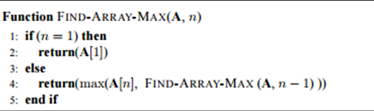
Example: Recursive Find-Array-Max
What is the complexity?

Slide 31
Example: Recursive Find-Array-Max
What is the complexity?
T(n) = T(n-1) + c n > 1
T(1) = 0
f(n) = c = Θ(1) so d = 0, a = 1 and b = 1
So T(n) = Θ(n⁰⁺¹) = Θ(n)

Slide 32
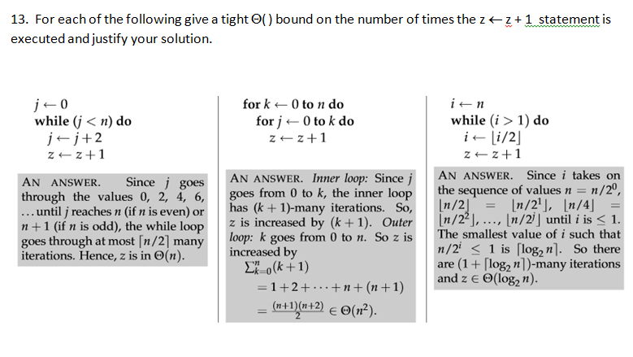

Slide 36
Example: Prefix Averages
Algorithm prefixAverages1(X, n)
Input array X of n integers
Output array A of prefix averages of X #operations
A ← new array of n integers n
for i ← 0 to n − 1 do n
s ← X[0] n
for j ← 1 to i do 1 + 2 + …+ (n − 1)
s ← s + X[j]
A[i] ← s / (i + 1) n
return A 1

Slide 37
Prefix Averages 2
The following algorithm computes prefix averages in linear time by keeping a running sum
Algorithm prefixAverages2(X, n)
Input array X of n integers
Output array A of prefix averages of X #operations
A ← new array of n integers n
s ← 0 1
for i ← 0 to n − 1 do n
s ← s + X[i] n
A[i] ← s / (i + 1) n
return A 1
Algorithm prefixAverages2 runs in Θ(n) time

Slide 38
Dynamic Programming
Used for optimization problems
Find a solution with the optimal value (minimum or maximum)
There may be many solutions that lead to an optimal value
Our goal: find an optimal solution

Slide 39
Elements of Dynamic Programming
Optimal Substructure
An optimal solution to a problem contains within it an optimal solution to subproblems
Optimal solution to the entire problem is built in a bottom-up manner from optimal solutions to subproblems
Overlapping Subproblems
If a recursive algorithm revisits the same subproblems over and over ⇒ the problem has overlapping subproblems

Slide 40
10. You are going on another long trip (this time your headlights are working). You start on the road at mile post 0. Along the way there are n hotels, at mile posts a₁, < a₂ < … < a_{n}, where each a_{i} is measured from the starting point. The only places you are allowed to stop are at these hotels, but you can choose which of the hotels you stop at. You must stop at the final hotel (at distance an), which is your destination.
You’d ideally like to travel 200 miles a day, but this may not be possible (depending on the spacing of the hotels). If you travel x miles during a day, the penalty for that day is (200-x)². You want to plan your trip so as to minimize the total penalty – that is the sum, over all travel days, of daily penalties. Give an efficient algorithm that determines the minimum penalty for the optimal sequence of hotels at which to stop.

Slide 41
10. You are going on another long trip (this time your headlights are working). You start on the road at mile post 0. Along the way there are n hotels, at mile posts a₁, < a₂ < … < a_{n}, where each a_{i} is measured from the starting point. The only places you are allowed to stop are at these hotels, but you can choose which of the hotels you stop at. You must stop at the final hotel (at distance an), which is your destination.
You’d ideally like to travel 200 miles a day, but this may not be possible (depending on the spacing of the hotels). If you travel x miles during a day, the penalty for that day is (200-x)². You want to plan your trip so as to minimize the total penalty – that is the sum, over all travel days, of daily penalties. Give an efficient algorithm that determines the minimum penalty for the optimal sequence of hotels at which to stop.
Let S[j] be the minimum total penalty when you stop at hotel j.
Let S[0] = 0
For j >= 1, j <= n
S[j] = inf;
For i = 0, i < j
S[j] = min { S[i] + (200- (a_{j} – a_{i}))² , S[j]}
Return: S[n]

Slide 42
Let S[j] be the minimum total penalty when you stop at hotel j.
Let S[0] = 0
For j >= 1, j <= n
S[j] = inf;
For i = 0, i < j
S[j] = min { S[i] + (200- (a_{j} – a_{i}))² , S[j]}
Return: S[n]
a₀ = 0 a₁ = 150 a₂ = 200 a₃ = 295 a₄ = 375 a₅ = 480 a₆ = 620
S[0] = 0
S[1] = 0 + (200-150)^2 = 2500

Slide 43
Let S[j] be the minimum total penalty when you stop at hotel j.
Let S[0] = 0
For j >= 1, j <= n
S[j] = inf;
For i = 0, i < j
S[j] = min { S[i] + (200- (a_{j} – a_{i}))² , S[j]}
Return: S[n]
a₀ = 0 a₁ = 150 a₂ = 200 a₃ = 295 a₄ = 375 a₅ = 480 a₆ = 620
S[0] = 0
S[1] = 2500
S[2] = 0 + (200-200)^2 = 0
2500 + (200-(200-150))^2 = 25000

Slide 44
Let S[j] be the minimum total penalty when you stop at hotel j.
Let S[0] = 0
For j >= 1, j <= n
S[j] = inf;
For i = 0, i < j
S[j] = min { S[i] + (200- (a_{j} – a_{i}))² , S[j]}
Return: S[n]
a₀ = 0 a₁ = 150 a₂ = 200 a₃ = 295 a₄ = 375 a₅ = 480 a₆ = 620
S[0] = 0
S[1] = 2500
S[2] = 0
S[2] = 0 + (200-200)^2 = 0
2500 + (200-(200-150))^2 = 25000

Slide 45
Let S[j] be the minimum total penalty when you stop at hotel j.
Let S[0] = 0
For j >= 1, j <= n
S[j] = inf;
For i = 0, i < j
S[j] = min { S[i] + (200- (a_{j} – a_{i}))² , S[j]}
Return: S[n]
a₀ = 0 a₁ = 150 a₂ = 200 a₃ = 295 a₄ = 375 a₅ = 480 a₆ = 620
S[0] = 0
S[1] = 2500
S[2] = 0
S[3] = 0 + (295-200)^2 = 9025
= 2500 + (200-(295-150)^2) = 5525
= 0 + (200-(295-200))^2 = 11025

Slide 46
Let S[j] be the minimum total penalty when you stop at hotel j.
Let S[0] = 0
For j >= 1, j <= n
S[j] = inf;
For i = 0, i < j
S[j] = min { S[i] + (200- (a_{j} – a_{i}))² , S[j]}
Return: S[n]
a₀ = 0 a₁ = 150 a₂ = 200 a₃ = 295 a₄ = 375 a₅ = 480 a₆ = 620
S[0] = 0
S[1] = 2500
S[2] = 0
S[3] = 5525
S[3] = 0 + (295-200)^2 = 9025
= 2500 + (200-(295-150)^2) = 5525
= 0 + (200-(295-200))^2 = 11025

Slide 47
Let S[j] be the minimum total penalty when you stop at hotel j.
Let S[0] = 0
For j >= 1, j <= n
S[j] = inf;
For i = 0, i < j
S[j] = min { S[i] + (200- (a_{j} – a_{i}))² , S[j]}
Return: S[n]
a₀ = 0 a₁ = 150 a₂ = 200 a₃ = 295 a₄ = 375 a₅ = 480 a₆ = 620
S[0] = 0
S[1] = 2500
S[2] = 0
S[3] = 5525
S[4] = 0 + (375-200)^2 = 30625
= 2500 + (200-(375-150)^2) = 3125
= 0 + (200-(375-200))^2 = 625
= 5525 + (200-(375-295)^2 = 19925

Slide 48
Let S[j] be the minimum total penalty when you stop at hotel j.
Let S[0] = 0
For j >= 1, j <= n
S[j] = inf;
For i = 0, i < j
S[j] = min { S[i] + (200- (a_{j} – a_{i}))² , S[j]}
Return: S[n]
a₀ = 0 a₁ = 150 a₂ = 200 a₃ = 295 a₄ = 375 a₅ = 480 a₆ = 620
S[0] = 0
S[1] = 2500
S[2] = 0
S[3] = 5525
S[4] = 625
S[4] = 0 + (375-200)^2 = 30625
= 2500 + (200-(375-150)^2) = 3125
= 0 + (200-(375-200))^2 = 625
= 5525 + (200-(375-295)^2 = 19925

Slide 49
Let S[j] be the minimum total penalty when you stop at hotel j.
Let S[0] = 0
For j >= 1, j <= n
S[j] = inf;
For i = 0, i < j
S[j] = min { S[i] + (200- (a_{j} – a_{i}))² , S[j]}
Return: S[n]
a₀ = 0 a₁ = 150 a₂ = 200 a₃ = 295 a₄ = 375 a₅ = 480 a₆ = 620
S[0] = 0
S[1] = 2500
S[2] = 0
S[3] = 5525
S[4] = 625
S[5] = 5750
S[5] = 0 + (480-200)^2 = 78,400
= 2500 + (200-(480-150)^2) =19,400
= 0 + (200-(480-200))^2 =6,400
= 5525 + (200-(480-295)^2 = 5750
= 625 + (200 – (480-375))^2 = 9650

Slide 50
Let S[j] be the minimum total penalty when you stop at hotel j.
Let S[0] = 0
For j >= 1, j <= n
S[j] = inf;
For i = 0, i < j
S[j] = min { S[i] + (200- (a_{j} – a_{i}))² , S[j]}
Return: S[n]
a₀ = 0 a₁ = 150 a₂ = 200 a₃ = 295 a₄ = 375 a₅ = 480 a₆ = 620
S[0] = 0
S[1] = 2500
S[2] = 0
S[3] = 5525
S[4] = 625
S[5] = 5750
S[6] = 0 + (620-200)^2 = 176,400
= 2500 + (200-(620-150)^2) =75,400
= 0 + (200-(620-200))^2 =48,400
= 5525 + (200-(620-295)^2 = 21,150
= 625 + (200 – (620-375))^2 = 2,650
= 5750 + (200 – (620-480))^2 = 9350

Slide 51
Let S[j] be the minimum total penalty when you stop at hotel j.
Let S[0] = 0
For j >= 1, j <= n
S[j] = inf;
For i = 0, i < j
S[j] = min { S[i] + (200- (a_{j} – a_{i}))² , S[j]}
Return: S[n]
Running time is Θ(n^2)

Slide 52
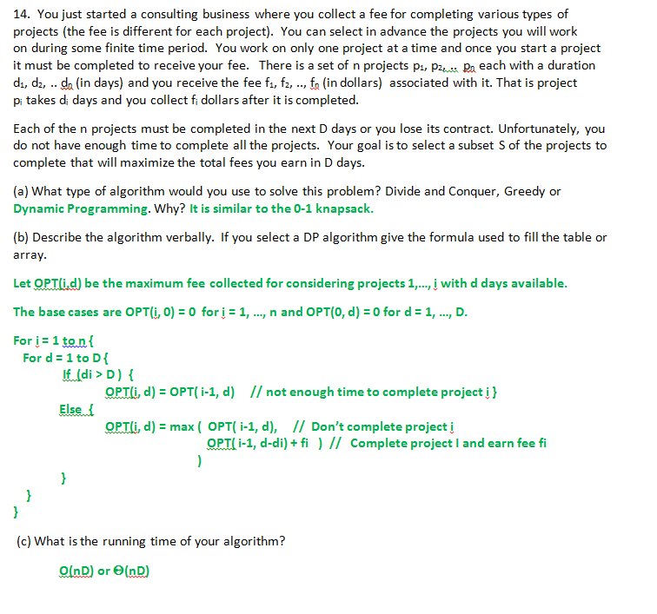
DP

Slide 54
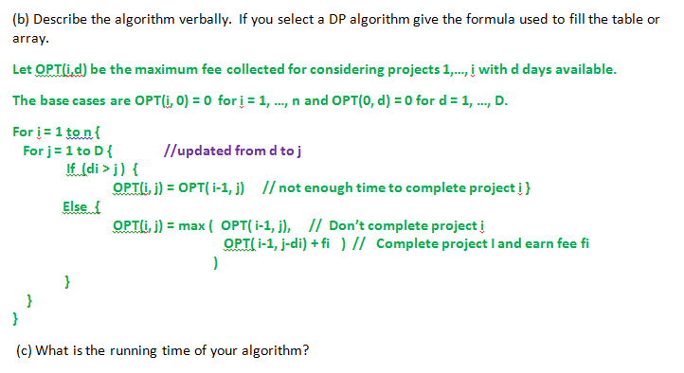
Θ(nD) pseudo-polynomial

Slide 55
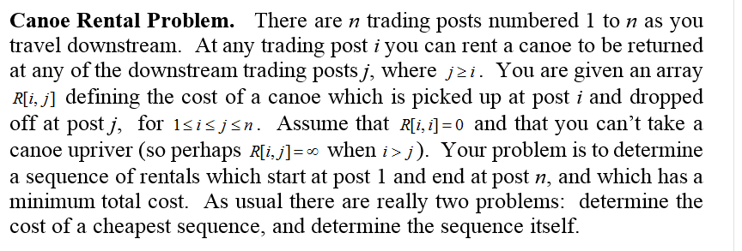

Slide 56
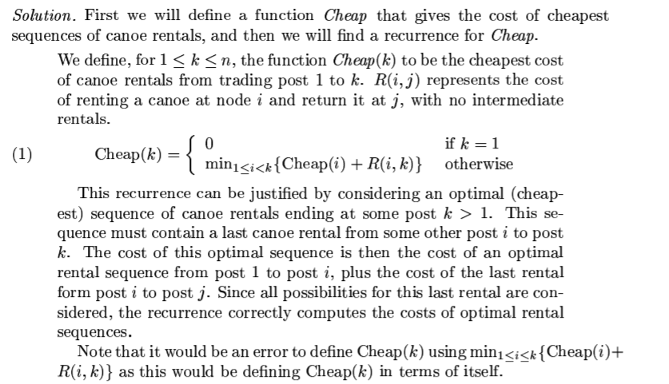

Slide 57
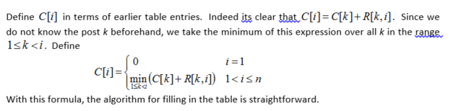
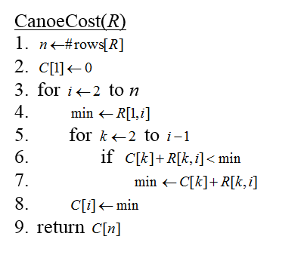
The running time is Θ(n²)

Slide 58
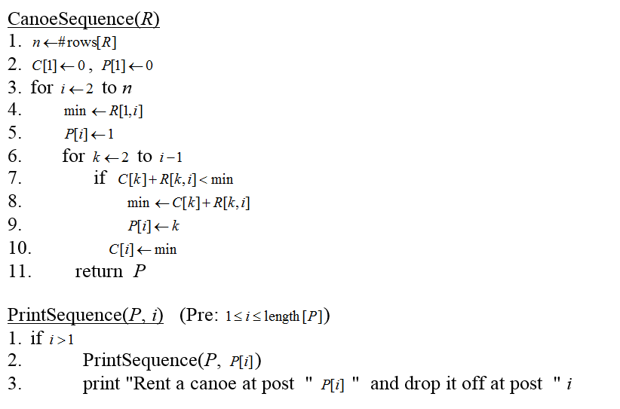

Slide 59
The Subset-Sum problem
Input: An array A[1 . . . n] of positive integers, and a target integer T > 0.
Output: True iff there is a subset of the A values that sums to T .
Example
Input: A = [1, 3, 4, 6, 10 ] and T = 16
Output: True
If we look at all subsets for a sum of T then the running time is exponential.

Slide 60
The Subset-Sum problem
Outline:
Let S[i, j] be defined as true iff there is a subset of elements A[1 . . . i] that sums to j .
Then S[n, T] is the solution to our problem.
In general:
S[i, j] = S[i − 1, j − A[i]] ∨ S[i − 1, j]
With initial conditions
S[i, 0] = True, and S[0, j] = False, for j > 0.

Slide 61
Translating to pseudo-code
for (i = 0; i <= n; i ++)
S [i, 0]= TRUE;
for (j = 1; j <= T; j ++)
S [0,j] = FALSE;
for (i = 1; i <= n; i ++)
for (j = 1; j <= T; j ++)
if j < A[i] then
S [i,j] = S [i -1, j];
else
S [i,j] = S [i -1, j] || S [i-1, j-A[i]]);
Time complexity is Θ(nT).

Slide 62
Greedy Algorithms
A greedy algorithm works in phases. At each phase:
You take the best you can get right now, without regard for future consequences
You hope that by choosing a local optimum at each step, you will end up at a global optimum
Notes:
2

Slide 63
Greedy vs DP
Greedy and Dynamic Programming are methods for solving optimization problems.
Greedy algorithms are usually more efficient than DP solutions.
However, often you need to use dynamic programming since the optimal solution cannot be guaranteed by a greedy algorithm.
DP provides efficient solutions for some problems for which a brute force approach would be very slow.
To use Dynamic Programming we need only show that the principle of optimality applies to the problem.

Slide 64
Examples of Greedy Algorithms
Knapsack
Coin Change
Data compression
Huffman coding
Scheduling
Activity Selection
Task Scheduling
Minimizing time in system
Deadline scheduling
Graph Algorithms
Breath First Search (shortest path 4 un-weighted graph)
Dijkstra’s (shortest path) Algorithm
Minimum Spanning Trees

Slide 65
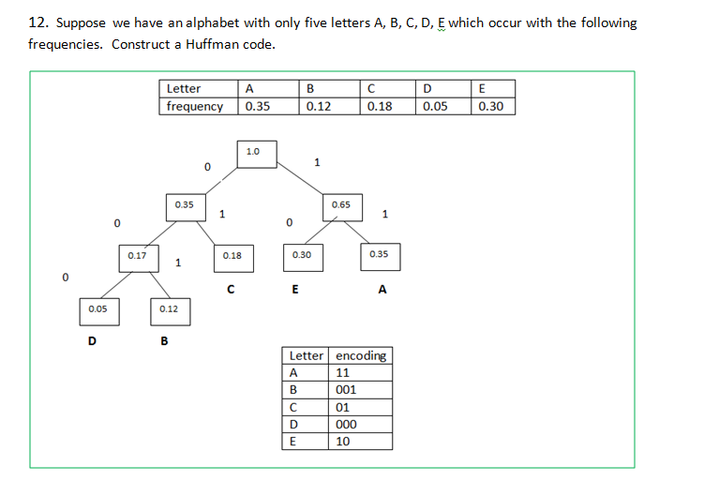

Slide 66
Given a set {x₁ ≤ x₂ ≤ … ≤ x_{n} } of points on the real line, determine the smallest set of unit-length closed intervals (e.g. the interval [1.25,2.25] includes all x_{i} such that {1.25 ≤ x_{i} ≤ 2.25} ) that contains all of the points.
Give the most efficient algorithm you can to solve this problem, prove it is correct and analyze the time complexity.

Slide 67
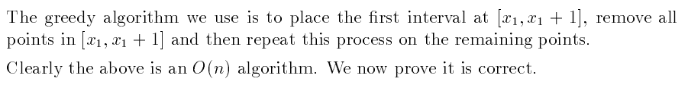
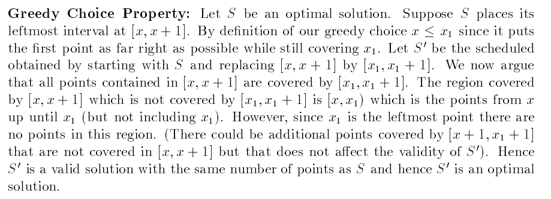

Slide 68
