Slide 1

Terms: Test (Case) vs. Test Suite
Test (case): one execution of the program, that may expose a bug
Test suite: a set of executions of a program, grouped together
A test suite is made of test cases
suite::tests flock:sheep

Slide 2
Kinds of Testing
Manual testing:
A human being sits at a program and enters inputs into a program to test it
Often employees non CS people
Beta testing, user testing obviously
Sometimes means a human writes out tests that run automatically, but usually means a person does the testing

Slide 3
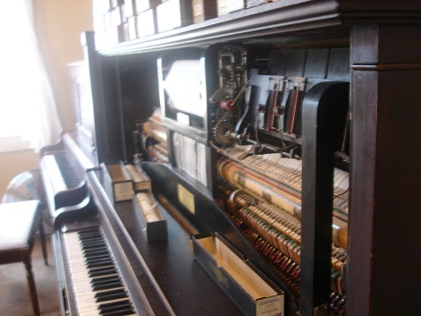
Kinds of Testing
Automated testing:
One meaning is that humans design tests, but use scripts or other methods to have the computer execute the tests without help
Another meaning is that humans write programs that produce tests
Essential for speed, automatic checks when a program is compiled, etc.

Slide 4
Kinds of Testing
Which is better?
Some academics will say that manual testing is ineffective and slow, often poorly thought out
Some folks in industry will say that automated testing is often a waste of time/money and humans find more bugs more cheaply
Both are right, both are wrong
Neither kind of testing is superior, and a good test engineer knows when to use each

Slide 5

Kinds of Testing
For more information on good manual testing:
Books by James Whittaker
Originally academic, then at MS, then google, then back to MS
Whittaker’s ideas bring us to next distinction, two kinds of manual testing

Slide 6

Kinds of Testing
Scripted testing vs. exploratory testing
In scripted manual testing, a tester follows a fixed script: “first open this file using this dialog, then click here, then resize the font…”
In exploratory testing, the tester may have some general guidelines “try all the choices in the File dialog” or an area to focus on but is free to explore
Whittaker’s book covers the value of guided exploratory manual testing

Slide 7
Unit, Integration, System Testing
Stages of testing
Unit testing is the first phase, done by developers of modules
Integration testing combines unit tested modules and tests how they interact
System testing tests a whole program to make sure it meets requirements
“Design testing” is testing prototypes or very abstract models before implementation

Slide 8
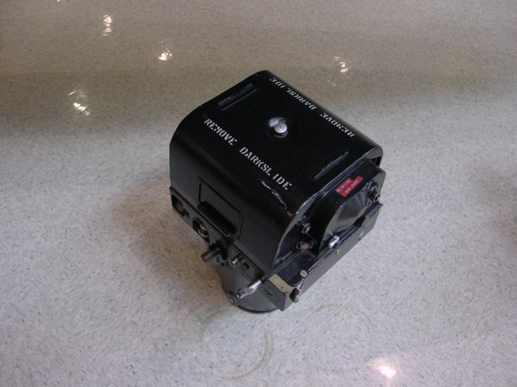
Terms: Black Box Testing
Black box testing
Treats a program or system as opaque
That is, testing that does not look at source code or internal structure of the system
Send a program a stream of inputs, observe the outputs, decide if the system passed or failed the test
Abstracts away the internals – a useful perspective for integration and system testing
Sometimes you don’t have access to source code, and can make little use of object code
True black box? Access only over a network

Slide 9
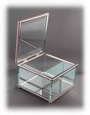
Terms: White Box Testing
White box testing
Opens up the box!
(also known as glass box, clear box, or structural testing)
Use source code (or other structure beyond the input/output spec.) to design test cases
Brings us to the idea of coverage

Slide 10

Regression Testing
Regression testing
Changes can break code, reintroduce old bugs
Things that used to work may stop working (e.g., because of another “fix”) – software regresses
Usually a set of cases that have failed (& then succeeded) in the past
Finding small regressions is an ongoing research area – analyze dependencies
“. . . as a consequence of the introduction of new bugs, program maintenance requires far more system testing. . . . Theoretically, after each fix one must run the entire batch of test cases previously run against the system, to ensure that it has not been damaged in an obscure way. In practice, such regression testing must indeed approximate this theoretical idea, and it is very costly." - Brooks, The Mythical Man-Month

