Slide 1

Popular Ways to Debug
Using “printf”
Often mocked, viewed as unscientific
In fact, just an easy way to apply dynamic/log analysis and perform experiments
If you ask the right questions, print can be a great debugging tool
Supports scientific debugging
I have no lessons here, other than to print intelligently, not blindly grope around

Slide 2
Popular Ways to Debug
Using a debugger
Usually thought of as “more scientific”
It can be!
A debugger is good when you want to:
Inspect closely what happens to some values
Slow down and carefully watch things during one part of a run
Get information across a lot of state at once
Hard to make guidelines, but in general printf is for “across time” and debuggers are for “across state”

Slide 3
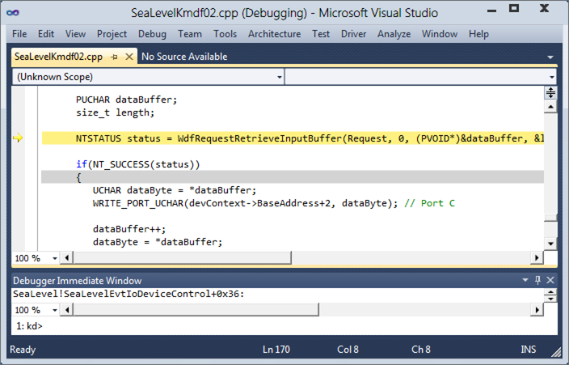
Debuggers
Let you “take over” a program and run it under more control than usual
Command line (gdb) and visual debuggers are both popular and widely used

Slide 4
GDB
There are many other debuggers out there
Won’t spend a lot of time on GDB specifics
Major features (common to many debuggers or becoming more common)
Single step through a program line at a time
GDB: step and next
next skips over functions called in a line
Inspect memory locations/values
Set breakpoints – places to stop execution
Can be conditional (break at line XX if y > z)
Set watchpoints – events to watch for in execution
Change values in memory
GDB can also “run a program backwards” a little bit now!

Slide 5
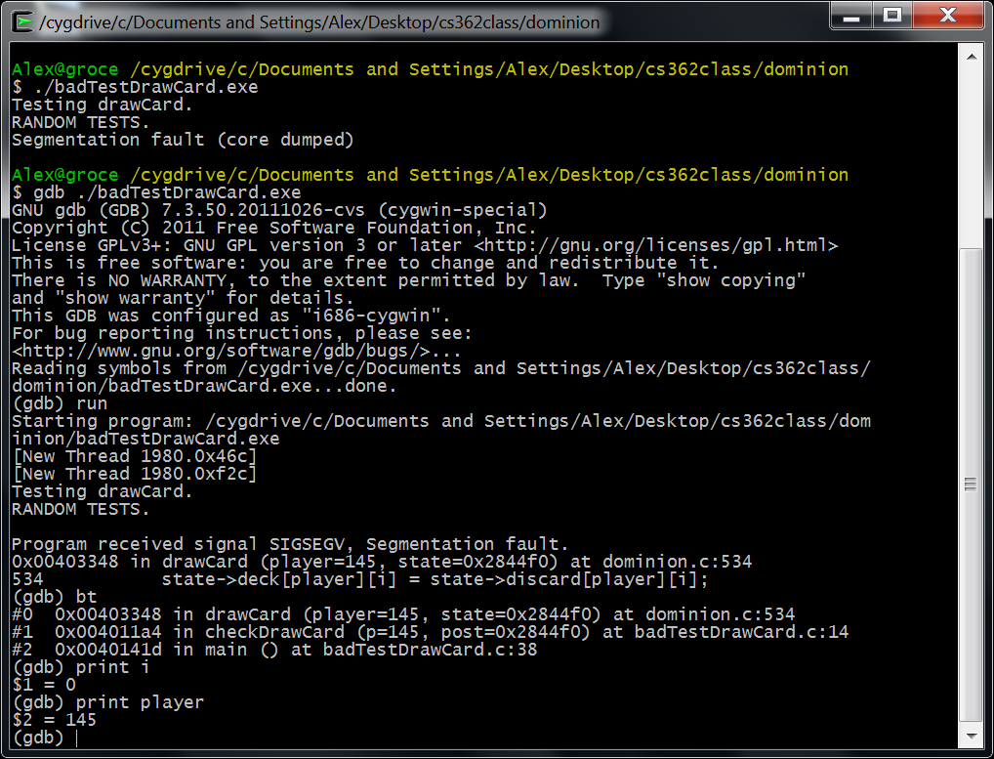
GDB
Single most popular GDB or other debugger feature, in C?
Ability to tell you where a segmentation fault took place in a program!
Can also do this with valgrind on linux, rather than a debugger

Slide 6
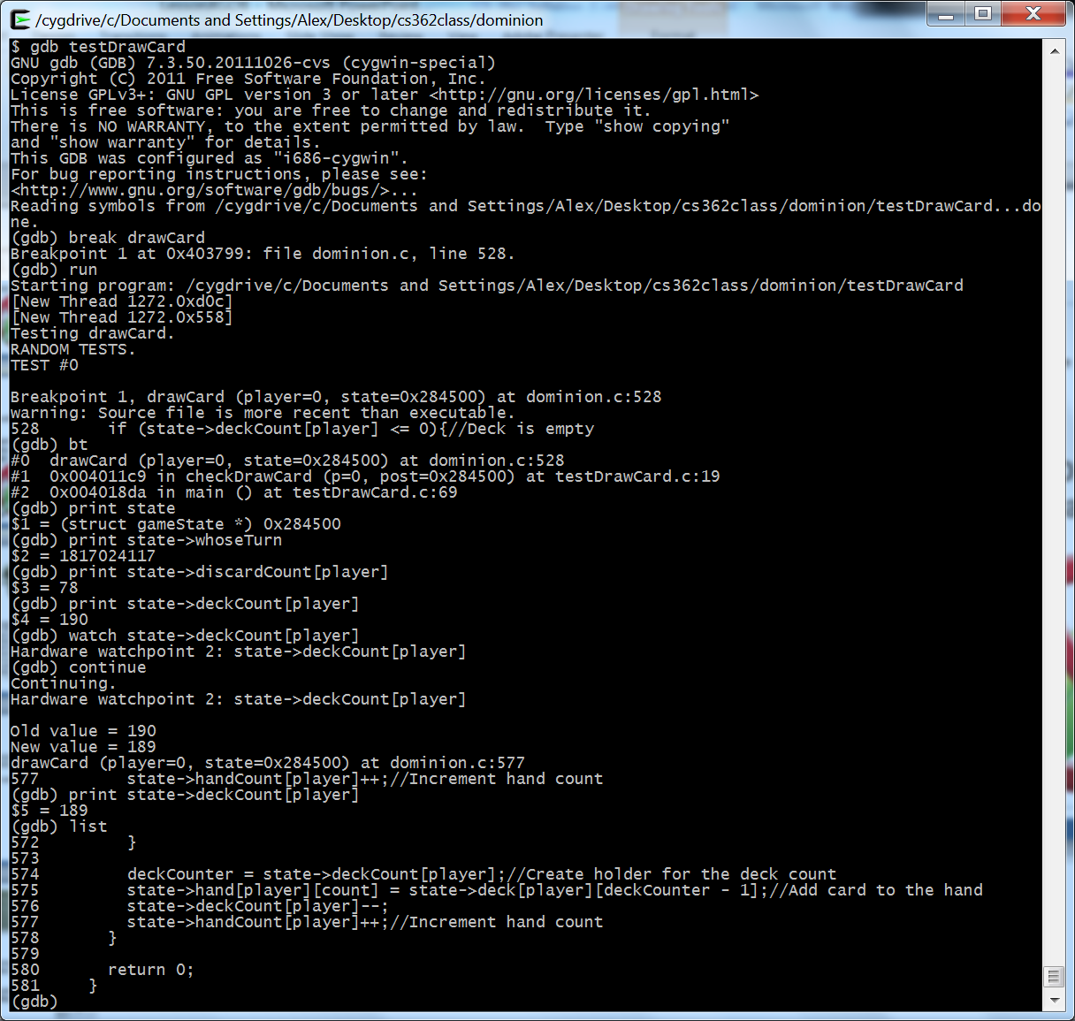
GDB

