Slide 1

Introducing Doc Bot
Doc Bot is a AI-powered chatbot that helps you address common non-deadly health symptoms quickly and conveniently. With its user-friendly interface and advanced natural language processing, Doc Bot provides the possible disease based on the symptoms given.

Slide 2
How Doc Bot Works
Personalized Advice
Based on the analysis, Doc Bot provides personalized recommendations for self-care and guidance on when to seek further medical attention.
Symptom Input
Users describe their symptoms to Doc Bot, through text.
1
2
3
Analysis
Doc Bot uses advanced AI and natural language processing to analyze the user's input and determine the most likely cause of the symptoms.

Slide 3

System Requirements
Smartphone
Internet Connection
Doc Bot is compatible with most smartphones, allowing users to access the chatbot on the go.
An internet connection is required for Doc Bot to function and provide real-time medical advice.

Slide 4




Advantages of Doc Bot
Time-Saving
Cost-Effective
Convenient
Private
Doc Bot provides instant access to medical advice, eliminating the need for lengthy doctor's appointments or long wait times.
Using Doc Bot is significantly more affordable than traditional in-person medical consultations.
The bot is available 24/7 and can be accessed from the comfort of your own home.
Doc Bot ensures your medical concerns are addressed discreetly and confidentially.

Slide 5




Architectural Overview
User Input
Natural Language Processing
Knowledge Base
Response Generation
Users can describe their symptoms through text or voice chat.
The bot references a comprehensive database of medical information to provide personalized recommendations.
Doc Bot generates a tailored response through text to address the user's needs.
Doc Bot's AI analyzes the user's input to understand the medical concern.

Slide 6
Implementation
First we collected the appropriate data from Kaggle.
We then trained a decision tree and K-NN classifier models.
We made a Pickle file where we saved the trained model object.
We used this pkl files and ran it using streamlit module in python that is used for the development of the front-end.

Slide 7
Libraries Used
Scikit Learn
pickle
NumPy
Pandas
Simple and efficient tools for predictive data analysis
Used to save the trained model as an object and use it.
Used to perform numerical operations and array operations.
Helps in operating data frames and csv files.

Slide 8
Models Used
Decision Tree
K-NN
It consists of nodes representing decisions or tests on attributes, branches representing the outcome of these decisions, and leaf nodes representing final outcomes or predictions
It is a type of supervised learning algorithm used for both regression and classification. KNN tries to predict the correct class for the test data by calculating the distance between the test data and all the training points.

Slide 9
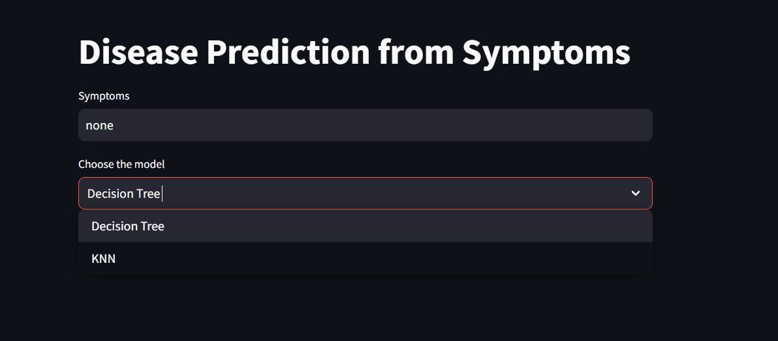
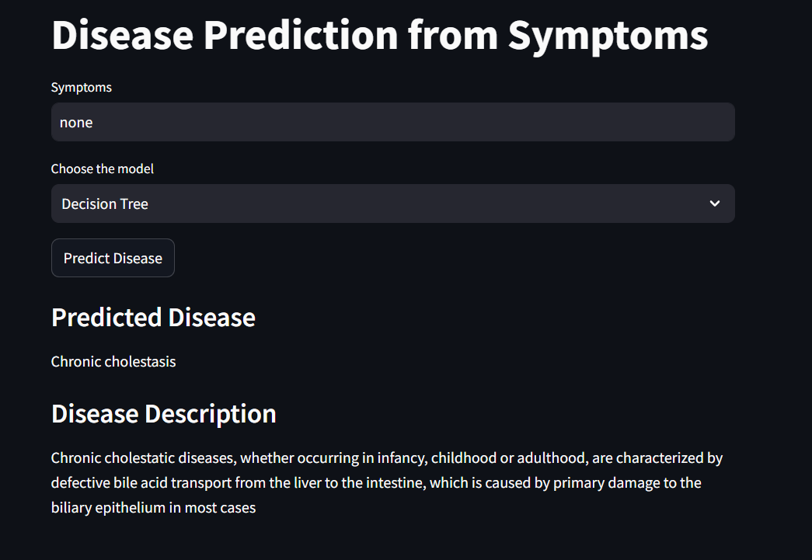
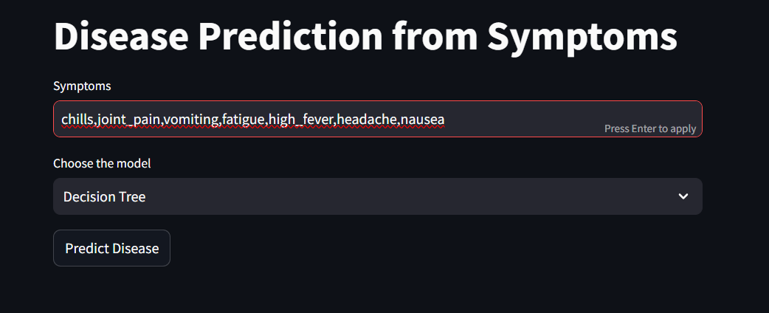
Output

Slide 10
Thank You.

