Slide 1
Hate Crimes in the United States:
An Exploratory Analysis
Sakshi Mathur and Abbie Tolon

Slide 2
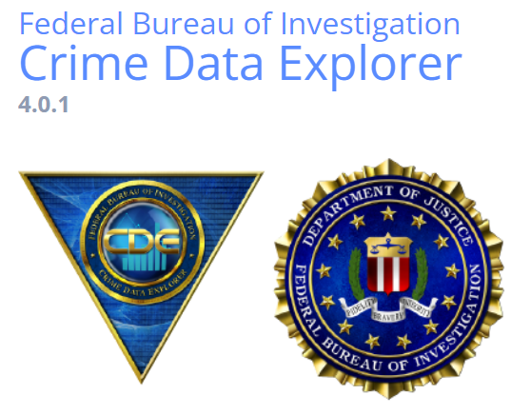
Background
National hate crime data were collected from the Federal Bureau of Investigation (FBI), Crime Data Explorer (CDE)
The data set spanned from 1991 to 2020
The sample size was 219,577 hate crimes

Slide 3
Research Questions
What have been the overall trends of hate crime frequency over the years?
Do the number of hate crimes vary by region of the United States?
How common are multiple offenses vs. single offenses and are they related to multiple vs. single bias?
What is the average number of victims for one hate crime? Is it common for a hate crime to involve multiple victims?

Slide 4
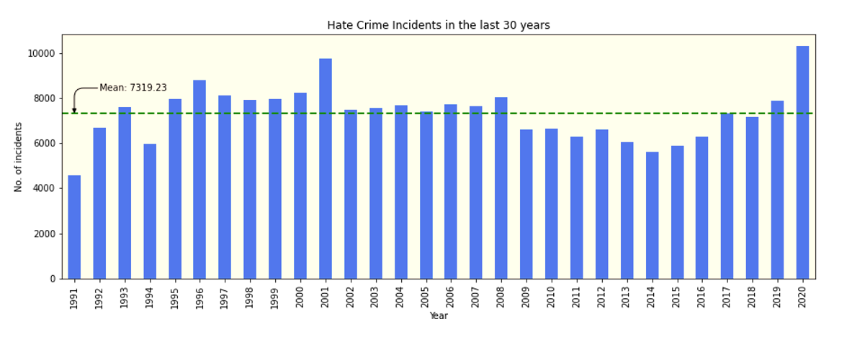
Hate Crime incidents per year (1991-2020)

Slide 5
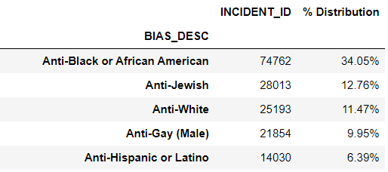
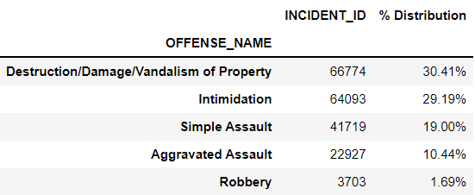
Data Inference : Bias and Offense
Bias of the Offender
Offense Type

Slide 6
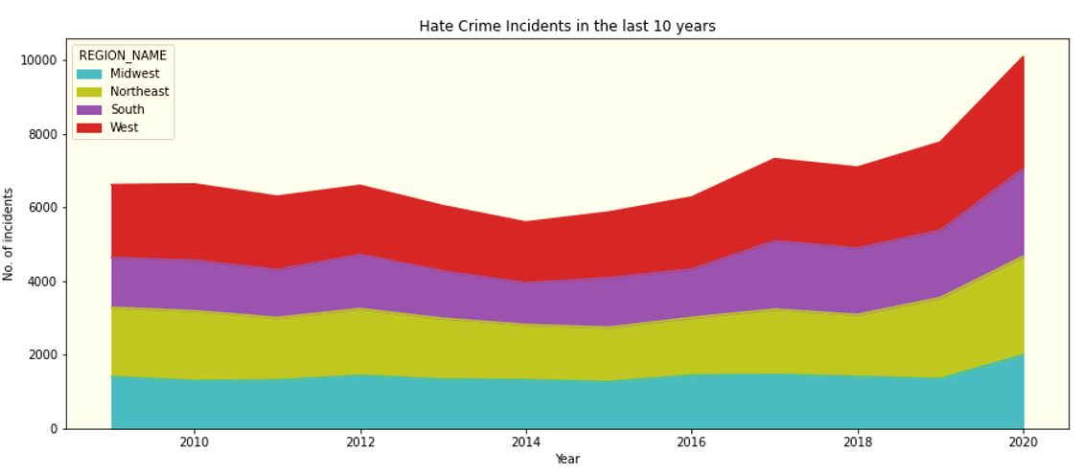
Hate Crimes by Region of the U.S.(2011-2020)
Insert text

Slide 7
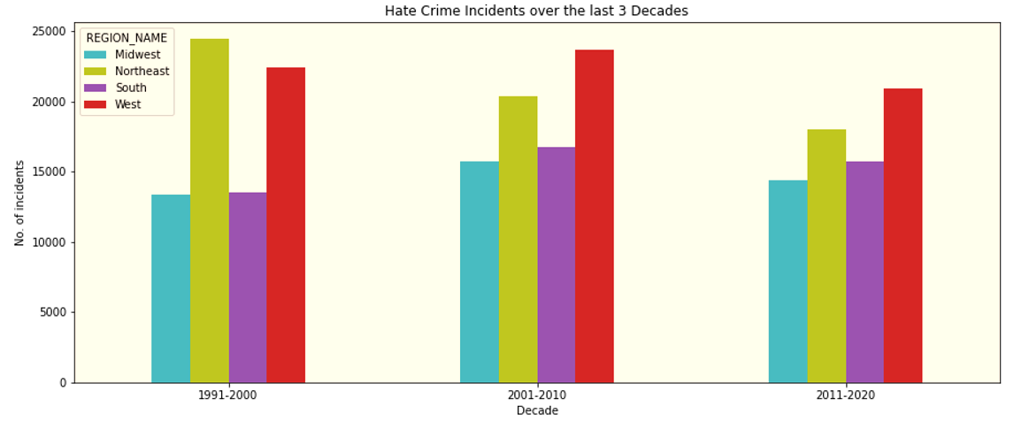
Hate Crimes by Region over 3 decades
Insert text

Slide 8
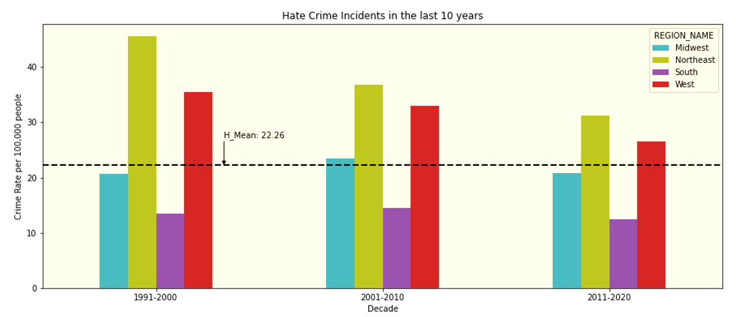
Hate Crimes Rate by Region over 3 decades
Hate Crime incidents per 100,00 people

Slide 9
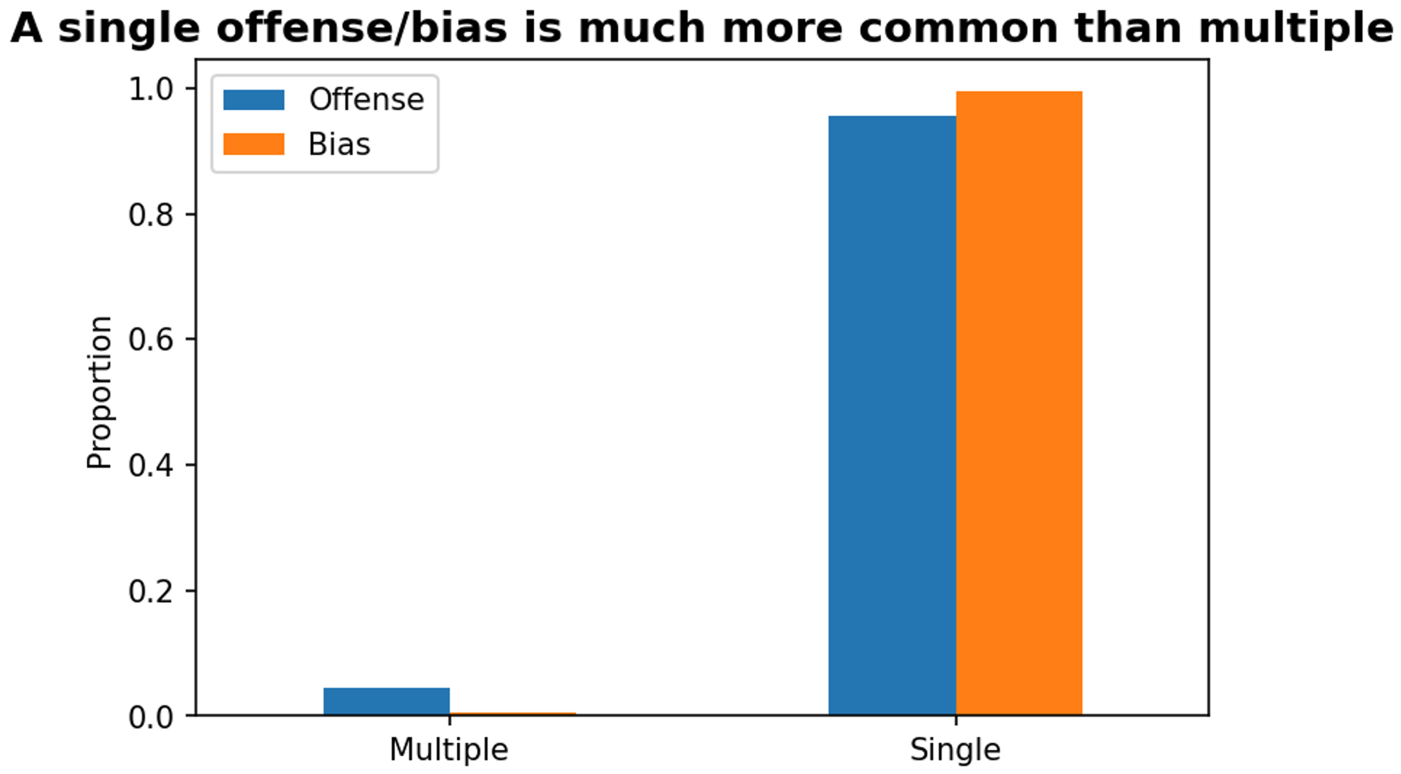
Offense (multiple/single) vs. Bias (multiple/single)

Slide 10
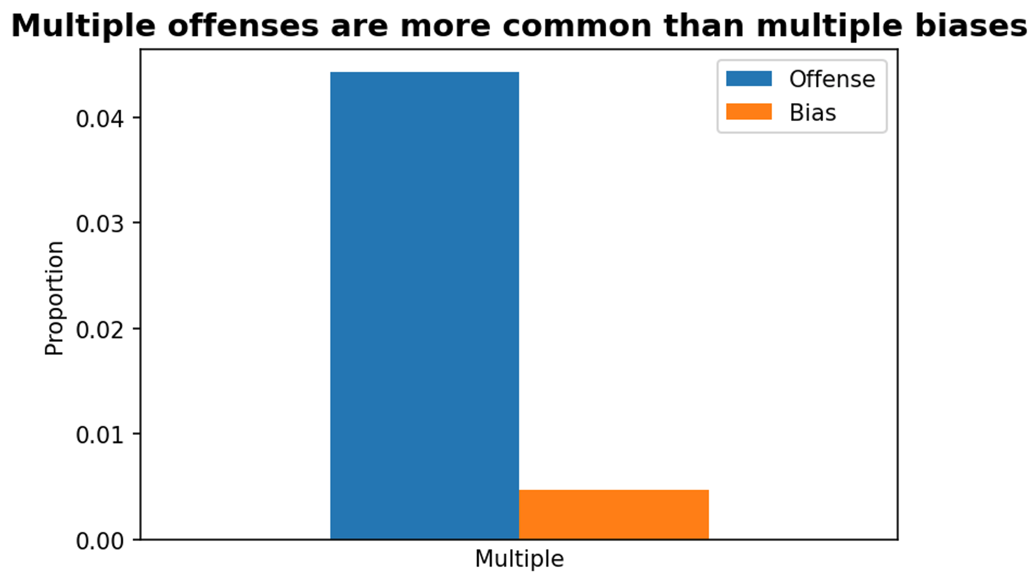
Offense (multiple) vs. Bias (multiple)

Slide 11
Offense (multiple/single) vs. Bias (multiple/single): Are they related??
Offense and Bias are statistically significantly related to each other (according to Chi-square test of independence)
We don’t know the strength or association of the relationship, however; we just know that a relationship exists

Slide 12
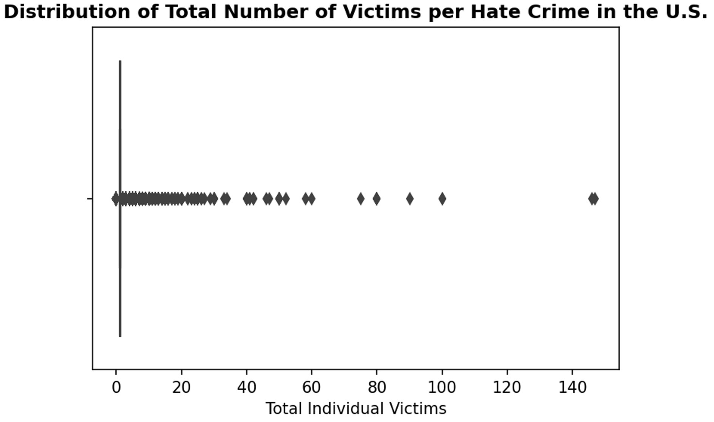
Number of Victims per Hate Crime
Mean = 0.98, std = 1.73, max = 147, min = 0

Slide 13
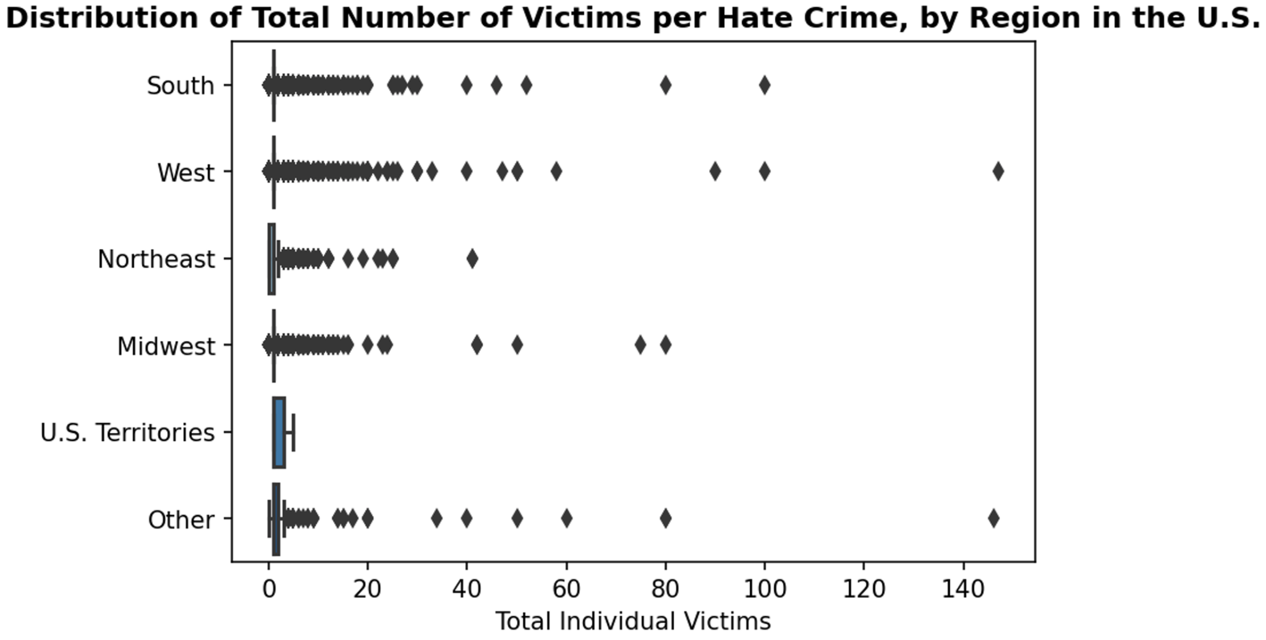
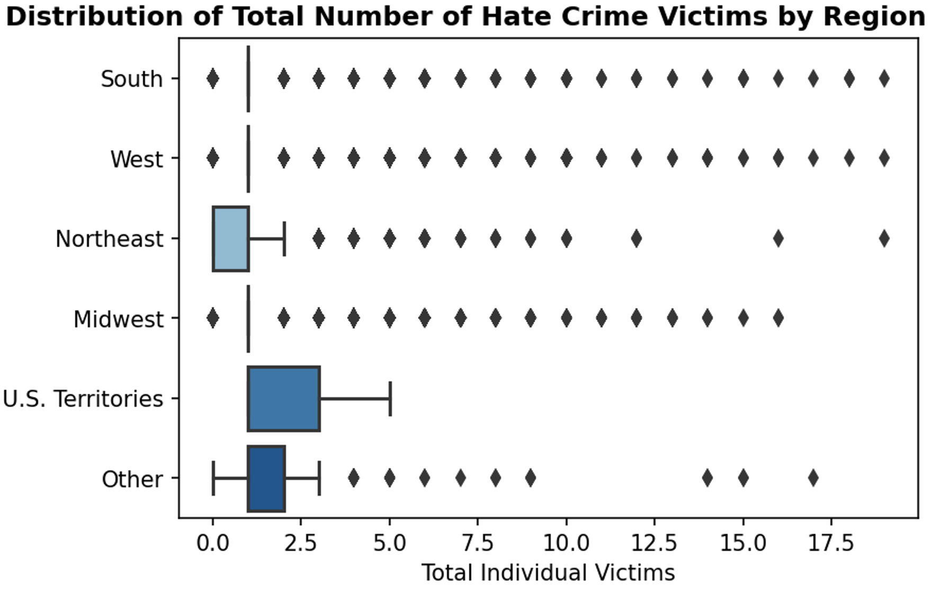
Outliers of total victim counts per hate crime are spread across Regions in the U.S.
Plot with some outliers removed

Slide 14
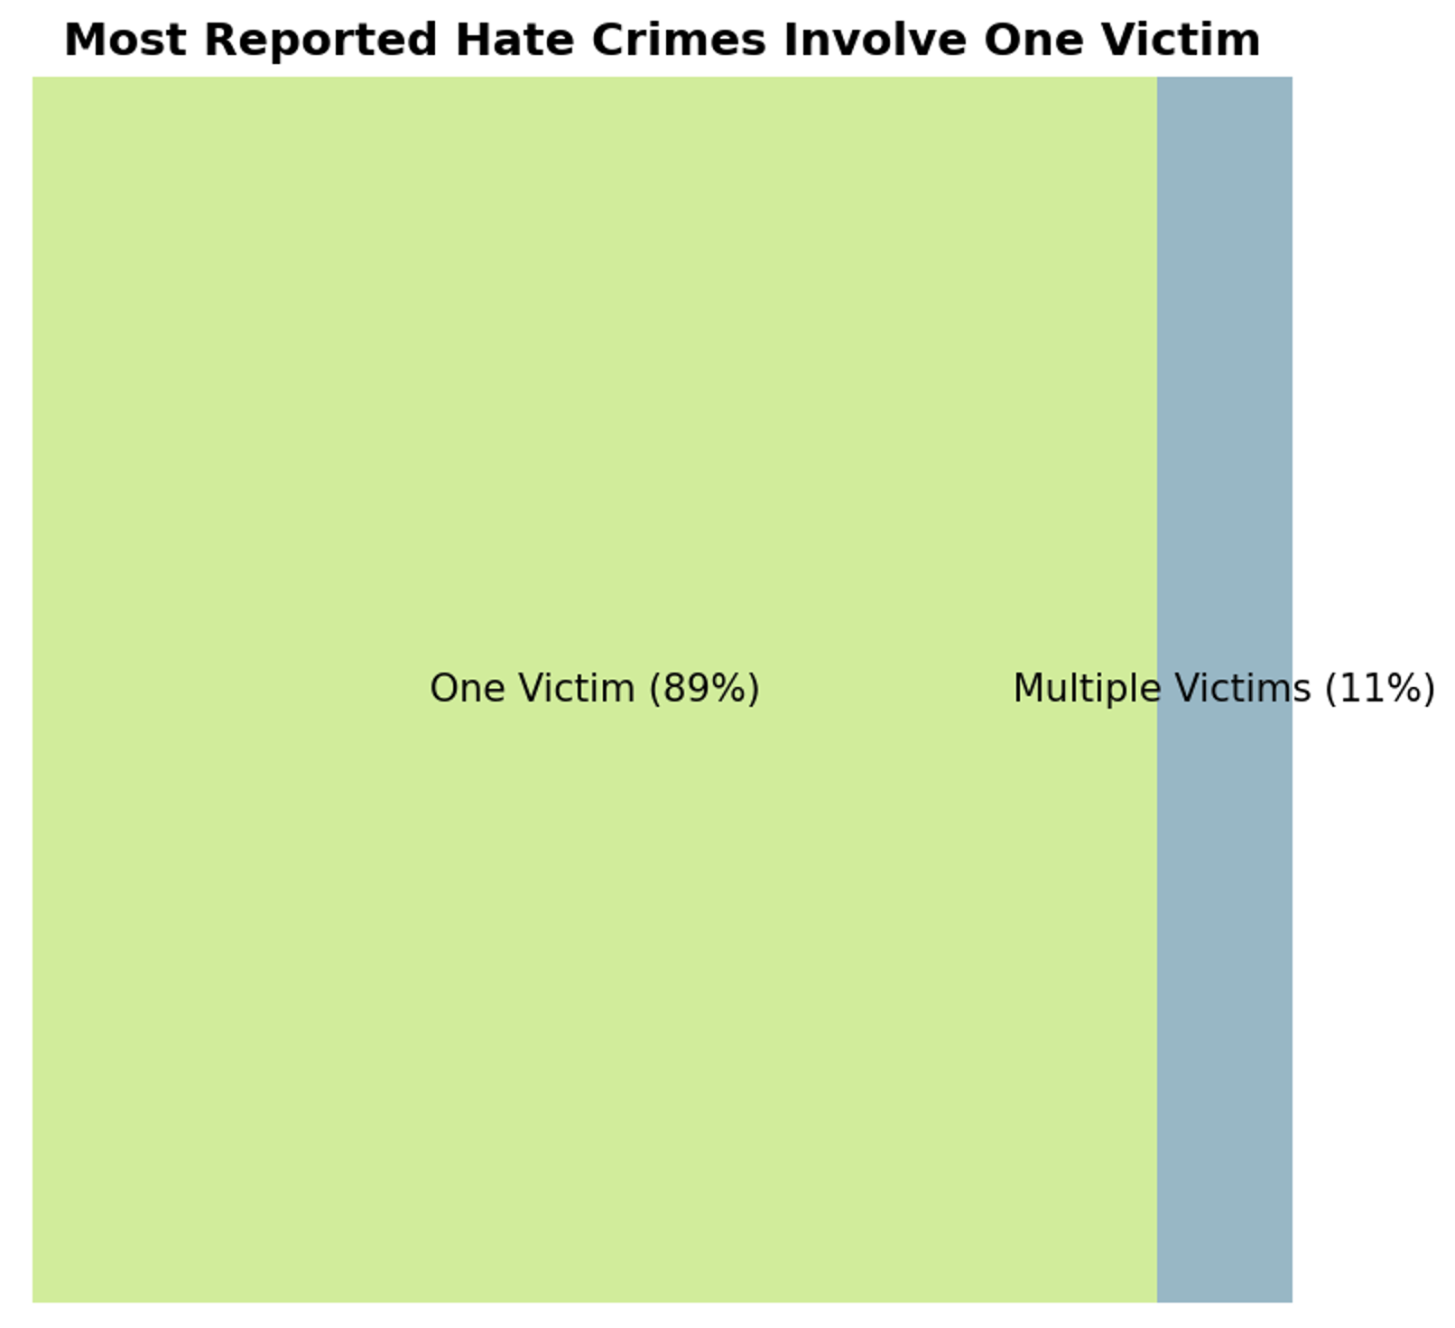

Slide 15
The dataset has many details that can be picked up for further analysis and to answer many other important questions. However, more research is required to acquire data that help us understand any associations between variables.
Thank You

