Slide 1
Design Space for GPS
Background Section A

Slide 2
Space of Graph Processing System
GPS Taxonomy
Graph Type
Graph Dynamism
Workload
Structural Graphs
Labeled Property Graph
Static Graph
Dynamic Graph
Whole-Graph Analytics
Traversals
Local Queries
Neighborhood Queries
RDF graphs exist, I don’t know anything about them

Slide 3
Space of Graph Processing System
GPS Taxonomy
Graph Type
Graph Dynamism
Workload
Structural Graphs
Labeled Property Graph
Static Graph
Dynamic Graph
Whole-Graph Analytics
Traversals
Local Queries
Neighborhood Queries
Some combinations do not make sense:
Structural + static + Point Queries

Slide 4
Static Graph Processing Systems
GPS Taxonomy
Graph Type
Graph Dynamism
Workload
Structural Graphs
Labeled Property Graph
Static Graph
Dynamic Graph
Whole-Graph Analytics
Traversals
Local Queries
Neighborhood Queries
Classification basis: Programming Model, Computation Model, Data Location, Data Layout

Slide 5
Static Graph Processing Systems
GPS Taxonomy
Graph Type
Graph Dynamism
Workload
Structural Graphs
Labeled Property Graph
Static Graph
Dynamic Graph
Whole-Graph Analytics
Traversals
Local Queries
Neighborhood Queries
Computation Model
BSP: compute – shuffle barrier – push result
Async : no communication barrier, always use most recent values
GAS: Pull state, compute, update state. Updates separated from scheduling

Slide 6
Static Graph Processing Systems
GPS Taxonomy
Graph Type
Graph Dynamism
Workload
Structural Graphs
Labeled Property Graph
Static Graph
Dynamic Graph
Whole-Graph Analytics
Traversals
Local Queries
Neighborhood Queries
Programming Model (Vertex Centric)
computation defined in terms of vertex programs
Depends on self state + neighborhood state
Needs: compute(), get_value(), update_value()

Slide 7
Static Graph Processing Systems
GPS Taxonomy
Graph Type
Graph Dynamism
Workload
Structural Graphs
Labeled Property Graph
Static Graph
Dynamic Graph
Whole-Graph Analytics
Traversals
Local Queries
Neighborhood Queries
Programming Model (Edge Centric)
computation defined in terms of edge programs
Edge Scatter sends update over e; Edge Gather applies update to e.dest
Needs: edge_scatter(e), edge_gather(u)

Slide 8
Static Graph Processing Systems
GPS Taxonomy
Graph Type
Graph Dynamism
Workload
Structural Graphs
Labeled Property Graph
Static Graph
Dynamic Graph
Whole-Graph Analytics
Traversals
Local Queries
Neighborhood Queries
Programming Model (Partition Centric)
computation defined in terms of partitions
Done to reduce cross-partition communication

Slide 9
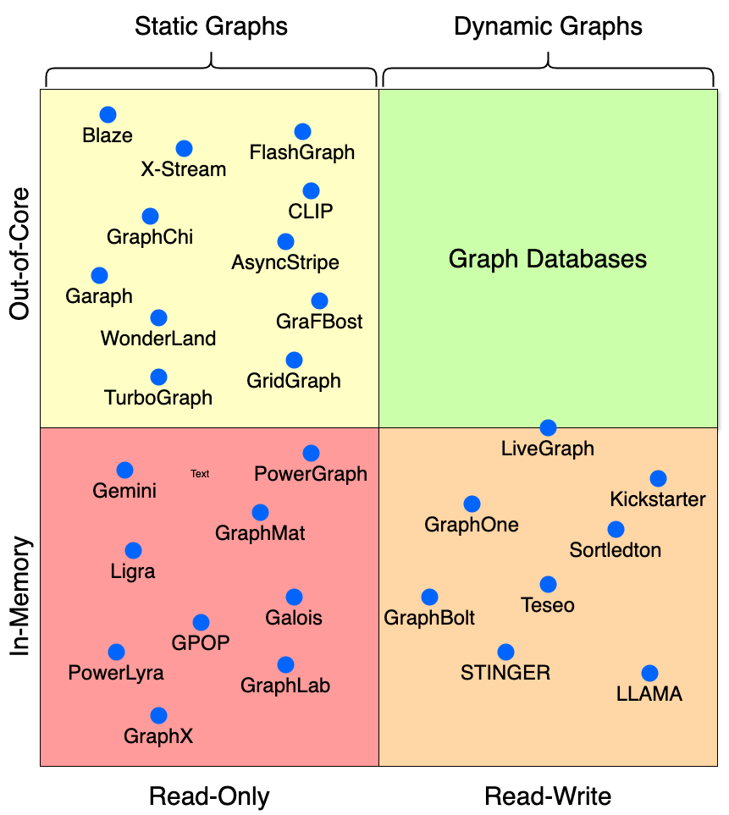
Primary Classification:
Static/Dynamic
and
In-memory/Out-of-Core

Slide 10
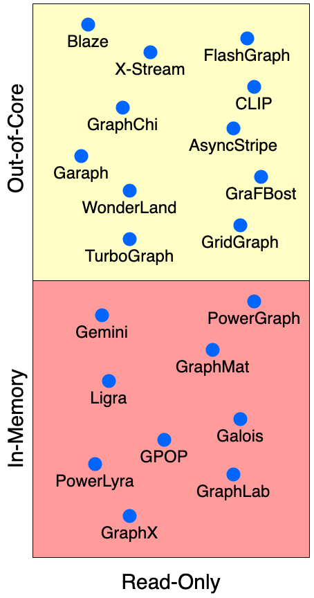
Static GPS Classification
Computation Model:
BSP
Asych
GAS
Programming Model:
Vertex-Centric
Edge Centric
Partition Centric

Slide 12
VC + GAS
GraphChi, GraphLab, PowerGraph
Partition-centric + GAS PCPM (ATC’18)
Gather- Apply- Scatter
Edge-Centric + GAS
Zhou et al 2018
Vertex centric Asynchronous
Griaph Unchained,
GRACE, ASPIRE, CoRAL, GraphChi
Asynchronous
???
???
Synch/Async Hybrid GraphLab, Hsync
Bulk Synchronous Processing (BSP)
Vertex centric BSP
Pregel, Giraph, Ligra,
Edge centric BSP
X- Stream, Chaos
Path- centric BSP
Blogel, PathGraph
VC/EC Hybrid
BSP Mosaic (2017)
Vertex-Centric
Edge-Centric
Path-Centric

Slide 13
Static Graph Processing Systems
GPS Taxonomy
Graph Type
Graph Dynamism
Workload
Structural Graphs
Labeled Property Graph
Static Graph
Dynamic Graph
Whole-Graph Analytics
Traversals
Local Queries
Neighborhood Queries
Data Location: In-Memory vs On-Disk vs Distributed

Slide 14
Non-GDB data Layouts
GPS Taxonomy
Graph Type
Graph Dynamism
Workload
Structural Graphs
Labeled Property Graph
Static Graph
Dynamic Graph
Whole-Graph Analytics
Traversals
Local Queries
Neighborhood Queries

Slide 15
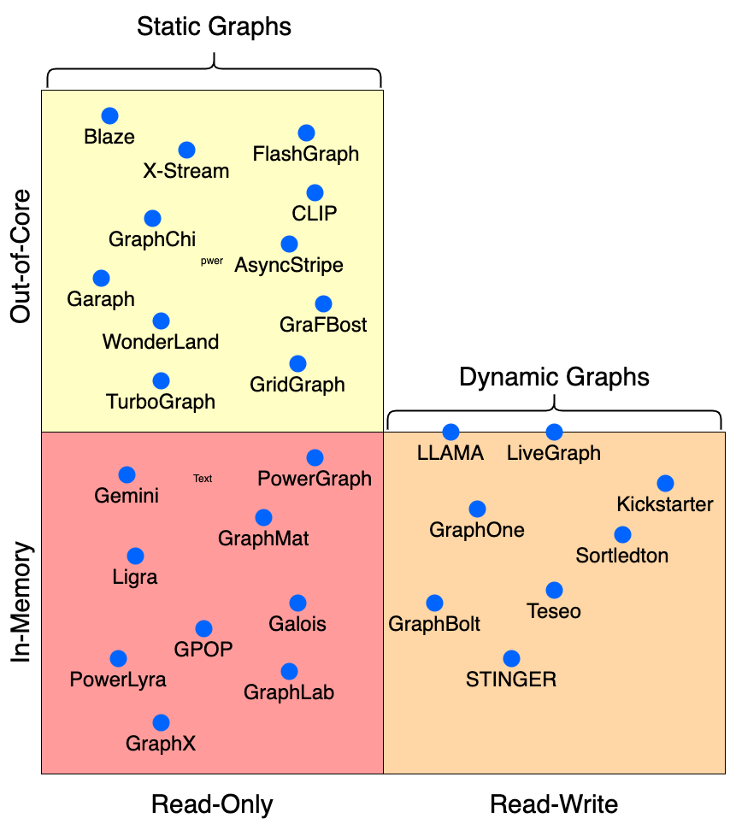
Non-GDB data Layouts
Out-of-core: Data Layouts that provide sorted neighborhood access, LLAMA’s snapshots
In-Memory: CSR, Adjacency Lists, Tree-based data structures for updates, Edge Logs (GraphOne and LiveGraph)

Slide 16
Dynamic Graph Processing Systems
GPS Taxonomy
Graph Type
Graph Dynamism
Workload
Structural Graphs
Labeled Property Graph
Static Graph
Dynamic Graph
Whole-Graph Analytics
Traversals
Local Queries
Neighborhood Queries
Classification basis:
Data location (mem/disk),
Concurrent R/W and Transactional support,
Architecture of incremental computation (refinement or recomputation),
API support ( Graph mutation or Graph Analytics, or both)

Slide 17
Graph Databases
GPS Taxonomy
Graph Type
Graph Dynamism
Workload
Structural Graphs
Labeled Property Graph
Static Graph
Dynamic Graph
Whole-Graph Analytics
Traversals
Local Queries
Neighborhood Queries
Emphasis is on transactional queries/updates on properties. Extensions allow complex analytics workloads queries
Classification criteria: Storage engines, Query API (we ignore this)

Slide 18
What you need to know to understand my thesis
Background Section B

Slide 19
Graph Workloads
Short, point queries
Neighborhood queries
Traversals
Whole-graph analytics
Systems specialize for one or a few of these
Point query
Whole graph Analytics
OLTP
OLAP
Increasing query complexity
Interactive workloads
BI workloads
Graph Analytics/ LDBC Workloads

Slide 20
Structural – metadata + properties
LHS: data operated on is the materialized view of the data on the RHS
Different ways to deal with the materialized views
Show the concentric circles and the category
Subsetting relationships
People typically use a certain point in the space for which they design their system
2x2
We zoom in and describe them.
No firm line – everything is a continuum.
Similarly RHS: goes back to materialized view stuff. GDB is everything and therefore it has functionlaity that does not exist elsewhere
RHS of the 2x2 can be defined by the table – go back to the RHS of the 2x2 and show the pinwheels.

Slide 21
Flexograph is a GDB
We don’t explicitly materialized graphs but we provide a mechanism for that to happen organically without sacrificnig the GPS perf
3 reps make sense – std(don’t extract anything and use RDBMS), CSR and AdjLists are good for scans and how do we create that in the KV store.
Architecure has 3 parts:
Reps
API rich enough to sit under any query language and does anything you want it to
Glue: between API and the low level operations that allows us to give higher level primitives.
Flexograph the storage system is not the interesting bit. We don’t need something super heavy. Why we used WT
Overview of WT. single process MT inherited in our application design, columns stores,

Slide 22
Implementation
Why WT and talk about key feat
How an application looks like: embedded API, uses low level
How do we realise the layouts in wt. neighborhood queries have to be fast. Carefully construct Primary Keys, and how we lay them out in that order (how it looks in adjlist and edgekey).
Iterator design.

Slide 23
Data Layouts – In memory
Graphs can be in memory
Use adjacency matrix – easy but wasteful
A representation that provides sequential access to neighborhoods is preferred.
Compact representations favored
CSR
Adjacency Lists
But RAM is expensive and graphs are large
Use Out-of-Core graph processing

Slide 24
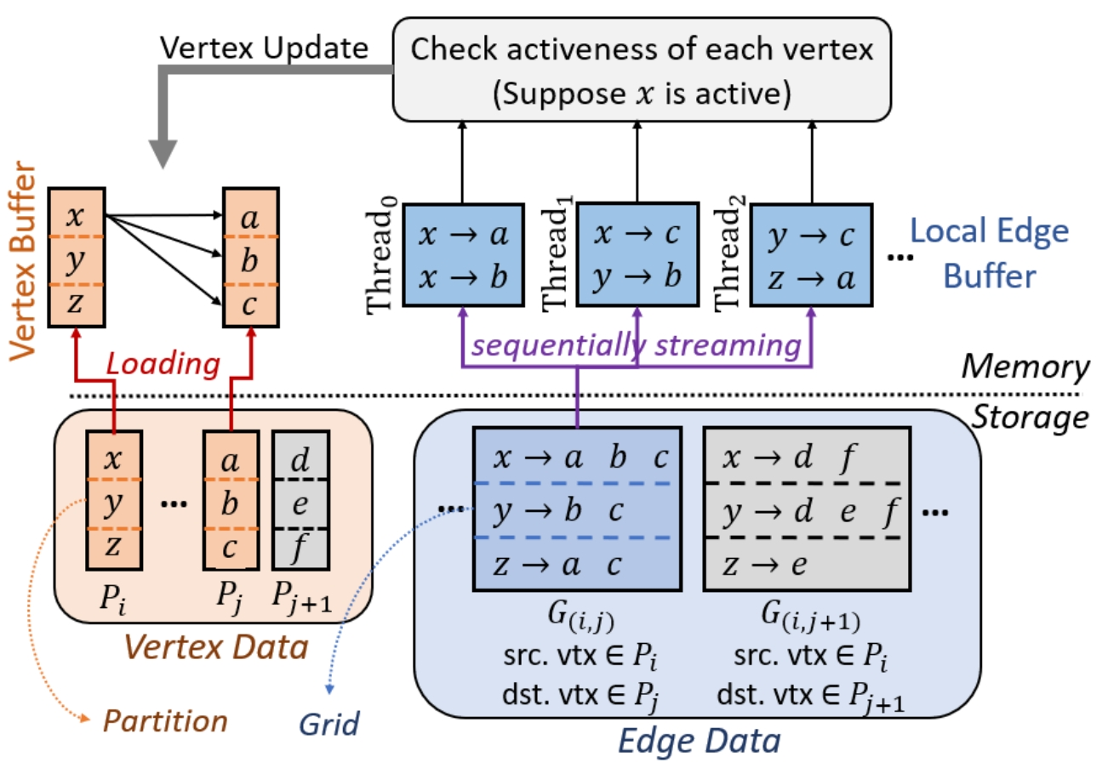
Out-of-core system Design
Typical systems:
Have a set of “Active” vertices
The vertices are partitioned into disjoint sets
Partition the edges by (src, dst)
Stream the edges from/to the active vertices and apply updates to the relevant vertex sets.
This leads to stringent layout design goals:
Selective scheduling
Sequential streaming of relevant edges
GraphChi
X-Stream
GridGraph and descendants

Slide 25
What happens if a graph changes?
Dynamic graphs are handled through:
Incremental updates to current version (batch or streaming)
Snapshots + cross-snapshot querying
Out-of-core dynamic graph processing systems:
Graph Databases
LiveGraph
Preprocessing Costs are often not amortized:
In-memory + incremental: yes
In-memory + rebuild CSR: no
Out-of-core + incremental: no because index might need to be rebuilt
Out-of-core + rebuild the data layout: no
Costs increase as size of the graph increases

Slide 26
Dynamic Graph Systems (RW)
Graph Analytics Systems (RO)
Transactions
Multi-Writer
Labeled Property Graph

