Slide 1
Design Space for GPS
Background Section A

Slide 2
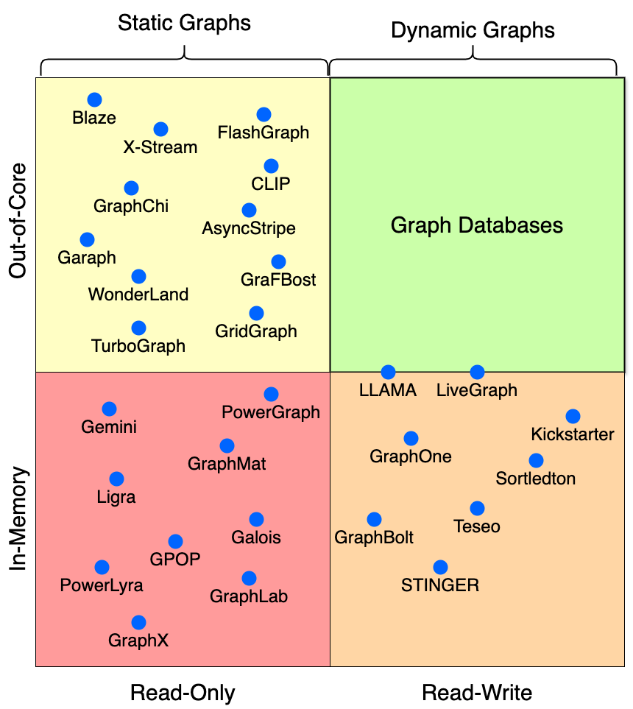
Primary Classification:
Static/Dynamic
and
In-memory/Out-of-Core

Slide 3
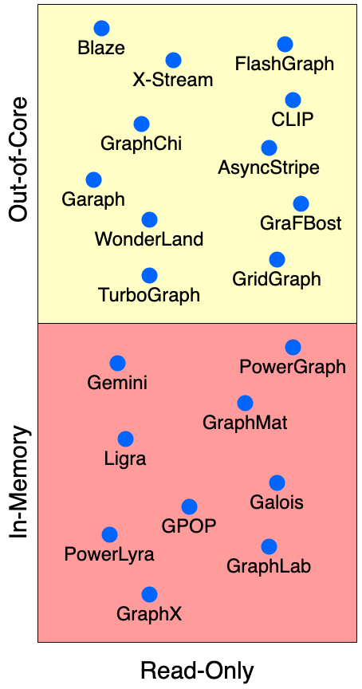
Static GPS Classification
Graphs can be in RAM or on disk
RAM is fast but limited, disk is slow but infinite
Classic tradeoff, systems have optimizations in place to use the memory-disk barrier more cleverly
The in-memory/external design space is a continuum

Slide 4
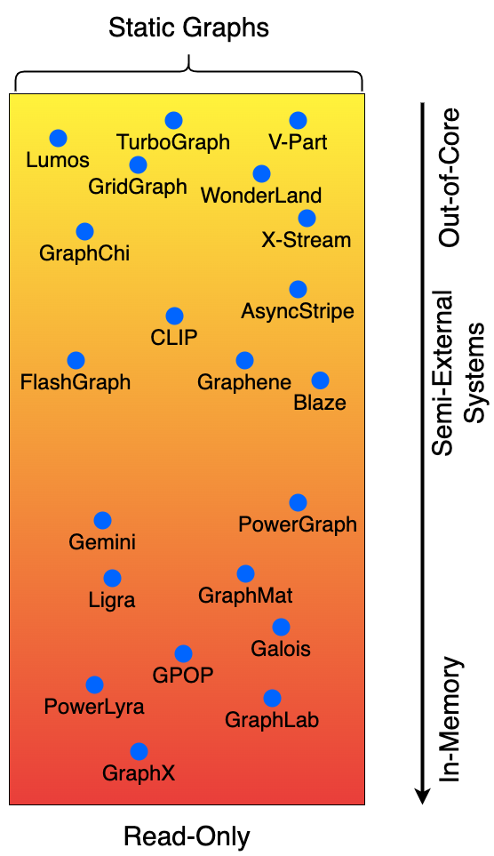
In-memory/external System Continuum for Static GPS
Some systems explicitly designed to keep the graph in memory:
In-memory systems are fast, work on structural graphs
Examples
External systems are designed to work on graphs much larger than RAM
Single system can process trillion edged graphs
Slower than in-memory systems
Examples
Optimizations exist to carefully choose what part of the graph can be cached in the main memory, Streaming the rest
Semi-External systems
Examples

Slide 5
The programming model/computation model classification does not do anything to help explain the space, neither does it help situate Flexograph in the research landscape.
SKIP?

Slide 6
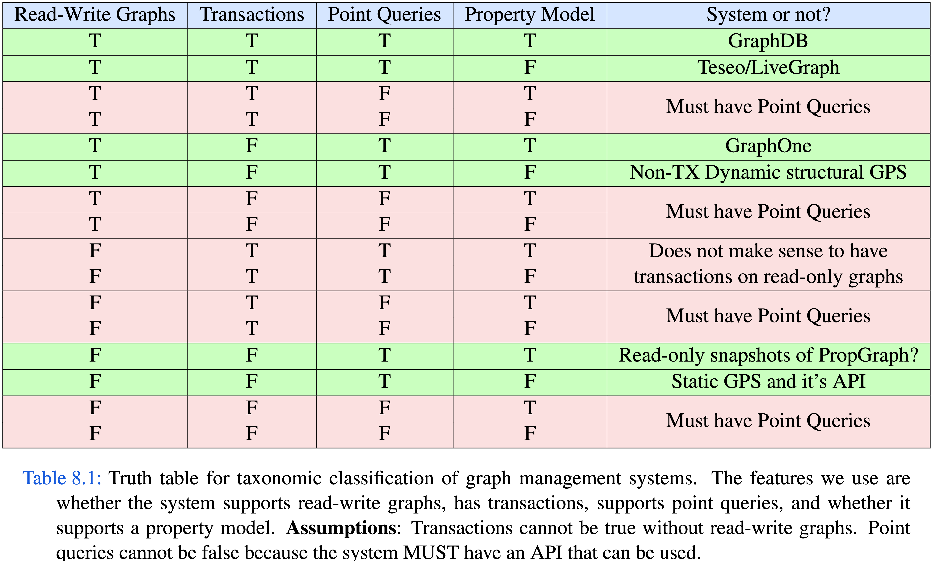

Slide 7
ASPEN, STINGER, … (RW, structural graph, no TX)
Read-Write Graphs
Transactions
Labeled Property Graph Model
Dynamic, structural graph
(Teseo)
GraphOne
LiveGraph,
Graph DBs
Snapshots/Dumps of Property Graphs
Por que?

Slide 8
Labeled Property Graph in Transactional R/W Database

Slide 9
Labeled Property Graph in Transactional R/W Database
Structural Graph
Materialized View

Slide 10
Read- Only (Static) Static Graph
Structural Graph
Read-Write (Dynamic) Structural Graph

Slide 11
Read- Only (Static) Static Graph
Read-Write (Dynamic) Structural Graph

Slide 12
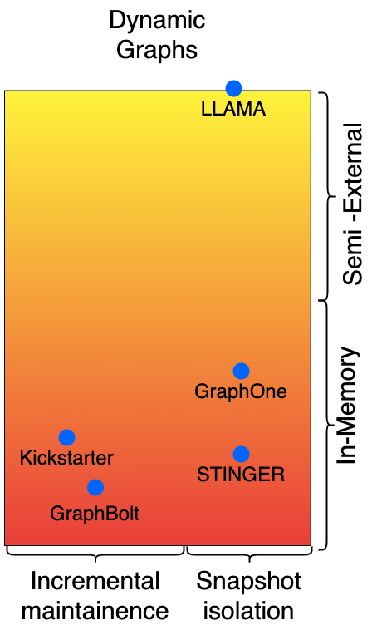
Non - Transactional
Read-Write (Dynamic) Structural Graph

Slide 13
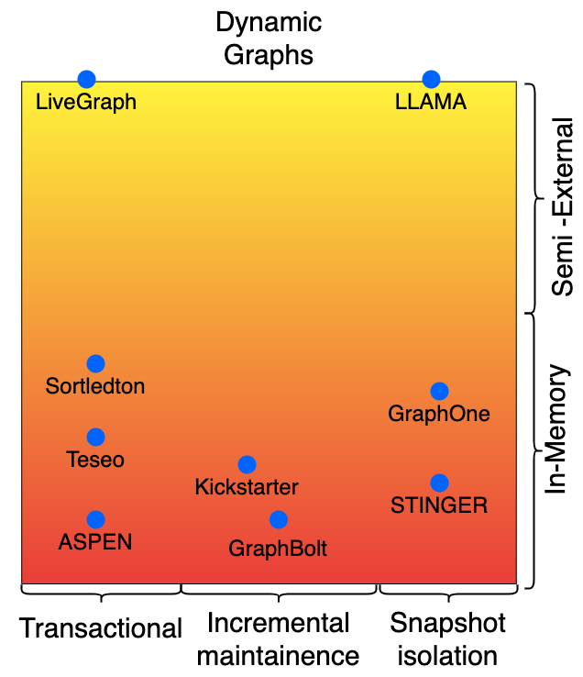
Structural Graph
Non - Transactional
RO (Static) Static Graph
Read-Write (Dynamic) Structural Graph
Non - Transactional

Slide 14
Structural Graph
Read-Write (Dynamic) Structural Graph
RO (Static) Static Graph
Common in-memory data-structures used
to store the graph

Slide 15
CSR - like
Adjacency List - like
Tree– Based

Slide 16
Rotate the two gradient images, aligning the in-memory systems and then talk about the representations, and how they are same
Transient Attributes vs Properties in a LPG – you never want to return transient attrs or query them.
When the algo finishes, persist them as actual properties

