Slide 1
Design Space of Graph Data Management Systems
Chapter 3

Slide 2
What we covered in Background:
How to model a graph
Structural graph
Labeled Property Graphs (LPG) aka Property Graphs (PG)
Workloads and their access patterns
Data structures that are used for these access patterns

Slide 3
Labeled Property Graph
Structural Graph
Materialized View
Notes:
It is quite likely that the relationships we are trying to model with graphs have a rich schema. The relationships themselves form a structure and can be used to compute some properties like connectivity /influence of nodes in a graph.
The properties and relationships, on the other hand, define filtering primitives for selections and projections on the structure.
We assume that a labeled property graph (potentially stored in a GDB) is the ground truth from which its structure can be materialized. The structural graph “are homogeneous, composed simply of vertices, edges and, possibly, a weight attached to their elements.”

Slide 4
Read- Only (Static) Static Graph
Structural Graph
Read-Write (Dynamic) Structural Graph
Notes:
We first examine structural graphs. All graphs *can* change, and that provides us a feature for classification:
Read-Write graphs: also called dynamic graphs. Can evolve. Updates are either streaming or batch dynamic (applied in batches).
Read-Only graphs: these are point-in-time versions and do not change. Used for batch-analytics.

Slide 5
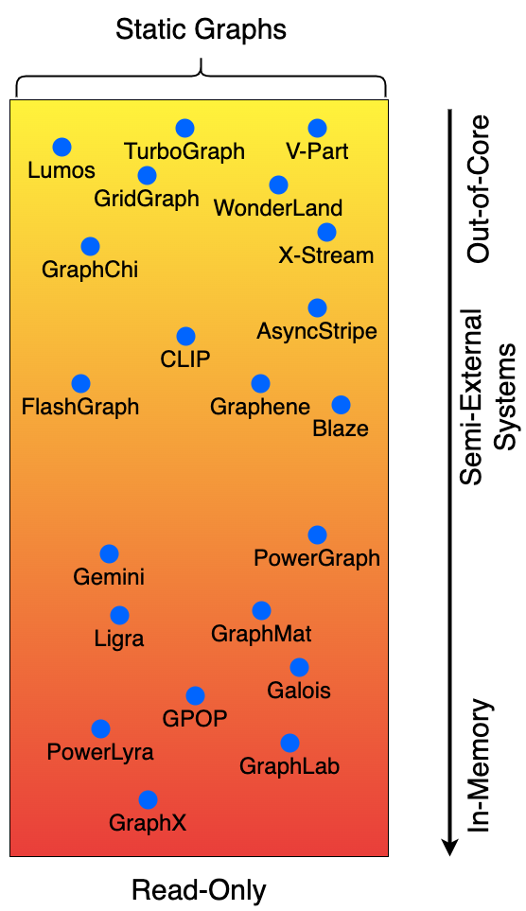
Read- Only (Static) Static Graph
Read-Write (Dynamic) Structural Graph
Notes:
Structural graph s and we only fo analytics on them
Static graphs have been the primary focus of the graph processing systems research for the past decade.
Graphs can be small and fit in main memory on a single machine:
Shared-memory systems are very performant on these. Ex: Gemini, Ligra, GraphMat, Galois, GPOP.
Graphs too large might need to be distributed on a compute cluster to get enough aggregate RAM.
Communication overheads are too large/ under-perform single-threaded programs sometimes
Ex: GraphX, Distributed GraphLab, PowerLyra, PowerGraph
Alternatively, graphs can be stored on disk and streamed to RAM for processing. These systems are called out-of-core systems
The graphs are stored on disk in layouts that maximize the sequential access to neighborhoods.
Ex: Graphchi, X-Stream, TurboGraph, Lumos, V-Part, Wonderland, GridGraph
Out-of-core systems are designed for the most severely memory constrained environments.
This is not true : modest workstations easily pack ~100 GB of RAM
A mid-point in the spectrum of in-mem/out-of-core systems are Semi External Systems
These systems store some part of the graph in-memory (likely the vertex state and updates) and stream edges from the disk.
If the memory budget exceeds the size of the graph, store the graph entirely in RAM
Some systems are strictly semi-external and are designed to operate in that fashion. Ex: FlashGraph, CLIP, AsyncStripe, Blaze, AsyncStripe
Other systems use an optional semi-external mode when the memory budget allows it. Ex: GraphChi, X-Stream.

Slide 6
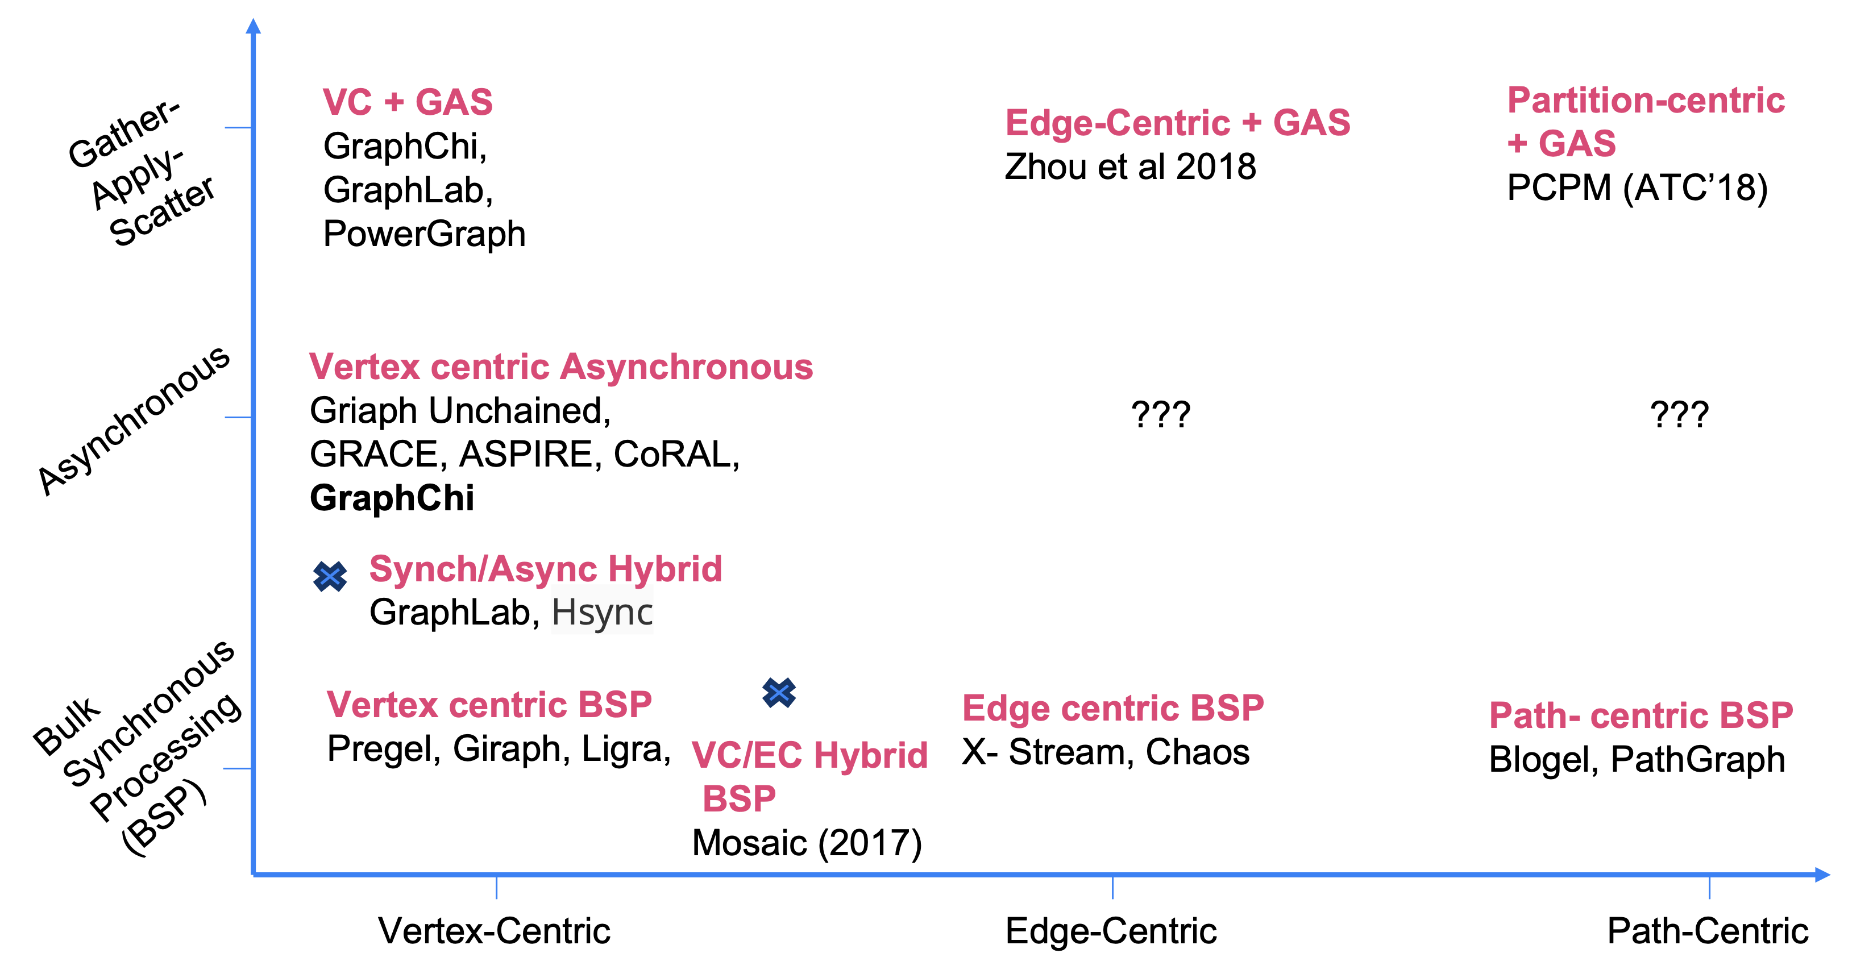
Notes:
Static graph processing systems can be futher/alternatively classified according to their programming model and computation model.
Computation Model: This classification identifies the phases involved in the computation model used by a system. The user provides compute functions for each phase.
Bulk-Synchronous Processing: This defines the “push” style of computation. Computations proceed in phases: Compute – Shuffle Barrier – Push result to neighbors.
Asynchronous Processing: There is no communication barrier, the computation always uses the most recent updates.
GAS: this model defines the “pull style” of processing. Gather (pull updates), use these to compute and update the local state.
The computation model is independent of scheduling – the vertices can be scheduled in interesting ways.
Programming Model: defines the unit of computation that is performed on every step of the computation model
Vertex Centric:
computation defined in terms of vertex programs
Depends on self state + neighborhood state
Needs: compute(), get_value(), update_value()
Edge Centric
computation defined in terms of edge programs
Edge Scatter sends update over e; Edge Gather applies update to e.dest
Needs: edge_scatter(e), edge_gather(u)
Partition Centric
computation defined in terms of partitions
Done to reduce cross-partition communication

Slide 7
Read- Only (Static) Static Graph
Read-Write (Dynamic) Structural Graph
Notes:
This concludes our taxonomy of Static GPSs

Slide 8
Non - Transactional
Read-Write (Dynamic) Structural Graph
Notes:
Read-Write systems handle evolving graphs. The updates to the graph structure can be applied in many ways:
1. Streaming updates: the updates are applied to the current version of the graph directly.
2. Batched streaming: The updates are batched and then applied to the graph to produce a new version.
Depending on the type of system, there are 3 common strategies employed to safely apply changes to the graph while a computation might be running.
Incremental Maintenance: A system can choose to batch updates and apply them to a “current version” of the structural graph. As the update is being applied, any ongoing computations use an additional transformation function that is used to apply the batched changes to the graph in a way that produces the same result as would be produced by the algorithm running on the modified graph directly.
Snapshot Based Isolation: All updates create versions of the graph and timestamps help to define which version of the graph a computation should use. Examples include GraphOne (archiving from edge list to adjacency list creates snapshots), LLAMA (explicit snapshots created as the graph evolves), and STINGER <I can’t figure out exactly what it does. I have a feeling this has no semantic guarantees about insertions>
ASPEN is also a snapshot-based system that operates like WAFL – a new subtree is constructed each time a vertex receives an update in its neighborhood. ASPEN uses a tree-like data structure that optimizes the amount of internal-node rewriting needed to update the tree. ASPEN is a single-writer system.
STINGER has no consistency guarantees – inconsistent snapshots
Amount of control over the updates: no control, batch dynamic (kickstarter/graphbolt), snapshots, transactional ← figure out
Another axis for classification of these systems is whether they store the graph in memory or on disk. LLAMA uses persistent snapshots and reads them into main memory as needed. The other systems work in memory. GraphOne has a write ahead log, but they disable it during their experiments.

Slide 9
Structural Graph
Non - Transactional
RO (Static) Static Graph
Read-Write (Dynamic) Structural Graph
Transactional
Notes:
Another way to design a dynamic graph processing system is to use transactions for applying updates to the graph.
Transactions help a system provide some/all of the ACID guarantees that a data management system strives to provide.
Most transactional dynamic GPS are in-memory, with the clear outlier being LiveGraph that uses mmap to provide in-memory behavior with persistence benefits.
Sortledton is in-memory, fully transactional and uses an adjacency list-like data structure to hold the graph.
Teseo is also in-memory and transactional, but it uses a “fat-tree” data structure to hold the graph.

Slide 10
The Taxonomy So Far
Structural Graph
In Memory
Graph in mem?
Y
Read-Only (Static) Structural Graphs
Maybe
Semi-External
N
Out of Core
Property Graphs
Materialize a view of the Graph Structure
Structural Graphs
N
Non - Transactional
Y
N
Read-Write?
Read-Write (Dynamic) Structural Graph
Transactional
Transactional?
Y

Slide 11
The Taxonomy So Far
Structural Graph
Out of Core
Graph in mem?
Y
Read-Only (Static) Structural Graphs
Maybe
Semi-External
N
In Memory
Property Graphs
Materialize a view of the Graph Structure
Structural Graphs
N
Non - Transactional
Y
N
Read-Write?
Read-Write (Dynamic) Structural Graph
What Unifies these Systems?
Transactional
Transactional?
Y

Slide 12
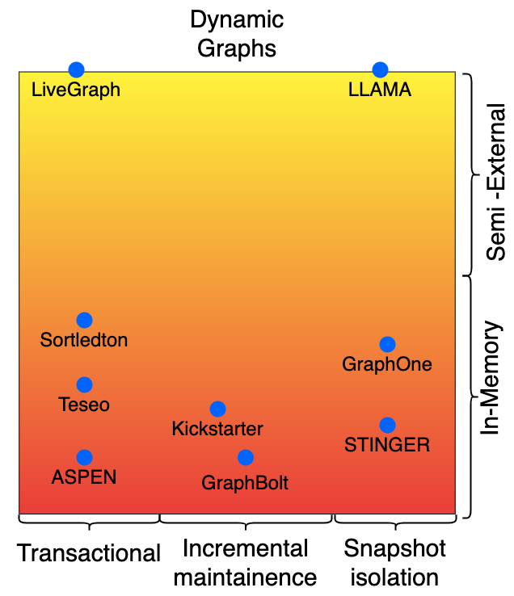
Structural Graph
Read-Write (Dynamic) Structural Graph
RO (Static) Static Graph
Common in-memory data-structures used
to store the graph
Notes:
In memory graph systems, regardless of other features, are unified by their use of data structures and therefore which workloads they are most optimized to serve.
We examined the common graph representations in the Background chapter and examined which workloads are best matched to their access primitives.

Slide 13
CSR - like
Adjacency List - like
Tree– Based
Notes:
The common graph data structures used by in-memory systems are CSRs, Adjacency Lists, and some Tree-based data structures.
CSRs are optimized for sequential vertex access and sequential neighborhood access. Therefore, they are well suited for whole-graph analytics workloads such as PageRank that operate on static graphs or snapshots of dynamic graphs.
Adjacency Lists are optimized for sequential neighborhood access. They are chosen by systems that must handle updates to the graph, but still need to provide sequential access for analytics. Adjacency Lists are great for traversals, neighborhood queries, and whole-graph analytics.
Tree-Based data structures are standard for storing highly dynamic data in databases and work well for graphs as well. The dynamism is easily handled by using a B-Tree equivalent and providing a hashmap/index to identify vertex neighborhoods. Trees are best suited for high-volume updates, point-queries, and neighborhood queries.

Slide 14
Structural Graph
In Memory
The Taxonomy So Far
Graph in mem?
Y
Read-Only (Static) Structural Graphs
Maybe
Semi-External
N
Out of Core
Property Graphs
Materialize a view of the Graph Structure
Structural Graphs
N
Non - Transactional
Y
N
Read-Write?
Read-Write (Dynamic) Structural Graph
Transactional
Transactional?
Y

Slide 15
Structural Graph
In Memory
The Taxonomy So Far
Graph in mem?
Y
Read-Only (Static) Structural Graphs
Maybe
Semi-External
N
Out of Core
Property Graphs
Materialize a view of the Graph Structure
Structural Graphs
N
Non - Transactional
Y
N
Read-Write?
Read-Write (Dynamic) Structural Graph
What about Property Graphs?
Transactional
Transactional?
Y

Slide 16
Property Graph Systems
Graph Databases are meant to store property graphs
Besta et al. define several features to compare GDBs
The data model : Labeled Property Graph / RDF (which we wholly ignore)
Data Organization:
fixed/variable sized records
use of direct pointers (no need for index)
Support for OLAP and OLTP queries
Storage Engine used
We are only interested in the storage backend used by GDBs
General-purpose storage engine for storing graph data structures (CSR/AdList)

Slide 17
Distillation of the Design Space
 | RW +TX | RW + ~TX | RO + TX | RO + ~TX
PG + PQ | Graph DB | ? |  | RO snapshots of Property Graphs?
PG + ~PQ |  |  |  | ?
SG + PQ | Teseo Sortledton | GraphOne |  | Static GPS + PQ API (?)
SG + ~PQ |  | LLAMA Kickstarter GraphBolt STINGER ASPEN |  | Static GPS
This combination does/should not exist
?
This combination could exist, I don’t know which system implements it
PQ: Point Queries are possible
PG: Property Graphs supported
SG: Structural Graphs Supported
TX: Transactional Support
Notes:
Make it a 3X3 SG & PG row and 1 RW+tX and RW ~TX

