Slide 1
Section 4: Evaluation

Slide 2
Research Question #0
Comparing ekey and adjlist
Notes:
I might think about this as two different evals (which autocorrect helpfully suggested should be evils):
Comparison to other systems
Graph Analytics
OLTP
Studying the impact of different configuration.
I’ve probably reversed the order here, but you get the idea.

Slide 3
Research Question #1
When running Flexograph with a cache large enough to hold the graph, what is the performance on graph analytics tasks against other in-memory systems?
Compare the best representation (Adj) against the other systems
Most systems do not optimize for NUMA and therefore we run this experiment on a single socket (add capability SYS_NICE to container)
Notes:
Again, I’d switch the phrasing a bit:
Comparing to graph analytic engines: since these systems run entirely in memory, we evaluate Flexograph when its cache is large enough to hold the entire data set.
[I’m thinking about the eval comprehensively for the thesis and perhaps not quite focused on the current paper, so adjust appropriately.]
You could imagine that in the internal eval, you start with memory holding the entire data set and then show how performance degrades (ideally gracefully) as the cache shrinks, e.g., 100%, 90%, 75%, 50% or something like that. We don’t have to do this now, but it’s the kind of thing we’d want to look at in the analysis of tweaking internal parameters.

Slide 4
Research Question #1
Metrics to report/collect:
Preprocessing time: time to go from CSV to in-memory data structure construction
COST: Single threaded time vs time with #threads and show speedup
rusage metrics: total memory consumption, #major and #minor faults
Systems to compare against:
GAPBS, Ligra, Gemini, Galois
Graph | System | BFS | PageRank | SSSP | WCC
DOTA League | GAPBS | Insert data here
 | Ligra
 | Galois
 | Gemini
 | Flexograph

Slide 5
Research Question #2
When the graph is too large to be cached, how does flexograph perform against out-of-core graph processing systems?
What is the preprocessing cost of these OOC systems?
We consider the CSV the base format and compute the time taken by each system to construct their specialized on-disk format
For flexograph, it is the time to construct a named checkpoint and to compute edge offsets for thread scheduling
Systems being compared: GraphChi, X-Stream, Blaze, GridGraph/Lumos
Notes:
I’d tweak this a bit: having compared to in-memory systems, let’s now consider systems that support OOC execution.
Do the systems we’re comparing to have a cache such that we should compare different fractions of the data set fitting in cache?

Slide 6
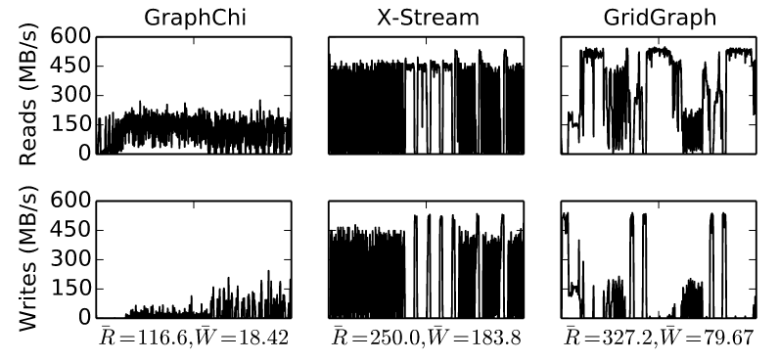
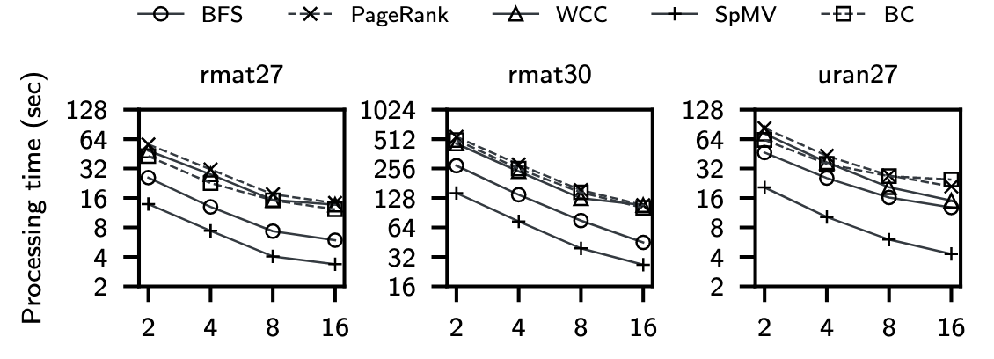
Research Question #2
Metrics to collect/report:
How does the performance vary as the memory-budget is dropped to 50% of the graph size?
How much IO does each system do to finish processing the graph?
Disk usage bandwidth during the experiment run.
How does the performance vary as the number of threads vary?
Graph | Preprocessing Time | Memory Budget | PageRank run time
 |  |  | Graphchi | X-Stream | Blaze | GridGraph
Dota League |  | 50%
 |  | 100%
← Disk bandwidth and avg bandwidth as PR progresses on different systems.
Time to run benchmark on different graphs as #threads vary →
Notes:
Ah — this is exactly what I was suggesting, but it fits into two parts: internally, we assess our own graceful degradation and then when comparing to other systems that support cache-like behavior, we can refer back to these results.
So completely agree with the RQ, but situate it as an analysis of Flexograph config parameters.
I think we probably want to try a few more values than just 100% and 50% (see earlier comments).

Slide 7
Research Question #3
How does Flexograph compare against in-memory dynamic graph stores?
Systems to evaluate against: Teseo, LiveGraph
Sortledton and GTX are newer, but I think having Teseo + LiveGraph should be enough?
We can compare CRUD operations as well as Analytics tasks
There is no “preprocessing” step in these systems -- they use a read-only transaction that performs a pass over the graph to construct a dense vertex ID map.
Notes:
What is the preprocessing time for an in-memory dynamic graph system and how is this different for FlexoGraph?
Teseo has results for both real-ID and logical ID based graphalytics runs. The logical ID based implementation uses a static hash-map for conversion. This is used in the Materialization step at the end of a Graphalytics algorithm.
From Teseo: “To ease the porting of existing algorithms, transactions expose an abstraction where vertices can be interchangeably referred by their real identifiers or their rank in the sorted order. This functionality is implemented by a materialised view, transparently computed upon first request. In our current implementation, computing the materialised view still requires a pass of the whole graph. The materialised view is implemented differently depending on the kind of transaction. In RO transactions, we employ a static hash table to translate a real vertex identifier into its logical counterpart, and by a static array for the other direction. In NUMA architectures, the data structures are duplicated in all sockets. In RW transactions, the materialised view is implemented by a single counting B+ tree, synchronously updated as the user alters the graph.”
Teseo uses a thread-safe cuckoo-hash to store vertex IDs (to check if the vertex has been created before adding an edge). This is independent of the TBB map they use to materialize external IDs for reporting graphalytics results.
On the other hand, they claim that systems that are based on a “vertex table” need to map external IDs to logical IDs (which is true).
LiveGraph: there is no *inherent need* to have a relabeled graph for the system to work (based on my reading). The dynamic graph evaluation framework we use (GFE driver, provided by Teseo) implements a TBB based map for real to logical vertex IDs.
GraphOne and Stinger have some data structure available to do this conversion.

Slide 8
Research Question #3
For the dynamic eval, we collect and report:
Strong scalability of the system: scalability as #threads vary
Insertion (no updates) throughput: average insertion throughput for different graphs
Throughput with updates: average throughput + throughput over time as the experiment progresses.
Memory Usage

Slide 9
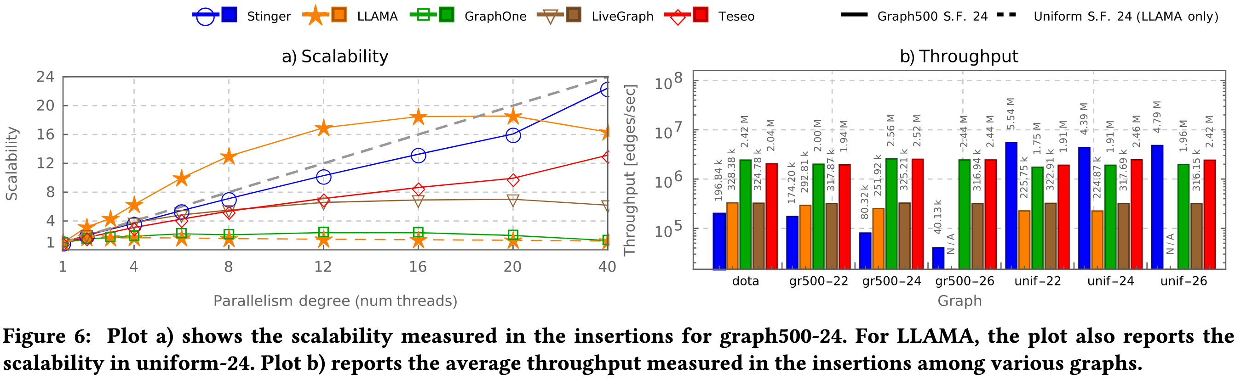
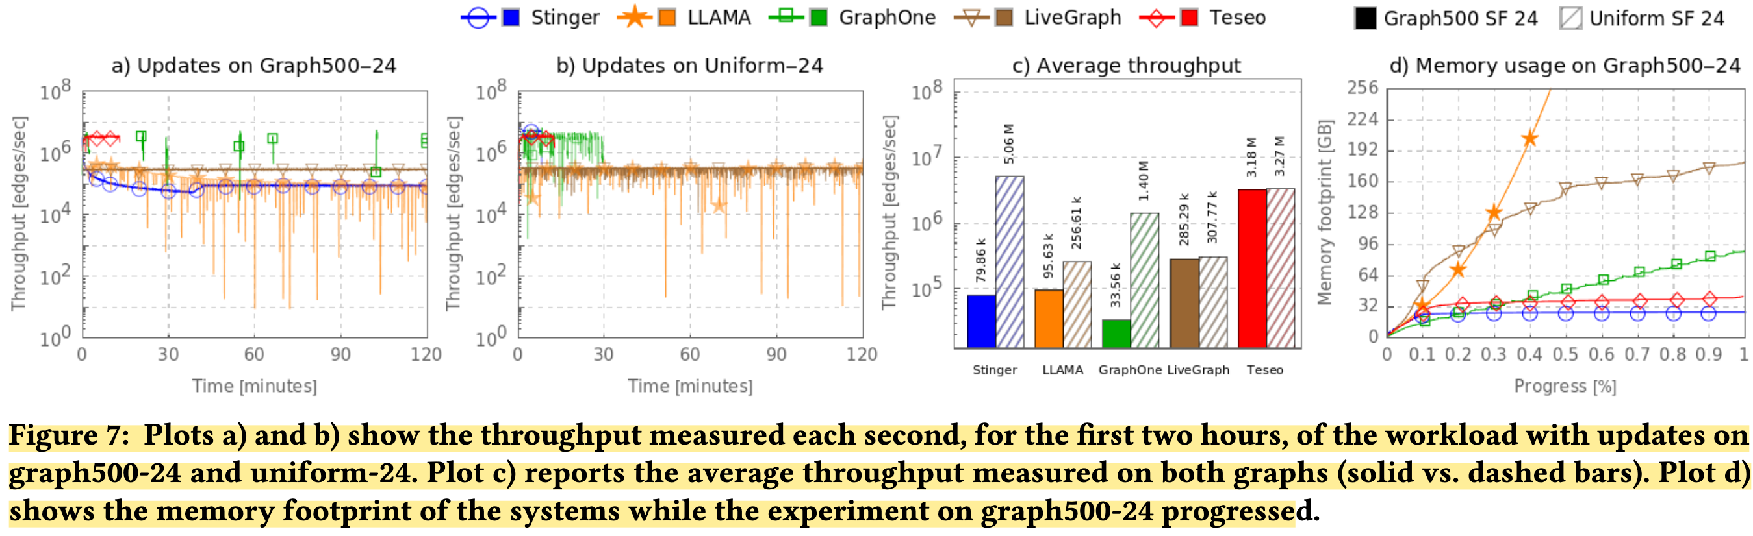
Research Question #3

Slide 10
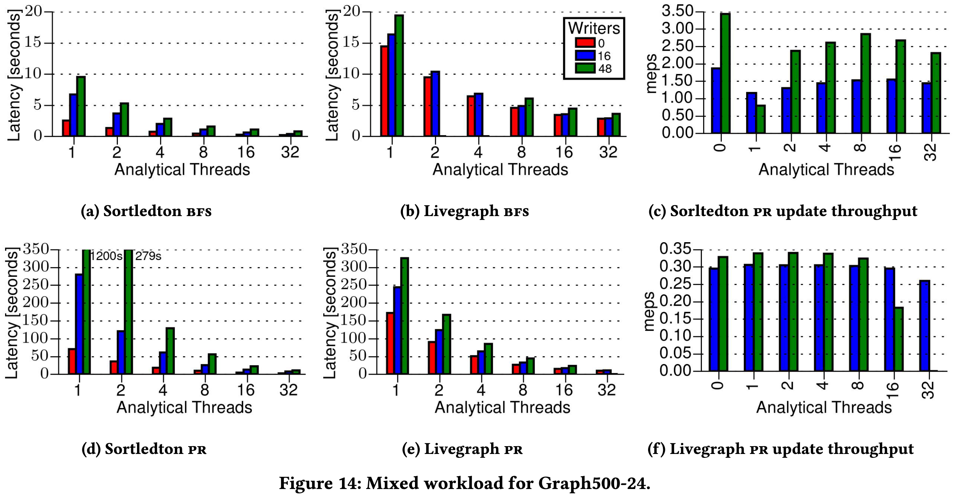
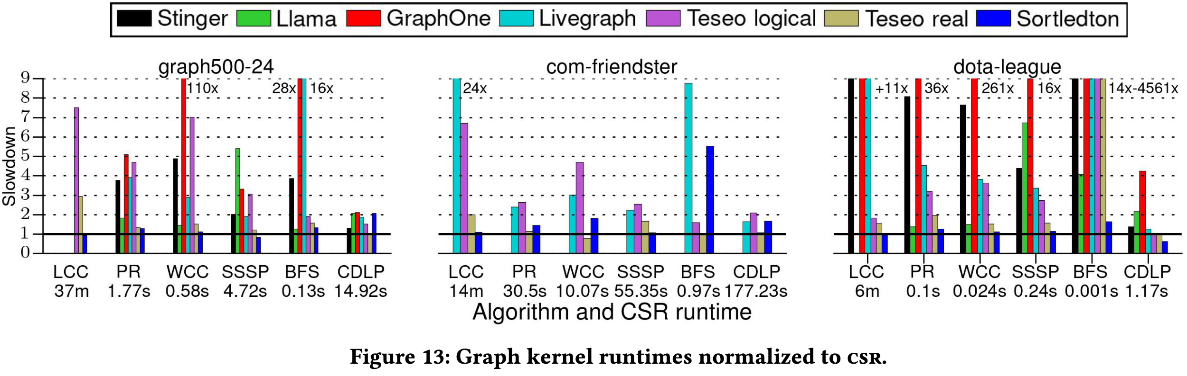
Research Question #3
For analytics:
Completion time for BFS, PR, SSSP, CC
Concurrent read-write workload:
Latency for inserts as the #analytical threads vary
Time to complete PR as the updates happen.

Slide 11
Evaluation Setup
Dual socket AMD EPYC 7643 48-Core Processor @ 2300 MHz with hyperthreading enabled
Ubuntu 22.04.5 LTS running Linux 5.15.0-143
All docker images based on Ubuntu 22.04 and compiled with GCC 11.4.0-1, OpenMP 4.5, and Intel OneAPI (TBB) 2025.2

Slide 12
Systems being evaluated
Static + In-memory GPS:
GapBS
Galois
Gemini
Ligra
Static + OOC GPS:
GraphChi (2013)
X-Stream (2015)
GridGraph(2015) / Lumos (2019): streaming graph processing, grid-based layout, Lumos is PR-specialized
Blaze (2022) specialized for NVMe SSDs

Slide 13
Systems being evaluated
Dynamic Graph Processing Systems (in-memory)
LiveGraph (2020) mmap-based system, sequential edge-layout
Teseo (2021): ART-based index to a packed-memory array
Sortledton (2023): blocked-array layout.

Slide 14
Datasets
Dataset Name | #Vertices | #Edges | Size (GB) | Used in
graph500-22 | 2.39 M | 64.15 M | 1
graph500-24 | 8.87 M | 260.38 M | 4.34
graph500-26 | 32.80 M | 1.05 B | 18.59
URand 22 | 2.39 M | 64.15 M | 1
Urand 24 | 8.87 M | 260.38 M | 4.34
Urand 26 | 32.80 M | 1.05 B | 18.59
Twitter MPI | 52.58 M | 1.96 B | 29.63
Graph500-30 | 447.80 M | 17.02 B | 339.25
Dota-league | 61.17 K | 50.87 M | 0.8

