Slide 1
Flexograph Architecture
Chapter 4

Slide 2
4.1 Goals of our design
We saw in Section 3.2 that all GPS use the same data structures to store their graphs
CSR (sequential vertex and neighborhood access) and Adjacency Lists (random vertex seek + sequential neighborhood scan)
Flexograph is a system that provides a persistent store for mutable graph data in formats that are close to in-memory representations amenable to graph analytics
So far, the project has focused on structural graphs
We will extend our analytics-first graph representations to store labels and properties of nodes and edges

Slide 3
4.1 Our Design: Current & Future Work
The current design of Flexograph is centered around structural graphs
This covers most of the design landscape we described in Section 3.1 – 3.2
Getting this right lays the foundation for building a robust system for property graph storage
This chapter details the Architecture as it exists today
Chapter 6 describes how I will extend this architecture to handle property graphs
There are two proposals for storing property and label information – inline with the element or separately using column stores
We provide mechanisms to do both and perform a comparative study of how they perform under a variety of workloads
Notes:
Although we have not done the property time graph stuff, we have spent considerable time in designing the system such that adding the properties does not require duplicating the structure nor does it affect the perf of the analytics stuff we will show in this chapter

Slide 4
4.2 What should a graph database provide?
A GDB must store the graph in formats that facilitates high performance analytics by supporting the workload’s access patterns
Sequential access to data
Indexes to find the desired node and edge types
A GDB must provide an API that abstracts the inner representation of the data away from the user
The user doesn’t need to know what is the internal representation used by the DB
A GDB must provide a framework to support fast graph operations
Iterators are critical for performance and should be first class primitives

Slide 5
API
Framework for Efficient Operators
Graph Representation

Slide 6
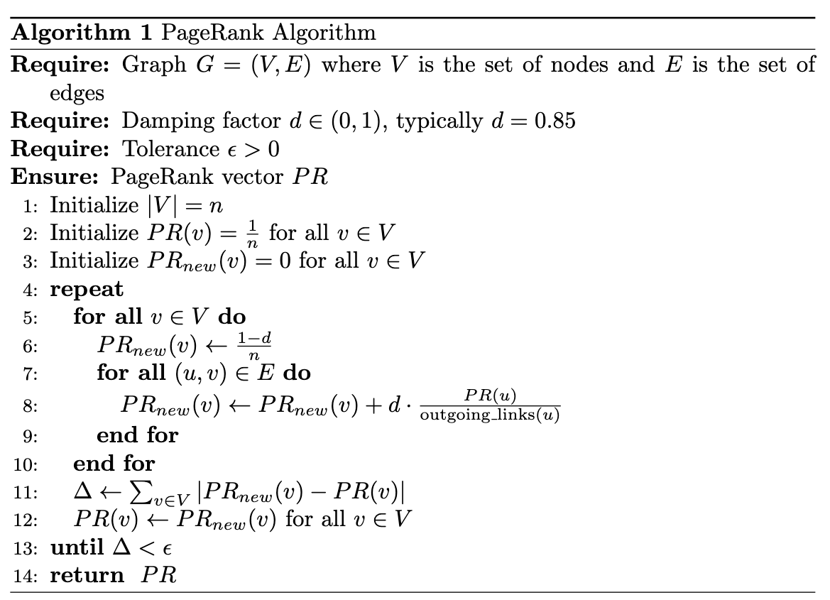
4.2 Examine A Use Case: PageRank
PageRank computation involves accessing the neighborhood of every vertex in the graph
Outer loop accesses the vertices in the graph
Inner loop accesses each edge in a vertex’s in-neighborhood (Line 7)
Access the results vector (Line 8):
For the vertex and all it’s in-neighbors
Ideally, our representation provides sequential access to all these elements
Notes:
Fix pseudocode

Slide 7
4.2 Desiderata for Running PageRank
The graph store must provide an API for:
Vertex iterator: for efficient vertex scans
Neighborhood iterator: for efficient neighborhood scans
?

Slide 8
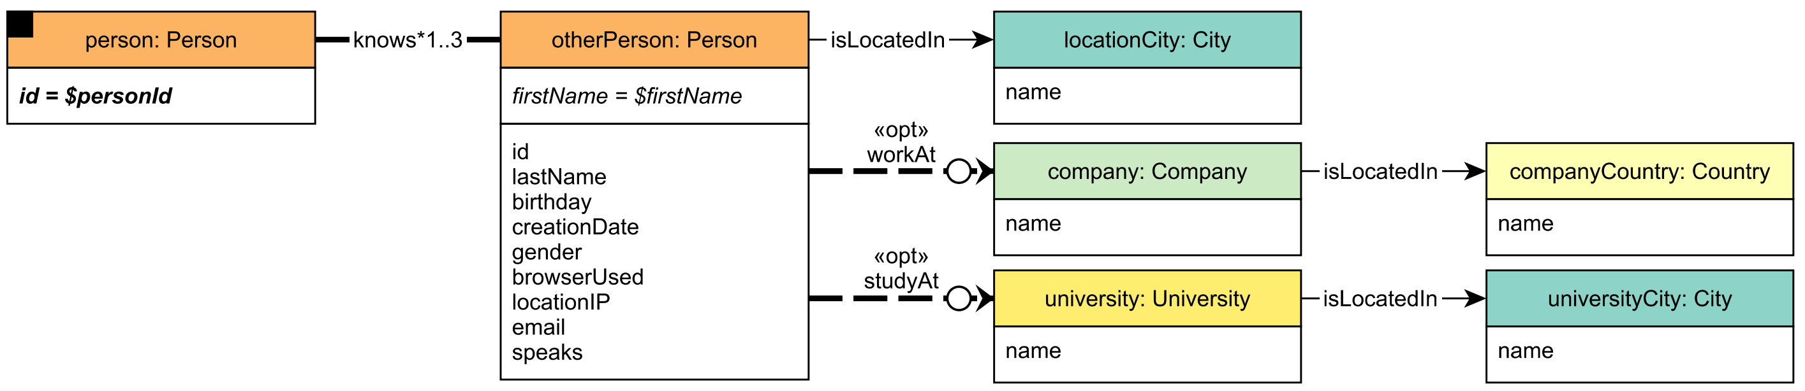
4.2 Examine Querying a Social Network
Examine LDBC SNB Interactive IC1 Query to find transitive friends with certain name
Given a start Person with ID $personId, find Persons with a given first name ($firstName) that the start Person is connected to (excluding start Person) by at most 3 steps via the knows relationships.

Slide 9
4.2 Desiderata for Querying a Social Network
Examine LDBC SNB Interactive IC1 Query to find transitive friends with certain name
Given a start Person with ID $personId, find Persons with a given first name ($firstName) that the start Person is connected to (excluding start Person) by at most 3 steps via the knows relationships.
Assume that the “knows” relationship graph has been materialized
The system provides neighborhood iterators
This query needs an API call to:
Find a node’s neighbors
Get a node’s properties

Slide 10
4.3 Flexograph Architecture
Graph Representations
API for Graph Access
Framework for Efficient Scans
In the previous section we saw the components needed to build a graph database
We now examine the architecture of Flexograph and its three building blocks: the representations, the API, and the framework for higher level access primitives
Storage Backend

Slide 11
4.3.1 Graph API
The Graph API provides the user a means to interact with the graph that elides the underlying storage backend or the representation used to store the graph
This increases portability of the application code
The Graph API must provide methods for:
Structural manipulation and querying (add/delete nodes and edges, get degrees, get a node’s neighborhood)
Property and Label manipulation and querying (add/query/remove property)
Adding and retrieving Metadata (querying the num nodes/edges, etc.)

Slide 12
4.3.1 Graph API
Different parts of the graph need different consistency guarantees
The structure of the graph can never be inconsistent:
Ex: the reverse edge must be atomically created for undirected graphs, an edge can only connect existing nodes
The properties/Labels of an element must also always be consistent
Ex: A node cannot exist unlabeled in a property graph
The Metadata does not have as strict a consistency requirement
Regardless of the needs of each operation, the API must have clearly defined semantics so that an application developer can reason about the code

Slide 13
Graph API
The API must not make assumptions about application semantics
Return appropriate error codes back to the application and let the application handle failures

Slide 14
4.3.2 Framework for higher level primitives
We saw in Section 3.X and 4.2 that analytics tasks require efficient access to neighborhoods of the graph
While the Graph API can find a vertex’s neighborhood, making repeated calls to the API for all nodes is tedious and inefficient
Moreover, the user might wish to access the graph in some specific fashion that is inefficiently expressed with the Graph API
Ex: the user might want to traverse the edges in a Hilbert Order, or she might want to iterate over some motifs in the graph
The system must provide a framework to express higher-level traversal primitives for use in graph analytics

Slide 15
4.3.2 Framework for higher level primitives
Such a framework should at the least provide:
Node iterators: to traverse over all nodes in the graph
Edge iterators: to traverse over all edges in the graph
Neighborhood Iterators to traverse over the in-and out- neighborhoods of all vertices in the graph
Additionally, the framework could provide ways to construct more complicated traversal schemes that progress in a certain order or access motifs.
(Future work)

Slide 16
4.3.3 Graph Representations
We graph workloads in Sections 2.2, and the graph representations that suit them in Section 2.3
And how most structural graph processing systems use CSR-like or Adjacency List-like representations to store data
A graph database should be able to persist these data structures in ways that allows for efficient reconstruction and access
The database designer must figure out how to store them in the underlying storage engine
Should be done in ways that preserves access locality to vertices and neighborhoods

Slide 17
4.3.3 Graph Representations
CSR:
store the vertex and all the incoming/outgoing edges to/from that vertex sequentially or in the same “chunk”
Provide an index/search to find where a node begins
Adjacency List:
The neighborhood of each node is materialized and stored inline with the node
The nodes can be sequentially laid out in some ordering of their ID

Slide 18
4.4 Implementation
Flexograph is a concrete realization of the architecture discussed in section 4.3
Our implementation discusses the following aspects:
Our choice of storage engine and how its design influences ours
An example of an application written using our GraphAPI
How we store the graph representations in our storage engine and how the API facilitates interaction with the data
The higher-level traversal primitives that Flexograph supports
How we manage transient attributes generated during an application run
The design of an efficient Bulkloader to fast-track data ingestion

Slide 19
4.4 Flexograph Implementation
Graph API (Section 4.4.2)
Traversal Primitives
(Section 4.4.4)
Transient Attributes
(Section 4.4.5)
Storage Engine
(Sec 4.4.1)
Graph Representations
(Section 4.4.3)

Slide 20
4.4.1 WiredTiger makes the World go Round
We use WiredTiger as our graph storage engine
Production-ready,
Excellent multi-threaded read performance – reads are non-blocking (critical since graph workloads are ready heavy)
ACID compliant and clear semantics for write-write conflicts to same object:
All but one concurrent writes to the same key will fail
Mention snapshots
Using a Key-value store allows more flexibility than using a RDBMS:
Relational Model does not allow flexibility to prototype layouts
Simpler to prototype things and write custom traversal operators in WT

Slide 21
4.4.1 WiredTiger: Essential Properties
WiredTiger is an embedded KV store:
The KV store is part of the application
A WT databases work on a single-process multi-threaded model
The WT API requires a single connection to the database (WT_CONNECTION object)
Thread safe
A Session object encapsulates the transactional context of data operations (WT_SESSION object)
WT_SESSION methods are not thread safe

Slide 22
4.4.1 WiredTiger: Essential Properties
Cursors are used to find, locate, and traverse over records in the database
WT_CURSOR objects are not thread safe and are tied to a session
The single-process multi-threaded model dictates the design of a WT application:
The process opens a database connection
Each application thread creates a new session and as many cursors as it needs
Application
WT_SESSION
WT_CURSOR
WT_CONNECTION
…
WT_CURSOR
WT_SESSION
WT_CURSOR

Slide 23
4.4.1 WiredTiger: Essential Properties
WiredTiger supports both row-stores and column stores
Traditional row-based storage is inefficient when we are primarily interested only in a small subset of properties
Column groups define groups of columns (properties) to be stored in a separate file
The same key can be used to access the row store and column group entry
Using column groups can significantly improve cache behavior by only reading WT files containing columns needed by the query
Especially critical in property graphs where nodes and edges can have arbitrary number of properties

Slide 24
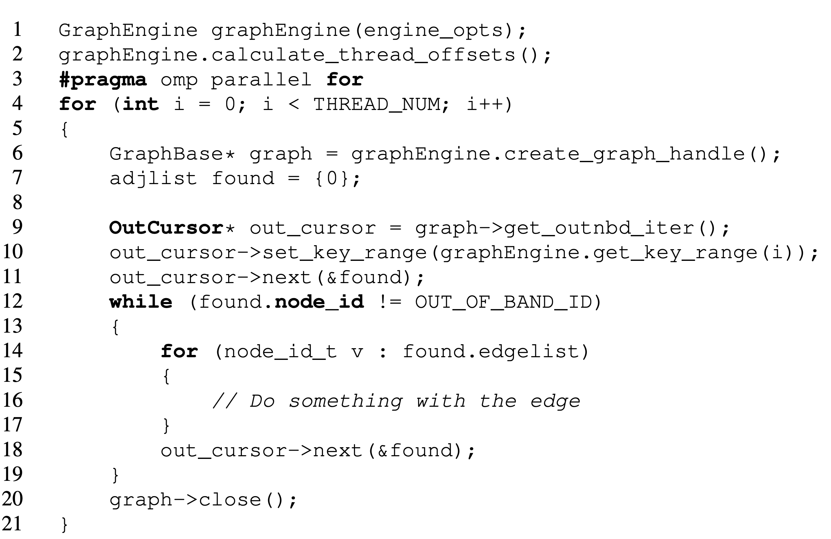
4.4.2 Writing a Flexograph Application
An application first creates a GraphEngine object
Encapsulates the connection to the DB
Compute the vertex ID ranges a thread operates over
Each thread creates a graph handle
Held in a GraphBase reference – has a session and few cursors pre-instantiated
A thread can then ask for an iterator from the API – here out nbd iterator
Iterators internally manage cursor operations and range checks
A sample application that traverses the out-neighborhoods of all nodes in the graph
Notes:
Explain graph handle

Slide 25
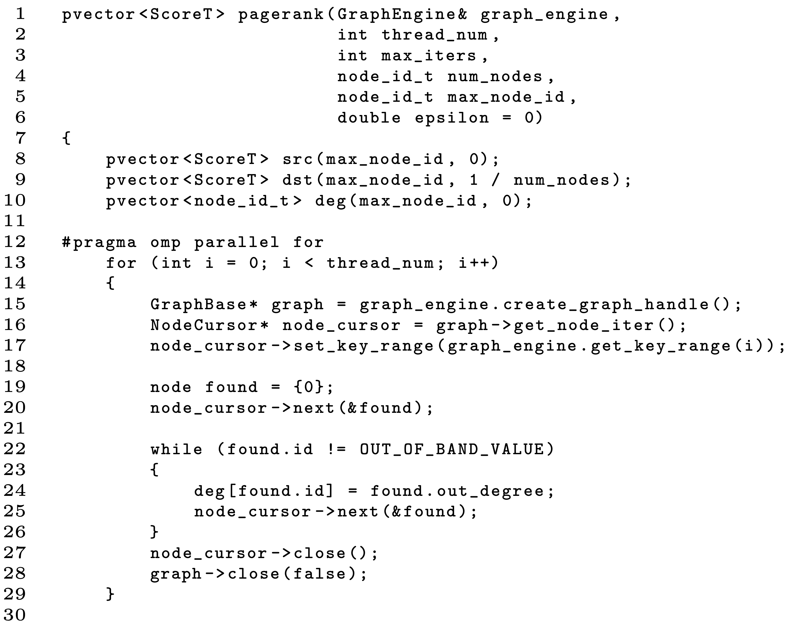
4.4.2 Application example: PageRank
Initialize the PR score vectors:
pvector initialization is parallel and handled in the constructor
deg vector holds the degrees of vertices
Initialization needs a traversal over the nodes
Uses a node iterator
API calls are marked in

Slide 26
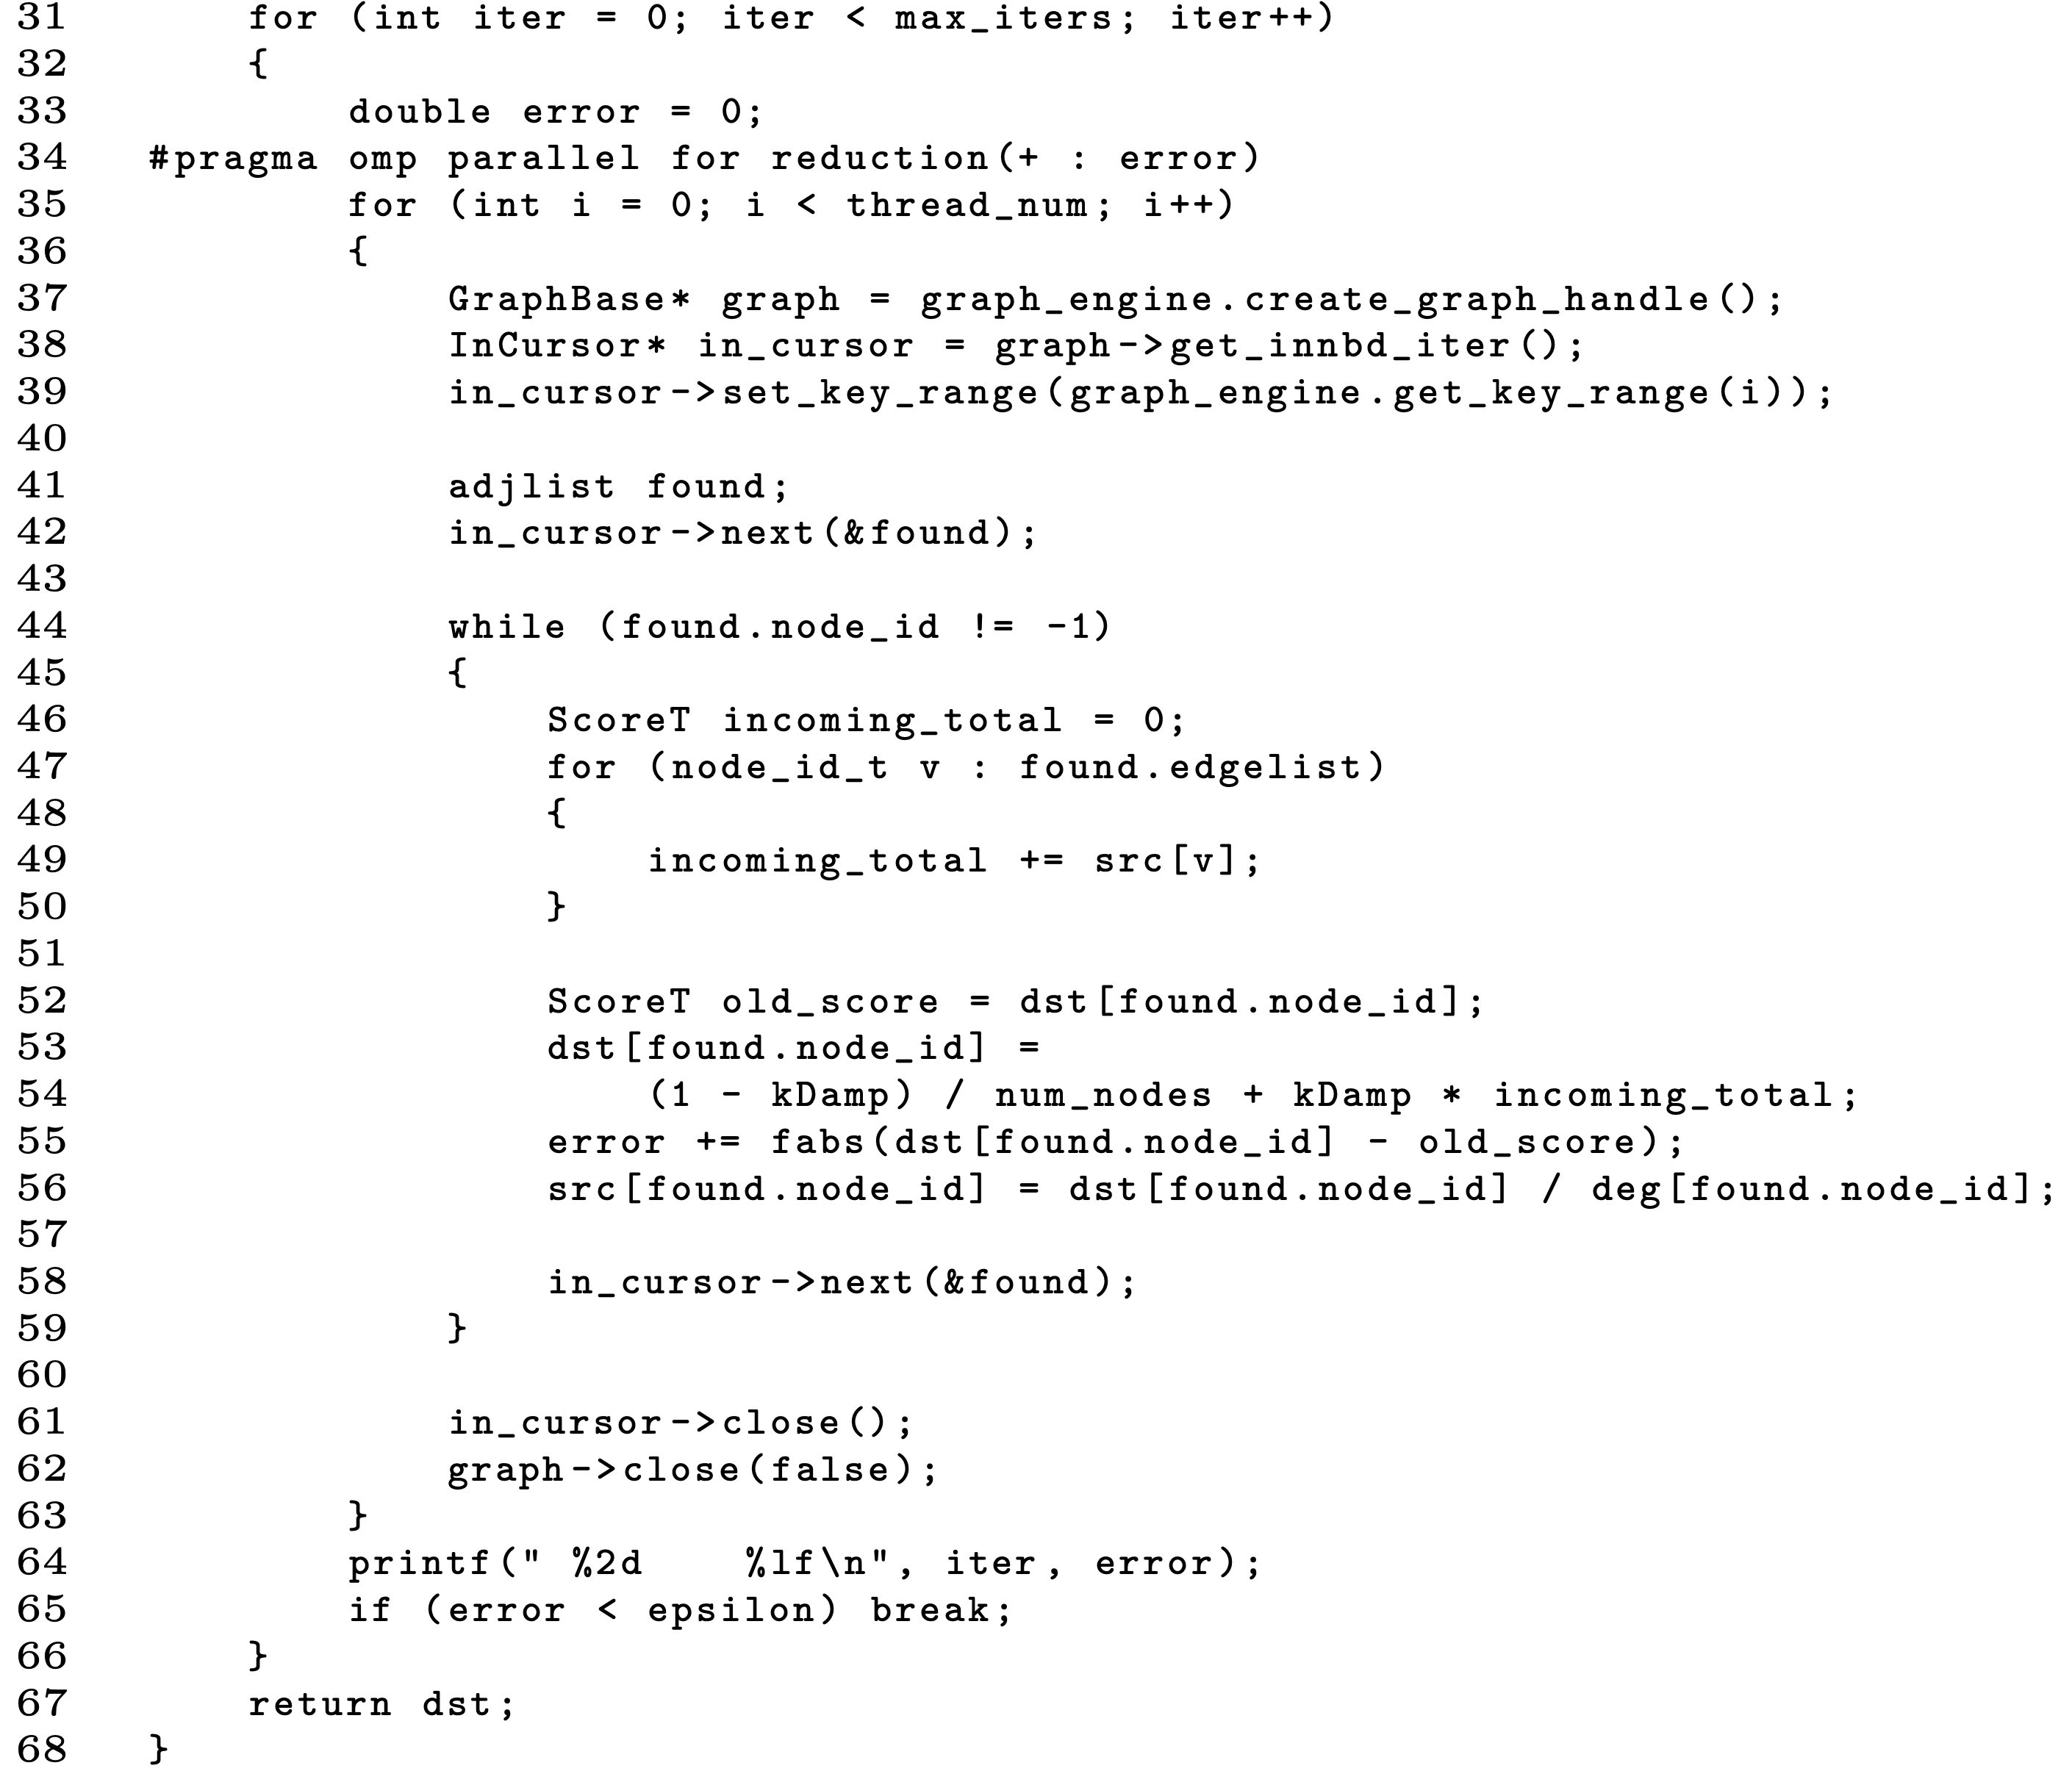
4.4.2 Application example: PageRank
The outer loop creates threads
Each thread opens a graph handle and gets a key range to traverse
Here, an in-nbd cursor gets a node ID range
The inner loop traverses over the neighborhood of each vertex from the outer loop and computes PageRank values
API calls are marked in

Slide 27
4.4.3 Graph Representations
Flexograph supports two representations for graphs
Adjacency List Representation
EdgeKey representation:
Designed to create a CSR-like representation in the key-value store
Another RDBMS-like representation was prototyped but abandoned
Poor benchmark performance across the board

Slide 28
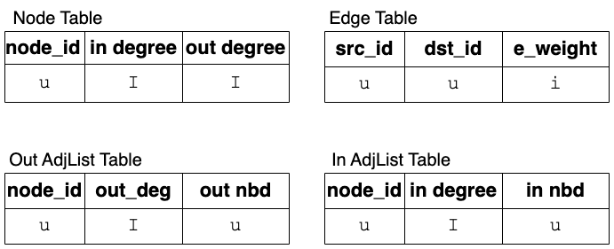
4.4.3 Adjacency List Representation
AdjList has two tables for structural information:
In/Out AdjList tables store the in/out neighborhoods of every vertex
Node and Edge tables are needed only if the table has labels and properties
This representation does not need any indexes
u denotes a serialized byte array
I denotes an unsigned integer
i denotes a signed integer
Notes:
Vertex types can be 64 bits

Slide 29
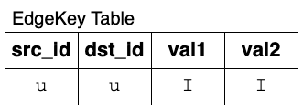
4.4.3 EdgeKey Representation - initial
EdgeKey uses one table to store both nodes and edges
Keyed on src_id and dst_id
Node entry:
src_id is the node ID
dst_id is an Out_Of_Band Value (INT32_MAX)
val1 is in degree & val2 is out degree if the table is read optimized (uninterpreted if not)
Edge entry:
src_id and dst_id store the source and destination node IDs for the edge
val1 stores edge weight (if weighted graph), val2 always 0
An index is used to find in-neighborhoods of nodes (keyed on <dst_id, src_id>)
u denotes a serialized byte array
I denotes an unsigned 32-bit integer
Iterativng over this secondary index destroys performance

Slide 30
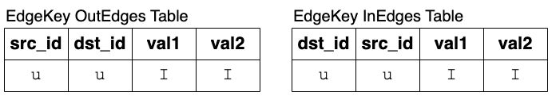
4.4.3 EdgeKey Representation – Split Design
The split design removes the neeed to use a secondary cursor for finding in-neighborhoods
This representation materializes the reverse edges
Out Neighborhood queries use the OutEdges table
In Neighborhood queries use the InEdges table
Everything else remains the same as the initial design
u denotes a serialized byte array
I denotes an unsigned 32-bit integer

Slide 31
4.4.4 Iterators
WiredTiger API provides methods to position a cursor on any table and iterate from a valid position till the end of the table is reached
We don’t want to allow the user to use these raw methods
GraphAPI has methods to get a nodes entire neighborhoods, but these methods do not allow finding neighborhoods of multiple/range of nodes
Doing so in the API would require a search for each node: HIGHLY INEFFICIENT
Also, tedious, repetitive, and needs knowledge of the graph representation
Iterators allow the user to define a start key and an end key and call the next() function to move to the next position

Slide 32
4.4.4 Iterators
Each representation has 4 associated iterator classes: EdgeCursor, InCursor, OutCursor, and NodeCursor
All of these classes provide the same interface: set_key_range(), next(), reset(), and close()
These methods abstract the internal representation being used
next()returns an Out_Of_Band value when the range has been exhausted

Slide 33
4.5 Managing Transient Attributes
An application can generate some temporary attributes while it runs
For example: PR values while the algorithm hasn’t converged
These might become a permanent attribute depending on the user/app
But while it is still a temporary value, it should not be stored with formal attributes of a graph element
We call these Transient Attributes
Typically, these are in-memory and lost when the application terminates
We provide a mechanism to persist them and reuse them for the next round of computation
Notes:
Mention PR exampke

Slide 34
4.5 Managing Transient Attributes
Flexograph stores Transient attributes in a file-backed mmap region
The GraphAPI handles the initialization of this region and also the syncing and unmapping when the application terminates
If an application wishes to reuse an old transient attribute file for bootstrapping the next round of computation, it must reconcile the old region and the changes in the graph that have happened
Can be automatically handled as long as a few rule are met: no vertex ID reuse, and the schema of the transient attributes does not change

Slide 35
4.6 Bulk Loading Graphs

