Slide 1
DSI Report
Zheng xie

Slide 2
CONTENT
Introduction
DSI Spec
ASIC Design
Plan

Slide 3
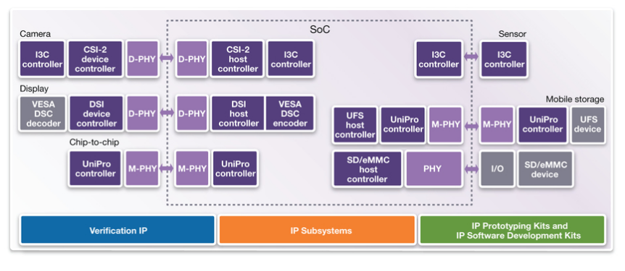
Introduction : Display Arch

Slide 4
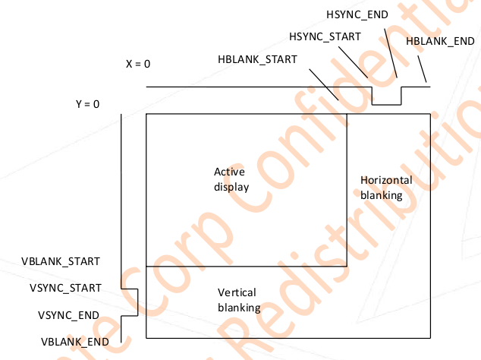
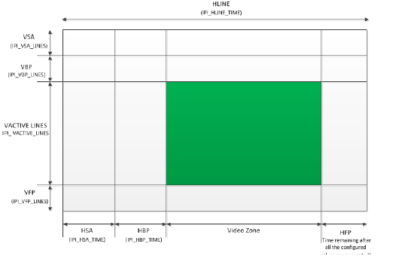
Introduction : Display

Slide 5
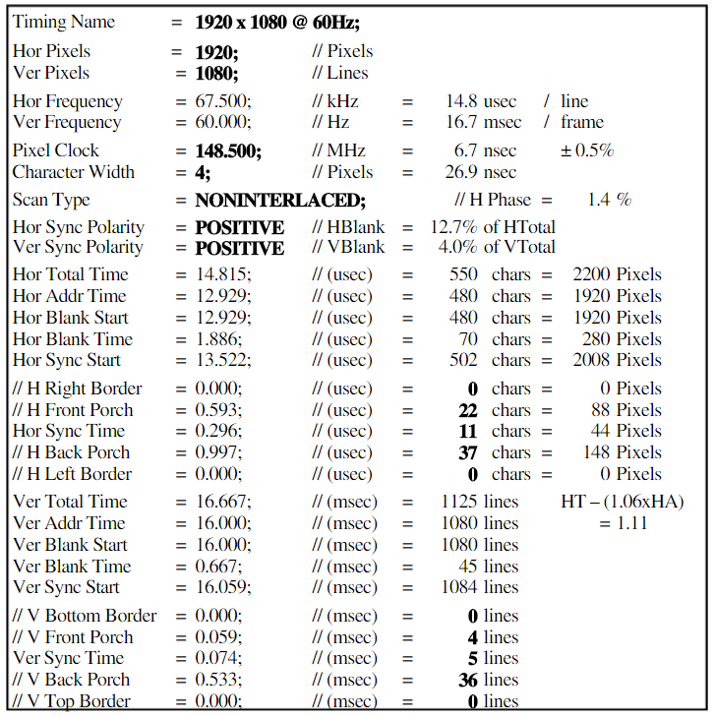
Introduction : VESA

Slide 6
DSI Spec
Protocol Layer
Command mode
Video mode
Physical Layer
HS mode
Escape mode

Slide 7
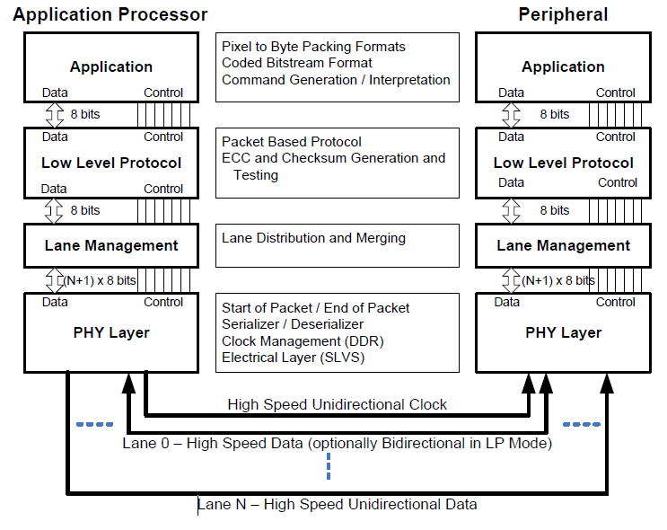
DSI Spec

Slide 8
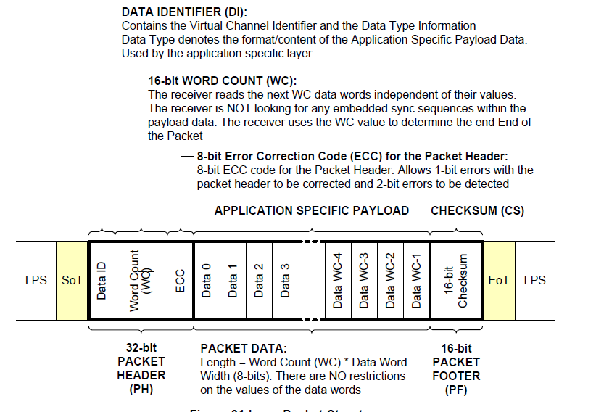
Packet Structure

Slide 9
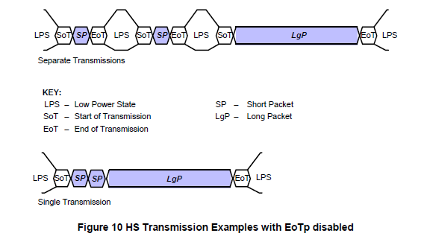
Multiple Packets per Transmission

Slide 10
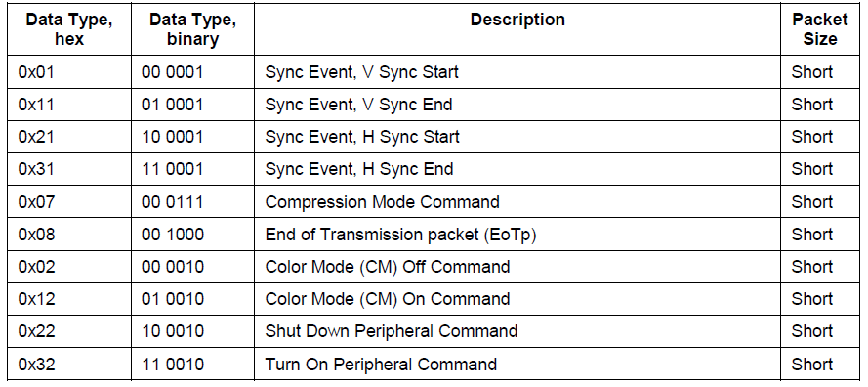
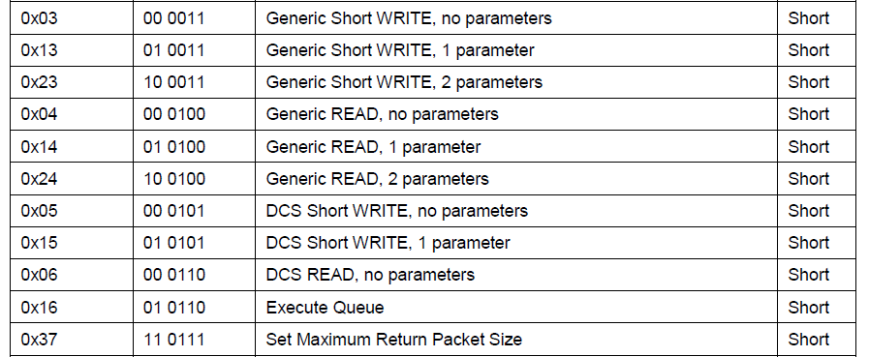
DSI Spec: Processor-sourced Data Type

Slide 11
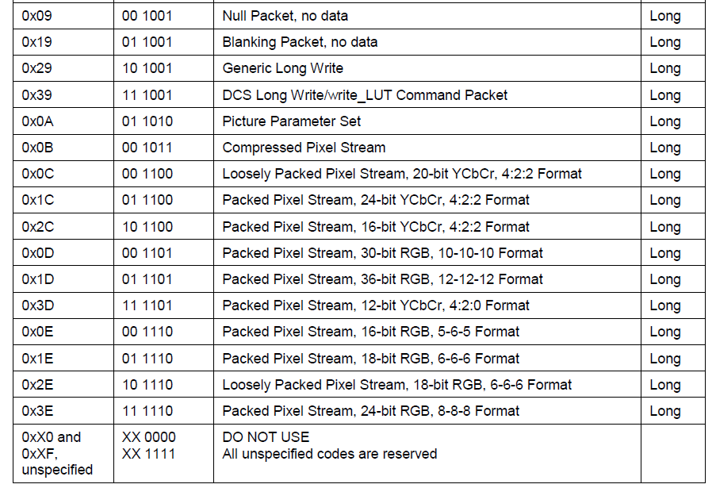
DSI Spec: Processor-sourced Data Type

Slide 12
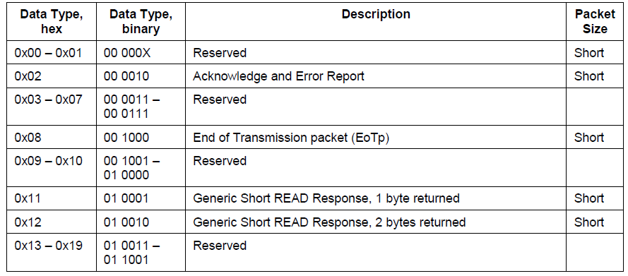
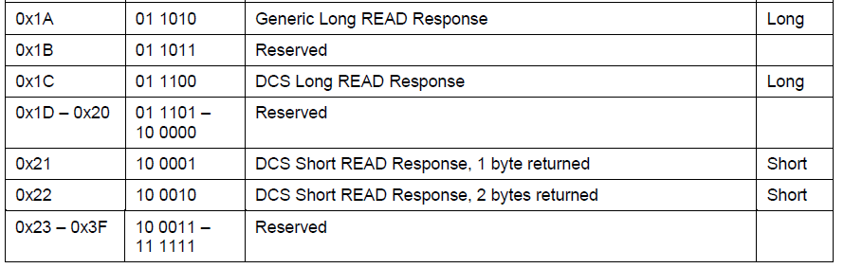
DSI Spec: Peripheral-to-Processor Transactions

Slide 13
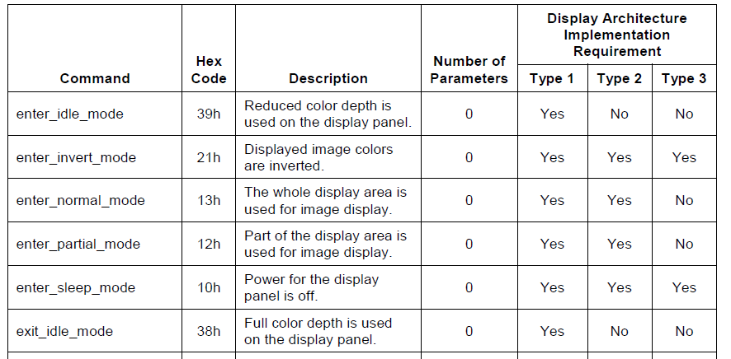
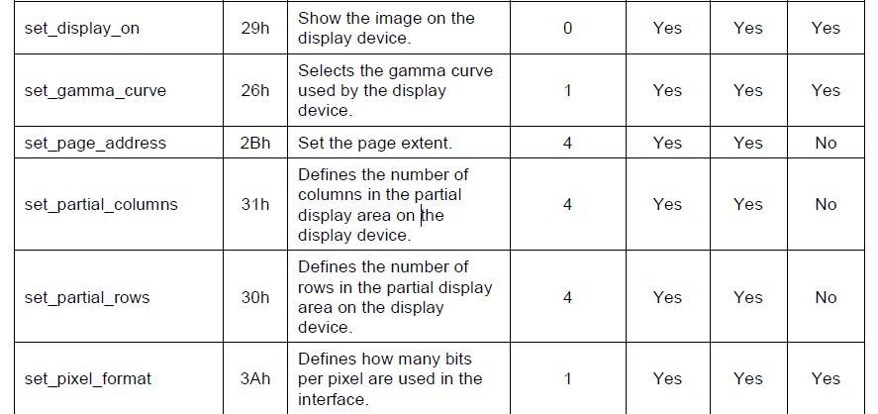
DSI Spec: DCS (Display Command Set)

Slide 14
Protocol Layer: Command mode
Command mode
Transactions take the form of sending commands and data to a peripheral.
BTA mode
Turning the bus around is controlled by a token-passing mechanism: host processor sends a Bus Turn Around (BTA) request and peripheral transmits packets back to the host processor. When finished, the peripheral return control of the bus back to the host processor.

Slide 15
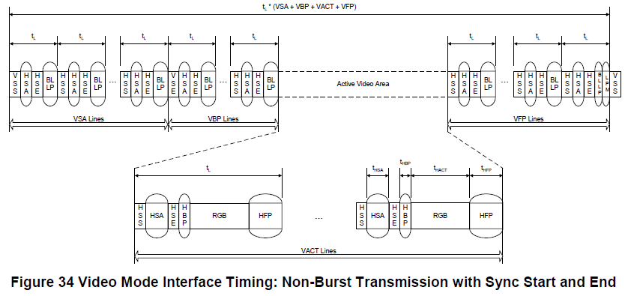
Video mode: Non-Burst Mode with Sync Pulses
Enable the peripheral to accurately reconstruct original video timing, including sync pulse widths.
Notes:
RGB888: (4096x2160)*24*30 = 6.371G
RGB666:

Slide 16
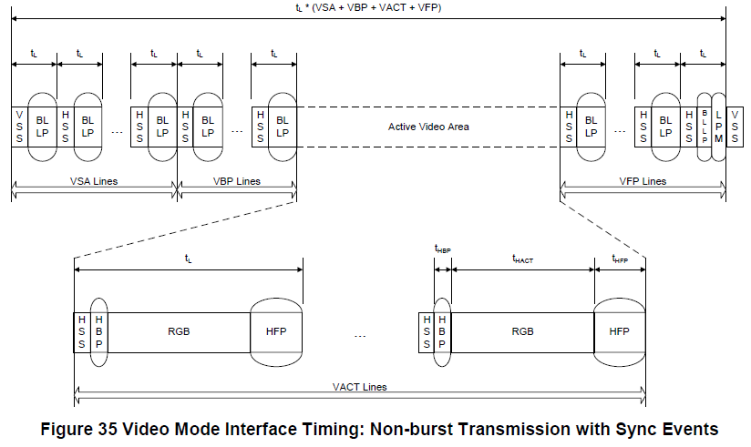
Video mode: Non-Burst Mode with Sync Events
Accurate reconstruction of sync pulse widths is not required, so a single Sync Event is substituted.
Notes:
RGB888: (4096x2160)*24*30 = 6.371G
RGB666:

Slide 17
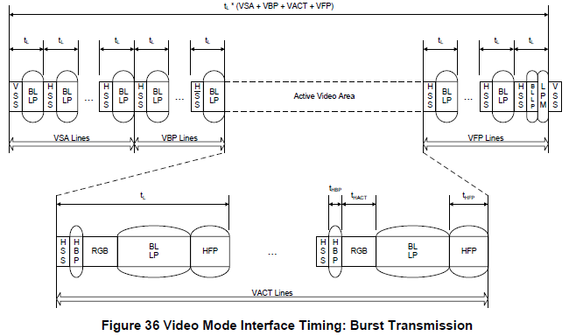
Video mode: Burst Mode
Pixel packets are time-compressed, leaving more time during a scan line for LP mode or for multiplexing other transmissions onto the DSI link.
Notes:
RGB888: (4096x2160)*24*30 = 6.371G
RGB666:

Slide 18
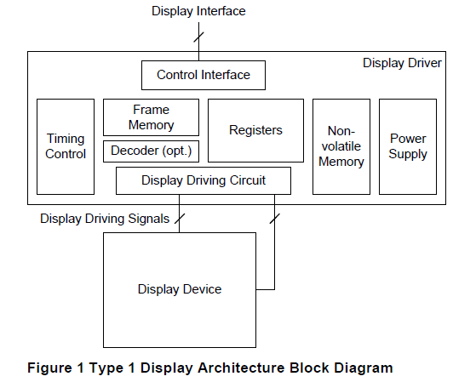
Display Architecture : TYPE1
The Display Command Set is used through control interface.
Notes:
RGB888: (4096x2160)*24*30 = 6.371G
RGB666:

Slide 19
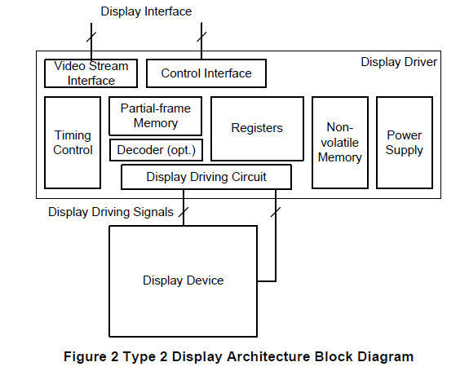
Display Architecture : TYPE2
Notes:
RGB888: (4096x2160)*24*30 = 6.371G
RGB666:

Slide 20
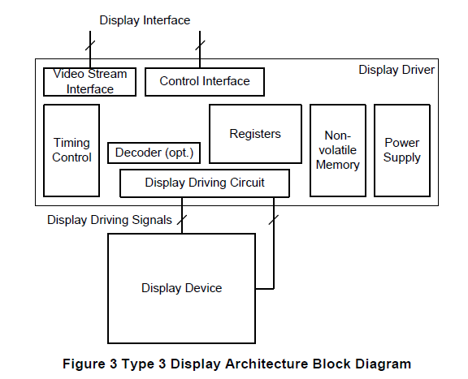
Display Architecture : TYPE3
Notes:
RGB888: (4096x2160)*24*30 = 6.371G
RGB666:

Slide 21
ASIC Design
Design Feature
ASIC Arch
Verify Env
Plan & Change

Slide 22
Design Features
DSI Host Controller, version 1.2. <2.5Gbps/lane>
Data lane configurable, max four data lanes.
Support 4k video output;
YUV420_8
YUV422_8/YUV422_10
RGB444/RGB565/RGB666/RGB888/RGB_10
Notes:
RGB888: (4096x2160)*24*30 = 6.371G
RGB666:

Slide 23
Performance analysis
Utilization ratio: 80%

Slide 24
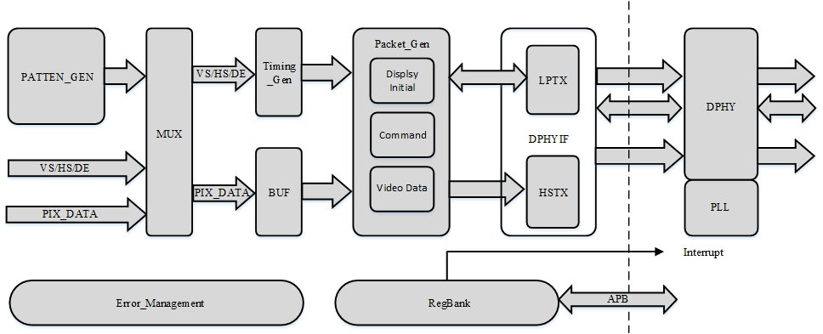
ASIC ARCH: Diagram

Slide 25
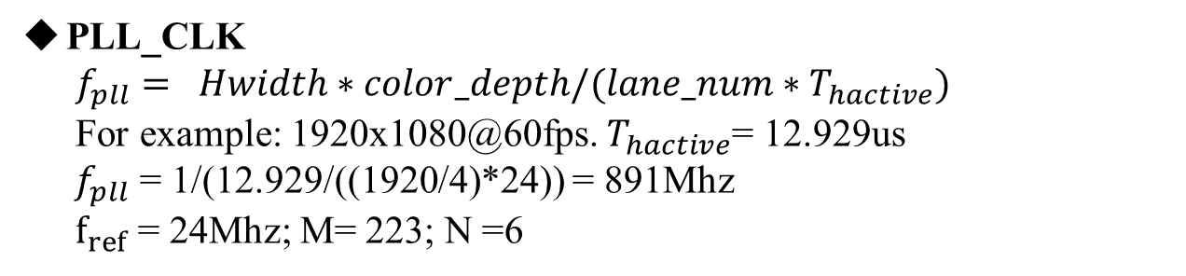
ASIC ARCH: CLK
PIX_CLK
From CGU, Based on VESA Standard, Max set 300Mhz.
REF_CLK
From CGU, 24Mhz.
PLL_CLK
$f_{pll}= Hwidth∗color_depth/(lane_num∗T_{hactive})$
For example: 1920x1080@60fps. $T_{hactive}$= 12.929us
${ f}_{pll}$ = 1/(12.929/((1920/4)*24)) = 891Mhz
$f_{ref}$ = 24Mhz; M= 223; N =6

Slide 26
Verify ENV
Local_sim
Veloce SIM
FPGA_SIM

Slide 27
SIM: Local Sim
DSI RX_Model is need.

Slide 28
SIM: Veloce Sim
All Suported:
BTA mode
Command mode
Video_mode
Non_Burst mode with Sync Pluse.
Non_Burst mode with Sync Events.
Burst mode

Slide 29
SIM: Fpga Sim
Solution 1: ZCU102 board

Slide 30
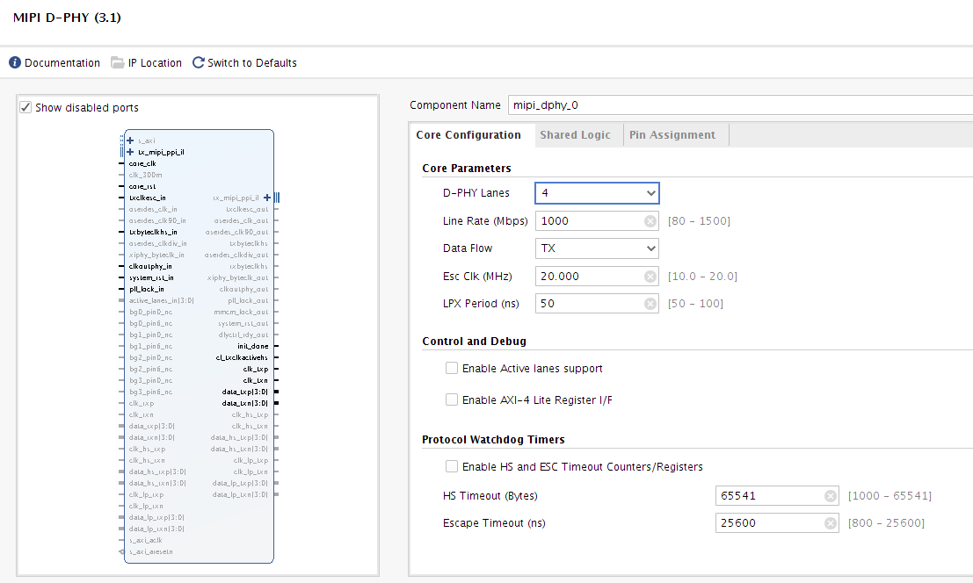
SIM: Fpga Sim
Solution 1: ZCU102 board
BTA Module is not supported.

Slide 31
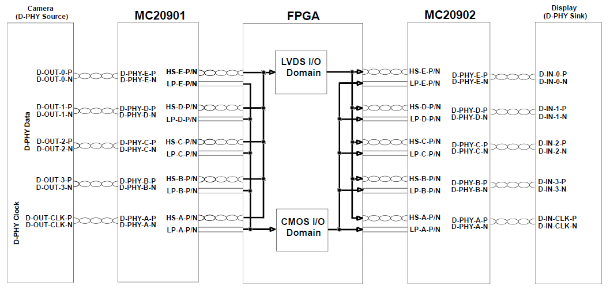
SIM: Fpga Sim
Solution 2: Voltage Switch Bridge IC
PHY Digital function model is needed! Need verify
Notes:
For CSI RX: MC20901(bridge IC) + deserializer module(FPGA hard core) + packet start_detection(in_house_design) For DSI TX: Packet start_generation(in_house_design) + serializer module(FPGA hard core) + MC20902(bridge IC)

Slide 32
DSI ARCH

Slide 33
PLAN
Writing Spec
RTL Coding
Local Sim
Veloce Sim
FPGA Sim

Slide 34
Change list
DPHY Architecture ??????
Two 2lane DPHY or one 4lane DPHY
DPHY share between DSI and CSI???
Support resolution to 1080p ????
Features complement

Slide 35
Thank You !

