Slide 1
Sirius FPGA Summary
Artosyn

Slide 2
Outline
1
Prototyping to FPGA
2
Debug Sirius On FPGA
3
How to improve

Slide 3
Map ASIC design to FPGA
Removed all ASIC clock gating cells
Replaced all the clock logic 、DDR4/3 and RAM logic of FPGA
Have a constraint for false path for which there are some false timing violations
Removed the BUFG CASCADE
Removed pin share parts for easy building

Slide 4
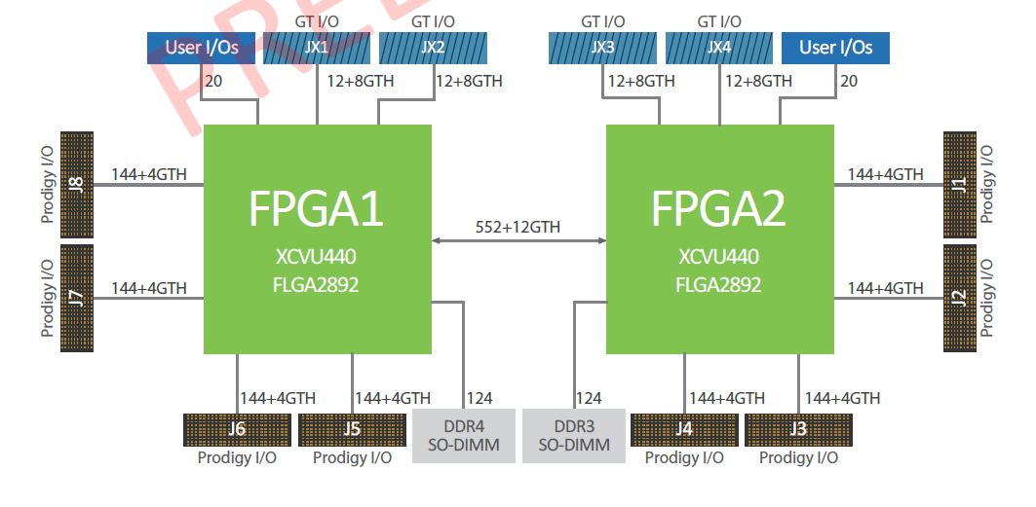

Map daughter card to fpga

Slide 5
Add debug core to FPGA
Instantiate ILA /VIO Core for debug topper module
Add nets to ILA for internal nets and signal
Connect Signal to I/O for debug more depth and more cycles signal

Slide 6
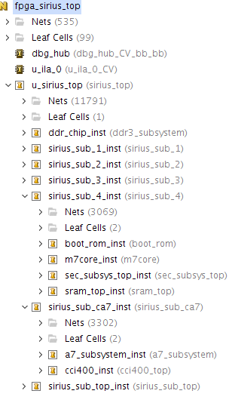
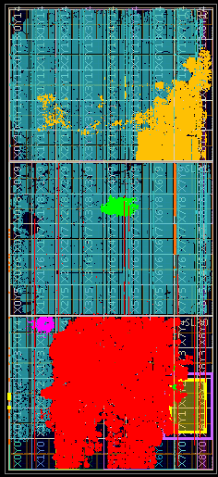
Sirius map as

Slide 7
2
Debug Sirius on FPGA

Slide 8
Synthesis problems
Udefined macro
Design ware lib recognize
System verilog syntax
H264 Hevc multip(*)whether using dsp resource

Slide 9
PR problems
Eco&Increment flow have unplace net and timing is worse
Probe signal’s tcl check single step pass but drc failed
If meet some non concerned critical warning could add constrain to avoid check
PCIE core is resolved as a black box

Slide 10
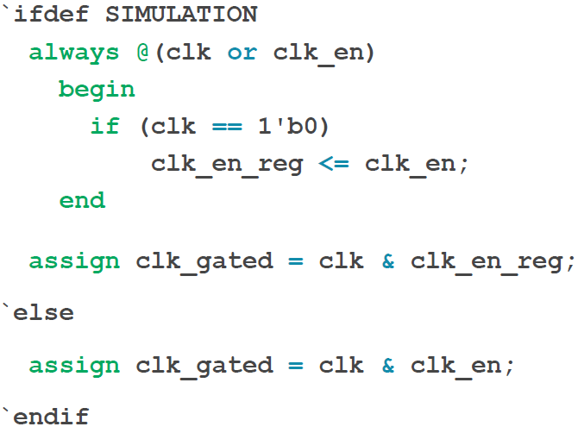
Sim problems
Cross- module reference resolution error
128 bit cascade Rom hex distribute
ARM simulation may cause failed with clk gated

Slide 11
Debug on board problems
Daughter card、I/O st
---SD、SWD 、CAN
Software operation
---TZC、emmc、ethernet
RTL fpga design
--- dummy、divide QSPI
Multi die effect
---- J6’s signal

Slide 12
3
how to improve

Slide 13
verify improvement
Map design (macro define /keep function with source design clkgate/ clock mux )
Debug design(debug net reserve)/pre confirm need test periph and pre prepare the corresponding daughter card
Eco flow & increment flow
Pre or post simulation try
Add more specific timing constrain refer ASIC
Build FPGA ASAP
Big memory consume

Slide 14
Thank You !
Artosyn

