Slide 1
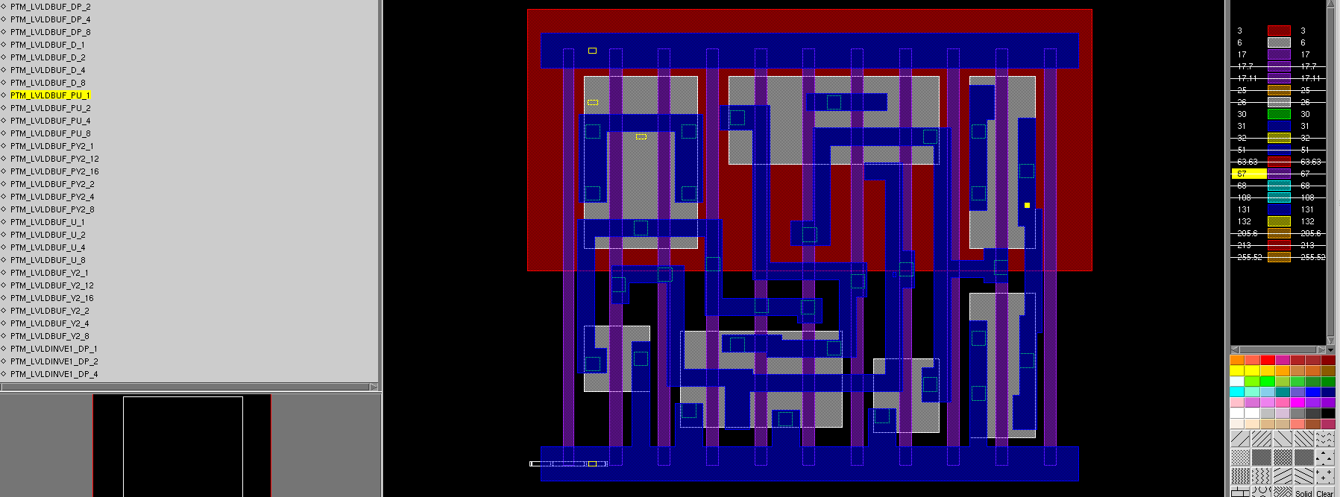
PTM_LVLDBUF_PU_1
HV and LV transistor share same NW
If NW tap to HV, LV transistor performance change
If NW tap to LV, voltage drop between p+ (source) and N+ (substrate) , will be leakage current.

