Slide 1
ERC summary (sirius_top)
Check | Results | Cells | Comments
floating.nxwell_float | 4391 (11060) | ABB, TypeC, PCIE/PAD, DDRIO, HDMI/PAD, USB3/PAD, MIPI/PAD, pll_ddr, pll_arm, IO | waived by waive list
floating.psub | 986 (2219) | ABB, TypeC, USB3, MIPI/PAD, mipi_pll | waived by waive list
mnpg | 7833 (88581) | TypeC, PCIE_PAD, DDRIO, pll_arm, pll_ddr, HDMI_PAD, USB3_PAD, MIPI_PAD, IO | waived by waive list
npvss49 | 232 (20665) | ABB, TypeC, PCIE/PAD, DDRIO, pll_arm, pll_ddr, HDMI/PAD, USB3/PAD, MIPI/PAD, IO | waived by waive list
npvss150 | 11 (11) | USB3 | waived by SNPS
ppvdd150 | 16 (16)

Slide 2
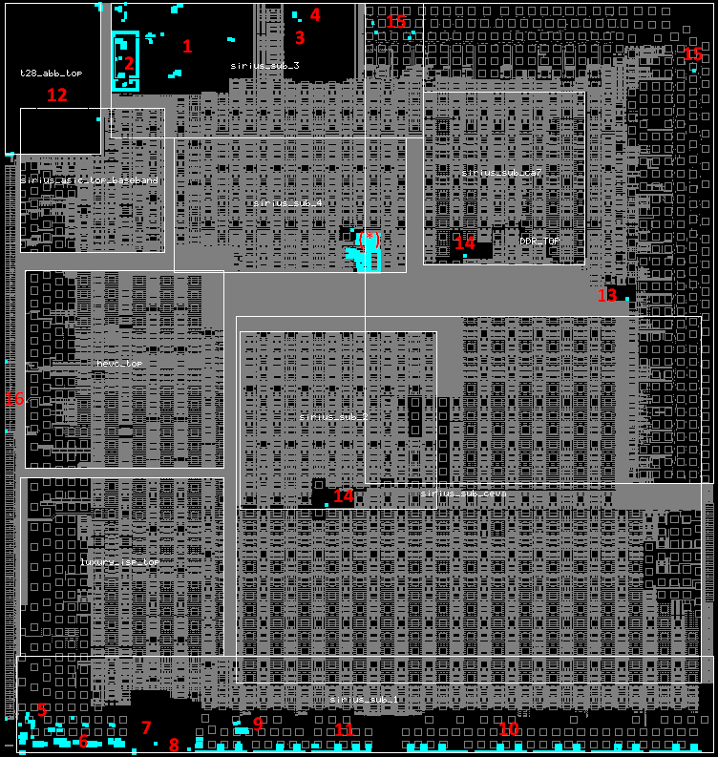
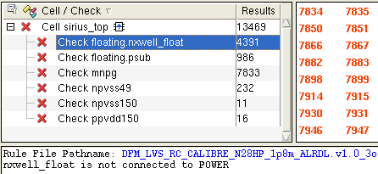
floating.nxwell_float
1. sdtc01cap_t28hpc_4t2r_vf180_6020
2. sdtc01pdp_t28hpc_xx_vf180_6020
3. dwc_pcie2_x2_ns
4. dwc_pcie2_pads_x2_ns
5. dwc_hdmi_20_rx_1p_phy_ns
6. dwc_hdmi1rxio
7. dwc_usb3_sspx1_hspx1_ns
8. dwc_usb3_pads_sspx1_hspx1_ns
9. dwc_mipi_2_bidir_dphy_ns_core
10. dwc_dphy2sio
11. dwc_dphy2bio
12. t28_abb_top
13. pll_ddr_top
14. t28_pll_arm_top
15. DDRIO
16. IO (PVSS1RGM, PVSS1SD, PVSS1CDE, PVSS3AE)
(*. kpts28hpc128_r08w01_45c5pl_0v0 (metal only))

Slide 3
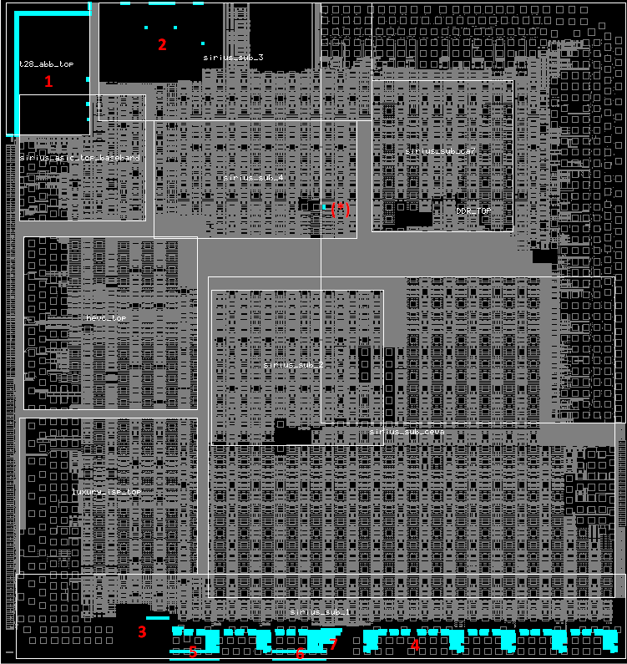
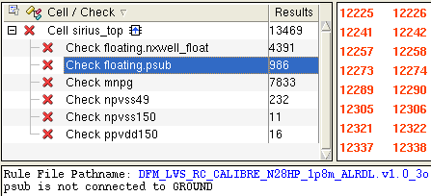
floating.psub
1. t28_abb_top
2. sdtc01cap_t28hpc_4t2r_vf180_6020
3. dwc_usb3_sspx1_hspx1_ns
4. dwc_mipi_2_bidir_dphy_ns_core
5. dwc_dphy2sio
6. dwc_dphy2bio
7. dwc_mipi_pll_dphy_ns
(*. kpts28hpc128_r08w01_45c5pl_0v0 (metal only))

Slide 4
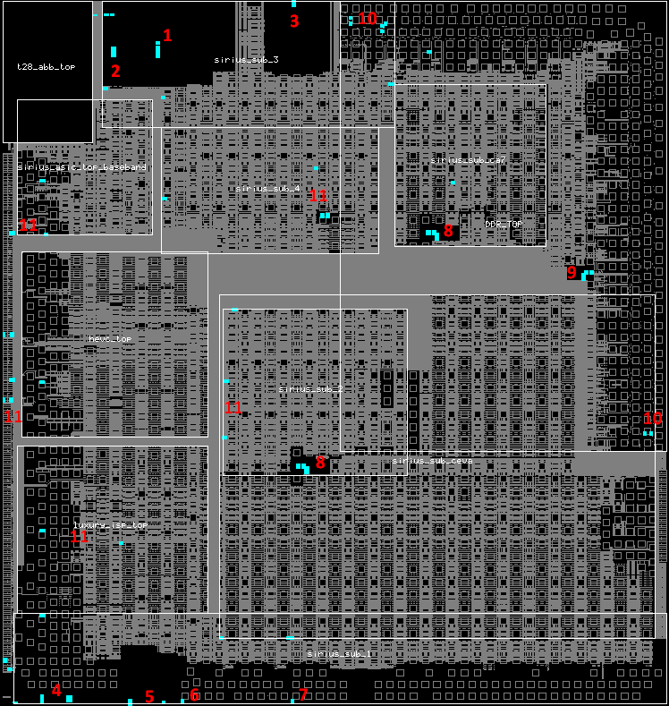
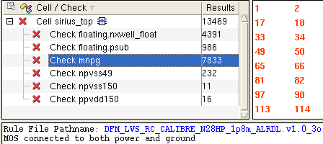
mnpg
1. sdtc01cap_t28hpc_4t2r_vf180_6020
2. sdtc01pdp_t28hpc_xx_vf180_6020
3. dwc_pcie2_pads_x2_ns
4. dwc_hdmi1rxio
5. dwc_usb3_pads_sspx1_hspx1_ns
6. dwc_dphy2sio
7. dwc_dphy2bio
8. t28_pll_arm_top
9. pll_ddr_top
10. DDRIO
11. IO (PVDD1RGM, PVDD18RGM, PVDD1SD, PVDD18SD, PVDD2CDE, PVDD1CDE, PVDD3AE, PCLAMPEC)

Slide 5
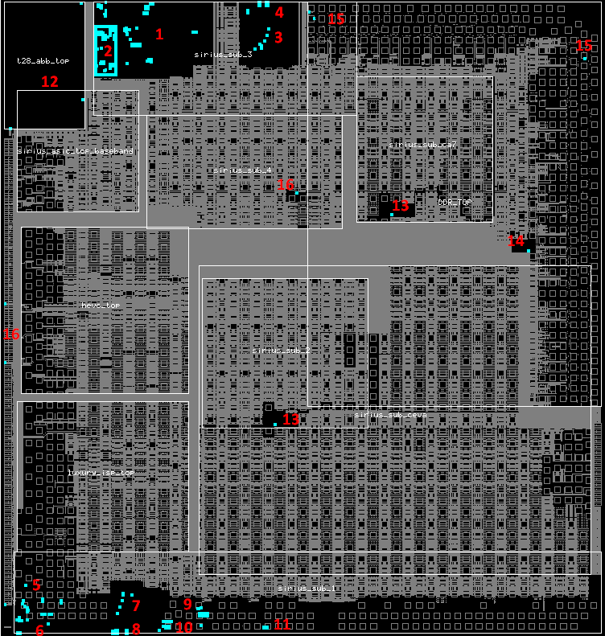
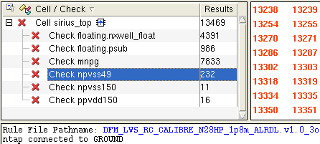
npvss49
1. sdtc01cap_t28hpc_4t2r_vf180_6020
2. sdtc01pdp_t28hpc_xx_vf180_6020
3. dwc_pcie2_x2_ns
4. dwc_pcie2_pads_x2_ns
5. dwc_hdmi_20_rx_1p_phy_ns
6. dwc_hdmi1rxio
7. dwc_usb3_sspx1_hspx1_ns
8. dwc_usb3_pads_sspx1_hspx1_ns
9. dwc_mipi_2_bidir_dphy_ns_core
10. dwc_dphy2sio
11. dwc_dphy2bio
12. t28_abb_top
13. t28_pll_arm_top
14. pll_ddr_top
15. DDRIO
16. IO (PVSS1RGM, PVSS1SD, PVSS1CDE, PVSS3AE)

Slide 6
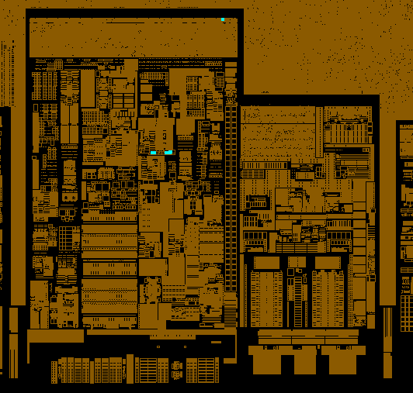
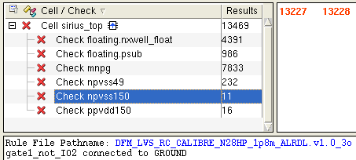
dwc_usb3_sspx1_hspx1_ns
npvss150

Slide 7
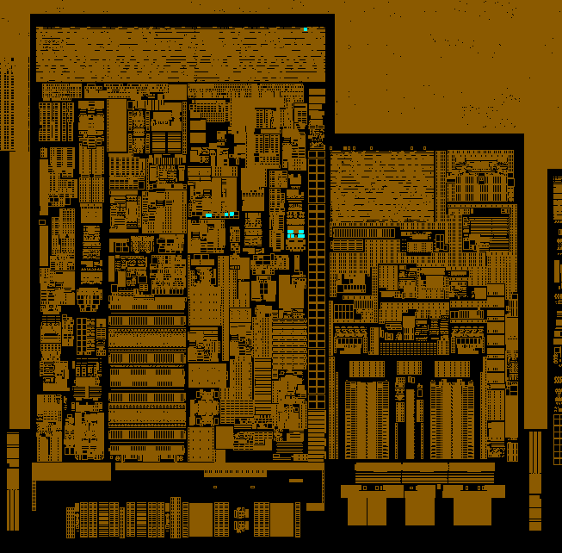
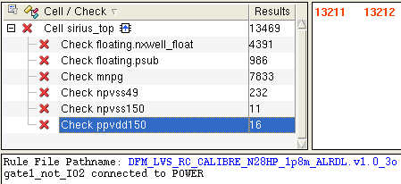
dwc_usb3_sspx1_hspx1_ns
ppvdd150

